Slide 1
Introduzione al DQM
D. De Gruttola
Centro Fermi Roma
24/10/2018
D. De Gruttola – EEE Run Coordination Meeting open to schools

Slide 2
Summary
basis for a good data taking
EEE Data Quality Monitor (DQM)
main quantities to be monitored
data and tools to analyze them
24/10/2018
D. De Gruttola – EEE Run Coordination Meeting open to schools
2

Slide 3
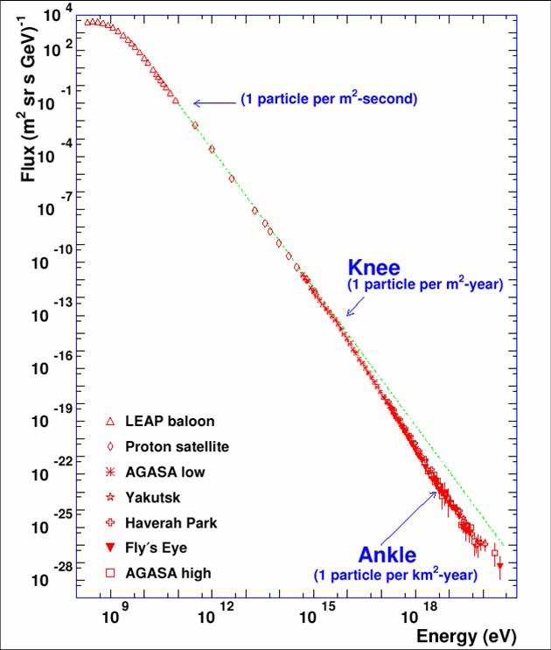
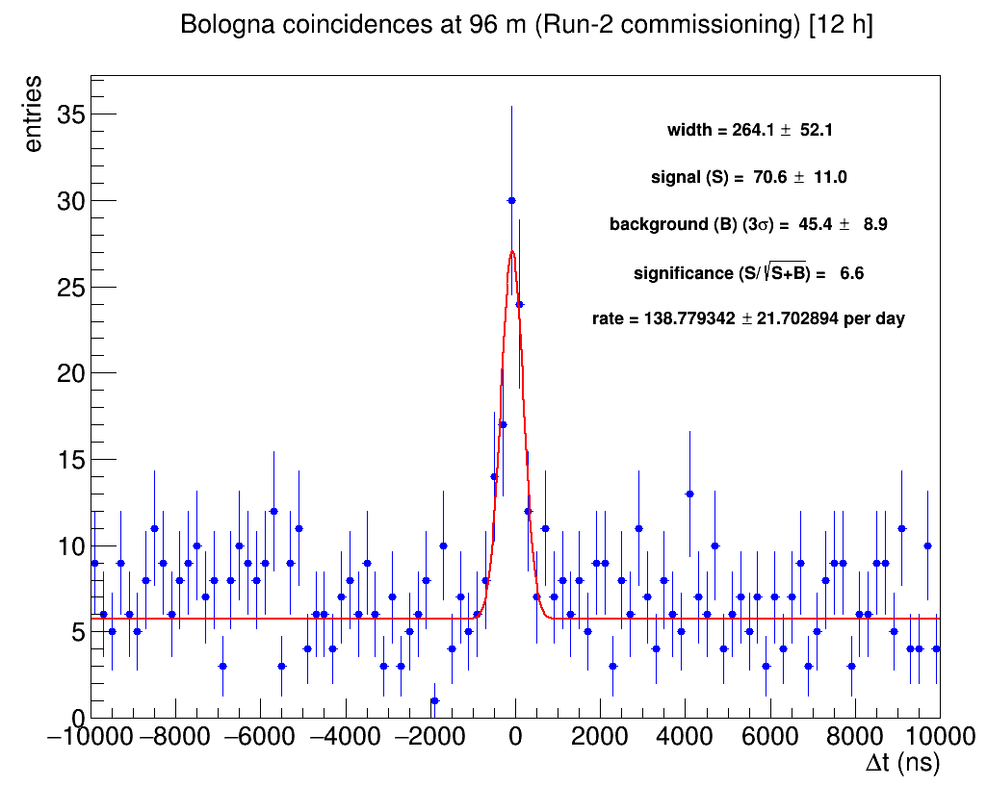
Data Taking and Data Quality Monitor (DQM)
effective data taking period (duty cycle) needs to be the highest possible
costant acquisition to perform several measurements (a few examples here)
data taking and DQM are crucial
each school has the needed tools to:
access DQM
check the correct behavior of the
telescope
perform data analysis to study performance and physics phenomena
24/10/2018
D. De Gruttola – EEE Run Coordination Meeting open to schools
3

Slide 4
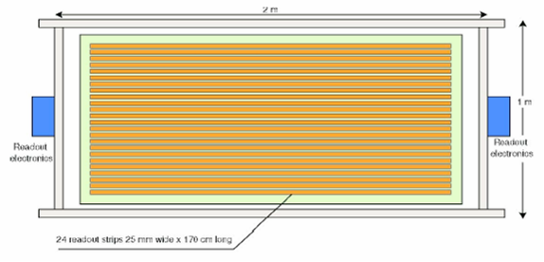
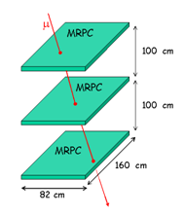
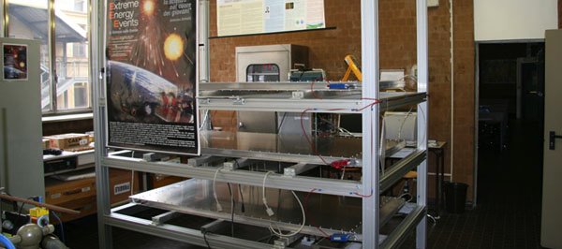
Position of the hits
x
24 copper strips to pick up the signal
trigger: six-fold coincidence (two chamber sides and three chambers)
x
y
- X coordinate determined by the fired strip
- Y coordinate obtained by measuring the time difference between the signals on the two sides of the chamber
y
24/10/2018
D. De Gruttola – EEE Run Coordination Meeting open to schools
4

Slide 5
DQM and quantities to be monitored
24/10/2018
D. De Gruttola – EEE Run Coordination Meeting open to schools
5

Slide 6
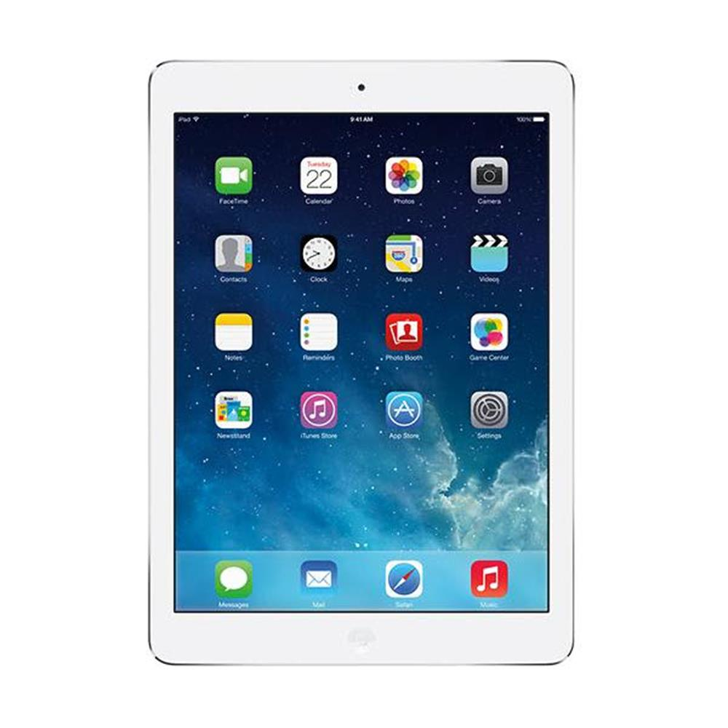
Data Quality Monitor
https://iatw.cnaf.infn.it/eee/monitor/
!!! each member of the Collaboration can monitor and analyze data from all the EEE telescopes !!!
24/10/2018
D. De Gruttola – EEE Run Coordination Meeting open to schools
6

Slide 7
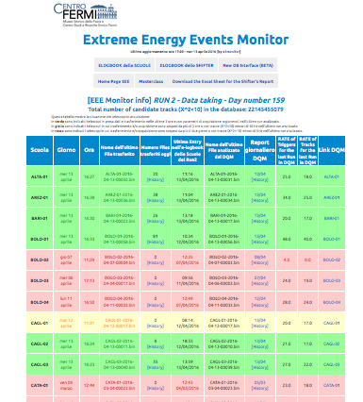
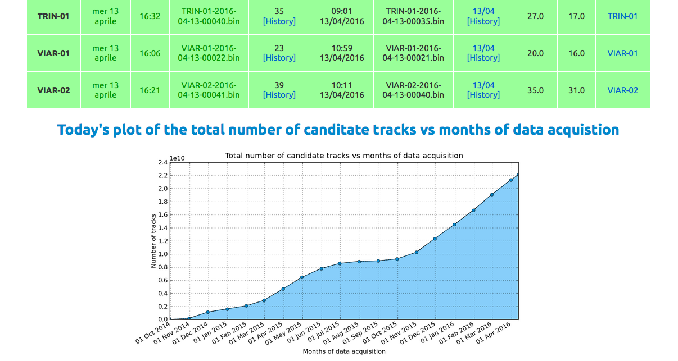
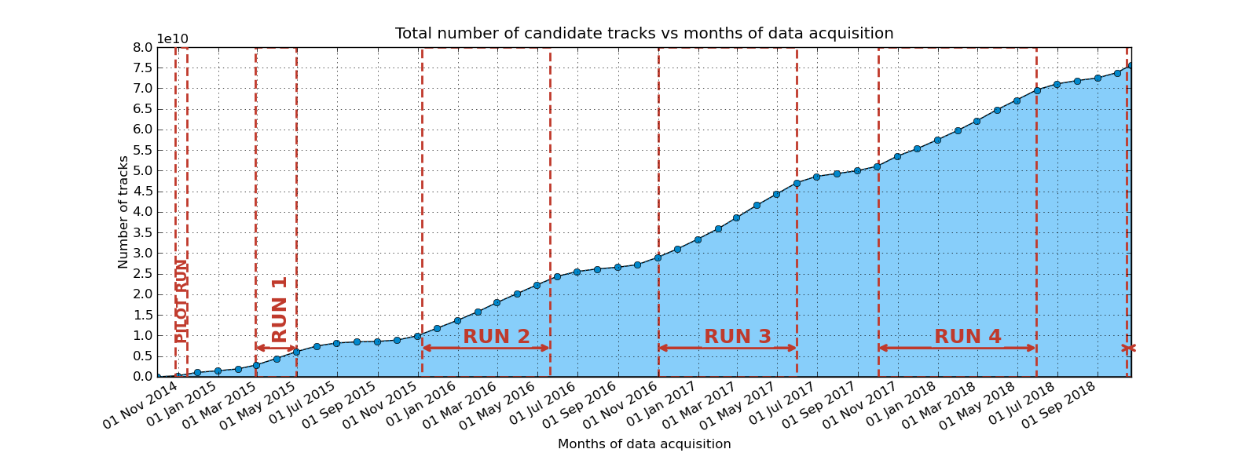
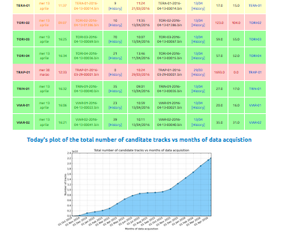
DQM home page
https://iatw.cnaf.infn.it/eee/monitor/
information on the last run transferred to CNAF are given per each school
the status of a school is GREEN if there is a transfer in the last 3 hours, with reasonable paramaters of the run (rate, fraction of reconstructed tracks, …)
links to check the data quality, by means of DQM plots, are given per each telescope
number of
collected tracks
v
v
v
online global monitor of all sites of the project
24/10/2018
D. De Gruttola – EEE Run Coordination Meeting open to schools
7

Slide 8
DQM home page
https://iatw.cnaf.infn.it/eee/monitor/
list of daily reports from DQM
link to transfer history
trigger rate
reconstructed
tracks rate
link to quantities to be monitored
24/10/2018
D. De Gruttola – EEE Run Coordination Meeting open to schools
8

Slide 9
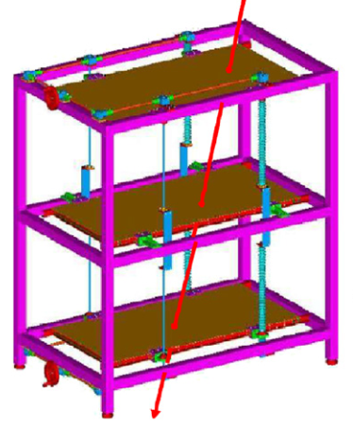
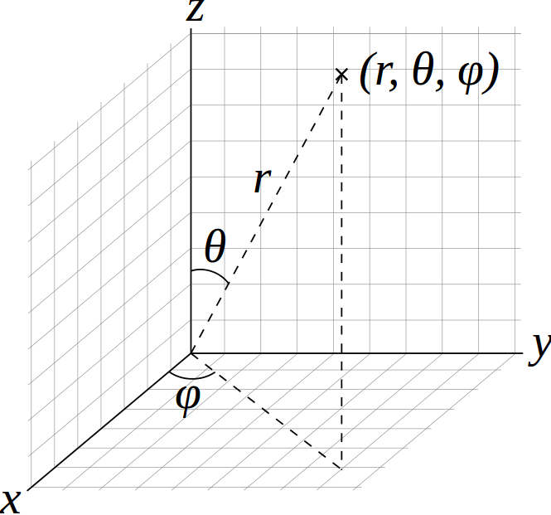
Telescopes acceptance
a tracking algorithm reconstructs trakcs crossing the telescope, by using the hits on each chamber
DQM is a basic tool to monitor the quality of the data taking
many quantities can be monitored online:
track lenght
Time of flight
angular distributiond
track quality (χ²)
multiplicity
trigger rate , rate of events with hits, rate of events with good tracks
24/10/2018
D. De Gruttola – EEE Run Coordination Meeting open to schools
9

Slide 10
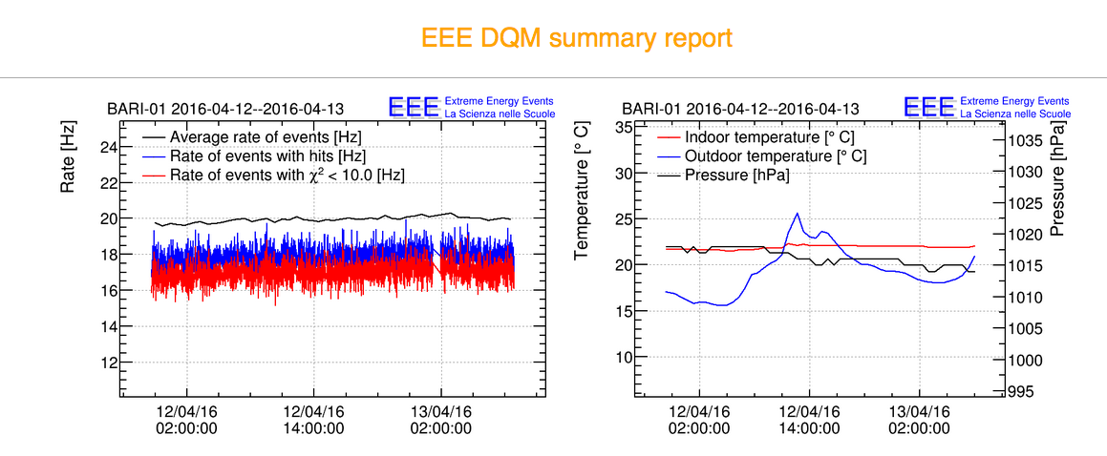
DQM: rate, pressure and temperature
Daily report of rate, pressure and temperature
click
immediate detecting:
immediate detecting:
noisy periods
telescope inactivity
Important temperature fluctuations
pressure fluttuations
high trigger rate
low reconstruction efficiency
useful to find good periods to get barometric corrections
24/10/2018
D. De Gruttola – EEE Run Coordination Meeting open to schools
10

Slide 11
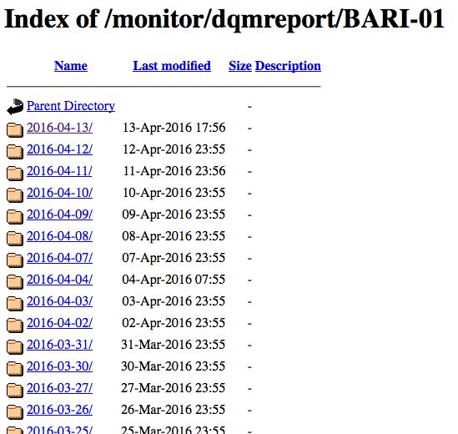
DQM: rate, pressure and temperature
history rate, pressure and temperature monitor
click
24/10/2018
D. De Gruttola – EEE Run Coordination Meeting open to schools
11

Slide 12
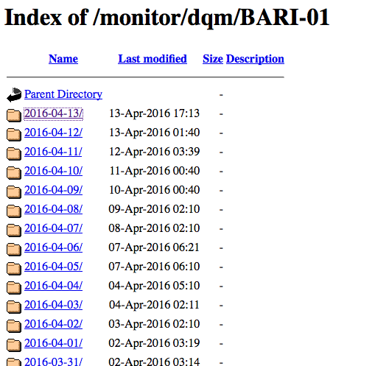
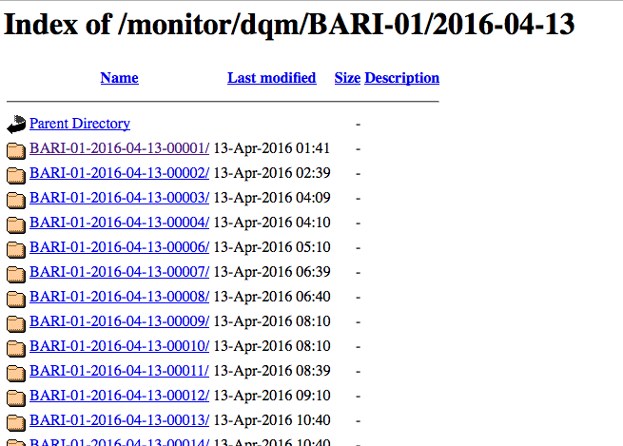
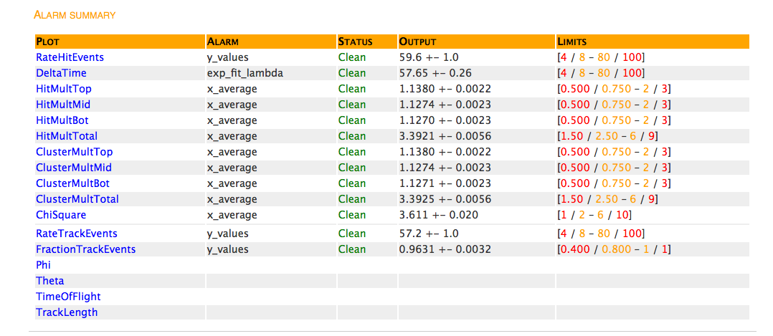
DQM: histograms and alarms
histograms and alarms automatically produced by DQM
click
24/10/2018
D. De Gruttola – EEE Run Coordination Meeting open to schools
12

Slide 13
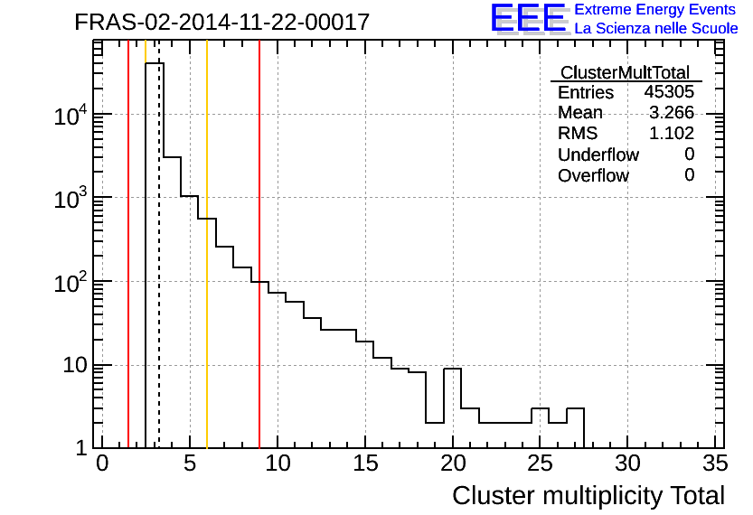
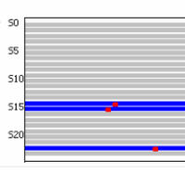
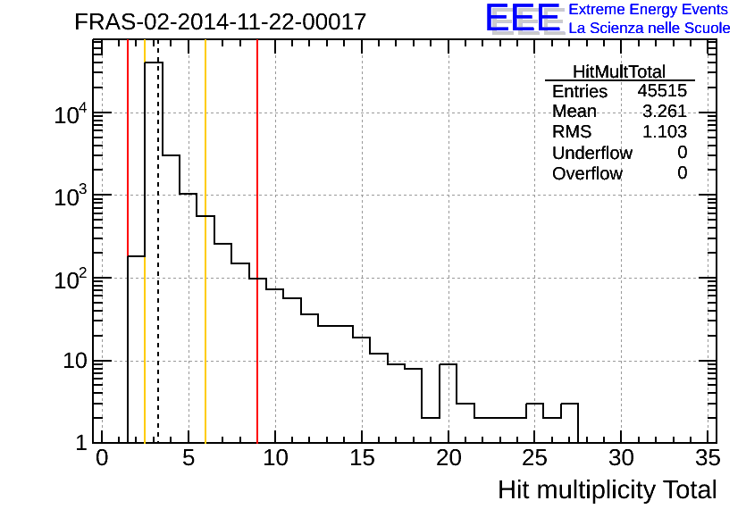
DQM: multiplicity
expected
multiplicity
cluster
hit multipliciity
noisy
events
single hit
cluster multipliciity
constant monitoring of event multiplicity
need of interventions on the telescope in case
the multiplicity is peaked at high values
24/10/2018
D. De Gruttola – EEE Run Coordination Meeting open to schools
13

Slide 14
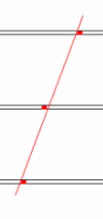
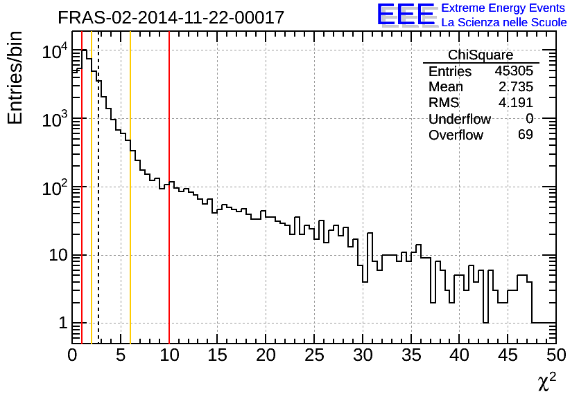
DQM: tracks and χ²
global measurement
χ² tracks distribution
χ² measures the shift of the track wrt hits
tracks with 1< χ² < 10: particle candidates
randomly aligned hits
and tracks of scattered particles:
tracks with high χ²
24/10/2018
D. De Gruttola – EEE Run Coordination Meeting open to schools
14

Slide 15
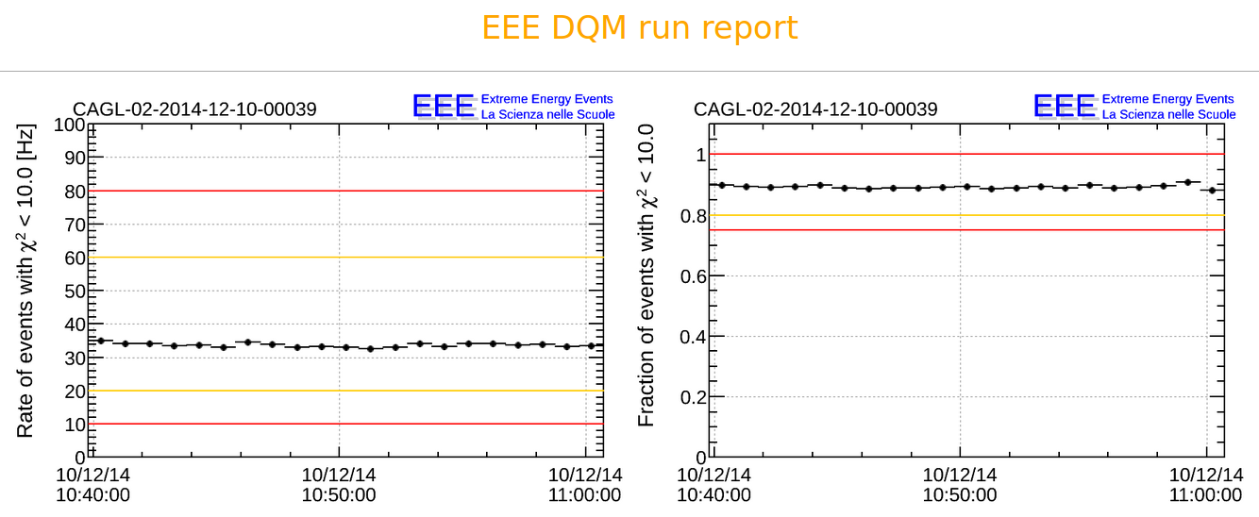
DQM: tracks and χ²
trending (measurement vs time)
rate of events with at least one good track
rate of good tracks,
i.e. with χ² < 10
24/10/2018
D. De Gruttola – EEE Run Coordination Meeting open to schools
15

Slide 16
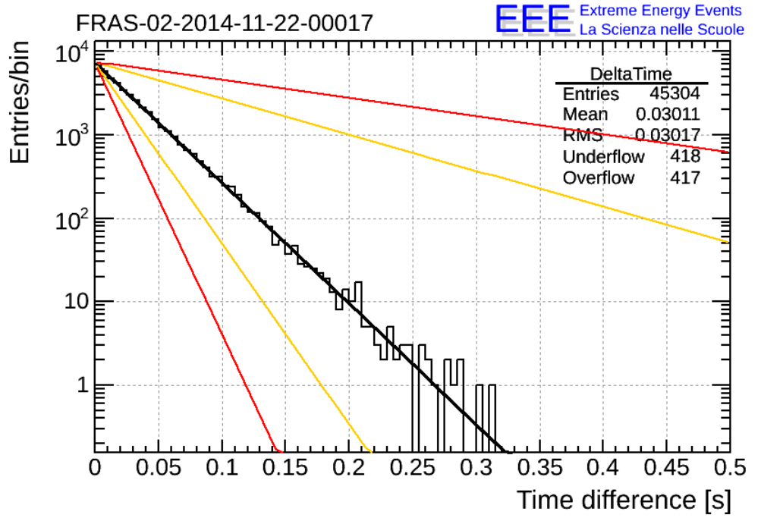
DQM: time difference between two events
delta time distribution
between two consecutive trigger events
→
slope inversely proportional to trigger rate
y = e^{-RΔT}
R = rate → 1/R = mean
24/10/2018
D. De Gruttola – EEE Run Coordination Meeting open to schools
16

Slide 17
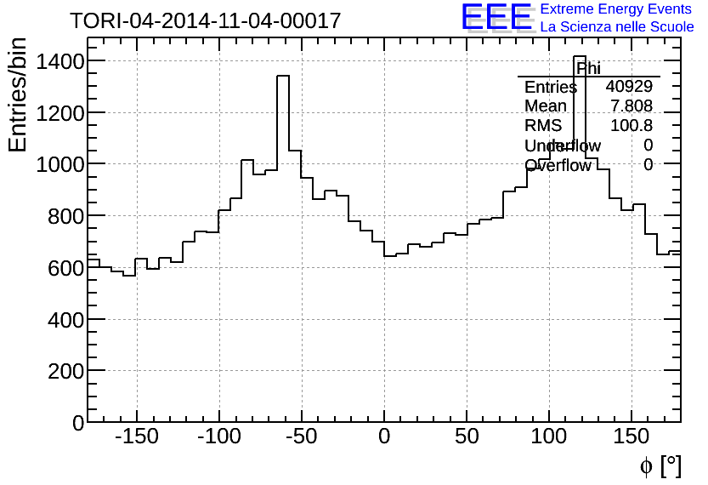
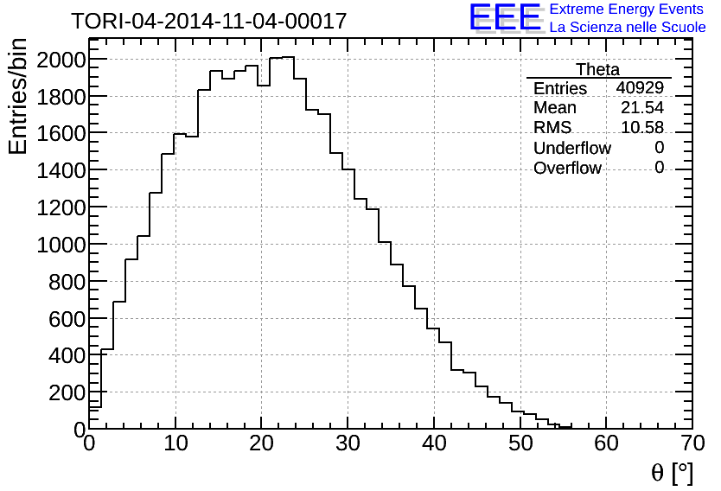
DQM: angular distributions
angular distributions: azimuthal and polar angle
Azimuthal distribution
(bigger acceptance in the corners)
Polar distribution
(affected by telescope acceptance)
24/10/2018
D. De Gruttola – EEE Run Coordination Meeting open to schools
17

Slide 18
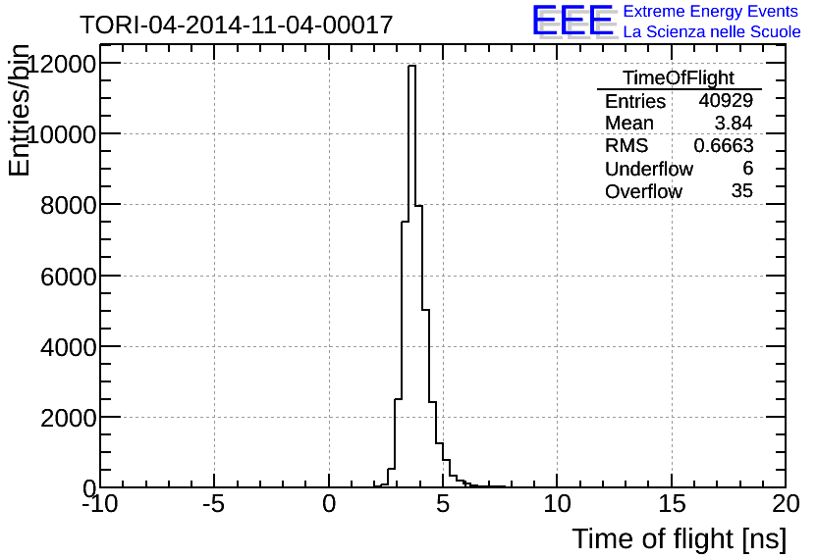
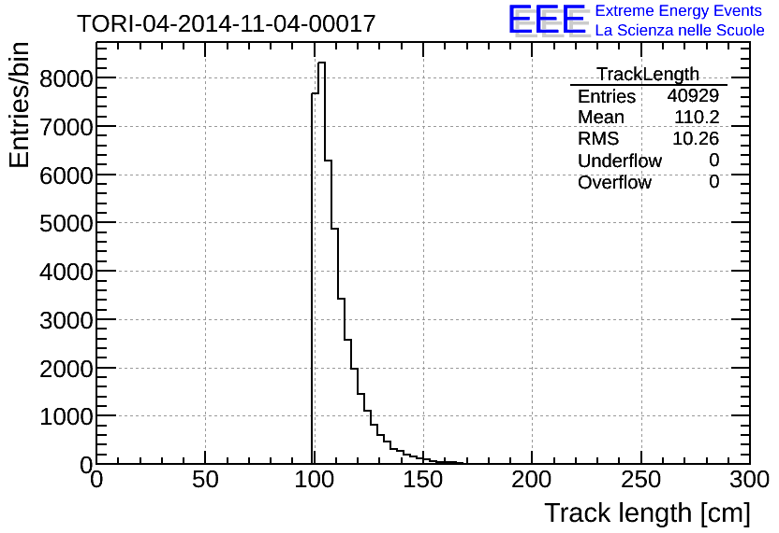
DQM: time of flight and track lenght
distributions of time of flight (TOF) and track lenght
tilted
tracks
distance between chambers 1 and 3
TOF ~ 3.3 ns → d= 1m
(d = distanza tra le camere)
24/10/2018
D. De Gruttola – EEE Run Coordination Meeting open to schools
18

Slide 19
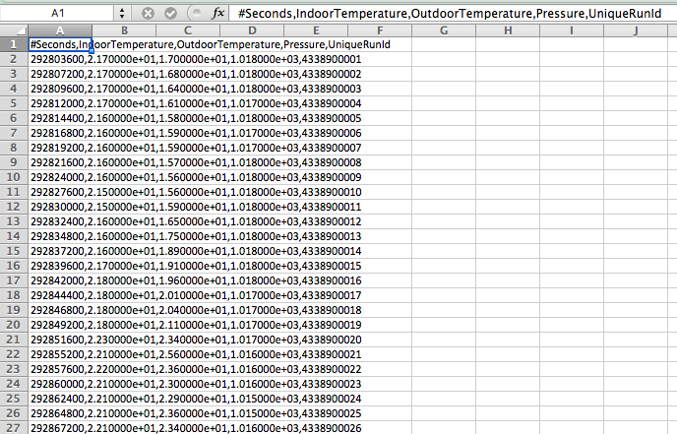
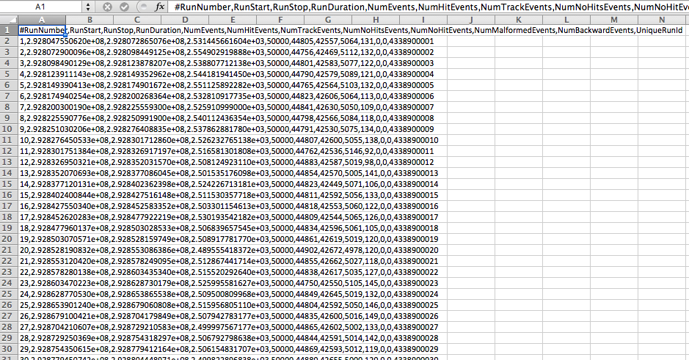
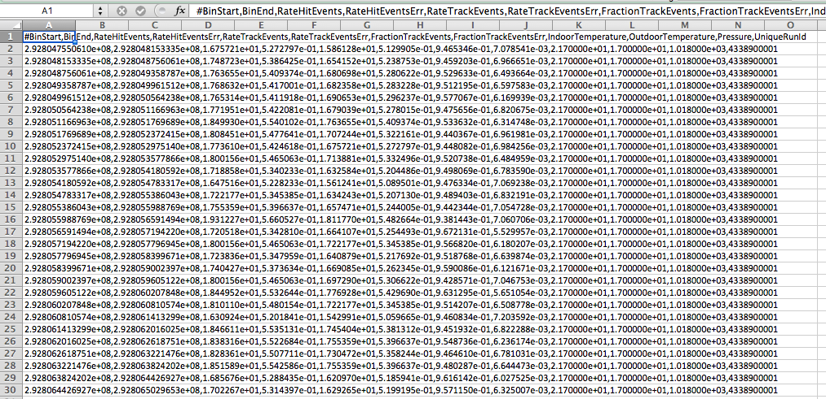
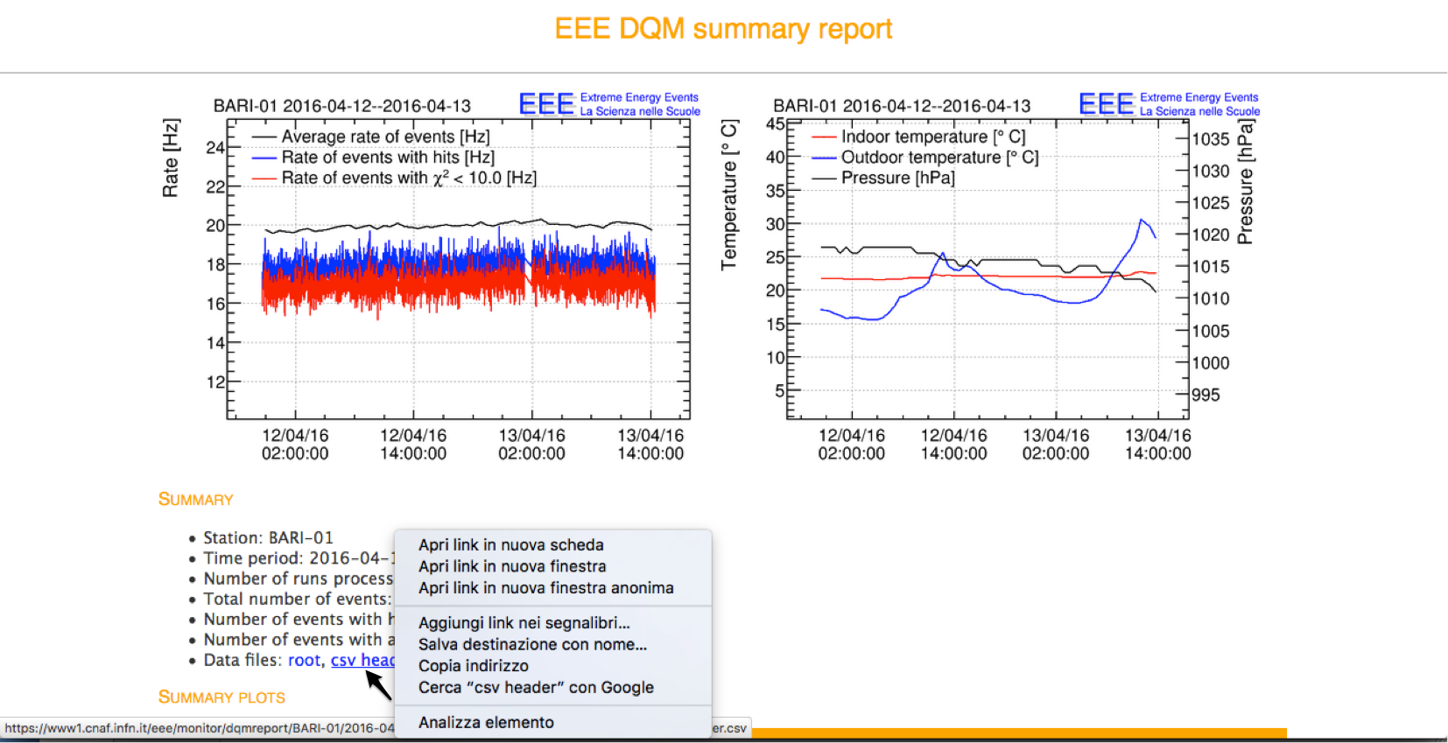
DQM: file csv per analisi dati
Data collected in csv (comma separated values) files
They can be analised in Excel
download dei file dati:
csv header → summary for one run
cdv trending → trending of measured quantities
csv weather → temperature and pressure
24/10/2018
D. De Gruttola – EEE Run Coordination Meeting open to schools
19

Slide 20
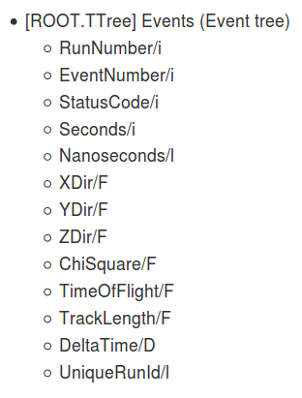
DQM: file root per analisi dati
Data are also collected as root files
root is a framework written in c++
24/10/2018
D. De Gruttola – EEE Run Coordination Meeting open to schools
20

Slide 21
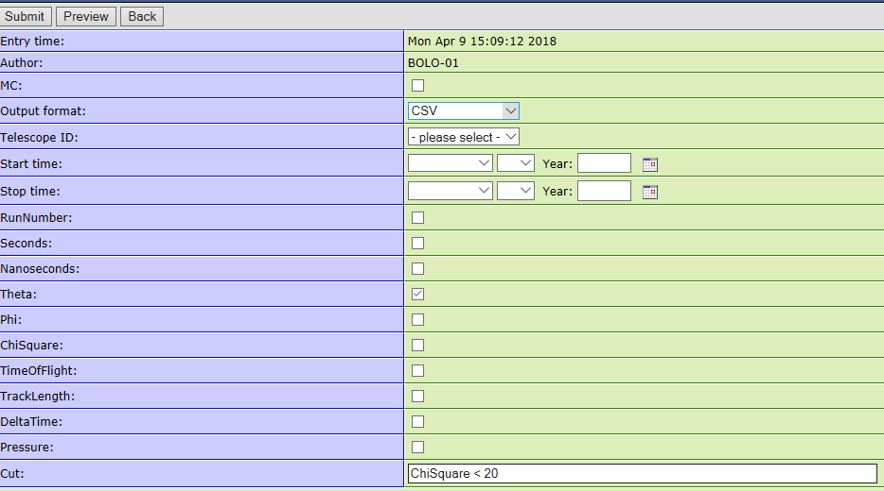
E-log: data query
It is possible to retrieve some data from several runs by using the elog
Real data and MC data are available
This tool has been used for ICD 2017
Chose a telescope
Chose date
(no more than 2 or 3 days)
Please check output dimensions before asking many days and have too big files
Tip it if you want MC data
Cut to have good tracks
24/10/2018
D. De Gruttola – EEE Run Coordination Meeting open to schools
21

Slide 22
Back up

Slide 23
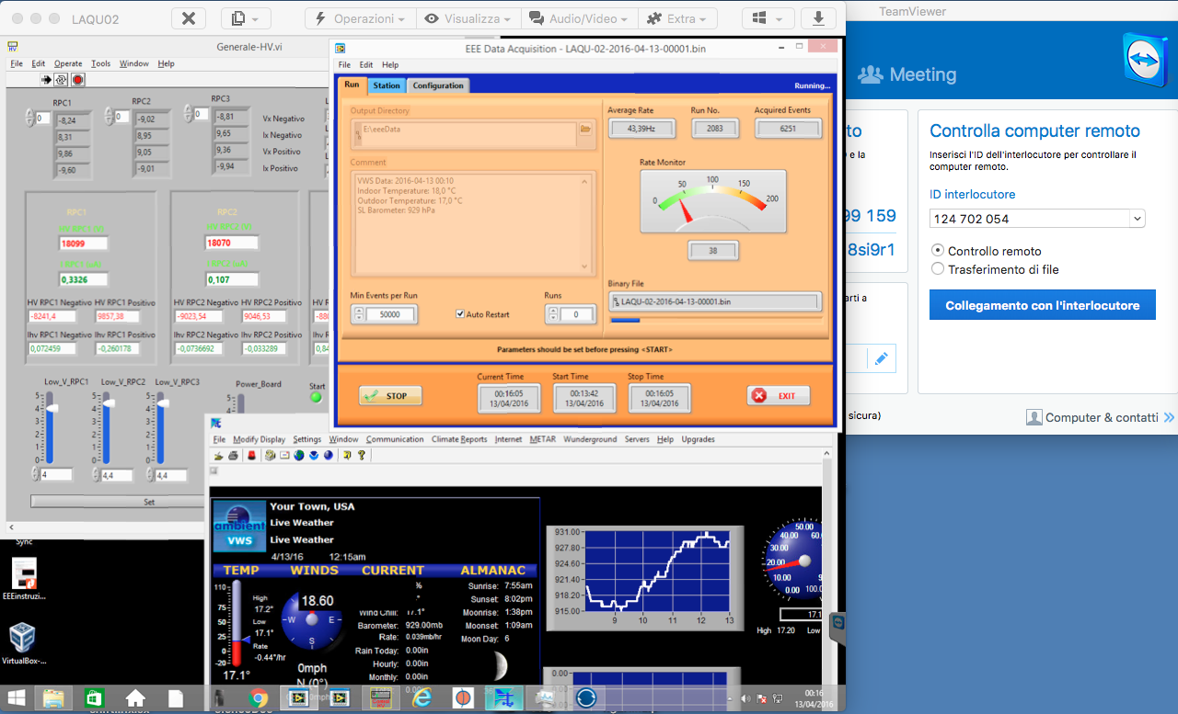
Team Viewer and Data Taking
controllo tensioni
acquisizione
monitoraggio T e p
!!! remote control of all the telescopes is always possible!!!

Slide 24
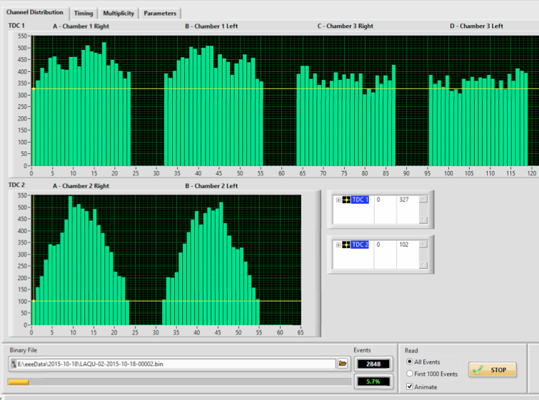
Strip multiplicity
multeplicity of 24
channels of a single FEA
possibility to check
the correct behavior
of each single channel
and identify dead or
noisy channels

Slide 25
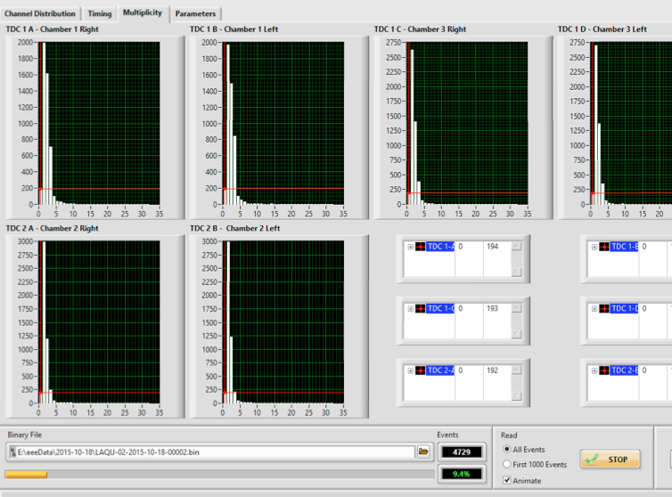
Event multiplicity
molteplicity of triggered
events
number of strips giving
a signal in each event
the distribuzione has to
be peaked at 1

Slide 26
Analysis example
dependence of rate from temperature and pressure(lecture from I. Gnesi, 16 April)
effect of solar flares on the cosmic ray flux (lecture from I. Gnesi, 16 April)

Slide 27
Barometric corrections
didactic experiments on cosmic rays
measurement with Geiger counters
and scintillators
muon yield
measurement of the
barometric effect
pressure variations affect the secondary cosmic ray flux according to the law:
atmospheric pressure
ΔI = -βΔp
yield corrected by pressure

Slide 28
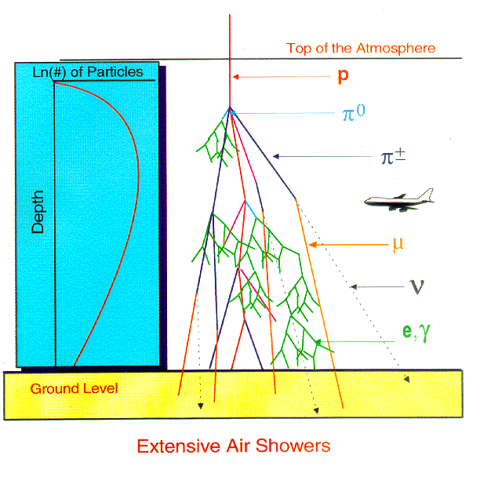
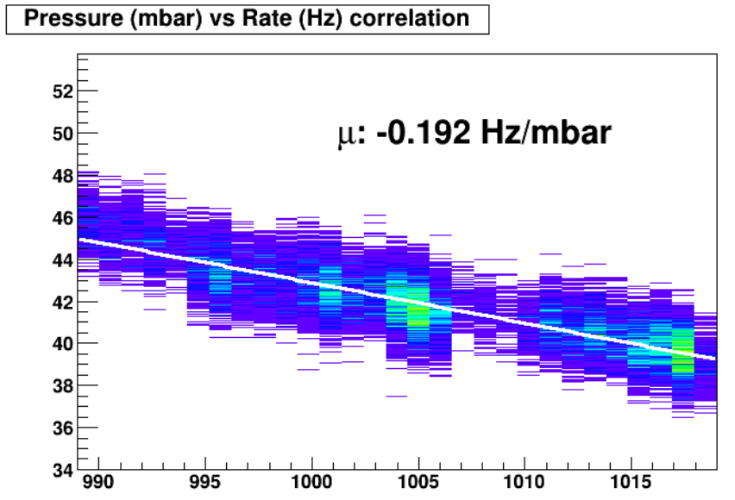
Barometric corrections
atmospheric pressure is a direct measurement of the amount of air to be crossed by a shower before reaching the telescope
pressure variations cause variations in the particle flux measured by the telescope

Slide 29
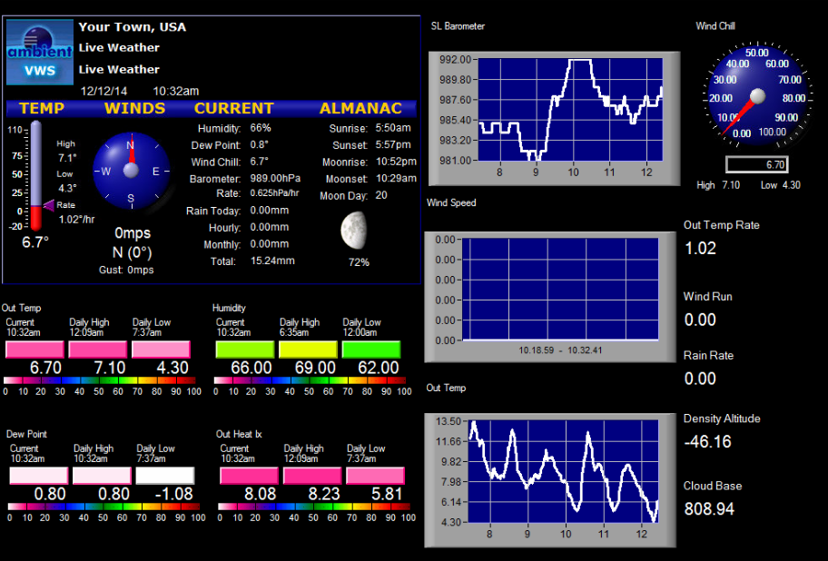
Pressure monitoring
pressure can be read
by weather station (if possible)
by siti di rilevamento nelle vicinanze

Slide 30
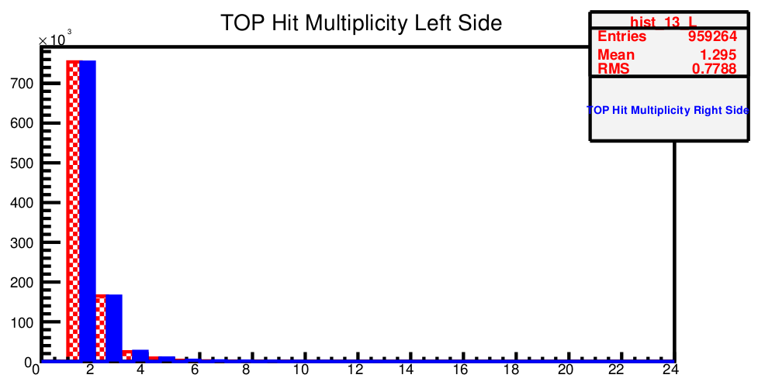
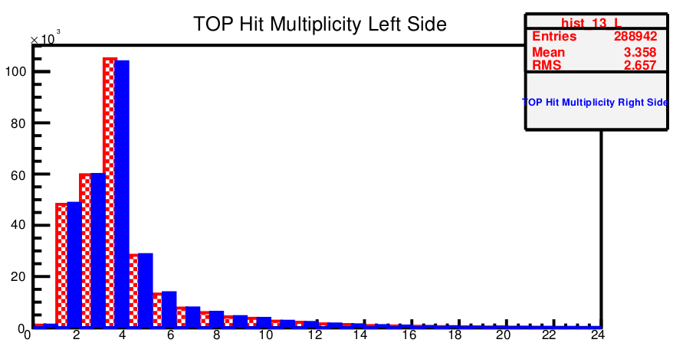
Bad behavior
if mean multiplicity greater than 2, an intervention is needed: need to tune the chamber voltage or the internal temperature
ottobre
luglio

Slide 31
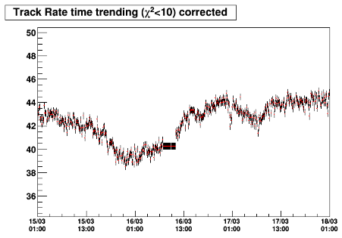
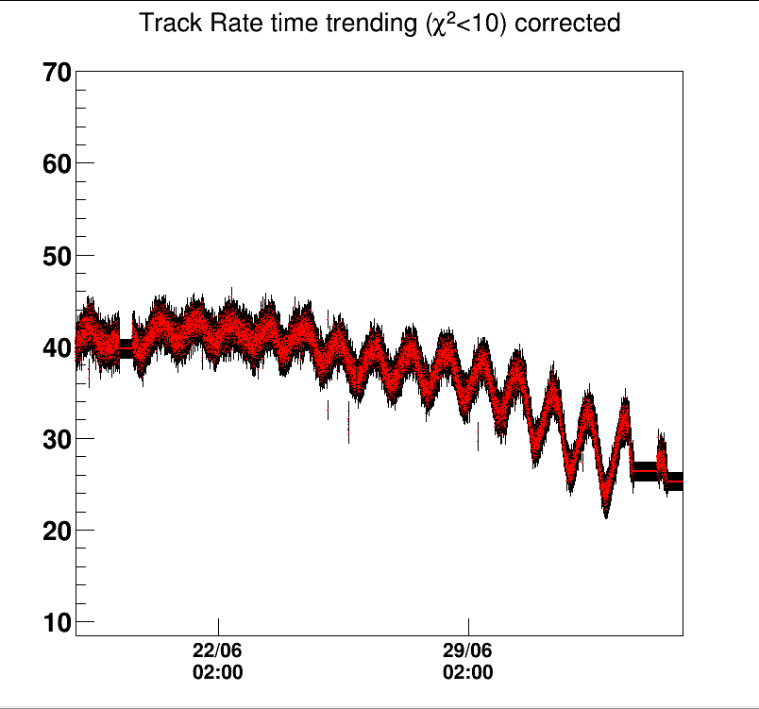
Barometric corrections
once the flux is corrected by atmospheric pressure physics observables become visible
Cosmic Ray Flux Decrease
day/night modulation
+
thermal drift

Slide 32
DQM: csv files for data analysis
data are collected in csv files (comma separated values)
and can be analyszed by Excel
download of data files:
csv header → summary of run information
cdv trending → quantities vs time
csv weather → data of temperature and pressure

Slide 33
DQM: root files for data analysis
data are collected also in root files
root is a framework written in c++

