Slide 1



Progetto: Microcavità Fotoniche (MiFo)
Photonic Microcavities
Linea di ricerca: Tecniche Avanzate per la Fisica Fondamentale:
Project Leader: Giancarlo Righini
Coordinator: Gualtiero Nunzi Conti
Participants:
assegnisti:
  Francesco Enrichi (04/2016 – 12/2018)
  Lidia Zur (12/2015 – 11/2018)
associati:
  Maurizio Ferrari CNR-IFN, dirigente di ricerca
  Gualtiero Nunzi Conti CNR-IFAC, ricercatore
  Stefano Pelli CNR-IFAC, primo ricercatore
  Alexander Quandt Wits Univ. (2013-2018)
  Giancarlo Righini Emerito CNR-IFAC
  Centro Fermi:
  Fabrizio Coccetti primo tecnologo
Research activities take place taks place at:
Istituto di Fisica Applicata “N. Carrara” (IFAC-CNR)
Istituto di Fotonica e Nanotecnologie (IFN-CNR, CSMFO Lab Trento)

Slide 2
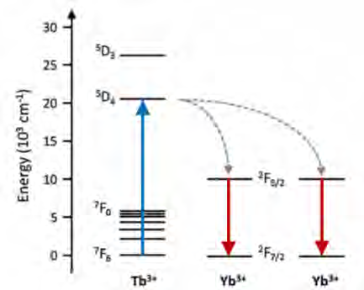
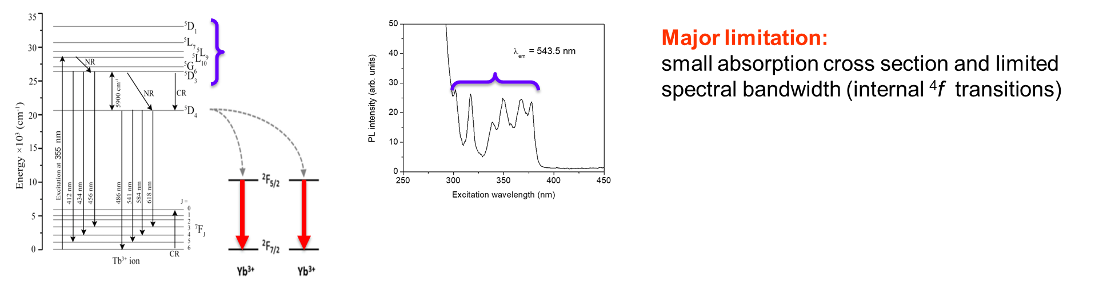
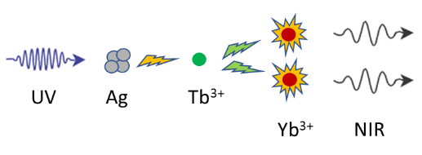
MiFo: Ag nanoaggregates (I)
Main goals and results achieved in 2018 with Ag nanoaggregates
Topic: Ag nanoaggregates and Tb³⁺/Yb³⁺ co-doped silica-hafnia and silica-zirconia sol-gel glasses and glass-ceramics for increasing the efficiency of solar cells (Grant Francesco Enrichi, also Vinnmer Marie Curie Incoming Fellow, Luleå University of Technology, Luleå (Sweden))
Host materials:
SiO₂-HfO₂ glass-ceramics (sol-gel)
SiO₂-ZrO₂ glass-ceramics (sol-gel)
RE³⁺ Major limitation:
Small absorption cross section and
limited spectral bandwidth (internal ⁴f transitions)
Possible solution:
Use of Ag nanoaggregates as broadband sensitizers
One UV or blue (488 nm) photon
Two infrared photons @ 980 nm

Slide 3
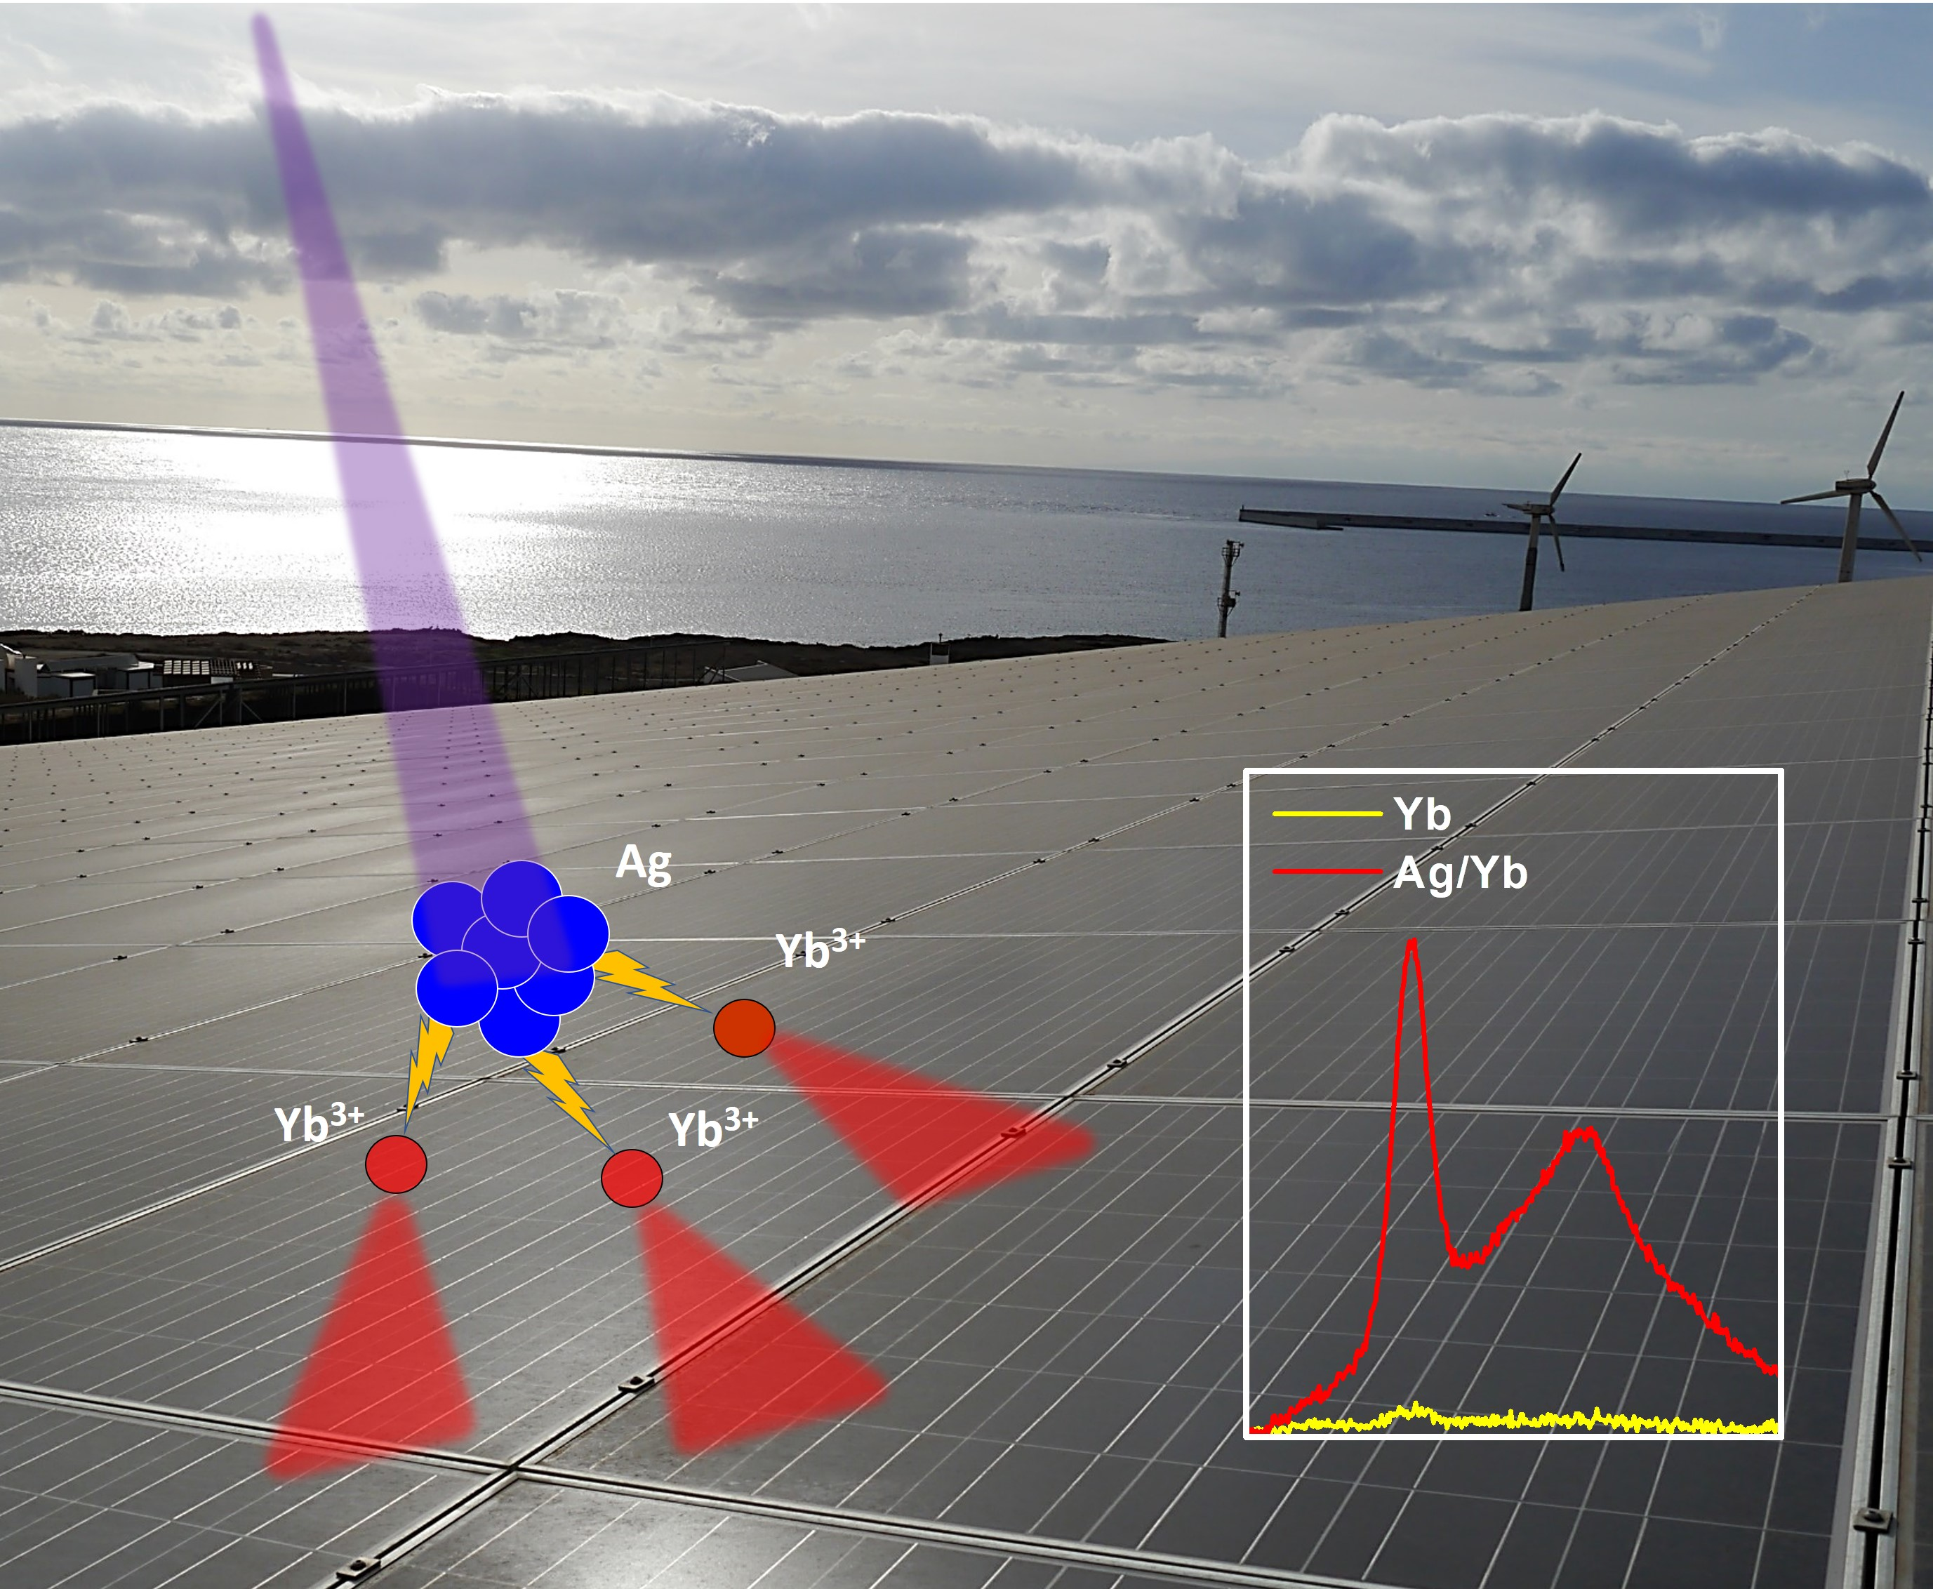
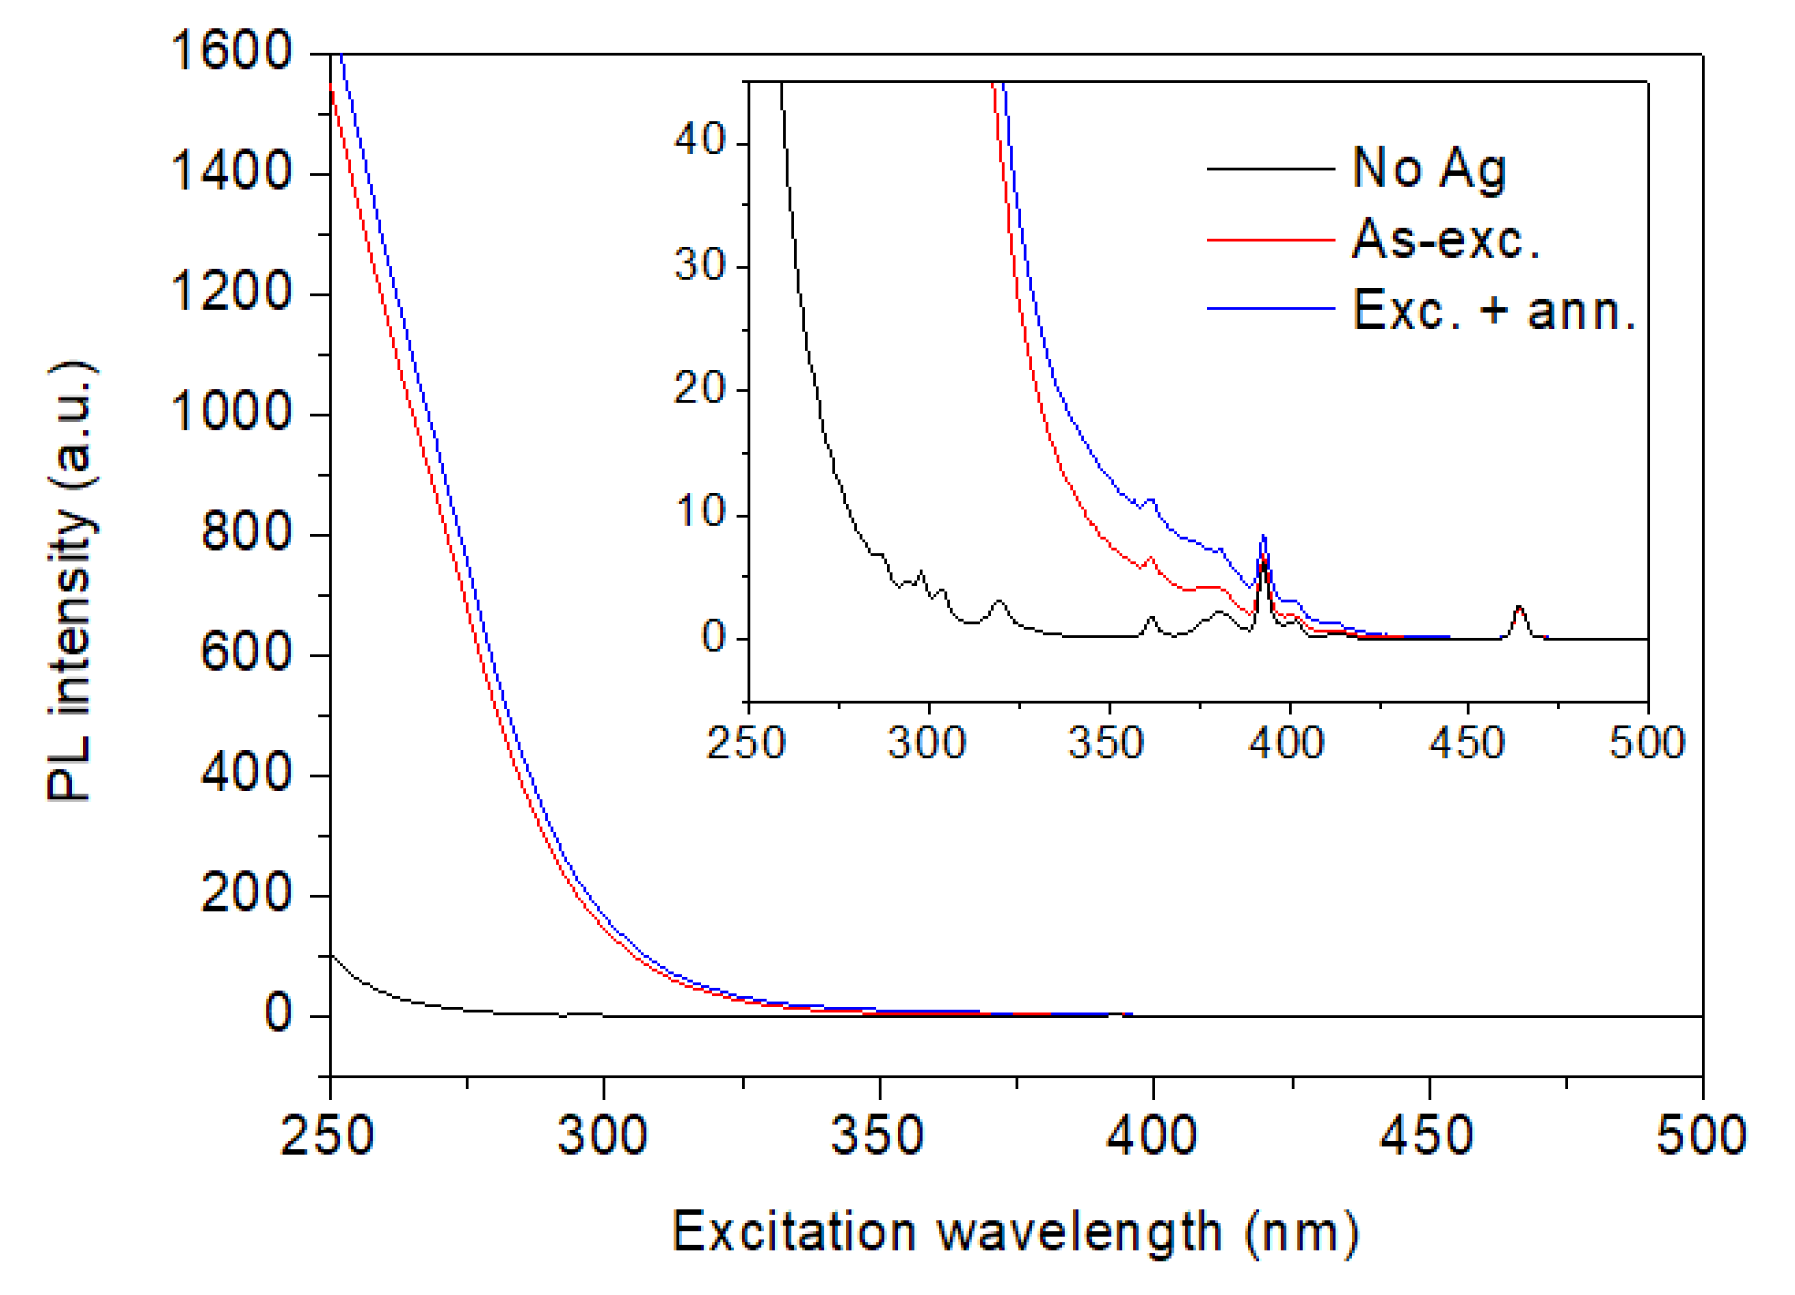
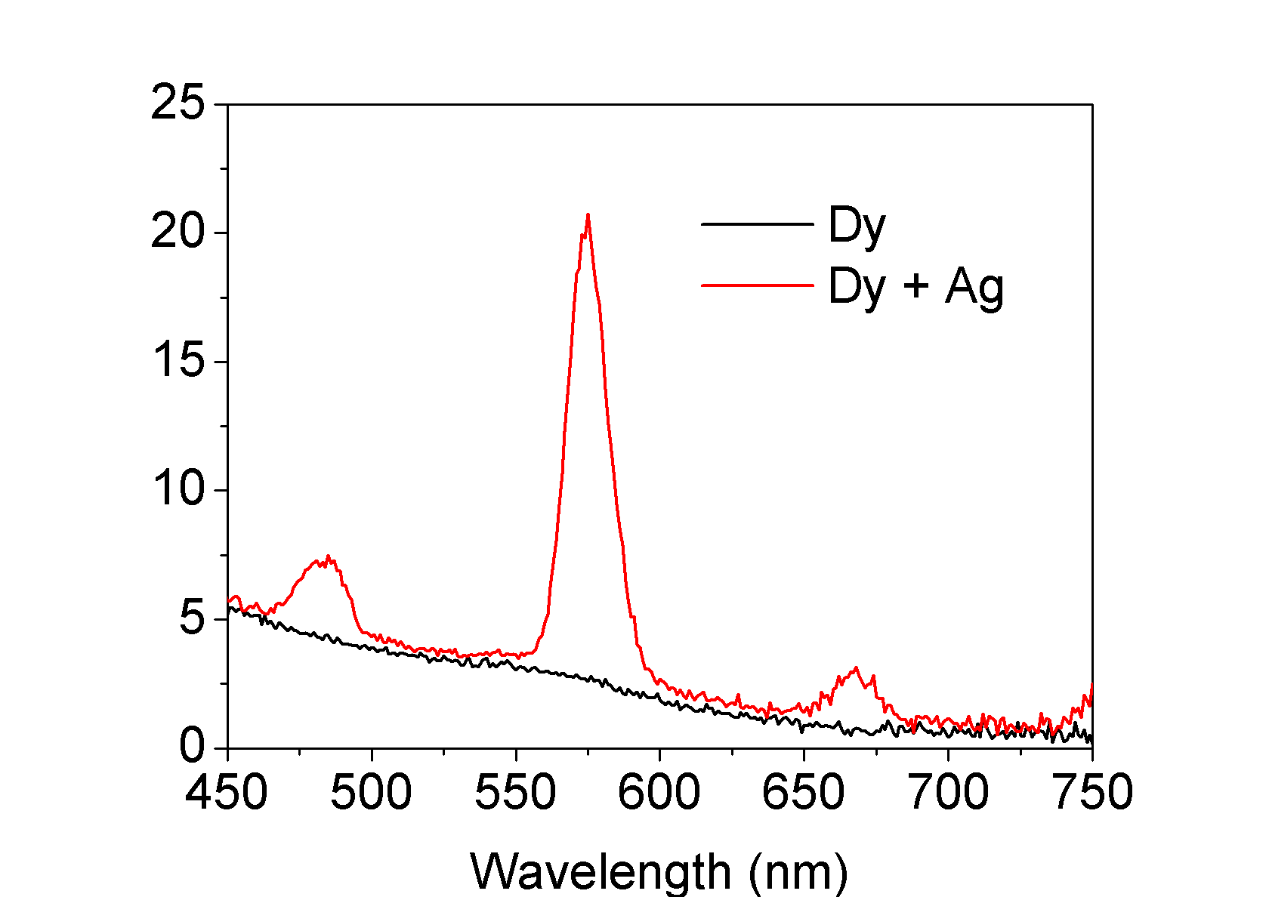
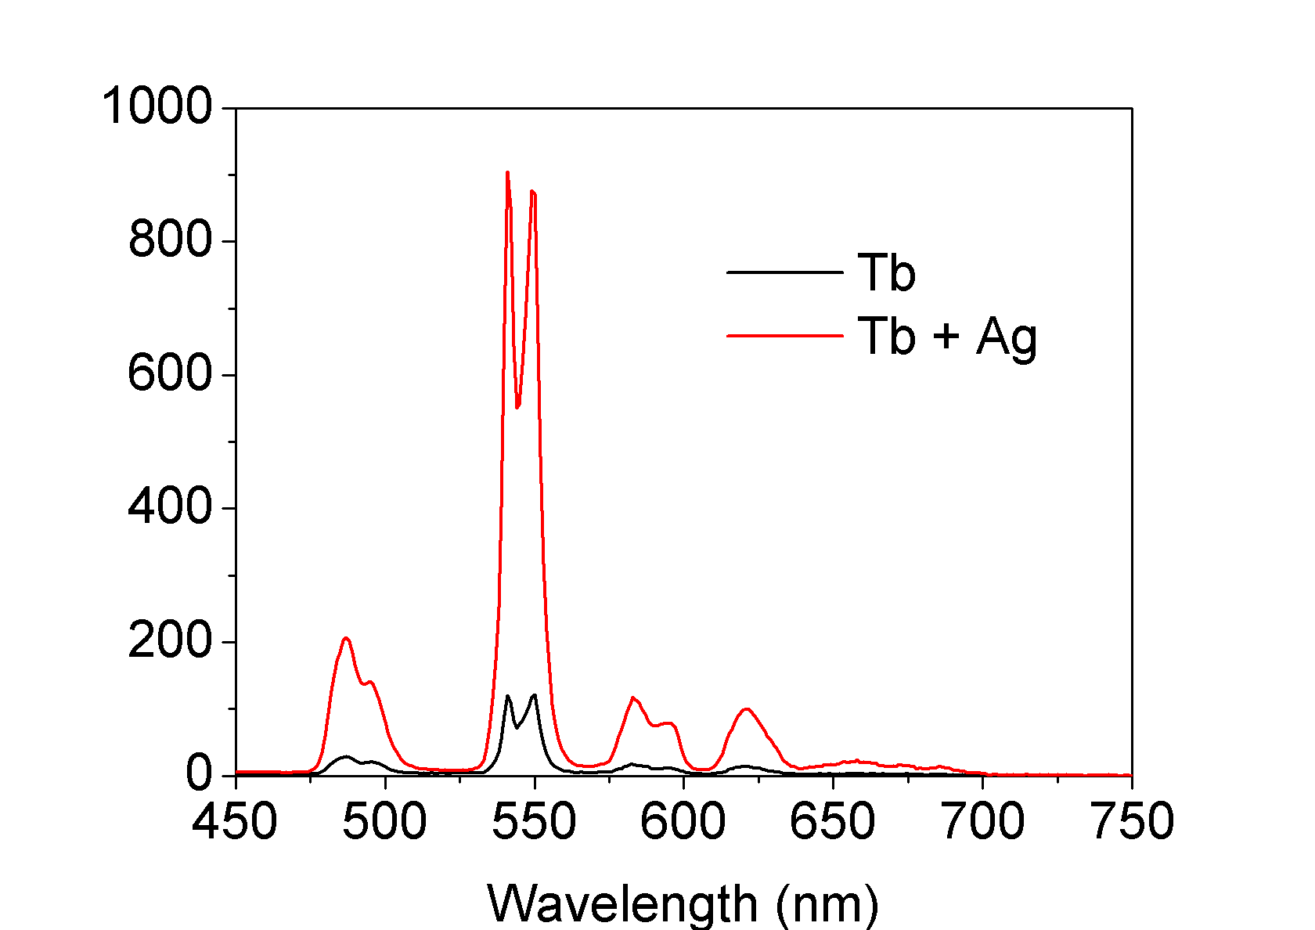
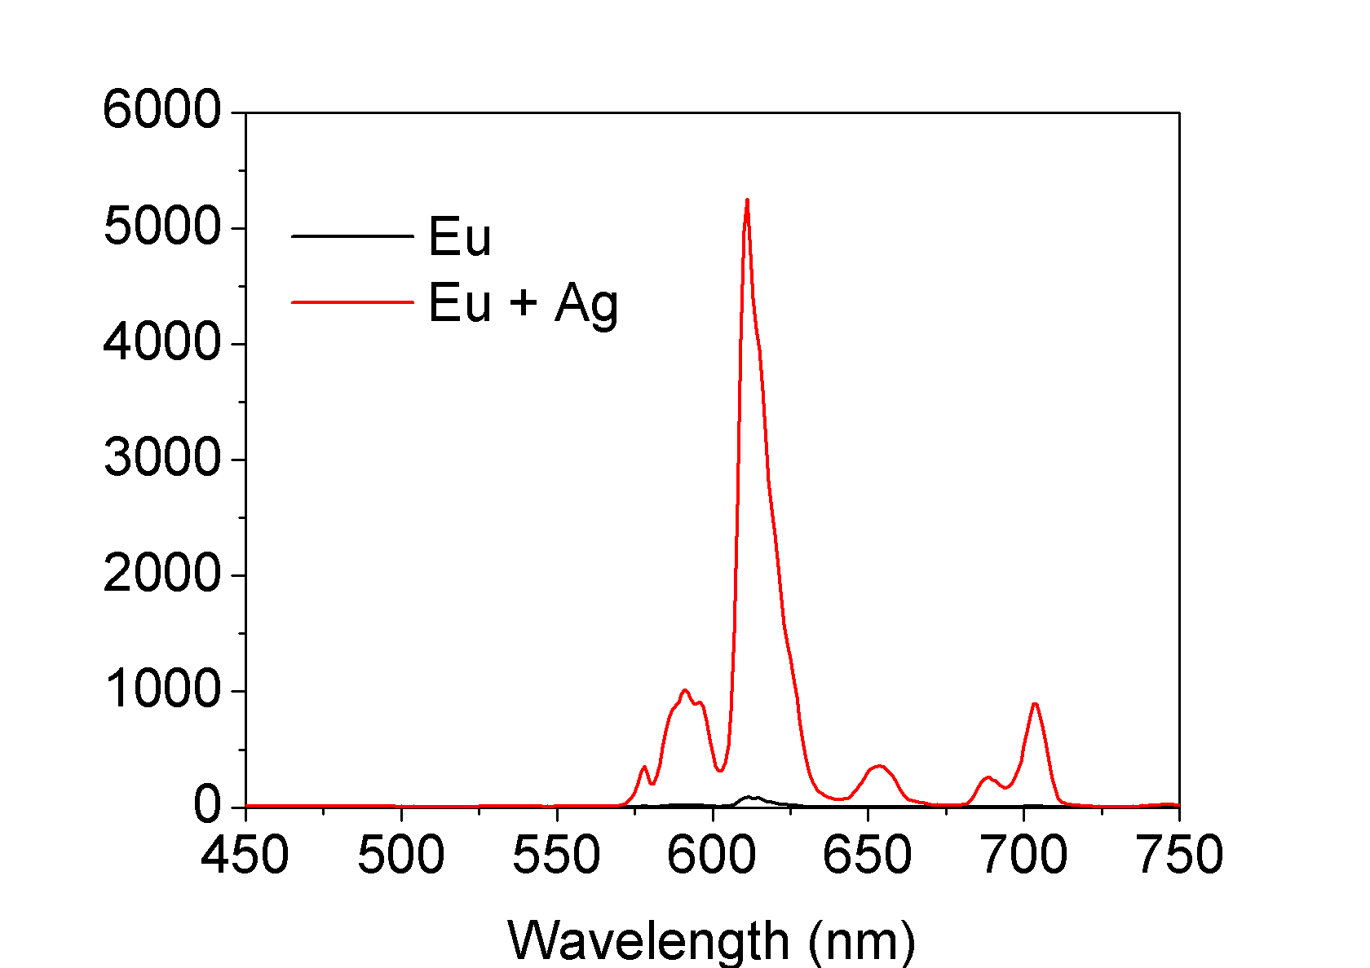
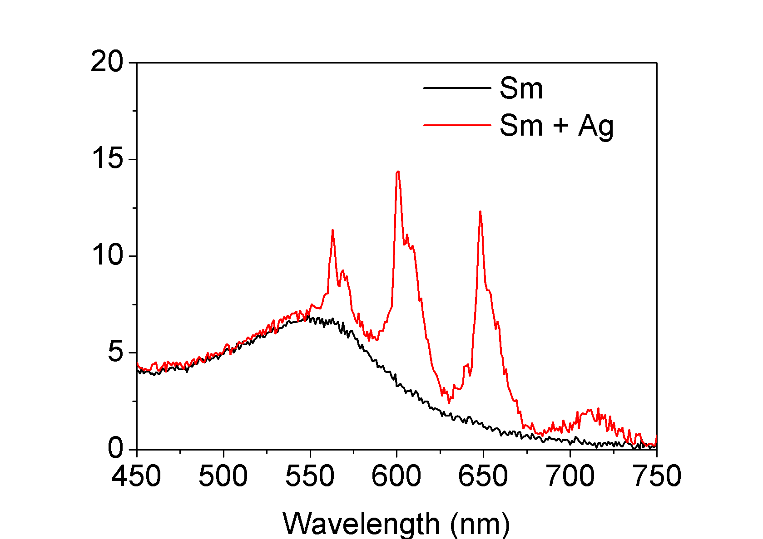
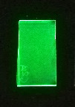
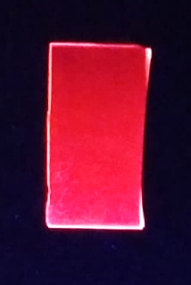
MiFo: Ag nanoaggregates (II)
Main goals and results achieved in 2018 with Ag nanoaggregates
Eu
Very efficient process!
17 times increase in Yb³⁺ PL emission
Broadband sensitization demonstrated for many RE³⁺ ions
STRONG POTENTIAL for many optical applications based on RE³⁺ ions: spectral conversion for solar cells, active materials for lasers, phosphors for lighting, …
Ag-RE³⁺ nanoaggregates
F. Enrichi, …, L. Zur, “Visible to NIR downconversion process in Tb3+-Yb3+ codoped silica-hafnia glass and glass-ceramic sol-gel waveguides for solar cells”, Journal of Luminescence 193, 44-50 (2018)
F. Enrichi, A. Quandt, G.C. Righini, “Plasmonic enhanced solar cells: Summary of possible strategies and recent results”, Renewable and Sustainable Energy Reviews 82, 2433-2439 (2018)
F. Enrichi, et al. “Ag-Sensitized Yb3+ Emission in Glass-Ceramics” Micromachines 9, 380, 1-7 (2018)
Tb³⁺
Eu³⁺
Notes:
La questione di quanti Yb si possano eccitare con un singolo fotone non Ã¨ al momento ancora chiara. E' perÃ² possibile (cosÃ¬ avevamo osservato nel caso di ioni erbio e nanoaggregati di silicio) che un singolo aggregato sia in grado di interagire con molti ioni diversi, da cui la possibilitÃ di assorbire e trasferire efficacemente molti fotoni UV a molti emettitori NIR. Questo era il senso dell'immagine: rappresentare un certo numero di emettitori per ogni sensitizzatore.

Slide 4
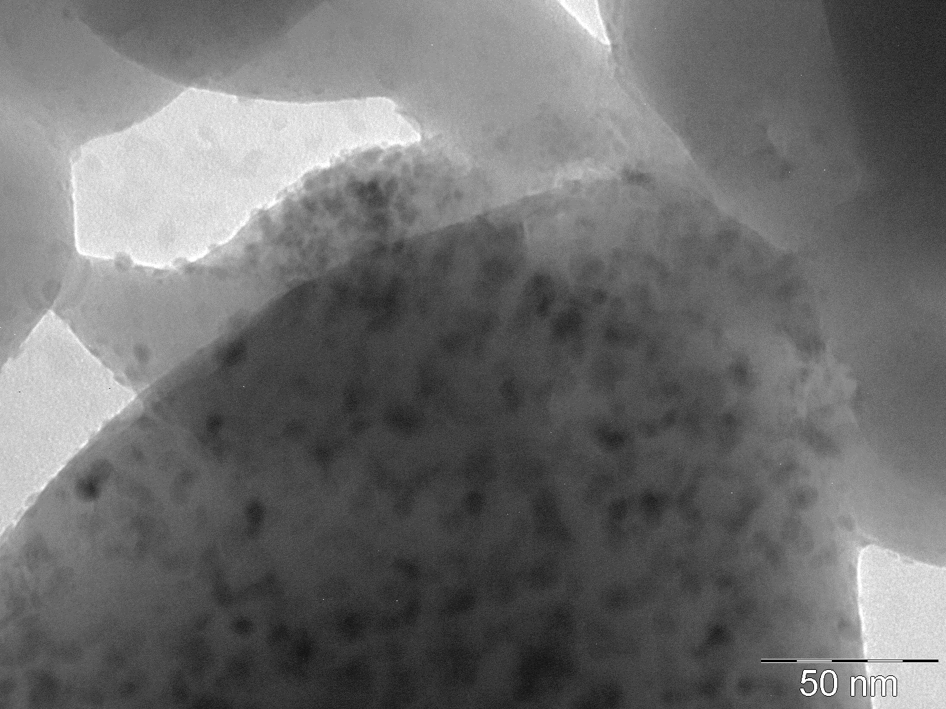
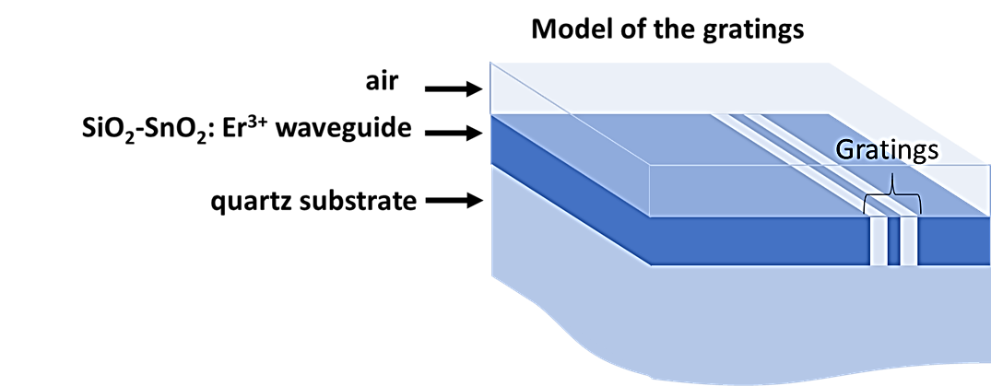
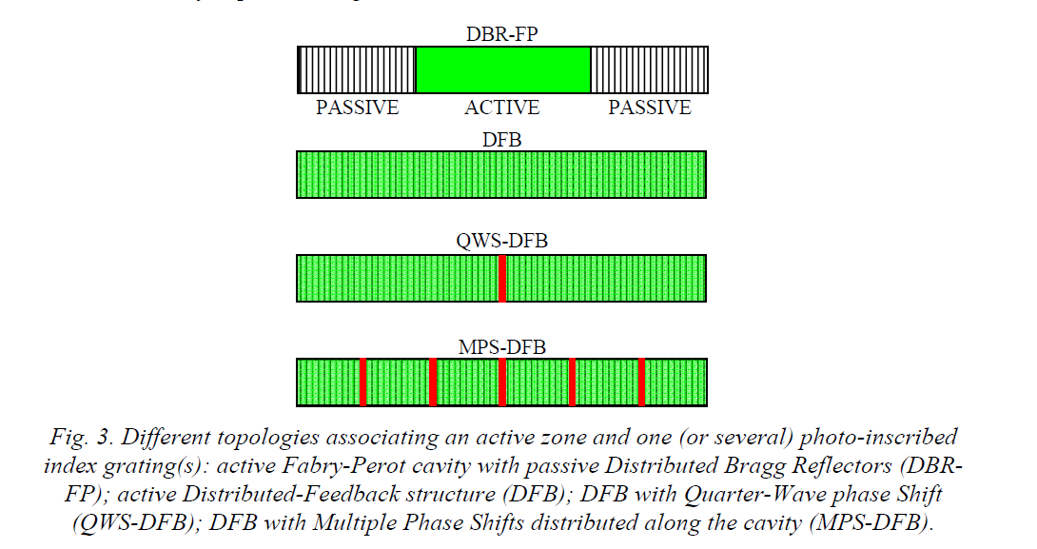
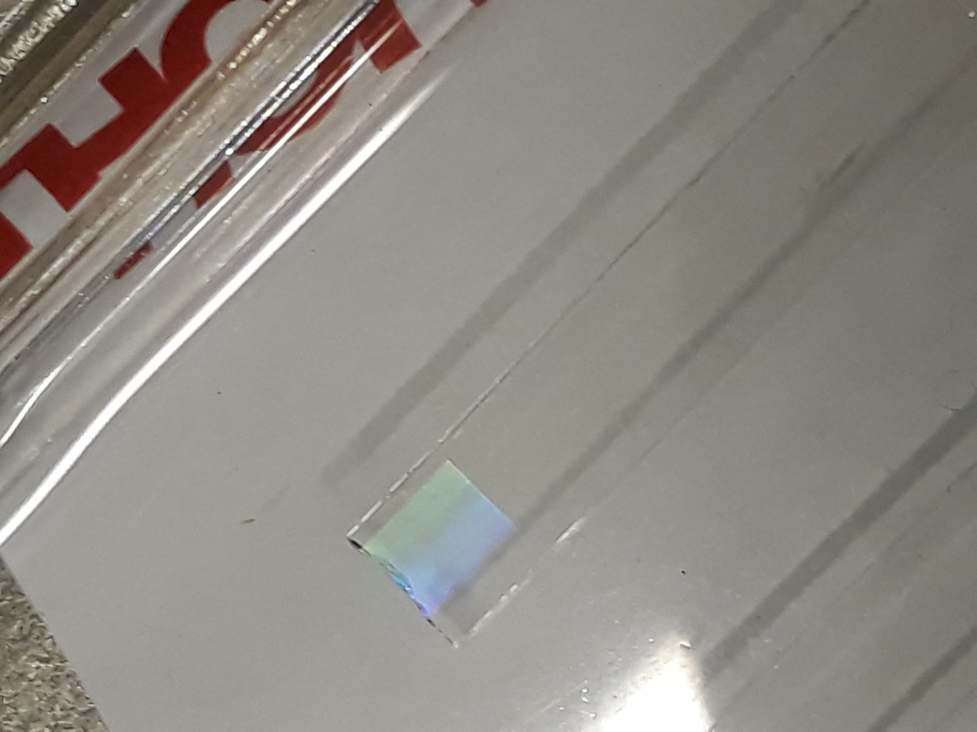
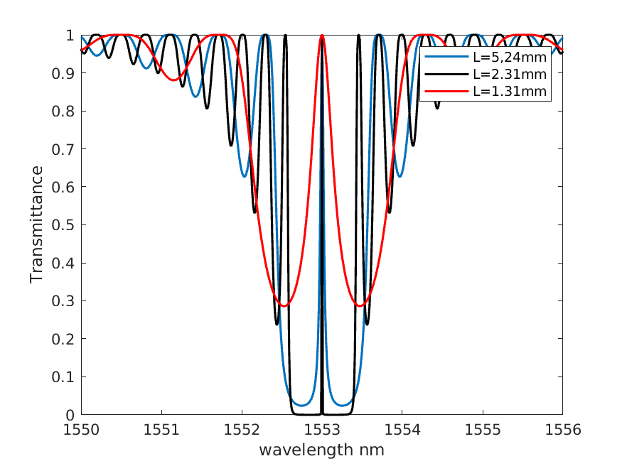
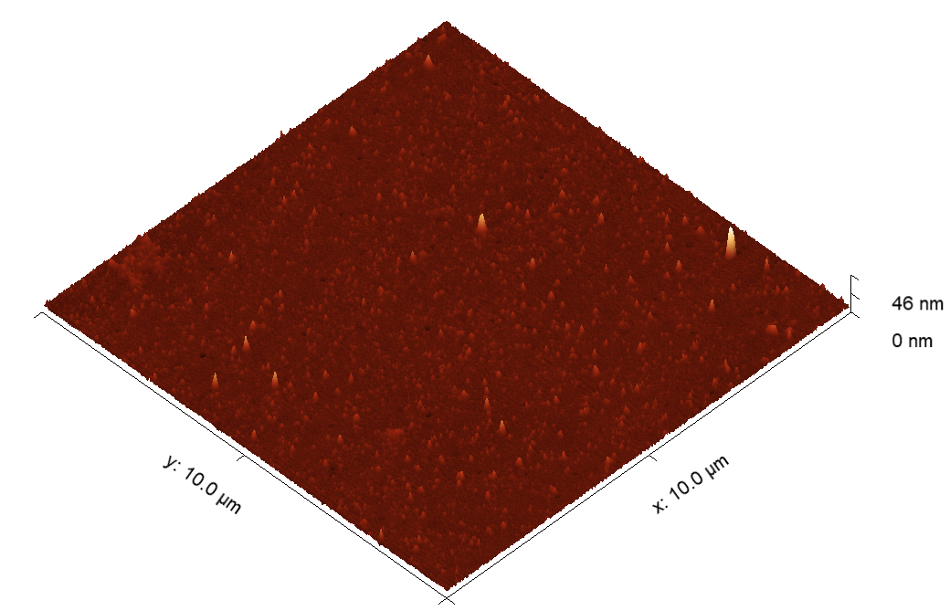
MiFo: SiO₂-SnO₂ glass-ceramics waveguides and devices
Nanocrystals of SnO₂: 4 – 6 nm
Photosensitivity
Design for planar photonic structure
Negative effective index change up to 1.6×10⁻³
DFB with Quarter-Wave phase Shift (QWS-DFB);
TEM image of
70SiO₂-30SnO₂:0.5Er³⁺
Glass-ceramic waveguide
Surface morphology
Bragg gratings inscription image
5µ pitch raster pattern
4x4mm² area
Fabrication parameter:
CW frequency doubled argon laser:
λ = 244 nm
Dose: 1 kJ/cm² , Δn_{average} = - 4.3 x10⁻³
70SiO₂-30SnO₂:0.5Er³⁺ planar waveguide RMS = 1.8 nm
Transmission spectrum of a QWS-DFB structure when not pumped, 20SnO₂-80SiO₂:0.5Er³⁺
Notes:
SiO₂-SnO₂ glass-ceramics waveguides
To obtain the systems with high photosensitivity, it is necessary to have as high as possible content of tin dioxide. Moreover, the high tin dioxide content is also needed to obtain high luminescence efficiency because it increases the solubility of Erbium. In addition, to avoid the non-radiative losses which decrease the luminescence efficiency, the scattering losses must be avoided by controlling the tin dioxide crystals in very small sized, at least less than 10 nm.
TEM: the evidence of obtaining very small tin dioxide nanocrystals. This is TEM image of the SiO₂-SnO₂ system. For this observation, the sample were ground into powder. Therefore, we see the grains of the sample powders. One can see that the tin dioxide is homogeneously distributed and well-separated in silica. From the scale, we also see that the size of tin dioxide crystals is in nanoscale, around 4 to 6 nm.
Surface morphology: it is necessary to have low roughness of the samples. Here, the AFM image of the surface of the planar waveguide. One can see that for the highest content of tin dioxide (30 mol%), we obtain the roughness of only 1.8nm. It is extremely important, because the standard requirement for the roughness of commercial integrated optics is 2 nm.
Photosensitivity: Exploiting the photosensitivity, the Bragg-gratings have been fabricated on the planar waveguide. Here is the image of the Bragg-gratings. The color that we see from image is the interference patterns scatter from the gratings based on the Bragg law. It is important to stress that our sample is more efficient for the fabrication of the gratings. To obtain the same value of refractive index change, the energy needed for germanate glasses which constitutes the fiber sensors is from 10 to 20 times higher than our material.
Design for planar photonic structure: here is the design for the integrated planar waveguides. To obtain this kind of laser, it is needed to fabricate the gratings and the channel waveguides. Here is the design for the grating exploiting the distributed feedback Bragg grating with quarter-wave phase shift structure. Increasing the length of the whole structure shows a better cavity feature.

Slide 5
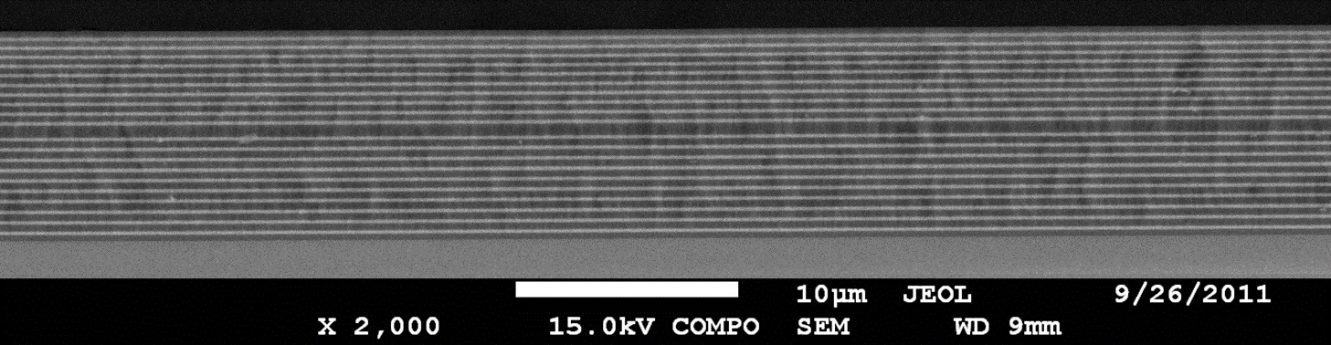
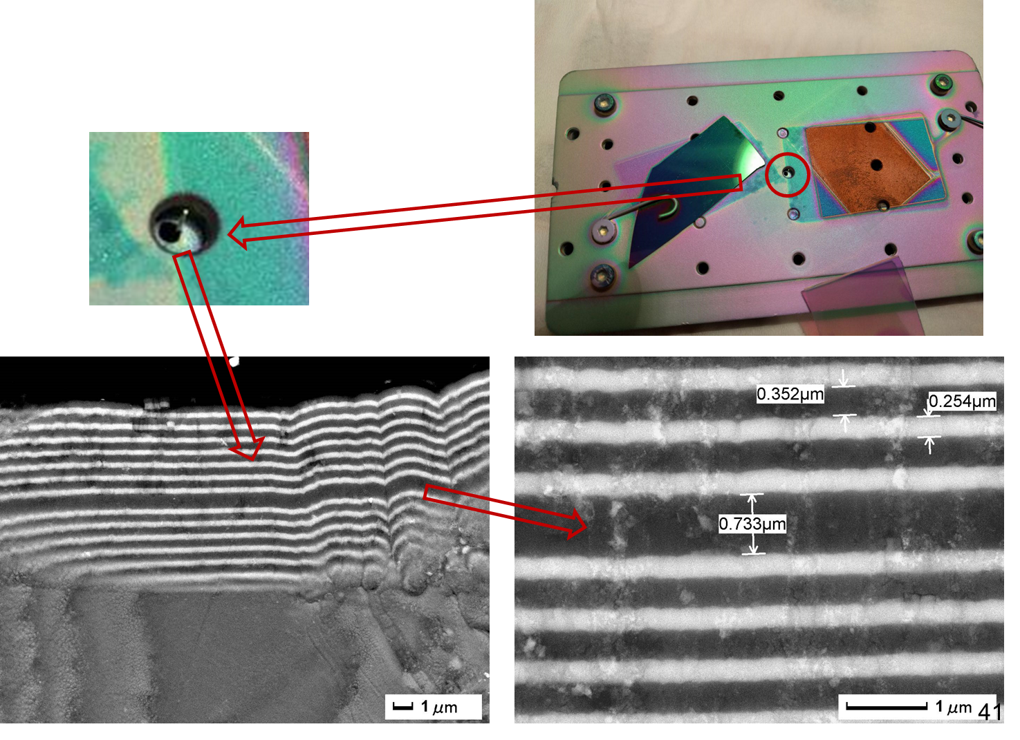
MiFo: Glass-derived Er³⁺-doped 1-D Microcavities by RF-sputtering
RF-sputtering fabrication protocols of 1D microcavities
Emission features-Bragg reflector with 10 layers
Transmission
Glass-derived 1D photonic crystals
First results of the integration on SMF28 Fiber
goal =>> Coherent emission @ 1.5 μm
Notes:
RF-sputtering fabrication protocols of 1D microcavities: Exploiting 1D photonic crystals as 1D photonic cavity in the active structure gives us the possibility to obtain Luminescence enhancement and handle Photon Management. The working principles of these aspect are:
Firstly, 1-D microcavities can enhance the luminescence which is resonant with the cavity, when the structure is activated by a luminescent species.
Secondly, when the cavity dimensions approach the wavelength of the emission, the density of electromagnetic states inside the cavity are strongly perturbed and can lead to significant enhancement of the luminescence quantum yield.
Therefore, this enhancement is achieved by increasing the number of the localized modes coupled with the emitter.
Another advantage of 1-D cavities is that 1D photonic crystals can lower laser threshold. Because as we know when the spontaneous emission of the emitter, embedded in the defect layer of a 1-D photonic crystal, is strongly enhanced the possibility of low threshold lasing could take place.
Transmission: Here one can see the transmission spectra of the Bragg gratings with different number of layers and the corresponding stop-band of different layer of the Bragg. The higher layers, the higher Q factor and the lower transmittance. Therefore, we need to find a trade-off between the Q factor and the transmittance. I would like also to draw your attention to the 3rd order of the main stop –band in the green at which we use for pumping.
Emission features-Bragg reflector with 10 layers: Here are the emission features of Er in the 1D microcavity with the Bragg reflector of 10 layers. The blue emission spectrum is the one when the sample was excited at low power by using the Xenon lamp. Here you can see only one-part spontaneous emission of Er which is resonant with the cavity. However, when the sample was excited at higher power using the Argon laser, the emission becomes sharper because of the coherent emission. In other words, the lasing action starts. The full width maximum of the peak is the resolution of the monochromator in the detector.
Glass-derived 1D photonic crystals: This structure has been recently applied for the fabrication on the commercial fiber. Here is one of the 1st results.

Slide 6
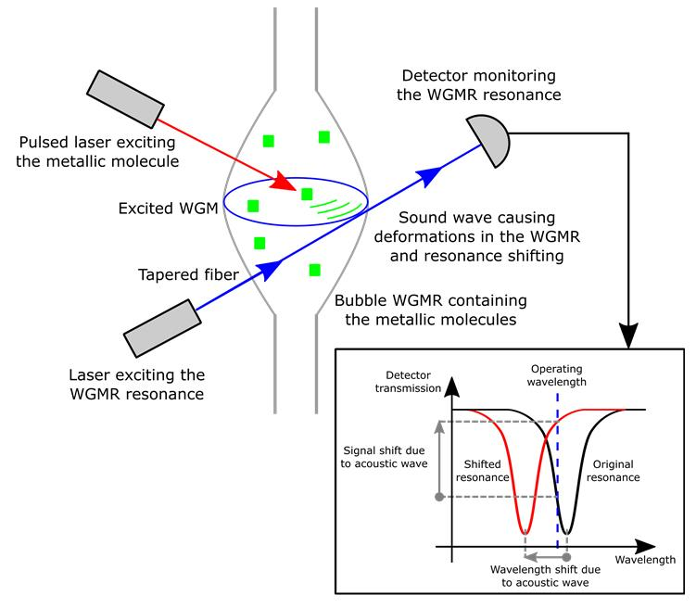
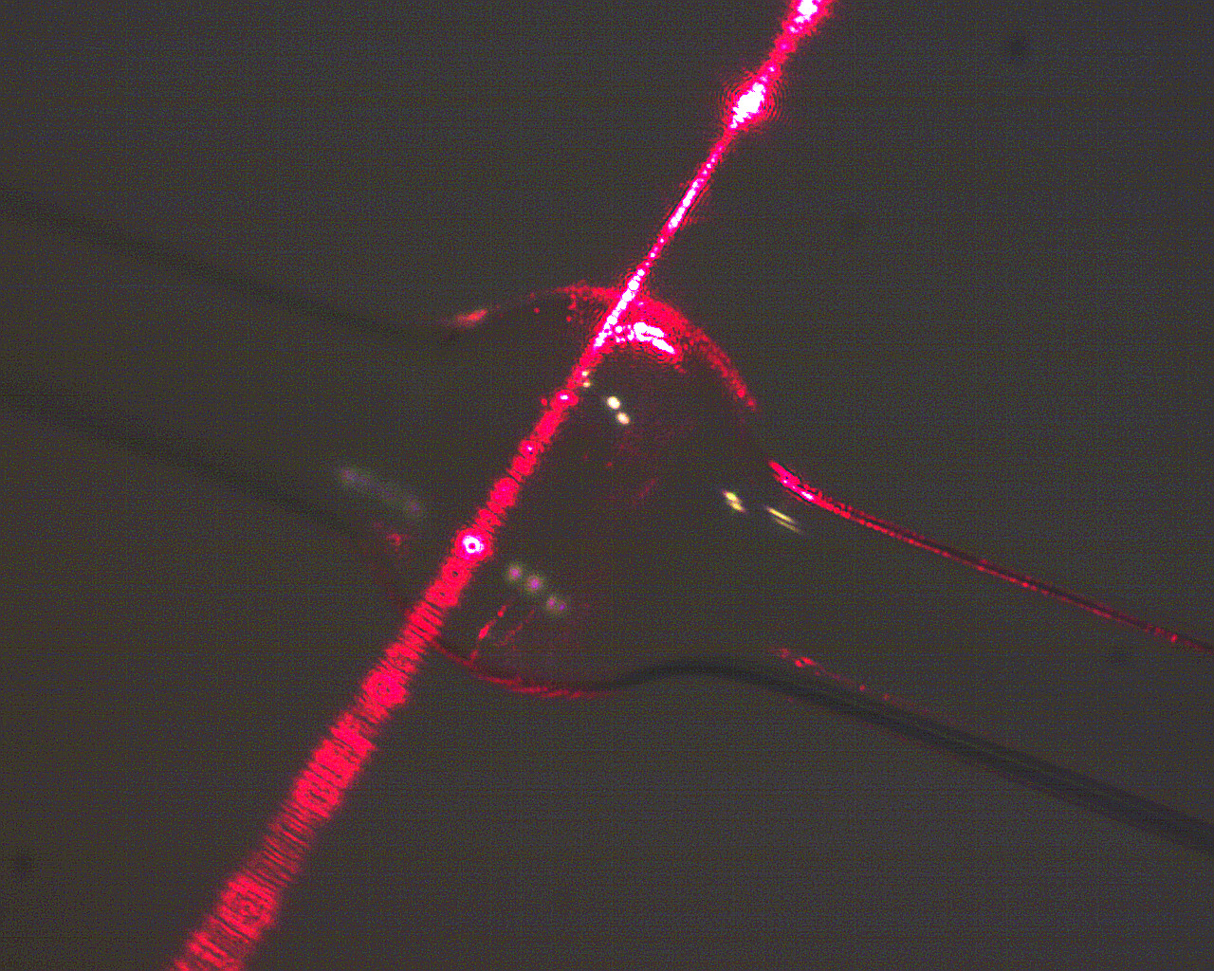
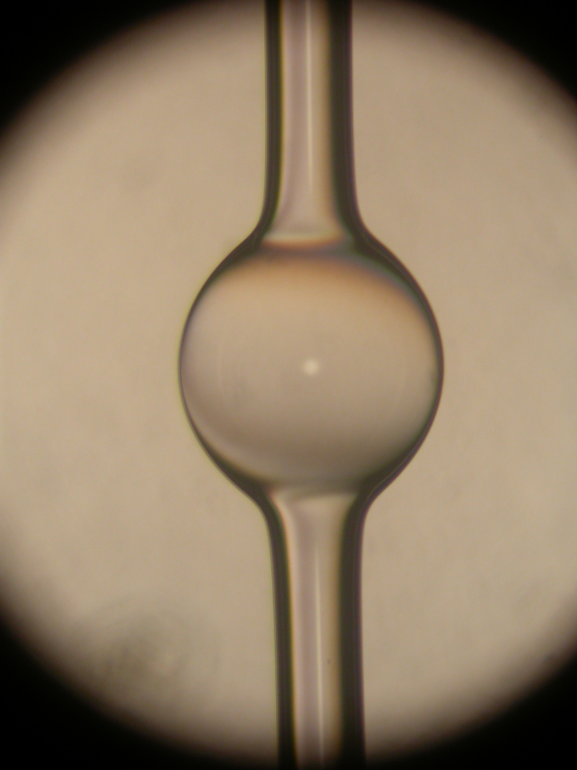
MiFo: photoacustics (PA) - (I)
The main task has been achieved by developing an innovative acousto-optical transducer based on optical micro-bubble resonators for applications in life and materials sciences
All optical PA esperiment with Gold NanoRods (GNRs)
Water based solustion of GNR flux with peristaltic pump
0.5 mm
Main results were obtained in the framework of a CNR-CONACYT project at IFAC-CNR (Silvia Soria PI, G. Frigenti, L. Cavigli, and F. Ratto)
Notes:
Photoacoustics: optical pulses → photothermal conversion → thermoelastic conversion → (ultra)sound
Optical absorbers: Plasmonic particles
Microfluidic platform to count/profile malignant cells in bio fluids, e.g. circulating metastases, by detection of photoacoustic signals from cells stained with dye probes for specific markers

Slide 7
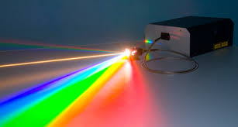
MiFo: photoacustics (II)
The chosen experimental configuration featured the microbubble resonator in the double role of ultrasonic (US) transducer and vial, allowing to avoid impedance-matching materials and to be sensitive to small volumes below 1 μL
Diluted GNRs, well-known contrast agents for PA applications, can be detected at concentration of few nM thanks to the resonant behavior (mechanical) of the resonator
Proper design of the cavity could further enhance detection limit down to the single red cell for ultrasensitive biophotonics applications
Water based solustion of GNR flux with peristaltic pump
A fiber based supercontinuum source we just acquired (Koheras SuperK COMPACT) will allow studying the photoacustic transducer response with varying excitation wavelengths for the GNR or other nanoparticle (NP) solutions in water (PA spectroscopy of diluted NPs)

Slide 8
MiFo: milestones and pubblications 2018
Milestones 2018:
Progetto e realizzazione di un trasduttore acustico ottico innovativo a banda larga e ultrasensibile basato su risonatori ottici a bolla
Design and implementation of a highly-sensitive, wide-band, innovative acousto-optical transducer based on micro-bubble resonators (100 % accomplished)
Integrazione del transduttore in un microscopio fotoacustico per l’analisi in tempo reale delle caratteristiche morfologiche di nanoparticelle metalliche
Integration of the transducer into a photoacoustic microscope for the real-time structural analysis of metallic nanoparticles (70% accomplished, new equipment needed, i.e. a supercontinuum source for photoacustic spectroscopy was just purchased)
Protocolli di fabbricazione di guide planari SiO₂-SnO₂; valutazione delle proprieta termodinamiche, ottiche, spettroscopiche e strutturali
SiO₂-SnO₂-based waveguides fabrication protocols; thermodinamic, optical, spectroscopic, and structural characterization (100 % accomplished)
Protocollo di fabbricazione di strutture multilayer per sensoristica mediante sputtering a radiofrequenza; caratterizzazione ottica e strutturale
RF-sputtering-based fabrication protocols of multilayer structures for sensing; optical, and structural characterization (100 % accomplished)
Publications 2018:
20 papers on ISI Journals
International Conferences 2018:
9 presentations by CF “assegnisti” (6 invited)
10 presentations by CF associates (7 invited)

Slide 9
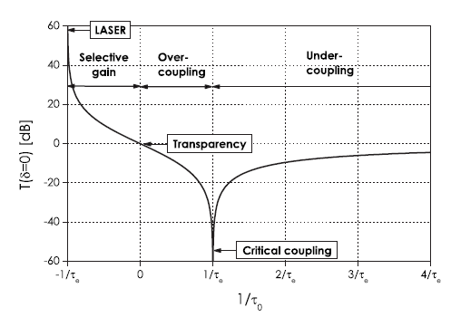
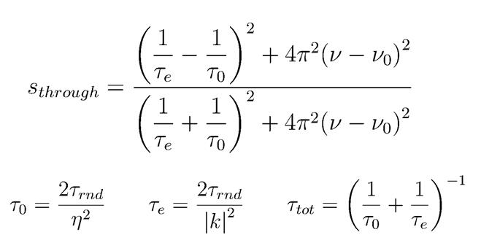
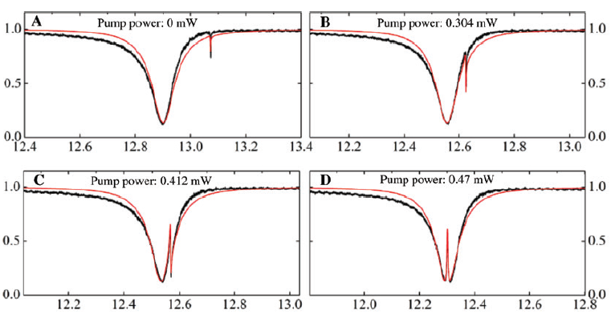
MiFo: Elettromagnetically Induced Transparency (EIT)
Study on coupling regimes by Cavity Ringdown Spectroscopy
Coupling regimes
s_{through}(ν=ν₀)
  |k|² < η²
  |k|² > η²
EIT with WGM resonators
R1
R2
S. Zhu, et al., Nanophotonics 2018; 7(10): 1669-1677

Slide 10
MiFo: milestones 2019
Milestones 2019:
Analisi di sospensioni di nanoparticelle con il sistema fotoacustico sviluppato utilizzando spettroscopia di eccitazione mediante una sorgente supercontinua impulsata
Analysis of NP suspensions by using the developed PA system and excitation spectroscopy with a pulsed supercontinuum source
Studio di sistemi ottici basati su microrisonatori a modi di galleria con trasparenza indotta elettromagneticamente e di cavità a guadagno variabile
Study of WGM-resonator-based optical systems with EIT and of variable gain microcavities
Nano vetro ceramiche trasparenti SiO₂-SnO₂: (a) utilizzo delle proprietà fotorefrattive per la sintesi di sorgenti laser integrate; (b) test preliminare di filatura a partire dalle preforme SiO₂-SnO₂
Transparent SiO₂-SnO₂ nano-glass-ceramic: (a) use of its photorefractive properties for the implementation of integrated laser sources; (b) preliminary drawing tests of SiO₂-SnO₂ preforms
Microcavità fotoniche attivate con ioni di terre rare per l'ingegnerizzazione dei processi di emissione, assorbimento e trasferimento d’energia in presenza di ioni donore-accettore
RE-doped activated photonic microcavities for the engineering of the emission properties, of the absorption and of the energy transfer of donor-acceptor systems

Slide 11
MiFo: plan 2019-21
Plan of activities 2019 - 2021
Photoacustics (PA), and electromagnetic induced transparency (EIT)
PA spectroscopy of diluted nanoparticles (NPs)
Optomechanical oscillations in optofluidic resonators
EIT systems based on coupled Whispering Gallery Mode (WGM) resonators
Generation of non-classical light from high-Q WGM resonators below the threshold for NL effects
High efficient coupling of quantum sources, like QD, to WGMs in high-Q resonators
Engineering of luminescent ions and cromophore activated nano-objects by using confined structures for controlling and modifying the quantum efficiency of the systems
Fabrication of rare-earth-activated SnO₂-based glass-ceramic waveguides and preforms for integrated laser sources and sensors
Development of scintillators based on high-density and non-toxic HfO₂ and SnO₂ NPs
Development of transparent nano-glass-ceramics and confined structures for the development of luminescent meta-surfaces

Slide 12
MiFo: grants and funding 2019-21
Expected funding in the 3-year period:
Request of funding by Centro Fermi
Grants (number and period requested):
  1 Junior Grant (2019-2021)
  1 Senior Grant (2019-2021)
consumables/inventory per year
20,000 € in 2019, 2020 and 2020
External funding
Collaborating CNR Institutes and Universities co-fund the research by covering the cost of their personnel (besides the listed collaborators) and of the laboratories which are made available for the research activities (estimated total 40 K€/year).
Conacyt-CNR bilateral project (All-optical morphogenesis of nanostructures characterized by photo-acoustic microscopy, 2017-2018) and EU-Photonics Sensing SafeWater project (On Chip Whispering Gallery Mode Optical Microcavities for Emerging Contaminant Determination in Waters, 2018-2020)

