Slide 1
News from Technical Coordination
D. De Gruttola
Centro Fermi

Slide 2
Summary
Material for new stations
New power supply
New FEA cards
Temperature and pressure monitoring
“Masking” of noisy channels
Setup for task force
Material of all telescopes

Slide 3
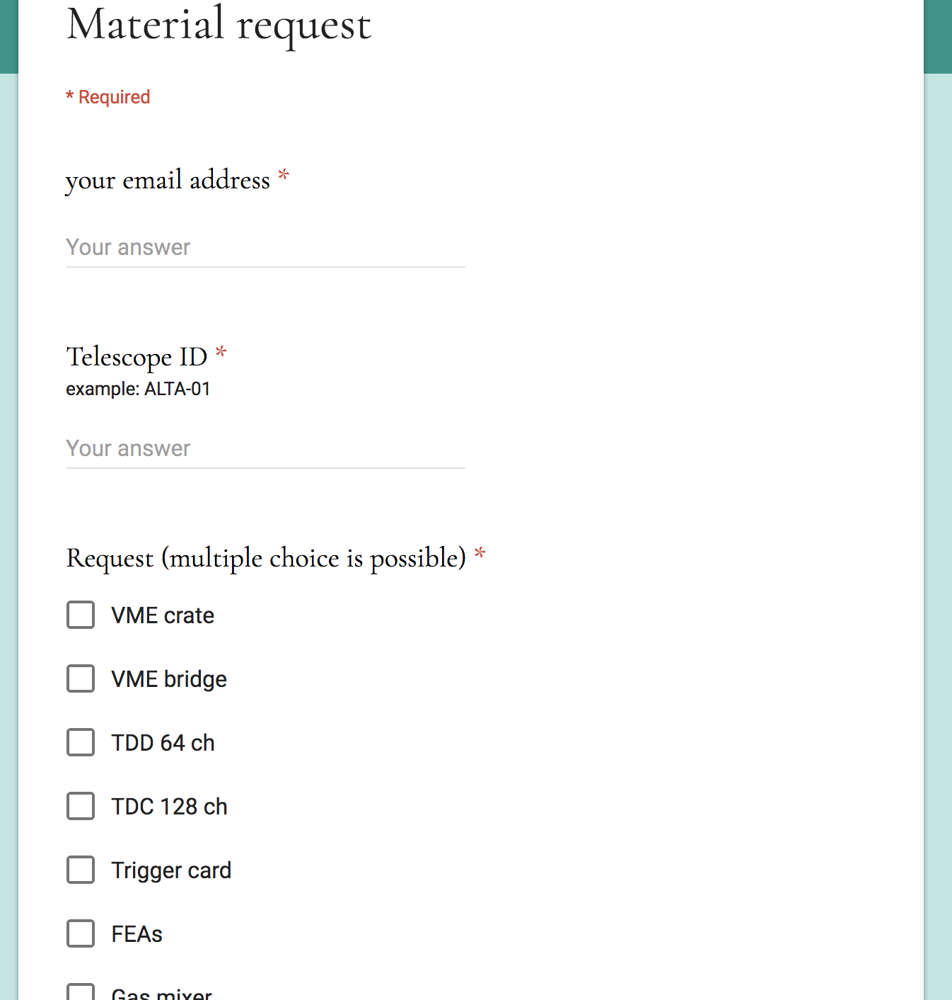
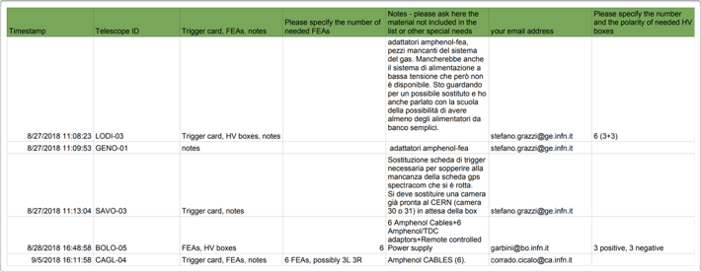
Material for new stations
https://sites.google.com/centrofermi.it/3etech/home/requests?authuser=0

Slide 4
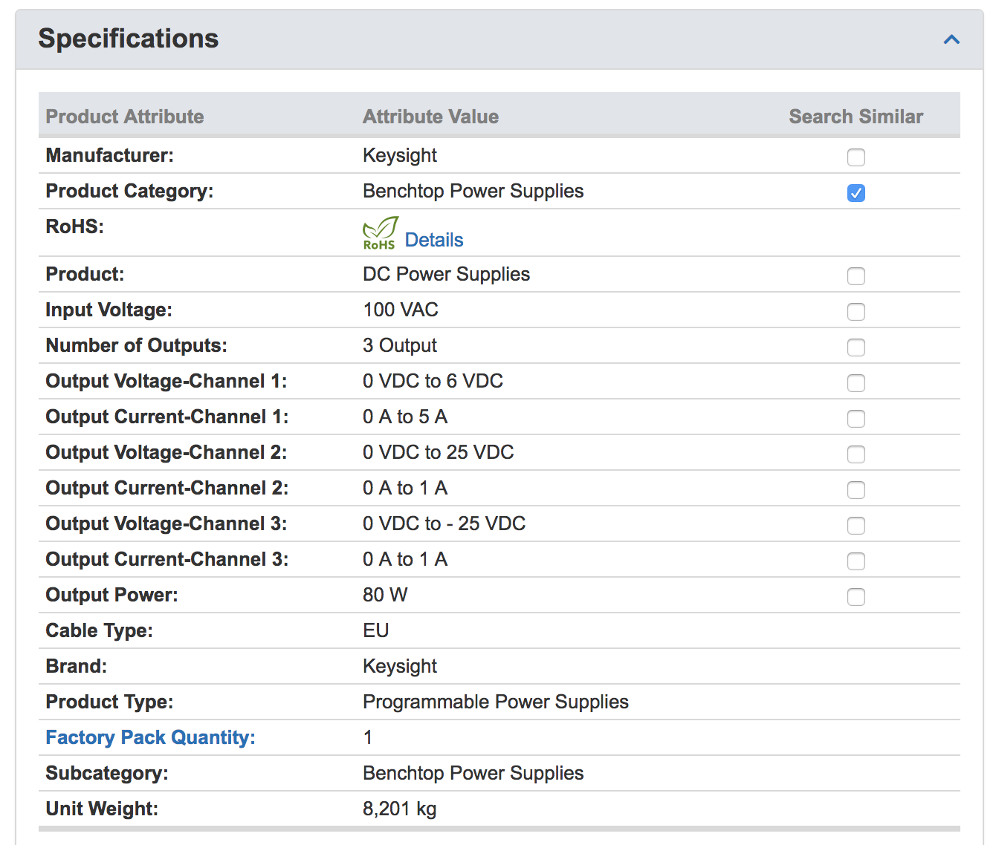
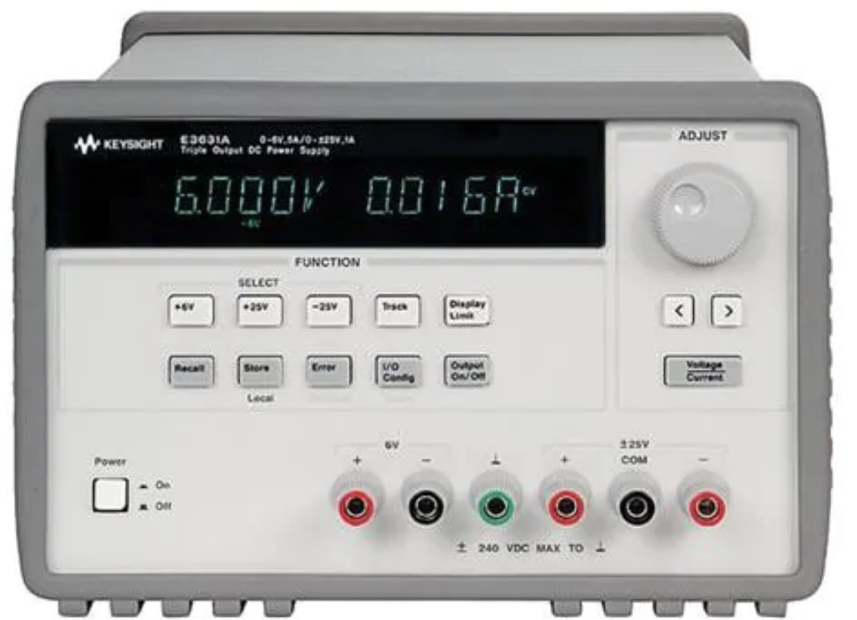
New power supply

Slide 5
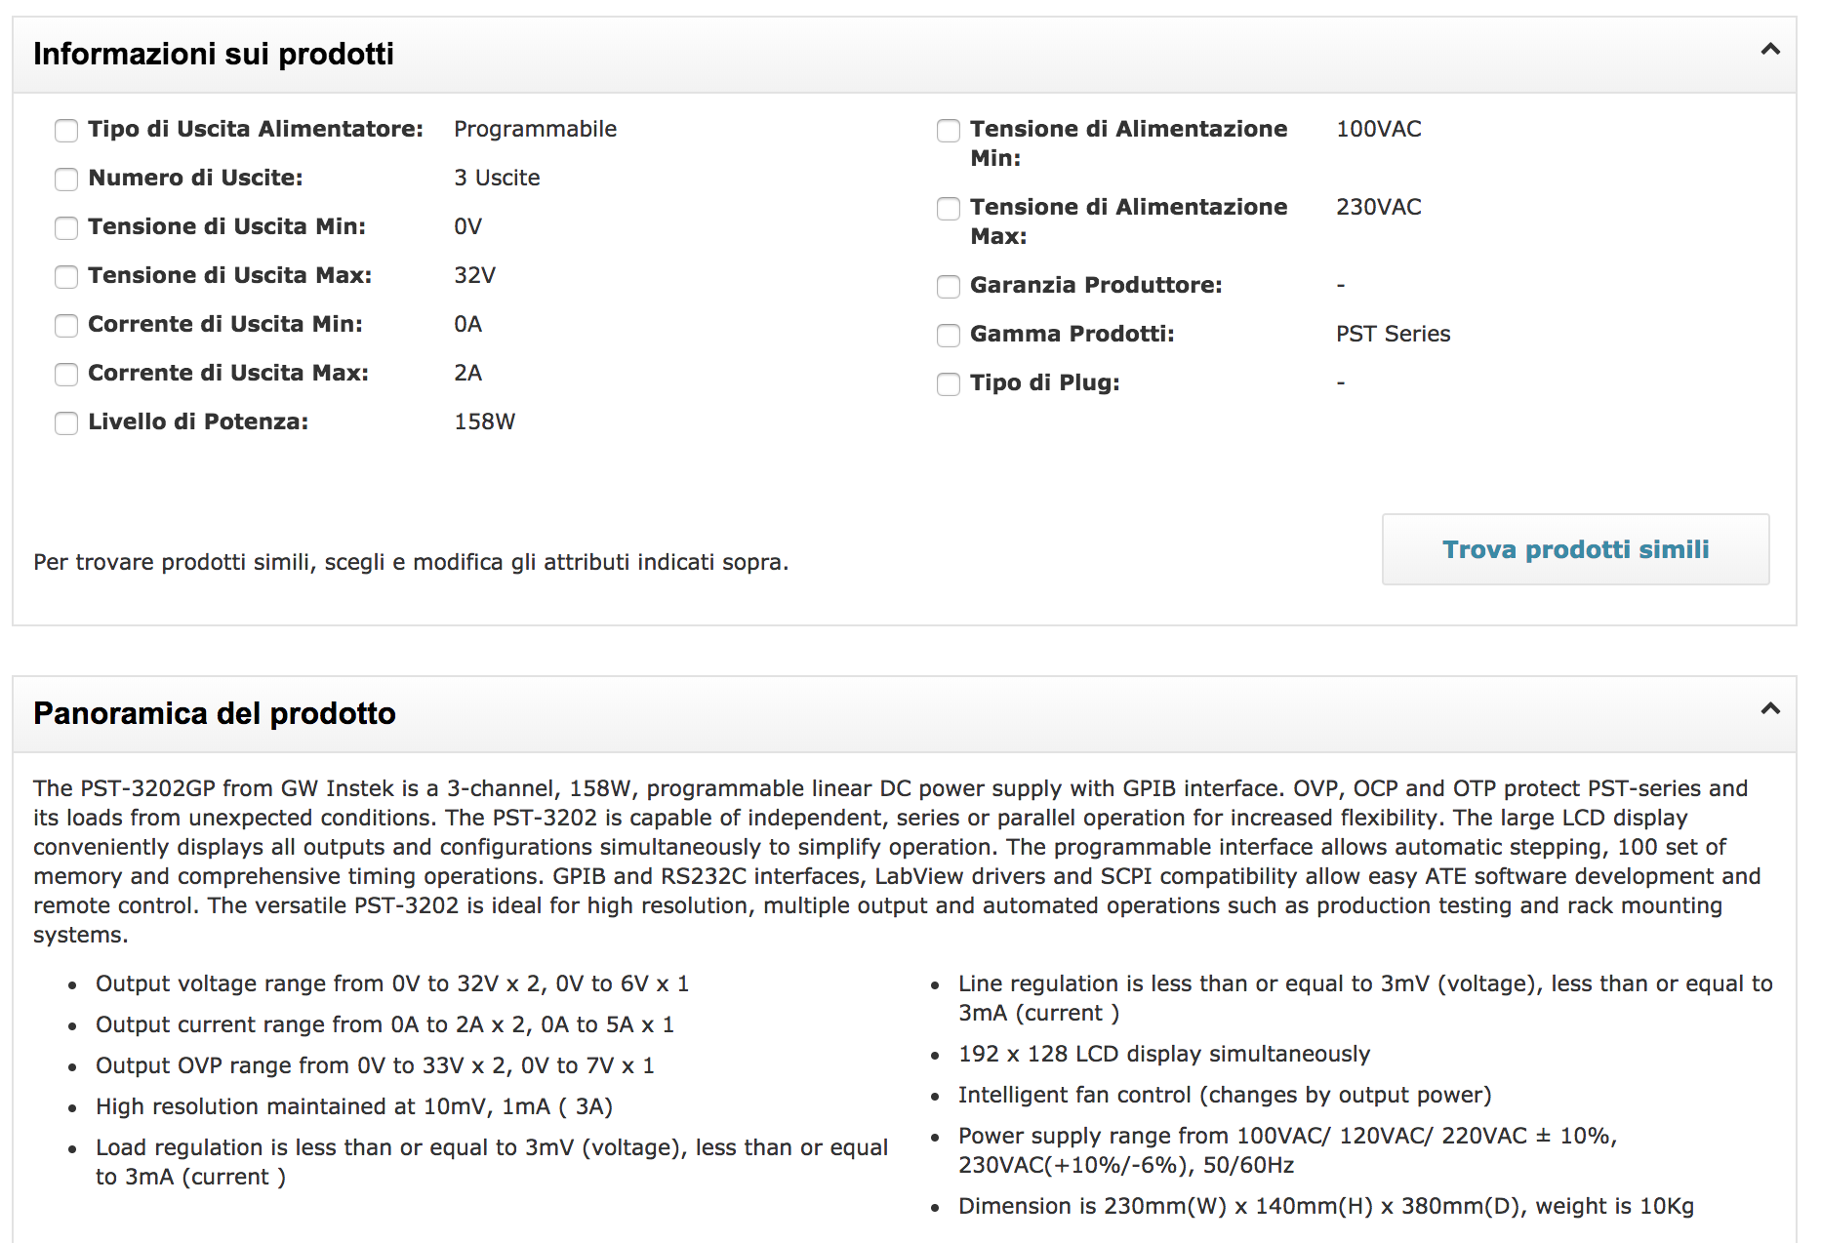
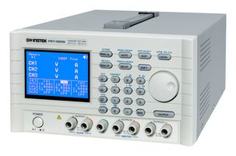
New power supply

Slide 6
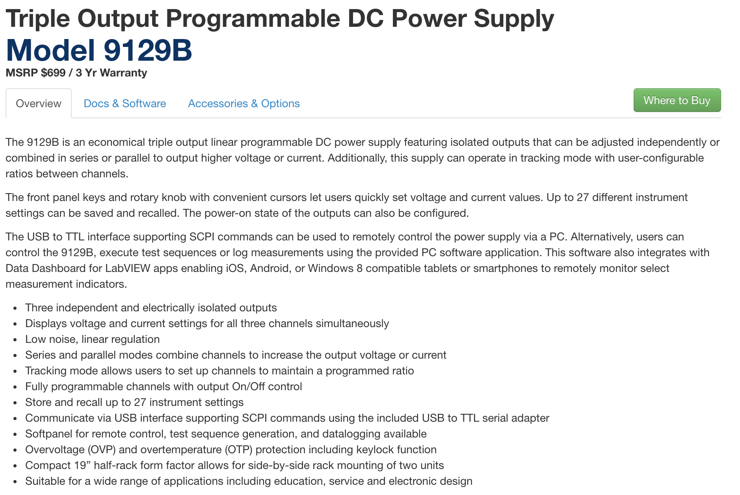
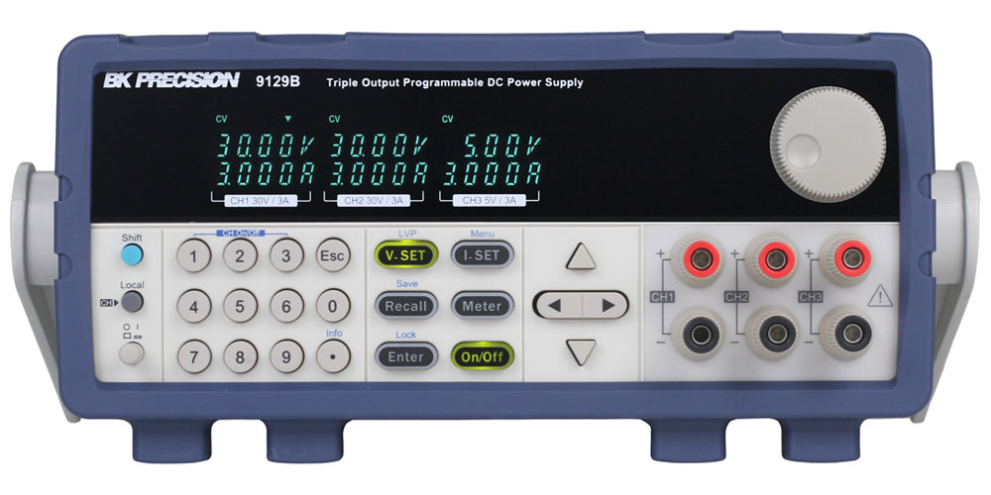
New power supply

Slide 7
New PS and V and I monitoring

Slide 8
New FEA cards

Slide 9
T and p monitoring

Slide 10
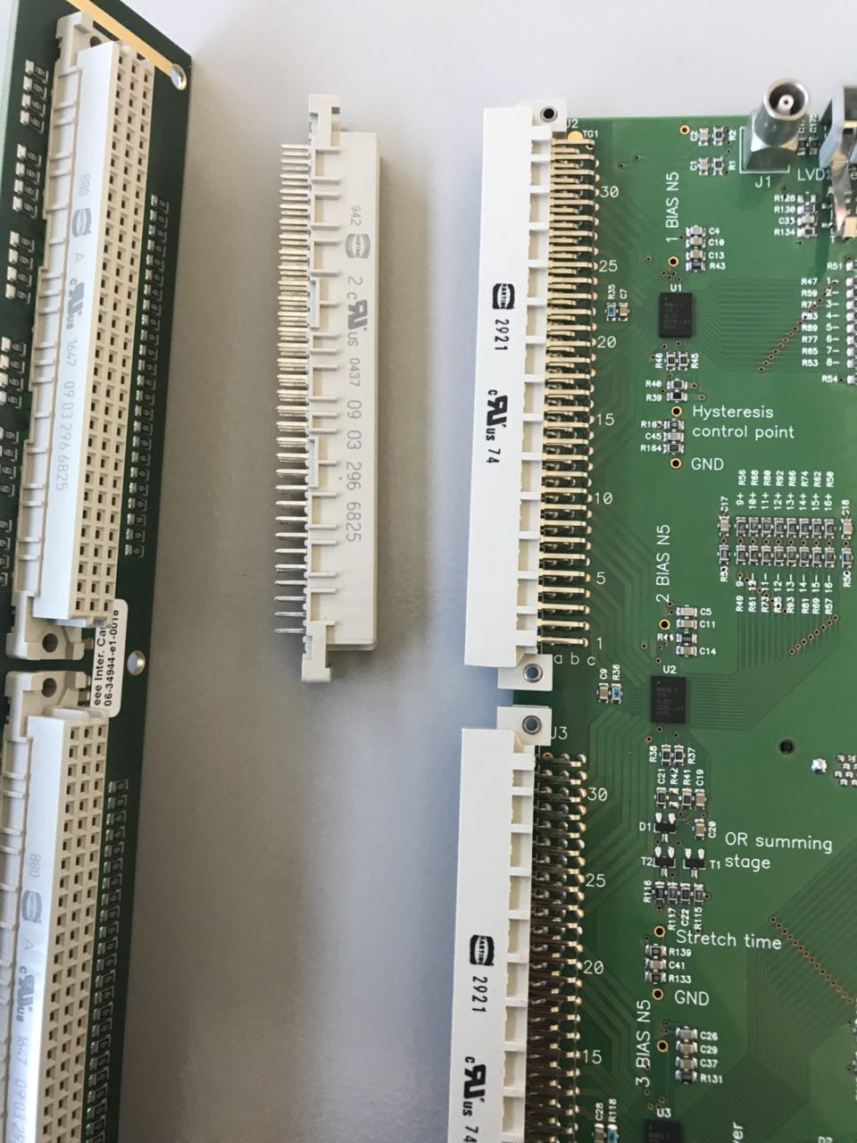
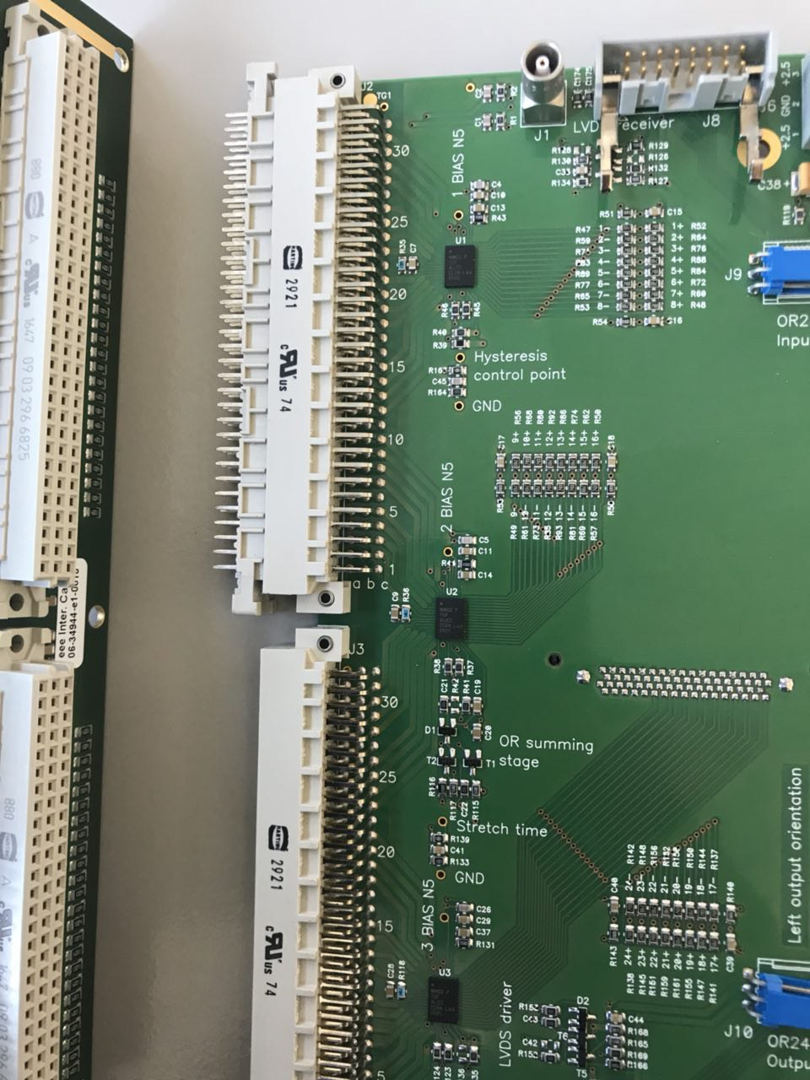
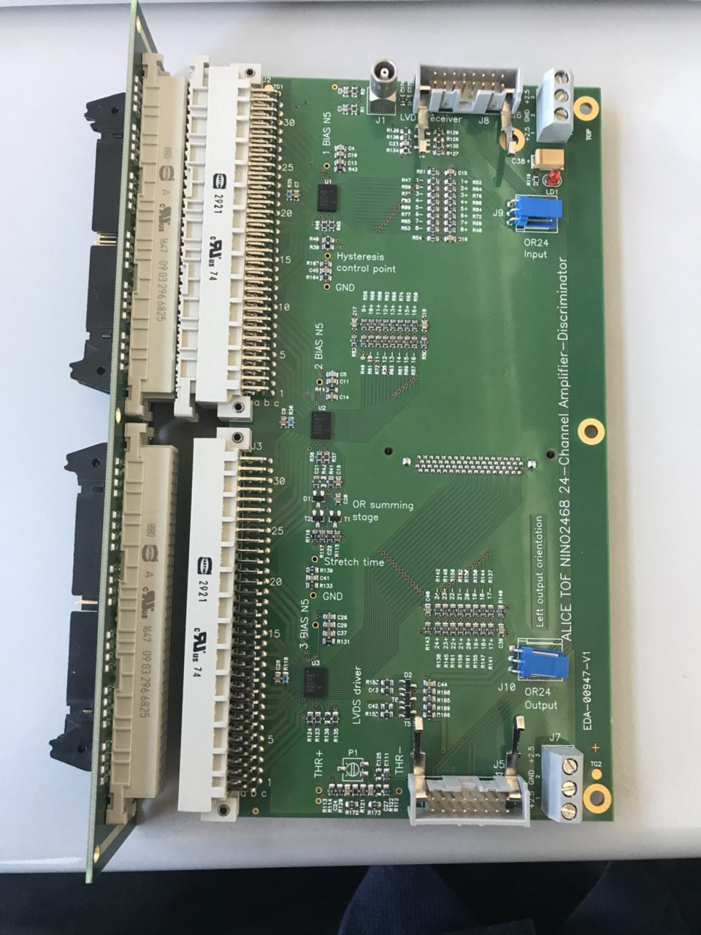
Noisy channels

Slide 11
Setup for task force

Slide 12
Telescopes material
https://sites.google.com/centrofermi.it/3etech/home/table-3?authuser=0

