Slide 1
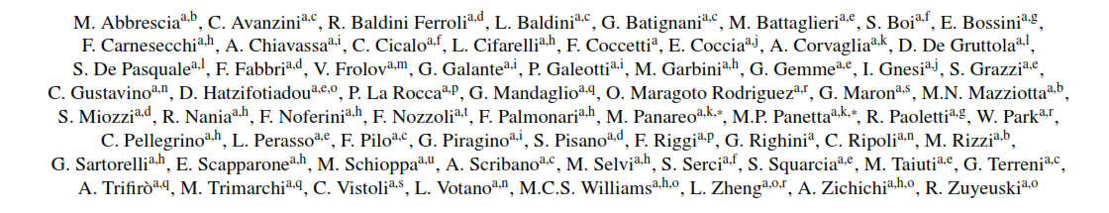
NIM template
The New Trigger/GPS Module for the EEE Project
Keywords:
Multigap RPC, EAS detection, Muon detections, Trigger system, Time stamping, Timing GPS

Slide 2
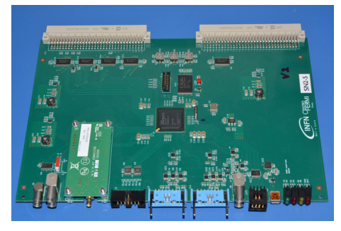
Sections
Abstract
The EEE Project
The EEE Telescope
The Data Acquisition System
EEE Trigger/Gps System
    Trigger Unit
    GPS Interface
Time Resolution Measuremets
Conclusions
Detectors array inside school buildings →
synchronization

Slide 3
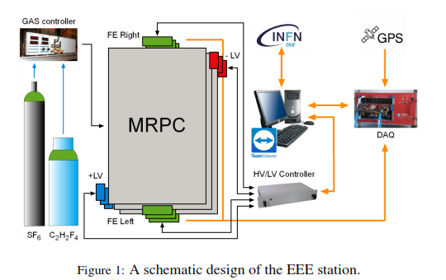
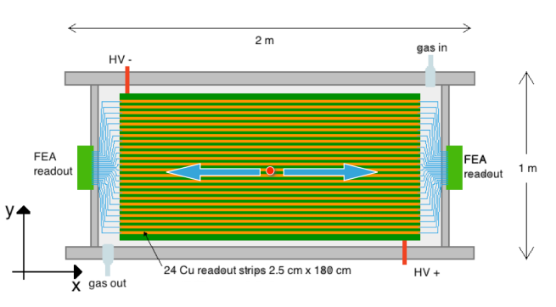
Sections
Abstract
The EEE Project
The EEE Telescope
The Data Acquisition System
EEE Trigger/Gps System
    Trigger Unit
    GPS Interface
Time Resolution Measuremets
Conclusions

Slide 4


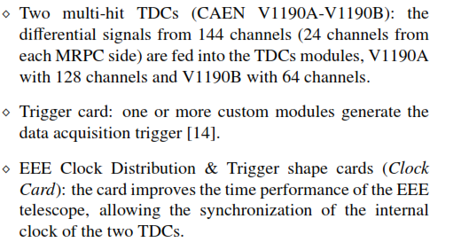

Sections
Abstract
The EEE Project
The EEE Telescope
The Data Acquisition System
EEE Trigger/Gps System
    Trigger Unit
    GPS Interface
Time Resolution Measuremets
Conclusions

Slide 5
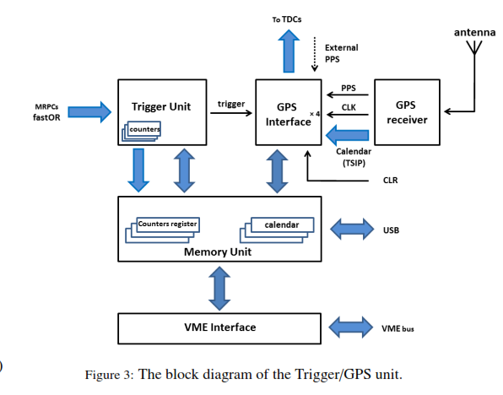
Sections
Abstract
The EEE Project
The EEE Telescope
The Data Acquisition System
EEE Trigger/Gps System
    Trigger Unit
    GPS Interface
Time Resolution Measuremets
Conclusions

Slide 6
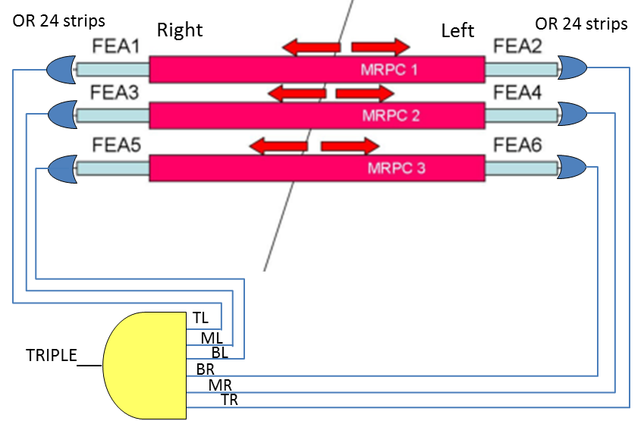
Sections
Abstract
The EEE Project
The EEE Telescope
The Data Acquisition System
EEE Trigger/Gps System
    Trigger Unit
    GPS Interface
Time Resolution Measuremets
Conclusions
TRIPLE
3 DOUBLE
3 SINGLE
6 Fea signals

Slide 7
Sections
Abstract
The EEE Project
The EEE Telescope
The Data Acquisition System
EEE Trigger/Gps System
    Trigger Unit
    GPS Interface
Time Resolution Measuremets
Conclusions
- Over-determinated clock mode

Slide 8
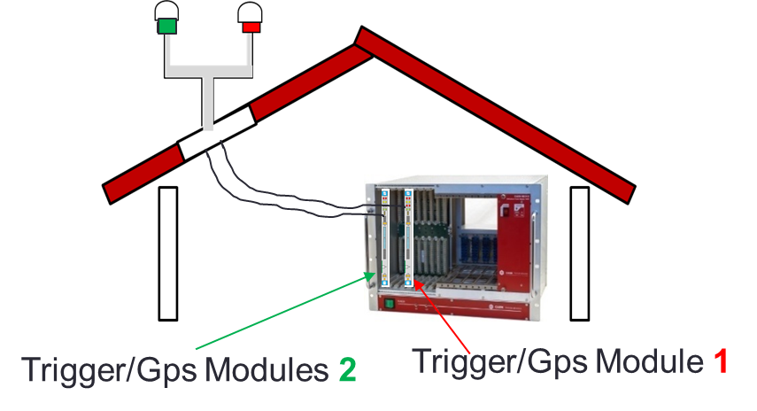


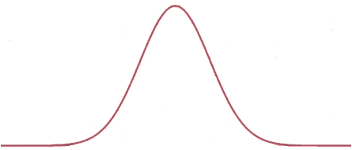
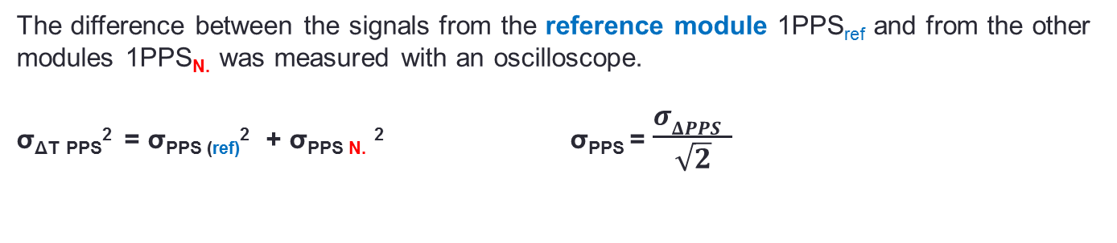
Time Resolution measurements
σ_{1PPS}, time resolution for 1PPS
Time Stamp jitter Δt measurements beetwen 2 different boards with the aim of evaluate the 1PPS resolution σ_{PPS}
σ _{ΔT PPS}
entries
The difference between the signals from the reference module 1PPS_{ref} and from the other modules 1PPS_{N.} was measured with an oscilloscope.
σ_{ΔT} _{PPS}² = σ_{PPS (ref)}² + σ_{PPS N.} ² σ_{PPS} = $\frac{σΔPPS }{\sqrt{2}}$

Slide 9
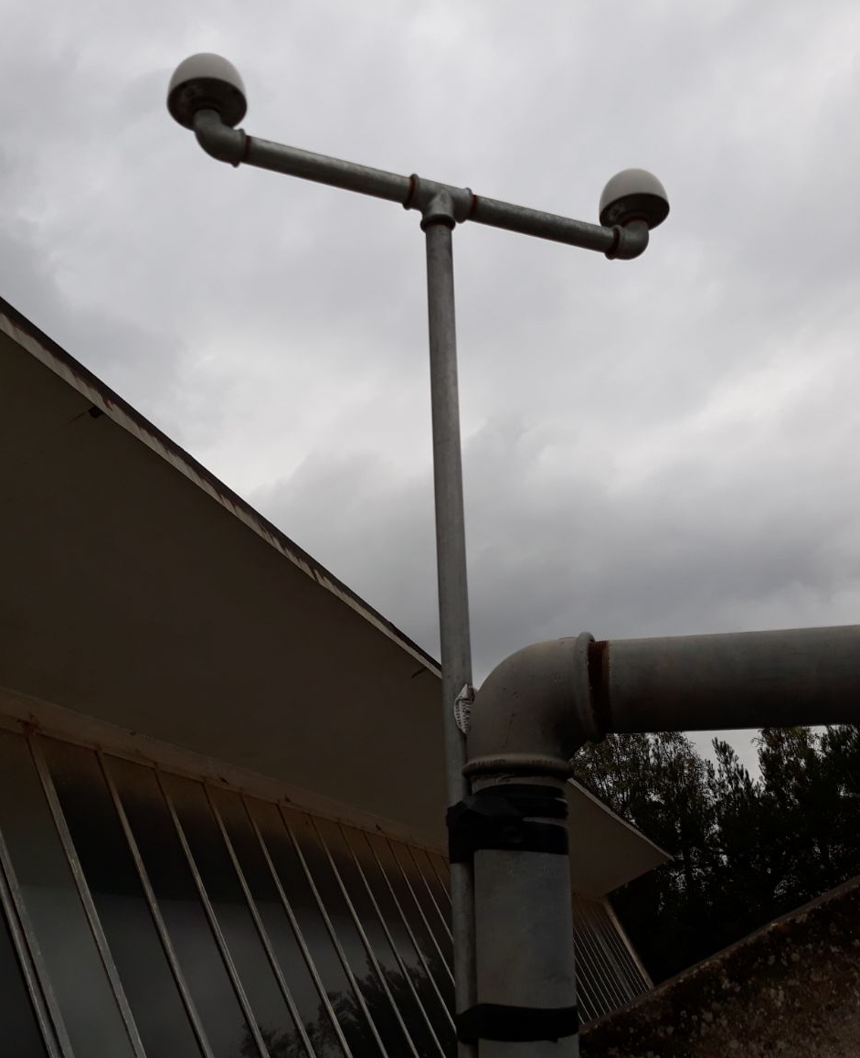
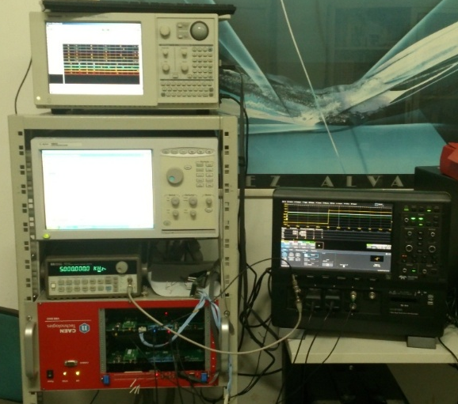
Set-up
The couple of boards are supply in the same VME crate
The couple of antenna are mounted on the roof above our laboratory, at a distant of 40 cm.
It is placed far from walls to avoid any GNSS signal reflections
16 board tested
Gps Antenna 1
Gps Antenna 2
ΔT = t_{PPS1} – t_{PPS2}
σ_{PPS}
entries
Notes:
(v_{cable} =0,66c → Δt = 15.9 ns )

Slide 10
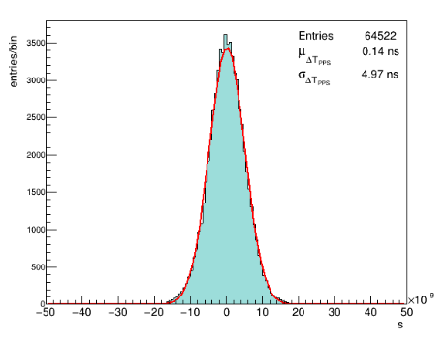

The difference between the signals from the reference module 1PPS_{ref} and from the other modules 1PPS_{N.} was measured with an oscilloscope.
Δ T_{PPS}
σ_{1PPS} = $\frac{σΔ1PPS }{\sqrt{2}}=3. 7 ns$
board SN005 – board SN007

Slide 11
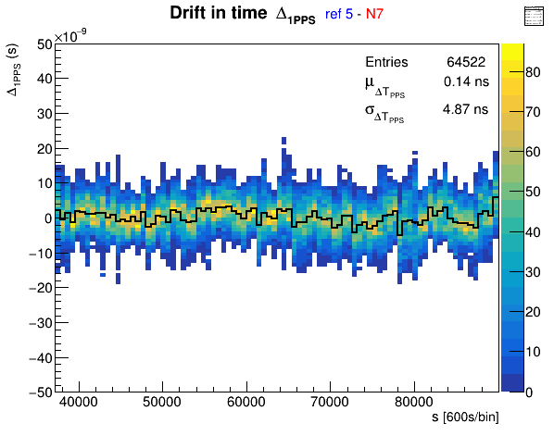
The Profile over the time of the distribution Δ T_{PPS} between the signals from the reference module 1PPS_{ref} and from the other modules 1PPS_{N.}
… to show PPS signals stability
board SN2005 – board SN2007
Bin value = 10 min.

Slide 12
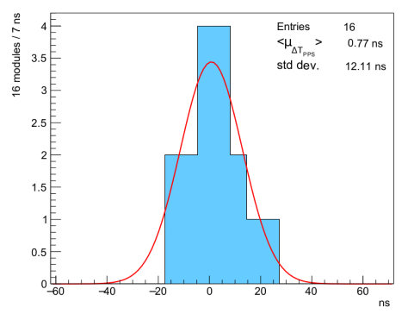
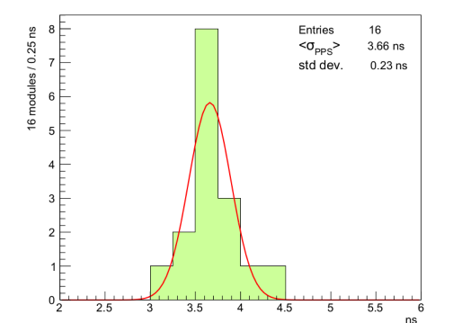


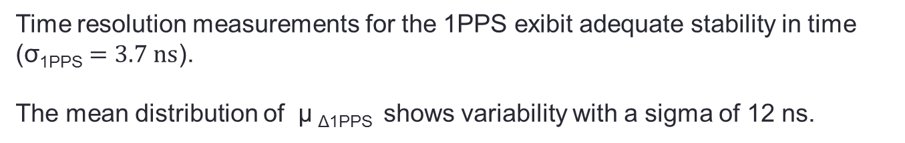
16 modules tested
Mean 1PPS difference Δ_{1PPS} distribution for all the module tested
Time resolution σ_{1PPS} distribution for all the module tested
<μ_{PPS} > = $0.8 ns$
<σ_{PPS} > = $3.7 ns$
Time resolution measurements for the 1PPS exibit adequate stability in time ($\text{σ}\text{1}\text{PPS}=3.7 ns$).
The mean distribution of μ _{Δ1PPS} shows variability with a sigma of 12 ns.
(the Trimble GPS Engine timestamp accuracy is 15 ns accord the data sheet).

Slide 13
Conclusions
The new version of EEE Trigger-GPS board
Performances are consistent with the experimental requests and specifications

Slide 14
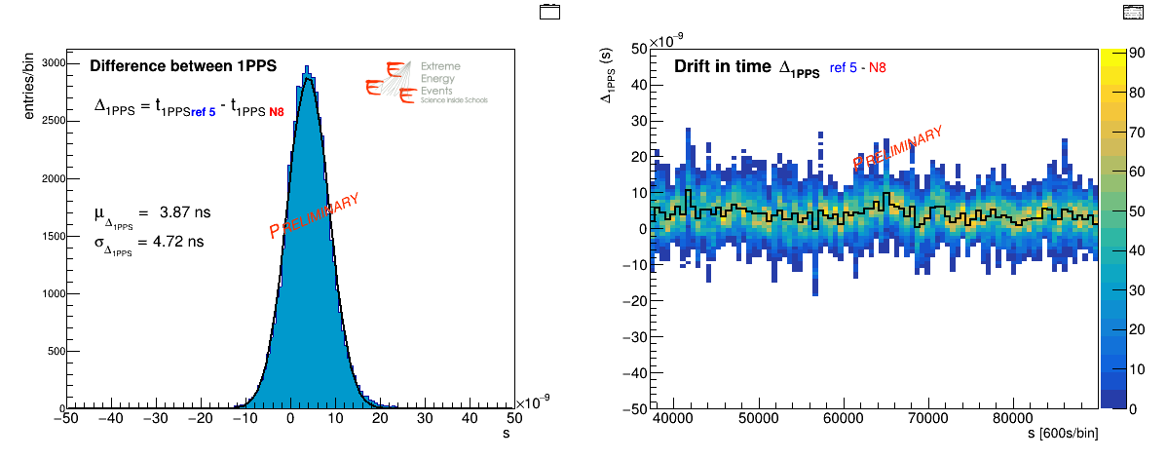
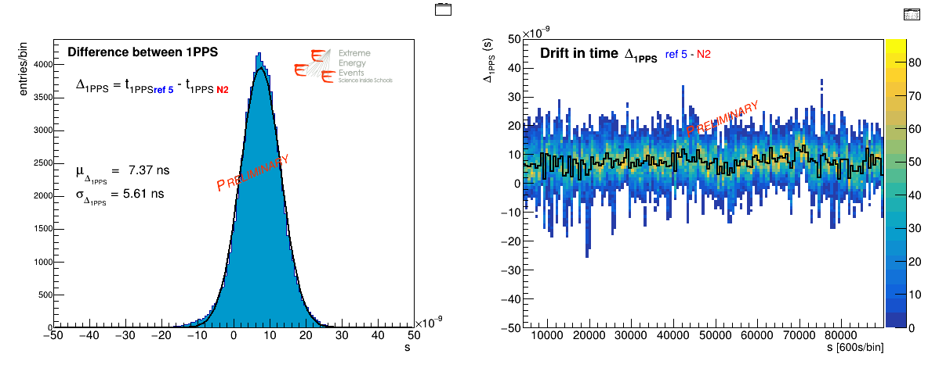
board SN2005 – board SN2008
board SN2005 – board SN2002

Slide 15
Sections
Abstract
The EEE Project
The EEE Telescope
The Data Acquisition System
EEE Trigger/Gps System
    Trigger Unit
    GPS Interface
Time Resolution Measuremets
Conclusions

Slide 16
Sections
Abstract
The EEE Project
The EEE Telescope
The Data Acquisition System
EEE Trigger/Gps System
    Trigger Unit
    GPS Interface
Time Resolution Measuremets
Conclusions

Slide 17
Spare slides
There is a cables length difference Spectrum analyzer → Δt = 14.7 ns

Slide 18
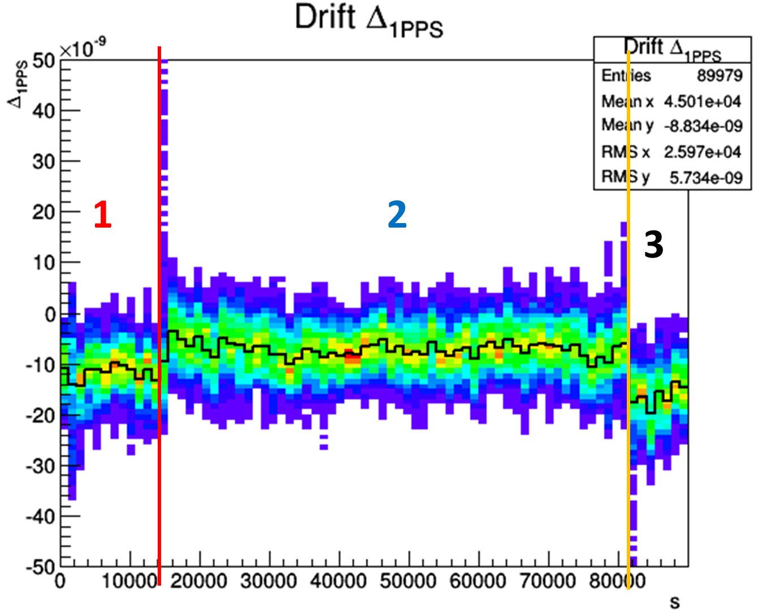
Signal drift in time: VME crate was turned off for a few minutes (1-2 minutes), after 14000 s, and after 80000 s.

Slide 19
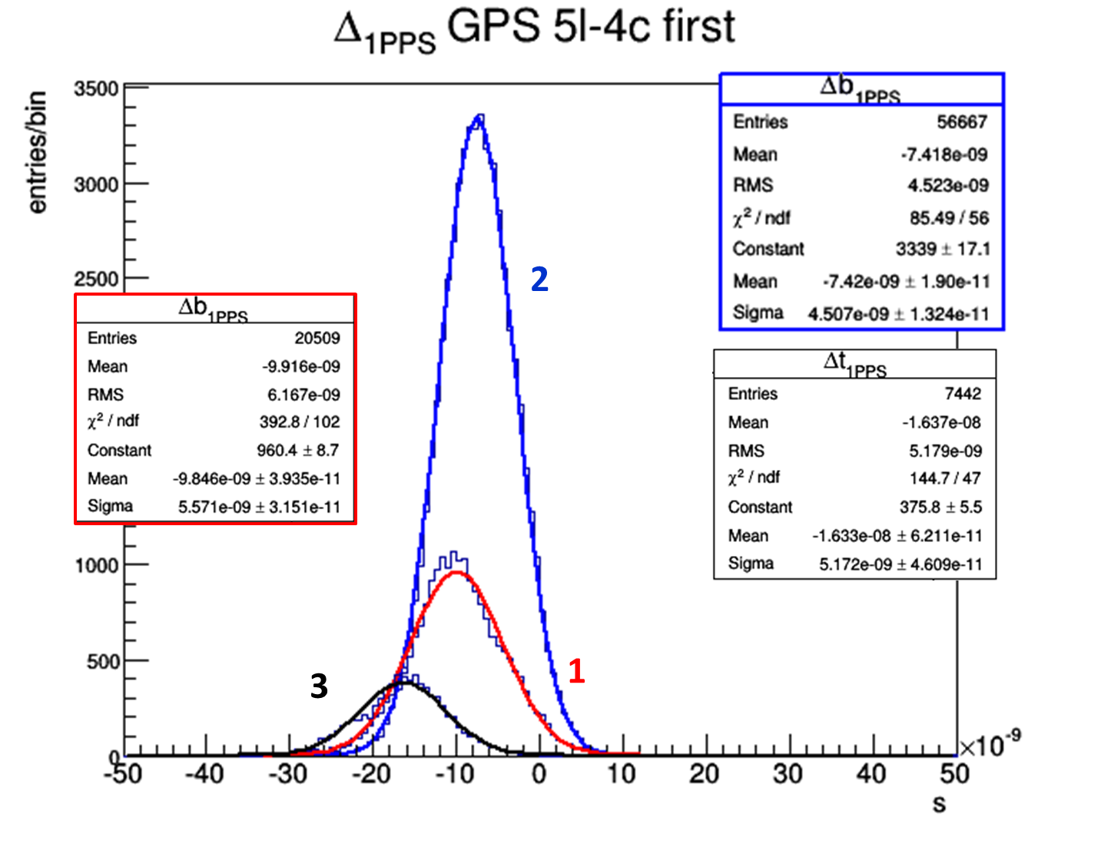
For each interval (first 1800 s are not plotted because the GPS engine needs 20 minutes at least for syncronization and for building its GPS constellation) we observe a different gaussian distribution, obtained from the same modules couples, with a different Δt _{1PPS} mean value
Larger variability for the average distribution Δ_{1PPS}
It is probably due to the differece in the satellite constellation built by the GPS engine
It is probably not due to any caracteristic of the board itself.
When the board power supply is turned off obviusly there is a reset of the GPS satellite costellation.

Slide 20
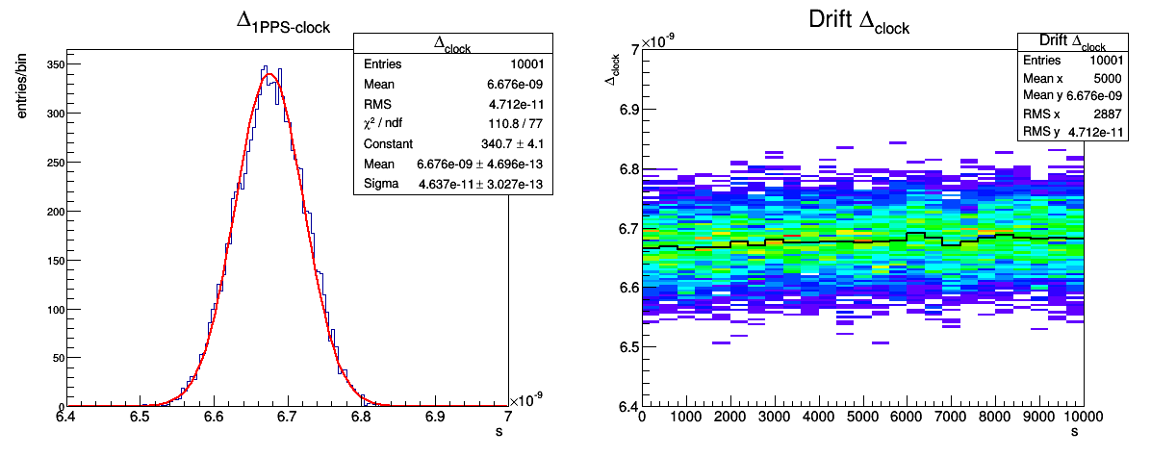
Clock Difference form the 1PPS
The GPS unit feeds both the TDCs with its clock disciplinated with the 1PPS to synchronize the TDCs internal counters
Module SN005
Δt _{clock} = 6.67 ns
σ _{clock} = 46 ps

Slide 21
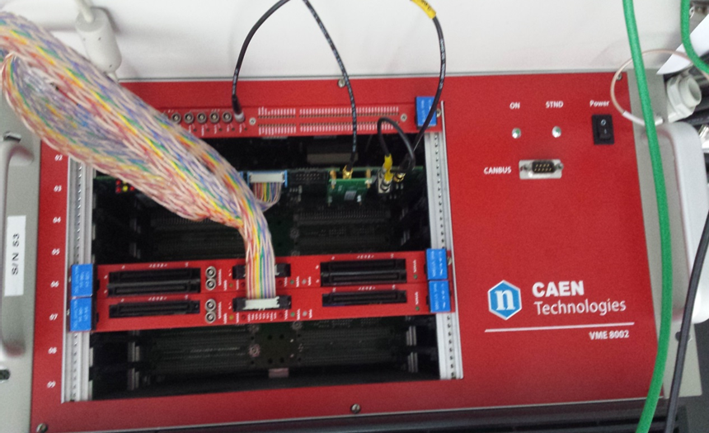
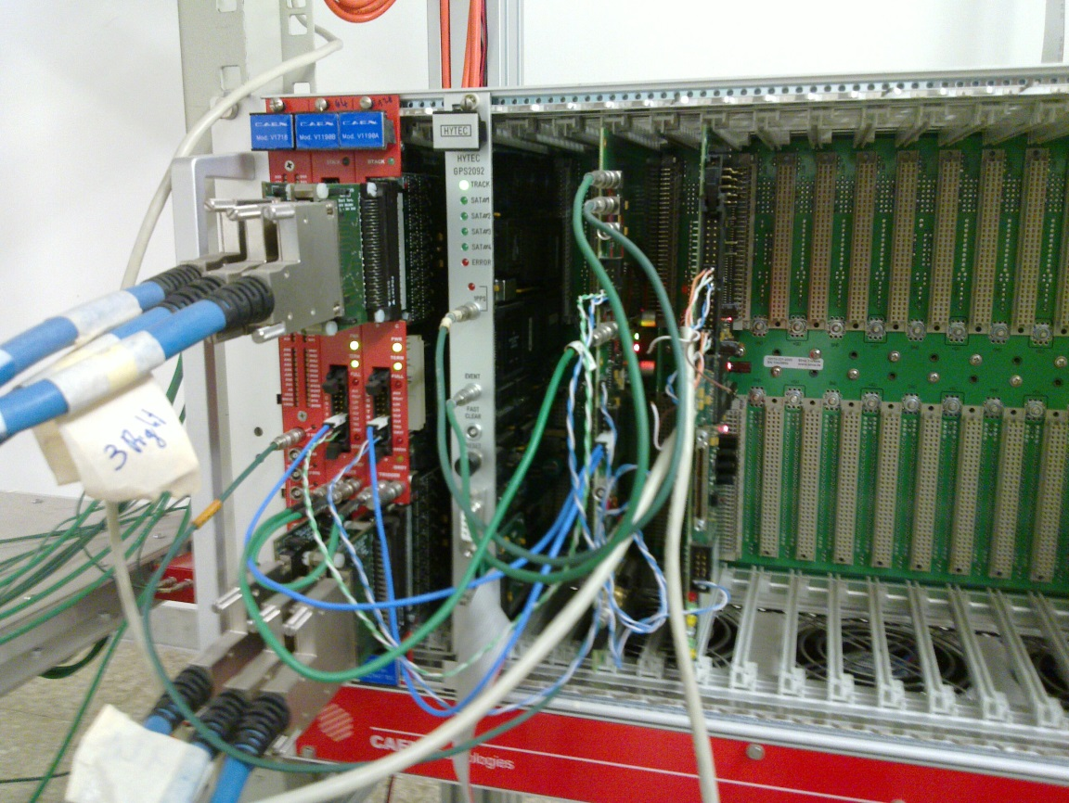

Slide 22
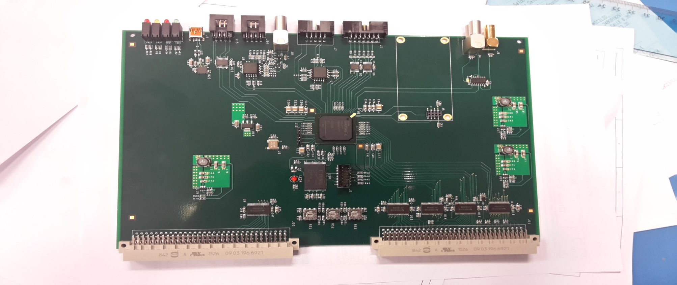
V.1
V.2

