Slide 1
Preliminary search for long distance correlations in EEE
F.Riggi
Dept. of Physics & Astronomy, Catania
EEE Meeting, 16 Novembre 2016

Slide 2
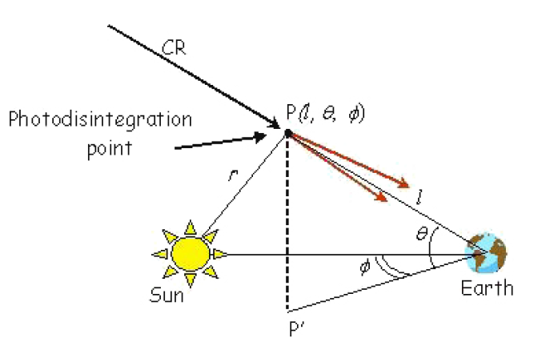
Physics processes for long distance correlations
Photodisintegration of cosmic ray nuclei in the solar field (GZ-effect)
Calculations of the probability of occurrence of such nuclei and of their separation distance carried out in the past with various results:
- Epele et al, 1999
- Medina-Tanco & Watson, 1999
- La Rocca & Riggi, 2006
- Fujwara et al, 2006
- Lafebre et al, 2008
Estimated number of events per year << 1 (10⁻² /year ?)
However, large uncertainties in such estimates, due to various factors

Slide 3
Physics processes for long distance correlations
Production of independent showers originating from a single primary
No quantitative estimation for such process available so far

Slide 4
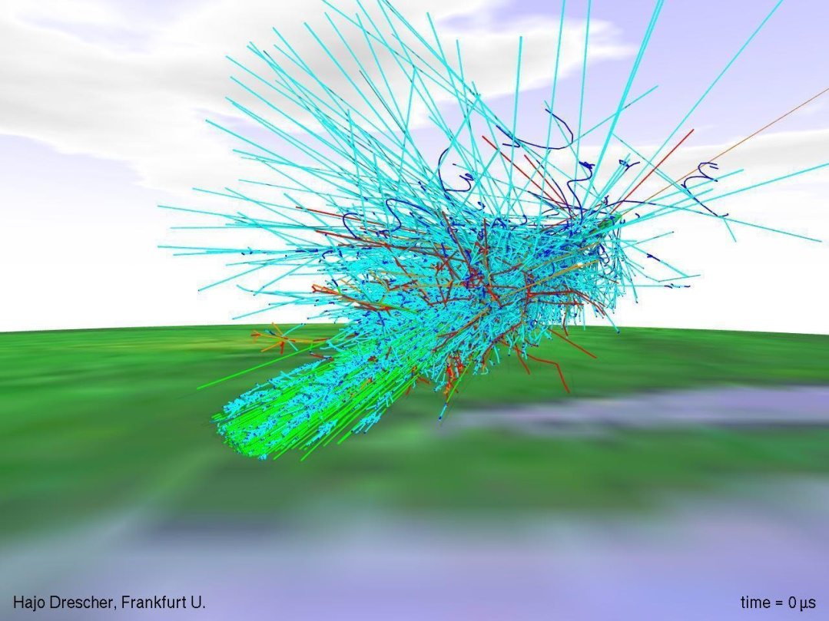
Physics processes for long distance correlations
A single shower of extremely high energy, extending over tens/hundreds km ?
Likely ruled out by negative results from Auger Observatory (50 x 60 km wide)

Slide 5
Experimental searches so far
Observation of such events exploited by a few experiments:
LAAS (Japan)
A Large Area Air Shower experiment: a Japanese array with a few (10 ) sites (several scintillators in coincidence at 5-10 m distance) with relative distances between sites 0.1 - 1000 km.
One decade observations have shown some enhancement at small relative times (ms) between distant sites, but no significant excess due to such events.
CHICOS (USA)
An educational network with 60 sites (2 scintillators in coincidence on each site at 3 m distance) with relative distances of the order of 50 km between sites. Some small excess observed for time difference < 10 microseconds in a period of 17 months data taking.
CZELTA (Czeh Republic)
An educational network with 5 sites (3 scintillators at 10 m distance). Search for very long baseline correlations with the ALTA sites in Canada (7200 km distance). No events observed in a few years collecting time

Slide 6
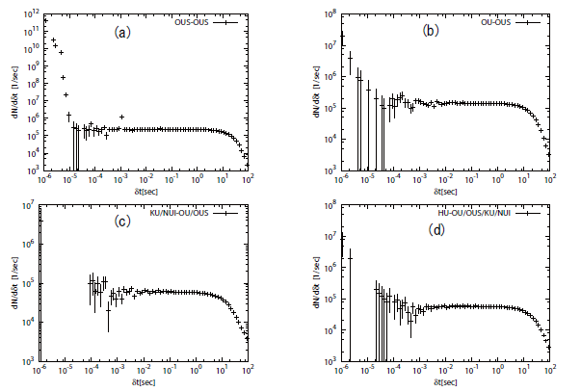
Results from LAAS experiment
< 1 km
1 km
150 km
~ 1000 km

Slide 7
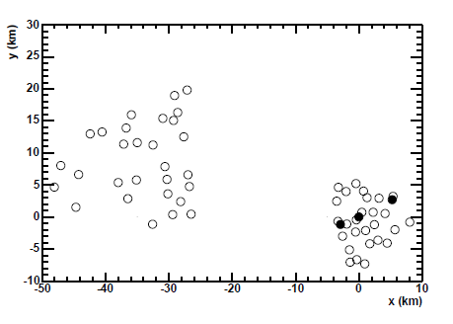
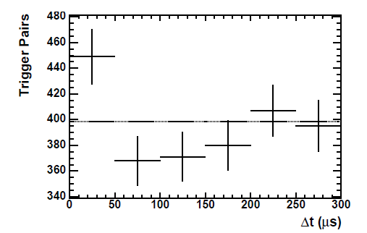
Results from CHICOS experiment
Distribution of sites in the CHICOS array
Some trigger pair excess at small time difference

Slide 8
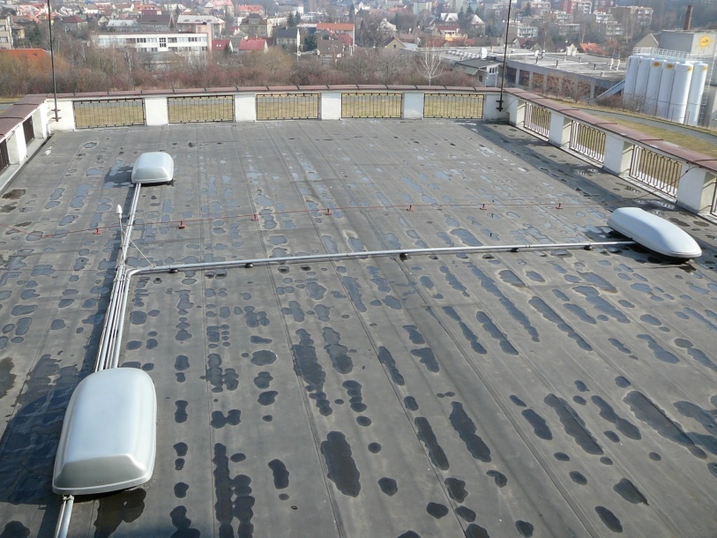
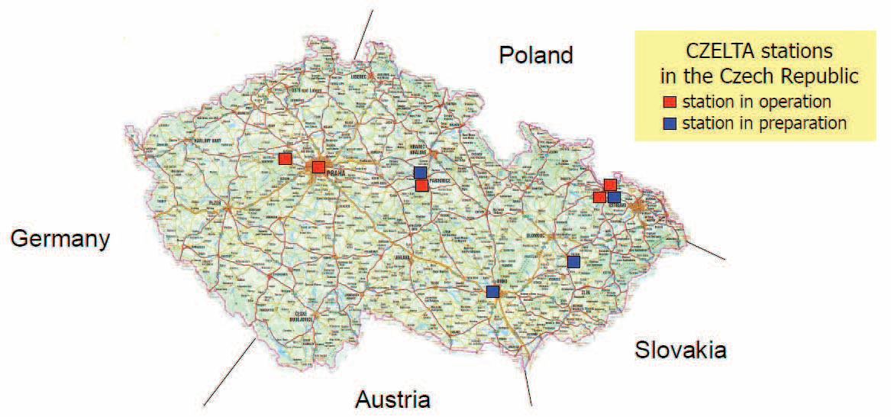
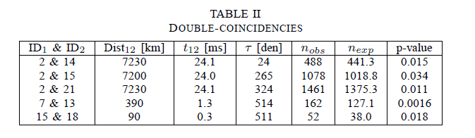
Results from CZELTA experiment
A typical station of the CZELTA array
Distribution of sites in the CZELTA array
Correlation with detectors located in US/Canada

Slide 9
The role of the EEE network in this context
The EEE sparse array could play a significant role in this context:
● Large number of sites distributed over a large area
● Relative distances between sites up to 1200 km
● Large statistics collected so far and more expected in the future
● Time and orientation of muons/primary available on individual sites
● Individual showers already identified in several sites (clusters)

Slide 10
The role of the EEE network in this context
Possible strategies for searching long distance correlations:
● Correlations between single muons in individual telescopes
Single rate = 10-40 Hz from site to site
Spurious rate in 1 ms time window: ~1 Hz (10⁵ /day, too high!!)
● Correlations between single muons and 2 track events
Single rate = 10-40 Hz, 2tracks rate: 0.01 - 0.1 Hz
Spurious rate in 1 ms: 10⁻⁴ – 10⁻³ Hz (100-1000/day, still high)
● Correlations between 2track events in both telescopes
2tracks rate = 0.01 - 0.1 Hz
Spurious rate in 1 ms: 10⁻⁷ - 10⁻⁵ Hz (0.01 - 1 /day)
● Correlations between individual showers in cluster telescopes
Shower rate: 0.001 - 0.04 Hz (depending on cluster and S/N ratio)
Spurious rate in 1 ms: 10-⁸ - 10⁻⁷ Hz (0.001 - 0.01/day)

Slide 11
The role of the EEE network in this context
Possible strategies for searching long distance correlations:
● Correlations between single muons in individual telescopes
Single rate = 10-40 Hz from site to site
Spurious rate in 1 ms time window: ~1 Hz (10⁵ /day, too high!!)
● Correlations between single muons and 2 track events
Single rate = 10-40 Hz, 2tracks rate: 0.01 - 0.1 Hz
Spurious rate in 1 ms: 10⁻⁴ – 10⁻³ Hz (100-1000/day, still high)
● Correlations between 2track events in both telescopes
2tracks rate = 0.01 - 0.1 Hz
Spurious rate in 1 ms: 10⁻⁷ - 10⁻⁵ Hz (0.01 - 1 /day)
● Correlations between individual showers in cluster telescopes
Shower rate: 0.001 - 0.04 Hz (depending on cluster and S/N ratio)
Spurious rate in 1 ms: 10-⁸ - 10⁻⁷ Hz (0.001 - 0.01/day)

Slide 12
EEE Cluster sites
Site | Approx.Distance between telescopes (m) | Time window (ns) | Overall Rate in time window (Hz) | Live time (days) | Net Rate per day
BOLO_0104 | 100 | 900-2100 | 0.0038 | 176 | 159
CAGL_0102 | 530 | -1400,1400 | 0.0017 | 474 | 17
CATA_0102 | 3030 | -10000, 10000 | 0.0031 | 127 | 2.9
CERN_0102 | 30 | -350, 150 | 0.0417 | 127 | 3549
FRAS_0203 | 620 | -1500, 1500 | 0.0068 | 104 | 27.8
GROS_0102 | 500 | -1000, 1000 | 0.0019 | 67 | 13.6
LAQU_0102 | 200 | -500, 500 | 0.0026 | 105 | 94
SAVO_0102 | 1170 | -5000, 5000 | 0.0272 | 353 | 10.7
TORI_0304 | 1070 | -7000, 7000 | 0.0412 | 163 | 12.2
VIAR_0102 | 1340 | -10000, 10000 | 0.0113 | 160 | 1

Slide 13
Distribution of distances between cluster sites
 | BOLO | CAGL | CATA | CERN | FRAS | GROS | LAQU | SAVO | TORI | VIAR
BOLO | -
CAGL |  | -
CATA |  |  | -
CERN | 450 | 835 | 1200 | -
FRAS |  |  |  | 725 | -
GROS |  |  |  | 558 |  | -
LAQU |  |  |  | 720 |  |  | -
SAVO |  |  |  | 285 |  |  |  | -
TORI |  |  |  | 180 |  |  |  |  | -
VIAR |  |  |  | 425 |  |  |  |  |  | -

Slide 14
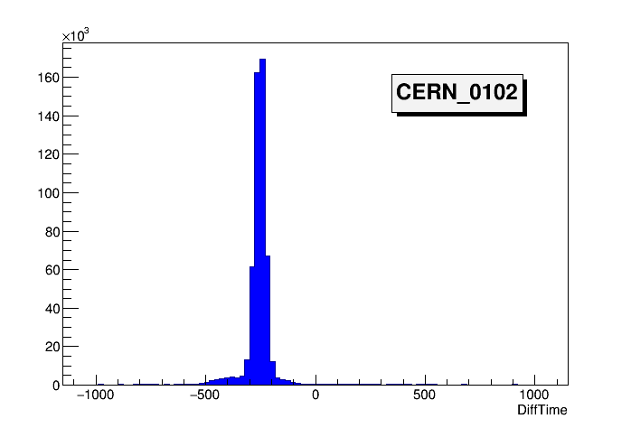
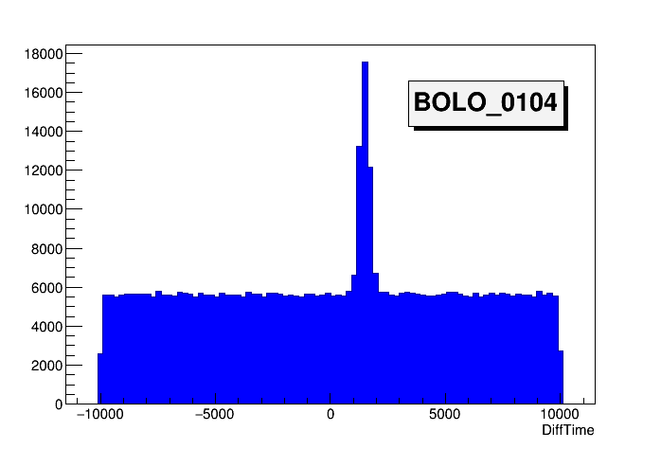
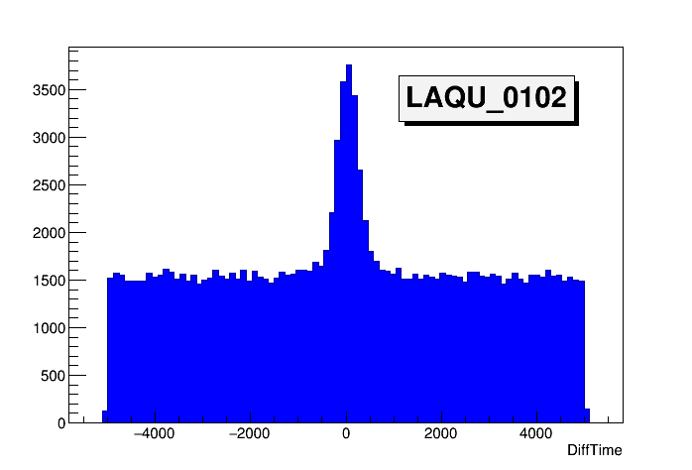
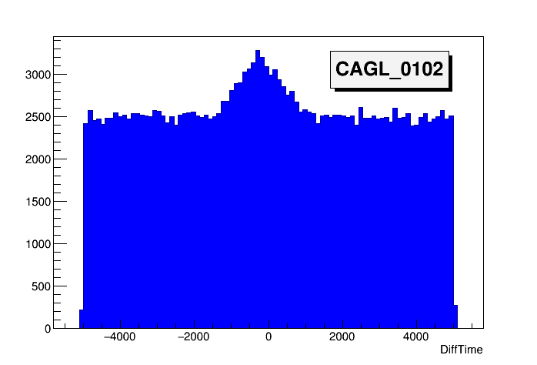
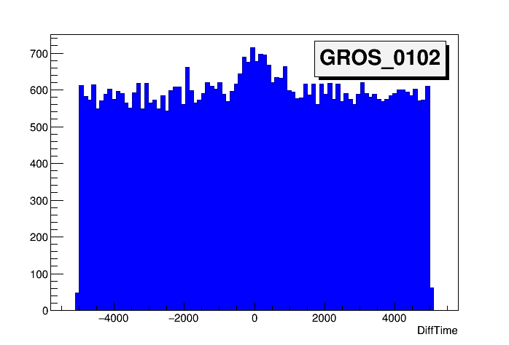
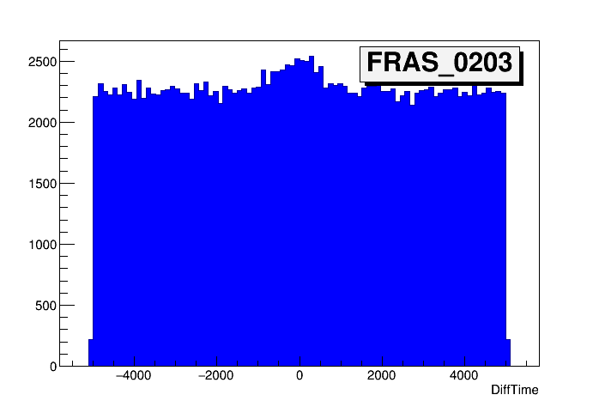
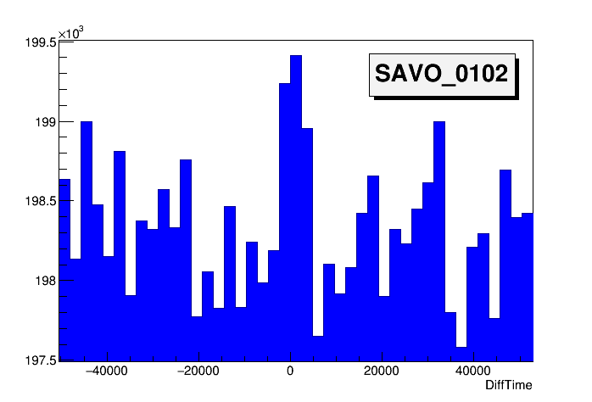
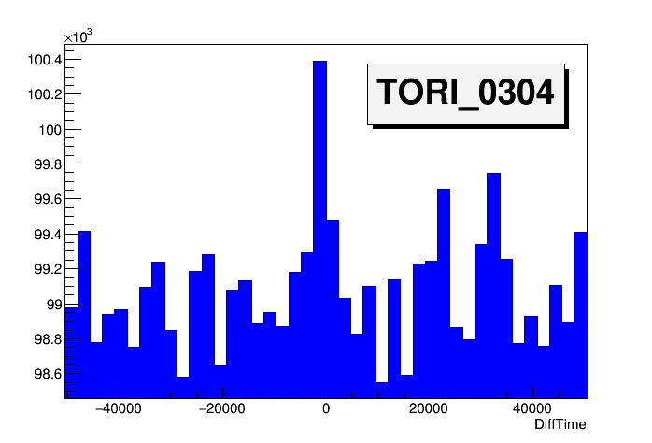
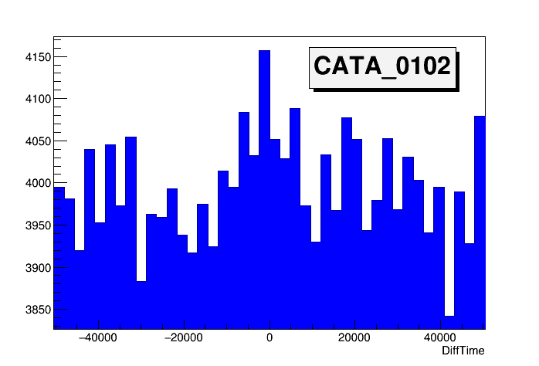
S/N ratio over different sites

Slide 15
Correlation analysis
● Selected time window for each telescope
● No cut on relative angle between showers
and track quality at the moment
● Build difference time spectra
● Estimate of common live time
with a granularity of 5 minutes
(thanks to Francesco Noferini for the help!)

Slide 16
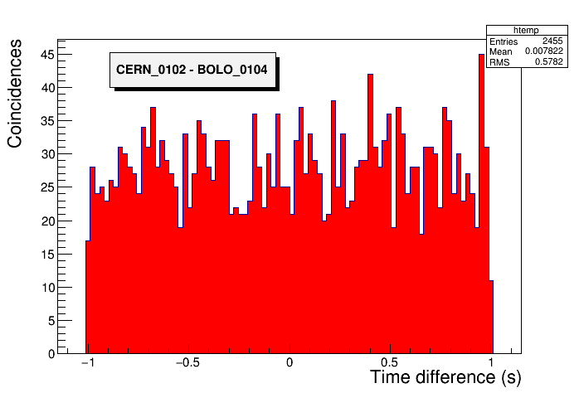
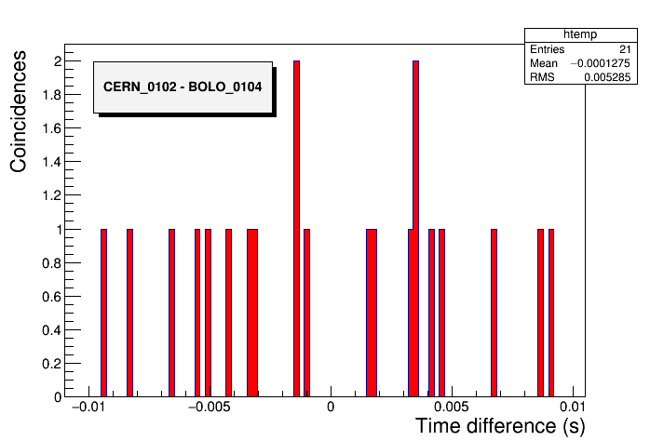
Typical time difference spectra between clusters
Time difference spectra between clusters, for various time windows (10 s, 1 s, …. 1 ms)
dN/d(Delta_t): Frequency of coincidence events

Slide 17
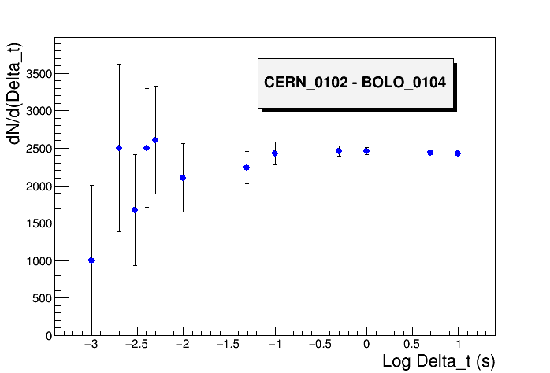
CERN_0102 – BOLO_0104 correlation
450 km distance
94.6 days live time
1 ms
10 ms

Slide 18
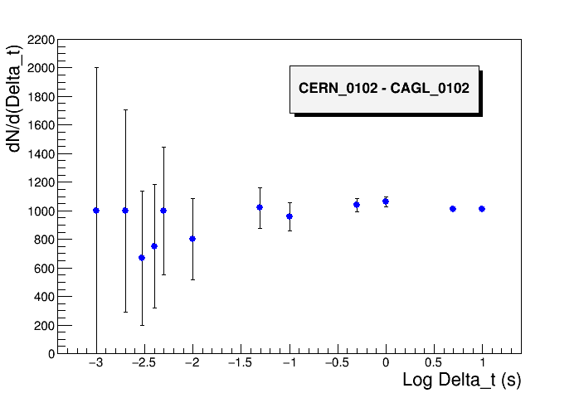
CERN_0102 – CAGL_0102 correlation
835 km distance
125.6 days live time

Slide 19
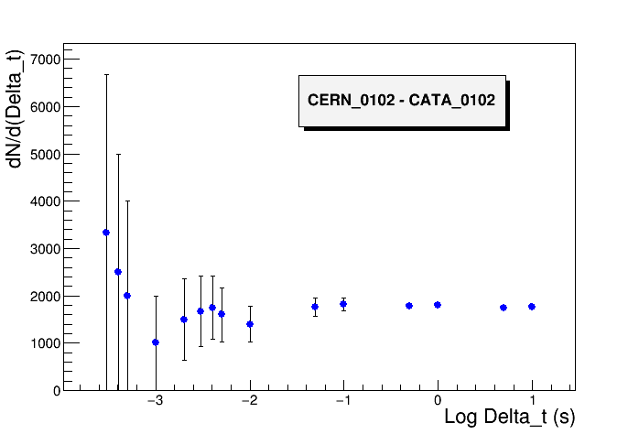
CERN_0102 – CATA_0102 correlation
1200 km distance
74.7 days live time

Slide 20
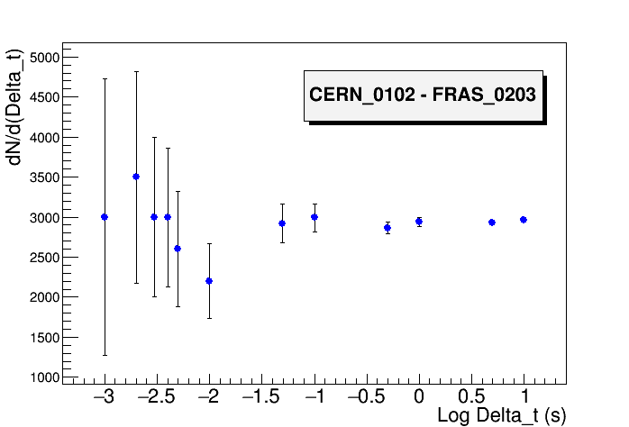
CERN_0102 – FRAS_0203 correlation
725 km distance
65.5 days live time

Slide 21
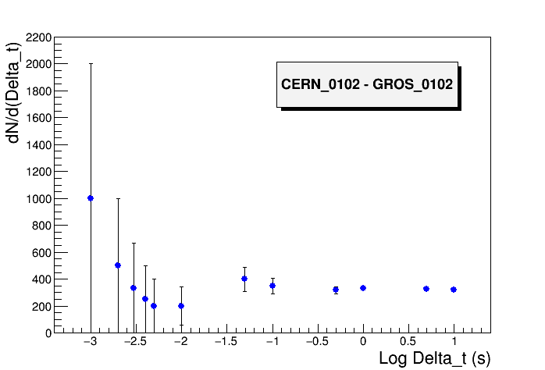
CERN_0102 – GROS_0102
560 km distance
26.7 days live time

Slide 22
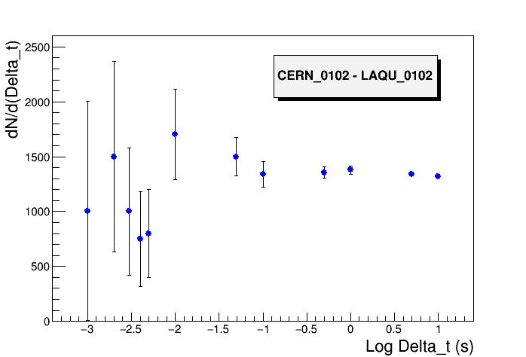
CERN_0102 – LAQU_0102
720 km distance
66.7 days live time

Slide 23
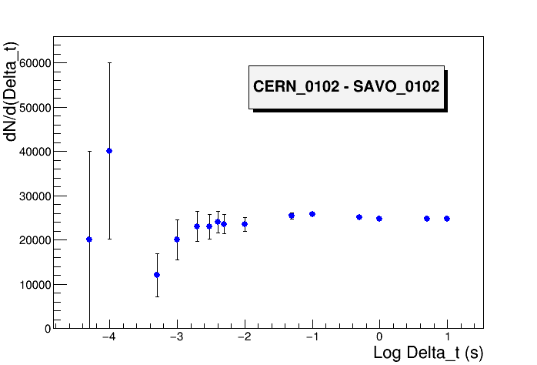
CERN_0102 – SAVO_0102
285 km distance
108.6 days live time

Slide 24
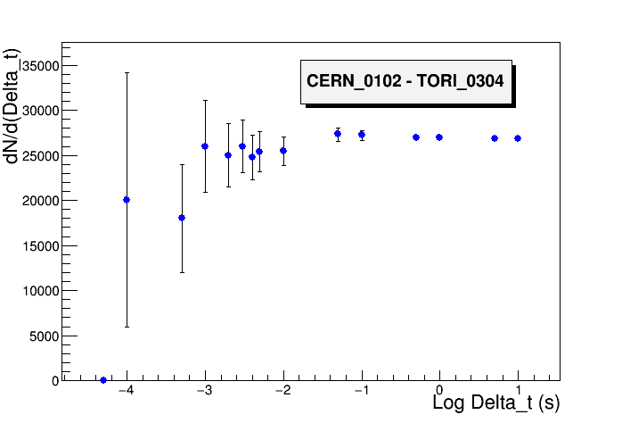
CERN_0102 – TORI_0304
180 km distance
86.4 days live time

Slide 25
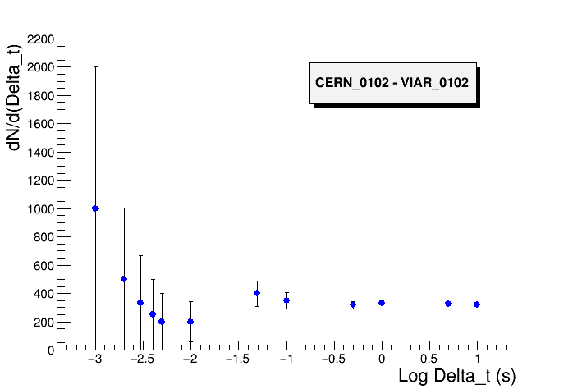
CERN_0102 – VIAR_0102
425 km distance
103.2 days live time

Slide 26
Outlook
Analysis of long distance correlations between EEE cluster sites in progress
● CERN- (any other site) correlation data analyzed ( 9 of 45 combinations)
● Relative distances probed so far: from 180 to 835 km
● Overall statistics roughly corresponding to 574 days live time
● No clear evidence so far of time correlations for distant sites
Next to be done:
● Analysis of remaining cluster combinations
● Estimate of upper limit, if any

