Slide 1
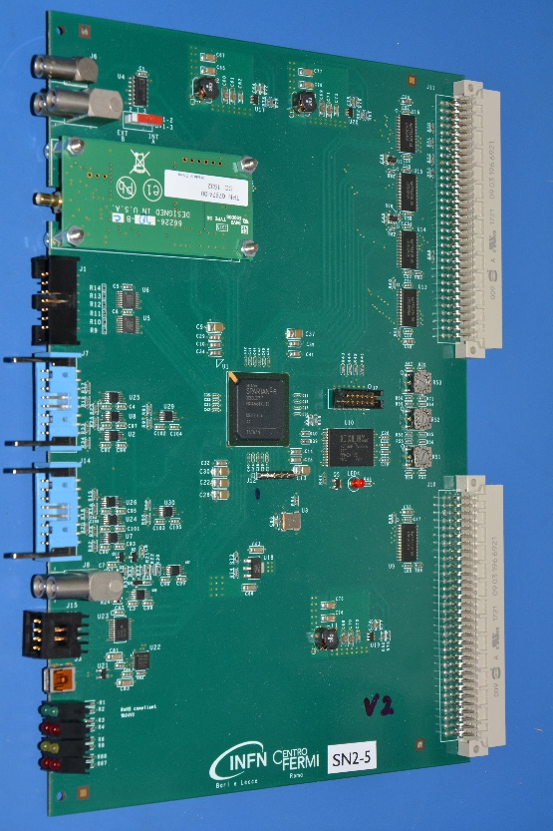
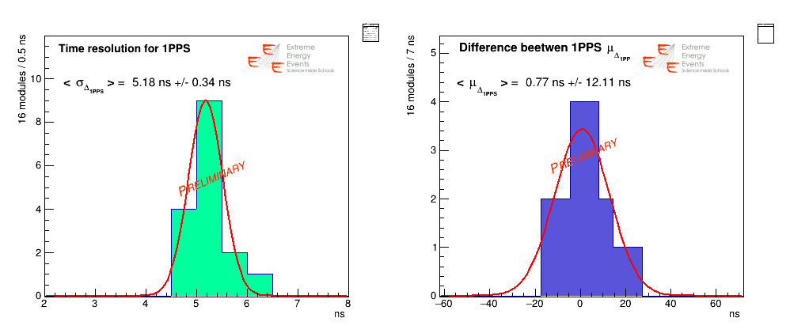
Nel caso si volessero usare delle slide dalla presentazione di Rimini, si potrebbe aggiornare la foto della scheda
Main features of EEE system
The DAQ system makes use of VME standards and the DAQ program is LabView based and runs on a PC connected to the VME crate by means of a CAEN USB-VME bridge
Each event acquired must be provided with the relative timestamp; this is given by a Global Positioning System (GPS) VME module integrated in the system and readout by the DAQ program
New card integrating the trigger card with the GPS receiver for timing application
Pressure and temperature sensors recorded by DAQ
Independent gas control system
GPS timestamp resolution <15 ns

Slide 2


The EEE Project
Trigger/GPS unit Performance
A. Corvaglia
Istituto Nazionale di Fisica Nucleare – Sezione di Lecce
Museo Storico della Fisica e Centro Studi e Ricerche “Enrico Fermi”
for EEE Collaboration

Slide 3
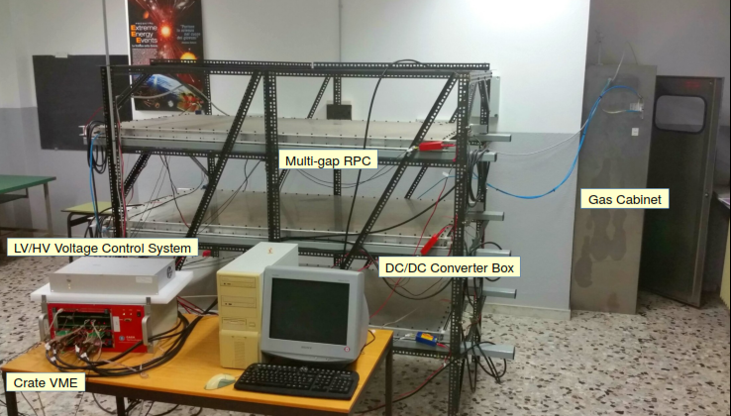
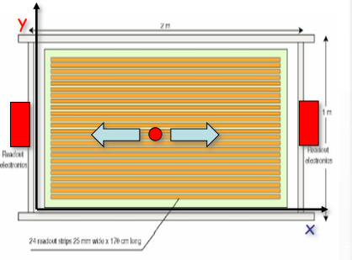
The EEE Telescopes
Three Multi-Gap Resistive Plate Chambers (MRPCs)
6 Front-End boards (FEAs) with 24 channels to process readout signal
VME bridge. DAQ connected to a PC via USB, controlled by LabView program
  1 Multi-Trigger Card: a six-fold coincidence of both FEAs of the 3 MRPCs generates the Data Acquisition (DAQ) trigger
  2 Multi-hits Time to Digital Converters (TDCs 128 + 64 channels) to reconstruct the particle impact point
GPS unit provides the event time stamp (UTC time) to record and synchronize informations
Voltage control System (VCS) in the MRPCs, DC/DC Converters and FEAs
Weather Station to monitor the temperature and the pressure inside and outside the telescopes building

Slide 4
The EEE Telescopes
Three Multi-Gap Resistive Plate Chambers (MRPCs)
6 Front-End boards (FEAs) with 24 channels to process readout signal
VME bridge. DAQ connected to a PC via USB, controlled by LabView program
  1 Multi-Trigger Card: a six-fold coincidence of both FEAs of the 3 MRPCs generates the Data Acquisition (DAQ) trigger
  2 Multi-hits Time to Digital Converters (TDCs 128 + 64 channels) to reconstruct the particle impact point
GPS unit provides the event time stamp (UTC time) to record and synchronize informations
Voltage control System (VCS) in the MRPCs, DC/DC Converters and FEAs
Weather Station to monitor the temperature and the pressure inside and outside the telescopes building

Slide 5

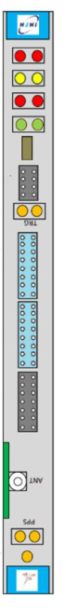
The New Trigger/GPS Module
A novel VME trigger unit for the EEE telescopes was developed, including an embedded GPS engine (TRIMBLE) for timing application. That allows extracting the event time stamping at level of the trigger unit, avoiding time drifts.

Slide 6
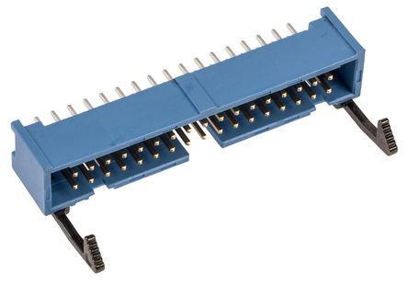
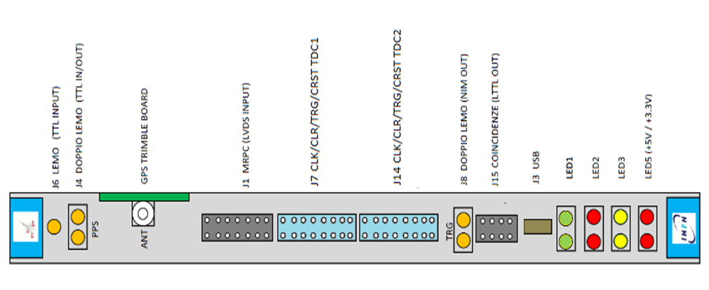
From 1st to 2nd version
1st version’s DAQ
2nd version’s DAQ
CLR to TD1
CLR to TD2
CRST to TDC1
CLK/CLR/TRG/CRST
to TDC1
CRST to TDC2
CLK/CLR/TRG/CRST
to TDC2
CLK to TDC1
CLK to TDC2
In firmware 2.0
Using a single clock line from FPGA (split on the output driver)
2 CLKs MEASUREs
Mean 65.3 ps
Std dev 2.8 ps

Slide 7
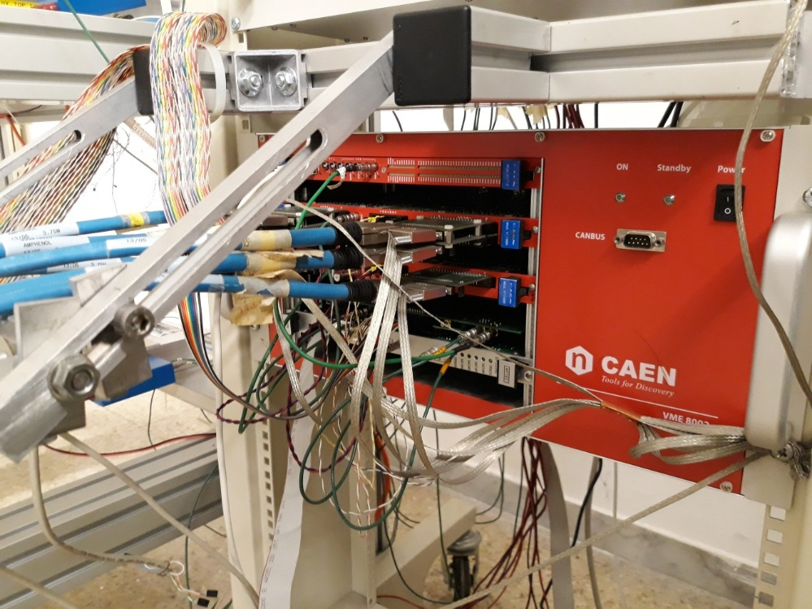
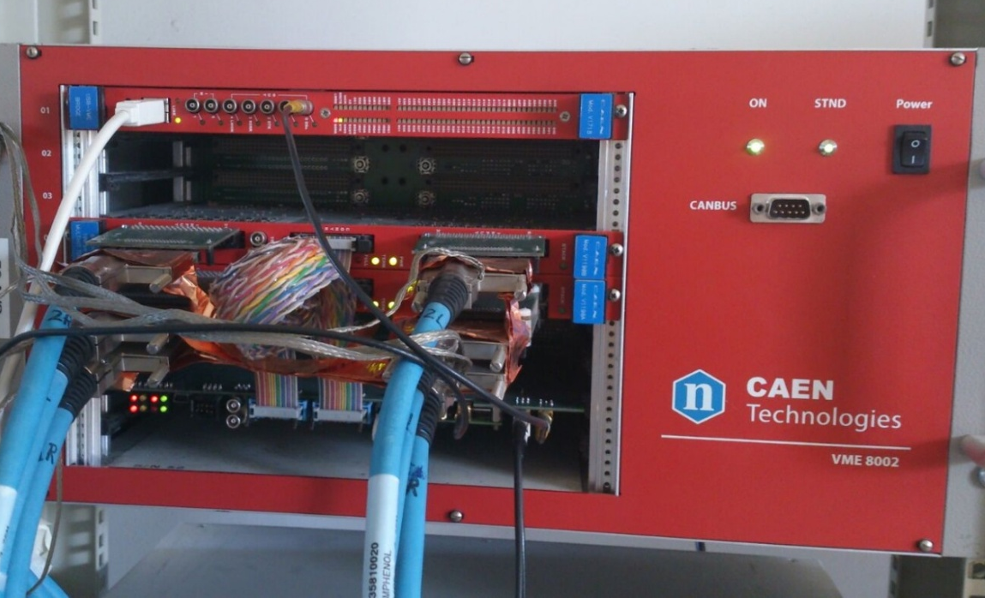
From 1st to 2nd version
1st version’s DAQ
2nd version’s DAQ
20 Trigger/GPS modules (+4 prototypes) were produced

Slide 8
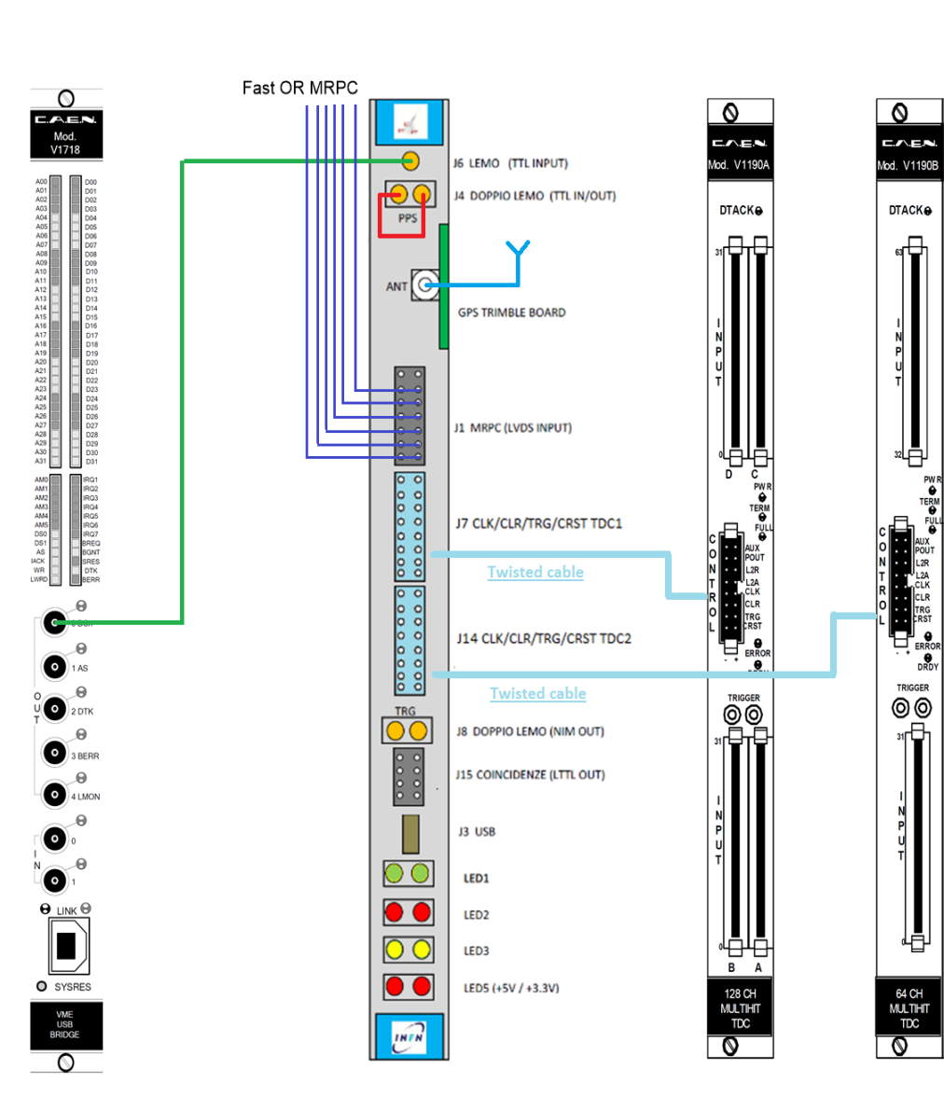
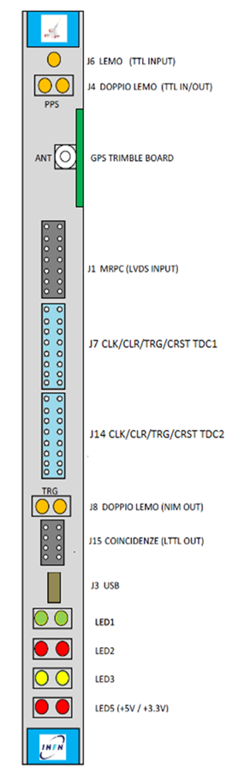
Internal GPS DAQ
Connections simplified
2 twisted cables
2 coaxial cables
CLK/CLR/TRG/CRST
to TDC1
CLK/CLR/TRG/CRST
to TDC2

Slide 9
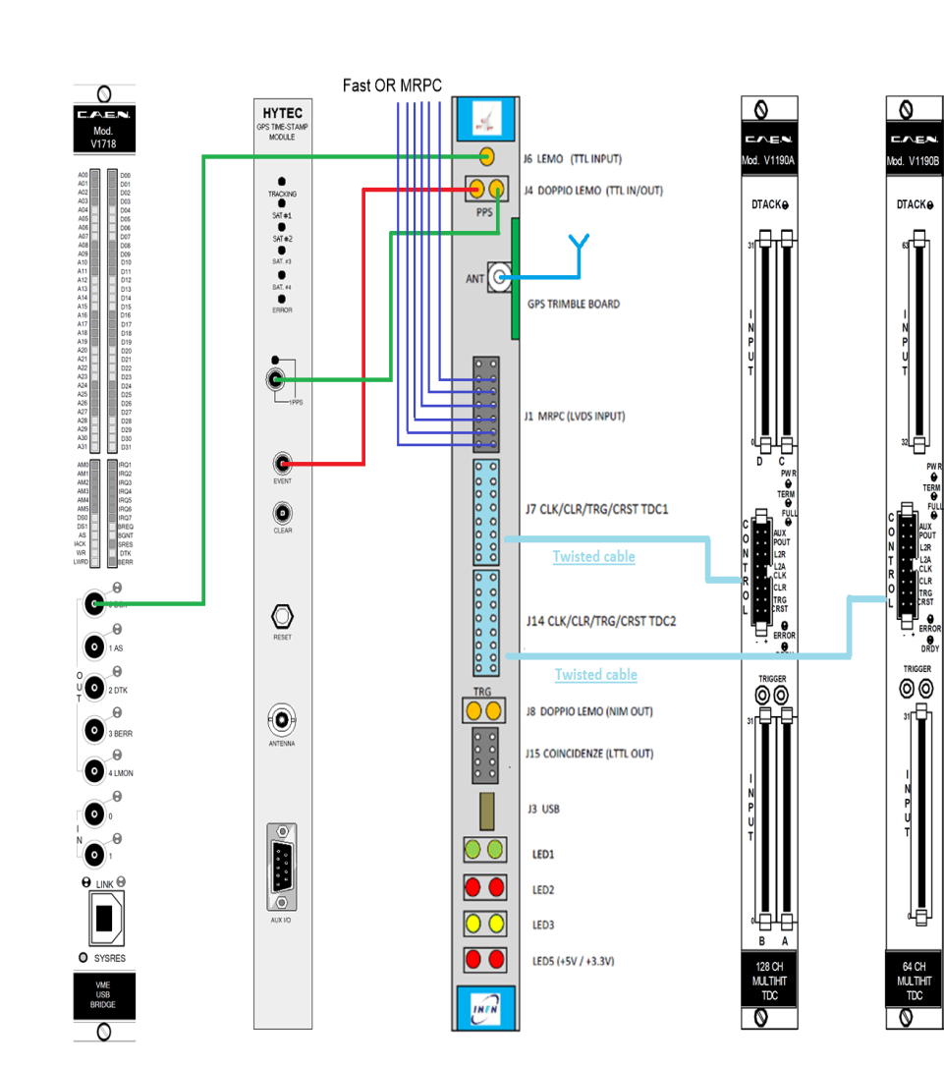
External GPS DAQ
Connections simplified
2 twisted cables
3 coaxial cables
CLR/CRST/CLK
to TDC1
CLR/CRST/CLK
to TDC2

Slide 10
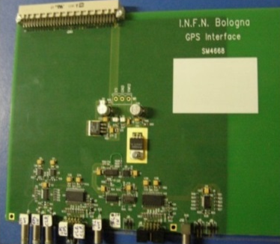
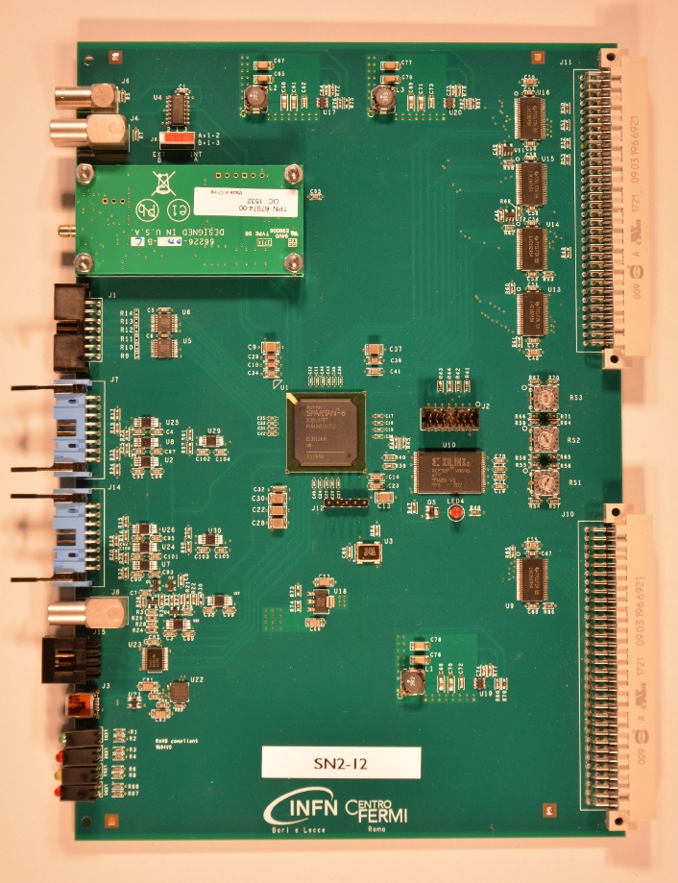
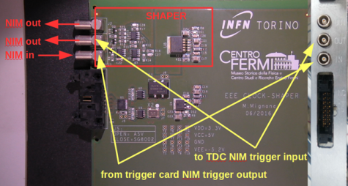
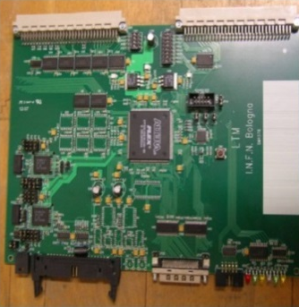
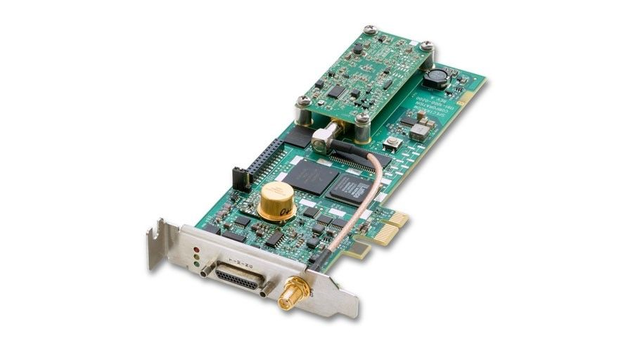
The Trigger-GPS board
GPS
Interface
Clock distributor
Trigger
(2 models)
GPS
(2 models)

Slide 11
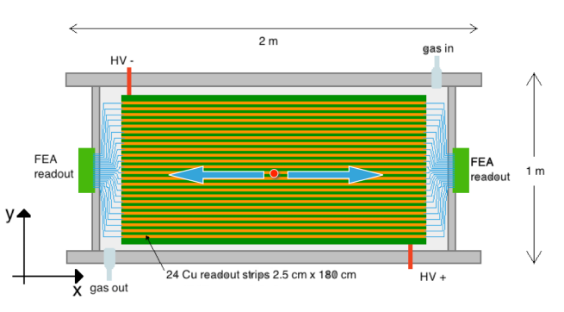
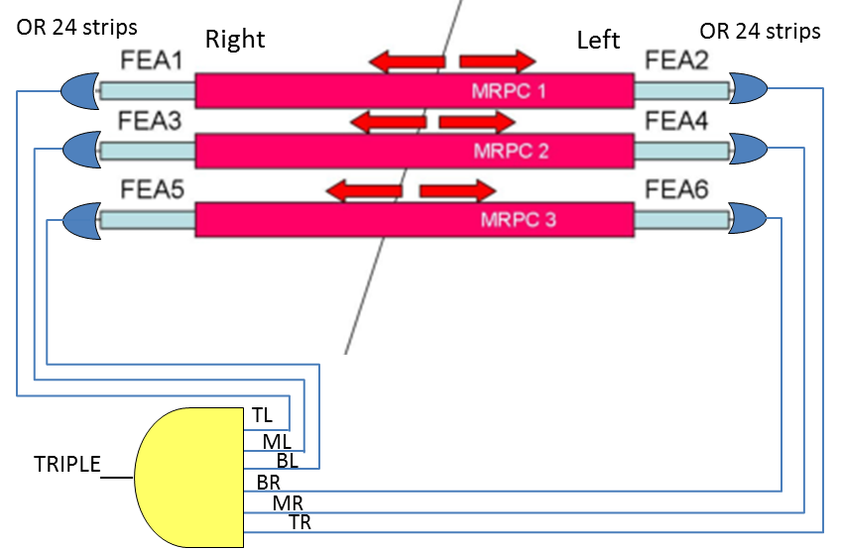
The EEE experiment and its trigger

Slide 12
The EEE experiment and its trigger
A 6-fold coincidence (within a 500 ns window) of the OR-signals from both FRONT-END cards of the 3 MRPCs, generates the data acquisition Trigger

Slide 13
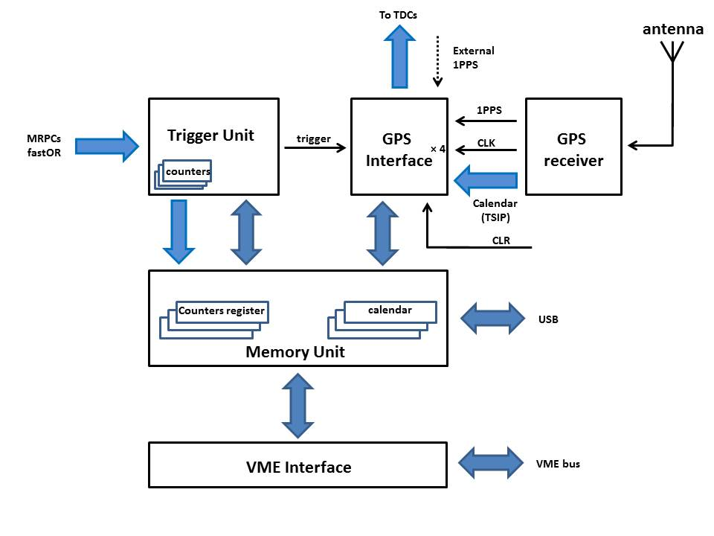
The Module Block Diagram

Slide 14
The Trigger UNIT
The trigger unit performs the count values of the triple (Trigger) chambers coincidences, the 3 doubles, the 3 single, and 6-FRONT-END outputs for testing purpose (efficiency measurements)

Slide 15
The GPS Interface
The GPS unit feeds both the TDCs with its clock disciplined to the one pulse per second signal (1PPS) to synchronize the TDCs internal counters
At each 1PPS pulse the TDCs internal counters are reset
Every time an event trigger occurs, the module feeds into each TDC a signal and the TDC stamps its time. The absolute time of an event is built as the TDCs event time plus the GPS timestamp for each 1PPS.
The LabView DAQ system directly sorts out and puts the data from the two TDCs into single events, reads out the module at appropriate times and insert the GPS time values within the data stream at the correct record.

Slide 16
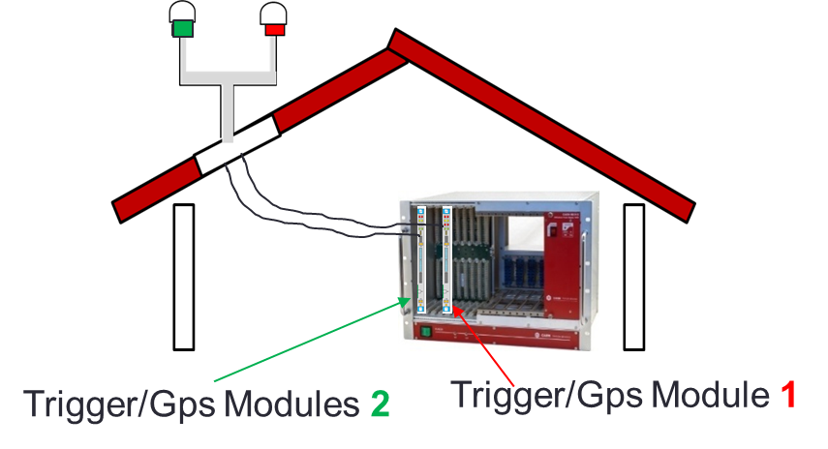

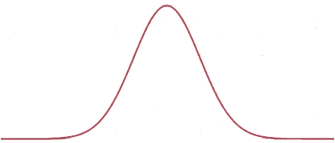
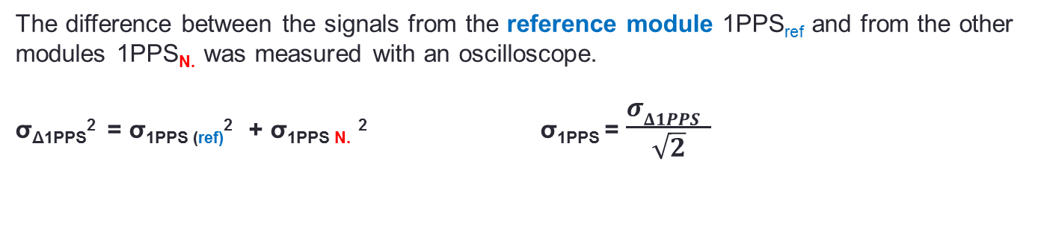
Time resolution for the 1PPS
The Global Time Stamping Resolution of the cosmic ray event σ_{GTS} should be the sum of :
σ_{HITS}, which depends on the signals from MRPCs and on TDC resolution (100 ps)
σ_{1PPS}, time resolution for 1PPS: σ_{GTS}² = σ_{HITS}² + σ_{1PPS}²
Time Stamp jitter Δt measurements beetwen 2 different boards with the aim of evaluate the 1PPS resolution σ_{PPS}
Δt = t_{PPS1} – t_{PPS2}
σ_{PPS}
entries
The difference between the signals from the reference module 1PPS_{ref} and from the other modules 1PPS_{N.} was measured with an oscilloscope.
σ_{Δ1PPS}² = σ_{1PPS (ref)}² + σ_{1PPS N.} ² σ_{1PPS} = $\frac{σΔ1PPS }{\sqrt{2}}$
Δ_{1PPS} = T_{1PPSref} - T_{1PPSN.}

Slide 17
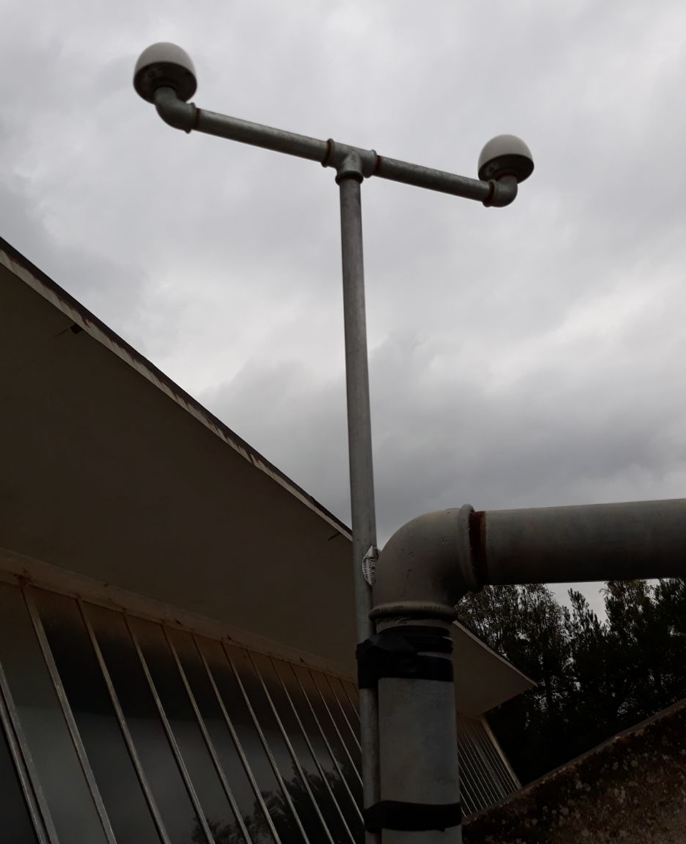
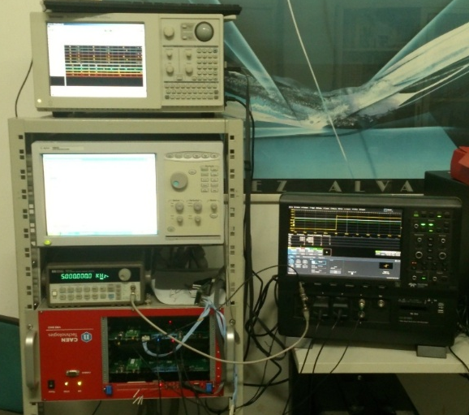
Set-up
The couple of boards are supply in the same VME crate
The couple of antenna are mounted on the roof above our laboratory, at a distant of 40 cm to the opposite ends of an alluminium arm. It is placed far from walls to avoid any GNSS signal reflections
16 board tested
Gps Antenna 1
Gps Antenna 2
Δt = t_{PPS1} – t_{PPS2}
σ_{PPS}
entries
Notes:
(v_{cable} =0,66c → Δt = 15.9 ns )

Slide 18
The test bench

Slide 19
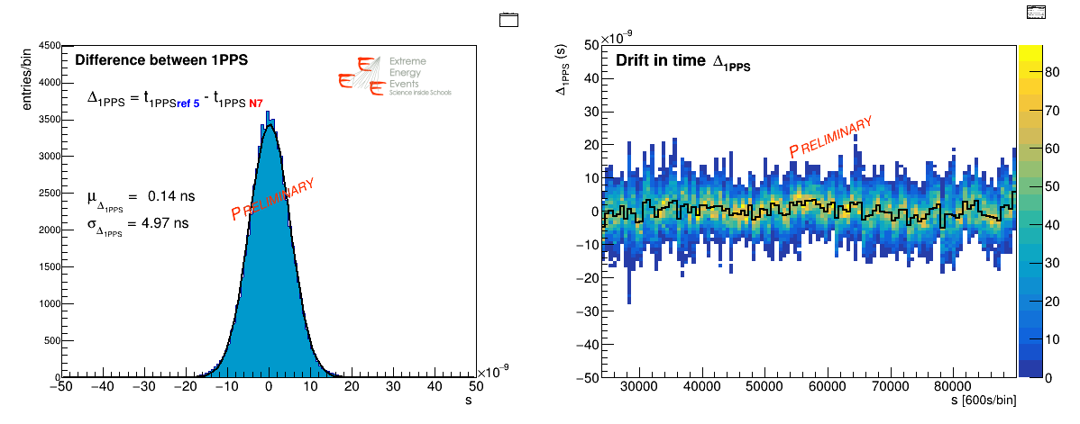

The difference between the signals from the reference module 1PPS_{ref} and from the other modules 1PPS_{N.} was measured with an oscilloscope.
board SN2005 – board SN2007
σ_{1PPS} = $\frac{σΔ1PPS }{\sqrt{2}}=3.5 ns$
Corrected for the cables length difference.

Slide 20
The difference between the signals from the reference module 1PPS_{ref} and from the other modules 1PPS_{N.} was measured with an oscilloscope.
board SN2005 – board SN2007
Corrected for the cables length difference.

Slide 21
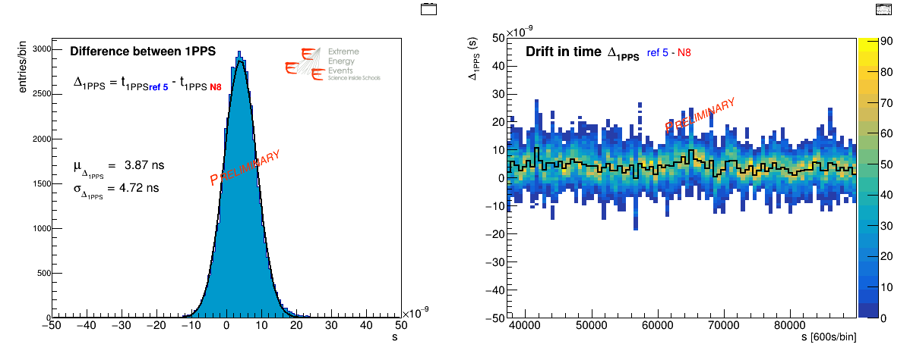
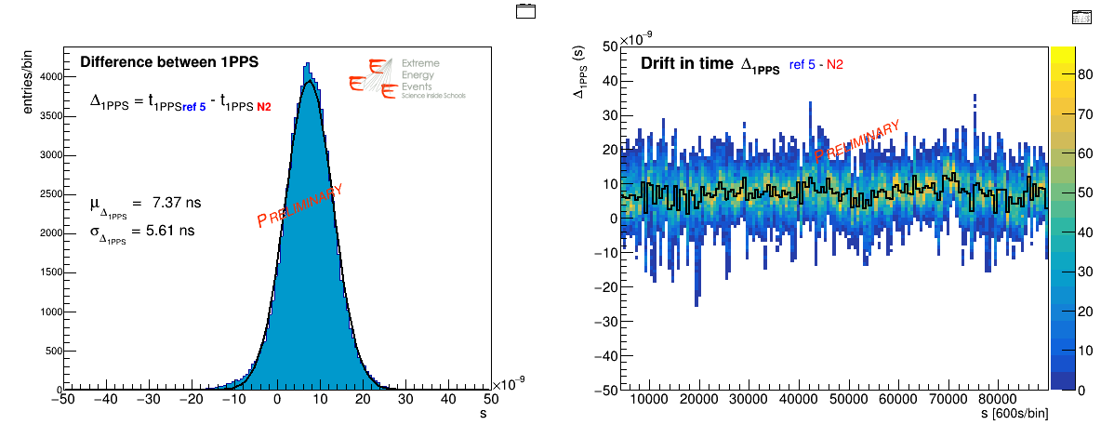
board SN2005 – board SN2008
board SN2005 – board SN2002

Slide 22
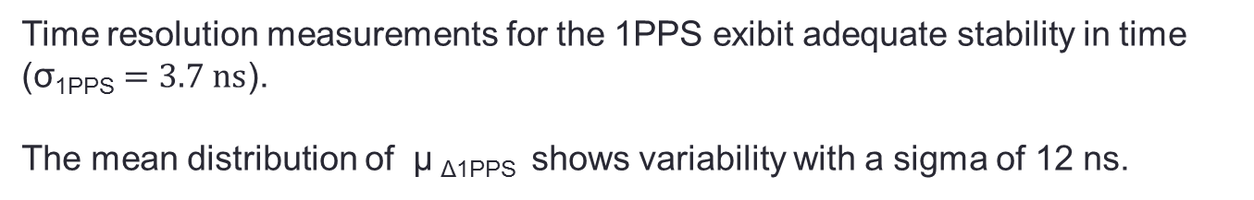

Mean 1PPS difference Δ_{1PPS} distribution for all the module tested
Time resolution σ_{1PPS} distribution for all the module tested
<σ_{1PPS} > = $3.7 ns$
Time resolution measurements for the 1PPS exibit adequate stability in time ($\text{σ}\text{1}\text{PPS}=3.7 ns$).
The mean distribution of μ _{Δ1PPS} shows variability with a sigma of 12 ns.
(the Trimble GPS Engine timestamp resolution is 15 ns accord the data sheet).

Slide 23
Summary
The new version of EEE Trigger-GPS board (V.2) has producesd and tested
Minor problems were solved
Performances are consistent with the experimental requests and specifications

Slide 24
Spare slides
There is a cables length difference Spectrum analyzer → Δt = 14.7 ns

Slide 25
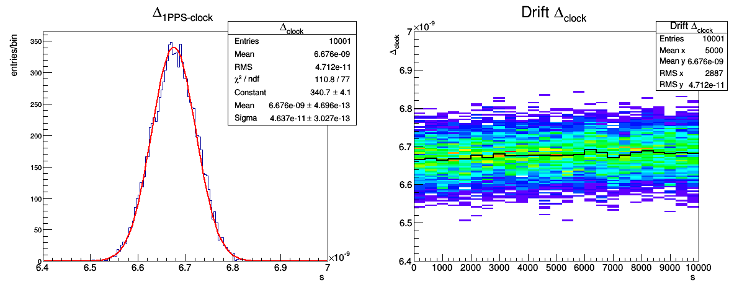
Clock Difference form the 1PPS
The GPS unit feeds both the TDCs with its clock disciplinated with the 1PPS to synchronize the TDCs internal counters
Module SN005
Δt _{clock} = 6.67 ns
σ _{clock} = 46 ps

Slide 26
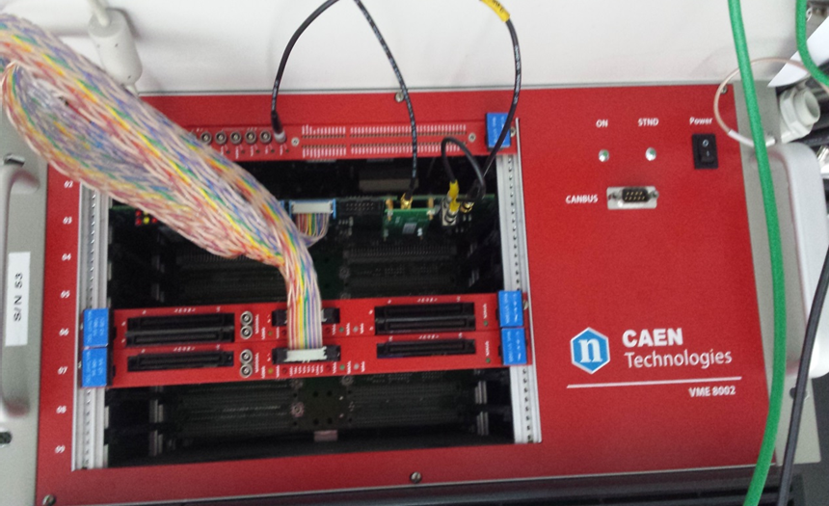
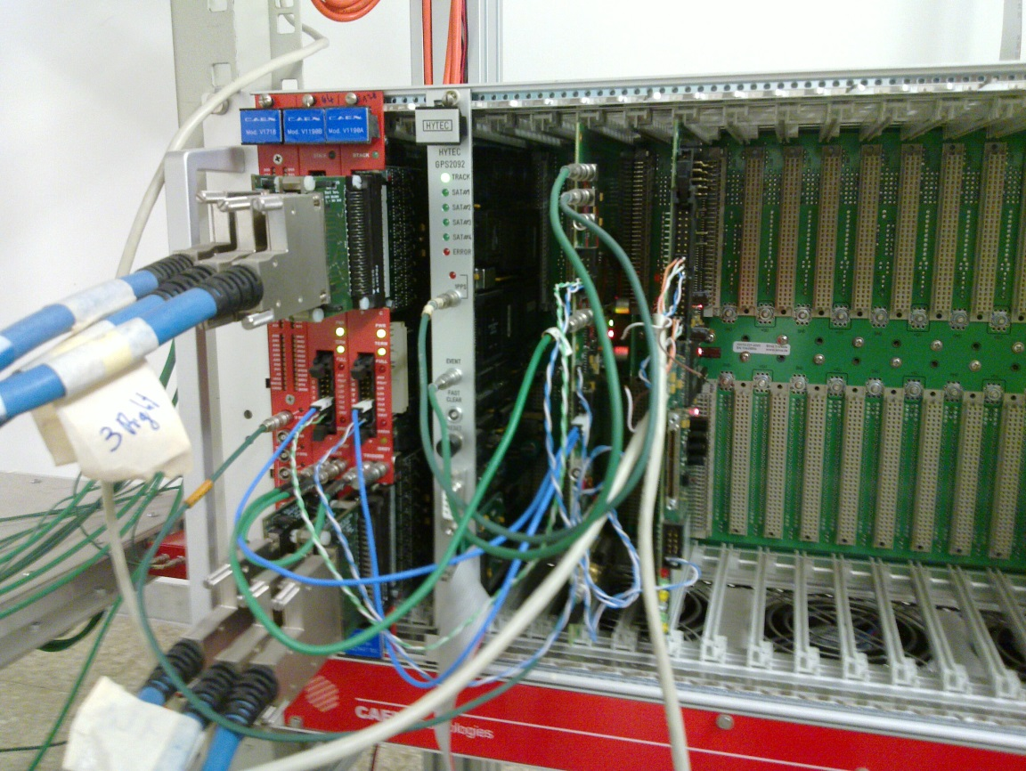

Slide 27
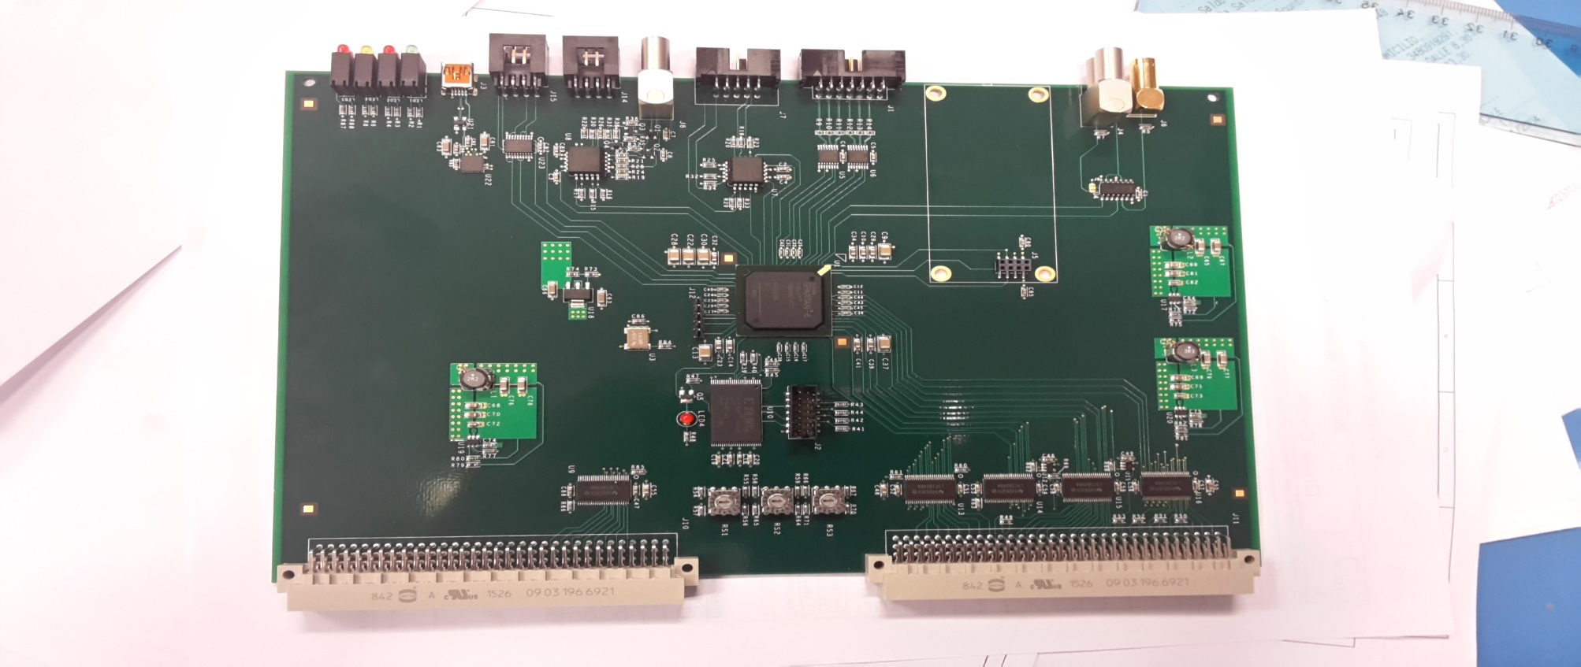
V.1
V.2

