Slide 1
Proposal to measure the muon flux underground with the cosmic boxes

Slide 2
Purpose of the measurement
Following the measurement done at different altitudes by the EEE collaboration (Erice, 2018), we propose to perform a cosmic flux study underground at different depths.
EEE students will participate to the detector istallation, data taking and analysis. EEE staff involved. Coordination INFN - Cagliari

Slide 3
The site: Seruci mine complex, south west Sardinia

Slide 4
This site will host the ARIA project to purify 40Ar from 39Ar, dedicated to Darkside experiment.
Measurement of muon flux can be useful also for this project.

Slide 5
Location survey
On May 2018 survey done by INFN Cagliari staff.
Three depths available: -500m, -250m, -89m. Frist two reachable with an elevator. Third by car (max 8 people).
220V power available in each site.

Slide 6
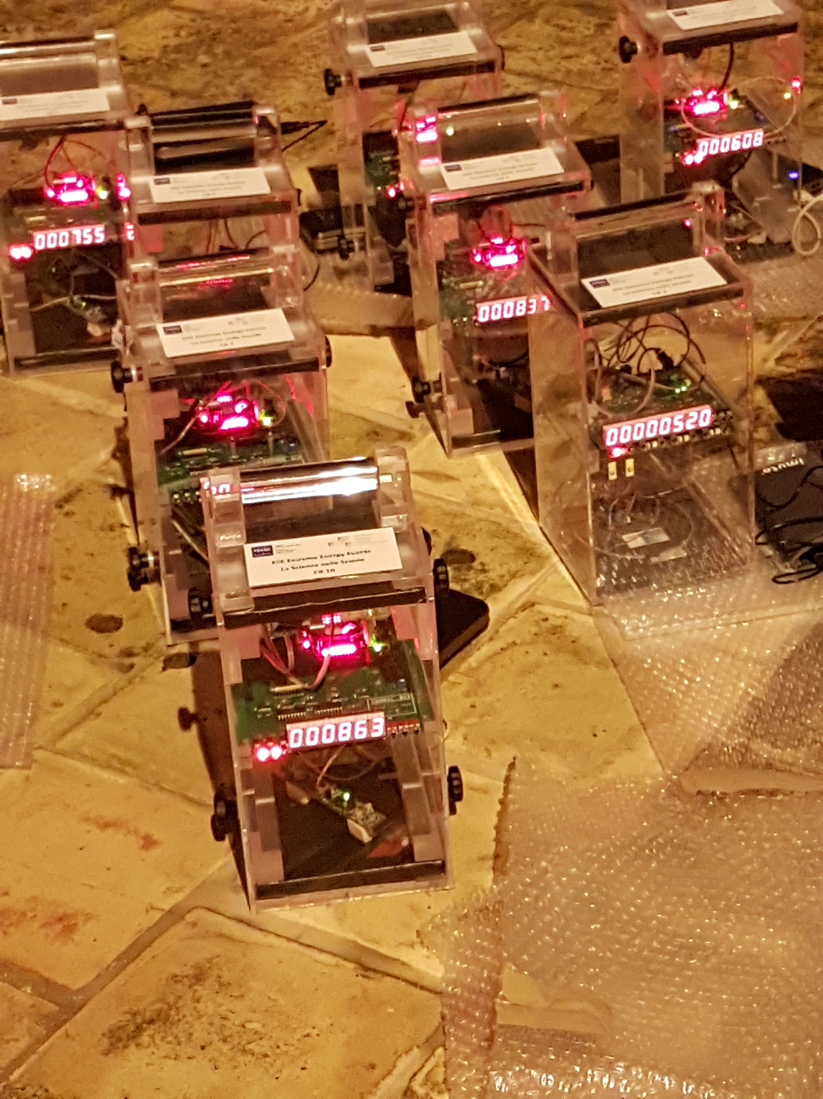
The detectors
Use 3 cosmic box, equipped with a Raspberry (small single board computer).
Active area 15x15cm^2
Connect to the 220V power. UPS available
Record each event with a time stamp.

Slide 7
Measurement program
The rate estimation on the cosmic box at -500m is ∼ 5 events/day
We need 2-3 weeks acquisition time at -500m, with three detectors simoultaneously ON.
Then move the cosmic box to -250m (∼ 10 days) and to -89m (5 days)
Involve a group af EEE students from Liceo Pacinotti (Cagliari) to participate to the measurement.

Slide 8
Time schedule
May 2018 → survey. Done
End of September → arrival of 3 cosmic boxes to Cagliari. Tests.
October 2018 → start of measurement.
End of november →end of data taking
December – January → data analysis and presentation of first results.

Slide 9
Muon Flux Underground

