Slide 1
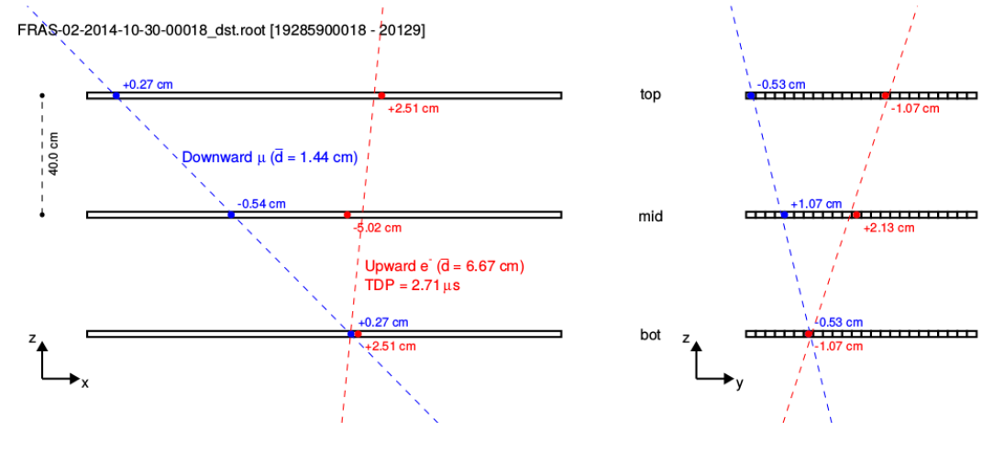
Upgoing events
Few upgoing events are observed (1/2000) in EEE telescopes
The nature of such events is under investigation
A fraction of them can be clearly identified as electrons coming from muon decays (in the floor under the telescope), looking at their time correlation with previous events (∼ 2 μs)

Slide 2
Four interesting measures…
arXiv:1606.06907
1) Muon flux @ sea level
- Angular distribution of relativistic muons
- Energy and angular distribution of slow muons (very few measures!)
2) Flux of primaries
- Reconstruction of average primary energy by means of the even multiplicity (and MC)
3) East-West effect
- crosscheck of the absolute orientation of the telescopes
4) Moon shadow
- sharp crosscheck of the absolute telescope orientation and tracking performanceforte

Slide 3
External collaborations
University of Santiago de Compostela (Spain) is anaylizing EEE data looking for correlations between cosmic ray flux and temperature and pressure conditions in the throposphere. First preliminary results on a limited set off samples
Students exchanges between Italy and Russia
High Schools abroad interested in EEE:
Albania (Korçë)
Cina (Beijing)
Mexico (Mexico City)
Russia (Moscow, Dubna, Novosibirsk)
South Africa (Cape Town)
Taiwan (Taipei)
Norway (Bergen, Oslo)
Israel

