Slide 1
Slide modificate riferite alla presentazione EEE_Erice_2018
Di seguito lo schema è “Slide di questo file <-> slide del file EEE_Erice_2018”
Slide 2 <-> slide 13
Nuovo disegno MRPC utilizzato nel paper
Slide 3 <-> slide 15
Nuovo disegno MRPC utilizzato nel paper
Slide 4 <-> slide 36
Reference al paper aggiornata al paper pubblicato
Slide 5 <-> slide 38
Plot aggiornati:
Time resolution -> plot del Run 3 al posto del Run 2, che mostra prima e dopo time slewing correction
Slide 6 <-> slide 39
Nuovo plot aggiornato a qeullo del paper
Slides 7-8 <-> slides 40-41
I plot sono aggiornati a quelli del paper; i vecchi contenevano un piccolo errore
Slide 9 <-> slide 42
Plot globale di efficienza al plateau aggiunto, con spiegazione annessa

Slide 2
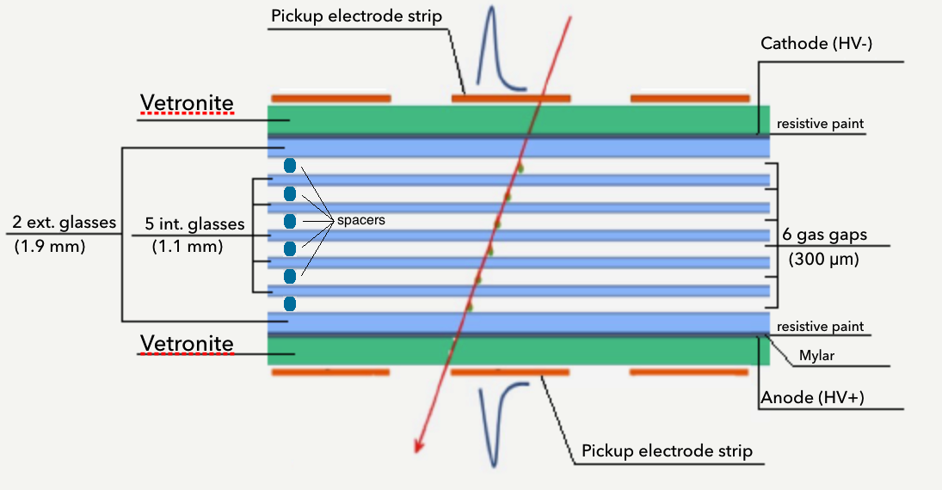
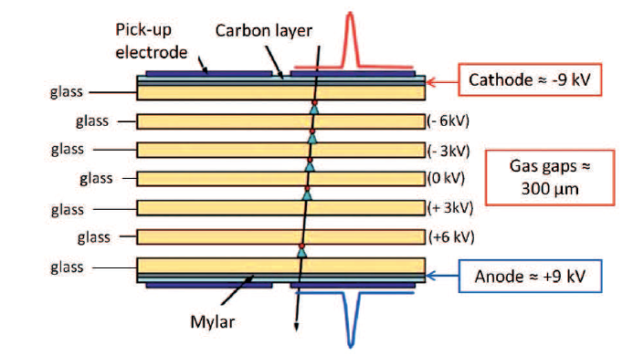
Main features of EEE MRPC
The MRPCs developed for the EEE Project
are characterized by 6 gas gaps each,
300 μm thick, obtained by separating
glass plates,1.1 mm thick, 80 x 160 cm²
in dimensions, by means of commercial
nylon fishing lines used as spacers
The outer glass plates are coated with resistive paint, and act as high voltage electrodes, while the inner ones are left electrically floating
The gas mixture is C₂H₂F₄ (tetrafluoroethane, Freon) / SF₆ (hexafluoride) mixed in 98 / 2 % proportions, flowing at a typical rate of 2–3 l/h

Slide 3
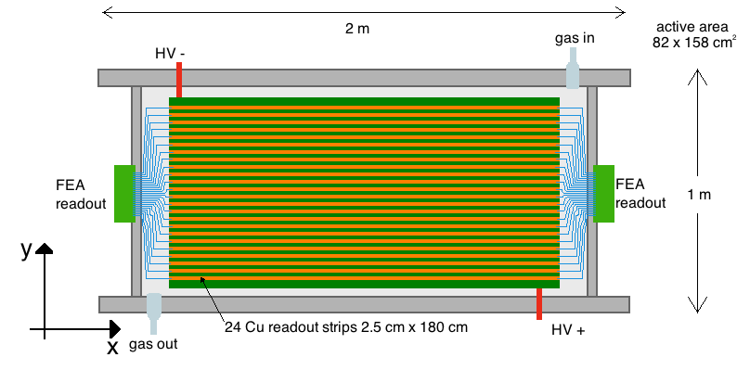
Main features of EEE MRPC
Since readout strips (180 cm along x, 2.5 cm with 0.7 cm pitch along y) lie longitudinally on the chambers, one coordinate (x) of the muon impact point is given by the difference of the signal arrival times at the two strip extremities, while the other (y) is directly obtained from the position of the fired strip

Slide 4
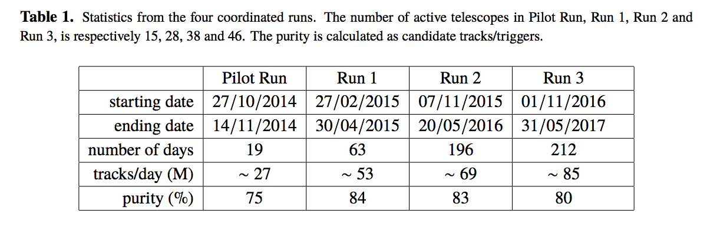
EEE Telescopes: Performance
"The Extreme Energy Events experiment: an overview of the telescopes performance", EEE Collaboration, 2018 JINST 13 P08026
(purity defined with χ² < 5 econstructed tracks)
Performance study with a sample of 8 billion tracks
over 31 billion tracks collected in Run-2 and Run-3
Notes:
8 billion tracks over 31 billions collected in Run 2 + 3
M million in all telescopes

Slide 5
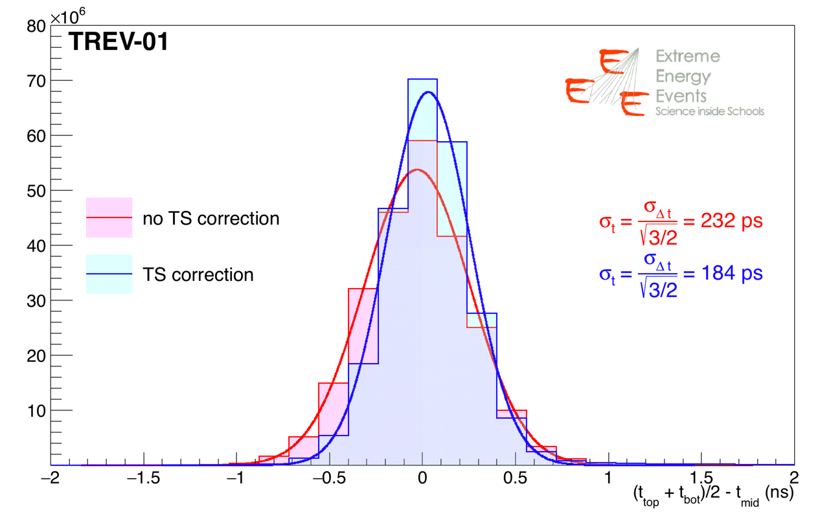
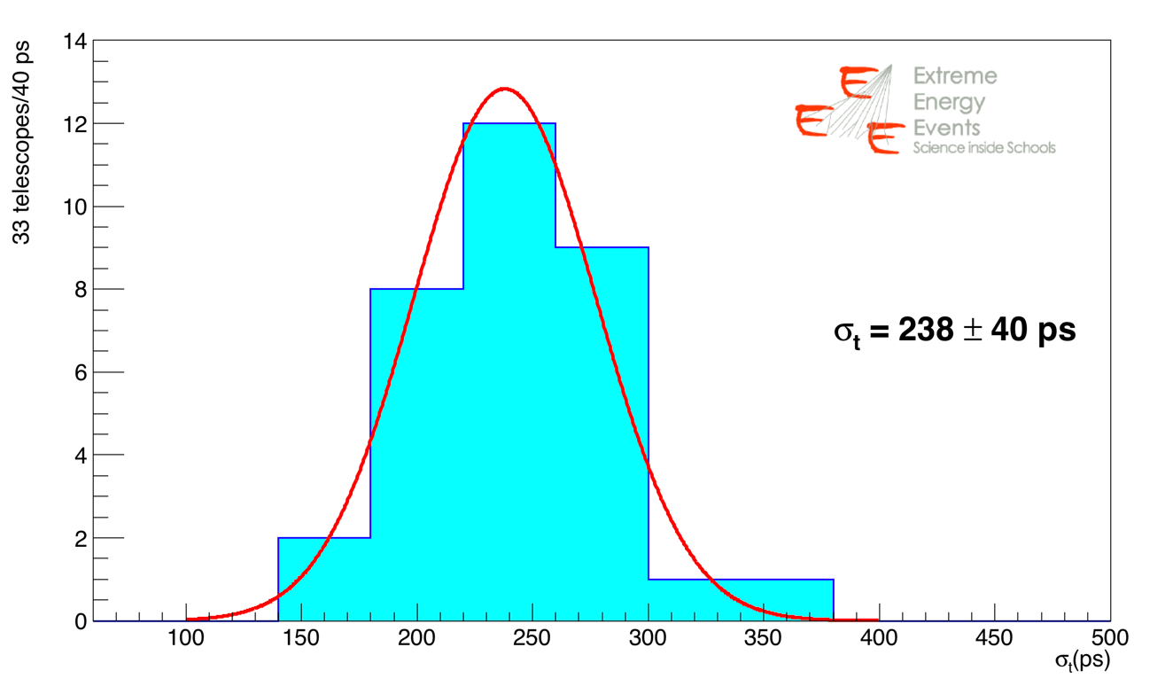
TOF resolution
∆t distribution is obtained by using external chambers as reference and comparing expected and measured hits on the middle chamber
∆t distribution for one of the EEE telescopes (TREV-01), showing the gaussian fit and the time resolution
σ_{t} = 184 ps (after Time Slewing correction)
Time resolution measured with data taken in Run 3, for 33 telescopes: the average time resolution is given by the gaussian fit and is σ_{t} = 238 ps

Slide 6
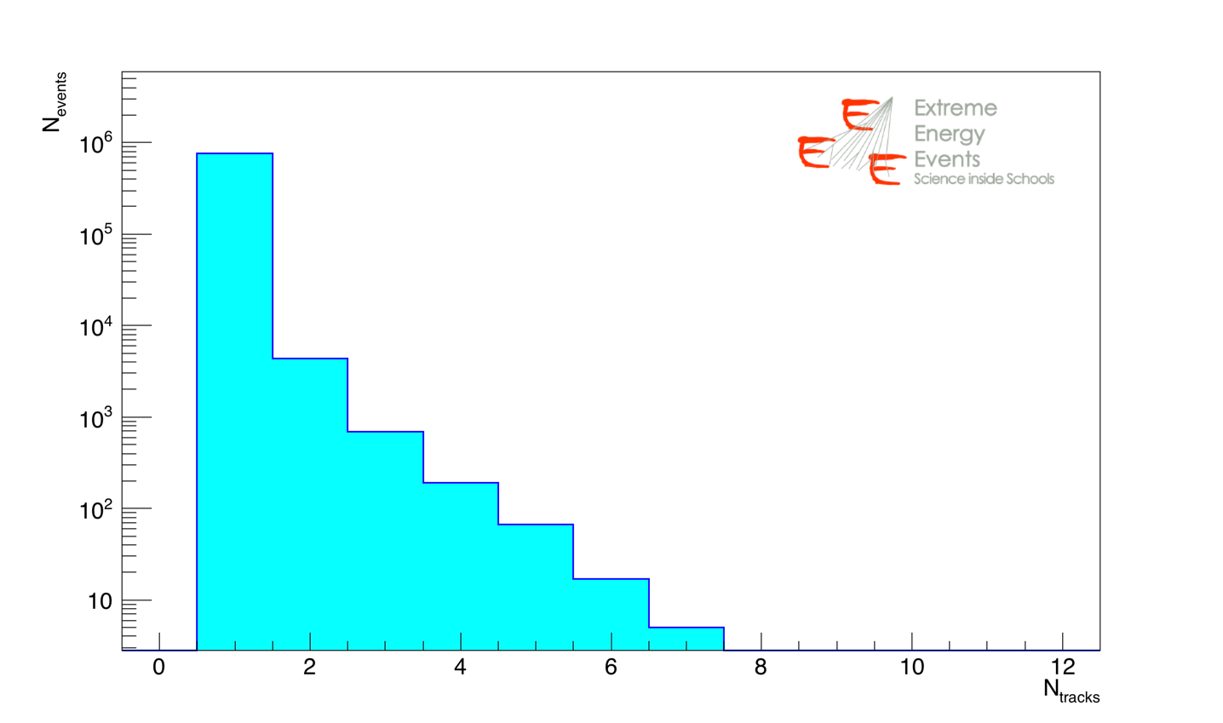
Reconstructed track multiplicity in a typical EEE telescope
(χ² < 5 for reconstructed tracks)
Track multiplicity distribution of one of the EEE telescopes (SALE-01, located in Campania)

Slide 7
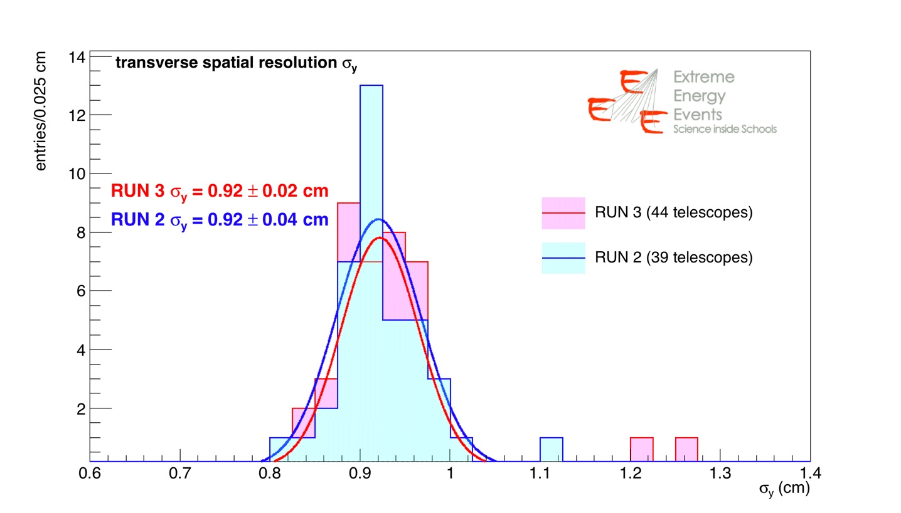
Transverse spatial resolution with 39(44) EEE telescopes in Run 2(3)
∆t distribution is obtained by using external chambers as reference and comparing expected and measured hits on the middle chamber
(0.92 cm expected)

Slide 8
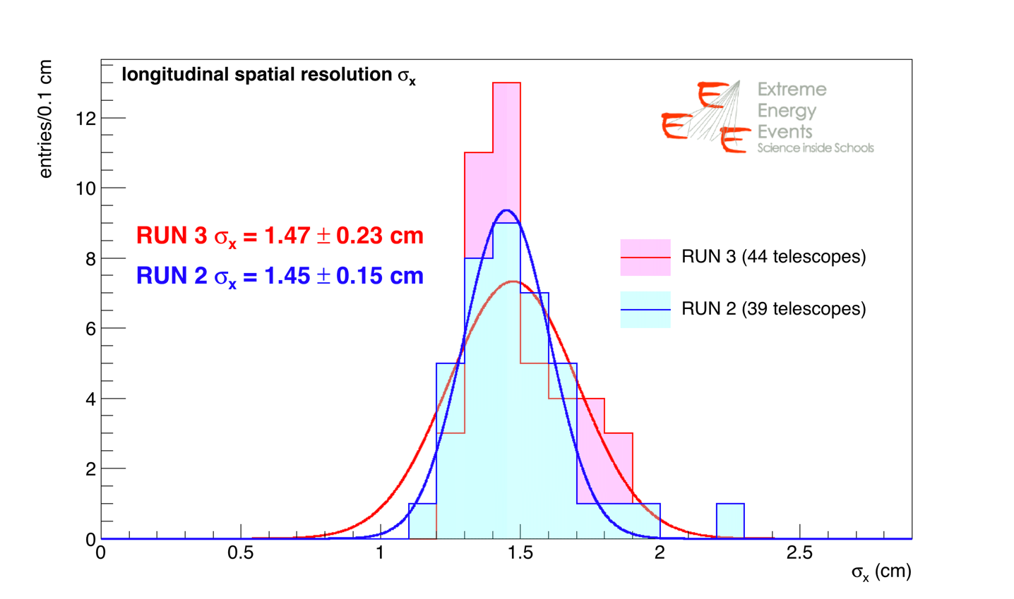
Longitudinal spatial resolution with 39(44) EEE telescopes in Run 2(3)
∆t distribution is obtained by using external chambers as reference and comparing expected and measured hits on the middle chamber
(0.84 cm on test beam)
Notes:
p and T differences, HV working point differences
TS calibrations

Slide 9
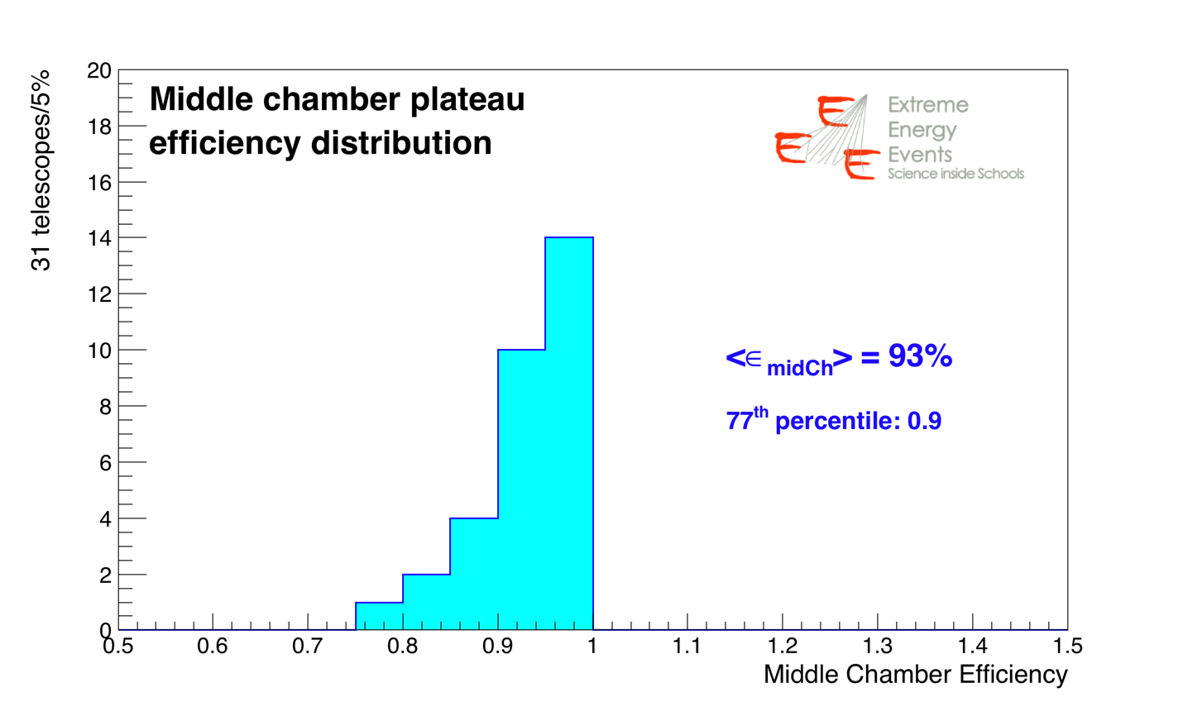
Efficiency in the middle MRPC with 31 EEE telescopes
- Example of HV scan with 9 telescopes
- Corrected for p and T effects
- Efficiency obtained at the plateau of the
middle MRPC for 31 EEE telescopes.
An efficiency better than 90% is reached by 77% of the network.

