Slide 1
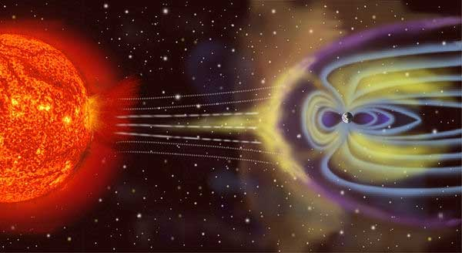
GCR flux variations @ EEE

Slide 2
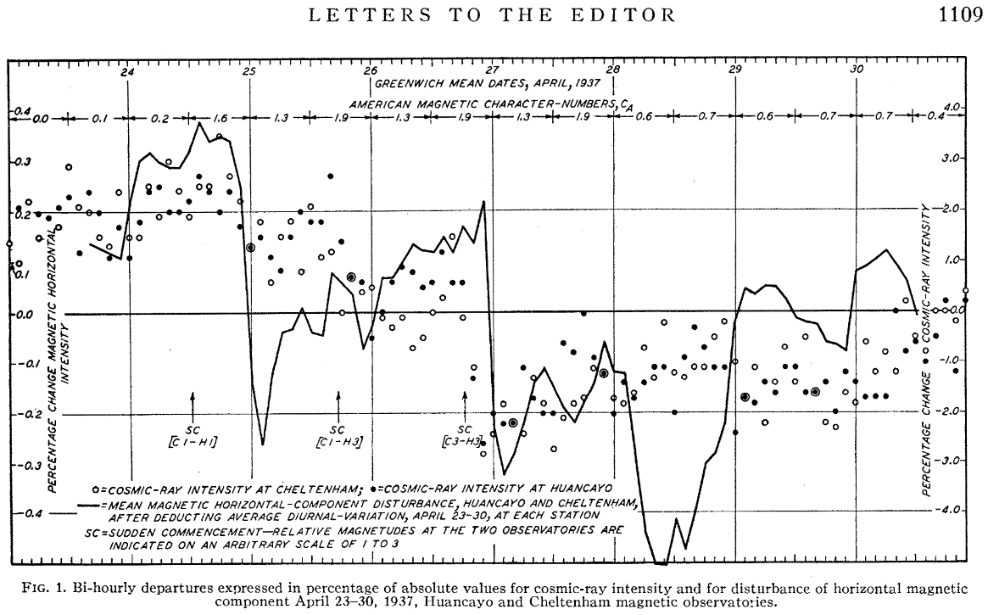
Forbush and GCRDs
First rigorous experimental observation of Cosmic Ray Flux Decrease was obtained by S. E. Forbush in 1937-38, after deep statisitcal analysis of data from “precision cosmic ray meter, Cheltenham, Maryland” and after studies on barometric and temperature effects.

Slide 3
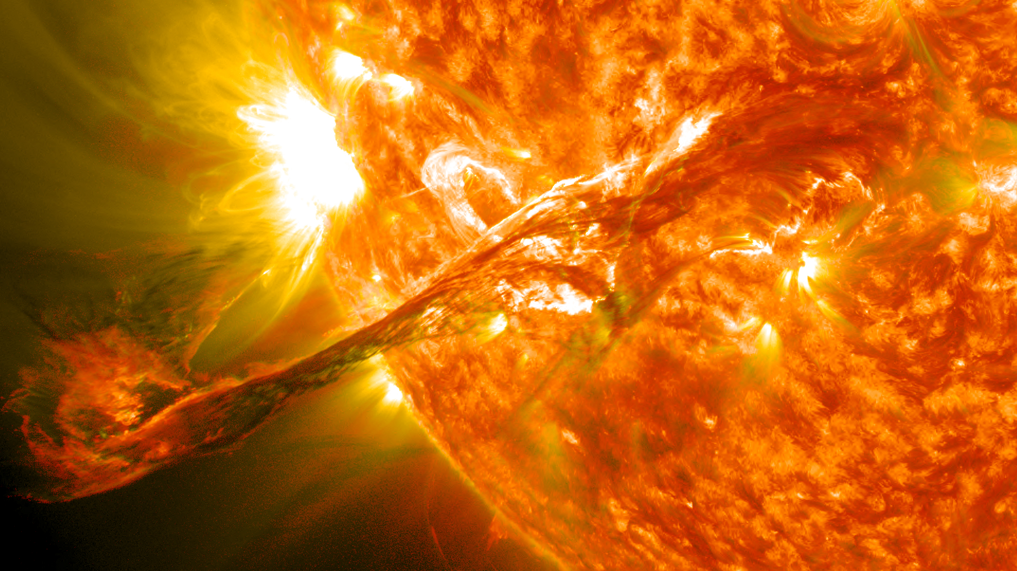
GCRD sources: Energetic events on Sun Corona
Coronal Mass Ejections
Ejection of particles from Sun Corona (protons, electrons)
Particles are accelerated from 20 to 2000 km/s
Average 400 km/s
Accelerated by the heating of underlying sun layers, confined by magnetic field
E_{tot} ≈ 10²³⁻²⁴ J
(Sun power P ≈ 4 10²⁶ W)
Rate of occurrence:
0.25 day⁻¹ (solar minimum)
4 day⁻¹ (solar maximum)
Flares
Sudden increase in brightness
Occurring in Sun Corona
a belt confined along sun equator by magnetic fields
Lasting secs to hour
E_{tot} ≈ 10²⁵ J
(Sun power P ≈ 4 10²⁶ W)
Observable in
visible
x-ray
Gamma-ray

Slide 4
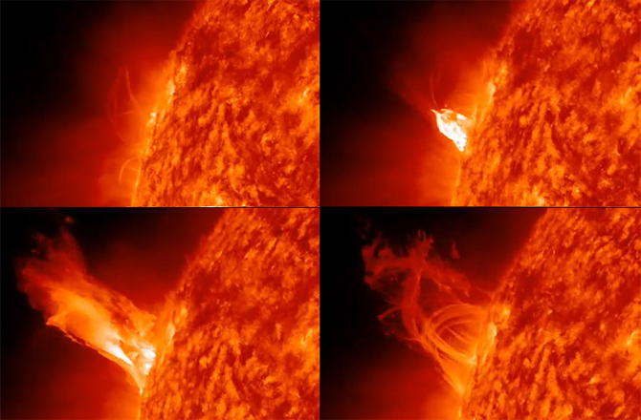
Flare – CME connection
Flares are believed to be the results of re-heating due to manetic lined reconnection after a CME. However Flares and CME are not always associated, even if this happens in case of the strongest events.

Slide 5
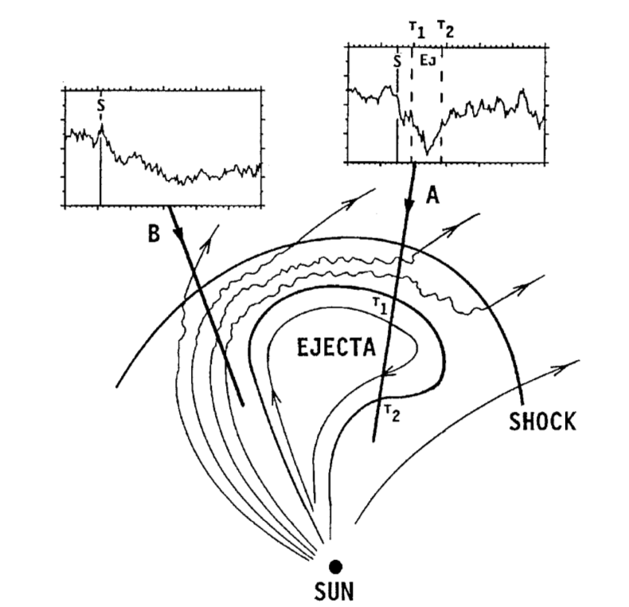
GCRDs occurs in interplanetary medium
Shock wave driven
by ejected particles
Particles ejected
Accelerated particles by shock wave
Swept particles

Slide 6
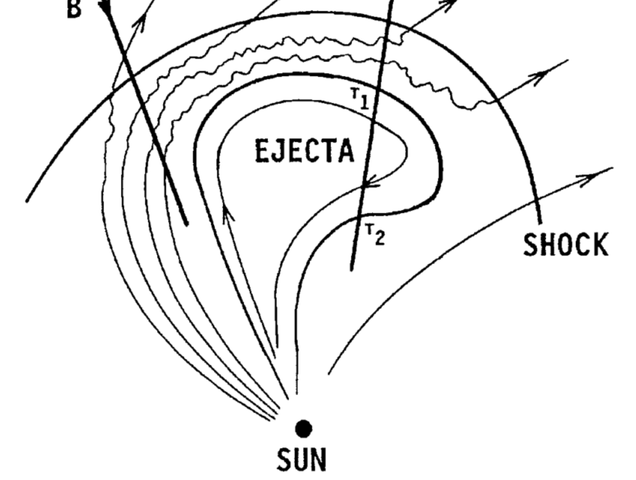
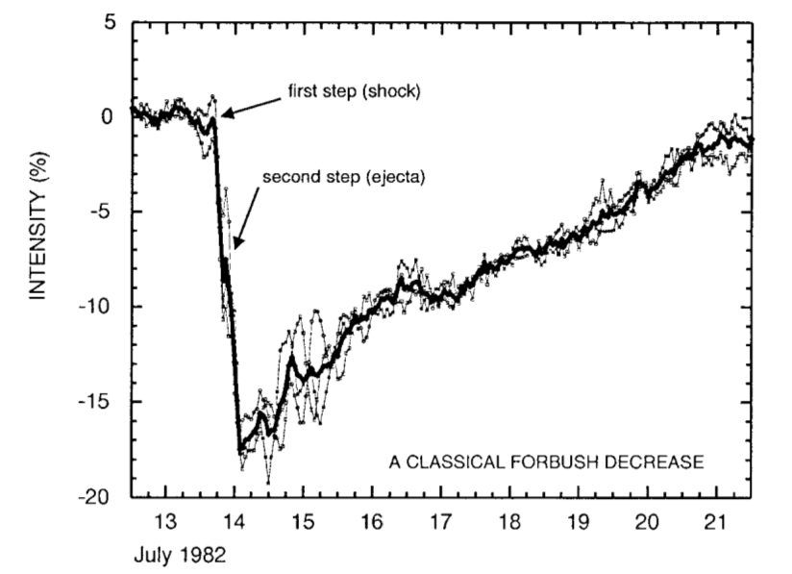
Effects on Earth: two-step mechanism
Initial particle increase may happen (only for strong CME, due to shock acceleration)

Slide 7
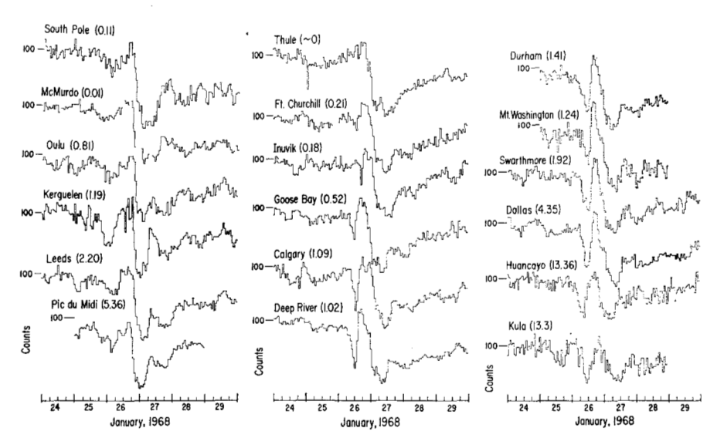
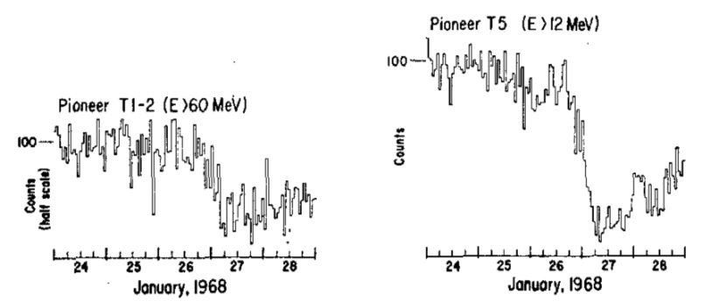
Neutron Monitors
Complex phenomenon: Energy threshold effects e.g . on two-step mechanism
Pioneer satellites

Slide 8
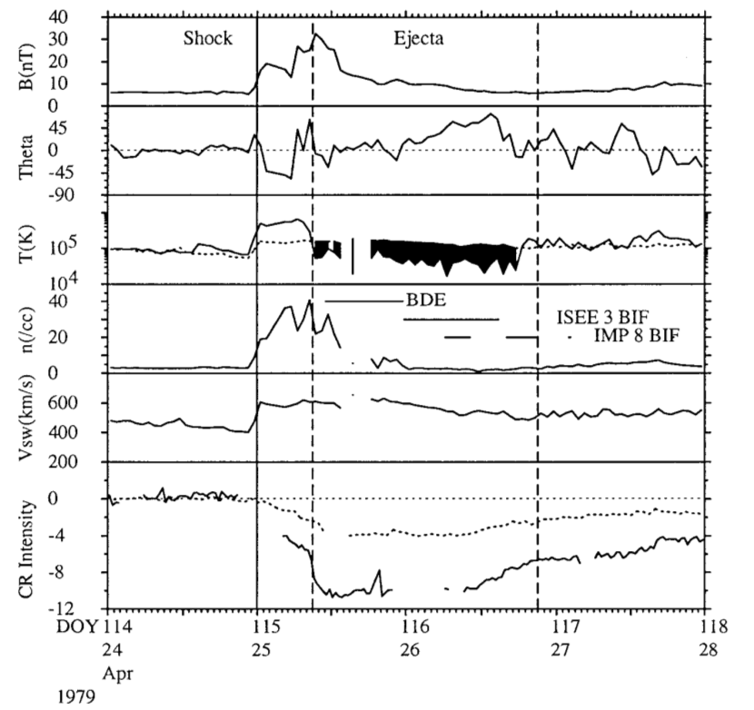
Magnetic Field
Magnetic Field
Magnetic field out of ecliptic
Proton Temp
Temp. decrease due to ejecta
Wind particle density
Bidirectional ion and proton flux
Wind speed
Forbush effect

Slide 9
GCRDs occurred since the beginning of coordinated data taking

Slide 10
The analysis and Forbush identification approach

Slide 11
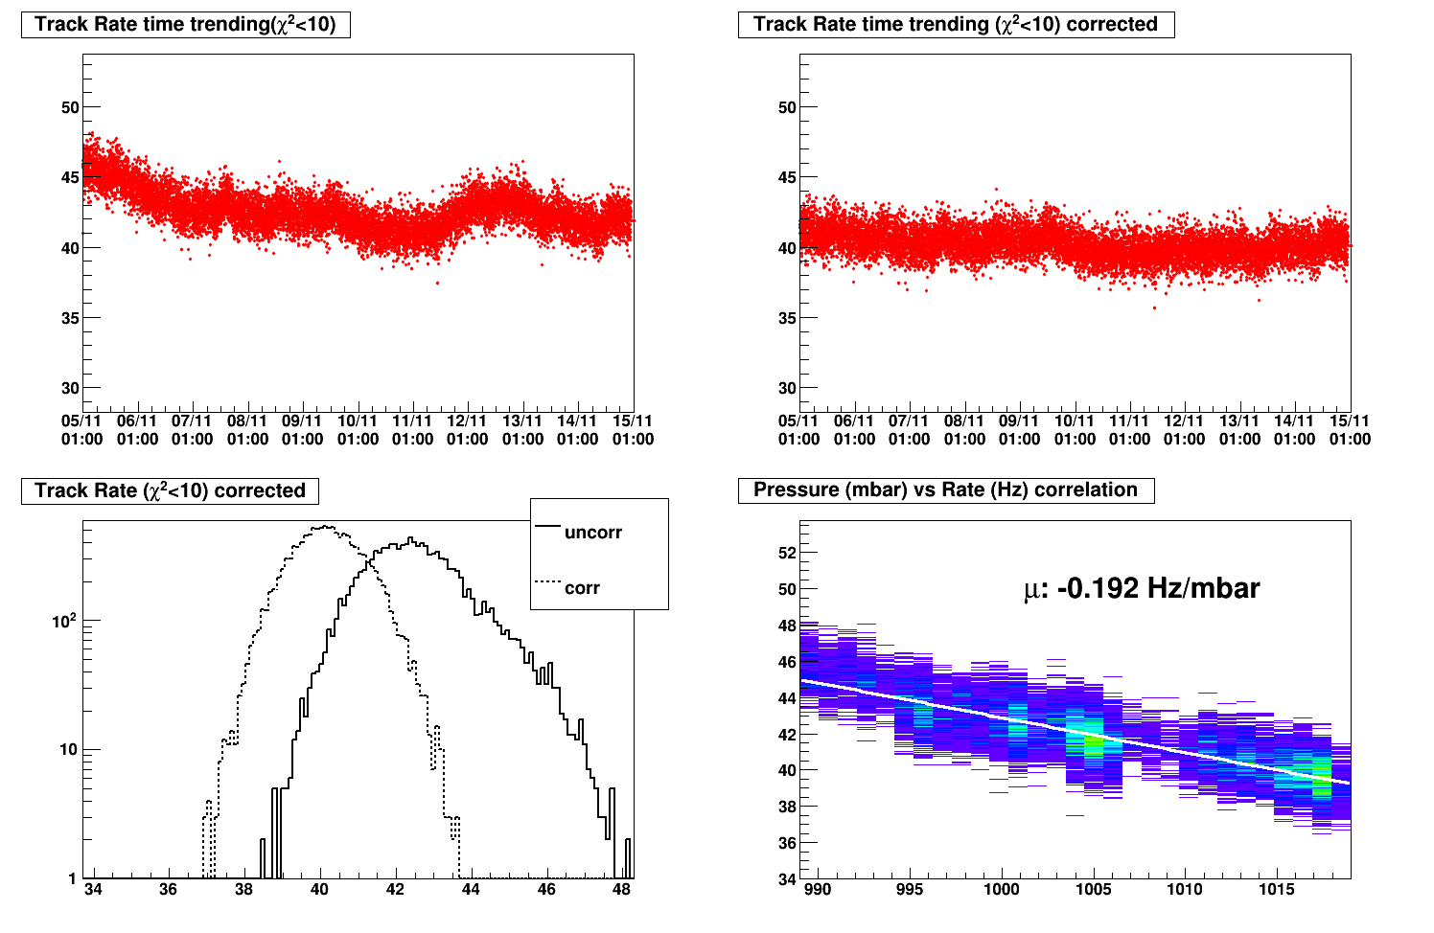
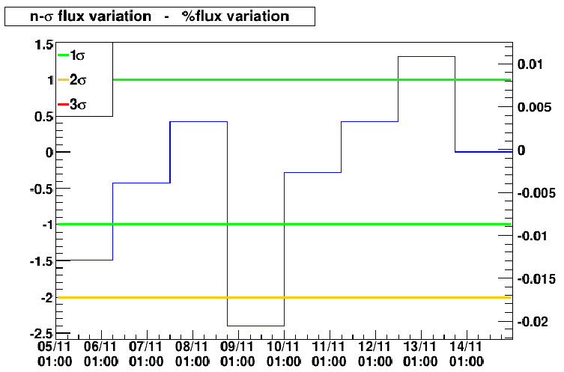
Corrections and Forbush identification
Uncorrected
Corrected
Statistical significance
Uncorr/corr rate distr.
Barometric correction

Slide 12
The observed events

Slide 13
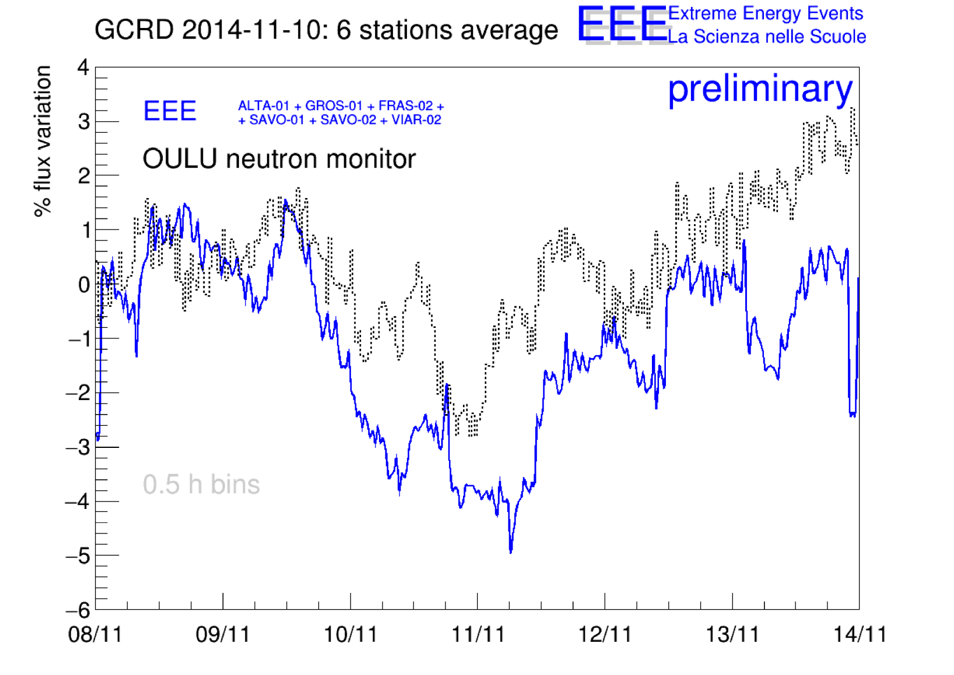

Slide 14
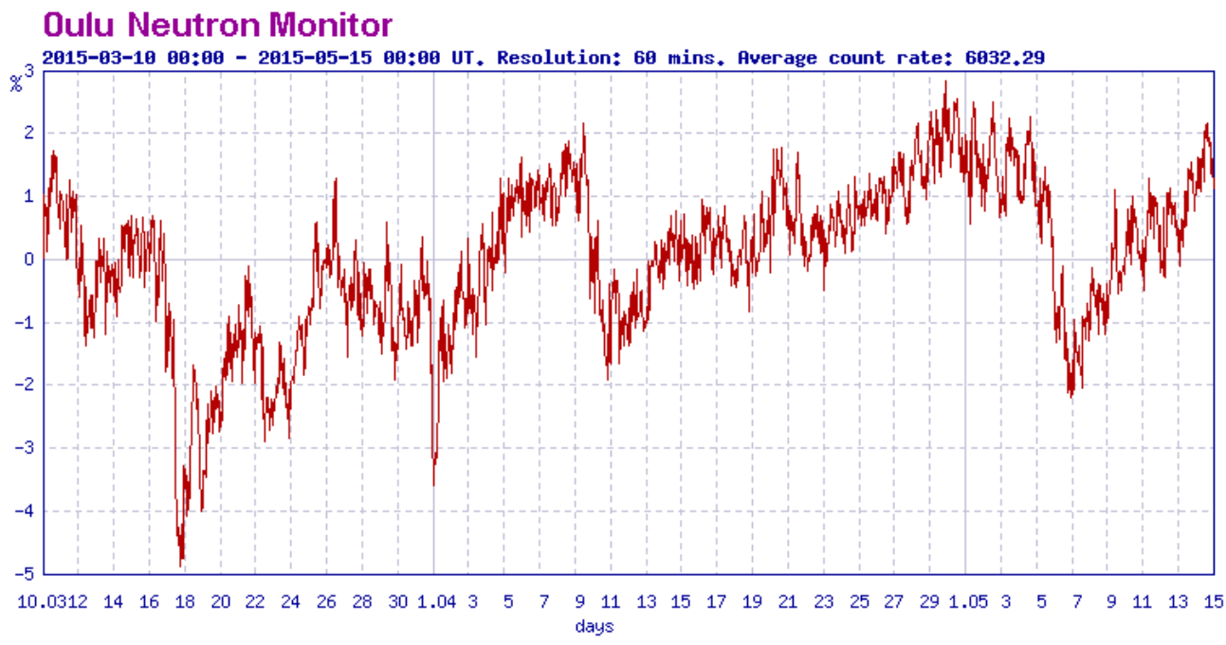
GCRD: 2015 March – May, an active season

Slide 15
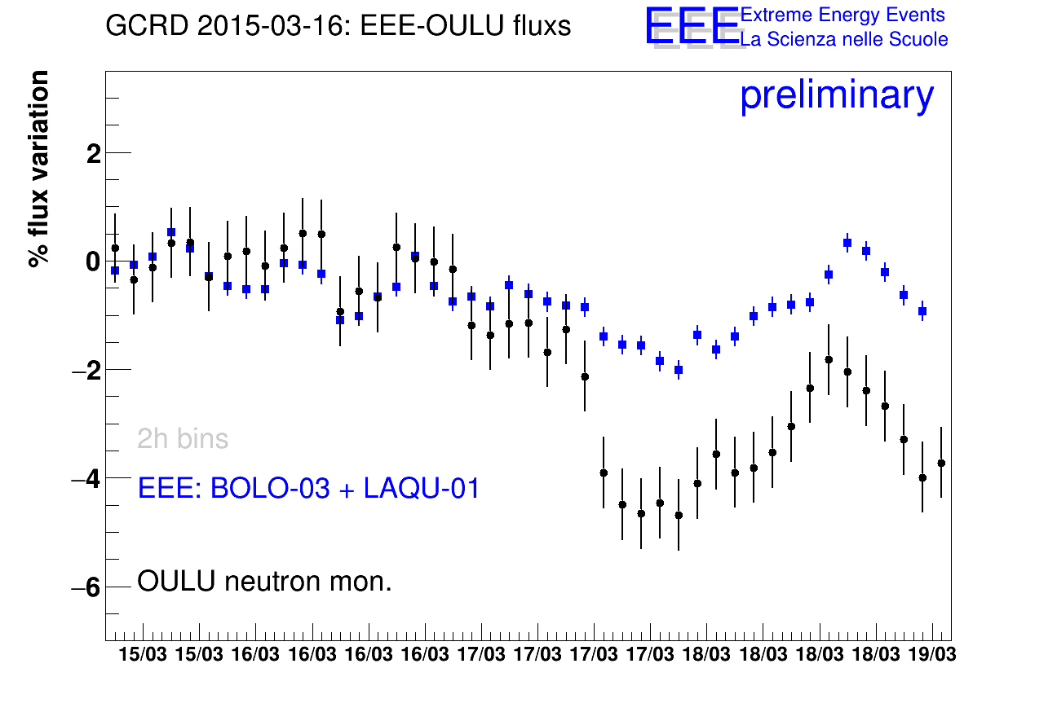

Slide 16
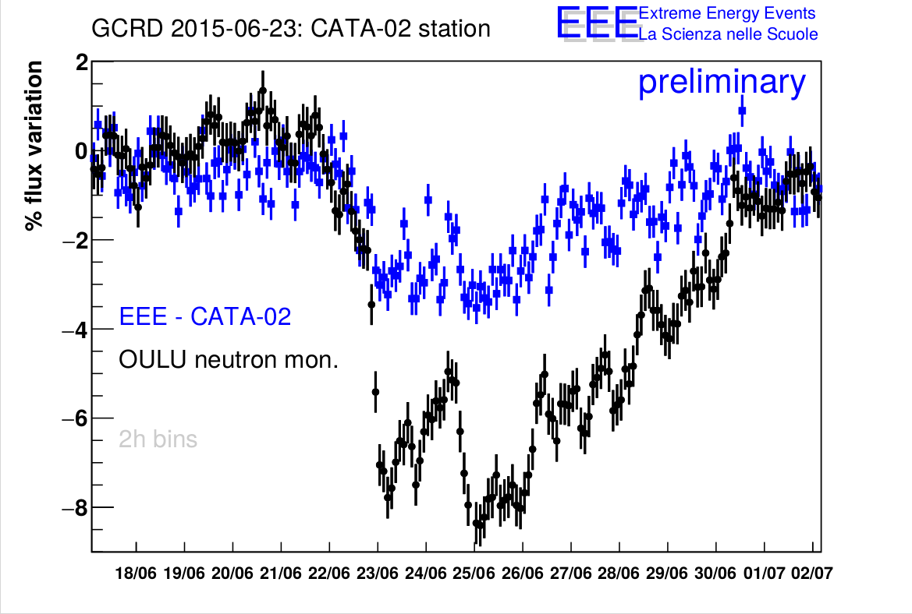

Slide 17
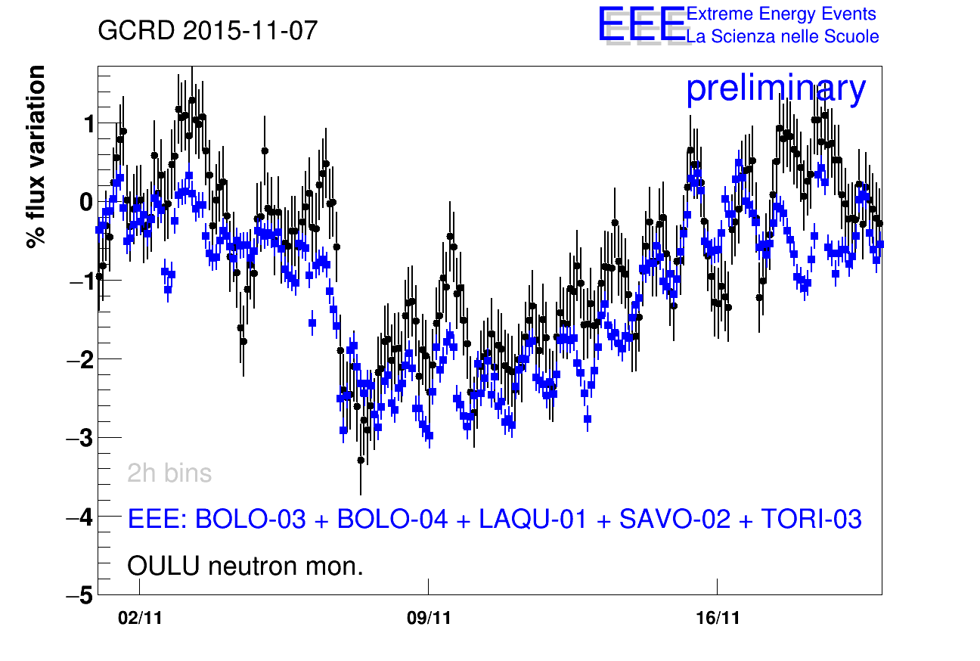

Slide 18
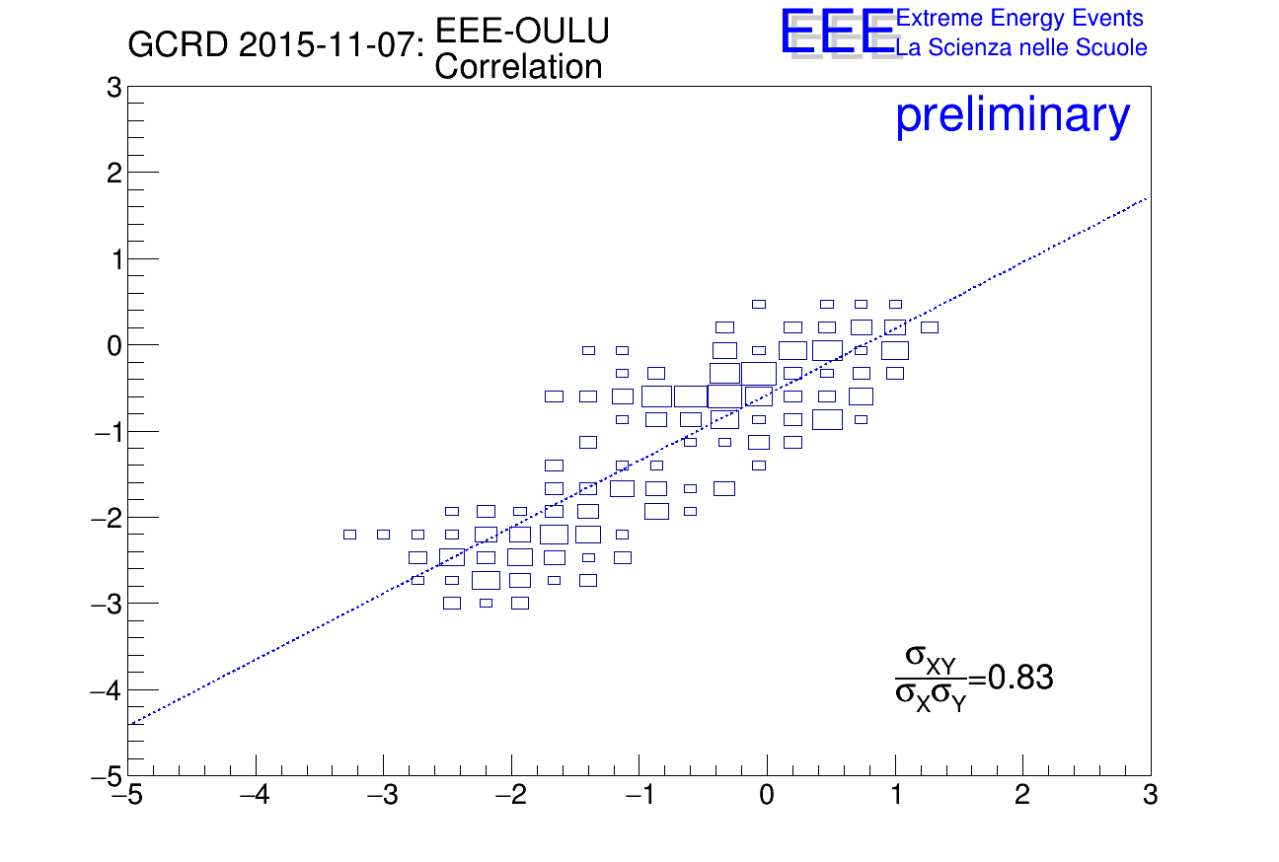

Slide 19
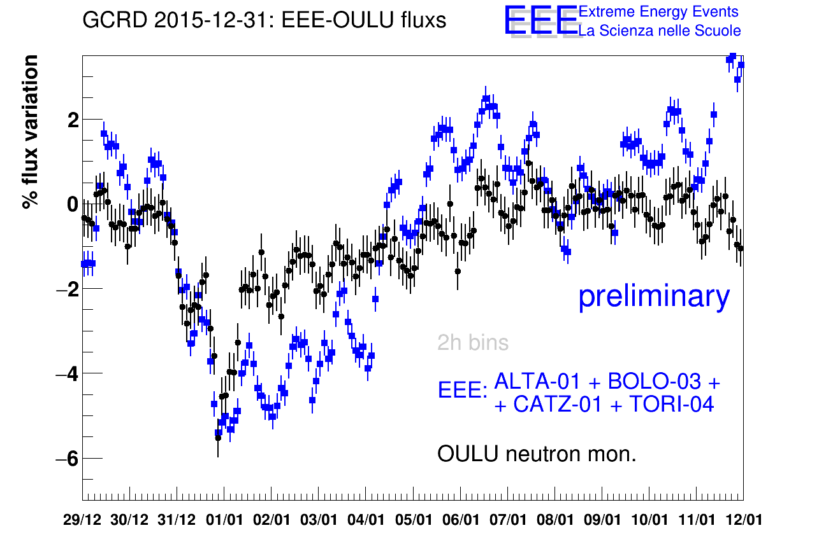

Slide 20
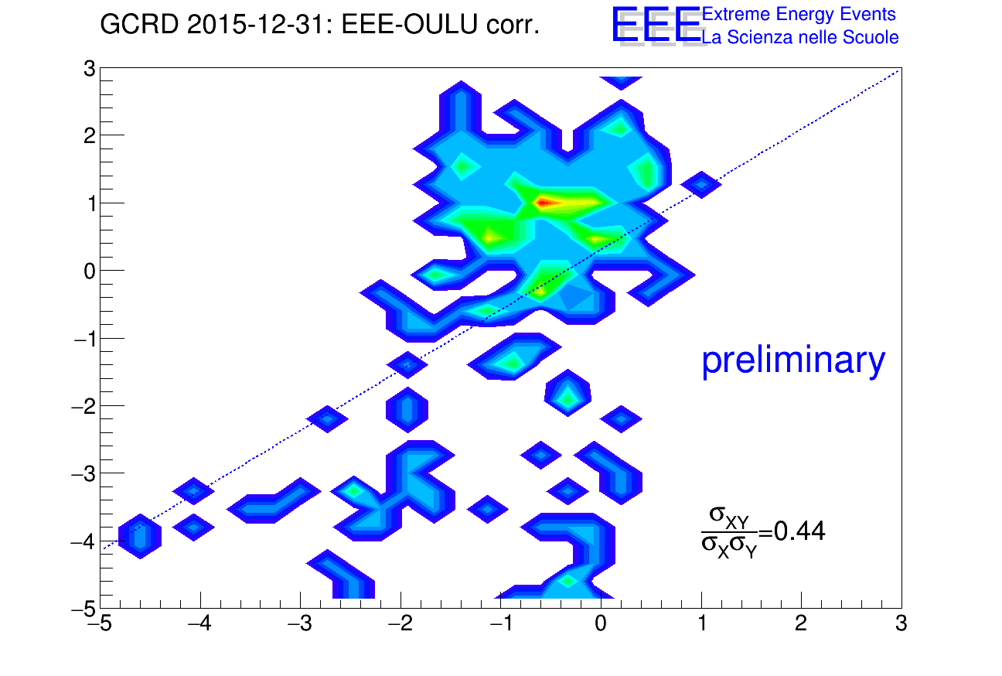

Slide 21
Forbush-Flares correlation

Slide 22
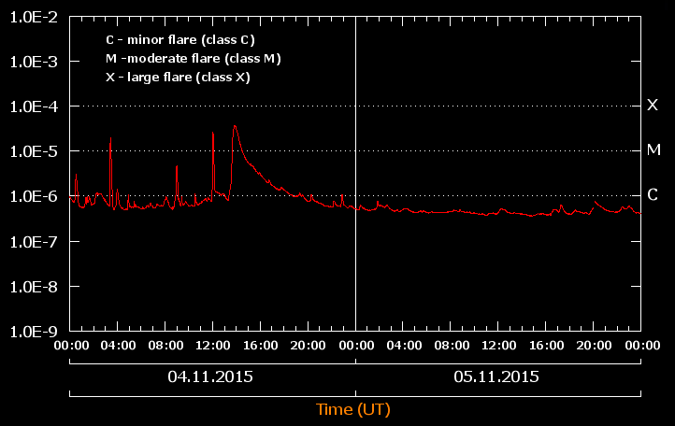
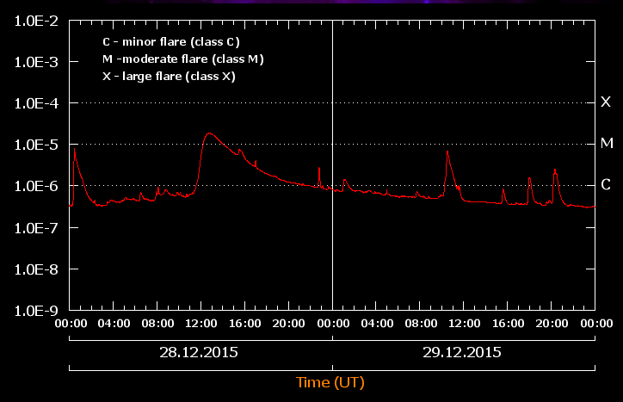
Flare of class M3.7
Flare of class M1.8

Slide 23
Latitude correlation search

Slide 24
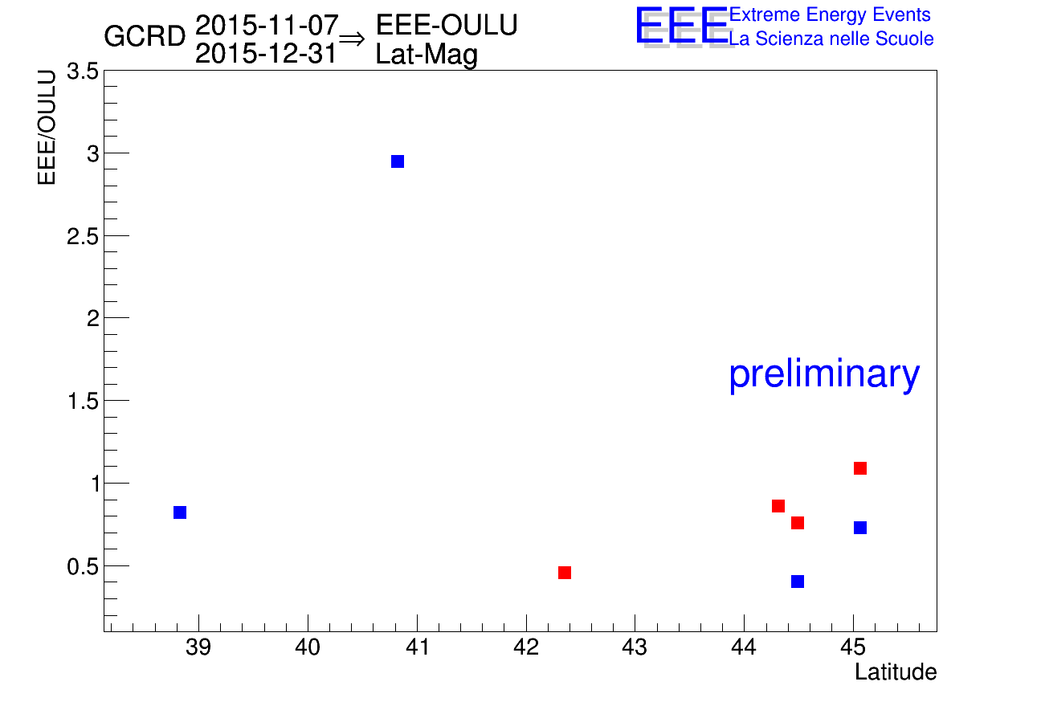
ALTA-01
SAVO-02
CATZ-01
LAQU-02
TORI-04
BOLO-03

