Slide 1
EEE Upgrade 2018:
construction and tests

Slide 2
33 MRPCs built
20170222001 LAMP-01
20170223002 LAMP-01
20170225003 LAMP-01
20170314004 GENO-01
20170316005 GENO-01
20170317006 GENO-01
20170405007 SIEN-02
20170406008 SIEN-02
20170407009 SIEN-02
20170425010 CARI-01
20170426011 CARI-01
20170427012 CARI-01
20170509013 TORI-05
20170510014 TORI-05
20170511015 TORI-05
20170523016 LODI-03
20170524017 LODI-03
20170524018 LODI-03
20170719019 spare – ROMA-01
20170921020 spare – FRAS-01
20170926021 CAGL-04
20170927022 CAGL-04
20170928023 spare
20171026024 spare – COSE-01
20171121025 BOLO-05
20171123026 BOLO-05
20171124027 BOLO-05
20180221028 CAGL-04
20180222029 spare
20180227030 spare
20180228031 spare
20180320032 spare
20180322033 spare
All of them 6 gaps 250 um
+ 5 glasses 280 microns

Slide 3
Tests flow
Test after
constructions:
Gas tightness
Efficiency
Dark rates
Dark currents
Test during the constructions:
HV
strips
Delivery
If any problem

Slide 4
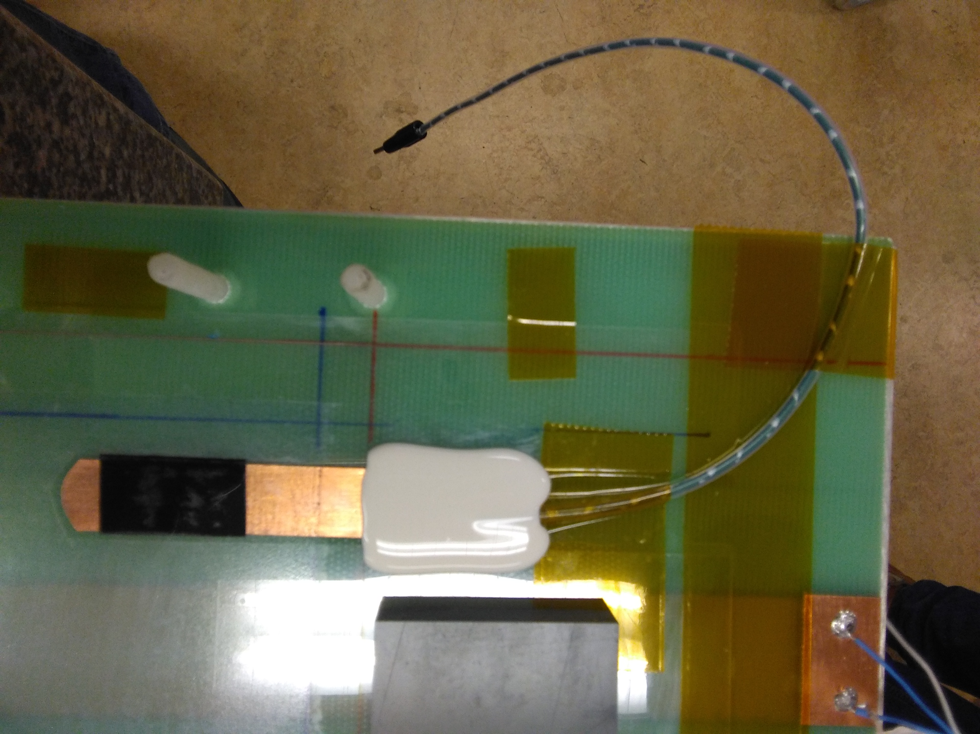
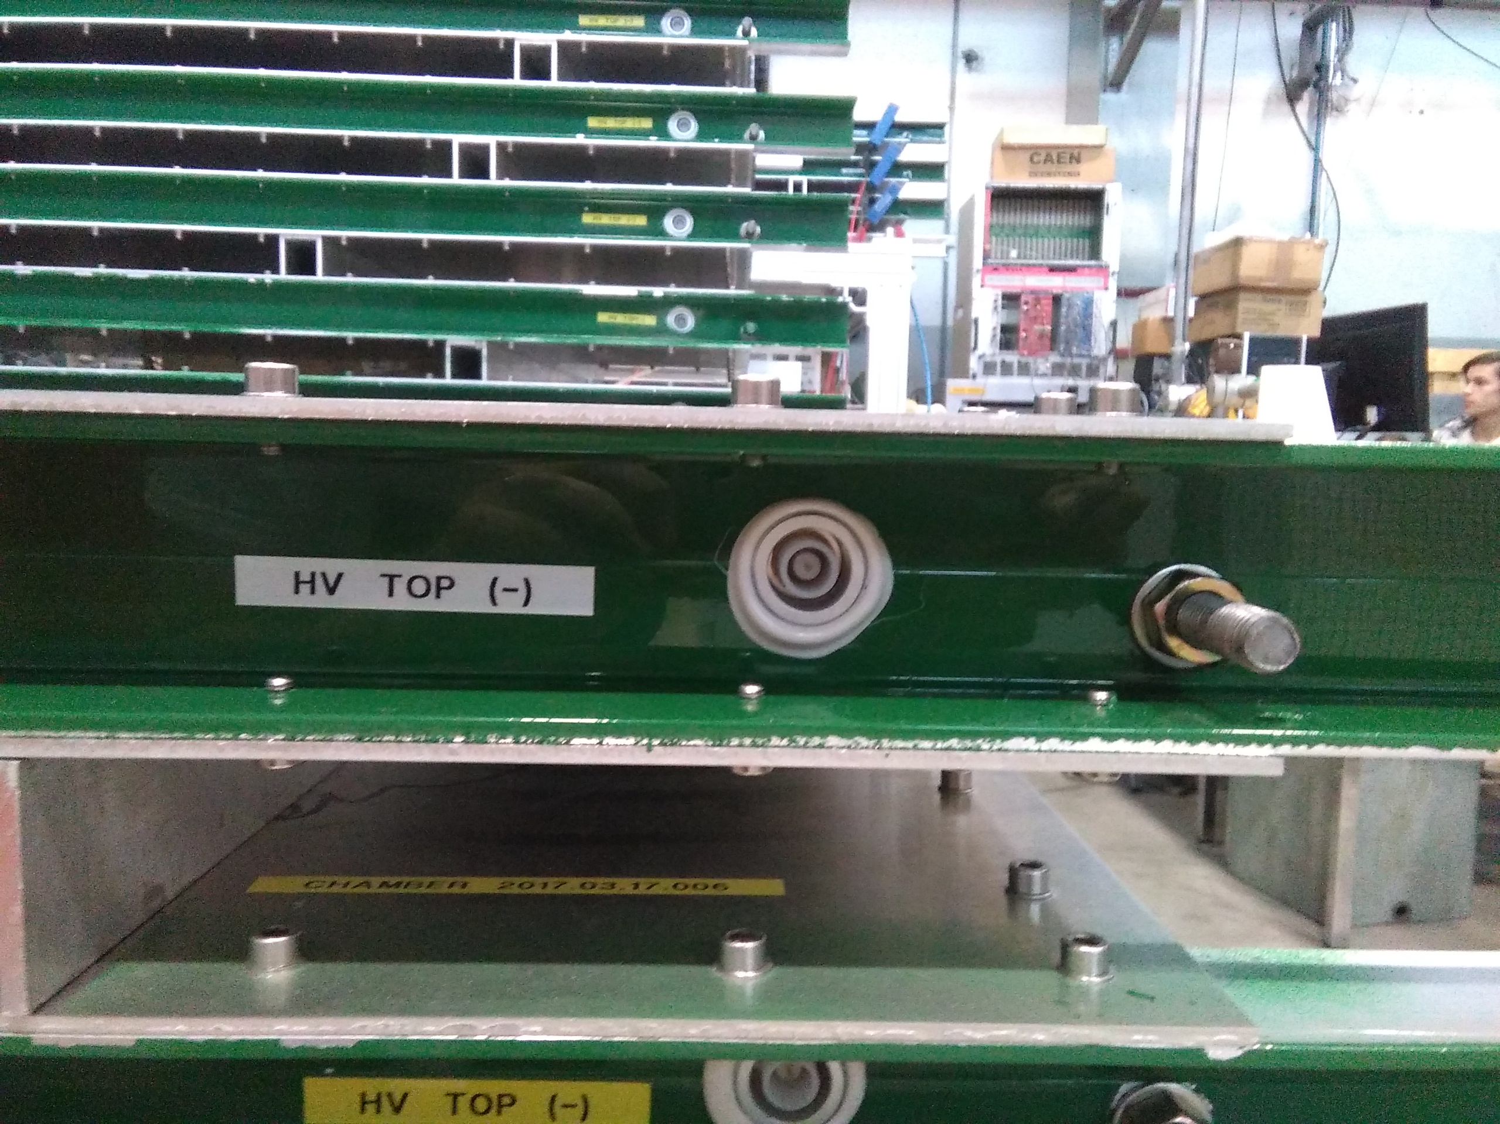
Tests during the constructions
HV
The good quality of HV contact on electrodes is ensured by carbon tape (black) between contact and glass.
The upper electrode is the negative.
The electrodes are
properly labeled for avoiding mistakes during the telescope installation

Slide 5
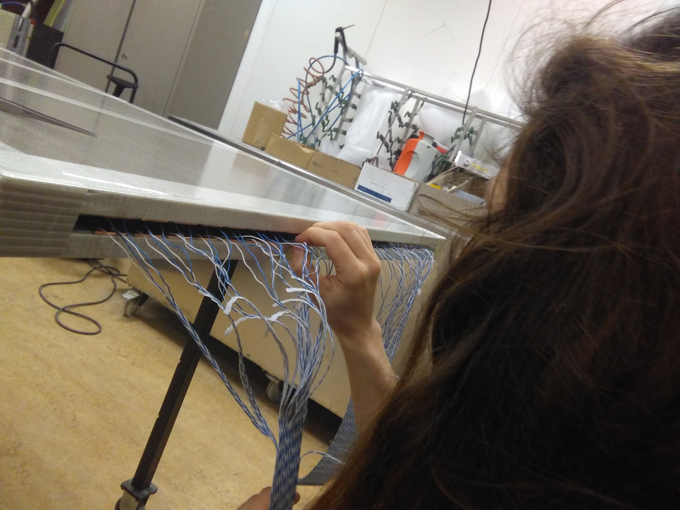
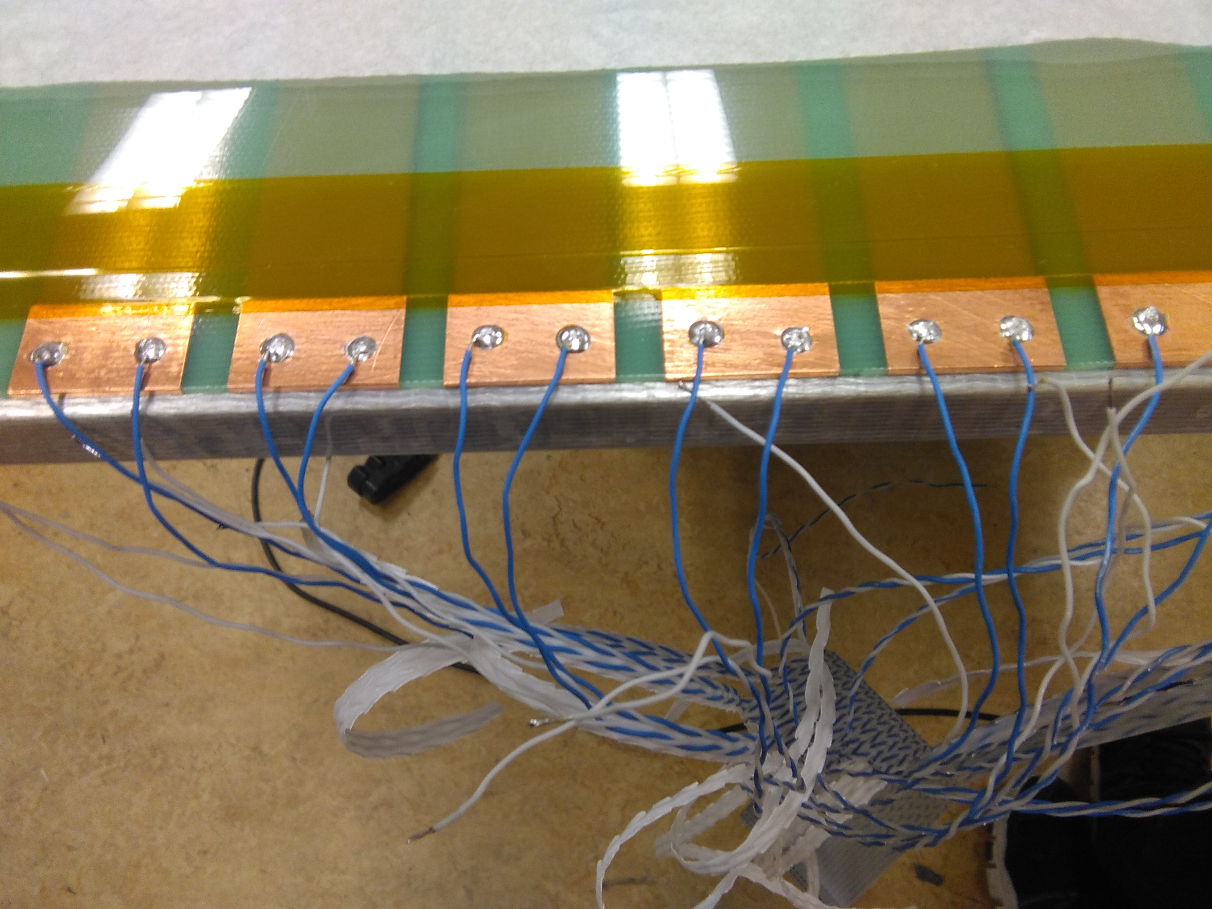
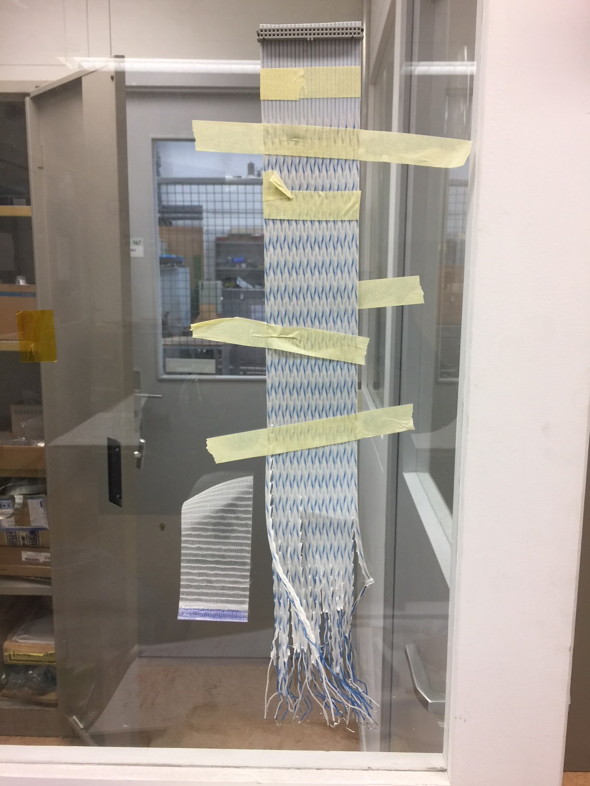
Tests during the constructions
Flat cables are prepared
in advance.
Right orientation is taught and checked during soldering.
Unused twisted pair are tied.
Strips
Solderings are checked
both for
1. mechanical strength
2. right order
several times and by different people

Slide 6
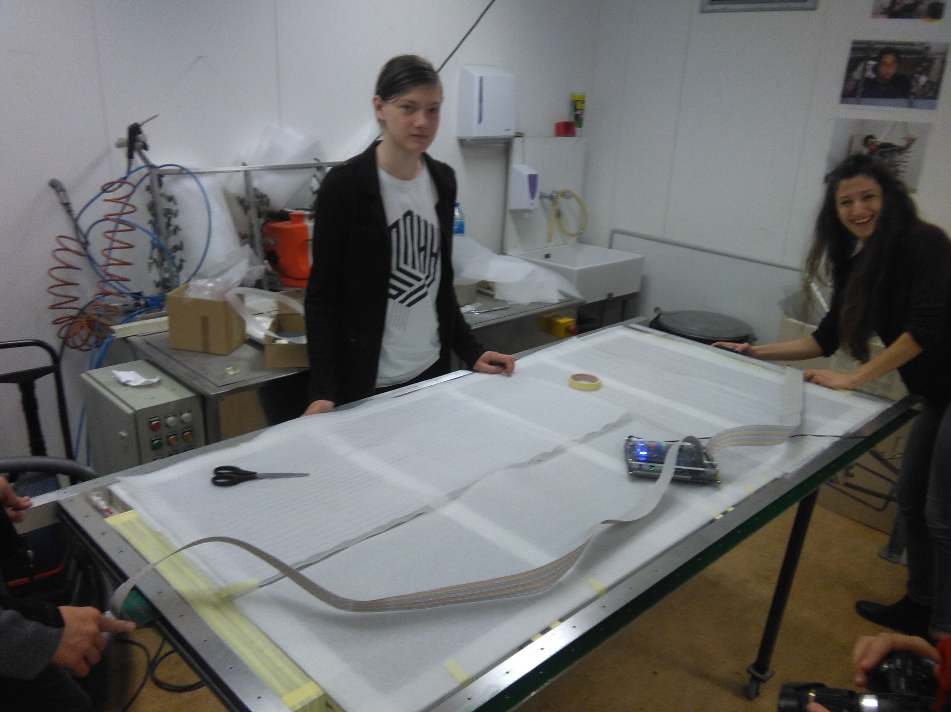
Tests during the constructions
Good electrical connections are tested
on both sides.
The test is repeated:
1. with dummy connectors before closing the chamber
2. after laying the chamber within the chassis
3. after chassis closing
Strips

Slide 7
Gas tightness tests
The gas tightness test is performed as follows:
1. 100 ml of air are injected during each step up to 2 mbar of overpressure
2. Volume vs Pressure curve is measured
3. the chamber is closed and the Pressure variation vs time is measured
4. corrections for volume variation due to Temperature are applied
5. the volume time derivative is the estimated leakage
100 ml syringe
Differential Manometer

Slide 8
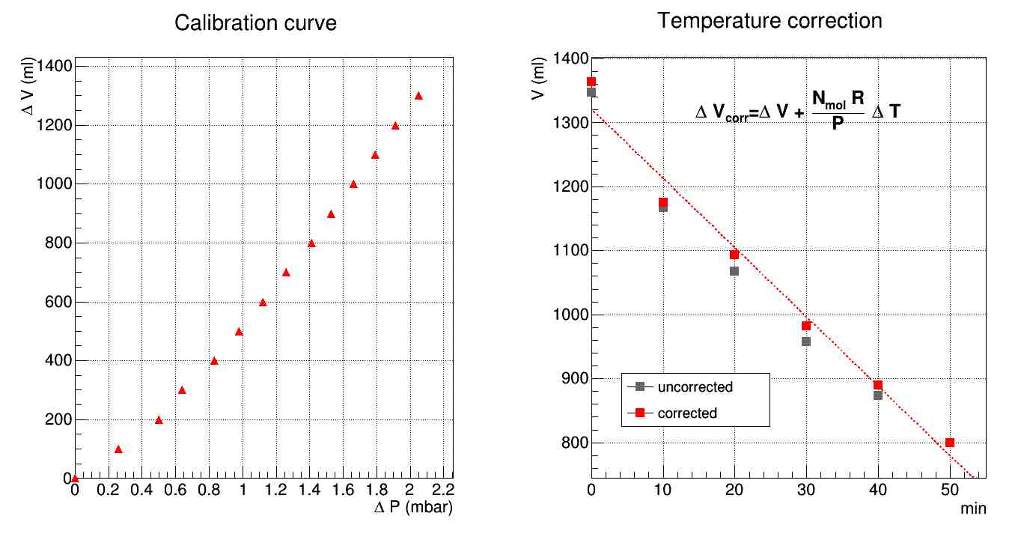
Gas tightness tests

Slide 9
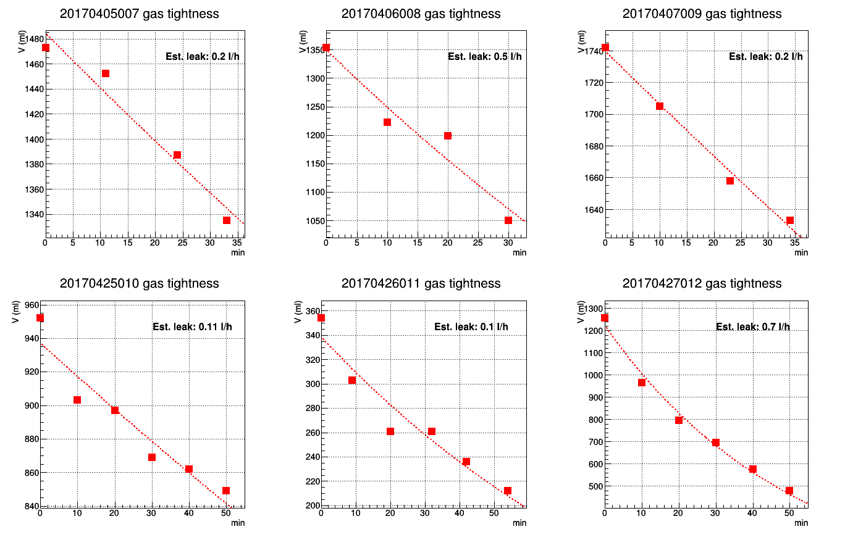
Gas tightness tests
Extraction of the leakage flux:
pressure decrease vs time exponential behaviour
allows to measure the chamber leakage at ΔP~1 mbar
close to operating conditions

Slide 10
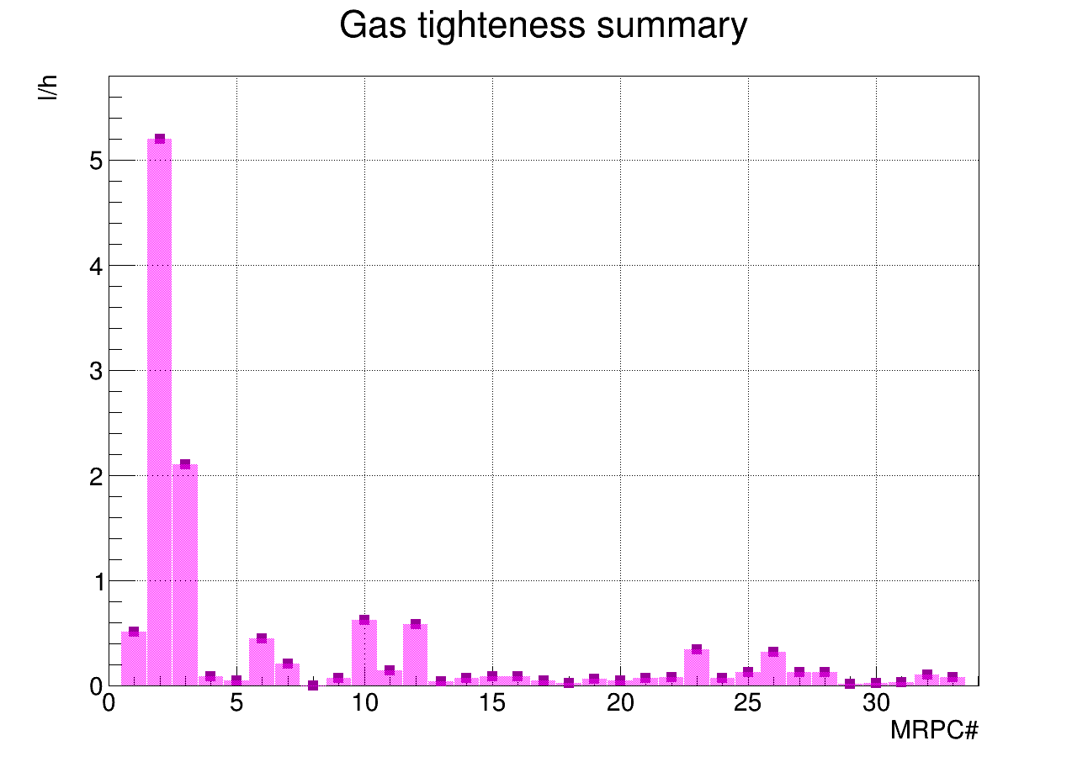
Gas tightness tests: trends
LAMP-01 GENO-01 SIEN-02 CARI-01 TORI-05 LODI-03 S CAGL-04 S BOLO-05 S S S

Slide 11
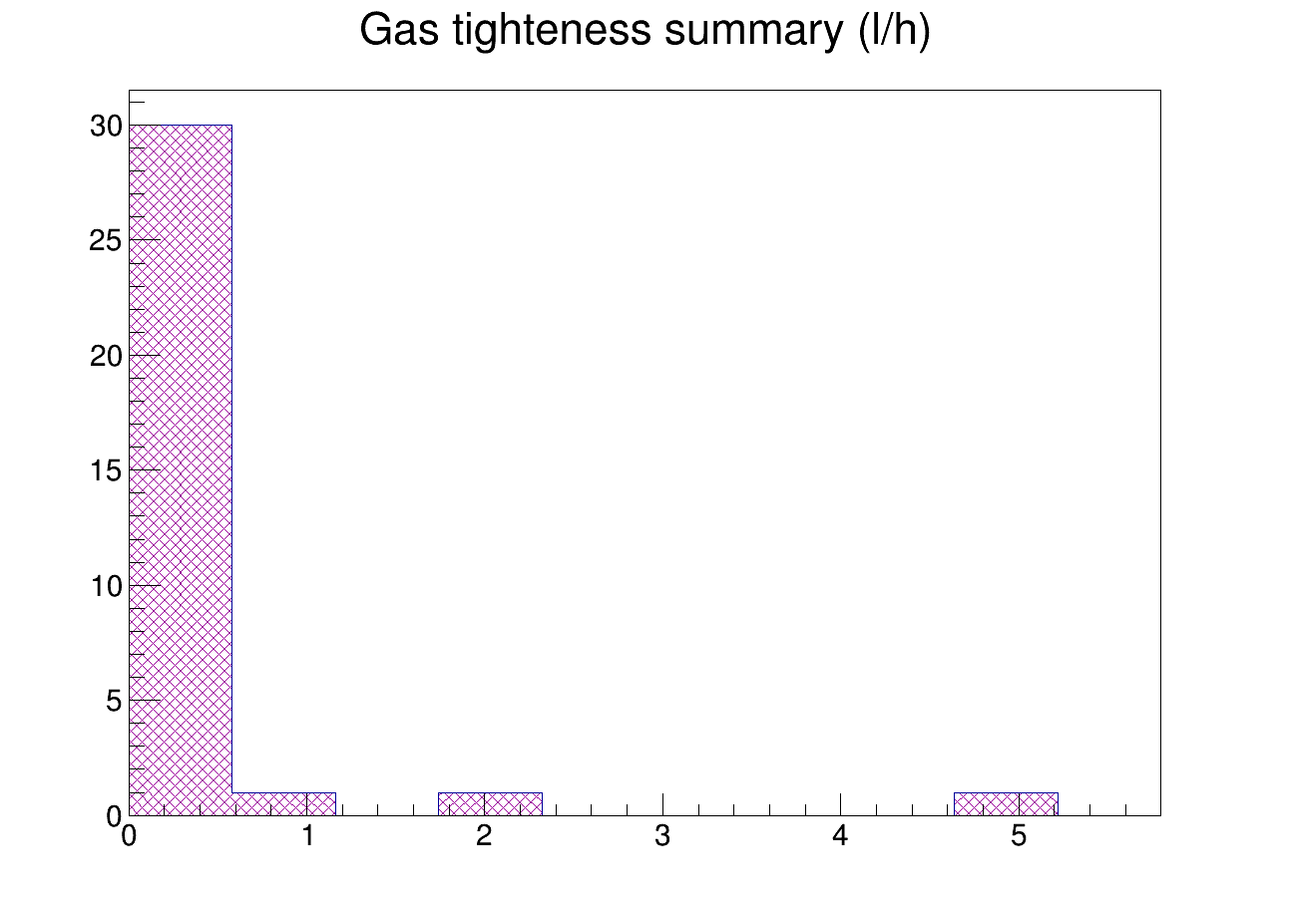
Gas tightness tests:
Leak distribution
L/h

Slide 12
Efficiencies/Dark Rate/Dark Current
Efficiency is measured
for the 3 chambers
laying on CERN-01 (green).
Chambers are fluxed
4 days before measurements.
The trigger is the CERN-01.
The data sent to DAQ come from
CERN-01 bottom and middle chamber and one of the chambers under test.
By reconstructing tracks triggered by CERN-01,
hits on tested chamber
are searched.
74
64
54
Data
44
Trigger (OR 24)
44

Slide 13
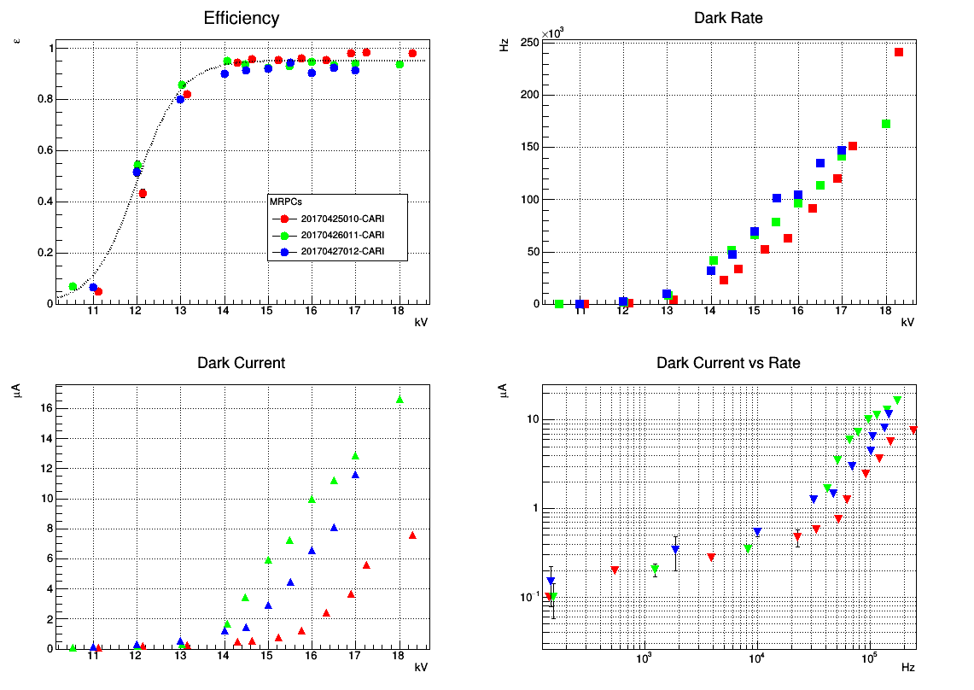
Efficiencies/Dark Rate/Dark Current
A typical 3 chamber-set parameters

