Slide 1
Search for anomalous EEE events during the multimessenger observations of Sept.22, 2017
_____________________________
F.Riggi
EEE Meeting, Sept. 12th, 2018

Slide 2
● On Sept. 22, 2017 at 20:54:30,43 UTC time a high energy (290 TeV) neutrino event was observed by the IceCube km³ neutrino Observatory
● This event is important, since the source of high energy neutrinos (apart from the SN1987a supernova) is still unknown
● The arrival direction of this event was consistent with the known position of a γ-ray blazar in an active state.
Blazar (Blazing Quasi Stellar Object) = sorgente molto energetica, associata ad un buco nero supermassivo al centro di una galassia ospitante
● A multiwavelength observations campaign was carried out just after this event by several Collaborations (from ground and from space), searching for γ-rays associated to this source.
● As a result, an association between high energy neutrino emission with a blazar emitting γ-rays was found, suggesting that blazar jets may be an important source of very high energy cosmic rays.
The IceCube Collaboration et al., Science 361, 146 (2018) 13 July 2018

Slide 3
What about EEE?
___________________________
First of all: was the EEE network active in that period?
A first survey for EEE telescopes working on Sept.22, 2017 gave a number of 18 potentially active sites on that day.
A more careful investigation on the data quality of the telescopes properly working around the time of the event reduced this number to 12:
AREZ-01 BOLO-03 CATA-01 FRAS-02 GROS-01 GROS-02 PISA-01 SALE-01 SALE-02 TORI-01 TORI-03 TORI-04

Slide 4
What to search for?
___________________________
Considering the availability of diifferent active telescopes in that period, in this analysis a search for coincident events between several EEE telescopes was carried out.
A coincidence time window of 5 ms between different telescopes was used, compatible with the max geometrical distances between EEE sites.
A time window of (-20 s, + 20 s) with respect to the neutrino event observed by IceCube was considered at the moment (see later for a discussion on this point).

Slide 5
The significance of a N-fold coincidence
___________________________
Possible events of interest must be always compared with the expectation of random coincidences.
Assuming roughly the same individual rate from each telescope (R_single), for a N-fold coincidence the spurious rate is given by
R_spurious ~ N (R_single)^{N} x ∆t ^{N-1}
Examples:
N = 2 R_spurious ~ 2 R² ∆t
N = 3 R_spurious ~ 3 R³ ∆t²
Assuming N=2, R_single= 20 Hz, ∆t= 5 ms, R_spurious= 4 Hz
This means that no significance may be associated to a simple coincidence between two telescopes within this large time window.
What about a coincidence between many telescopes (i.e. large N)?

Slide 6
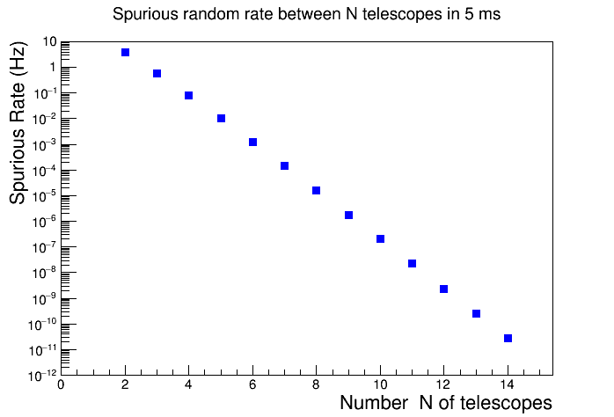
The significance of a N-fold coincidence
___________________________

Slide 7
The significance of a N-fold coincidence
___________________________
For instance observing a coincidence between 7 EEE telescopes is significant?
The spurious rate would be ~ 10⁻⁴ Hz

Slide 8
The significance of a N-fold coincidence
___________________________
But there is something more to consider…
If we had only 7 telescopes, the expected spurious rate is really 10⁻⁴ Hz
But if we have 12 telescopes, how many combinations of 7 telescopes (out of 12) can we build?
In general, with N telescopes how many k-fold coincidences may be observed?
The answer is:
For instance, for k=2 , the number of pairs is P = N x (N-1)/2
If N = 12 and k=2 P = (12 x 11)/2 = 66 possible 2-fold coincidences

Slide 9
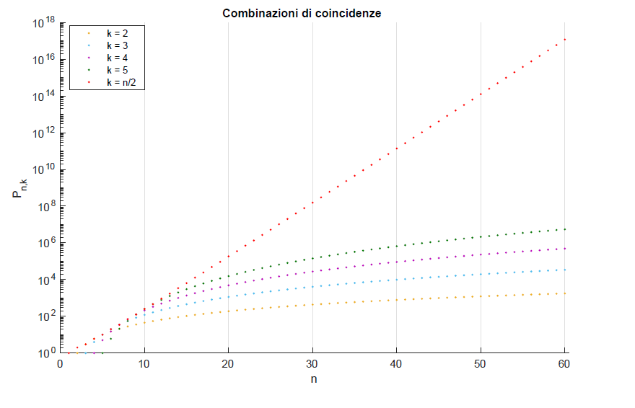
The significance of a N-fold coincidence
___________________________
In general, the number of possible combinations of k elements (for a given N) increases with k, up to its limiting value k=N/2, then decreases again.
For N=12 and k=7: 792 combinations!

Slide 10
The significance of a N-fold coincidence
___________________________
Then, the true expected spurious rate is given by the product between the spurious rate for a specific combination and the number of combinations.
Example: For N=12, k=7
Spurious rate for a specific combination ~10⁻⁴ Hz
Number of combinations: 792
Expected actual rate of spurious 7-fold coincidences ~ 0.1 Hz
This means that roughly every 10 seconds we have a coincident event between 7 out of 12 EEE running telescopes in a 5 ms window, so there is no surprise to have so many EEE telescopes responding at the same time!

Slide 11
Look for larger k-fold coincidence events?
___________________________
Is there any possibility to search for larger k-fold coincidences?
Limiting case: N=12 k=12 Number of combinations = 1
Spurious rate ~ 2.4 10⁻⁹ Hz

Slide 12
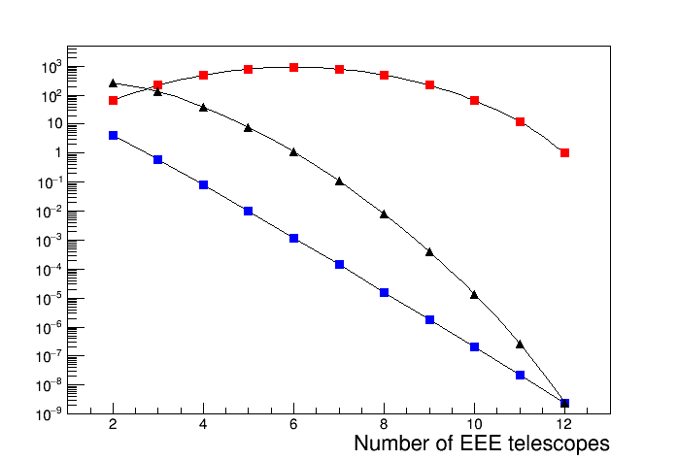
Look for larger k-fold coincidence events?
___________________________
Number of combinations
Overall spurious rate
Spurious rate for a specific combination

Slide 13
Realistic range to reduce the spurious rate
___________________________
Number of combinations
Overall spurious rate
Spurious rate for a specific combination

Slide 14
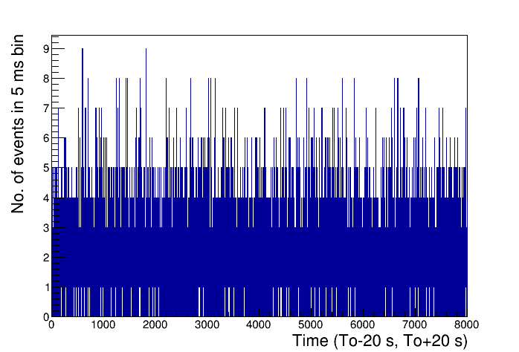
Experimental search over the EEE events
___________________________
- Consider a time window of 20 s around the expected event of interest
- Scan 8000 bins (5-ms wide)

Slide 15
Experimental search over the EEE events
___________________________
3 bins with 9 events
Several 5 ms-bins with 8 events

Slide 16
Experimental search over the EEE events
___________________________
- Since the average rate from individual telescopes is 20-30 Hz (1 event every 40-50 ms), there is a non-negligible chance to have 2 events in the same bin from a single telescope.
- Count only events belonging to different telescopes

Slide 17
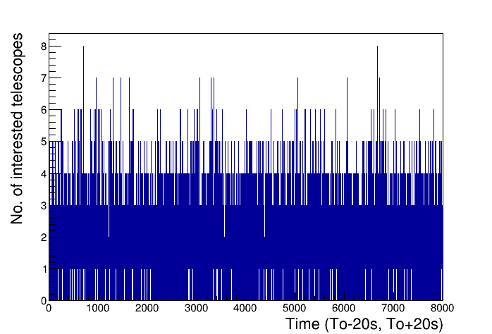
Experimental search over the EEE events: only 1 event/telescope
___________________________
Events involving 8 different telescopes: 2 (0.32 expected)
Events involving 9 different telescopes: : 0 (0.01 expected)

Slide 18
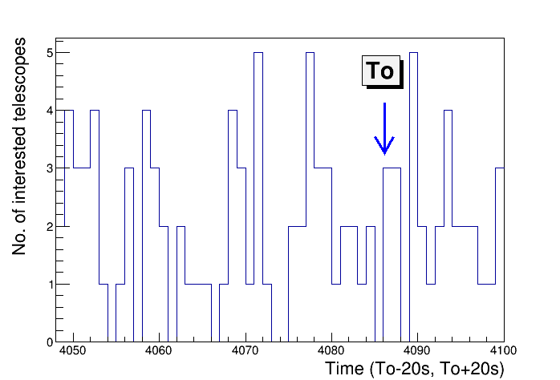
Experimental search over the EEE events: only 1 event/telescope
___________________________
250 ms

Slide 19
When to search for?
___________________________
The time window for joint searches between Gravitational Wave transients (GW), High Energy Neutrinos (HEN) and Gamma Ray Burst (GRB) has been investigated considering the duration of the various emission mechanisms.
(B.Baret et al., Astroparticle Physics 35(2011)1)
Results from this analysis give roughly these windows:
t_{HEN} - t_{GW} = (-500 s , + 500 s)
t_{GW} - t_{GRB} ~ t_{HEN} - t_{GRB} = (-350 s, + 150 s)
Possible extension to a large time interval?

Slide 20
Summary
___________________________
● A search for coincidence events involving several EEE telescopes in a time window around the observed multi-messenger event carried out
● Data are in agreement with statistical expectations
● A larger time window could be exploited in the future for this specific class of events
● Search for multi-telescope events in EEE may become a new point of interest
even in normal data taking periods.
This will require however more sophisticated processing tools
to scan periods of several years in small time windows.

