Slide 1
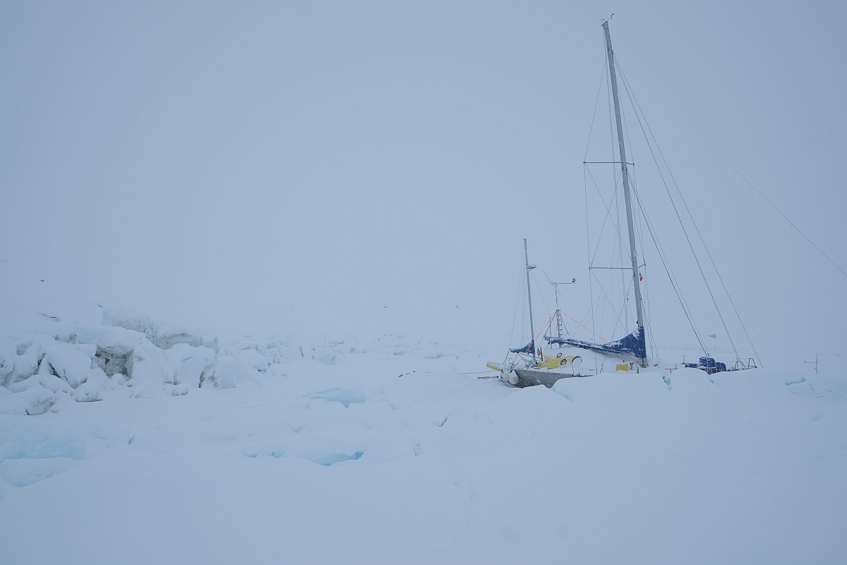





Preliminary results from PolarQuEEEst expedition
F. Noferini
INFN Bologna

Slide 2
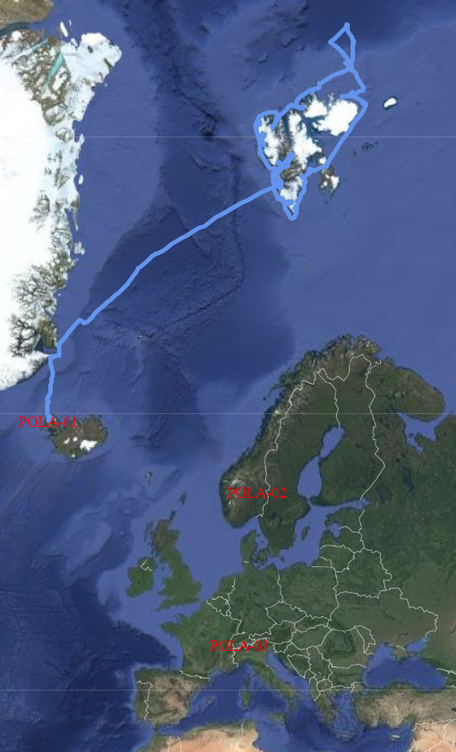
The trip
eee.centrofermi.it/monitor
eee.centrofermi.it/monitor/dqm2/datatransfer/tempPola/
Polar QuEEEst expedition started on the 22nd (data from 21st) of July from Isafjordur and stopped in Tromso on the 4th of September.
During this period one of the our telescope (POLA-01) was hosted in the Nanuq and sailed towards the North Pole.
Two other identical stations were installed in two high schools: one in Norway (POLA-02) and one in Italy (POLA-03).
Data monitor accessible at
eee.centrofermi.it/monitor
To be completed (so far data available till the 24th of August)

Slide 3
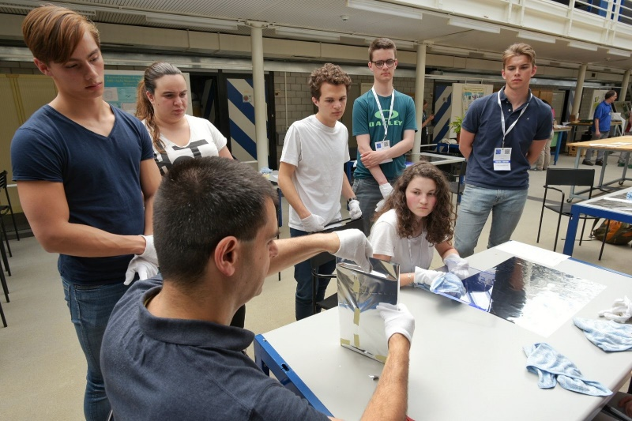
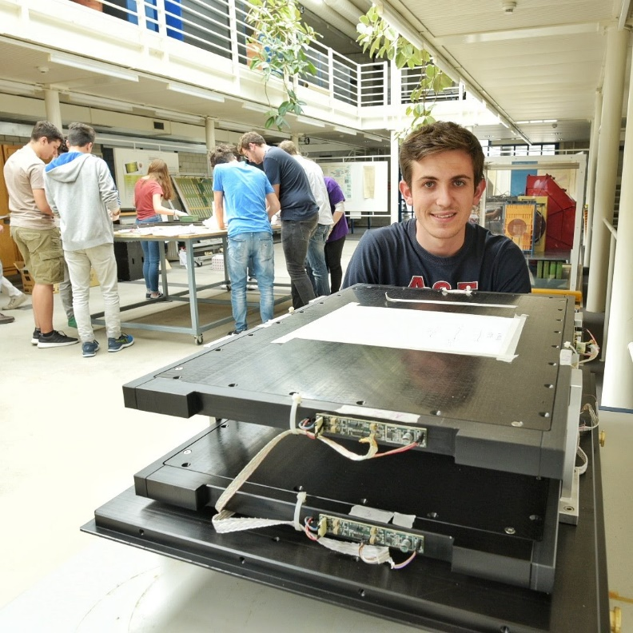
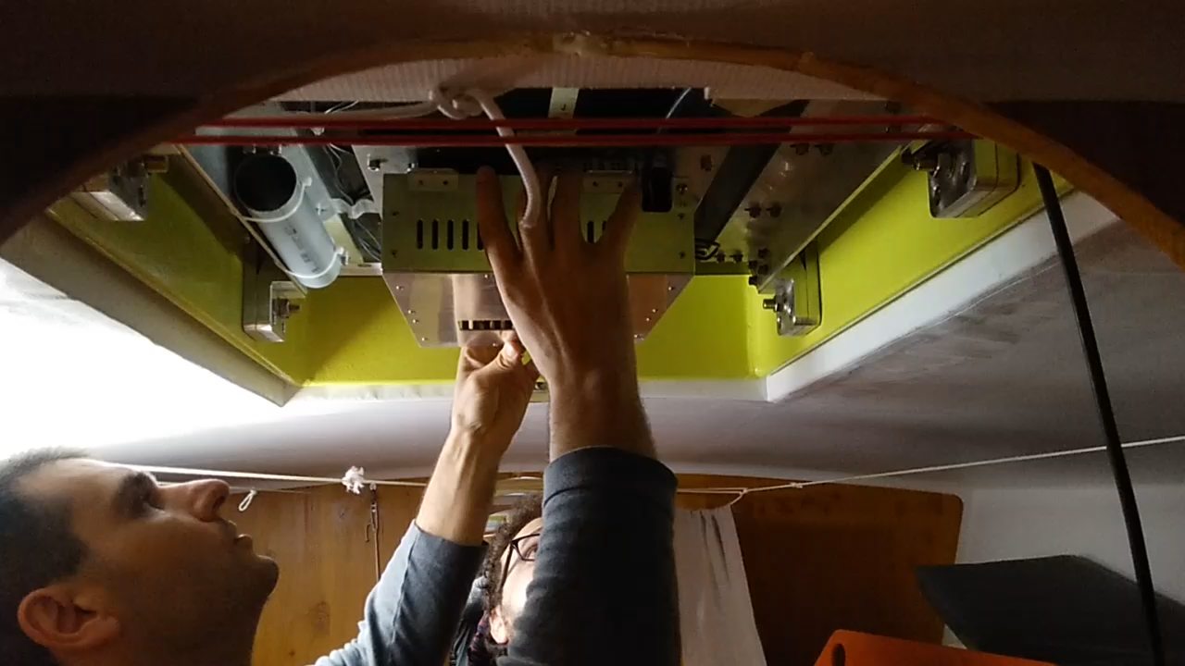
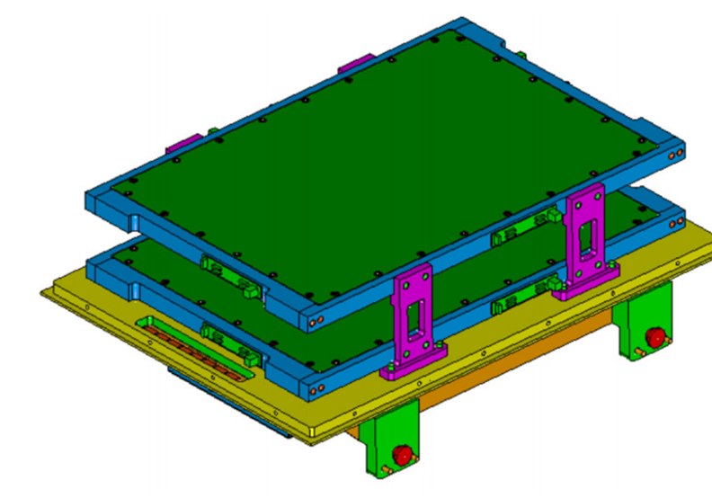
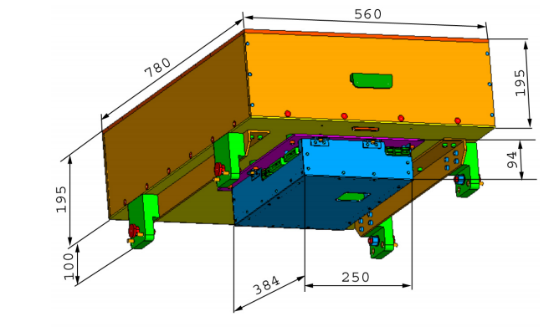
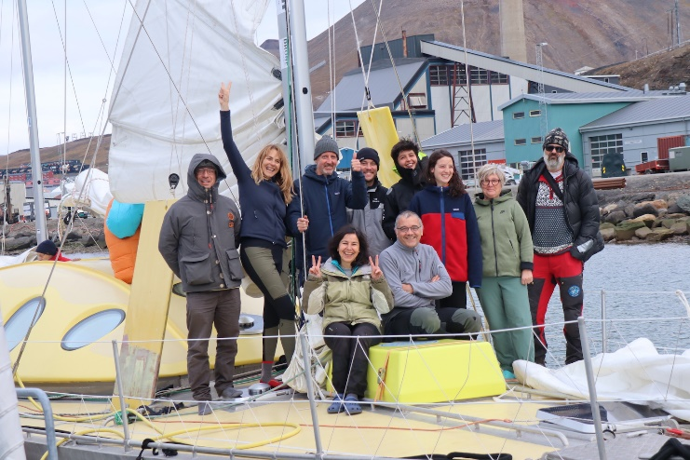
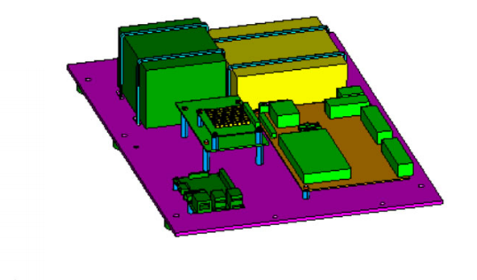
The telescope
The detector
2 scintillator planes
Distance between planes: 15 cm
4 tiles per plane 30 cm x 20 cm
Each tile 2 SiPM
Efficiency > 96% (overall)
Detector construction @CERN
POLA-01 installation on Nanuq

Slide 4
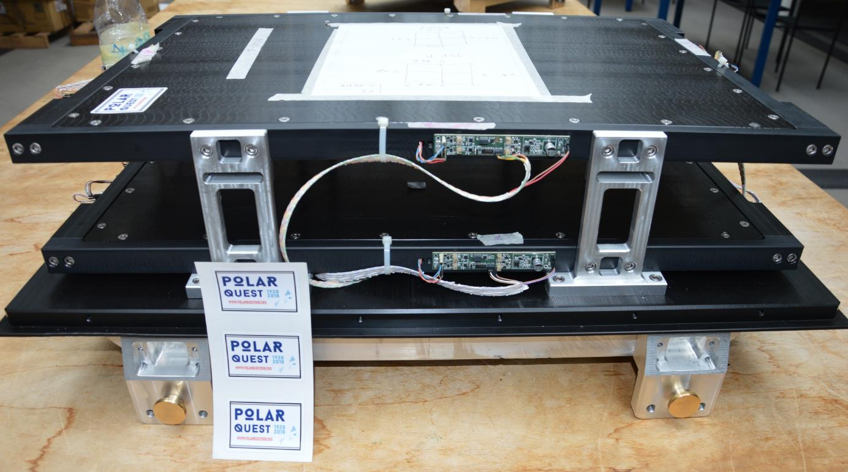
SIPM
Front End (one for 2 SiPM)
Set Voltage, thresholds
Discriminator LVDS signals
TOT signals for charge measurements

Slide 5
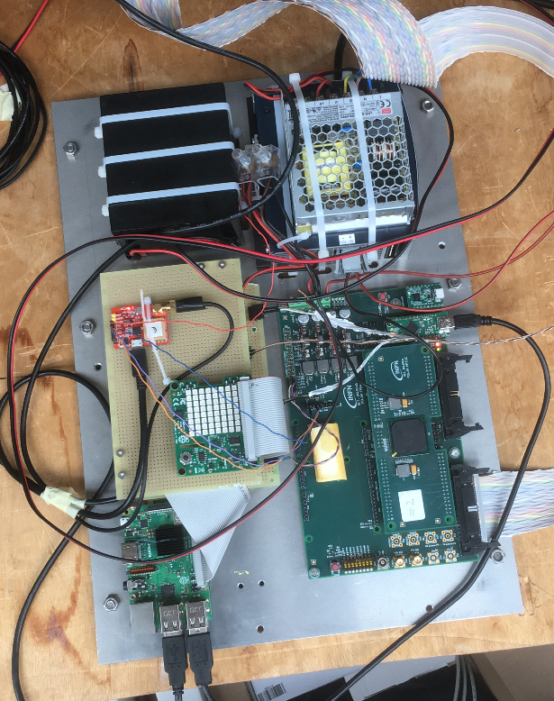
The PolarQuEEEst Detector Electronics
Power box
Back-up Battery
GPS
GNSS-Ublox
Readout board
FPGA Altera Cyclone 5
For Trigger and TDC readout
Sense Hat
Gyroscope
Accelerometer
Magnetometer
Temperature
Barometric pressure
Humidity
HPTDC piggy-back
for TDC readout
Raspberry PI
Control readout
GPS
GNSS-Ublox
Total power consumption 12,5 W
16 ch TDC-TOT , Trigger, DAC, GPS, Controls

Slide 6
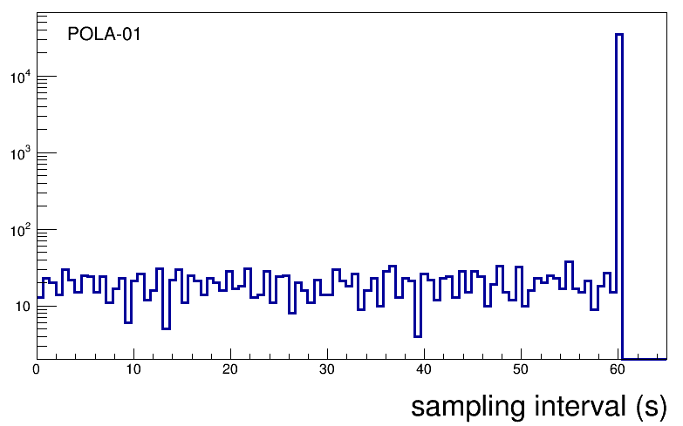
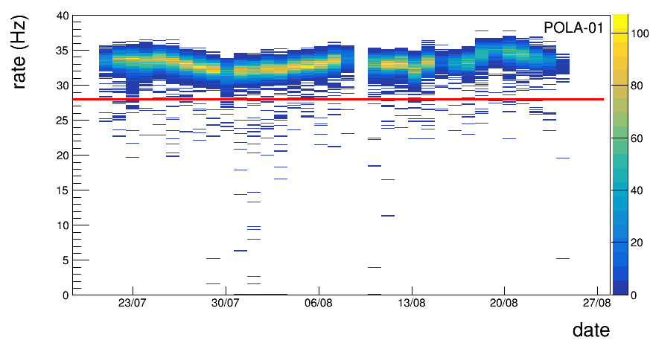
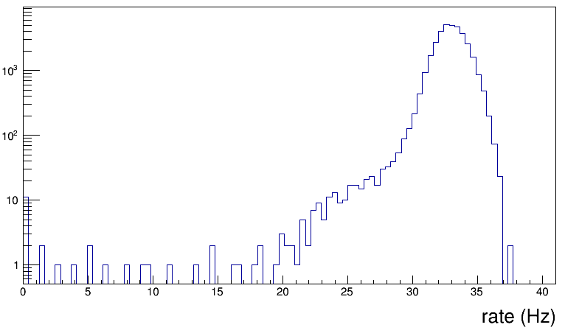
DATA selection
The data trending is constructed by counting events in the same minute and then extracting a rate. At the beginning and at the end of a run the effective time to compute the rate can be less than 60 seconds. In such a case the point is discarded.
Cut-1
Sometimes (not so often) we loose events when decoding fails (header missing, …). Currently we are not able to tag the minute when it happens so we applied a cut to remove events with a too small rate.
Cut-2
Cut-2

Slide 7
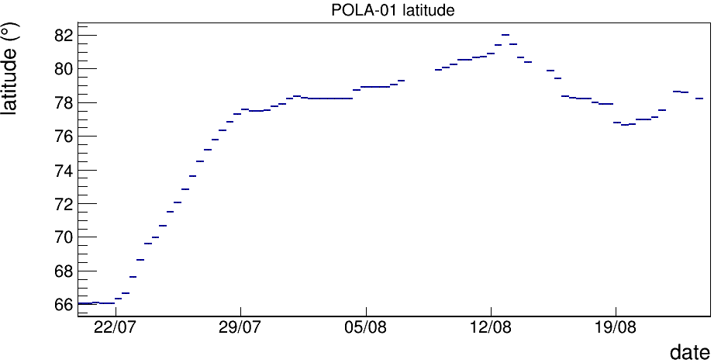
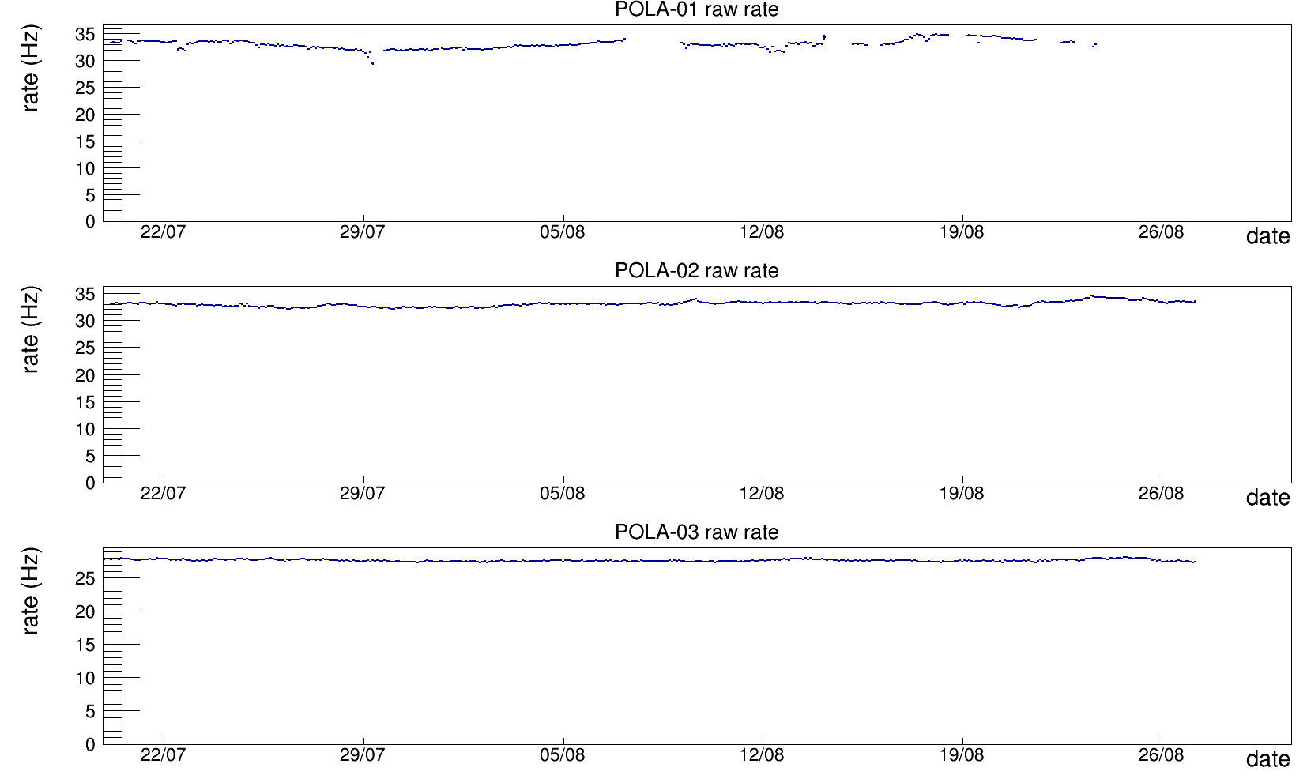
The rate (uncorrected)

Slide 8
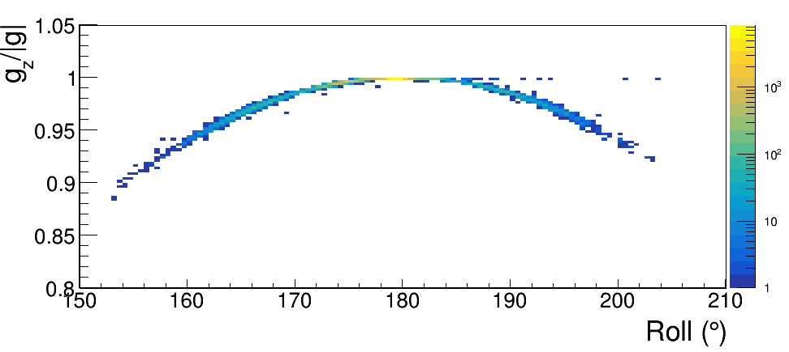
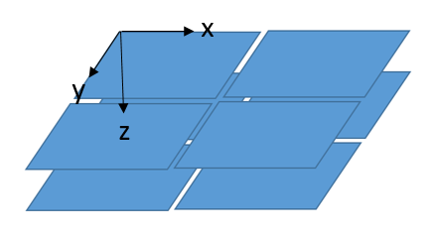
Orientation of the telescope (zenithal)
θ
Roll
g = g_{z}
g_{z}
g
The telescope acceptance depends on the zenithal orientation of the station.
When sailing this orientation may change but we can measure it using the accelerometer and looking at the direction of the gravity acceleration in the local system.
cosθ = g_{z} /g
The max acceptance is expected to be at cosθ=1 (θ=0) since the flux of secondaries has a maximum in the vertical direction.

Slide 9
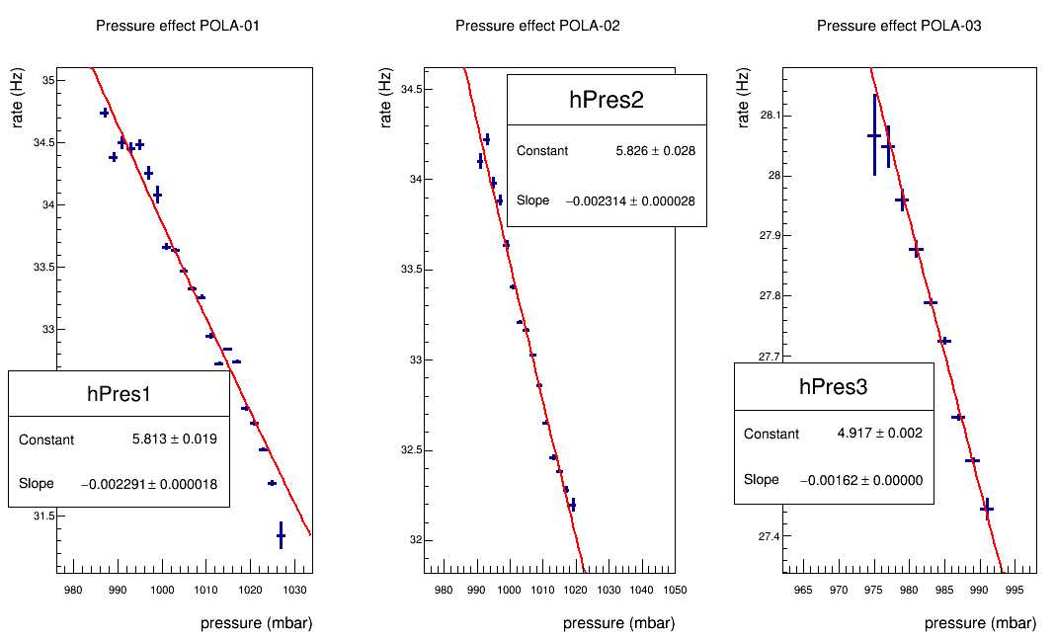
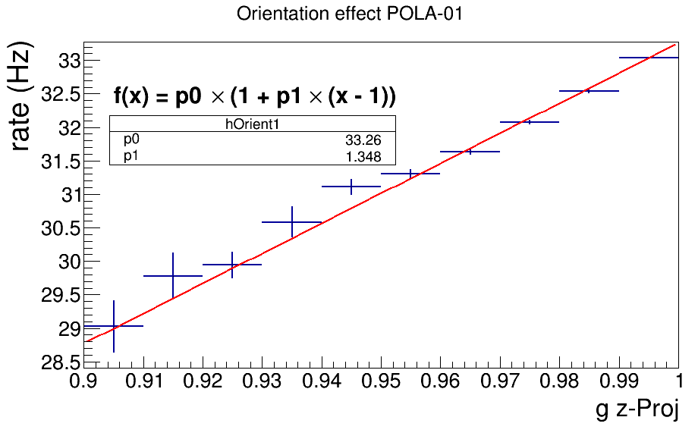
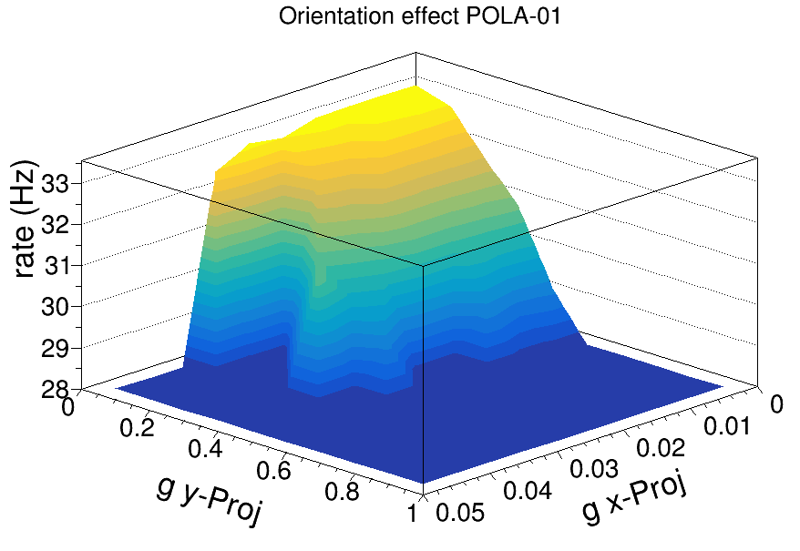
Corrections
The rates have to be corrected for the barometric effect since the absorption of secondaries (muons) increases with the amount of matter in the atmosphere and the pressure is proportional to that. We estimated the corrections by fitting the rate dependence on the pressure for each station separately during the full period.
For POLA-01 we also estimated the correction due to the telescope orientation which may change when sailing (less relevant than pressure correction). The simple way was to correlate the rate with the azimuthal angle of the telescope estimated using the accelerometer installed in the station (z-projection of the acceleration, 1 means vertical direction → gravity).

Slide 10
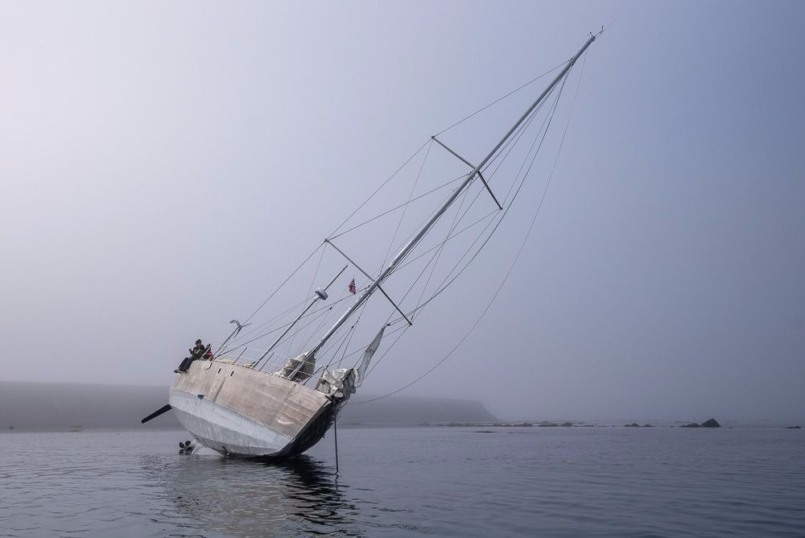
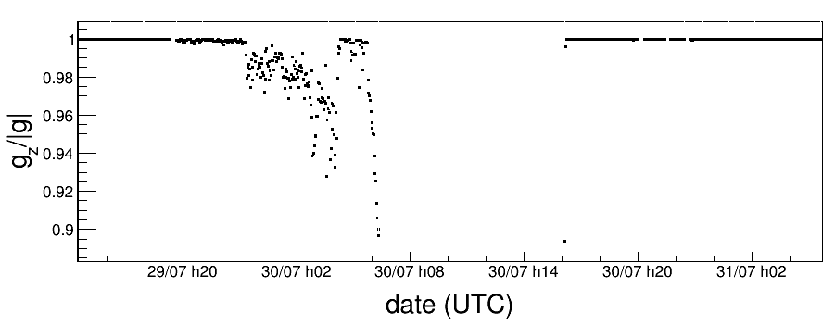
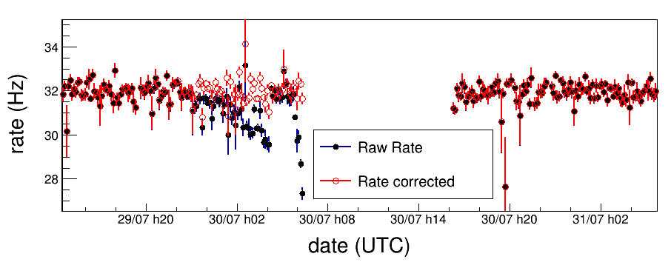
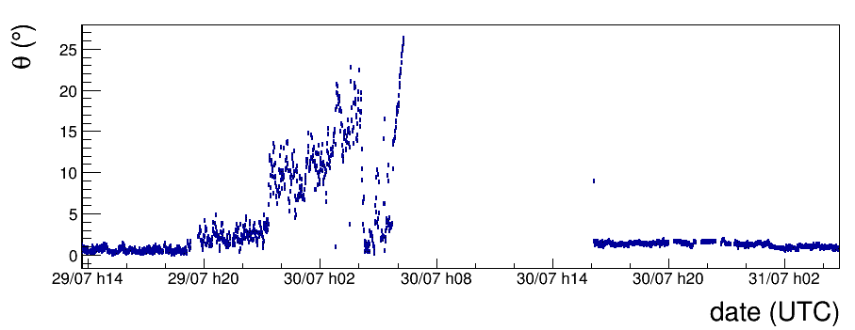
Orientation correction
On the 30th of July a problem occurred for nanuq (during low tide).
We were able to collect data before to reach this exotic position.
This special event allowed to verify the proper calibration of the orientation correction.

Slide 11
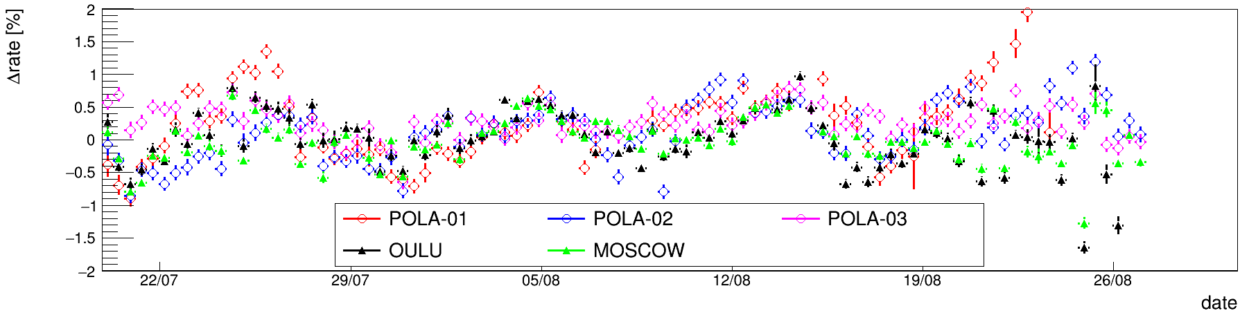
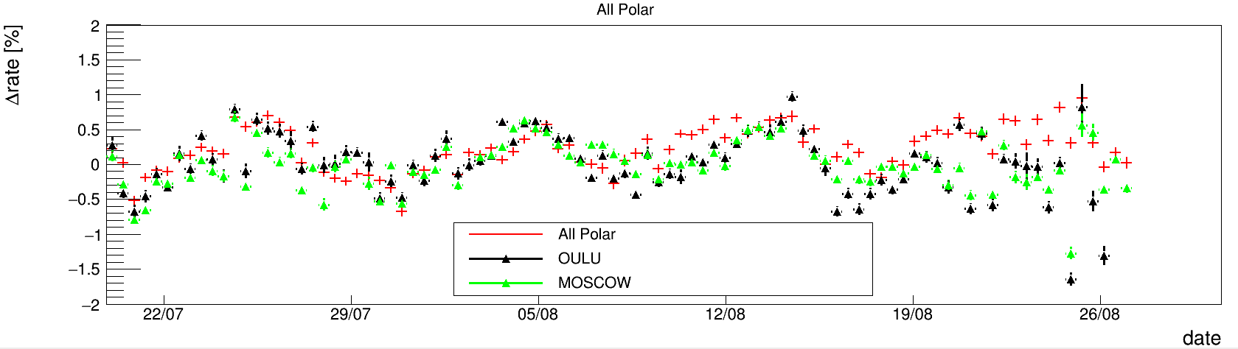

Trending (corrected)
Bin width = 10 h
$$rate= \frac{rate−\left\langle rate\right\rangle }{\left\langle rate\right\rangle }$$
To reabsorb acceptance and efficiency effects

Slide 12
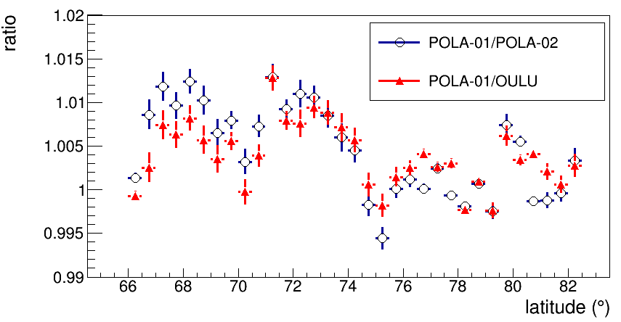
Rate vs latitude
Bin width = 0.5 grad
We used POLA-02 as reference since it is closer in latitude than POLA-03
We are not observing any significant effect (possible variations lower than 1%).

Slide 13
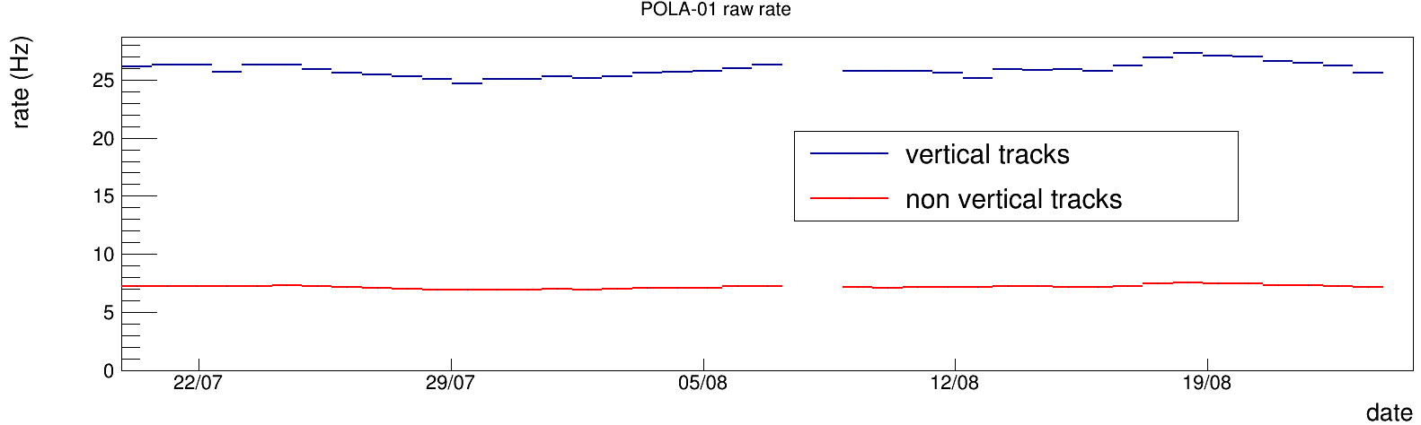
Zenithal dependence
We repeated the analysis splitting data in two different samples:
vertical tracks → only events in two correspondent plates
non vertical tracks -> only events in two non correspondent plates
We recalculated the corrections in the two sample (no relevant difference in the barometric coefficient but differences in the orientation correction)

Slide 14
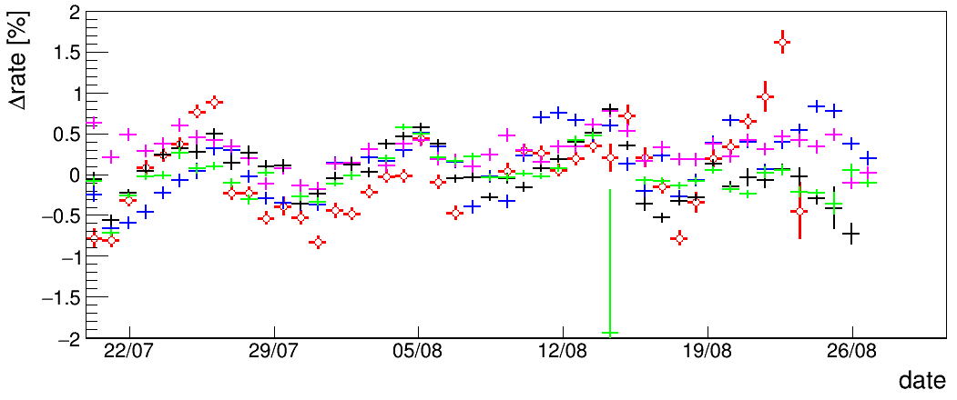

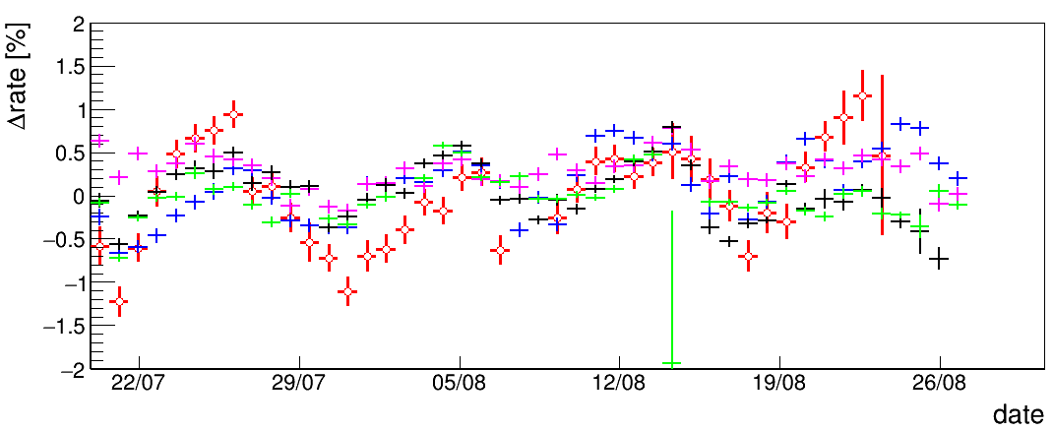
Trending using zenithal information
Bin width = 20 h
Vertical tracks
No zenithal dependence was observed in the trending
Non vertical tracks

