Slide 1
Taking data efficiently in RUN 5
Fabrizio Coccetti
Centro Fermi – Museo Storico della Fisica e Centro Studi e Ricerche “Enrico Fermi”, Via Panisperna, Roma

Slide 2
Run 3
Start of Run 3 | 1/11/2016
End of Run 3 | 31/5/2017
Number of Days | 212

Slide 3
Run 4
Start of Run 4 | 2/10/2017
End of Run 4 | 30/5/2018
Number of Days | 241

Slide 4
Days of Data Taking - ALL RUNs

Slide 5
Tracks – Triggers ALL RUNs

Slide 6
Tracks – Triggers ALL RUNs

Slide 7
Tracks – Triggers ALL RUNs

Slide 8
Tracks – Triggers ALL RUNs

Slide 9
Performance – All RUNs
Performance = candidate_tracks / triggers
RUN Number | Performance
Run 0 | 0.754
Run 1 | 0.845
Run 2 | 0.827
Run 3 | 0.796
Run 4 | 0.795

Slide 10
Timeline RUN 5
Date | Schedule
September, 3-7 | Turn on the gas
September, 10-14 | Turn on the detector
September 17 (Monday) | Check the status of all detectors
September 19 (Wednesday) | Meeting to discuss actions for each detector
October 15 (Monday) | Start of RUN 5

Slide 11
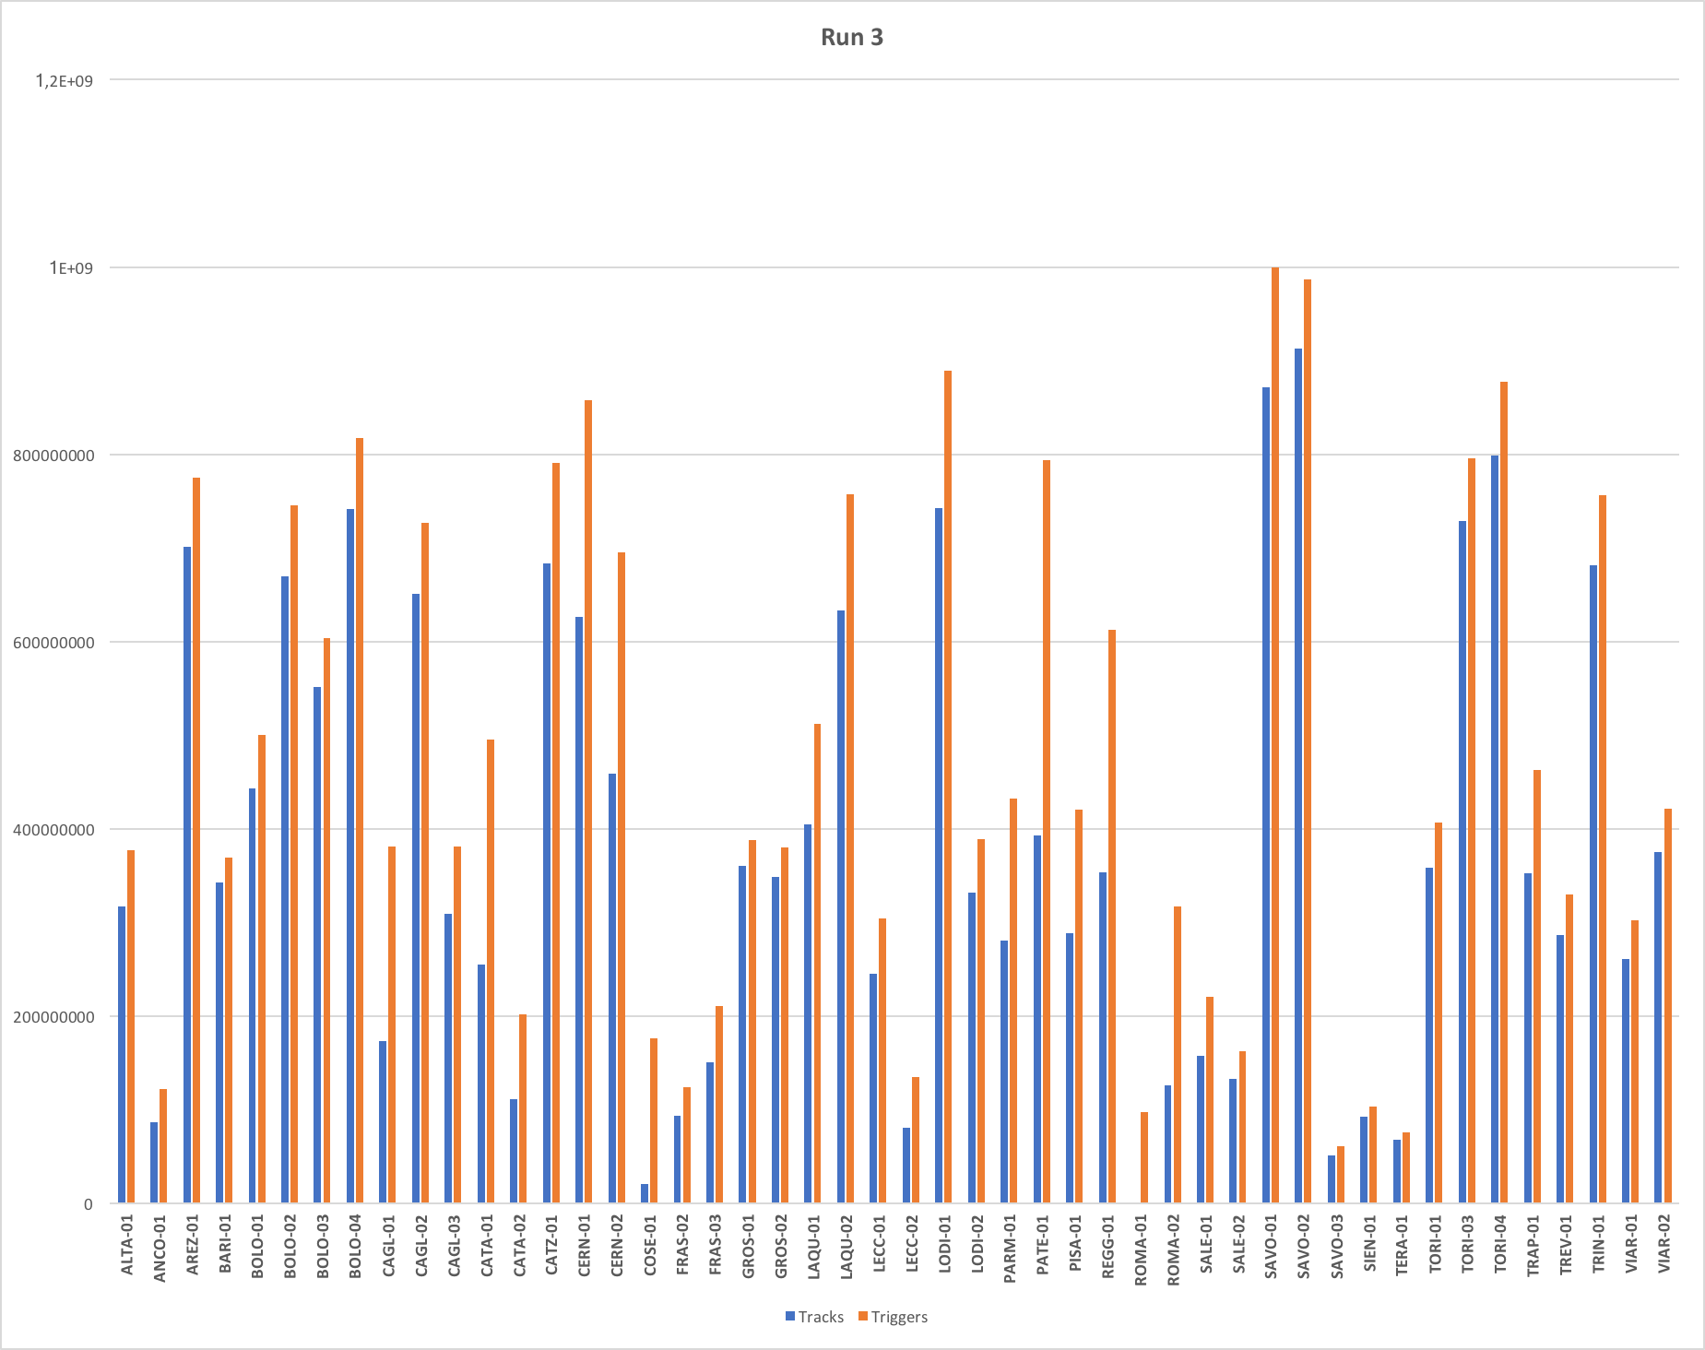
Tracks – Triggers RUN 3

Slide 12
Tracks – Triggers RUN 4

Slide 13
Triggers – All RUNs
RUN Number | Total number of Triggers | Triggers per day
Run 0 | 690029958 | 36317366.21
Run 1 | 3929628885 | 62375061.67
Run 2 | 16358442453 | 83461441.09
Run 3 | 22744780236 | 107286699.23
Run 4 | 23113691647 | 95907434.21

Slide 14
Candidate Tracks – All RUNs
RUN Number | Total number of Tracks | Tracks per day
Run 0 | 520418111 | 27390426.89
Run 1 | 3321758288 | 52726322.03
Run 2 | 13523368343 | 68996777.26
Run 3 | 18107812793 | 85414211.29
Run 4 | 18386090161 | 76290830.54

