Slide 1
Progetto E.e.e.
Extreme Energy Events

Slide 2
Fundamental points
Introduction
Project
Laboratory

Slide 3
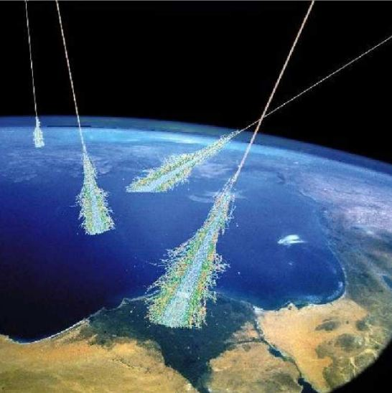
Introduction
The E.E.E. project consists
of a special research
activity about the origin of
cosmic rays and it has been
conducted with the important contribution of students and teachers of Higher Educational Institutes.

Slide 4
Project
Step 1
Step 2
Listen
Study
Make
Step 3
Listen to the presentation
Study the circuit to be implemented
Make the circuit

Slide 5
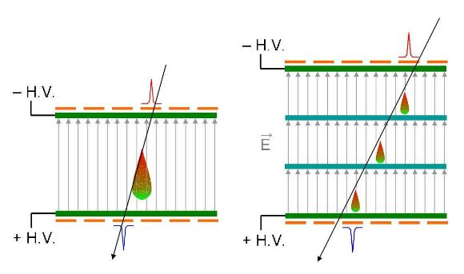
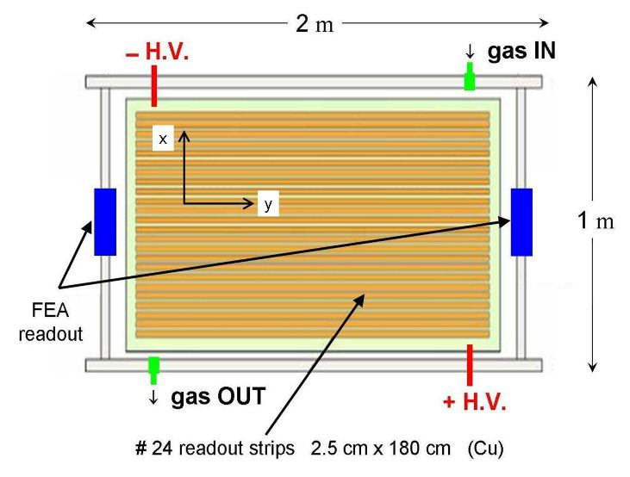
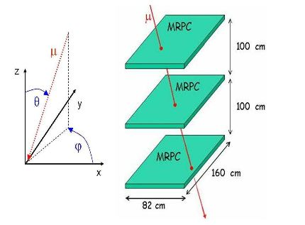
Study and implement the circuit

Slide 6
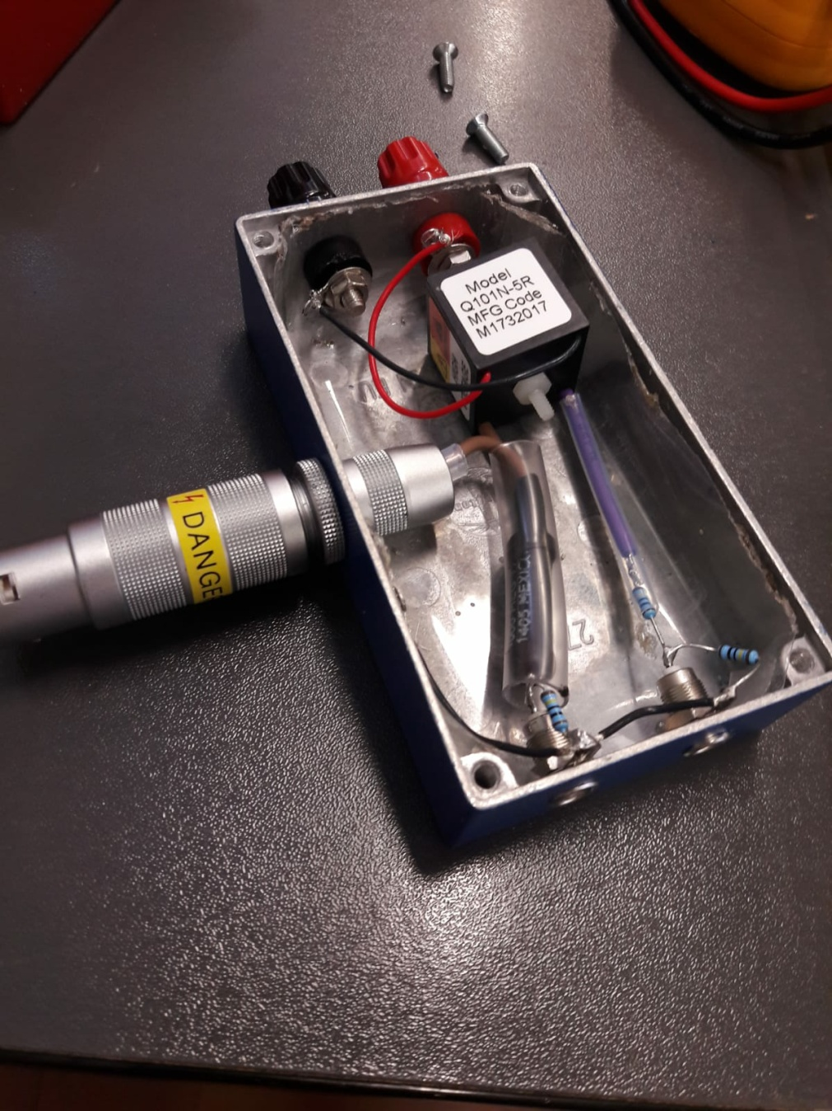
Laboratory
To build the circuit we need: - 1x 1 GΩ resistor - 3x 1 KΩ resistors - 1x 10 MΩ resistor - 1x high-voltage connector - 2x low-voltage connectors - 1x DC-DC converter

Slide 7
Group work
Classe | Gruppo 1 | Gruppo 2
Class 3B tlc. | 10 fellow | 10 fellow
Class 4B tlc. | 10 fellow | 10 fellow
The first group performed the D.C converter circuit using tools to weld the tracks, cut the cables, paint the casings. The second group took the circuits executed by the first group and carefully measured them with a power supply and a digital multimeter to perform the output measurement.

Slide 8
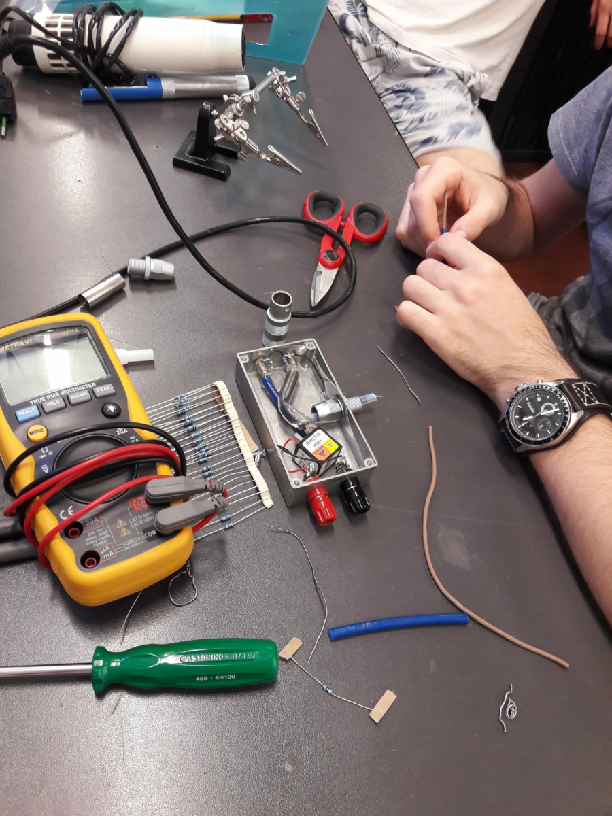
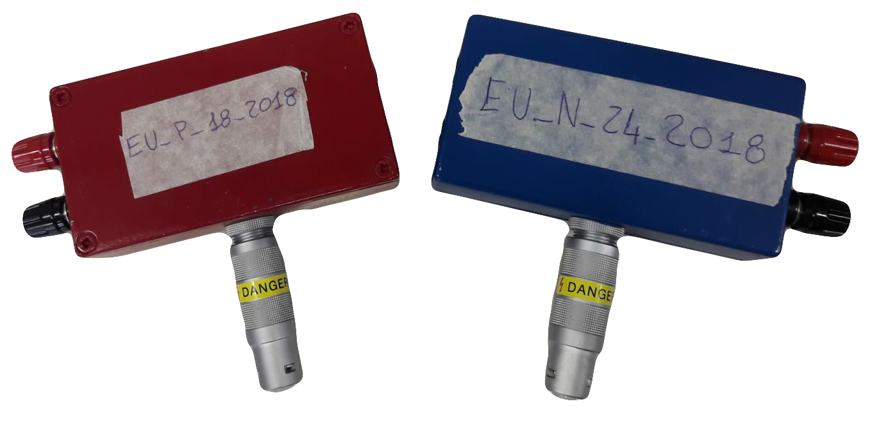
First group: make the circuit
finished project

Slide 9
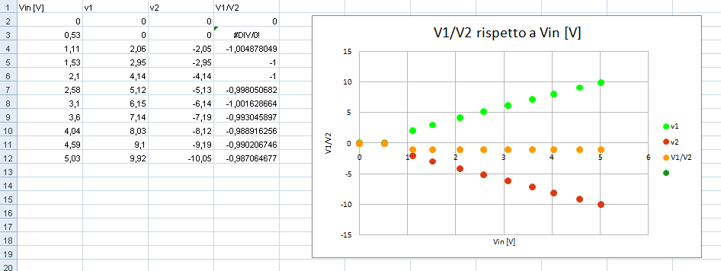
Second group: make the measurements chart

Slide 10
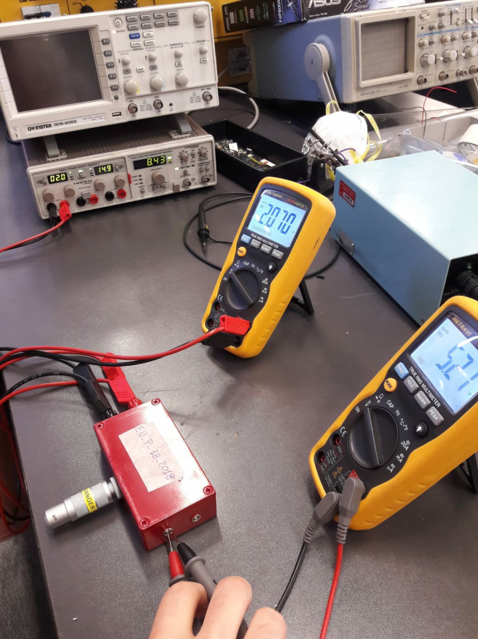
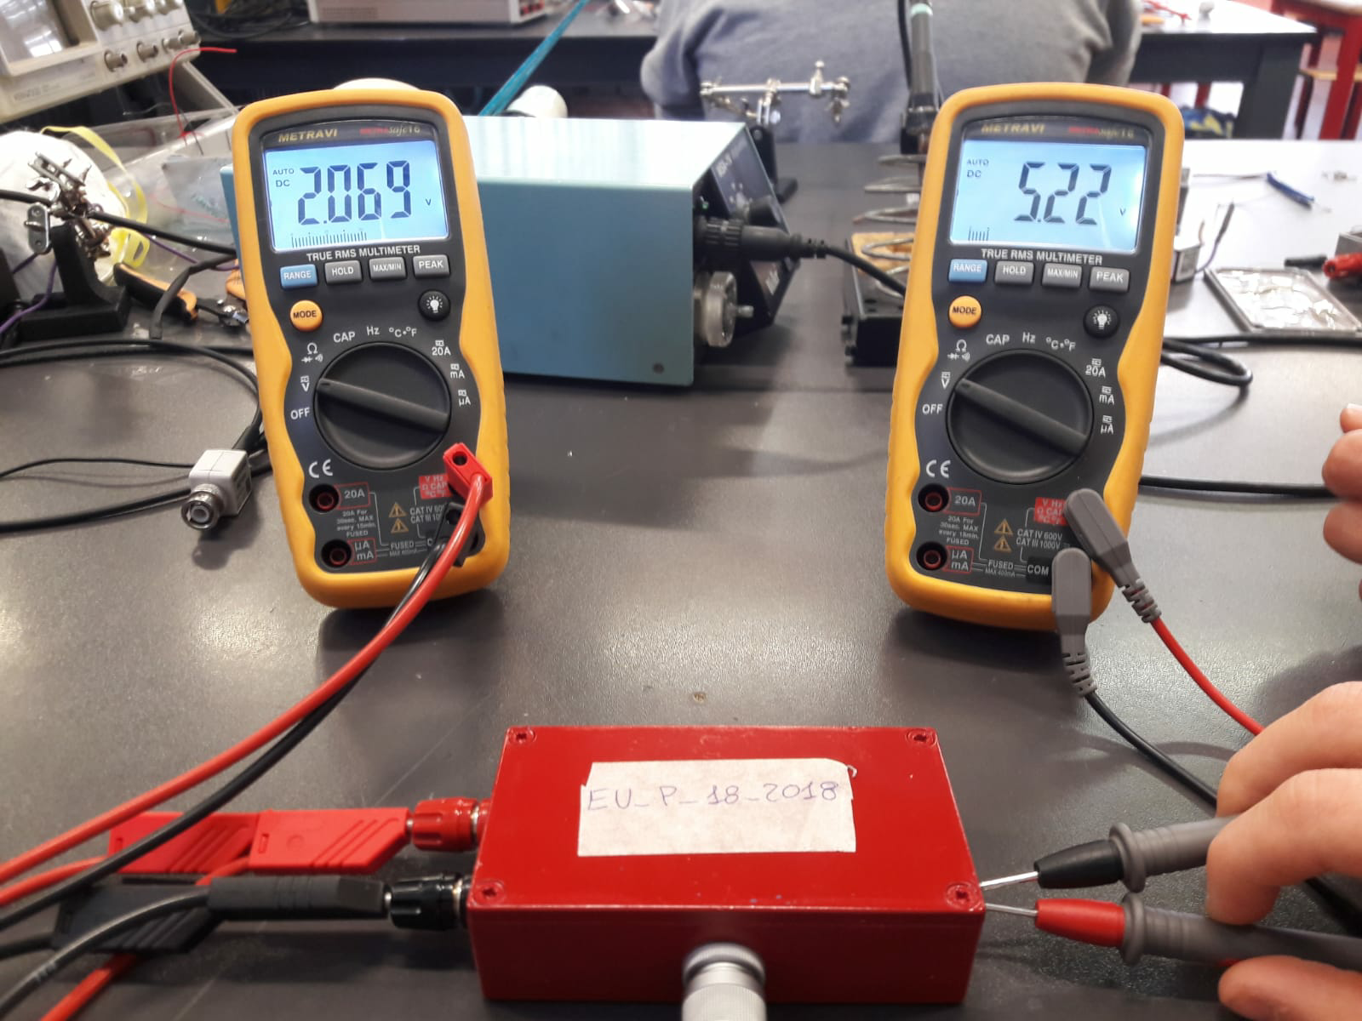
Second group: make the measurements

Slide 11
Now it's up to you

