Slide 1
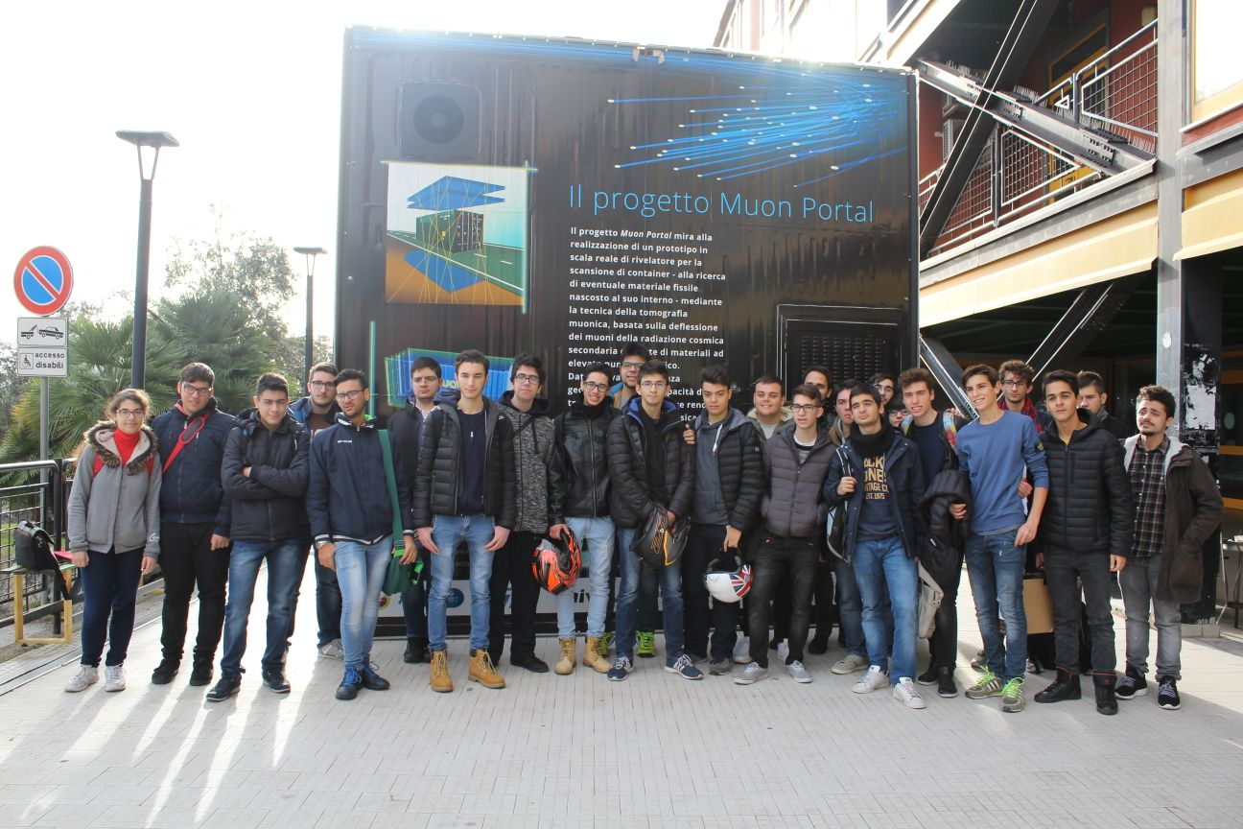
Update on muon velocity analysis: a comparison for different telescopes
Sandro Torrisi
I.I.S.- I.T. Guglielmo Marconi, Catania

Slide 2
Conclusions previous analysis presented in the last EEE run coordination meeting
<V> = 28.4 cm/ns
σ(v) = 3.1 cm/ns
CATA-02 vs CAGL-01
Mean muon velocity of about 26 ± 4 cm/ns in CATA-02 data, indipendent from analyzed period, while CAGL-01 data show a mean velocity of 28 ± 3 cm/ns
cm/ns
The width of the velocity distribution is strongly related to the width of the time of flight distribution
<V> = 25.5 cm/ns
σ(v) = 4.2 cm/ns
Mean velocity is rather indipendent from track lenght while seems to depend from time of flight
cm/ns
Track lenght-time of flight scatterplots show small correlation

Slide 3
Outline
CERN-01 telescope:
Time of flight, track lenght and velocity distributions
Muon velocity distributions for different time of flight and track lenght bins
Mean muon velocity vs time of flight and track lenght
Time of flight – track lenght scatterplot
Time of flight and velocity distributions with track verticality and azimuthal angle conditions
Comparison of distributions for different telescopes: CERN-01, BOLO-02, TORI-03, TRAP-01, TREV-01, CATA-02, CAGL-01
Conclusions

Slide 4
cm

Slide 5
CERN-01 18/4/2018 tof>0 ChiSquare <10 RunNumber <10

Slide 6
CERN-01 18/4/2018 tof>0 ChiSquare <10 RunNumber <10
Cut: 10<v(cm/ns)<50
vm=29.1 cm/ns
σ~2.9 cm/ns
cm/ns

Slide 7
Muon velocity distribution for Δtof bins

Slide 10
Verticality condition: 88.0 < TL (cm) < 88.1

Slide 11
Azimutal Angle Condition: 18° < θ < 19°
ns

Slide 12
Time of flight
vs
Track Lenght scatterplot
CERN-01
TORI-03
V_{Bf}= 28,4 cm/ns
V_{Bf}= 28,6 cm/ns
BOLO-02
TREV-01
TRAP-01
V_{Bf}= 28,1 cm/ns
V_{Bf}= 27,9 cm/ns
V_{Bf}= 26,5 cm/ns

Slide 13
TL distribution
Tof distribution
v distribution
CERN-01
BOLO-02
cm/ns
TORI-03
cm/ns
TREV-01
cm/ns
TRAP-01
cm/ns

Slide 14
 | CALC |  | Gauss |  | Best Fit
TELESCOPI | Vm | σ | Vm | σ | Vm
CERN-01 | 29.1 | 3.5 | 29.1 | 2.9 | 28.6
BOLO-02 | 28.6 | 3.1 | 28.5 | 2.7 | 28.1
TORI-03 | 28.9 | 3.3 | 28.6 | 2.7 | 28.4
TRAP-01 | 27.0 | 3.6 | 27.0 | 3.1 | 26.5
TREV-01 | 28.7 | 3.3 | 28.8 | 2.8 | 27.9
CATA-02 | 25.5 | 4.2 | / | / | /
CAGL-01 | 28.4 | 3.1 | / | / | /
CATA-02
CAGL-01

Slide 15
Conclusions
A comparison between different telescopes confirms the results presented in the previous meeting:
The width of the velocity distribution is strongly related to the width of the time of flight distribution
Mean velocity is rather indipendent from track lenght while seems to depend from time of flight
And shows that:
Track lenght-time of flight scatterplots show good correlation and best fit procedure allows obtaining muon velocity values compatible with those extracted from muon velocity distributions

