Slide 1
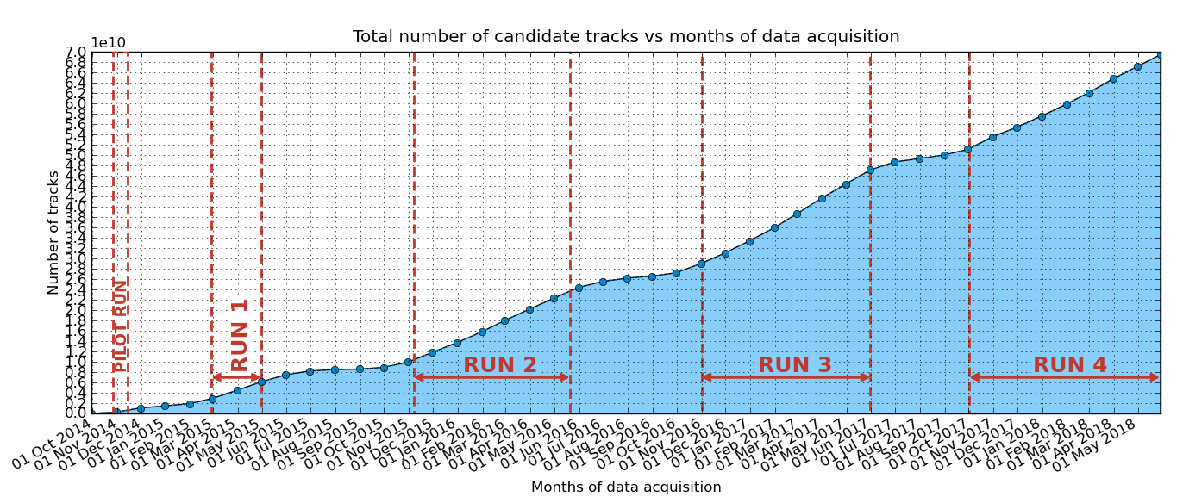
RUN-4 has finished
About 70 (!!!) billions of candidate tracks collected up to now
About 20 (!!!) billions of candidate tracks collected in RUN-4

Slide 2
What do to now
You can keep your telescopes ON for as long as you wish
Do NOT keep them ON if the temperature INSIDE the room hosting the telescope exceeds 27C
You do NOT need to write an elog report every day
You have to write an elog report every week
It is important that you monitor (remotely) the data taking using the DQM plots (the most important!)
Coordinate with your local responsible!

Slide 3
We do not stop
RUN-5 will start next September 17th
You can switch on your telescop as soon as you wish
Coordinate with your local responsible
Activate yourself to have the telescope rooms air-conditioned

