Slide 1
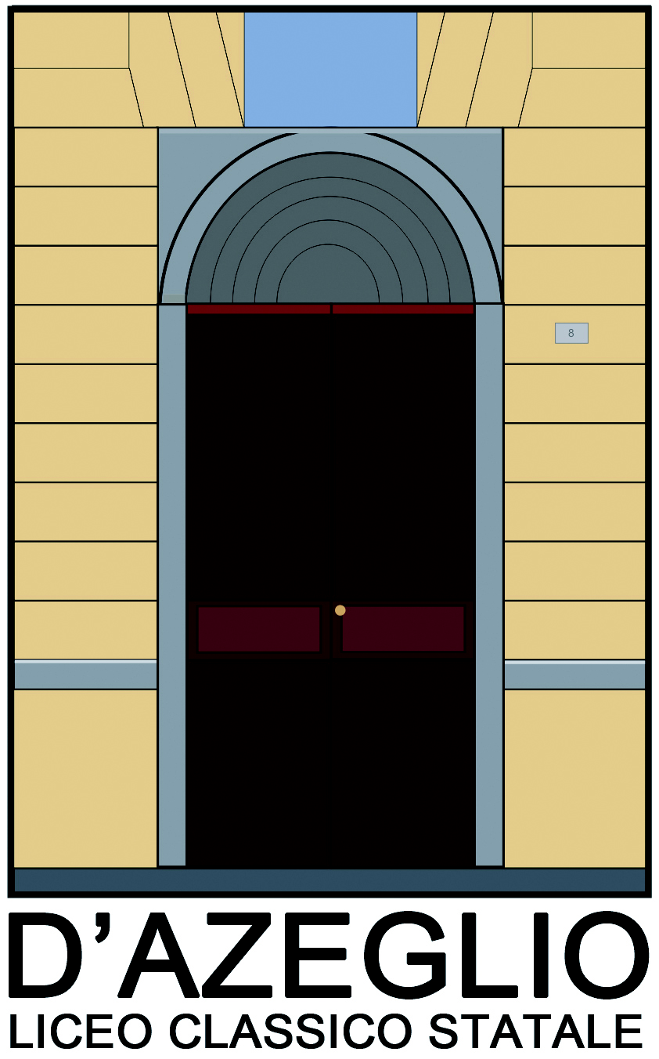
Extreme Energy Events Project
Liceo Classico D’Azeglio di Torino
Anno scolastico 2017/2018

Slide 2
Study of the temperature dependence of the EEE telescope dark currents.

Slide 3
Our experience
Our work consists in comparing the variation of current in the MRPCs with the variation of temperature in the room the telescope is located in.
It was observed that with the increase of temperature in the room, the current in the chambers increased as well.

Slide 4
The excessive increase of current could damage the telescope, so on the 4th of July 2016 an air conditioning system was installed in the room.
Since then, the temperature and the current have decreased and have become stable.

Slide 5
Stages of the research (IIID)
Period of time taken in consideration: from 7/11/2015 to 28/6/2016
The data analised is regarding the total intensity of currents and temperatures.
It's been used a dispersion graphic with tendency line, which depicts the average behavior of events.
In the graphic we can notice that the majority of events registered appear below 24,4°C of temperature, over which events become sporadic. Also, some isolated events may be seen in corrispondence with higher temperatures and intensities. The yellow line represents the average of the events.

Slide 6
Intensity as a function of temperature

Slide 7
Stages of the research (IIIA,IIIB)
Two periods were taken into consideration:
- 1st period: before A/C installation , from 7/11/2015 (start of RUN 2) to 28/6/2016 ( last data taken before A/C installation);
-2nd period: from 8/7/2016 ( first data taken after A/C installation) to 28/2/2017
It was verified that the data (dates, temperatures and positive and negative currents) from different documents match.
3)In every graphic we found peaks, some because of mistakes made during the revelations: where it was possible, we corrected them.

Slide 8
Top before A/C installation
The positive current feels the effect of temperature, while the negative one does not. The phenomenon in which one of the two is irregular prevails.

Slide 10
Observations
Before the air conditioner the currents maintain opposite sign as expected. After the installation their value decreases in module, which means it gets closer to zero, and they show a steady trend with a decrease in peaks. This is caused by the decrease in the Freon’s ionisation tendency related to the decrease in outside temperature.

Slide 11
Middle before A/C installation
The graphic for the middle chamber is the most stable. Around the 26th of may 2016 an abnormal spike is caused by the operator who increased the current because of a malfunction in the MRPC.

Slide 12
Middle after A/C installation
The currents remain constant with the varying of the temperature. No anomalies registered.

Slide 13
Bottom before A/C installation
Currents: on 30th May their signs reverse and their modulus increases and they are specular.

Slide 14
Bottom after A/C installation
They are correlated and their modulus is constant, but it’s lower than the usual

Slide 15
Observations
The currents show an anticorrelated behavior, and have opposite sign as expected. This chamber’s more regular trend is due to the purity of the Freon introduced in it.
After the installation of the air conditioner the currents stabilise further, getting closer to zero. The apparent correlated peaks in the graphic are probably caused by data registration errors.

Slide 16
General observations and problems
The Graphics of the Bottom chamber and of the middle chamber, are more regular.
The Chamber top has an irregular attitude, in particular before the installation of the A/C. We have tried to understand if the problem was caused by a possible interference or noise, but nothing specific has been noticed.
The situation of both chambers stabilized after the installation of the A/C.
About the TOP before A/C installation: the positive current feels the effect of temperature, while the negative one does not. The phenomenon in which one of the two is irregular prevails. We don’t know why this happens.
Overall, the installation of the air conditioner has brought good results.

Slide 17
Credits
A special thanks to professor Laura Fenocchio, referent of the EEE Project
To our local referent of Centro Fermi for the EEE Project, Dr. Ivan Gnesi
To our class tutors, professor Ersilia Sada, professor Mariarosa Trabucchi, professor Fiorella Macera
To our project assistant Beniamino Vicino
To the ex student Gaia Gavello who helped us with our project

