Slide 1
Elena Marenco
Istituto statale Duce degli Abruzzi
Treviso, Italy

Slide 2
Patch contest of PolarQuest 2018, for the mission Microplastics

Slide 3
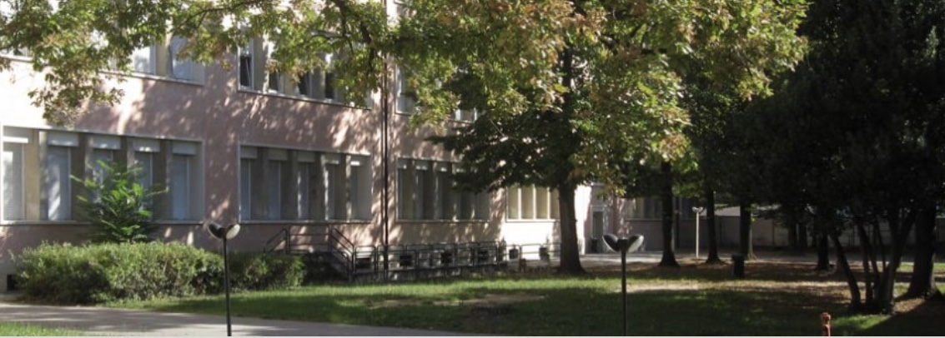
Duca degli Abruzzi

Slide 4
The telescope

Slide 5
Thanks for the attention.
–Elena Marenco
I want to thank:
PolarQuest 2018
CERN
Progetto EEE
Centro Fermi
The teacher Monica Nardin

