Slide 1
Update on the new analyzer and more
E. Bossini, F. Coccetti, F. Noferini

Slide 2
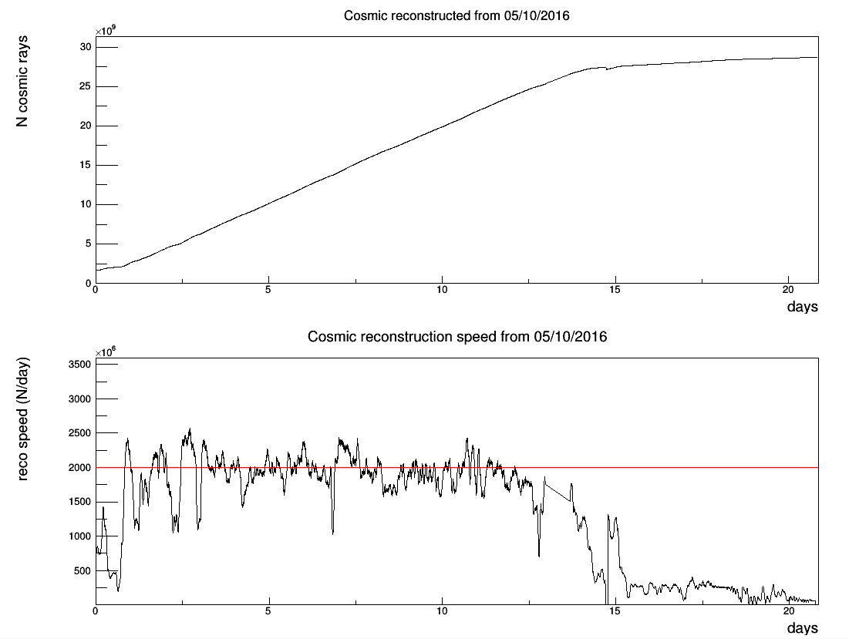
Reconstruction with the new analyzer
The re-processing of the data took about 2 weeks.
2 Billion tracks reconstructed per day (using 16 cores)

Slide 3
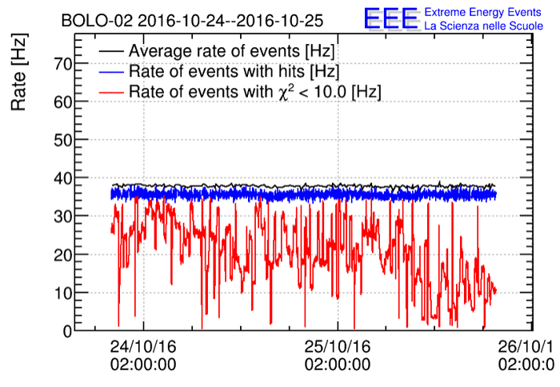
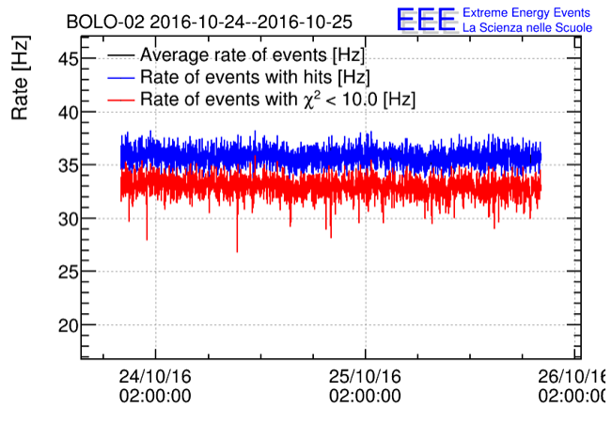
Daily reports
Daily reportes were already processed now.
Some fixes applied with the new structure (by Edoardo).
For PISA-01 we needed to fix something in the analyzer on the timestamp in the weather station info (valid from October 2016).
Some improvements observed for high-noisy telescope.
OLD
NEW

Slide 4
DQM update
1) We suggest to look at the DQM plots to check if everything is fine.
By the end of this year we will find a moment to collect any suggestion to fix/improve DQM reports.
In principle we can add other information like:
Trending of gps status
Multi-track info
P(χ²) distributions
…
We will circulate soon a list of data reconstructed with the old analyzer we want to keep at CNAF before to start the cancellation of old files.
At this stage for sure we keep:
Data with coincidences
Data used for the published paper (anisotropy and muon decay)

Slide 5
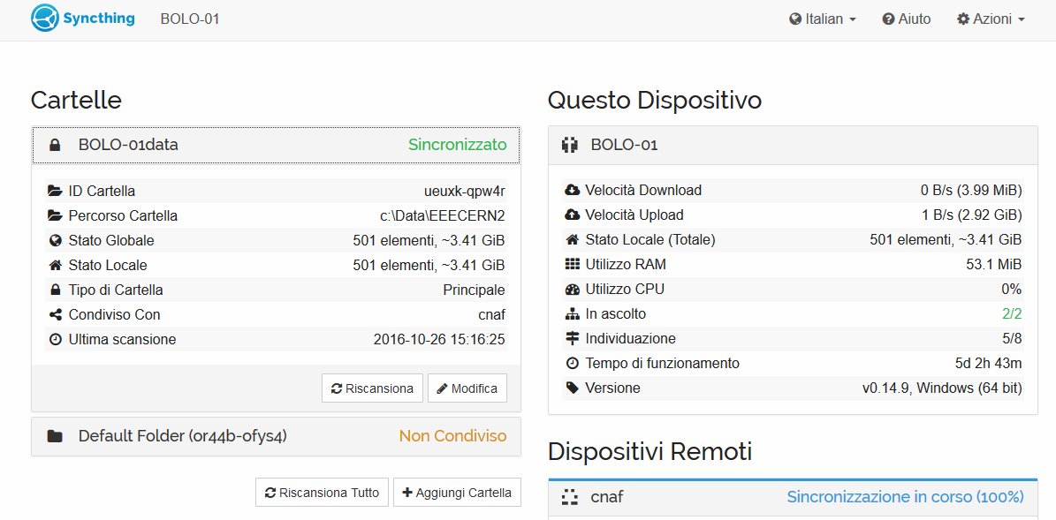
New transfer tool (under test)
We are testing a new tool to perform trasnfer (in Bologna and Bari telescopes) → sytncthing
The typical view at the school.

Slide 6
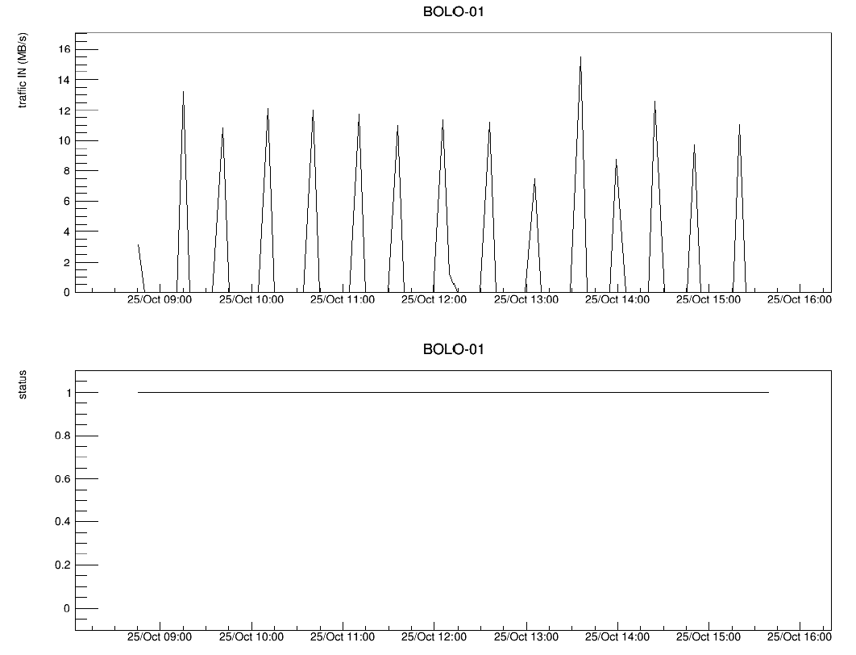
The monitor plot we produce at CNAF (5 minutes granularity)
Traffic
Connection status
1 = connected

Slide 7
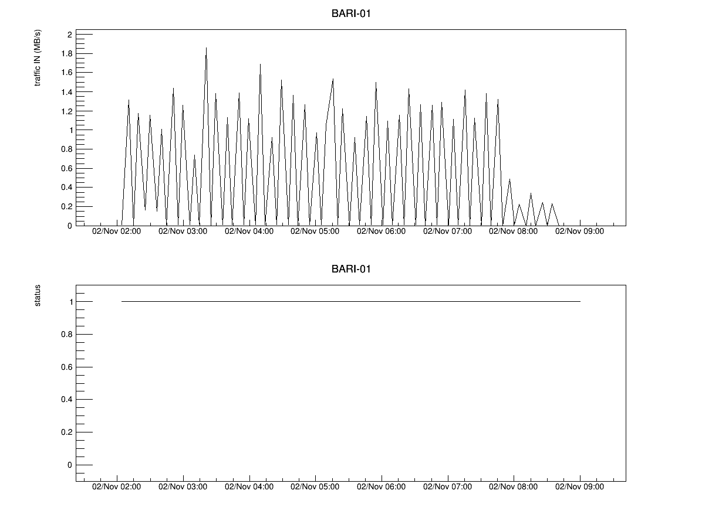
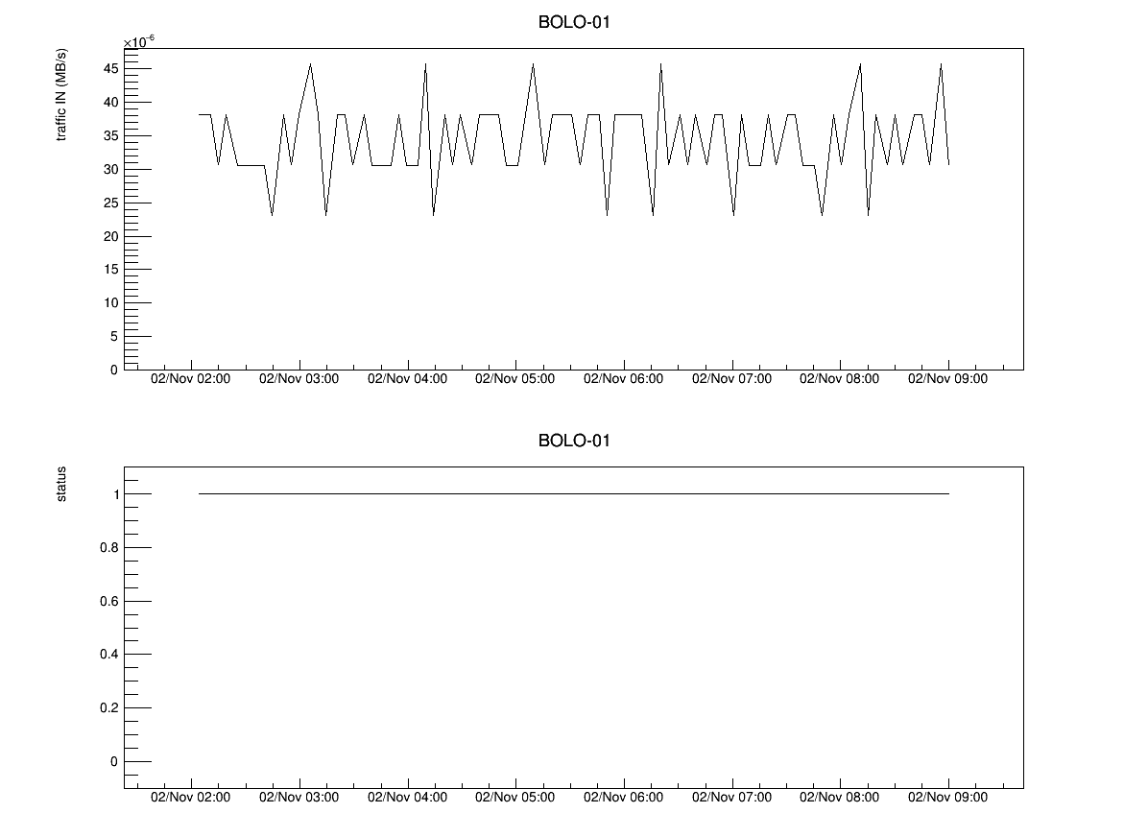
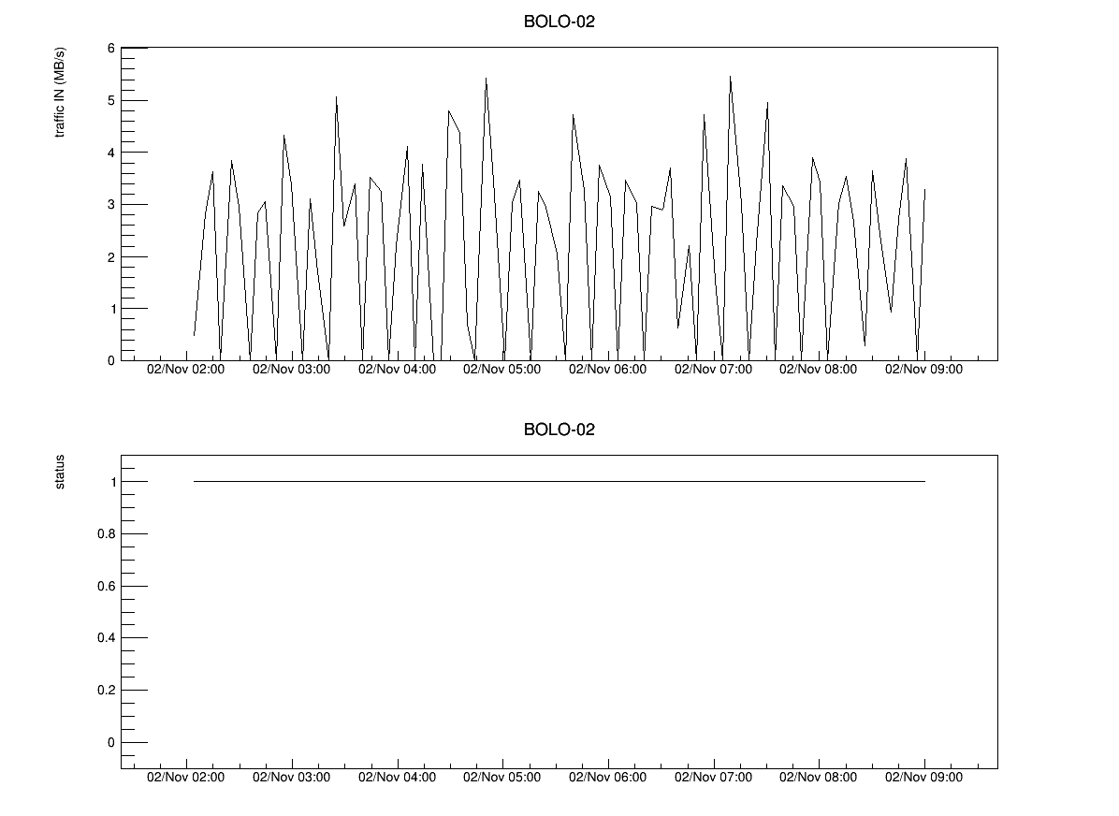
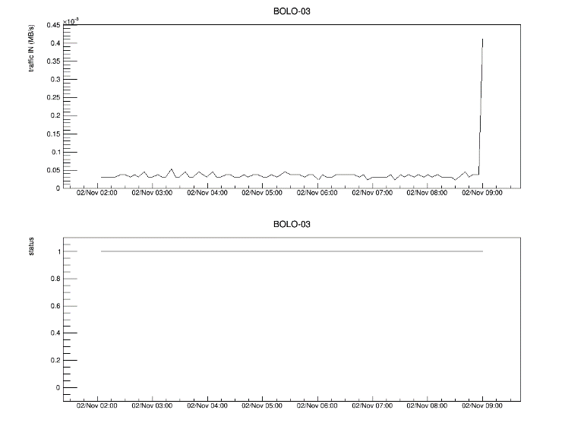
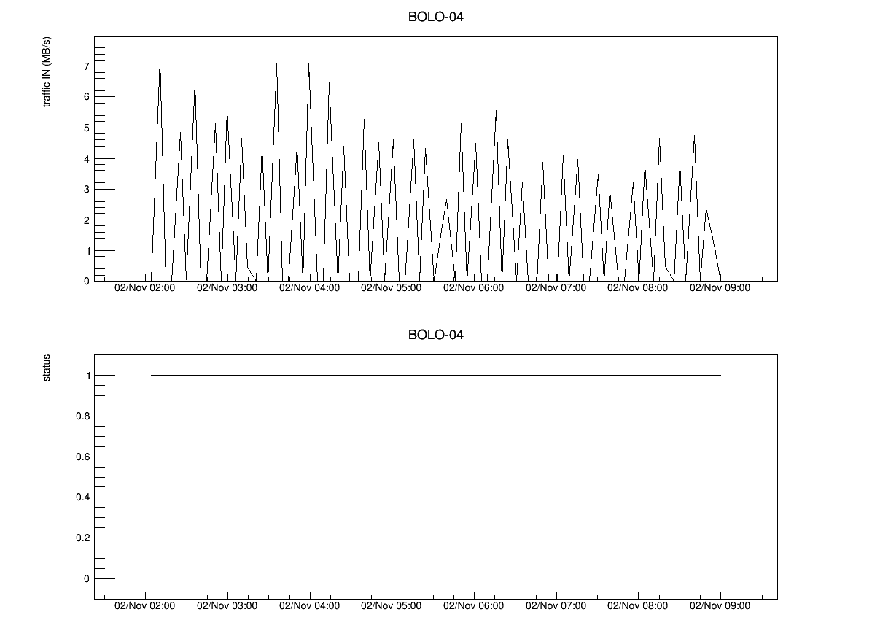
Last day traffic

Slide 8
GPS (1 second offset in Run-3)
We observed in Bologna a 1 second offset in 2 telescopes (of 4).
The offset is exactly of 1 s (confirmed in the coincidences analysis).
After a discussion (with M. Panareo) we realized that in July 2016 it was announced a one leap* second, scheduled at the end of the year.
It may be that some telescopes already applied the shift
(see also http://support.spectracom.com/articles/FAQ/Why-is-there-a-1-second-time-error-from-my-GPS-reference ).
We perform some checks in our telescopes to trace the problem (see next slide).
*A leap second is a one-second adjustment that is occasionally applied to Coordinated Universal Time (UTC) in order to keep its time of day close to the mean solar time, or UT1. (wikipedia)

Slide 9
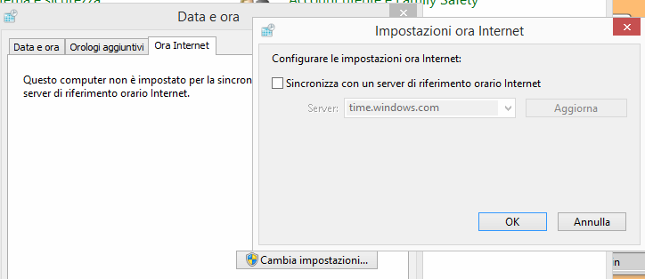
How to perform the check
disable
set the windows time from GPS
disable the time sync from internet
run the clock demon of the spectracom gps (update time = 5 mins)
Once the time is taken from gps, open the site http://time.is which returns the status of sync with respect a well tested reference (precision 0.01 – 0.1 s)
run

Slide 10
Status of our GPS
BOLO-01 Il tuo orologio è 1,0 secondi indietro. La precisione della sincronizzazione è stata di ±0,029 secondi. BOLO-02 Il tuo orologio è 1,0 secondi indietro. La precisione della sincronizzazione è stata di ±0,024 secondi. BOLO-03 Il tuo orologio segna l'ora esatta! La differenza rispetto a Time.is è stata di +0,006 secondi (±0,032 secondi). BOLO-04 Il tuo orologio segna l'ora esatta! La differenza rispetto a Time.is è stata di +0,129 secondi (±0,133 secondi). PARM-01 (Tform 8) Il tuo orologio è 1,0 secondi indietro. La precisione della sincronizzazione è stata di ±0,039 secondi. COSE-01 Il tuo orologio segna l'ora esatta! La differenza rispetto a Time.is è stata di +0,005 secondi (±0,169 secondi).

Slide 11
Perspectives for coincidences
Since we have the data reconstructed with the new analyzer we are going to re-process also the analysis of coincidences.
Simulation with Corsika are ready at CNAF (we are now converting binaries into root format) and we need to start to look into that .
Expected rates
Acceptance correction
Perspectives for 3 telescope coincidences
Start to write the paper
We need to find a moment to organize the work (probably in the second half of November)

