Slide 1
Effective energy: which analyses in ALICE?
F. Noferini, R. Preghenella
INFN Bologna

Slide 2
Summary
Why Effective Energy (EE)?
Which analyses in ALICE?
Past attempts using the ZDC calorimeters
pp high multiplicity events vs event properties (EE?)
Discussion

Slide 3
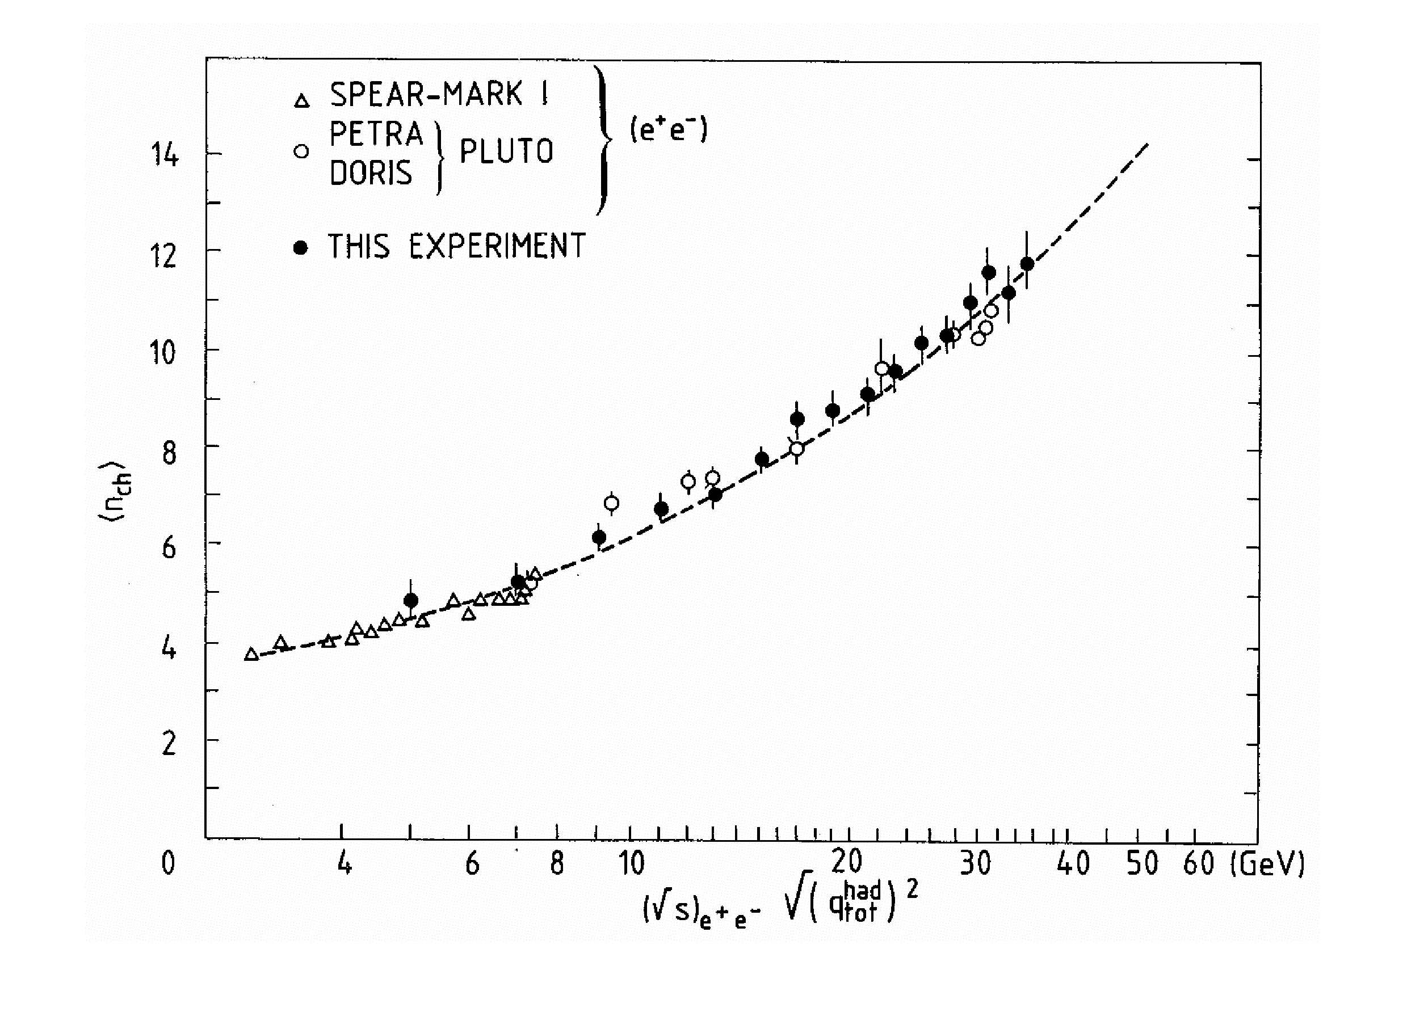
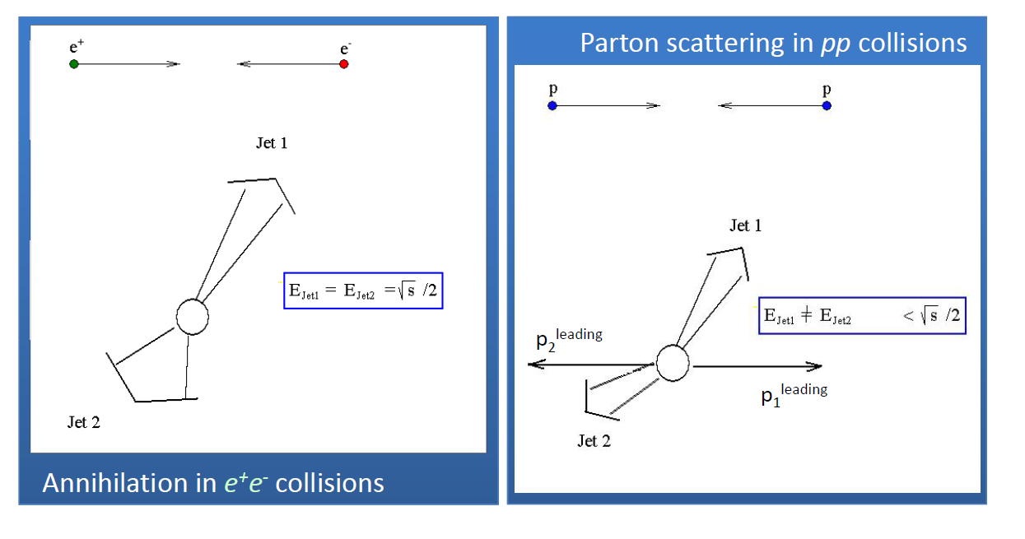
Effective energy universality
Particle production mechanism is ruled by QCD in non-perturbative regime.
It looks independent of the nature of colliding systems.

Slide 4
ZDC in pp collisions
We tried in the past to use the ZDC to reconstruct the energy of leading nucleons.
leading proton
Magnetic field
⊗
ALICE DETECTOR
ZDCP
beam pipe OUT
ZDCN
~116 m
beam pipe IN
A side
y
C side
ZDCP (proton) range 0.3 < x_{F} < 0.6
because of the optics
ZDCN (neutron) range 0.4 < x_{F} < 0.9
x_{F} < 0.4 photon contamination too high
x_{F} > 0.9 big resolution effects
z
A = Anti-clock wise
C = Clock wise
x

Slide 5
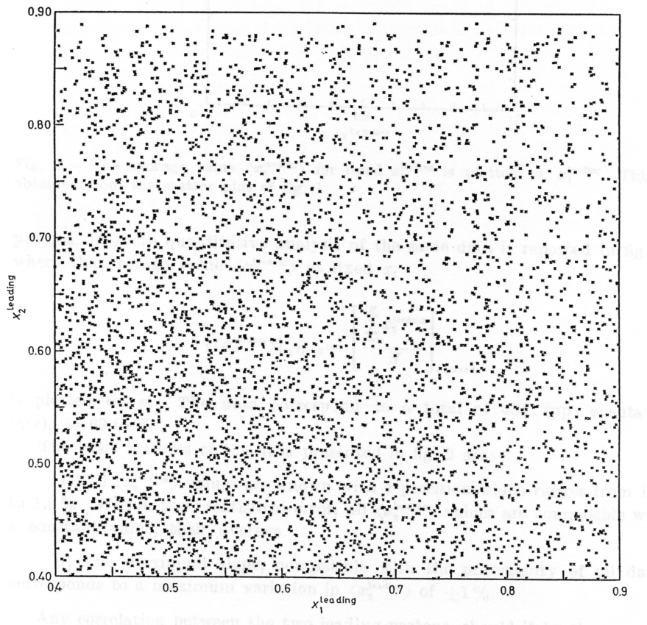
Independency of hemispheres [I]
ISR pp@62 GeV
LHC pp@7 TeV
ALICE
Work in progress
The independency of hemispheres was tested for leading neutron in the same x_{F} range of ISR: (ZDCN-A vs ZDCN-C) @ 7 TeV.
However, there are uncertatinties in the E_{ZDC} calibrations which make difficult to quantify the effect.

Slide 6
A first attempt using the ZDC
As mentioned we tried in the past to use the ZDC to reconstruct the energy of leading nucleons.
We were able to reconstruct some observables…
… unfortunately it is rather difficult to manage calibration and run condition issues so we started to look at observables independent of the calibrations.

Slide 7
Interesting observation in pp high multiplicity events
(ALICE) Nature Physics 13 (2017) 535-539
A strangeness enhancement was observed with the multiplicity → similar trend if compared to p-Pb and Pb-Pb collisions.
How to interpret this result?
Can we establish a direct link between multiplicity and the effective energy?

Slide 8
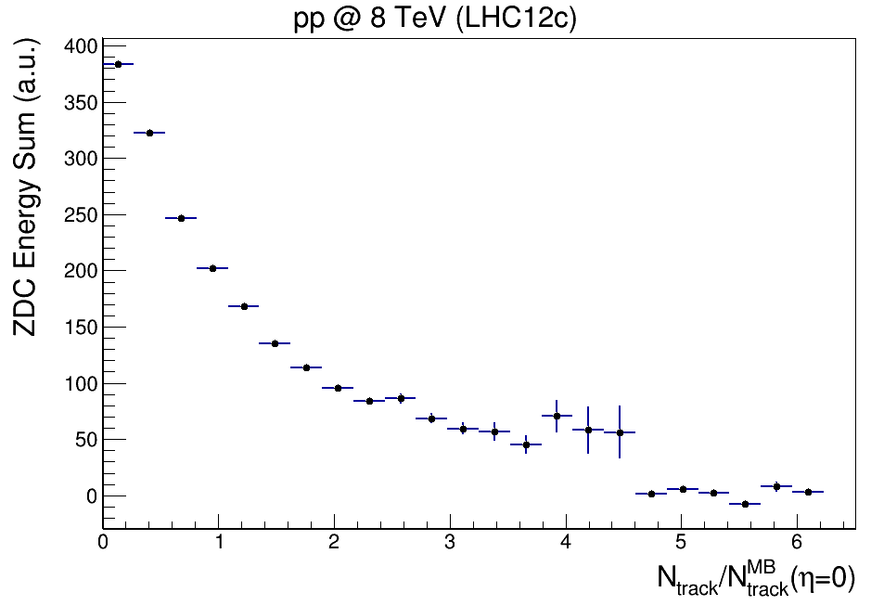
Mutliplicity vs ZDC energy
Low-multiplicity events correspond, on average, to events with significant energies released in the ZDCs (lower energy available in particle production)
High-multiplicity events correspond to events with a zero signal in all the ZDCs (higher energy available in particle production)

Slide 9
About interpretations
One of the main questions (for me!) concerns the possibility to ascribe the observation to:
Initial state effects: Effective Energy (EE), multi-parton interactions, …
or
Final state effects: High particle density environment/“medium effect” …
Do we have a way to test the two different scenarios?
We tried to address this question in the next slides.

Slide 10
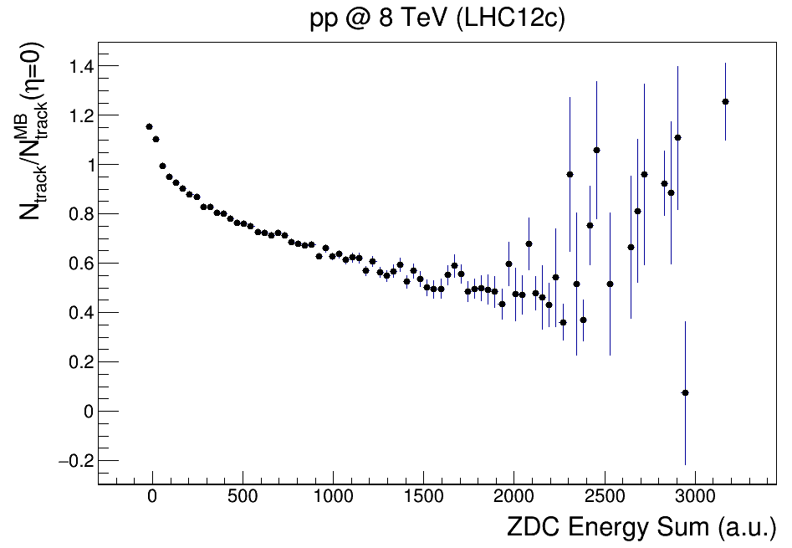
ZDC energy vs multiplicity
ZDC Energy Sum defined as:
ZDC-N-A + ZDC-P-A + ZDC-N-C + ZDC-P-C
Such a variable allows for some contamination due to the limited acceptance of the ZDC (we can loose some particles) but allows not to loose statistics!!!!
Average multiplicity vs ZDC energy (sum over all calorimeters).
To avoid calibration issues we would like just to group events depending on the ZDC Energy sum
lowest E_{ZDC} (yellow) → highest Effective Energy
highest E_{ZDC} (green) → lowest Effective Energy

Slide 11
Differential analyses vs multiplicity
Scenario 1
If strangeness enhancement is an initial state effect (effective energy)
→ Multiplicity dependence has to disappear!
Repeating the measurement after selecting the ZDC energy (two regions) we expect two different scenarios for the initial / final status effects
Scenario 2
If strangeness enhancement is a final state effect (just depends on multiplicity) →
no change!

Slide 12
pp data sample
The results published on Nature Physics were obtained on a pp data sample (7 TeV) of 140 M events.
We identify two periods in 2012 pp data with also the ZDC information available:
pp@8 TeV → 295 M events (LHC12b,c,f)
The amount of data seems to be enough to perform such a measurments!!!

Slide 13
Conclusion
In order to characterize Effective Energy effects in the ALICE experiment, at present we propose:
a well defined measurement in high energy pp collisions,
in a channel where we have excellent expertise (strangeness production),
focused on a hot topic in our physics program (strangeness enhancement vs multiplicity)
Future extensions to other systems will be possible depending on the results we are going to collect.

