Slide 1
Investigation of multi-messenger and
rare events in EEE
F.Riggi & P. La Rocca
CERN, April 30th, 2018

Slide 2
Outline
Search for long distance correlations between EEE telescopes
- Various analysis strategies
- First published results
- Ongoing analysis
2. Search for correlations between EEE and multimessenger events
- Look for EEE events in coincidence with GW events recently observed

Slide 3
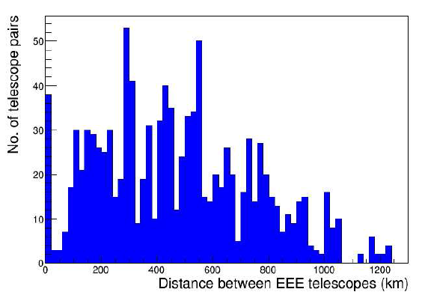
Distance coverage of the EEE telescopes
With 50 telescopes,
>1200 combinations
Cluster sites (< 5 Km)

Slide 4
Analysis strategies
RARE EVENTS → NEGLIGIBLE BACKGROUND NEEDED!
Correlations between independent telescopes (single track events)
R_{spurious} ≈ 2 x 20 x 20 x 10⁻³ = 0.8 Hz
Correlations between a single muon and a two-track event in another telescope
R_{spurious} ≈ 2 x 20 x 0.02 x 10⁻³ = 8 · 10⁻⁴ Hz
Correlations between two and multi-track events in both telescopes
R_{spurious} (2 tracks) ≈ 2 x 0.02 x 0.02 x 10⁻³ = 8 · 10⁻⁷ Hz
Correlations between telescope pairs (extensive air showers)
R_{spurious} ≈ 2 x 0.04 x 0.001 x 10⁻³ = 8 · 10⁻⁸ Hz (typical values)

Slide 5
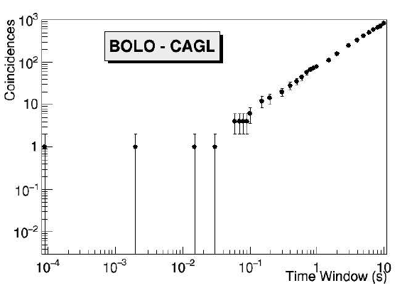
First results from showers (cluster sites)
Analyzed coincidences between the 45 pairs of the 10 EEE cluster sites hosting at least two telescopes
3968 days of time exposure
96 observed events against 77.8 estimated background
5 candidate events with a p-value < 0.05

Slide 6
First results from showers (cluster sites)
Eur. Phys. J. Plus (2018) 133: 34

Slide 7
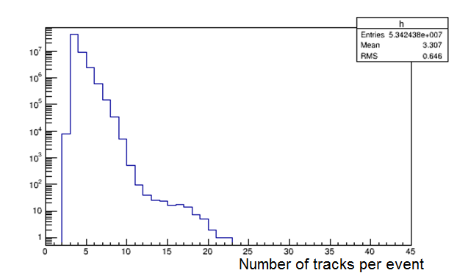
Alternative strategies: multi-track events
Telescope 1
Telescope 2
Only events with
> 2 tracks shown

Slide 8
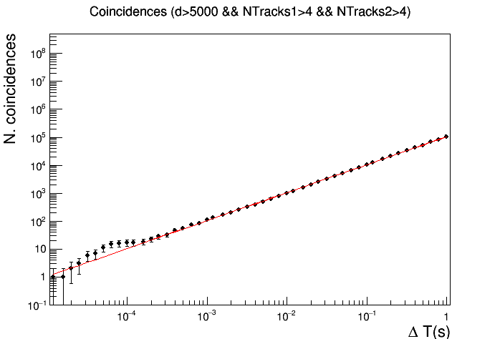
Preliminary results from Run 2 & 3 & 4
Data description
No. of telescopes: 39 telescopes + 5 clusters
No. of Events: 50 millions of events
Period: 2016-01-01 → 2018-03-26
(RUN2 + RUN3 + RUN4), 816 days
Ntracks > 4
Distance > 5 km

Slide 9
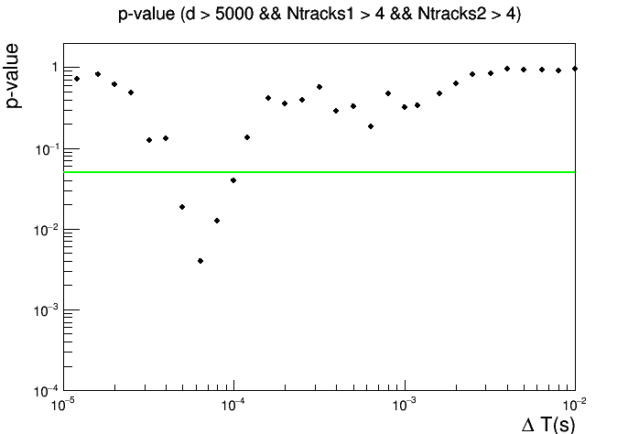
Preliminary results from Run 2 & 3 & 4
Significance level 0.05

Slide 10
Work in progress
Systematic study of p-value
Effect of a cut on the relative angle
Effect of a cut on the telescope distance
Detailed analysis of the significant events

Slide 11
Search for multimessenger events
Gravitational Wave events
Recent searches for other probes synchronized with the arrival of GW
- Gamma Ray Burst detected in coincidence with GW170817 by INTEGRAL and FERMI Collaborations (Delay 1.74 s)
- Combined search for high energy neutrinos by Auger, IceCube and ANTARES within +/- 500 s → No evidence found
Possible activities from EEE
- Many telescopes usually active
- Several analysis conditions (single track, multi-tracks, showers)
- First analysis of the GW events observed in 2017

Slide 12
List of GW recently observed
Label UTC Time Notes
GW150914 | 2015-09-14 09:50:45 | First GW detection;
GW151226 | 2015-12-26 03:38:53
GW170104 | 2017-01-04 10∶11:58 | Farthest confirmed event to date
GW170608 | 2017-06-08 02:01:16 | Smallest BH progenitor masses to date
GW170814 | 2017-08-14 10∶30:43 | First detection by three observatories; first measurement of polarization
GW170817 | 2017-08-17 12∶41:04 | First detection of Em counterpart

Slide 13
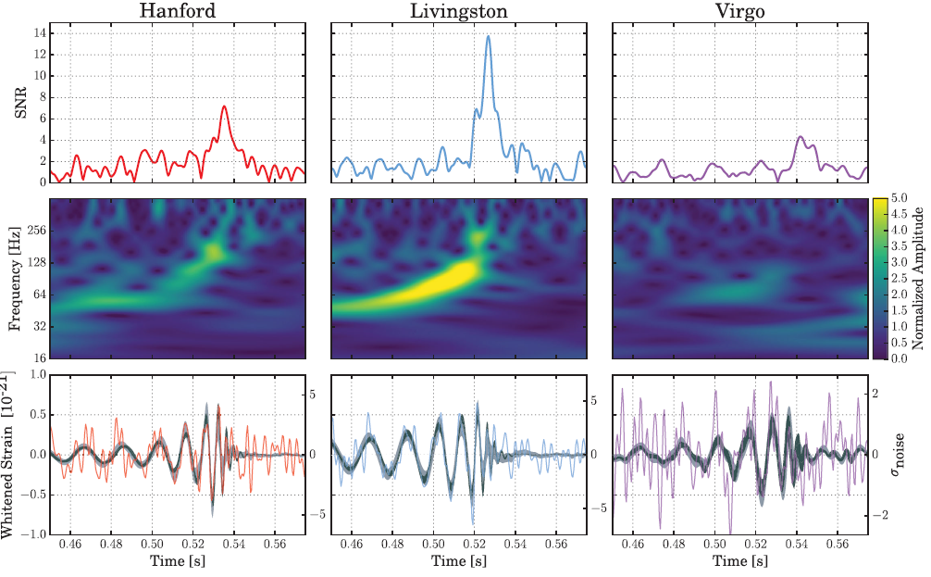
The time scale: tens of milliseconds
Time scale of the order of 0.01 s
0.02’’

Slide 14
Analysis strategy
Only 6-7 EEE telescopes active on August 14 and 17 (school holidays)
● Carry out some search on the active telescopes around the expected UTC time for the August 14 & 17 GW events
● Evaluate the background for single track events and multi-track events
● Search for any event close to the expected time and compare to the background

Slide 15
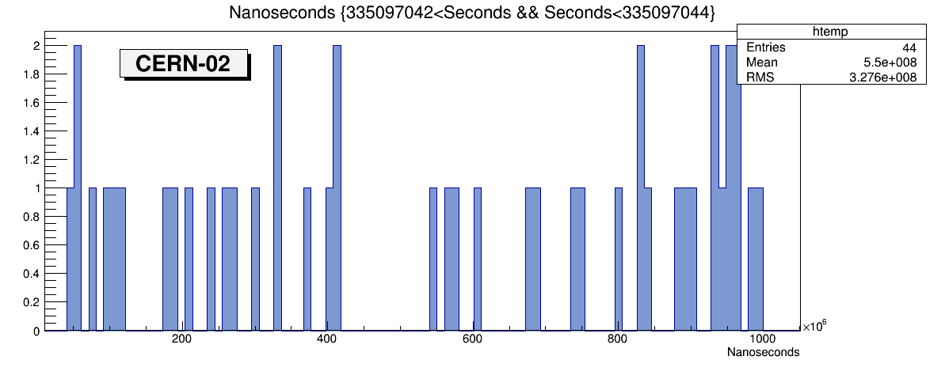
The GW event on August 14, 2017
GW event
1 s
Similar results from all other telescopes

Slide 16
The GW event on August 14, 2017
● About 40 events/s, hence 0.4 events on average in 0.01’’
● Probability to get >=1 events in 0.01’’ very large, so no chance
● Better strategy: search on multitrack events
● Rate of multitrack events: 10-60 events in 1000’’
First analysis carried out in +/- 500 s around the GW event of interest for all the active EEE telescopes

Slide 17
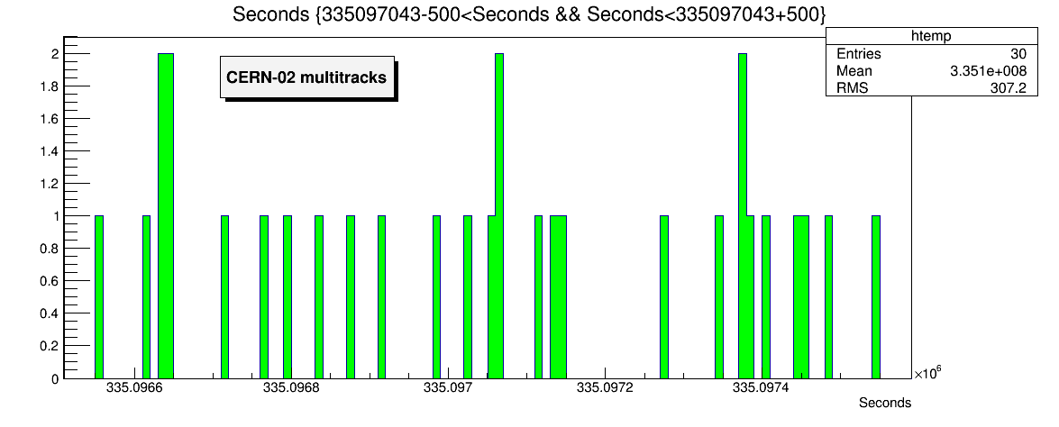
Scan of multi-track events over ± 500 s time window
August 14, 2017
GW event
1000 s

Slide 18
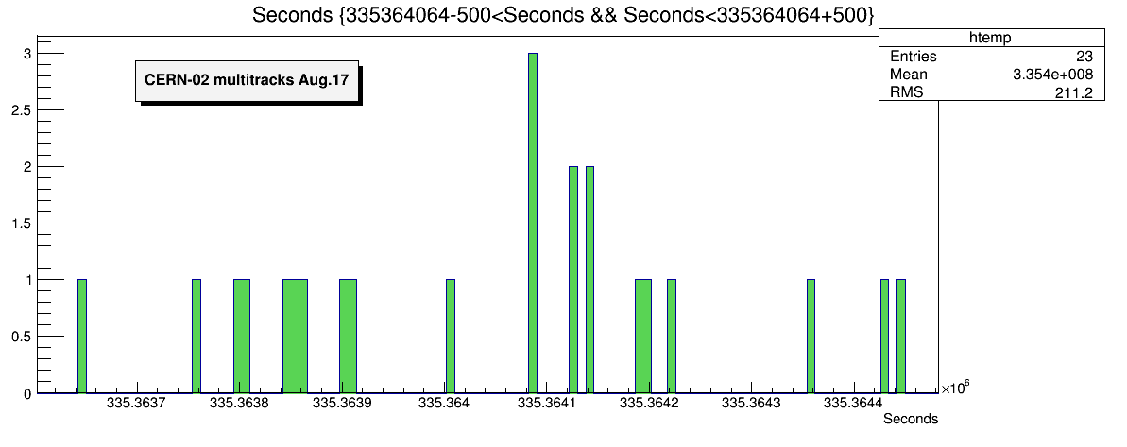
Scan of multi-track events over ± 500 s time window
…
August 17, 2017
GW event
1000 s

Slide 19
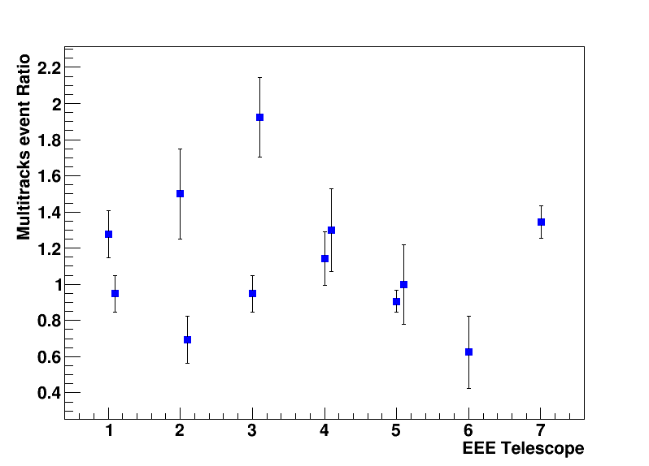
Overall result from the two GW events
Average Ratio= 1.13
Ratio between number of events observed in a time interval of 500 s after and before the GW event for the two GW events

Slide 20
Summary on GW events analysis
● At the moment everything seems to be compatible with no observation of any specific anomaly.
● Very small excess of multitrack events observed in a time interval of 500 s after GW events in different sites (Any meaning?)
● New analysis strategies possible?
● Check any coincidence event between far telescopes close to the observed GW events (only few combinations unfortunately available)
Work is in progress..

