Slide 1
Search for long distance correlations by selecting multi-tracks events Update n.1
P.La Rocca and F.Riggi

Slide 2
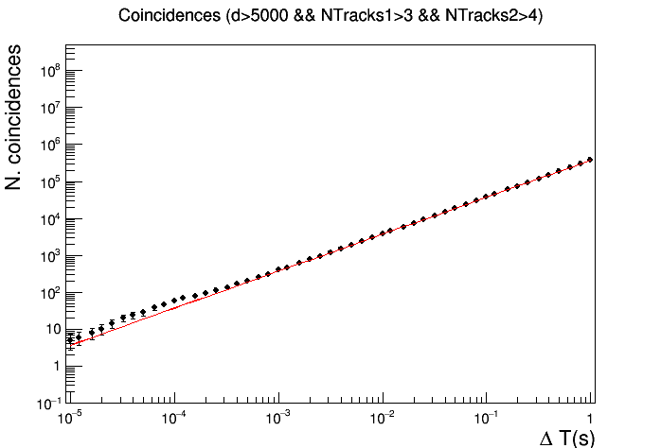
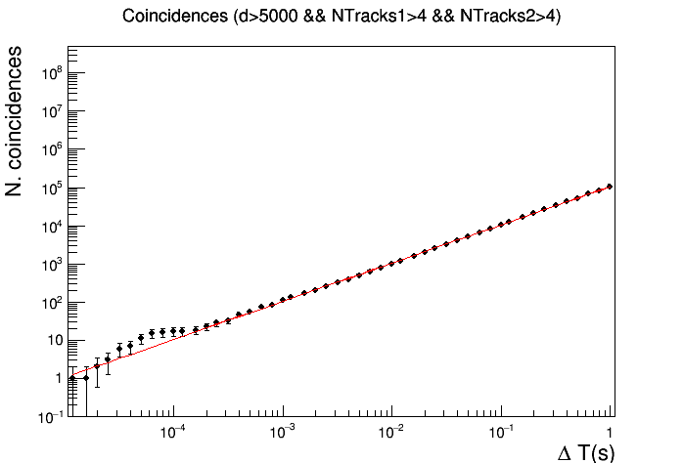
BEST CUTS ON NTRACKS
Ntracks1>3
Ntracks2>4
Ntracks1>4
Ntracks2>4
ΔT = 0.12 ms
N_{exp} = 44.9
N_{obs} = 69
p-value = 0.0005
ΔT = 64 us
N_{exp} = 6.7
N_{obs} = 15
p-value = 0.004

Slide 3
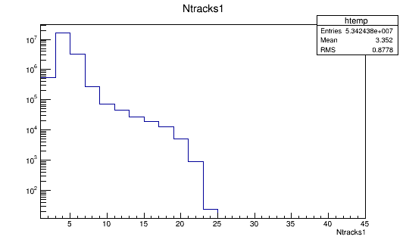
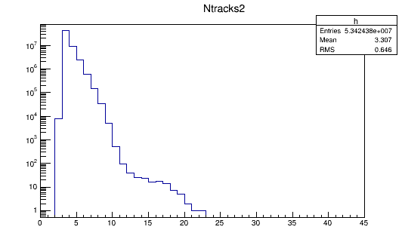
DISTRIBUTION OF NTRACKS VARIABLE

Slide 4
NEXT STEPS
Systematic study of p-value
Effect of a cut on the relative angle
Effect of a cut on the telescope distance
Detailed analysis of the significant events

Slide 5
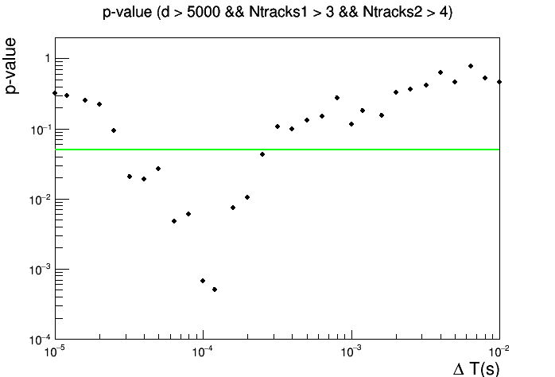
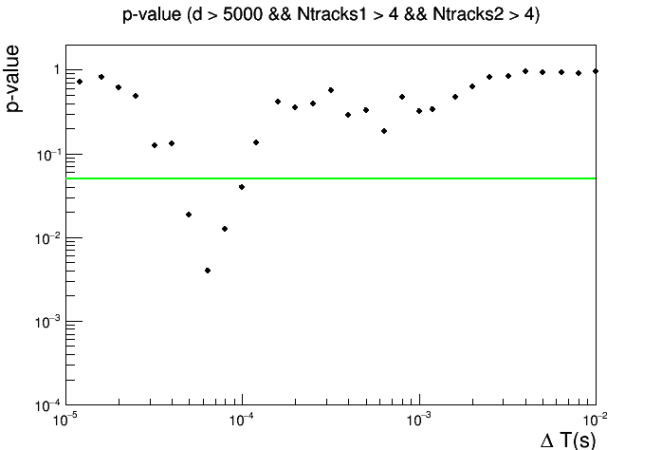
SYSTEMATIC STUDY OF P-VALUE
Significance level 0.05
Significance level 0.05

Slide 6
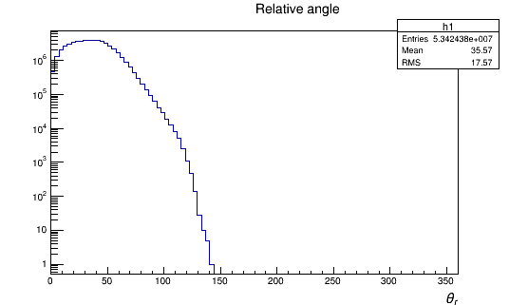
DISTRIBUTION OF THE RELATIVE ANGLE BETWEEN TRACKS

Slide 7
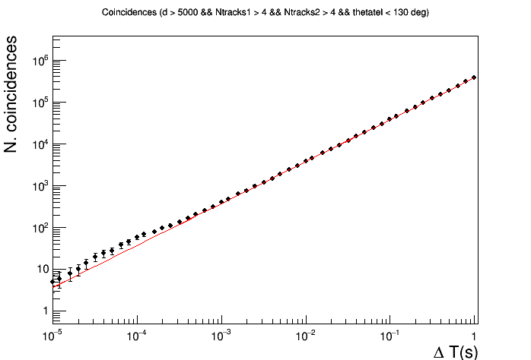
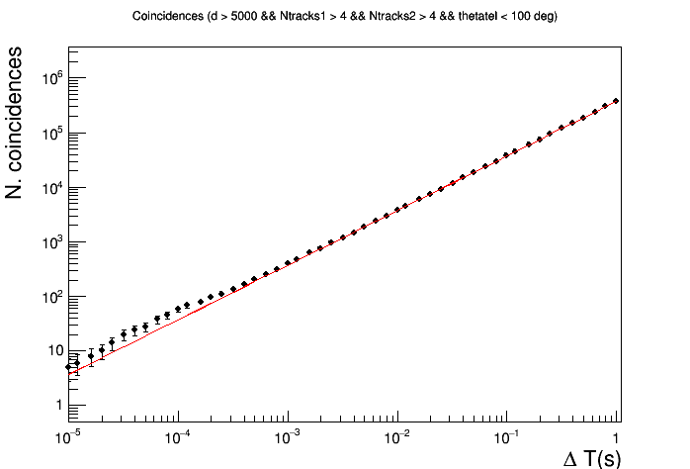
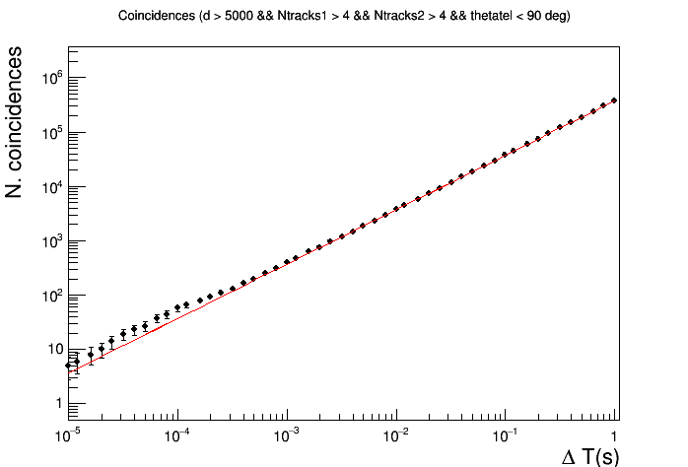
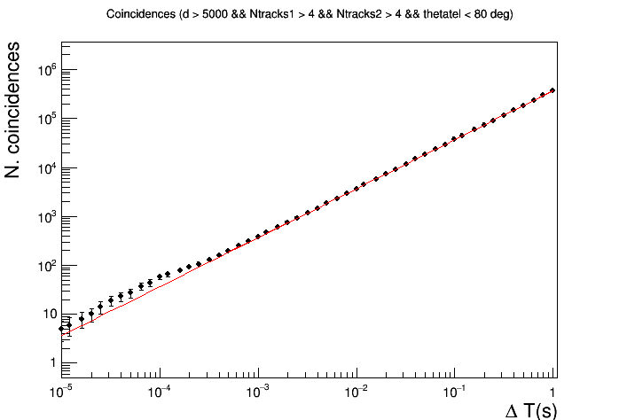
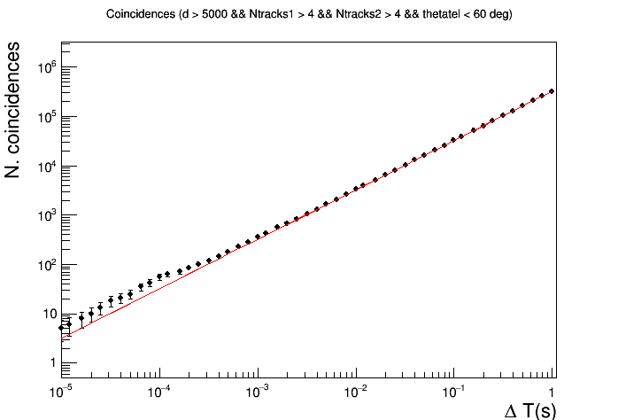
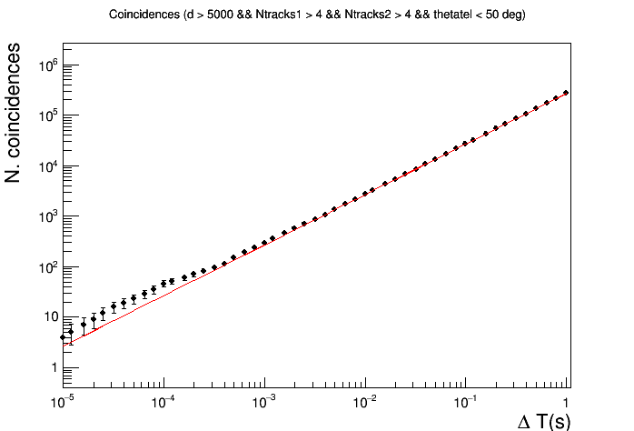
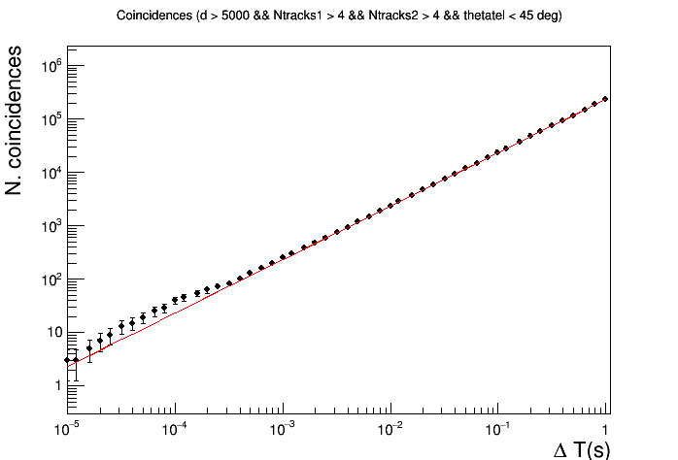
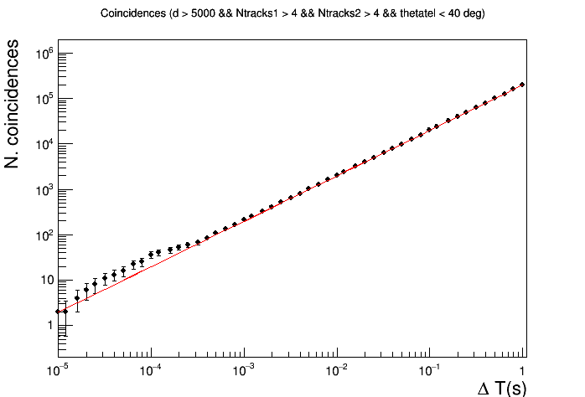
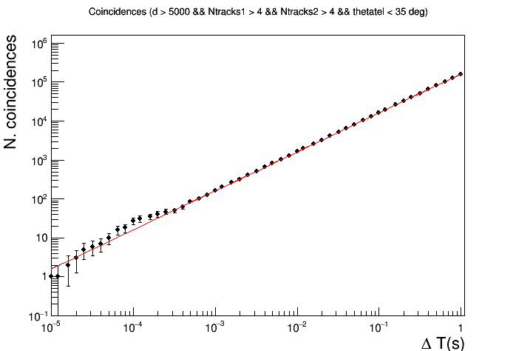
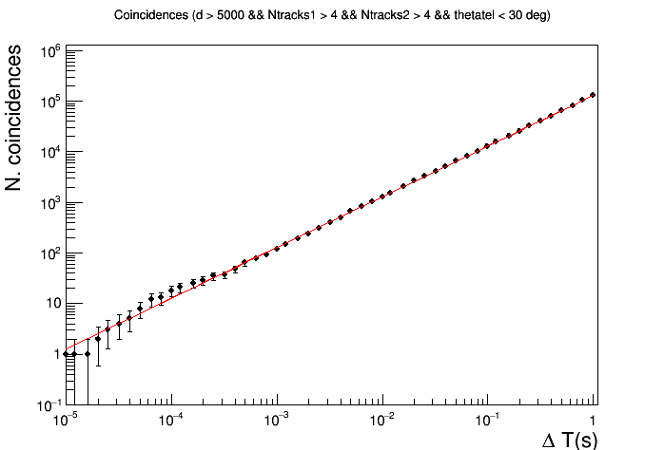
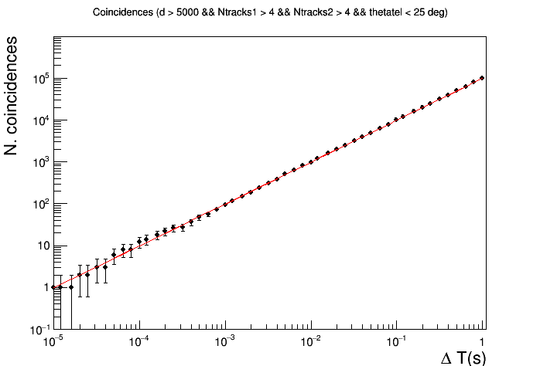
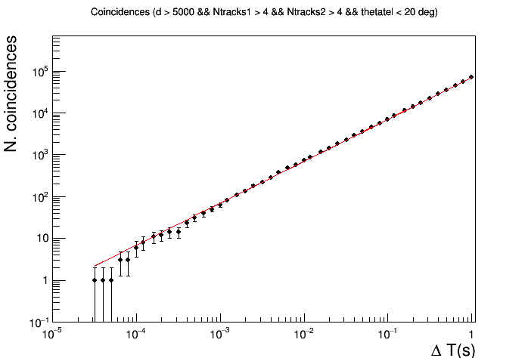
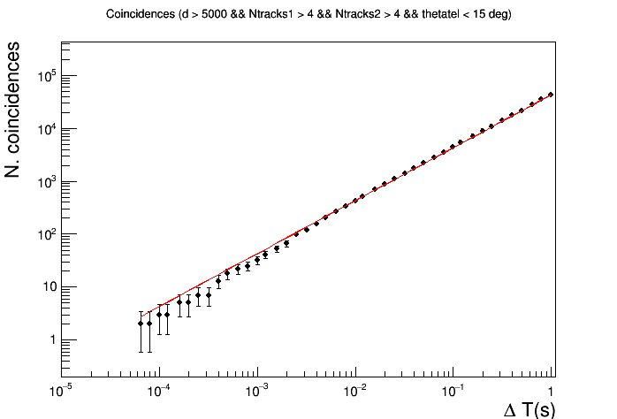
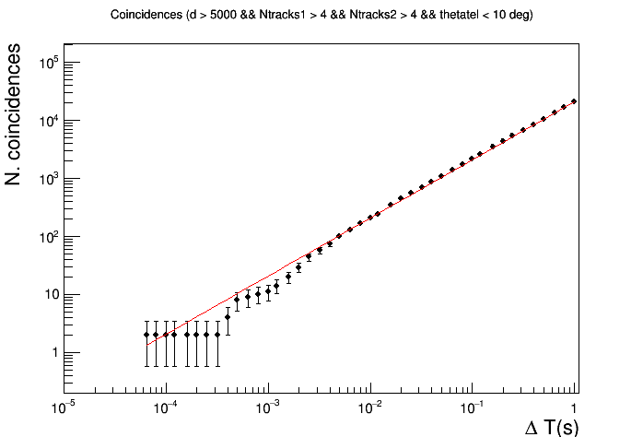
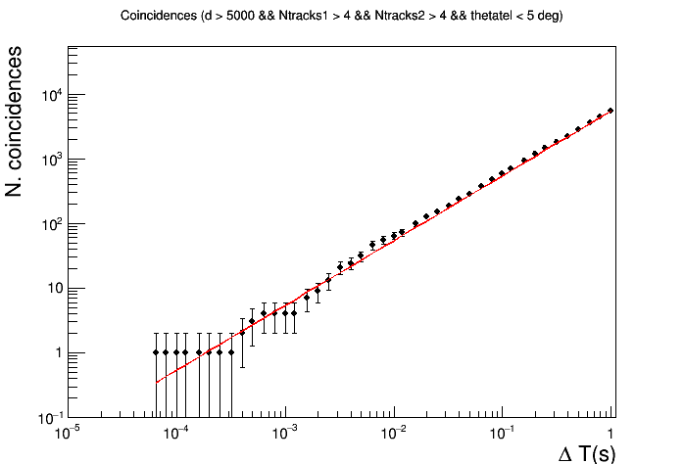
EFFECT OF A CUT ON THE RELATIVE ANGLE

Slide 8
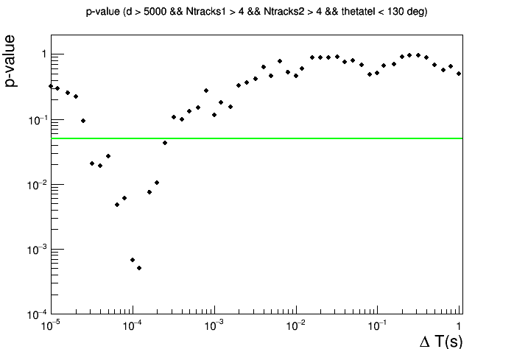
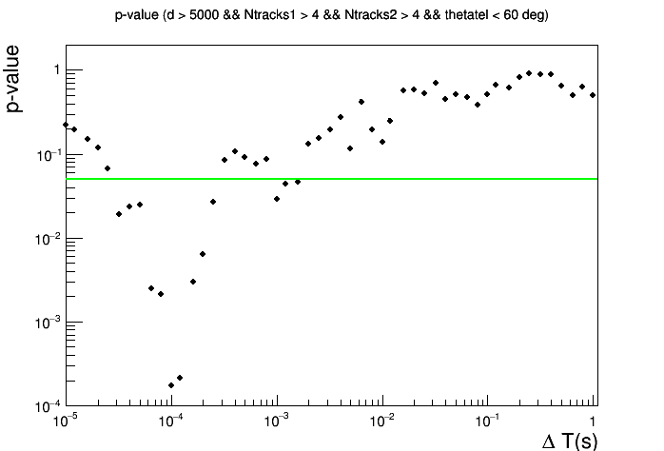
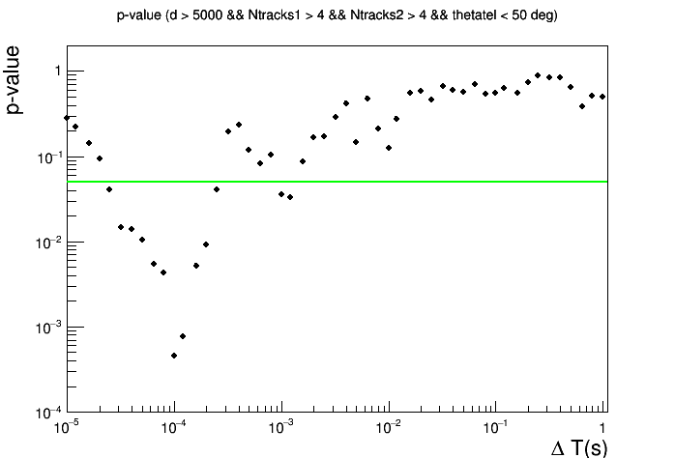
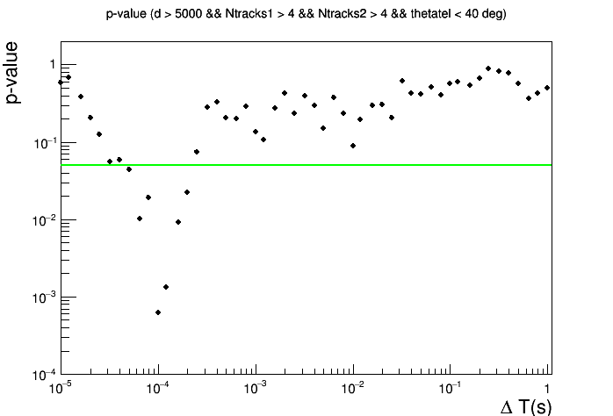
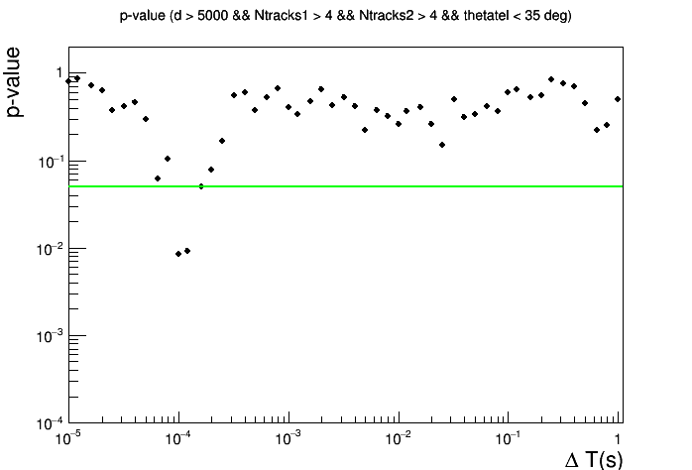
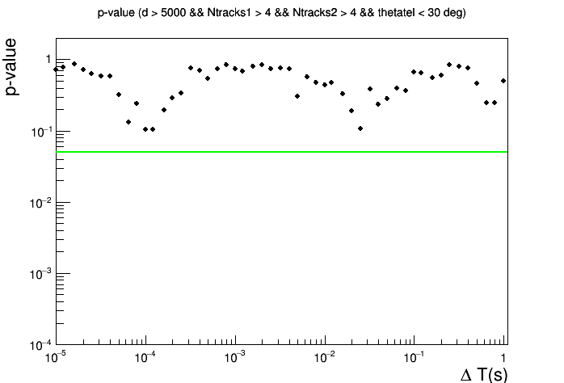
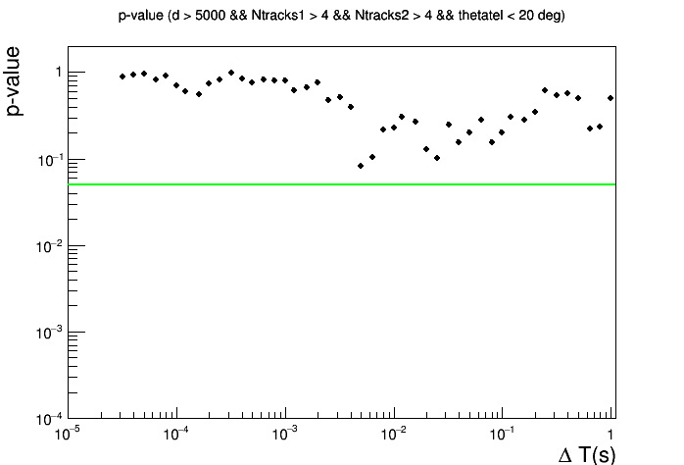
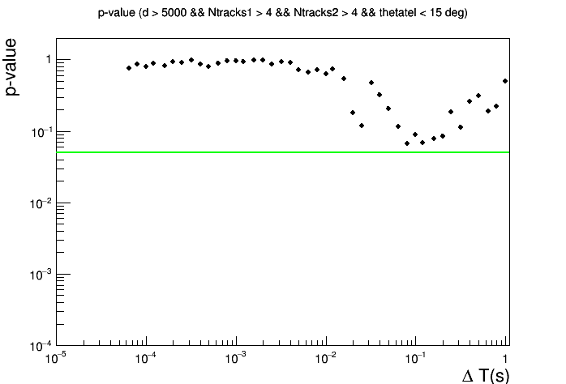
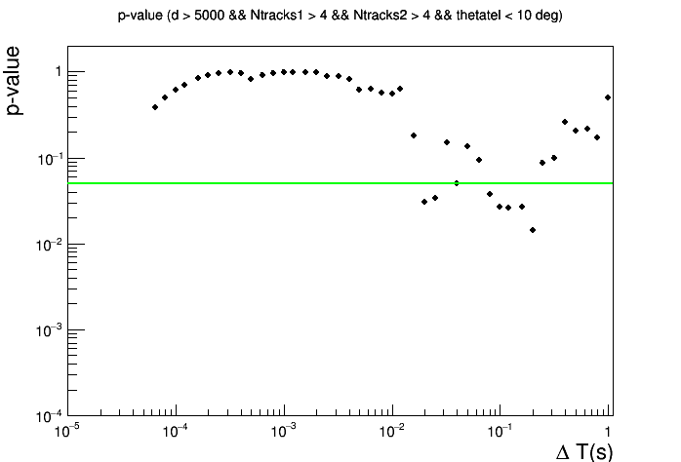
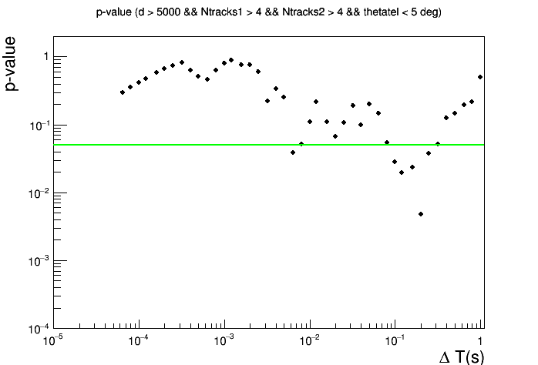
EFFECT OF A CUT ON THE RELATIVE ANGLE
Significance level 0.05

Slide 9
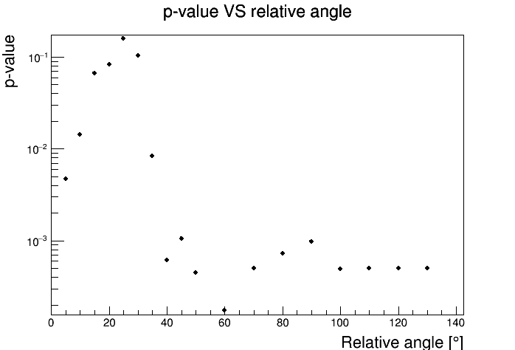
EFFECT OF A CUT ON THE RELATIVE ANGLE

Slide 10
NEXT STEPS
Systematic study of p-value
Effect of a cut on the relative angle
Effect of a cut on the telescope distance
Detailed analysis of the significant events

