Slide 1
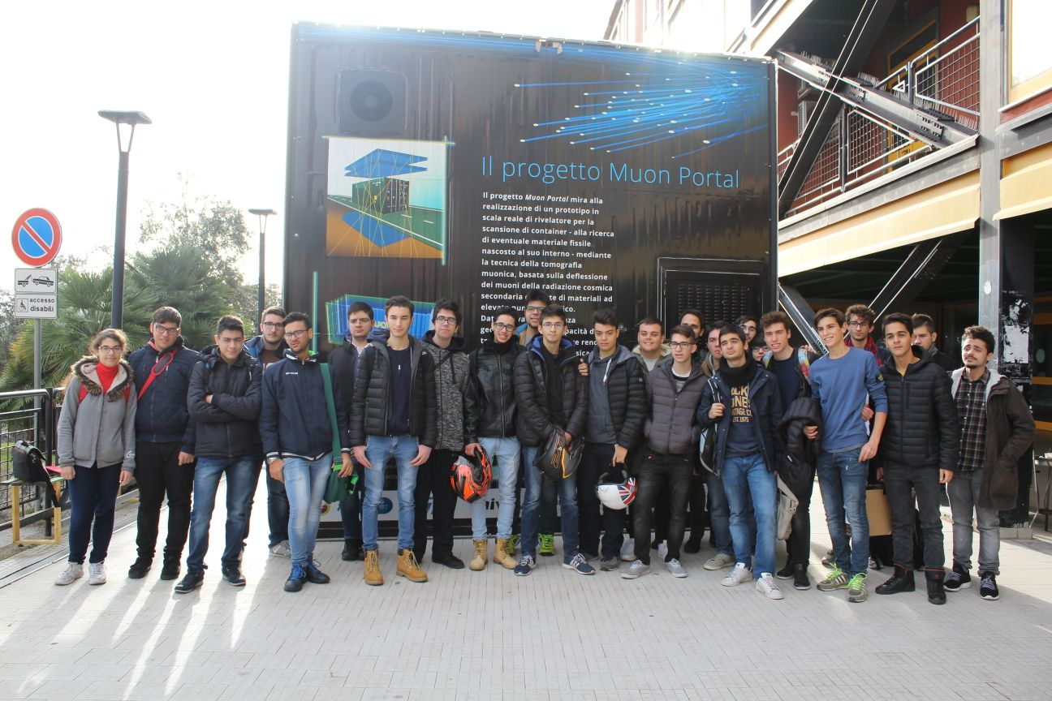
Measure of muon velocity in EEE data
Sandro Torrisi
I.I.S.- I.T. Guglielmo Marconi, Catania
Joined to EEE project: 2017
50 students and 2 teachers
ICD 2017 partecipation
FOTO
Erice Conference 2017 partecipation
ASL convention 2018: 20 students
Activities at the school on a weekly basis

Slide 2
Outline
Time of flight, track lenght and velocity distributions for different data sets of CATA-02 telescope
Comparison of CATA-02 and CAGL-01 distributions
Muon velocity distributions for different time of flight and track lenght bins
Mean muon velocity vs time of flight and track lenght
Time of flight – track lenght scatterplot
Conclusions

Slide 3
CATA-02 17/04/2018 ChiSquare <10 RunNumber <10
no cut
no cut
ns
Top-bottom chamber distance = 100 cm
cm
cut: tof > o
cut: tof > o
ns
cm/ns

Slide 4
CATA-02
17/04/2018
ChiSquare < 10
Run Number < 10
Cut: 3<tof(ns)<7
Track Lenght (cm) | Tof (ns) V = 30 cm/ns | Tof (ns) V = 26 cm/ns
100 | 3.3 | 3.8
180 | 6.3 | 6.9
ns
<V> = 25.5 cm/ns
Track Lenght
cm/ns
cm

Slide 5
16/01/2018
CATA-02
ChiSquare < 10
Run Number < 10
Cut: 3<tof(ns)<7
TIME | <V> (cm/ns) | σ(v) (cm/ns)
23/01/2016 | 25.61 | 3.02
22/01/2017 | 25.78 | 3.23
16/01/2018 | 25.51 | 3.02
15/04/2018 | 25.81 | 4.21
17/04/2018 | 25.51 | 4.17
23/01/2016
23/01/2016
cm/ns

Slide 6
<V> = 28.4 cm/ns
σ(v) = 3.1 cm/ns
CATA-02 vs
CAGL-01
cm/ns
Comparison between the muon velocity distributions obtained from the data of CATA-02 and CAGL-01 in the same day (17/04/2018) with the same time of flight cut: (3.0<tof(ns)<7.0)
<V> = 25.5 cm/ns
σ(v) = 4.2 cm/ns
cm/ns

Slide 7
Muon velocity distributions for ΔL bins
CATA-02
17/04/2018
ΔL(cm)
Similar velocity distribution for different track lenght ranges
Velocity (cm/ns)

Slide 9
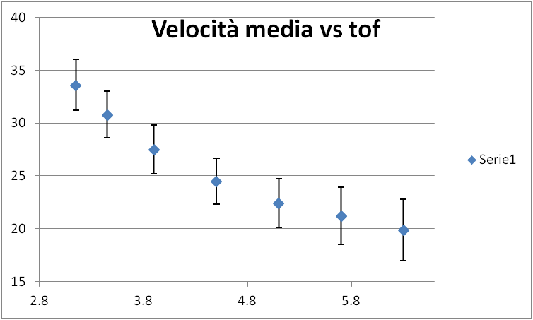
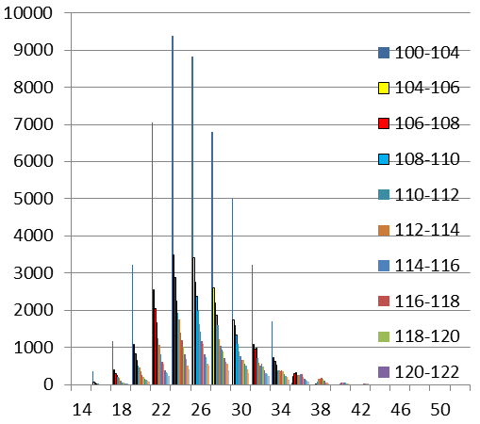
Mean muon velocity vs time of flight
cm/ns
ns
cm/ns
cm

Slide 10
Time of flight distribution for muon vertical tracks
101 < Tl (cm) < 102
105 < Tl (cm) < 106

Slide 11
CAGL-01
tl(cm)
tof(ns)
CATA-02
tl(cm)
tof(ns)

Slide 12
Conclusions
Mean muon velocity of about 26 cm/ns in CATA-02 data is indipendent from analyzed period, while the standard deviation increase from 3.0 to 4.2 cm/ns in recent data
CAGL-01 data show a mean velocity of 28 ± 3 cm/ns
Mean velocity is rather indipendent from track lenght while seems to depend from time of flight
The width of the velocity distribution is strongly related to the width of the time of flight distribution
Track lenght-time of flight scatterplots show small correlation

