Slide 1
The arrival of Gravitational Waves and the EEE network:
An update
F.Riggi & P. La Rocca
EEE Meeting, April, 2018

Slide 2
List of GW observed so far
Label UTC Time Notes
GW150914 | 2015-09-14 09:50:45 | First GW detection;
GW151226 | 2015-12-26 03:38:53
GW170104 | 2017-01-04 10∶11:58 | Farthest confirmed event to date
GW170608 | 2017-06-08 02:01:16 | Smallest BH progenitor masses to date
GW170814 | 2017-08-14 10∶30:43 | First detection by three observatories; first measurement of polarization
GW170817 | 2017-08-17 12∶41:04 | First detection of Em counterpart

Slide 3
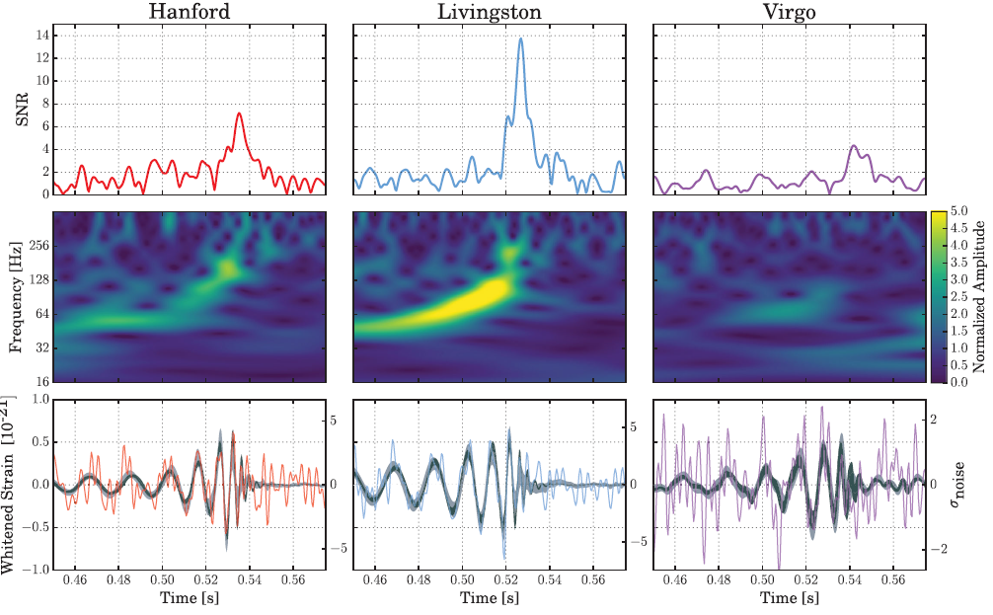
The time scale: tens of milliseconds
Time scale of the order of 0.01 s
0.02’’

Slide 4
What about other messengers
Recent searches for other probes synchronized with the arrival of GW
(See our previous presentation on March 28 for details):
Gamma Ray Burst detected in coincidence with GW170817 by INTEGRAL and FERMI Collaborators (Delay 1.74 s)
Combined search for high energy neutrinos by Auger, IceCube and ANTARES within +/- 500 s → No evidence found

Slide 5
The EEE network: Where and when to search
Showers initiated by high energy protons or nuclei arrive with an unknown delay (even many years!) with respect to GW or photons
Assuming a distance of 540 Mpc ( 1Mpc = 3.086 x 10²² m)
Proton Energy γ (c-v)/c Delay over 540 Mpc
1 TeV 1066 4.4 10 ⁻⁷ 790 years
10¹⁹ eV 10¹⁰ 4.4 10 ⁻²¹ 250 µs
Search for events associated to showers initiated by gammas or neutrinos?

Slide 6
Work in progress
Only 6 EEE telescopes active on August 14 and 17
Carry out some search on the active telescopes around the expected UTC time for the August 14 & 17 GW events
Evaluate the background for single track events and multi-track events
Search for any event close to the expected time and compare to the background

Slide 7
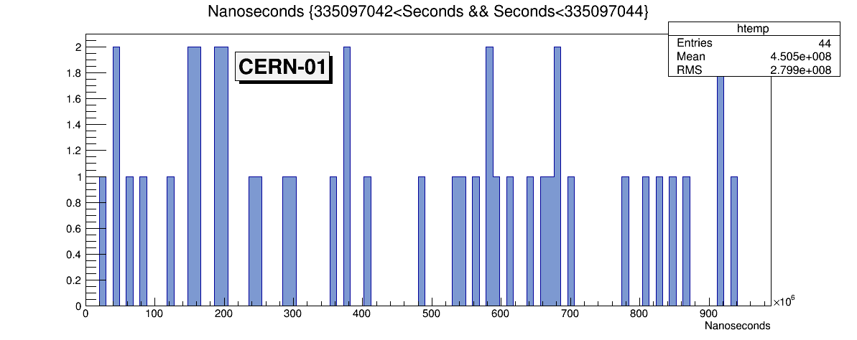
The GW event on August 14, 2017
UTC Time 10h30’43’’,53 = 335097043’’ since Jan.1, 2007
CERN-01 Telescope

Slide 8
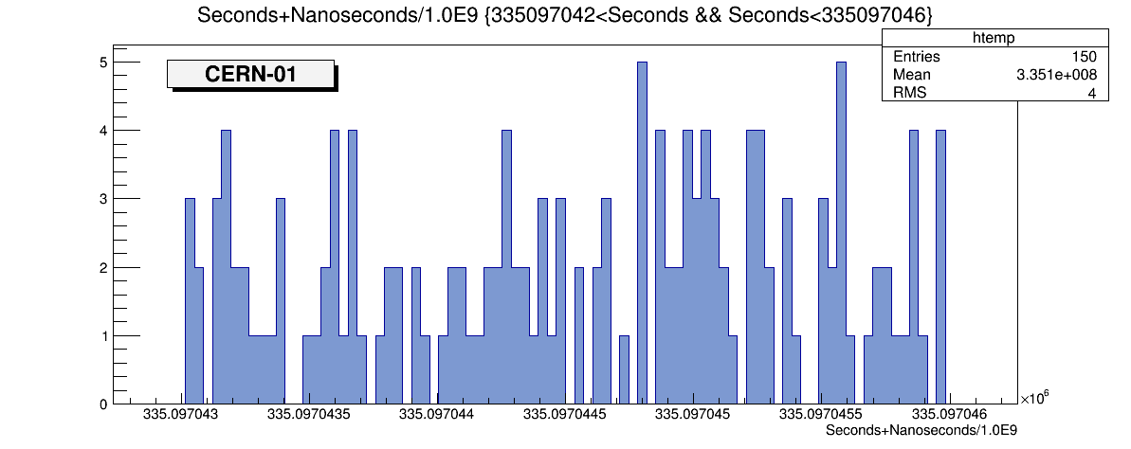
The GW event on August 14, 2017
A 3-seconds scan after the expected event

Slide 9
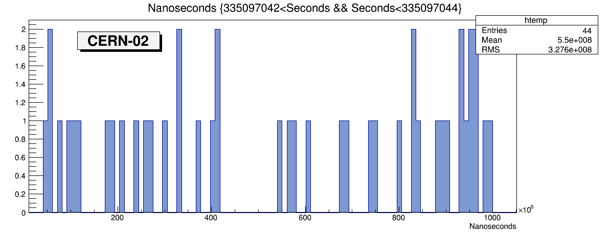
The GW event on August 14, 2017
Another telescope: CERN-02, similar results

Slide 10
The GW event on August 14, 2017
About 40 events/s, hence 0.4 events on average in 0.01’’
Probability to get >=1 events in 0.01’’ very large (>30%), so no chance
(unless we would observe a burst of events)
Better strategy: search on multitrack events
Rate of multitrack events: 10-60 events in 1000’’
First analysis carried out in +/- 500 s around the GW event of interest
for all the 6 active EEE telescopes

Slide 11
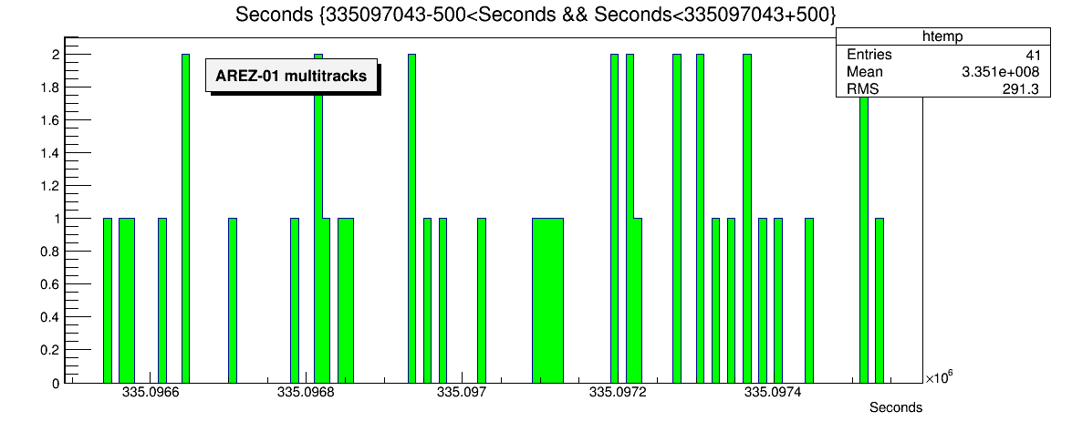
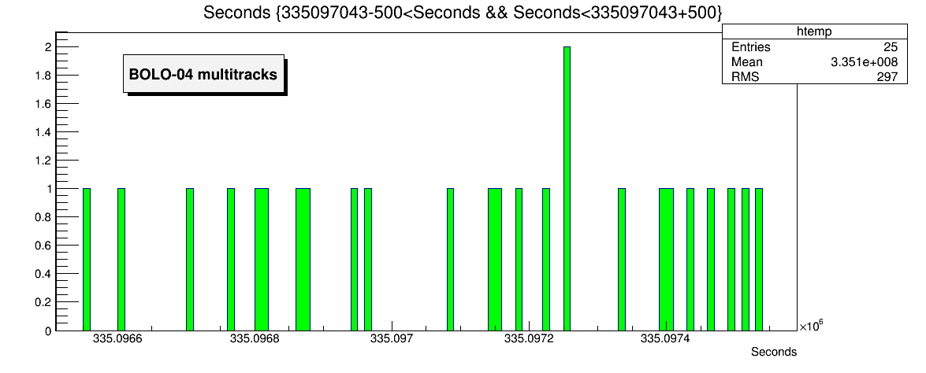
The GW event on August 14, 2017

Slide 12
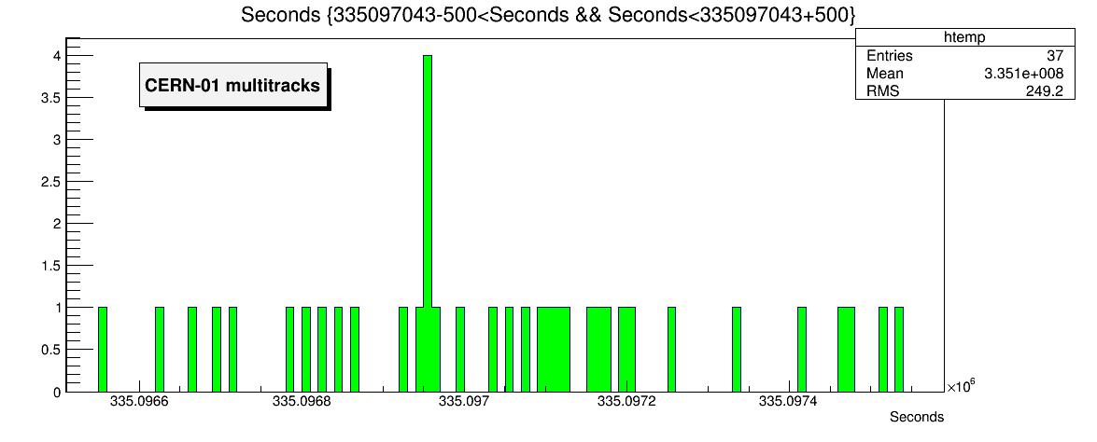
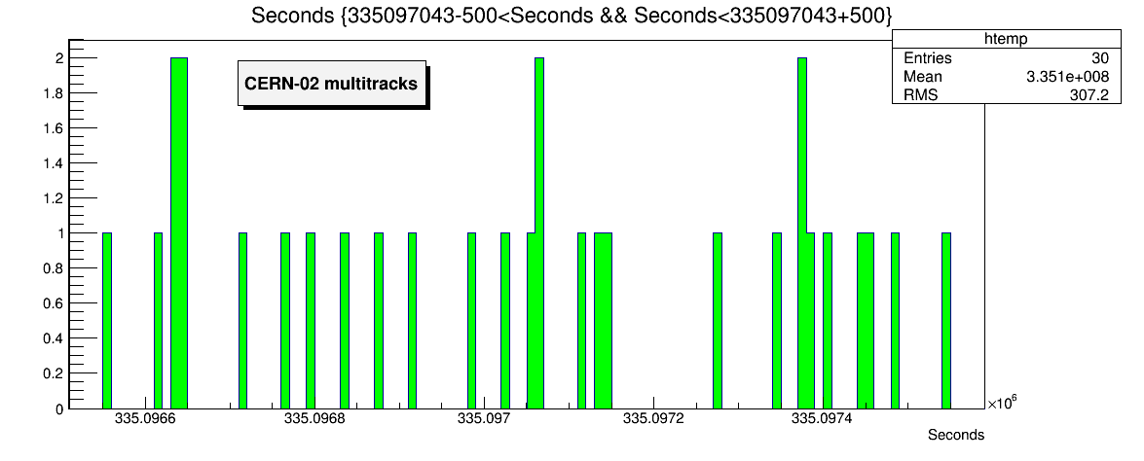
The GW event on August 14, 2017

Slide 13
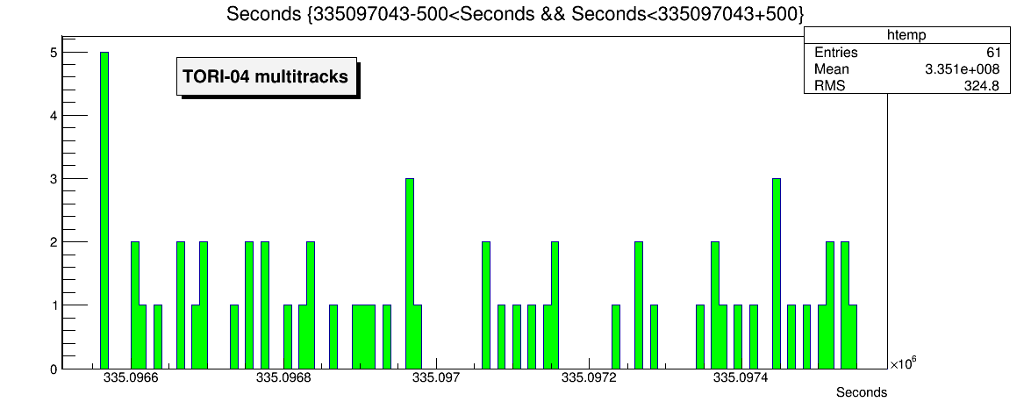
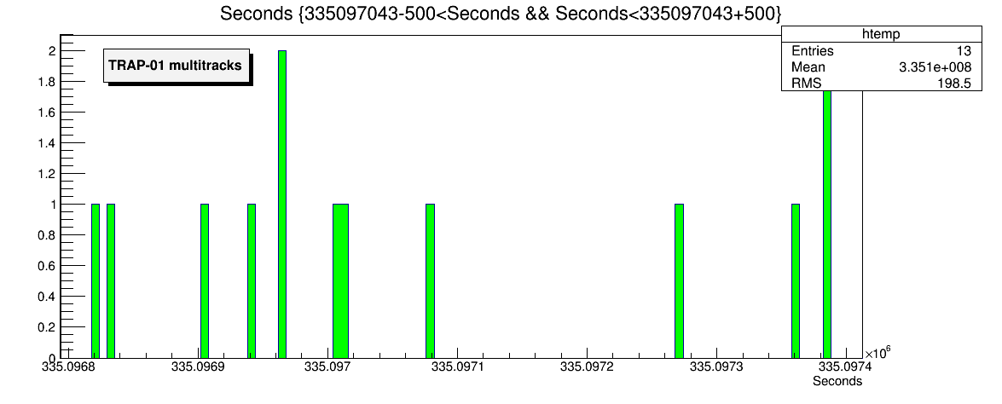
The GW event on August 14, 2017

Slide 14
The GW event on August 14, 2017
Telescope | Events in 1000’’ | Closest events after GW event (335097043,53)
AREZ-01 | 41 | 335097099,82 (+56 s)
BOLO-04 | 25 | 335097085,57 (+42 s)
CERN-01 | 37 | 335097050,70 (+7 s)
CERN-02 | 30 | 335097054,97 (+11 s)
TORI-04 | 61 | 335097061,65 (+18 s)
TRAP-01 | 13 | 335097076,22 (+33 s)

Slide 15
The GW event on August 14, 2017
Ratio between number of events observed in a time interval of 500 s after and before the GW event:
Telescope | N(t0+500)/N(t0-500)
AREZ-01 | 23/18
BOLO-04 | 15/10
CERN-01 | 18/19
CERN-02 | 16/14
TORI-04 | 29/32
TRAP-01 | 5/8
Total | 106/101

Slide 16
The GW event on August 17, 2017
Similar analysis also carried out for GW event observed on August 17
UTC Time: 335364064,4’’
Telescope | N(t0+500)/N(t0-500)
AREZ-01 | 18/19
BOLO-04 | 9/13
CERN-01 | 25/13
CERN-02 | 13/10
TORI-03 | 9/9
TORI-04 | 35/26
Total | 109/90

Slide 17
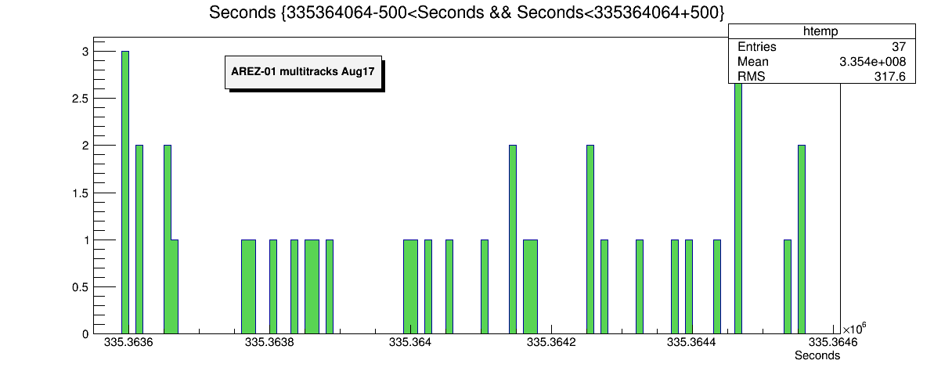
The GW event on August 17, 2017

Slide 18
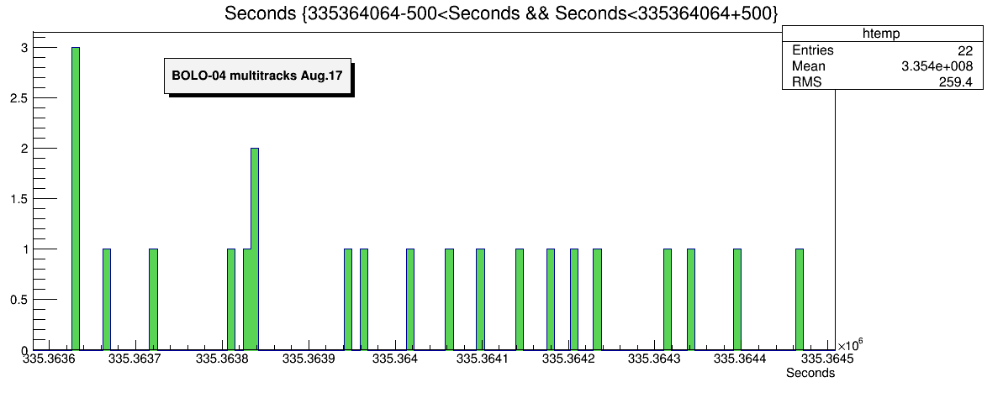
The GW event on August 17, 2017

Slide 19
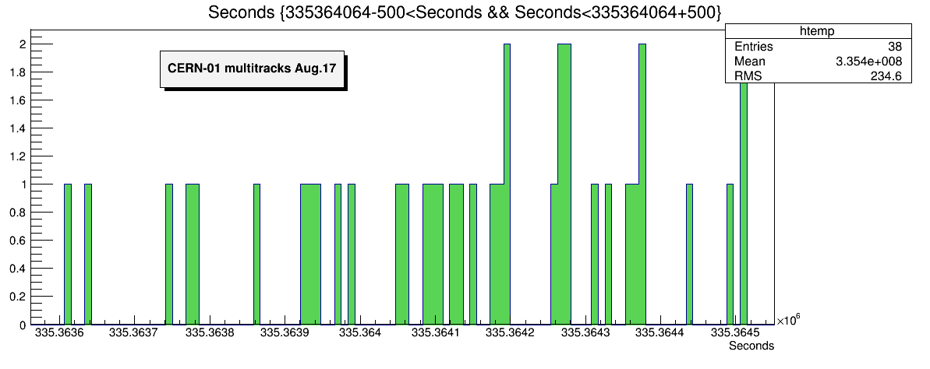
The GW event on August 17, 2017

Slide 20
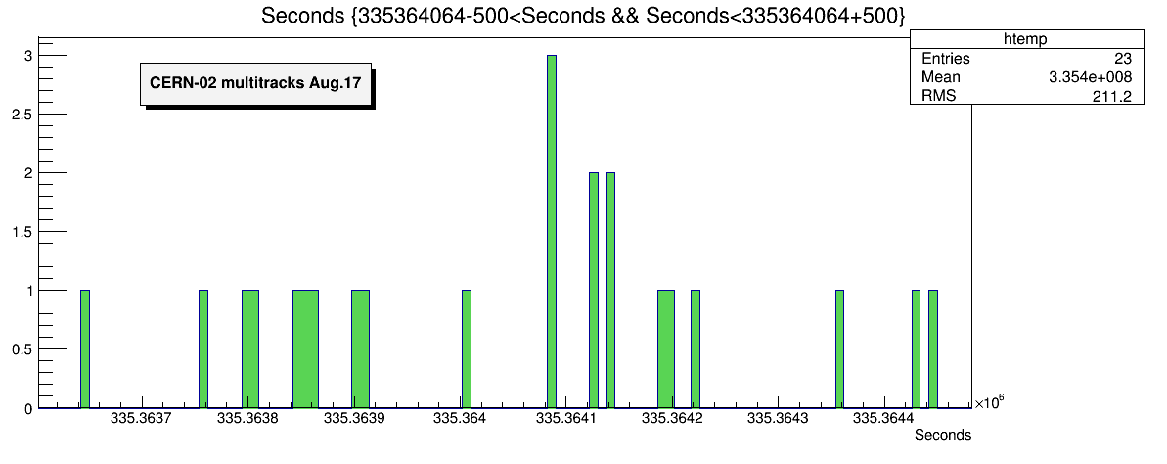
The GW event on August 17, 2017

Slide 21
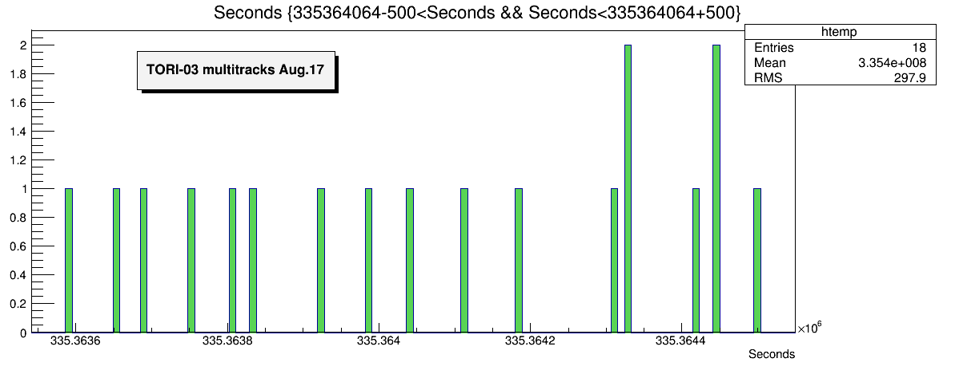
The GW event on August 17, 2017

Slide 22
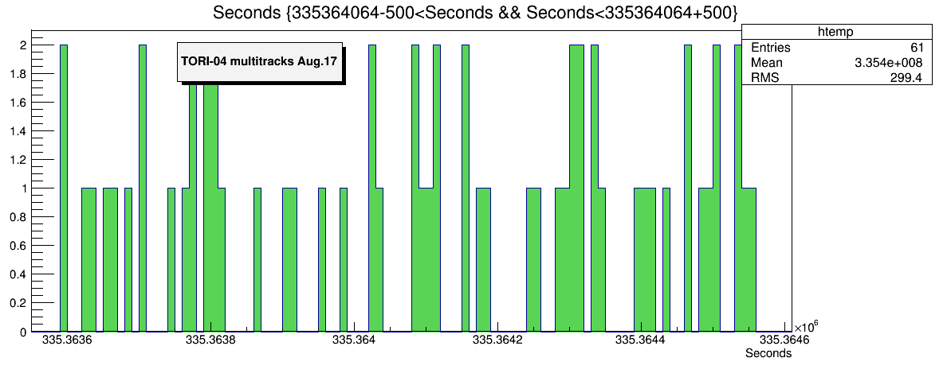
The GW event on August 17, 2017

Slide 23
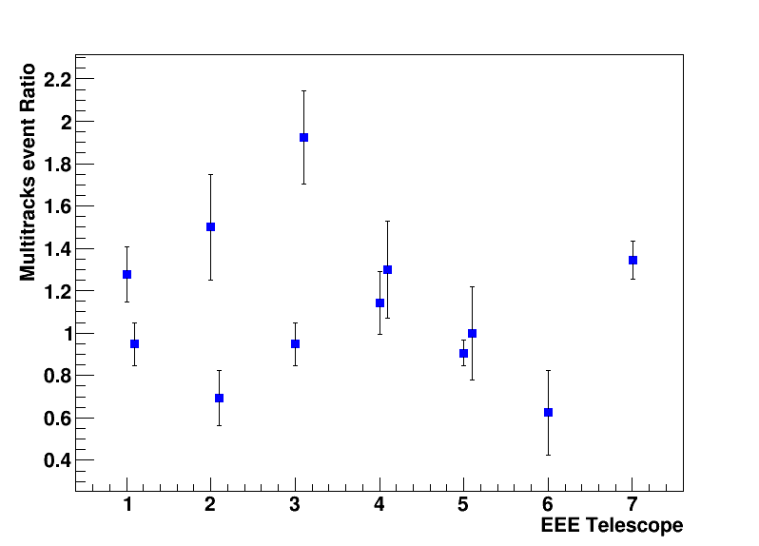
Overall result from the two GW events
Average Ratio= 1.13
Ratio between number of events observed in a time interval of 500 s after and before the GW event for all sites and for the two GW events

Slide 24
Summary
At the moment everything seems to be compatible with no observation of any specific anomaly.
Very small excess of multitrack events observed in a time interval of 500 s after GW events in different sites (Any meaning?)
New analysis strategies possible?
Possibly check any coincidence event between far telescopes (only few combinations available)

