Slide 1
Power and UPS
PRO:
Cheaper
Simpler
CONS:
- Two different control systems
PRO:
More Homogeneous
One control system for both
CONS:
One more device = point-of-failure
More expensive
Scenario 1
Scenario 2
~ 350 Euro
~ 200 Euro
220 AC to 24 V DC
220 V AC to 12 V with UPS
school
24 V DC to 12 V with UPS
school
Battery 12 V
Battery 12 V
~ 330 Euro
~ 330 Euro
24 V DC to 12 V with UPS
24 V DC to 12 V with UPS
boat
boat
Note: all are CERN discounted special prices
Battery 12 V
Battery 12 V

Slide 2
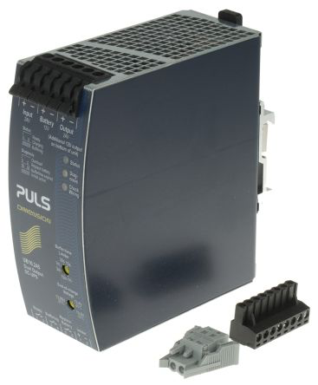
Power supplies with integrated UPS control
220 AC – DC 12V
RS Italia (cod. 2866598) 288 Euro
Farnell CERN discount: 180 Euro
DCDC 24V – 12V
RS Italia (cod. UB10.245) 317 E
RS CERN discount: 222 Euro
(Marco@BO ordered RS)
(Ombretta@CERN
Received 14/3/2018)
Can use the same external 12 V battery model
Similar control signals (to be verified)

Slide 3
Batteries
Pb battery, light, 12V 0.8 A
14 Euros
Farnell code 2145726
Bologna?
(Ombretta@CERN
Received 14/3/2018)

Slide 4
Testing AC-DC UPS at CERN
0V,0V,0V
AC power OK
12V,0V,0V
Battery failure
0V,12V,0V
Monitoring with 3 signals 12V (corresponding to LED alarms)
We need circuitry (voltage dividers?) to reduce 12 V and read it with Raspberry Pi (to GPIO pins, 1.2V to max 3.3V)
AC power failure (working on battery)

