Slide 1
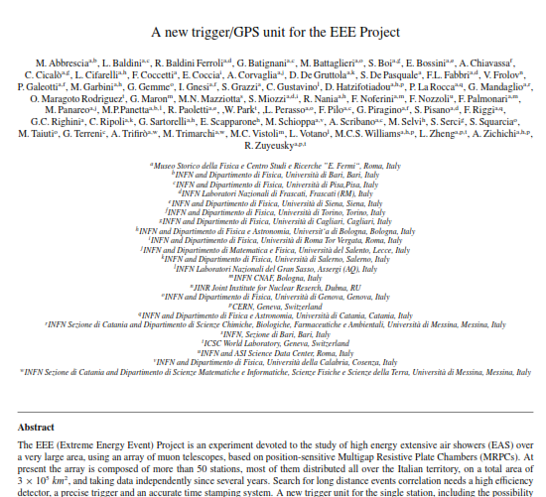
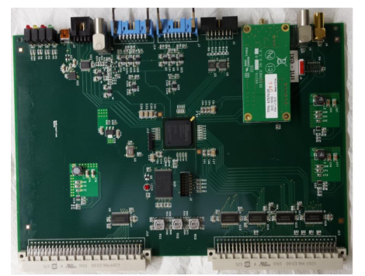
A new Trigger/GPS Unit for the EEE Project
A. Corvaglia
M. Panareo
M.P. Panetta
(M. Rizzi)

Slide 2
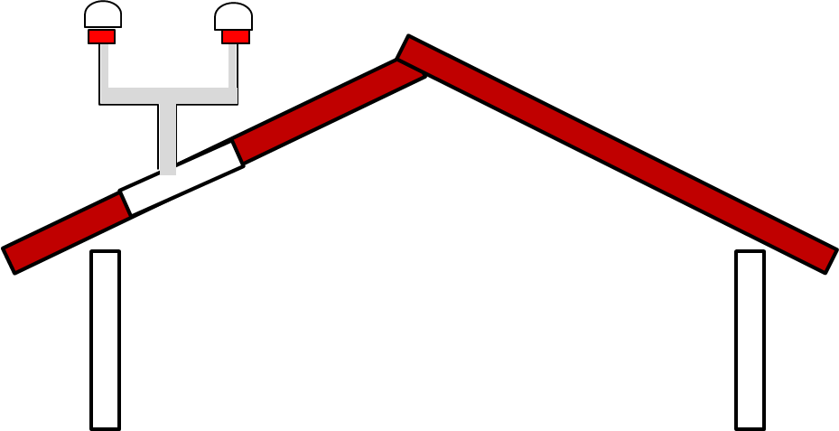
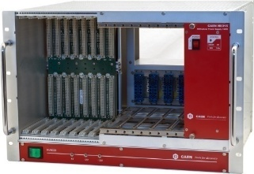
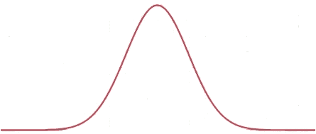
A new Trigger/GPS Unit for the EEE Project
Abstract
Introduction – the EEE Project
The EEE Data Acquisition
A brief introduction of the old System
EEE Trigger/Gps System
Trigger System
GPS Interface
Event Time Stamp
Time Stamp jitter Δt measurements beetwen 2 different boards (same VME Crate, same length cable) with the aim of evaluate the PPS resolution σ_{PPS} ( 30 ns). The global Time Stamping resolution should be the sum of the TDC resolutions σ_{TDC} (100 ps TDC resolution) and of PPS resolution σ_{PPS}
Conclusions
Trigger/Gps Board 2
Trigger/Gps Board 1
˜
Δt = t_{PPS1} – t_{PPS2}
PPS resolution
σ_{PPS}
entries

Slide 3
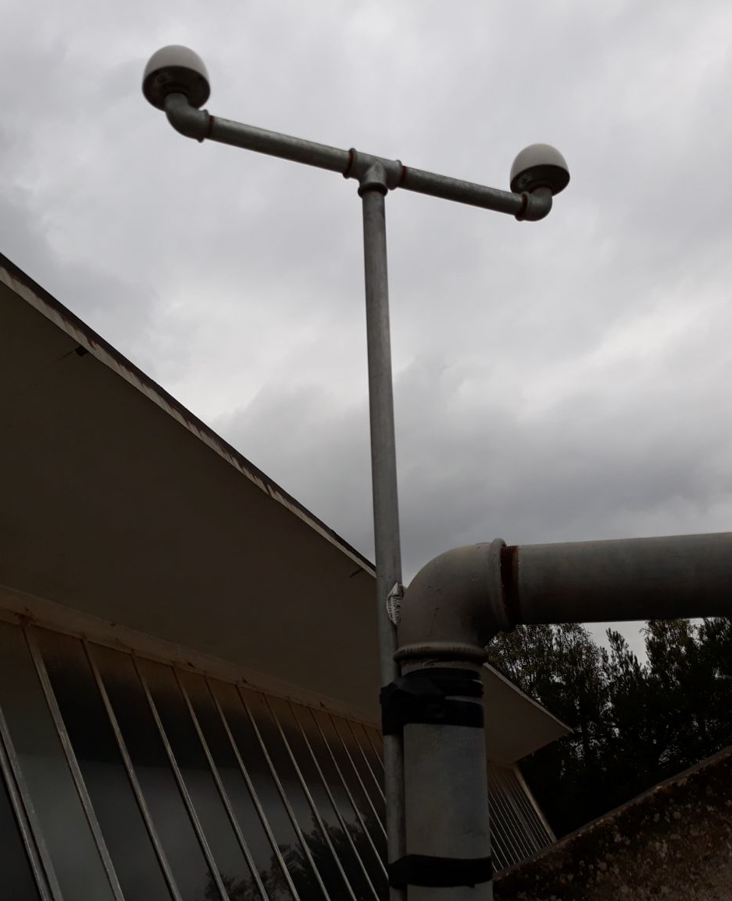
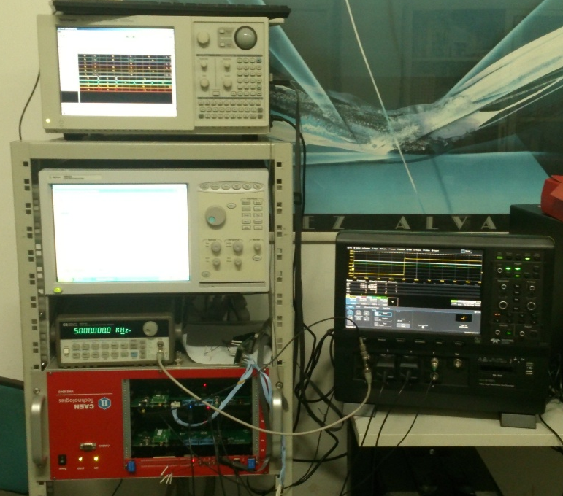
A new Trigger/GPS Unit for the EEE Project
Time Stamp jitter
20 Trigger/GPS Boards in the Electronic Lab. at Lecce
The bracket was mounted, the other GPS antenna was mounted
20 Boards already tested
5 under test
Trigger/Gps Board 1
Trigger/Gps Board 2
Δt = t_{PPS1} – t_{PPS2}
σ_{PPS}
entries

Slide 4
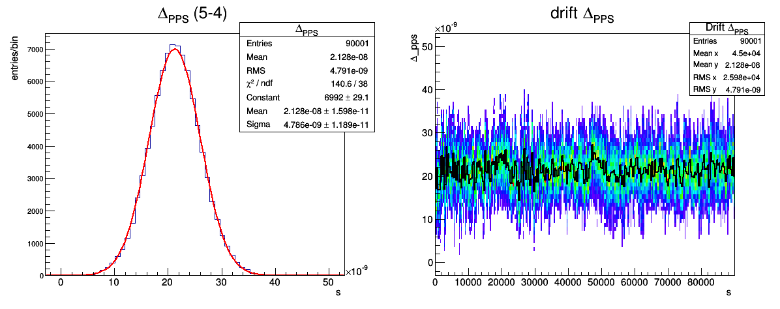
Time Stamp jitter
Boards N. 5 - N.4
Δ_{PPS} = t_{PPS1} – t_{PPS2}
Δ_{1PPS(mean)} = 21,3 ns
σ_{1PPS(mean)} = 4,79 ns
T = 90000 s
Length difference between the Antenna cables = 2,7 m
~ 13 ns

Slide 5
Time Stamp jitter
Boards N. 5 - N.4
Δ_{PPS} = t_{PPS1} – t_{PPS2}
Δ_{1PPS(mean)} = 21,3 ns
σ_{1PPS(mean)} = 4,79 ns
T = 90000 s
Drift of Δ_{PPS} during 1 day
Bin width =300 s

Slide 6
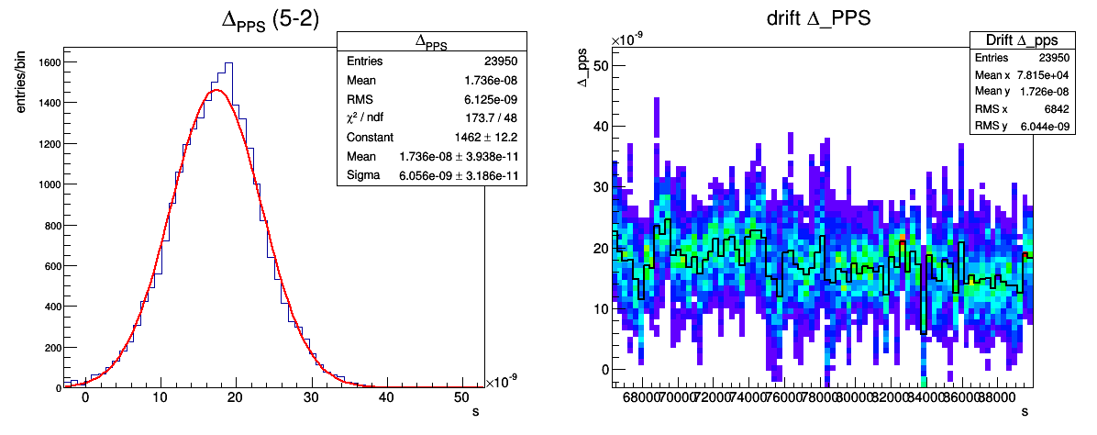
Time Stamp jitter
Boards N. 5 - N.2
Length difference between the Antenna cables = 2,7 m (~ 13 ns )
Δ_{PPS} = t_{PPS1} – t_{PPS2}
Δ_{1PPS(mean)} = 17,4 ns ;
σ_{1PPS(mean)} = 6,06 ns ;
T ~ 24000 s
Δ_{PPS} = t_{PPS1} – t_{PPS2}
Drift of Δ_{PPS} during 7 h
Bin =300 s

Slide 7
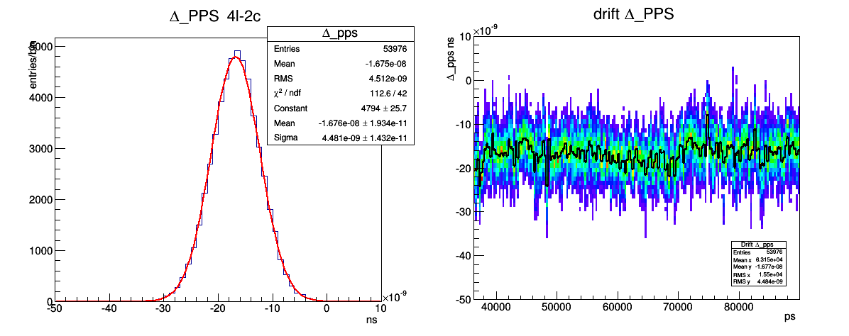
Time Stamp jitter
Boards N. 4 - N.2
Length difference between the two Antenna cables = 2,7 m (~ 13 ns )
Δ_{PPS} = t_{PPS1} – t_{PPS2}
Δ_{1PPS(mean)} = 16,8 ns
σ_{1PPS(mean)} = 4,48 ns
T ~ 54000 s
Δ_{PPS} = t_{PPS1} – t_{PPS2}
Drift of Δ_{PPS} during 15 h
Bin =300 s

Slide 8
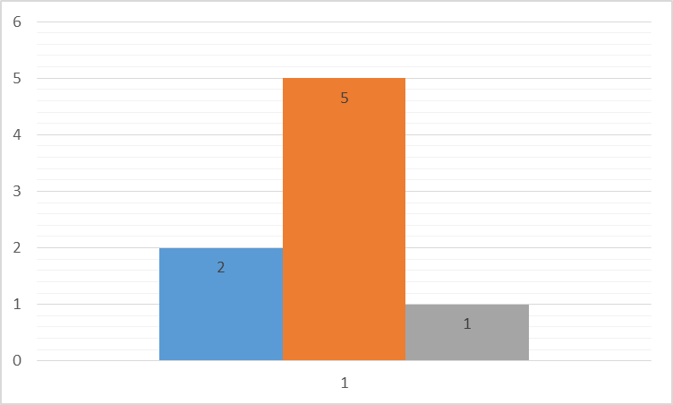
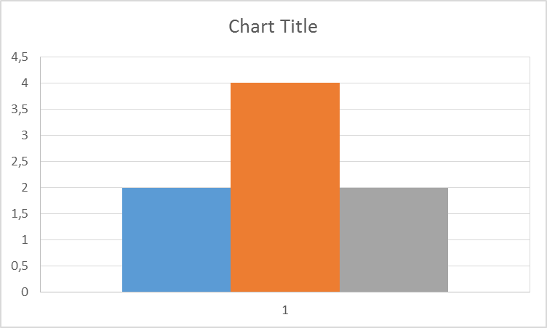
Time Stamp jitter
Δ_{PPS} = t_{PPS1} – t_{PPS2}
Measurements of 8 couples
σ_{Δ1PPS} distribution
σ _{Δ 1PPS}
Δ_{PPS_MEAN}
entries
3,5 4,5 5,5 ns
10 20 30 ns
Length difference between the two Antenna cables = 2,7 m (~ 13 ns )

Slide 10
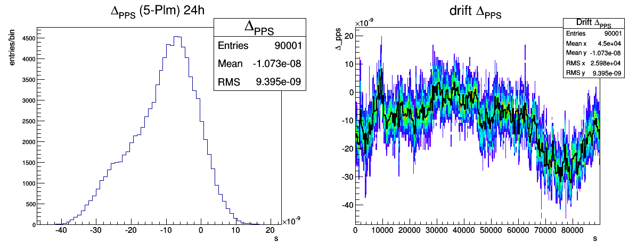
To be check…

