Slide 1
The arrival of Gravitational Waves and the EEE network:
A few preliminary considerations
F.Riggi & P. La Rocca
EEE Meeting, March 28, 2018

Slide 2
List of GW observed so far
Label UTC Time Notes
GW150914 | 2015-09-14 09:50:45 | First GW detection;
GW151226 | 2015-12-26 03:38:53
GW170104 | 2017-01-04 10∶11:58 | Farthest confirmed event to date
GW170608 | 2017-06-08 02:01:16 | Smallest BH progenitor masses to date
GW170814 | 2017-08-14 10∶30:43 | First detection by three observatories; first measurement of polarization
GW170817 | 2017-08-17 12∶41:04 | First detection of Em counterpart

Slide 3
List of GW observed so far
Label UTC Time Notes
GW150914 | 2015-09-14 09:50:45 | First GW detection;
GW151226 | 2015-12-26 03:38:53
GW170104 | 2017-01-04 10∶11:58 | Farthest confirmed event to date
GW170608 | 2017-06-08 02:01:16 | Smallest BH progenitor masses to date
GW170814 | 2017-08-14 10∶30:43 | First detection by three observatories; first measurement of polarization
GW170817 | 2017-08-17 12∶41:04 | First detection of Em counterpart

Slide 4
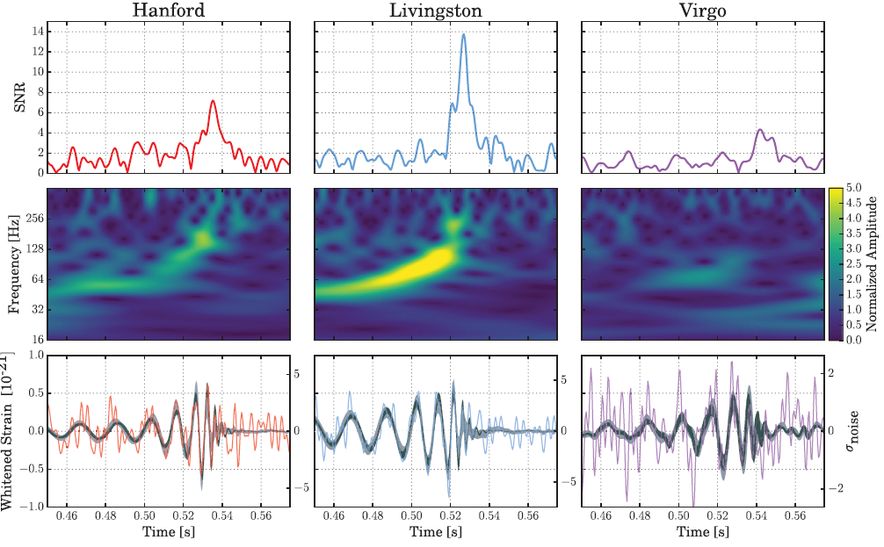
The event on August 14th, 2017 (UTC Time 10:30 43)

Slide 5
The time scale: tens of milliseconds
The observed events were lasting times of the order of 0.01 s
0.02’’

Slide 6
What about other messengers
Observation of GW events together with other probes measured by different experiments has been a point of interest even in the past.
Possibilities:
Search for High Energy Neutrinos or Gammas

Slide 7
A past search from LIGO, VIRGO & ANTARES
Analysis of old data (Jan-Sept. 2007) from LIGO, VIRGO & ANTARES for high energy neutrinos, carried out in 2013

Slide 8
What about other messengers: Gamma Ray Burst
Following recent observation of GW events, multimessenger searches have become increasingly important.
A recent example is the Gamma Ray Burst (GRB) detected by FERMI and INTEGRAL Collaborations

Slide 9
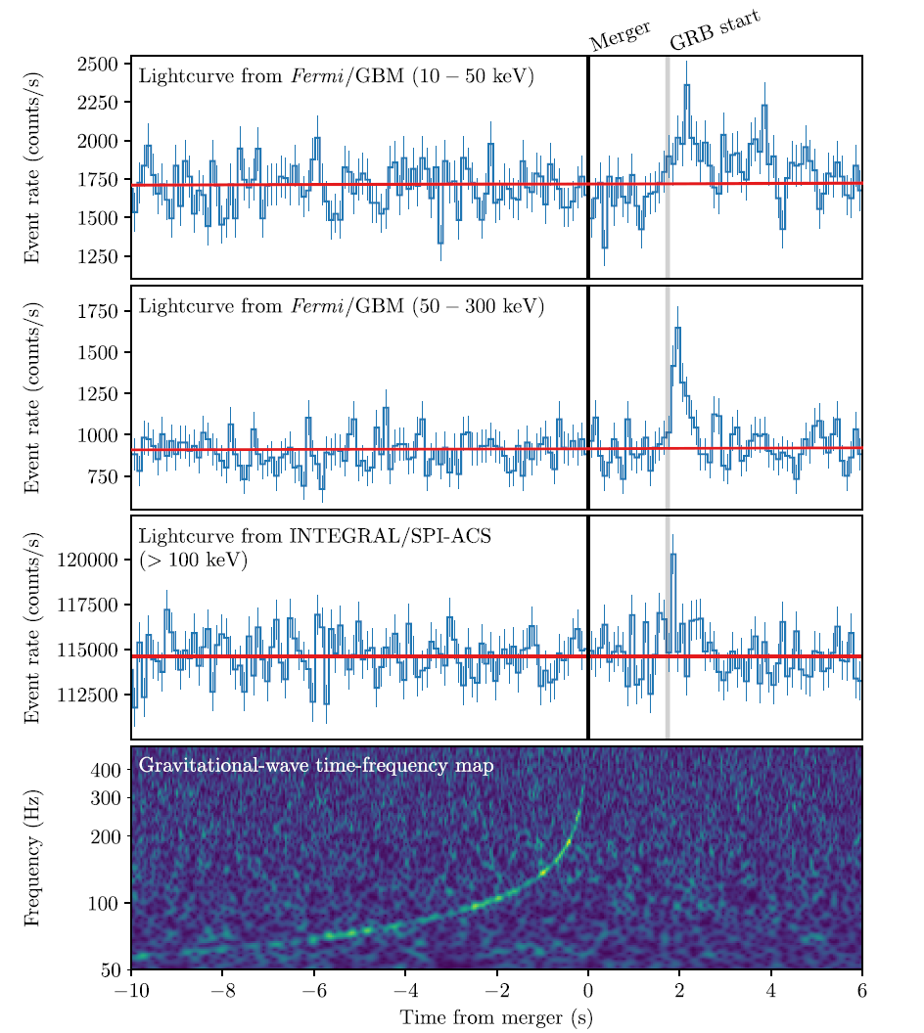
What about other messengers: Gamma Ray Burst
Observation of a GRB by the Fermi Gamma-Ray Burst Monitor and by the INTEGRAL station on August 17, 2017
Time delay = (1.74 ± 0.05) s
-3 10⁻¹⁵ < (c- speed of gravity)/c < +7 10 ⁻¹⁶

Slide 10
What about other messengers: neutrinos
A combined search for high energy neutrinos within ± 500 s

Slide 11
The EEE network: Where and when to search
The main problem is that showers initiated by high energy protons or nuclei arrive with an unknown delay with respect to GW or photons.
Assuming a distance of 540 Mpc ( 1Mpc = 3.086 x 10²² m)
Proton Energy γ (c-v)/c Delay over 540 Mpc
1 TeV 1066 4.4 10 ⁻⁷ 790 years
10¹⁹ eV 10¹⁰ 4.4 10 ⁻²¹ 250 µs

Slide 12
The EEE network
Does it make any sense to search for correlated events from EEE?
Individual EEE telescopes are mainly sensitive to muons from low energy showers (10¹¹- 10¹³ eV = 0.1 – 10 TeV)
Telescope clusters are sensitive to higher energy showers, depending on the mutual distance
Probably also for individual telescopes detecting multi-track events
During August 2017 only a few telescopes were active

Slide 13
The EEE network: Active telescopes in August 2017
Telescope 14/08 17/08 AREZ-01 x x BOLO-04 x x CERN-01 x x CERN-02 x x TORI-03 -- x TORI-04 x x TRAP-01 x --

Slide 14
Next steps
Carry out some search on the active telescopes around the expected UTC time for the August 14 & 17 GW events
Evaluate the background for single track events and multi-track events
Search for any event close to the expected time and compare to the background

Slide 15
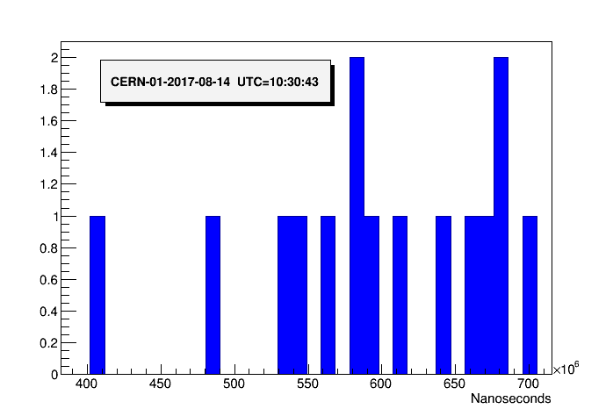
Just a first example..
More in the next weeks….

