Slide 1
Measurement of the speed of muons
International muon week
http://www.i2u2.org/elab/cosmic/home/project.jsp
Silvia Pisano
*Museo Storico della Fisica e Centro Studi e Ricerche Enrico Fermi
and Laboratori Nazionali di Frascati - INFN

Slide 2
Measurement of the muon speed
«Dear Cosmic Ray Experimenters,
International Muon Week has begun! It’s not too late to participate if you’d like to join in!
We have asked participants to measure the speed of muons, but if you want to tackle something a
bit easier, your group can take data measuring the flux of muons as usual. Even if you can’t
participate this week, consider measuring the muon speed sometime over the next few weeks and sharing your results with others.
I’ve also cced this as a late invitation to our Global Cosmics colleagues. Please contact me if you have any questions.
Regards,
Mark»
http://www.i2u2.org/elab/cosmic/home/project.jsp

Slide 3
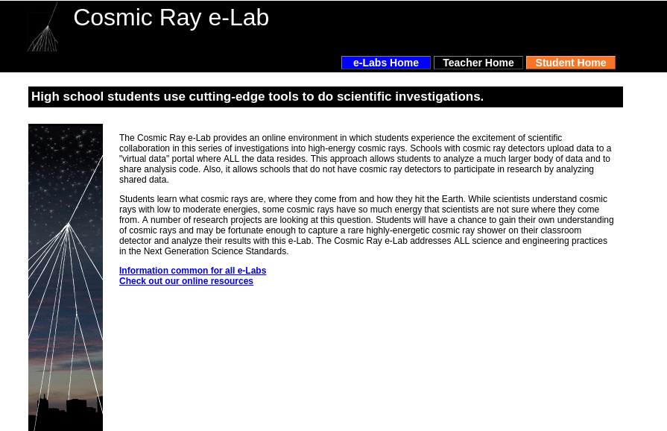
Measurement of the muon speed
http://www.i2u2.org/elab/cosmic/home/project.jsp

Slide 4
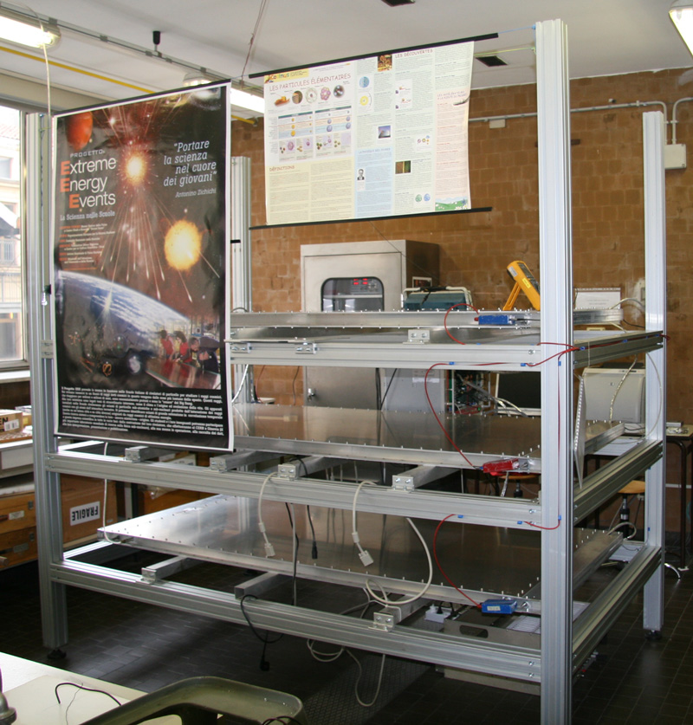
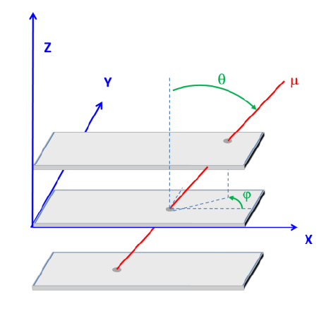
A perfect tool for the purpose: an EEE telescope

Slide 5
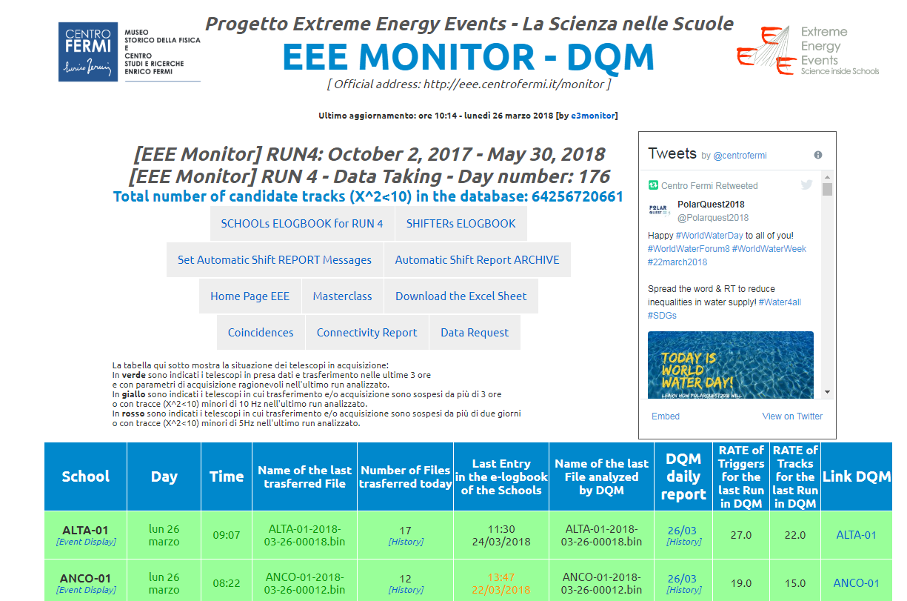
…an its data

Slide 6
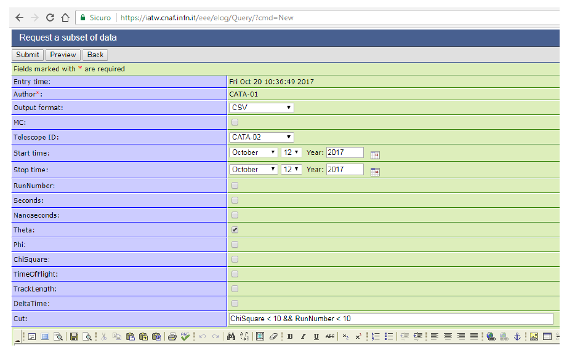
Access to data
see instructions for the International Cosmic Day

Slide 7
How to perform and optmize the measurement?
What are the relevant variables?
How do we get to the muon speed?
How do we extract the final value?
How many data points? How many stations to be included? The more the better?
What is the precision of the measurement?
How to optmize it?
Comment on the results: how the measured value compares with other fundamental quantities (e.g., c)?

Slide 8
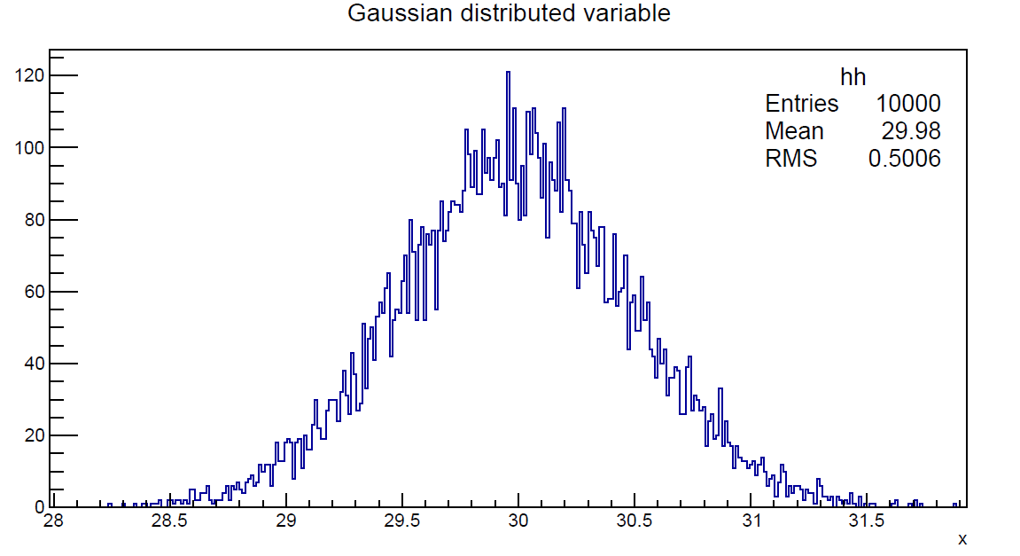
Statistics: mean
x (a. u.)

Slide 9
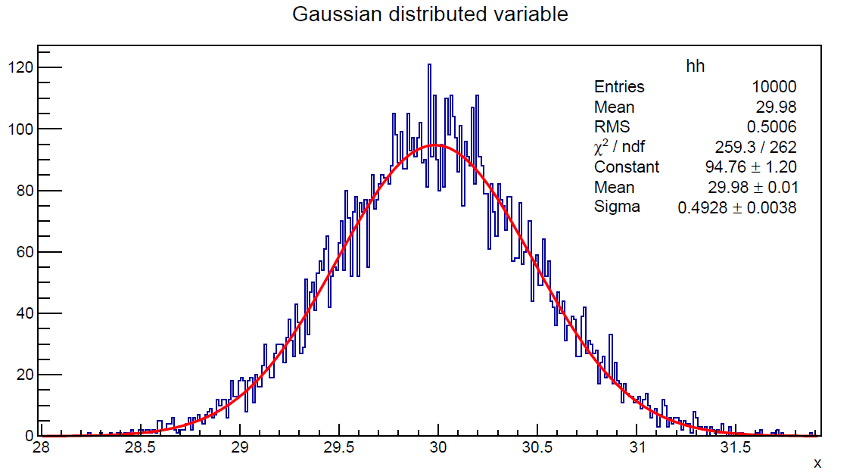
Statistics: fitted mean
x (a. u.)

Slide 10
The measurement can be done at different levels: it is left to your own initiative to optimize it
Final results will be presented in the next EEE run coordination meeting on a voluntary base
If no volunteers will be found, schools will be extracted randomly to present their results
Best measurement/presentation will be awarded

Slide 11
Do not try to corrupt your local referent
to get help!
The measurement can be done at different levels: it is left to your own initiative to optimize it
Final results will be presented in the next EEE run coordination meeting on a voluntary base
If no volunteers will be found, schools will be extracted randomly to present their results
Best measurement/presentation will be awarded

