Slide 1


Status and Plans of the
Extreme Energy Events experiment
M. Abbrescia for the
Extreme Energy Events collaboration

Slide 2
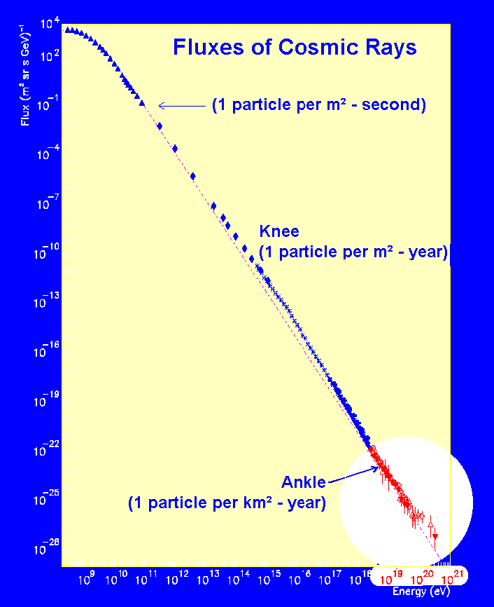
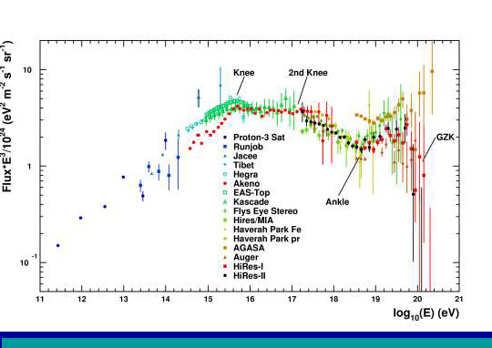
The project
Conceived in 2004 by its scientific leader, prof. A. Zichichi
Aims at covering the most interesting, and still unexplored, region of the cosmic ray spectrum:
  E > 10¹⁸ eV
  Extragalactic sources
  GZK cutoff
  (Greisen, Zatspein and Kuz’min)

Slide 3
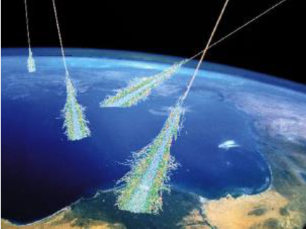
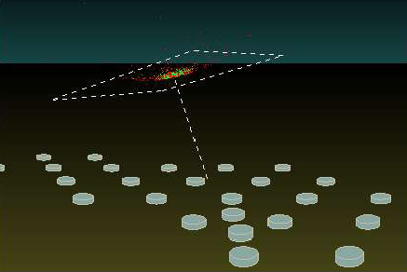
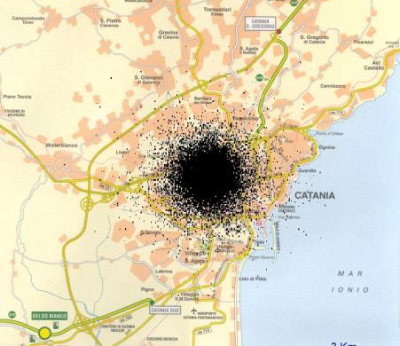
The EAS array
Detect muons arriving at the surface
Many, low cost, easy to operate stations
Simulation of the shower induced by a 10¹⁶eV proton
At ground level 1 million muons arrive, over an area with radius at least 2 km.
City of Catania

Slide 4
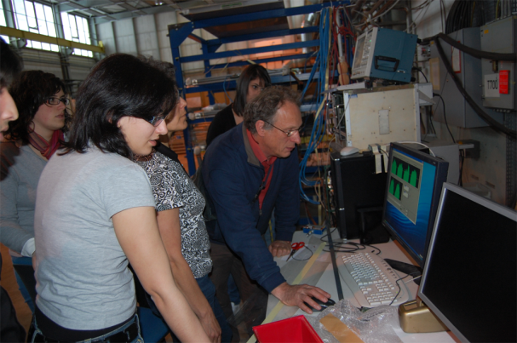
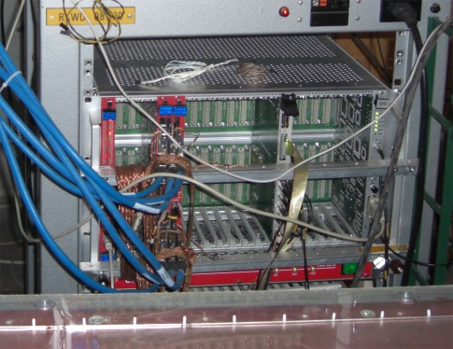
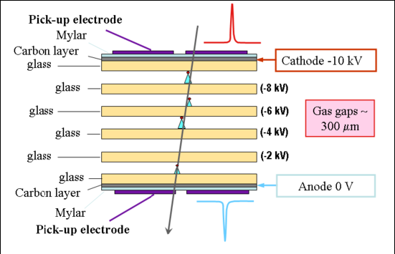
The EEE experiment structure
Each station consists of a telescope made out of 3 MRPC
  Exceptional tracking and timing performance
  Very similar to the ones used in ALICE@CERN
Coincidences among distant telescopes are searched for, to spot high energy showers

Slide 5
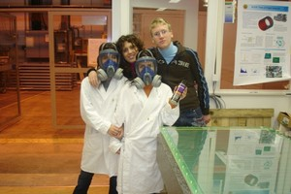
EEE is so innovative…
  because the experiment does not take place in scientific labs but…
in italian high schools
  because main actors of the experiment are not scientists but…
high schools students and teachers
  With the help of experts from the scientific world, students and teachers, they:
  Build their detectors at CERN
  Build the stations at their schools
  Take care of the data taking and relative analysis

Slide 6
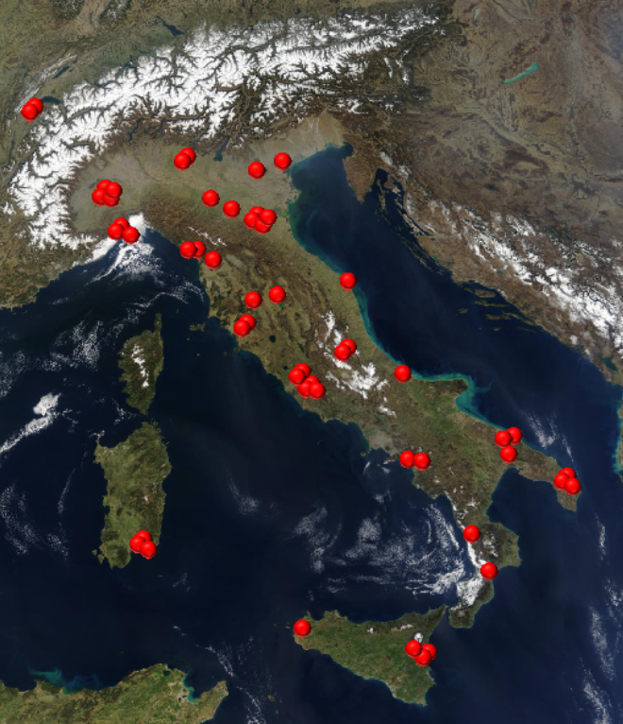
The schools involved
At present, 46 High Schools
are involved:
They are mostly distributed in
clusters in the whole Italian territory
+ 2 telescopes at CERN
+ 4 in INFN Units
Total: 52 telescopes

Slide 7
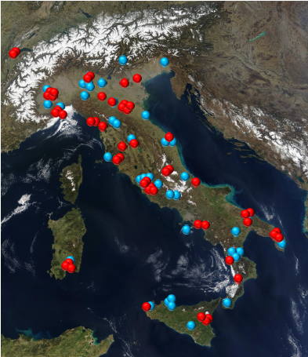

The schools involved
At present, 46 High Schools
are involved:
They are mostly distributed in
clusters in the whole Italian territory
+ 2 telescopes at CERN
+ 4 in INFN Units
Total: 52 telescopes
… and many, many others in the waiting list

Slide 8
Data taking
During Pilot Run (2014) and Run-1 (2015) around 5 billions candidate tracks acquired in total
During Run-2, collected around 15 billions candidate tracks!
  Run-2 started on 7th November to last until mid May
Run-3 starting TODAY up to end of June 2017
  double the statistics of Pilot Run+Run-1+Run-2
  improve the duty cycle
We are an observatory, we have no control on the interesting physics events that might take place!

Slide 9
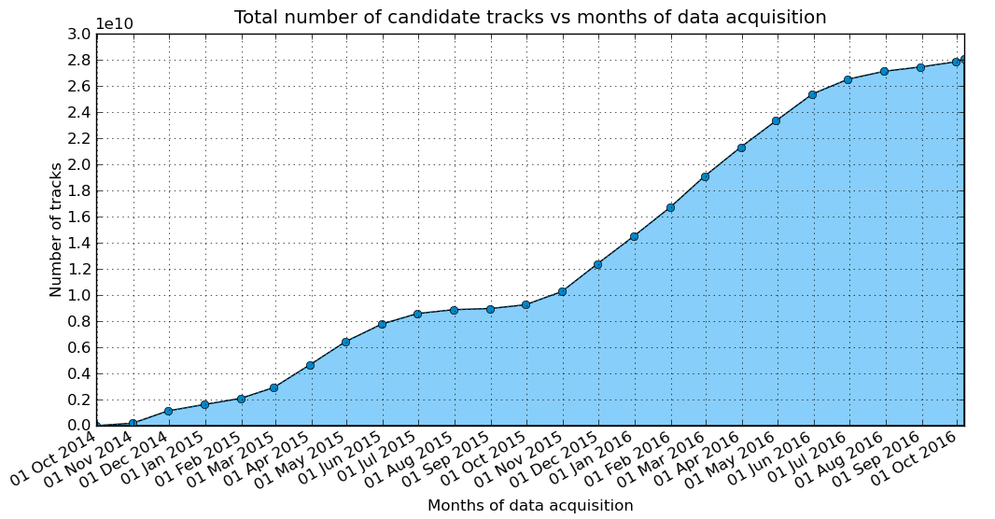
A few numbers…
Events acquired during EEE coordinated runs
20 billions tracks
Run 2
Pilot Run
Run 1

Slide 10
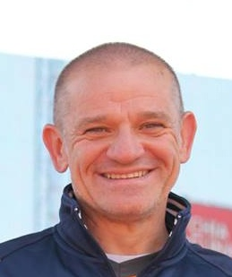
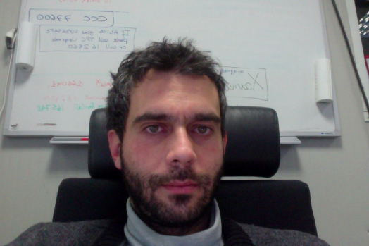

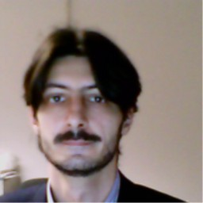
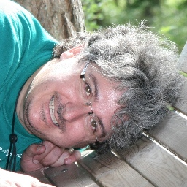
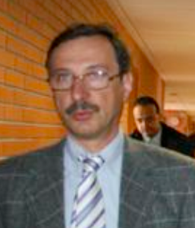
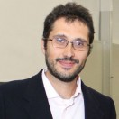
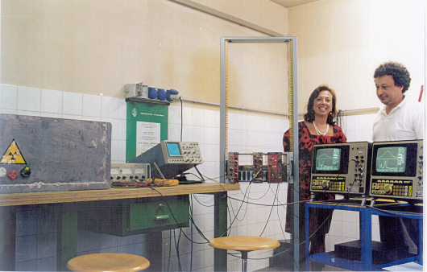
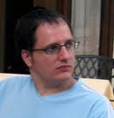
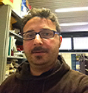

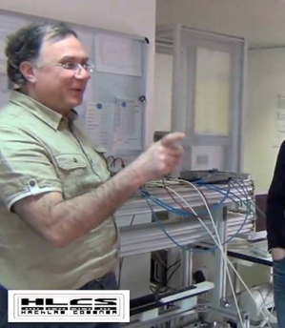
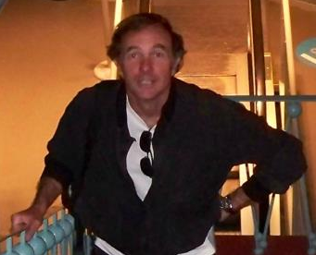
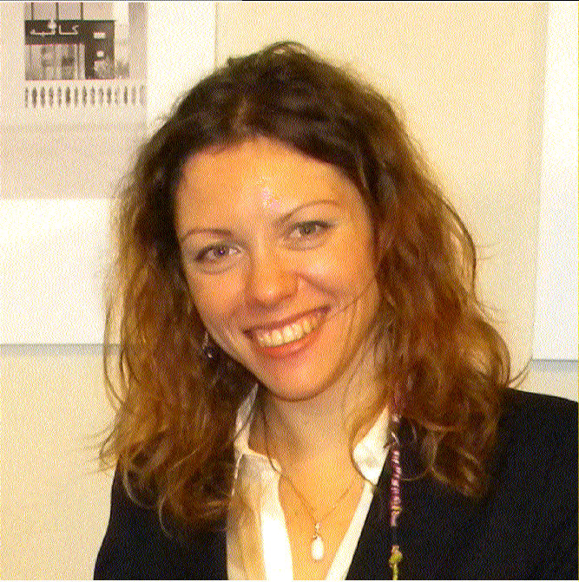
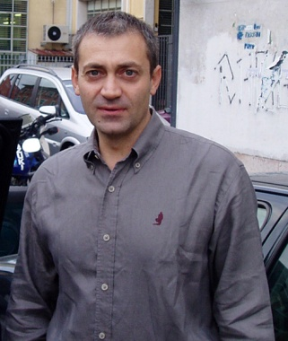
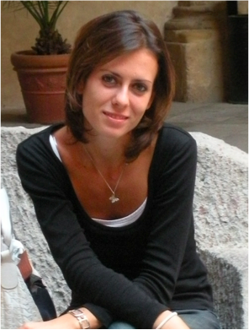
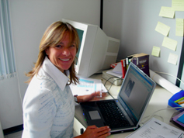
The EEE shift crew…
Corrado, Daniele, Edoardo, Federico, Fabrizio, Francesco Nof., Francesco Noz., Giovanni, Ivan, Laura, Luca, Marco G., Marco P., Marco S., Marcello, Maria Paola, Nicola, Paola, Silvia, Stefano

Slide 11

Results: Coincidences…
Coincidence is God’s way to remain anonymous (A. Einstein)

Slide 12
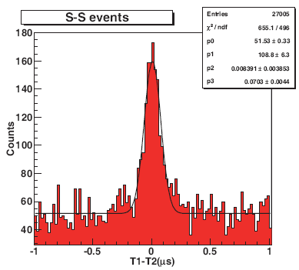
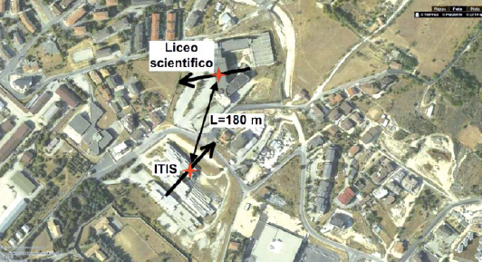
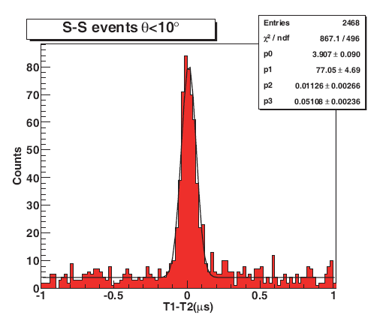
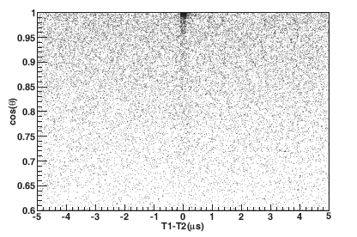
First coincidences detected
  At L’Aquila, closest stations of the experiment
  Angular correlations between “coincidences”
  Time difference
  between events
  revealed at the
  two stations
  No cuts
  Angular cut
  (requiring quasi parallelism) improves S/N

Slide 13
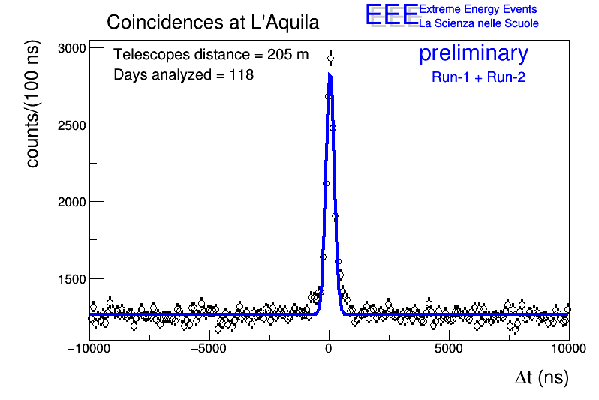
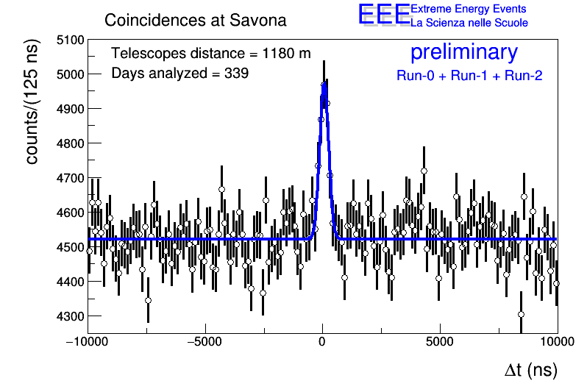
Results from Run-1 + Run-2
Coincidences:signature of high-evergy showers impinging on many stations at the same time
  observed at many telescope clusters
At L’Aquila peak almost twenty times more evident than first EEE publication (even after the earthquake!)
First observation of coincidences at distances > 1 km
larger distances=higher energies

Slide 14
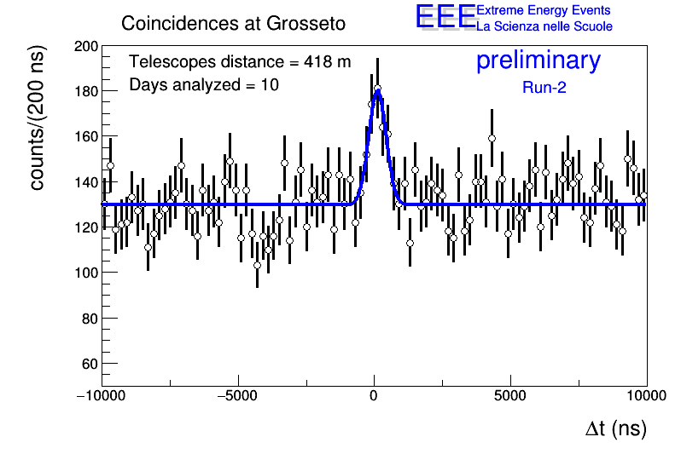
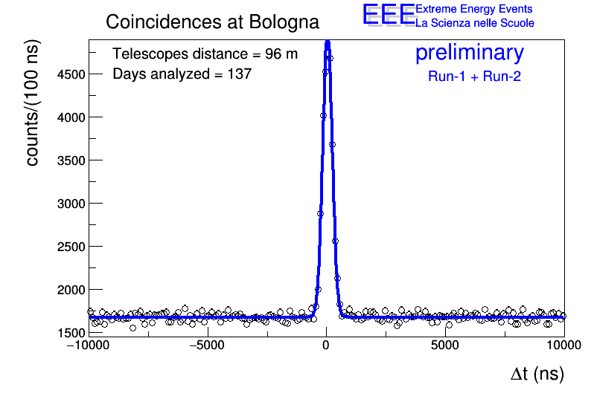
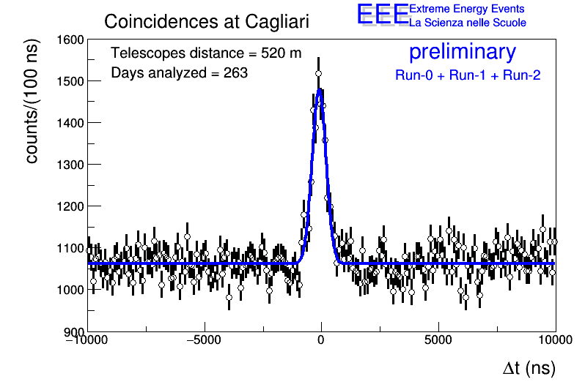
… and some other stations
Coincidences well reconstructed at several distances, from 15 to 1200 m
Larger distance = larger primary energy
More data taking needed to observe a peak above the background of accidental coincidences
Last born in the EEE family

Slide 15
Just coincidences?
Cosmic Rays (Forbush)Decreases
Local anisotropies
Upward going events

Slide 16
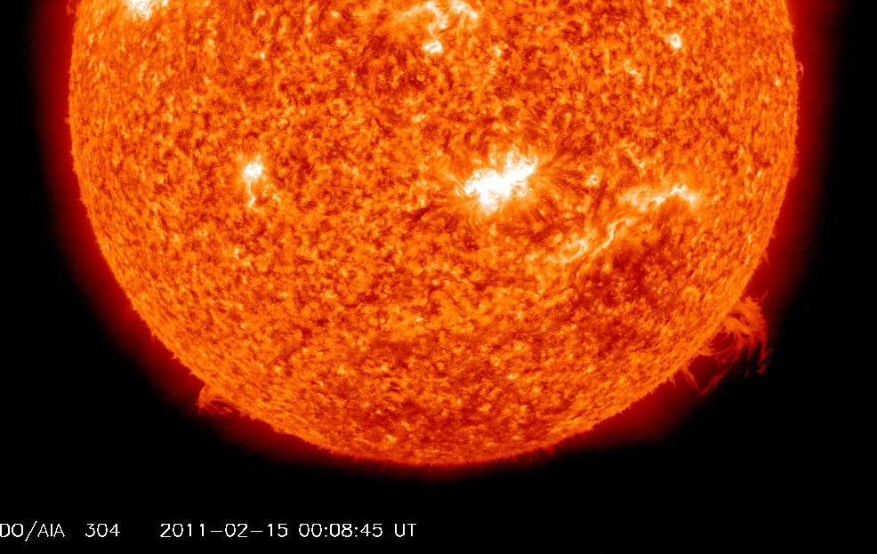
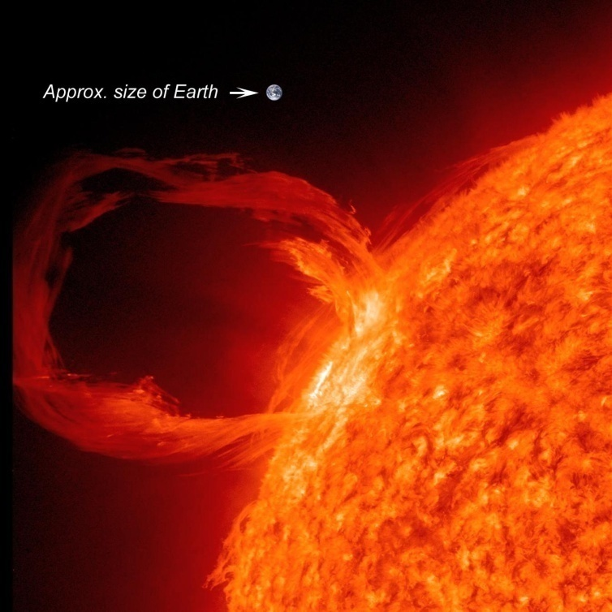
2011 Valentine’s Day Solar Flare
Flare recorded by the Solar Dynamics Observatory (SDO)
on the night between
14th and 15th
February 2011.
It is a solar flare, of category X2, followed by an important Coronary Mass Emission (CME)
This kind of flares are constantly monitored since they can have relevant consequences on Eartth

Slide 17
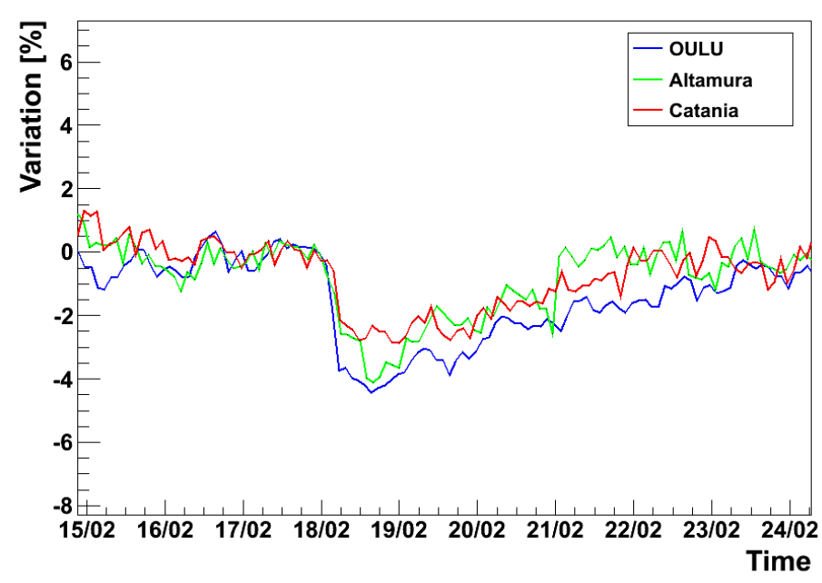
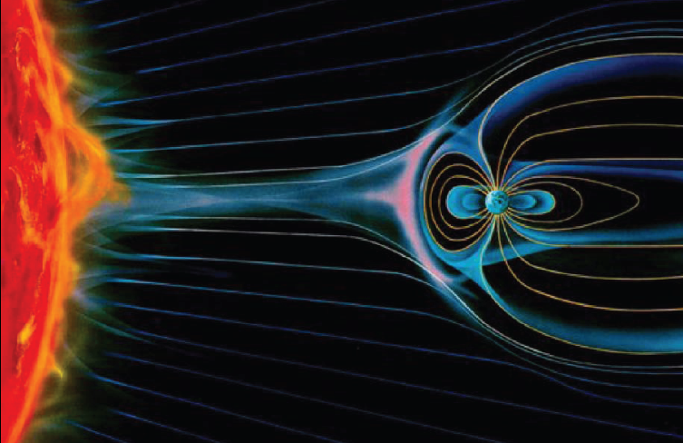
The Valentine’s Day solar flare as observed by the EEE Altamura telescope
First school ever to observe a cosmic-rays
decrease
Observed in the muon channel (rather rare)
First in the world to publish!
Data quality comparable to the one of professional observatories
(as presented to ICRC 2011)
Notes:
Qui i dati ottenuti ad Altamura vengono confrontati con quelli di Catania (sempre telescopio EEE, ma sito presso il dipartimento di fisica)
e quelli di OULU dove c’è un Neutro Monitor.

Slide 18
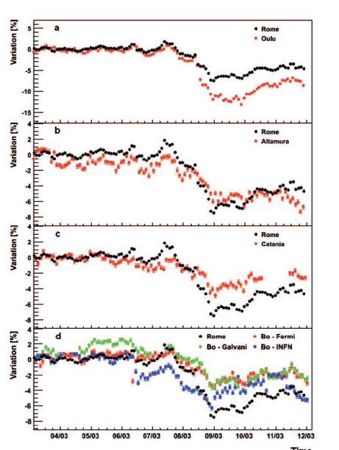
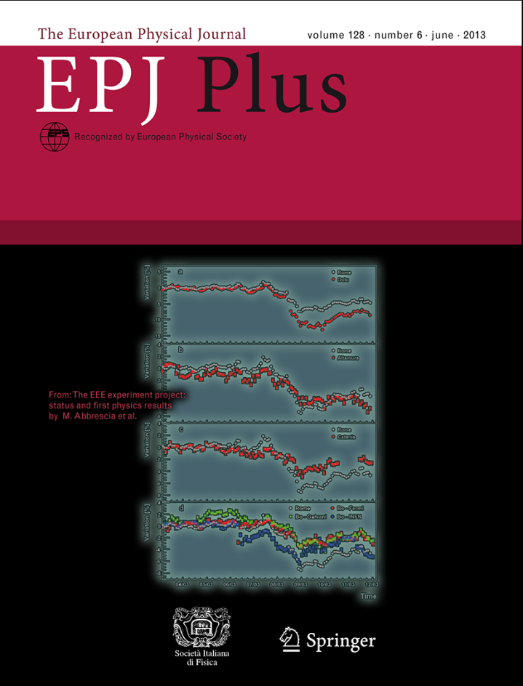

The March 2012 decrease
observed by
the Oulu (Finland) and Rome detectors
of the Neutron Monitor Network
5 EEE telescopes:
Altamura, Bologna (3), Catania
Notes:
Qui i dati ottenuti ad Altamura vengono confrontati con quelli di Catania (sempre telescopio EEE, ma sito presso il dipartimento di fisica)
e quelli di OULU dove c’è un Neutro Monitor.

Slide 19

Being up h24…
The 2016 new year Forbush: at 24.00 of 31/12/2015 our telescopes -in schools- were up and running!
New year!

Slide 20
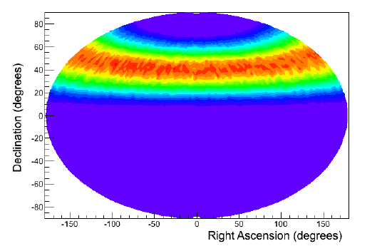
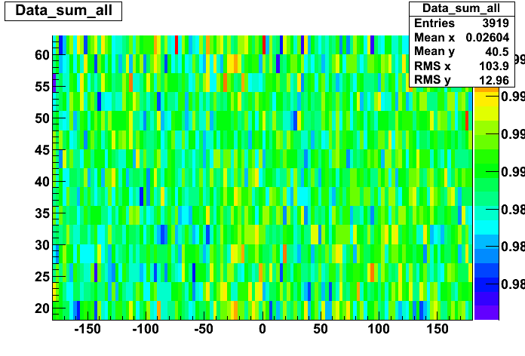
Local anisotropies
We assume that the direction of secondary muons mirrors, within a few degrees, that of the primary particle
Aitoff map of the sky coverage of a typical EEE telescope
possibility to explore the sky in the low energy region, where the influence of local phenomena could produce non uniformity over space and time
Skymap in equatorial coordinates from all sites (1-15 April 2015)
Exploring the cosmic rays anisotropy at the 0.2 % level
- EPJ-Plus (2015), 130:187
Notes:
Qui i dati ottenuti ad Altamura vengono confrontati con quelli di Catania (sempre telescopio EEE, ma sito presso il dipartimento di fisica)
e quelli di OULU dove c’è un Neutro Monitor.

Slide 21
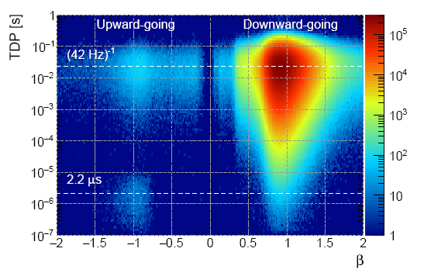
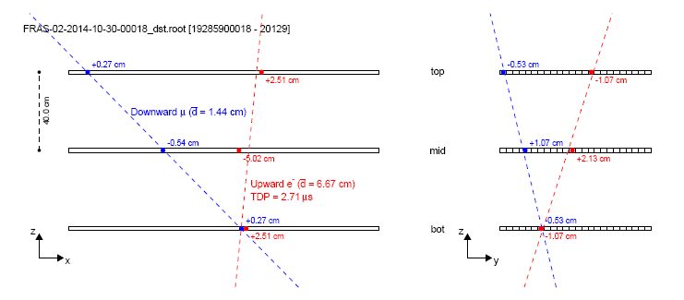
Upward-going events
About 1 event over 2000 observed to go in an upward direction
Some of them identified as
electrons coming from muon decays (in the floor or in the bottom chamber),
Blue track: downward muon
Red track: upward electron
Tagged downward µ + upgoing electron
Event display
(in the two projections)
EEE collaboration, A study of upward going particles with the Extreme Energy Events telescopes, NIM-A 816 (2016), 142-148
Notes:
Qui i dati ottenuti ad Altamura vengono confrontati con quelli di Catania (sempre telescopio EEE, ma sito presso il dipartimento di fisica)
e quelli di OULU dove c’è un Neutro Monitor.

Slide 22


Recent papers
EEE coll.: Looking at the sub-TeV sky by
cosmic muons detected in the EEE MRPC
Telescopes, EPJ-Plus (2015), 130:187
EEE coll.: A study on upward going particles with the Extreme
Energy Events telescopes, Nucl. Instr. and Meth. A 816 (2016) 142:148
+ three proceedings on peer-reviewed journals
... and in preparation
The EEE Telescope performances
An extended study of subTeV anisotropies with the EEE array
A study of multistation coincidences at the km scale with the EEE array
A Forbush decrease survey with the EEE telescopes

Slide 23

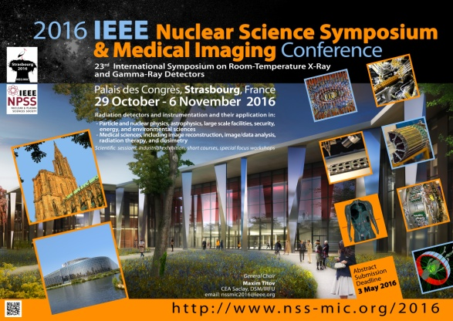
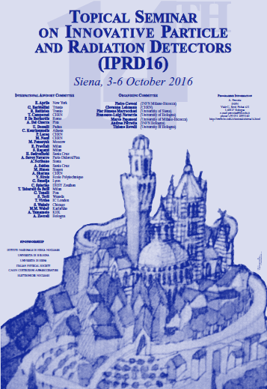

Conferences in 2016
Many presentations given by our younger collegues! ☺
8 presentations at SIF congress 2016
+ Ghent, Vienna, Ischia, Torino, Siena, Strasbourg

Slide 24


What’s next
We are at the beginning of a new
long period of data taking:
  at least double the statistics
  improve our hardware&software
  search for three telescopes coincidences
Extend coincidence measurements to larger (>2 km) distances
  coincidences of clusters of telescopes between different cities
Search for upgoing events
  Muon decays, backscattering, other?
Test the pointing capabilities of telescopes
  Cosmic rays anisotropies
  Moon (and Sun) shadow

Slide 25



Conclusions
The EEE experiment is an innovative
approach to:
  scientific research + scientific communication
Its stations, located in high schools, take data almost continuosly
  incredible enthusiasm by students and
  teachers
EEE produces -a lot of- physics!
  detectors performance similar to LHC
  very interesting observations of
  cosmics phenomena

Slide 26
The End:
Thanks for the attention
Questions?

