Slide 1
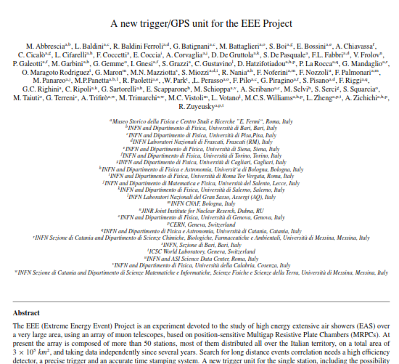
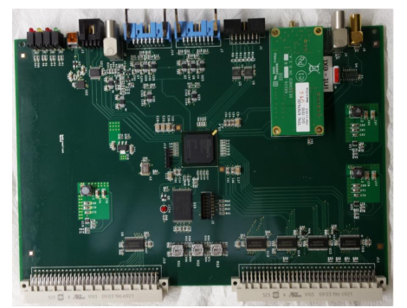
A new Trigger/GPS Unit for the EEE Project
A. Corvaglia
M. Panareo
M.P. Panetta
(M. Rizzi)

Slide 2
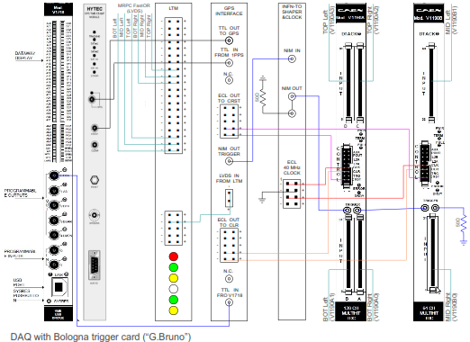
A new Trigger/GPS Unit for the EEE Project
Abstract
Introduction – the EEE Project
The EEE Data Acquisition A brief description of the old System
EEE Trigger/Gps System
Trigger System
GPS Interface
Event Time Stamp
Time Stamp jitter
Conclusions

Slide 3
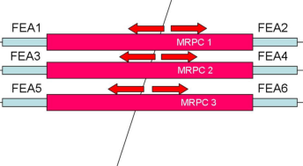
A new Trigger/GPS Unit for the EEE Project
Abstract
Introduction – the EEE Project
The EEE Data Acquisition
A brief introduction of the old System
EEE Trigger/Gps System
MRPC Trigger System
GPS Interface
Event Time Stamp
Time Stamp jitter
Conclusions
OR 24 strips
Right
Left
OR 24 strips
TL
ML
TRIPLE
BL
BR
MR
TR

Slide 4
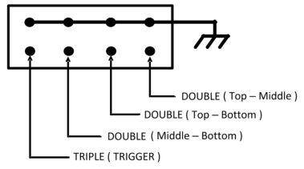
A new Trigger/GPS Unit for the EEE Project
Abstract
Introduction – the EEE Project
The EEE Data Acquisition
A brief introduction of the old system
EEE Trigger/Gps System
MRPC Trigger System
GPS Interface
Event Time Stamp
Time Stamp jitter
Conclusions

Slide 5
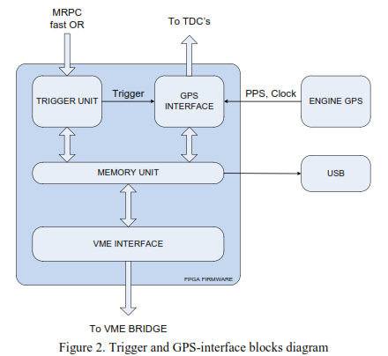
A new Trigger/GPS Unit for the EEE Project
Abstract
Introduction – the EEE Project
The EEE Data Acquisition
A brief introduction of the old System
EEE Trigger/Gps System
Trigger System
GPS Interface
Event Time Stamp
Time Stamp jitter
Conclusions

Slide 6
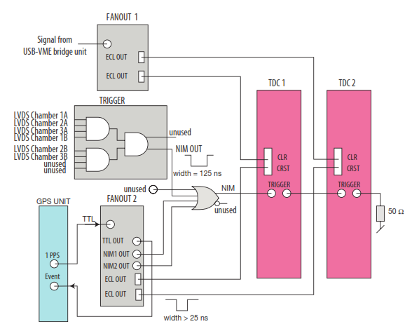
A new Trigger/GPS Unit for the EEE Project
Abstract
Introduction – the EEE Project
The EEE Data Acquisition
A brief introduction of the system ??
EEE Trigger/Gps System
Trigger System
GPS Interface
Event Time Stamp
Time Stamp jitter
Conclusions

Slide 7
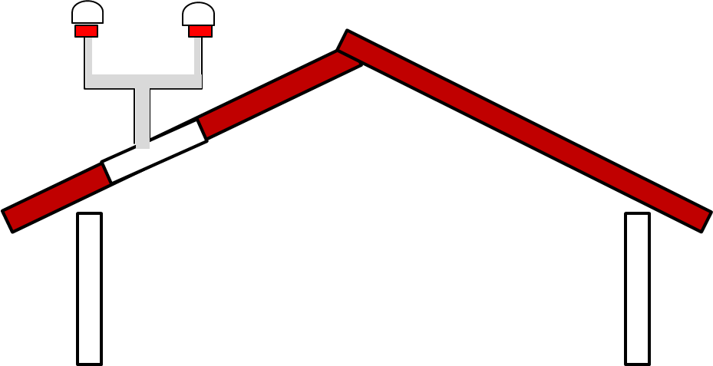
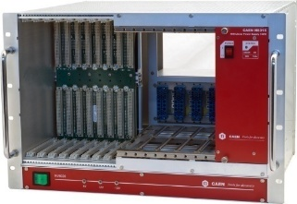
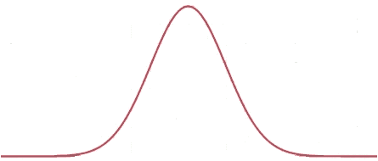
A new Trigger/GPS Unit for the EEE Project
Abstract
Introduction – the EEE Project
The EEE Data Acquisition
A brief introduction of the old System
EEE Trigger/Gps System
Trigger System
GPS Interface
Event Time Stamp
Time Stamp jitter Δt measurements beetwen 2 different boards (same VME Crate, same length cable) with the aim of evaluate the PPS resolution σ_{PPS} ( 30 ns). The global Time Stamping resolution should be the sum of the TDC resolutions σ_{TDC} and of PPS resolution σ_{PPS}
Conclusions
Trigger/Gps Board 2
Trigger/Gps Board 1
˜
Δt = t_{PPS1} – t_{PPS2}
PPS resolution
σ_{PPS}
entries

Slide 8
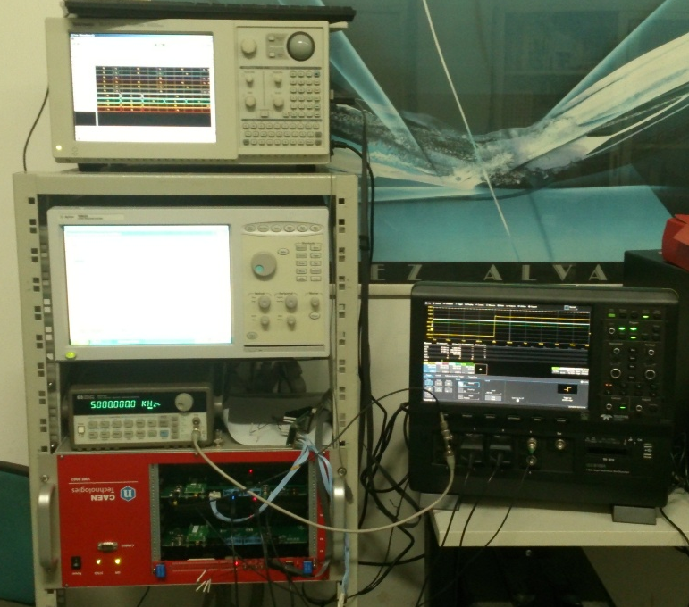
A new Trigger/GPS Unit for the EEE Project
Time Stamp jitter
5 Trigger/GPS Boards in the Electronic Lab. at Lecce
The bracket was mounted, we should mount the other GPS antenna
4 Boards already tested
Minor fixing need
15 Boards in Lab. next week
Trigger/Gps Board 1
Trigger/Gps Board 2
Δt = t_{PPS1} – t_{PPS2}
σ_{PPS}
entries

Slide 11
EEE Trigger/GPS Test
Logic Analyzer
Oscilloscope
Pattern Generator
Waveform Generator

Slide 12
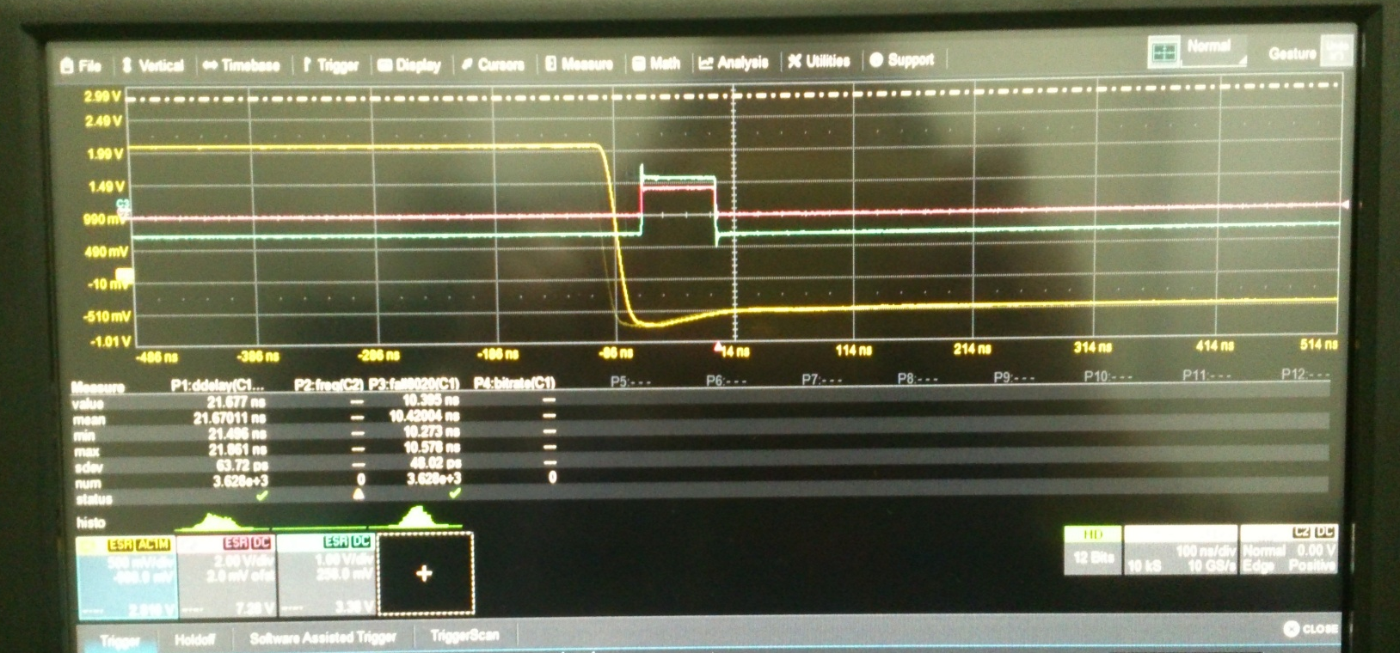
2 Clear signals TDCs
By means of a Waveform Generator we simulate the TTL Signals from the Bridge VME 40 μs lenght
Two ECL Signals of 25 ns length to the CLEAR TDCs

Slide 13
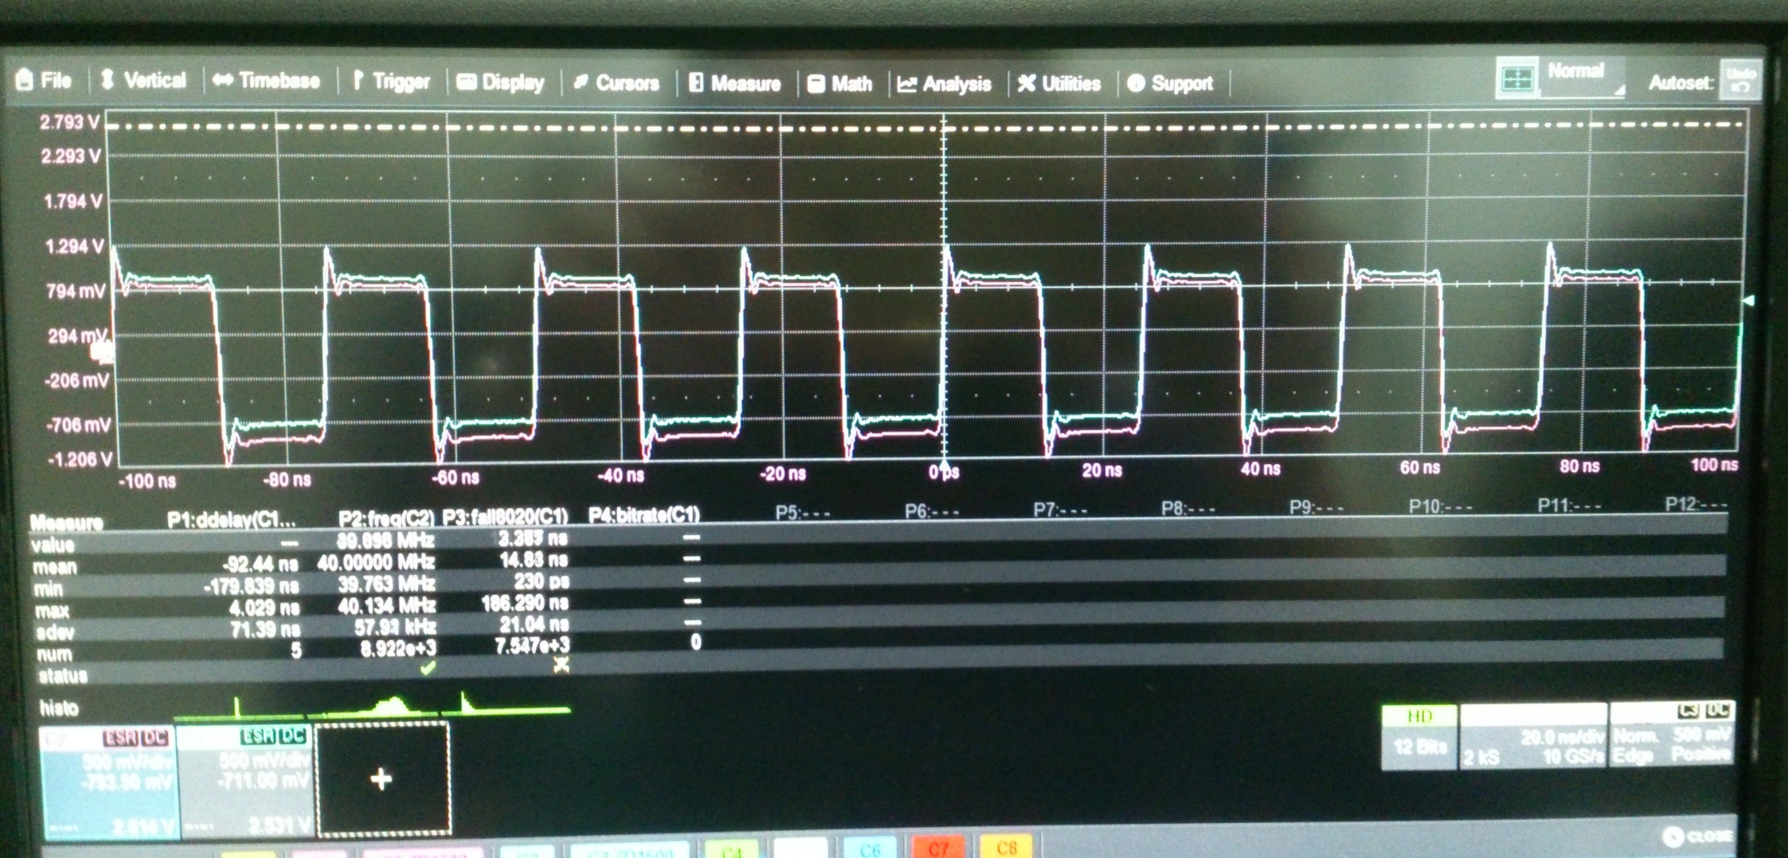
2 Clock Signals
2 Disciplinated Clock to the TDCs 40 MHz (25 ns period)

Slide 14
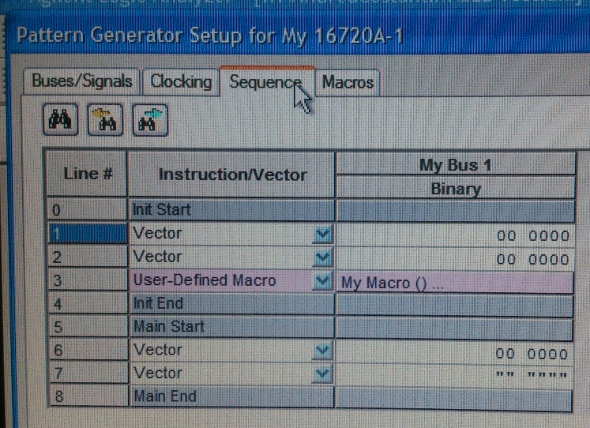
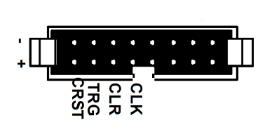
TDC Trigger signals
By means of the Pattern Generator we simulated 6 Trigger LVDS signals from the MRP Chambers and send it to the Trigger Board which generate 1 Triple coincidence and 3 Double coincidences
6 LVDS signals from MRPCs

Slide 15
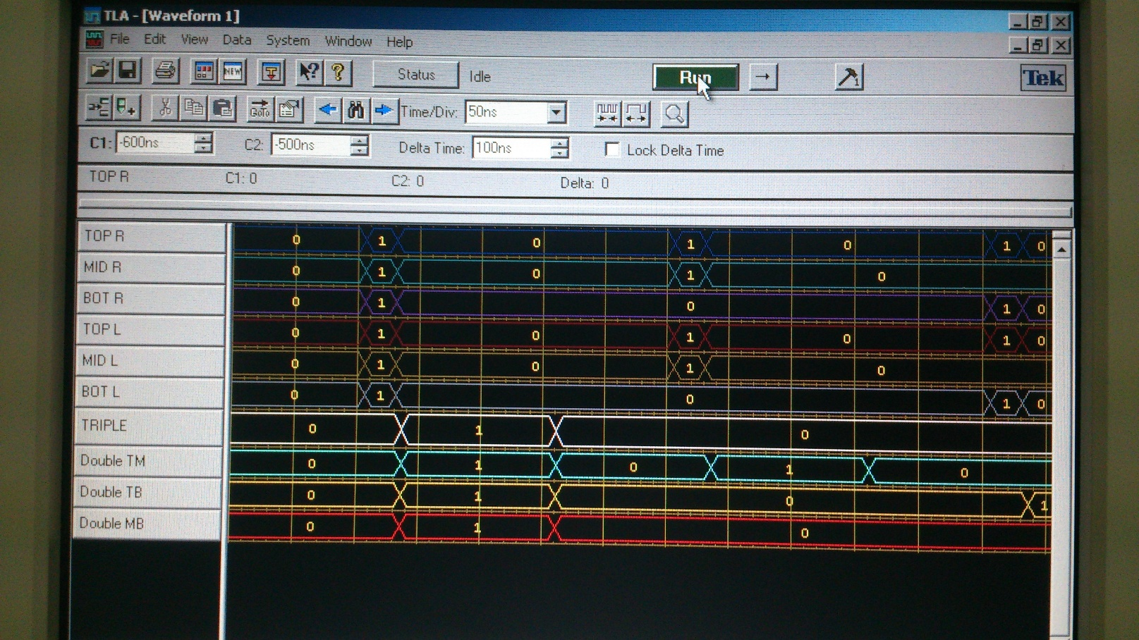
TDC Trigger signals
LVDS signals from the Pattern Generator
Logic Analyzer read
ECL from the EEE-Trigger/GPS Board
and

Slide 16
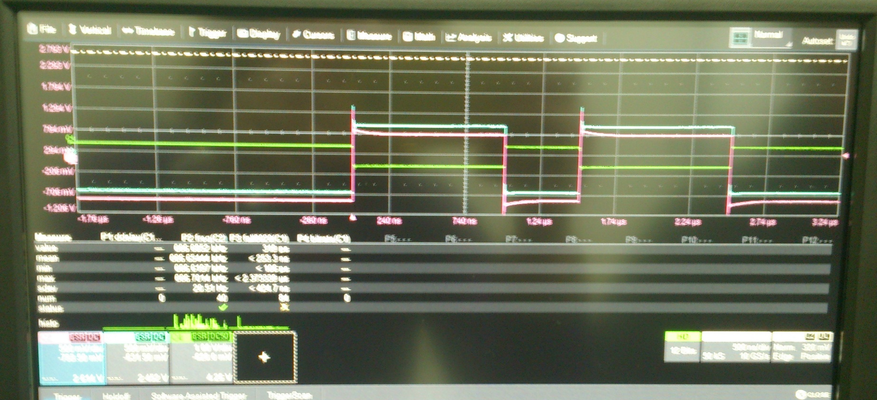
2 PPS for the DAQ GPS Trigger
Each PPS from the GPS receiver on board, the Unit generate 2 signals ECL to the TDCs (and 2 signals NIM for retro-compatibility) of 1 μs length after an interval of 0.5 μs

Slide 17
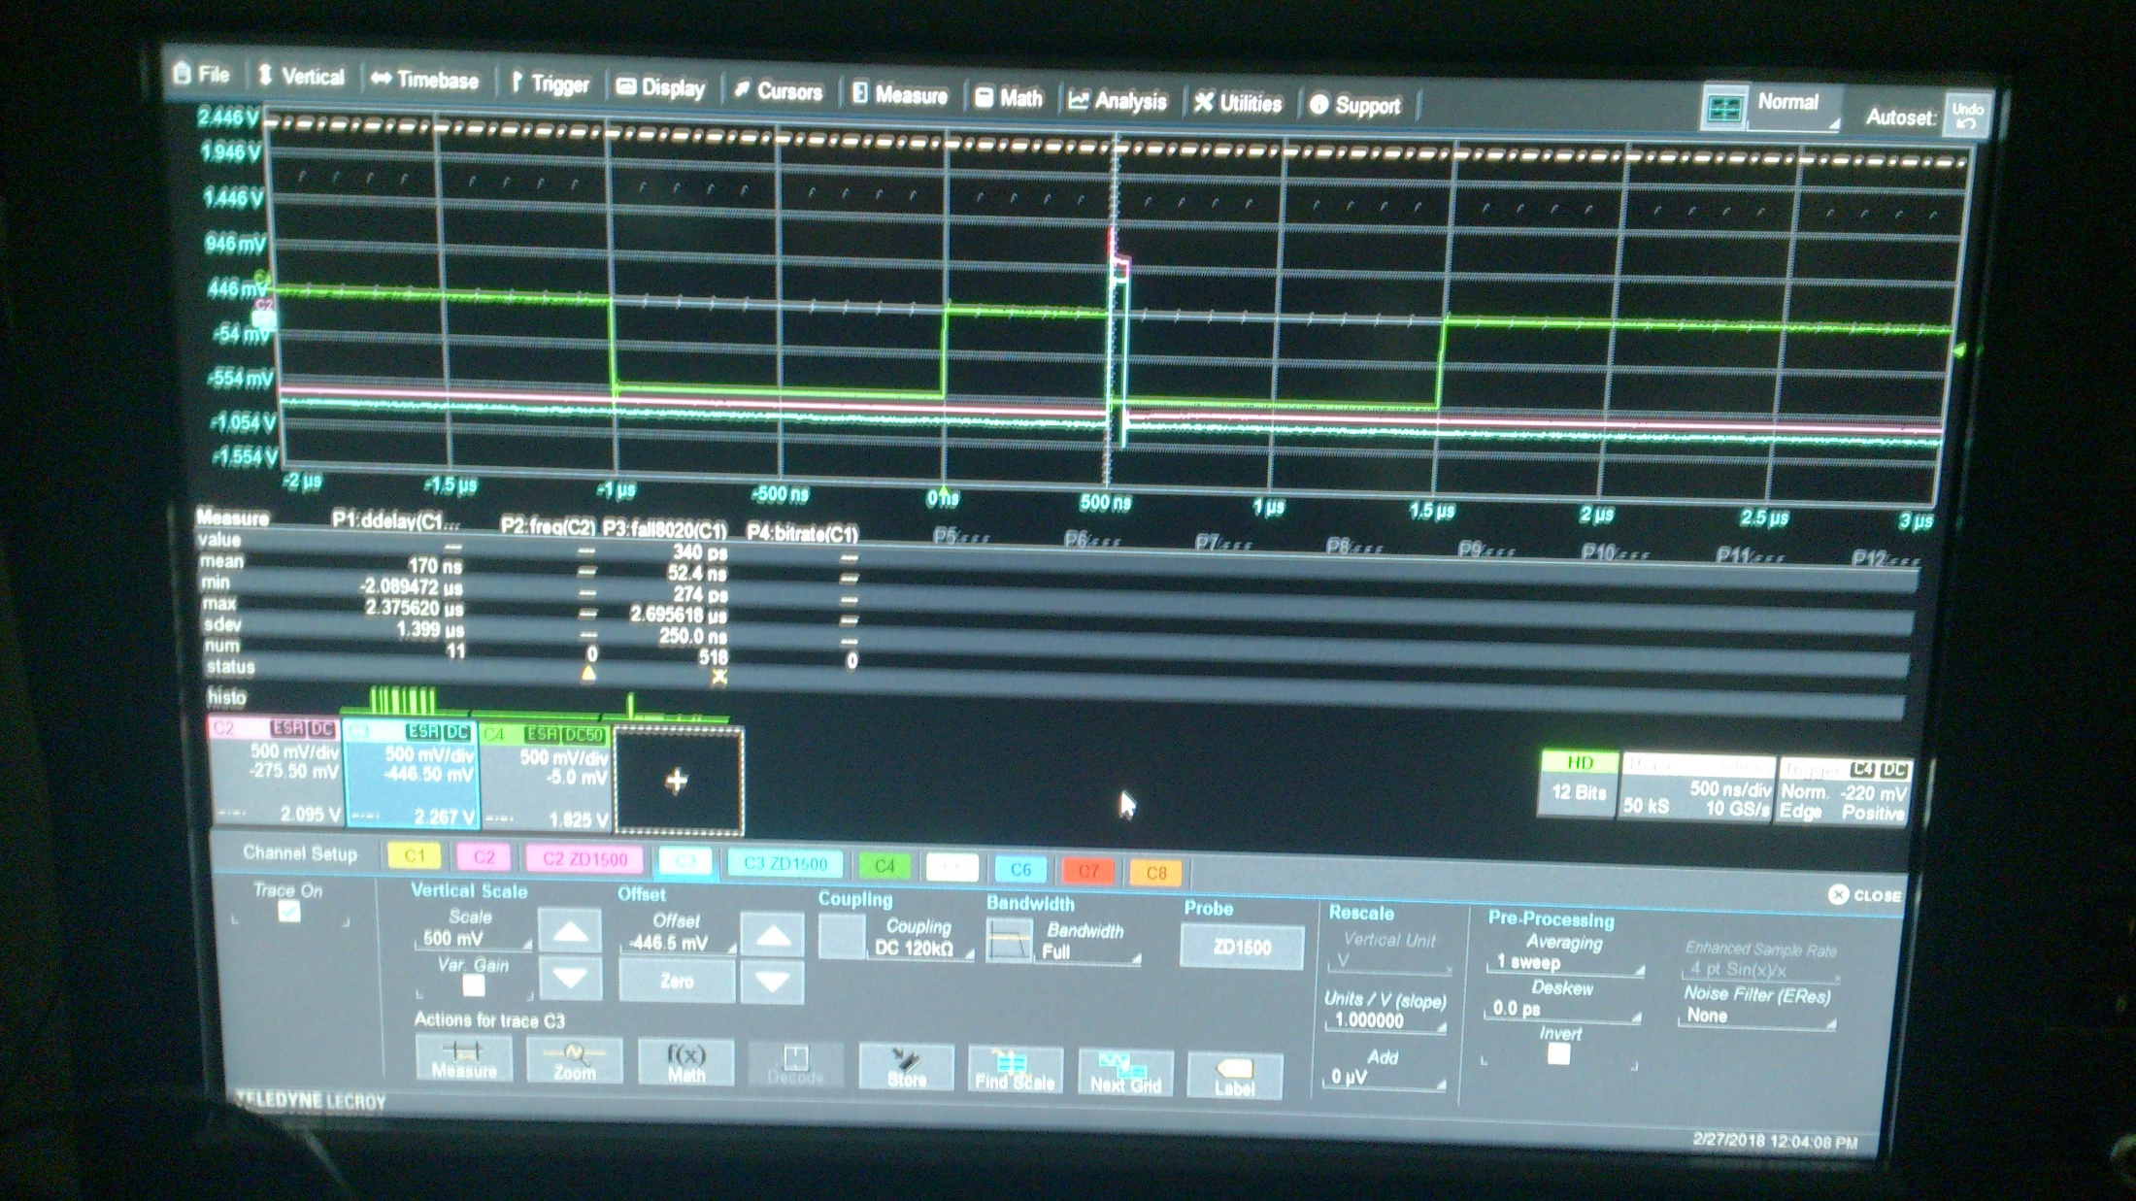
CRST signals
CRST signal to the TDC performances the TDC Bunch RESET each PPS, 1,5 μs after the PPS signals

Slide 20
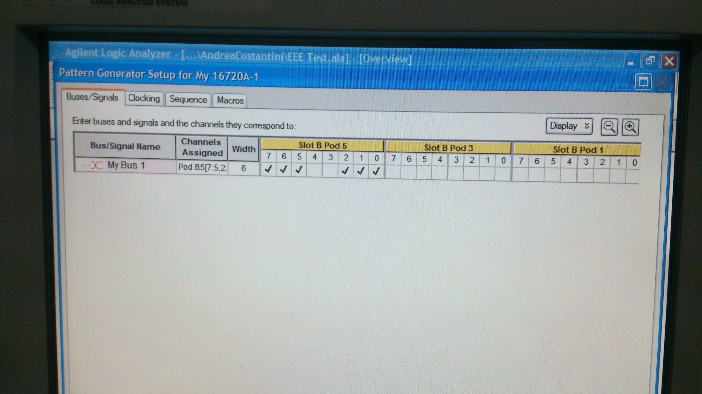

Slide 21
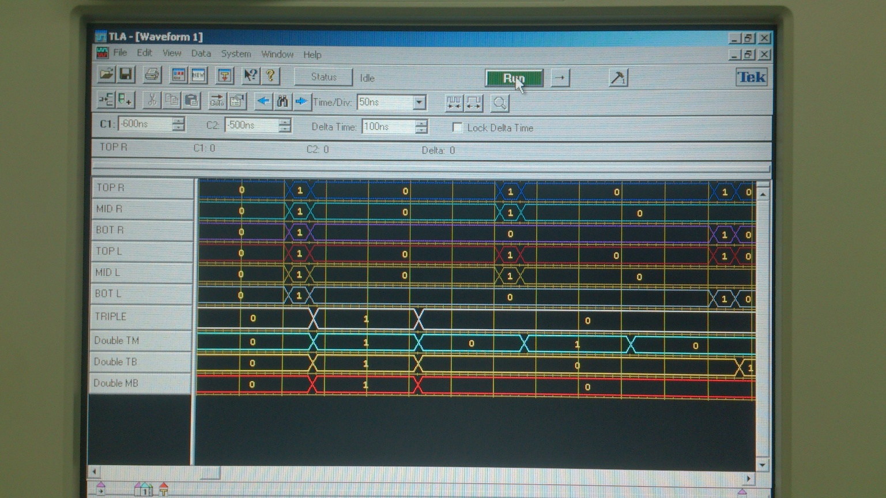

Slide 22
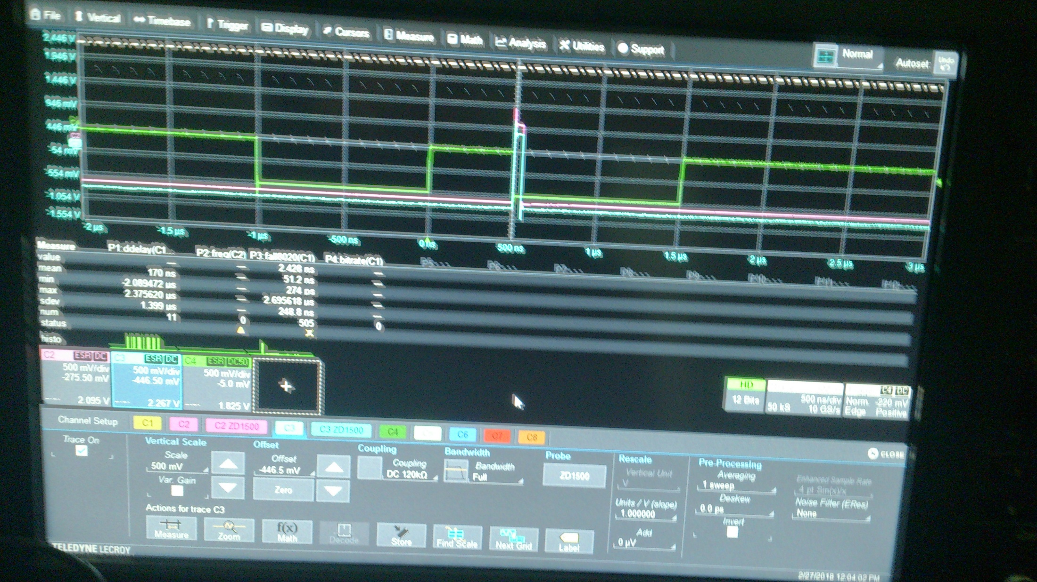

Slide 23
