Slide 1

The upgrade of the
Extreme Energy Events
experiment
M. Abbrescia for the
Extreme Energy Events collaboration

Slide 2
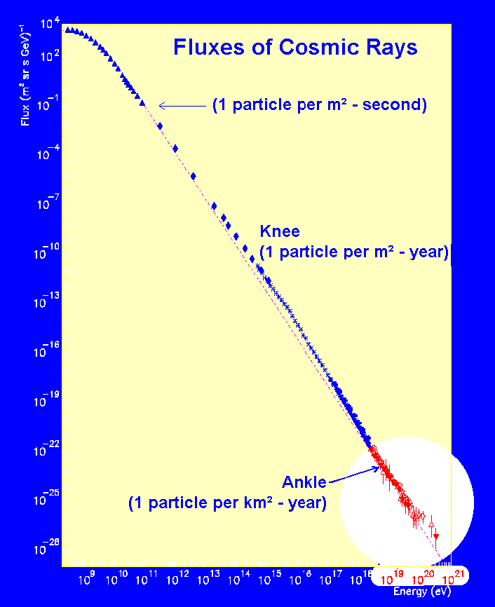
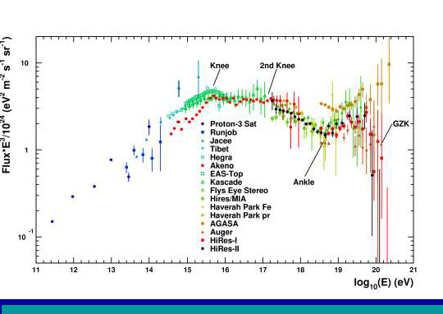
The project
Aims at covering the most interesting, and still partially unexplored, region of the cosmic ray spectrum:
  E > 10¹⁸ eV
  Extragalactic sources
  GZK cutoff
  (Greisen, Zatspein and Kuz’min)

Slide 3
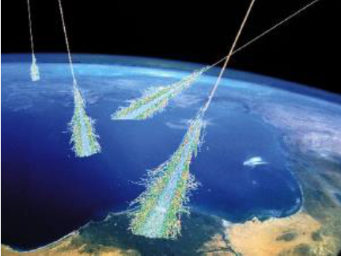
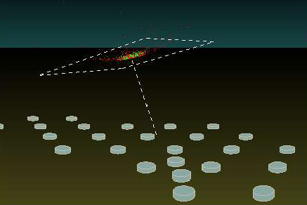
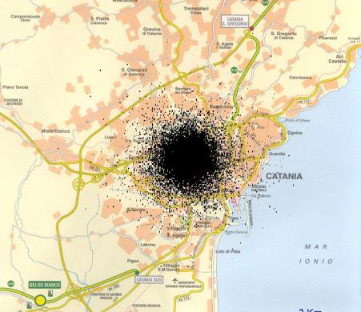
The EAS array
Detect muons arriving at the surface
Many, low cost, easy to operate stations
Simulation of the shower induced by a 10¹⁶eV proton
At ground level 1 million muons arrive, over an area with radius at least 2 km.
High energy showers revealed by detecting muons at different stations at the same time (“coincidences”)
City of Catania

Slide 4
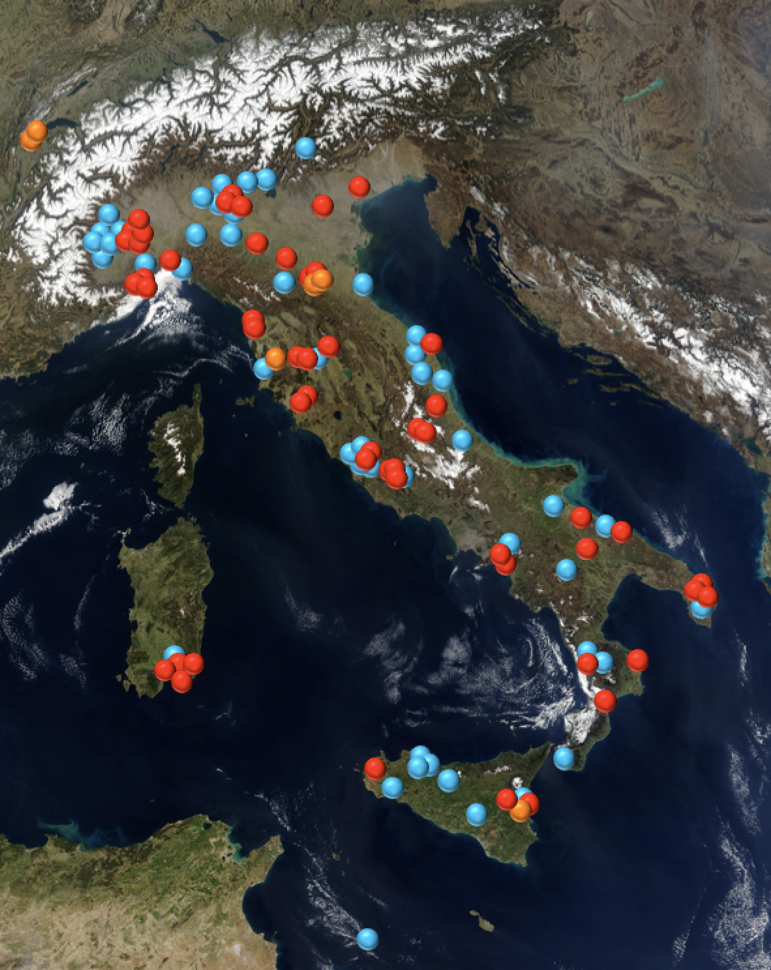
Present status
50 telescopes at High Schools
+ 2 telescopes at CERN
+ 4 at INFN Units
Total: 56 telescopes
+ ≈ 50 institutes on the waiting list
Largest (in terms of total detector area) system using MRPCs
Largest cosmic rays experiment
in Europe
Stations in operation at schools
Stations in operation at research
centers
Institutes in the waiting list

Slide 5
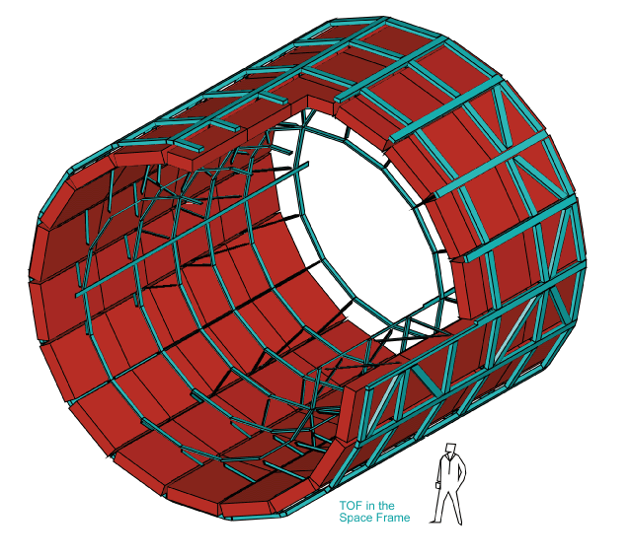
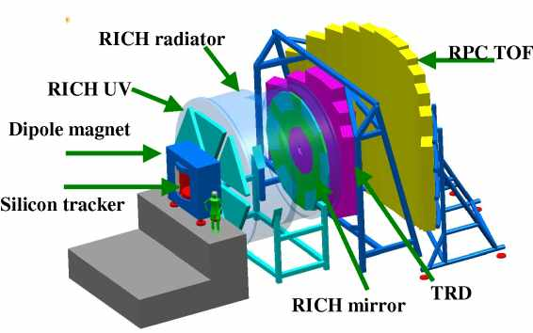
EEE: The largest MRPC system
EEE: 56 telescopes x 3 chambers ≈ 220 m² covered
Synchronized at o(10 ns) across whole Italy
Taking data at the same time
Data transferred to a central repository
EEE is a system of detectors operating in a coordinate way
Monitoring MRPC performance is intrinsically interesting:
See talk by D. De Gruttola
Second largest system using MRPCs :
ALICE TOF: 144 m² covered
Future largest system using MRPCs:
CBM TOF: ≈ 110 m² covered
Upgrade of the CMS muon system
≈ 100 m² covered

Slide 6
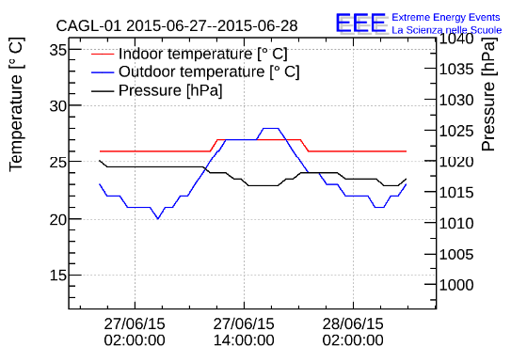
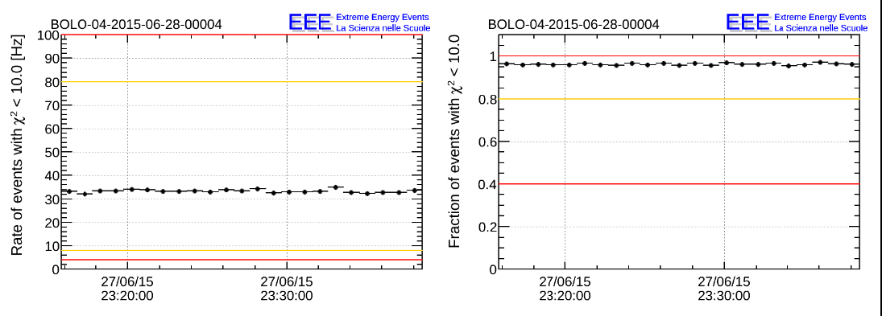
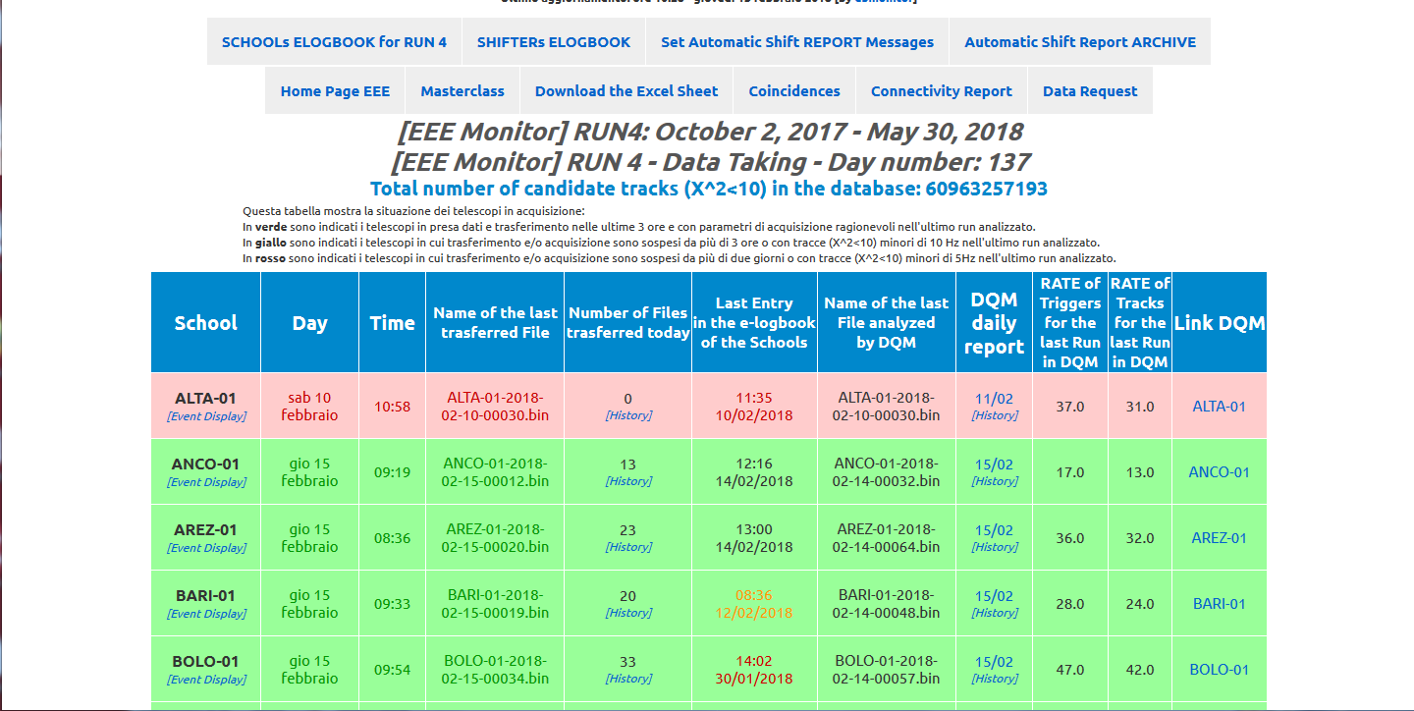
EEE Online monitoring
eee.centrofermi.it/monitor
Fraction of reconstructed tracks
Trigger rate
Link to the “day by day” DQM
Two e-logs and automatic shifter reports
Link to the “run by run” DQM

Slide 7
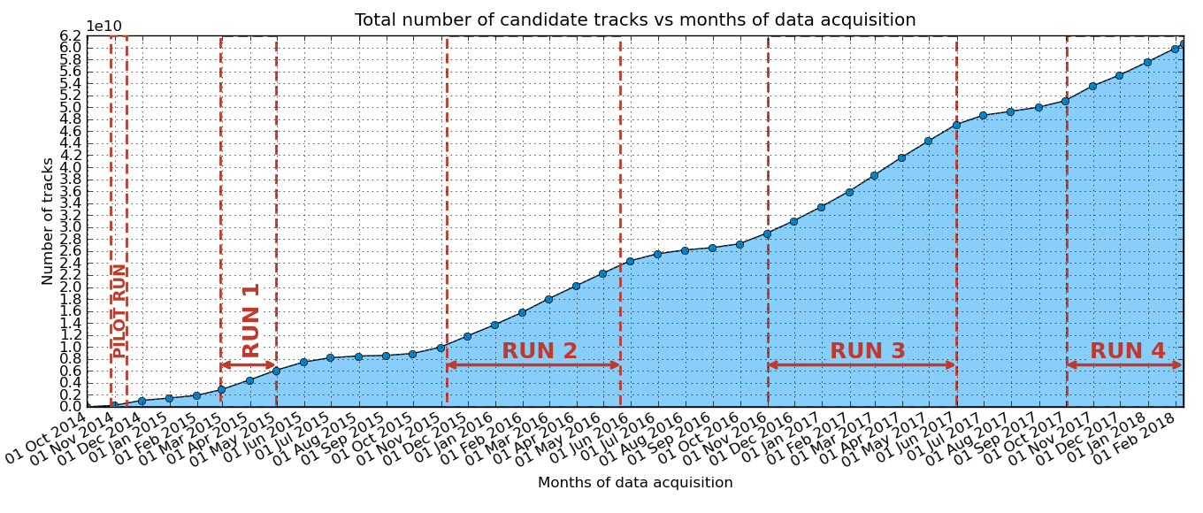
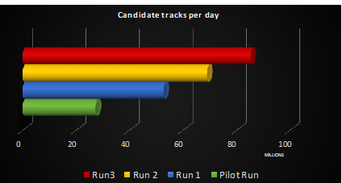
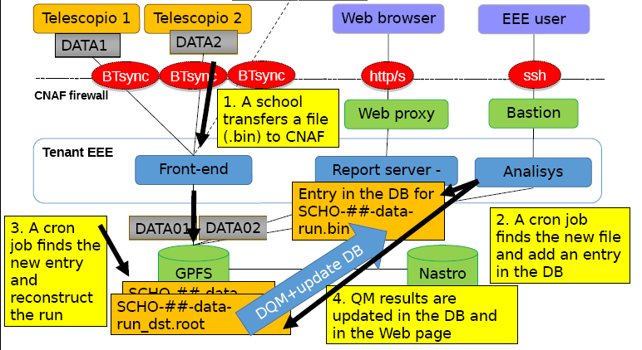
Data taking
About 60 billion events collected since the start of organized data taking
More than 20 billion events collected during Run-3 only!
Software architecture
Almost 100 millions of reconstructed tracks/day

Slide 8
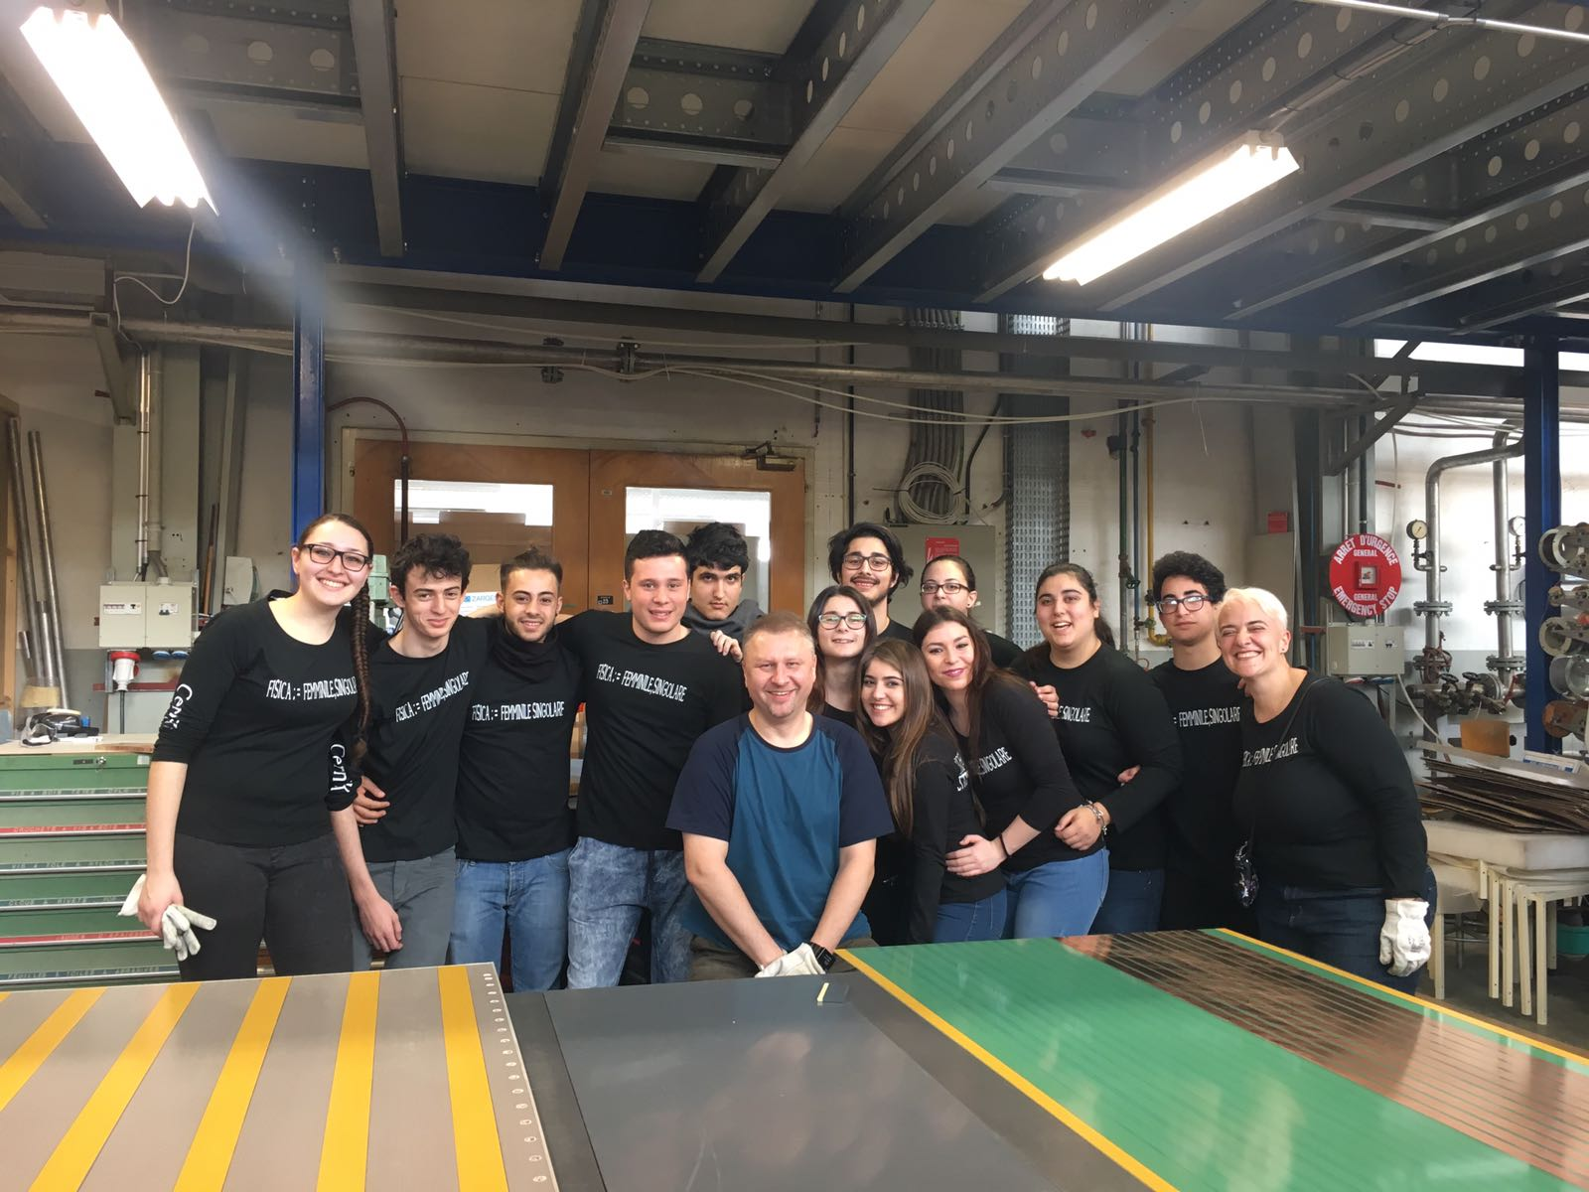
The EEE network upgrade
Plan to build another 20 telescopes
Will increase the capability of the EEE network to study the high-energy part of the cosmic rays spectrum
Huge effort for 2017-18!
First bunch already completed
20-27 February → Lampedusa
12-18 March → Genova
23-29 April → SIEN-02
7-13 May → TORI-05 + Moscow
21-27 May → LODI-03
10-14 July → LODI + Korca
(spare chambers)
25-29 September → CAGL-04
21-24 November → BOLO-05
Lampedusa: the southermost point of Italy

Slide 9
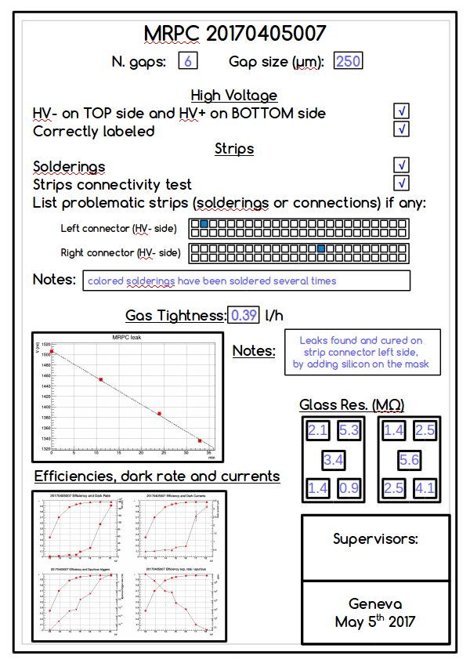
New chambers for new telescopes
250 µm six-gap chambers
Conceived for new eco-friendly gases
Reduce operating voltage
EEE plans to soon operate some telescopes with eco-friendly gases:
See talk by S. Pisano for details
Improved front-end boards
Amphenol cables and connectors
replaced by Nugent ones
New boards in production
New test protocol at CERN
Tests on electrical (strip) connectivity
Tests on gas tightness
Tests on current, rate and efficiency
Everything stored in a dedicated DB

Slide 10
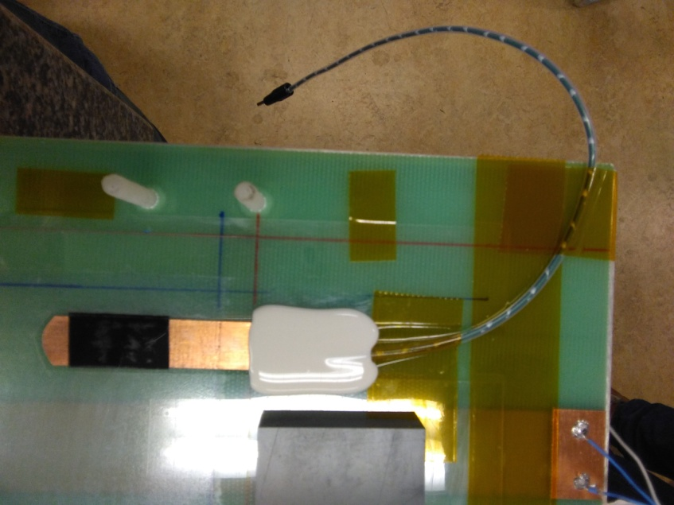
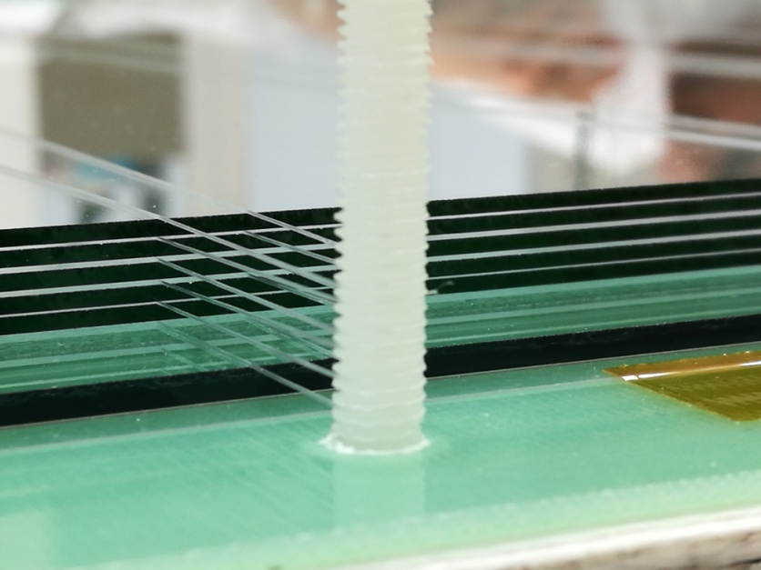
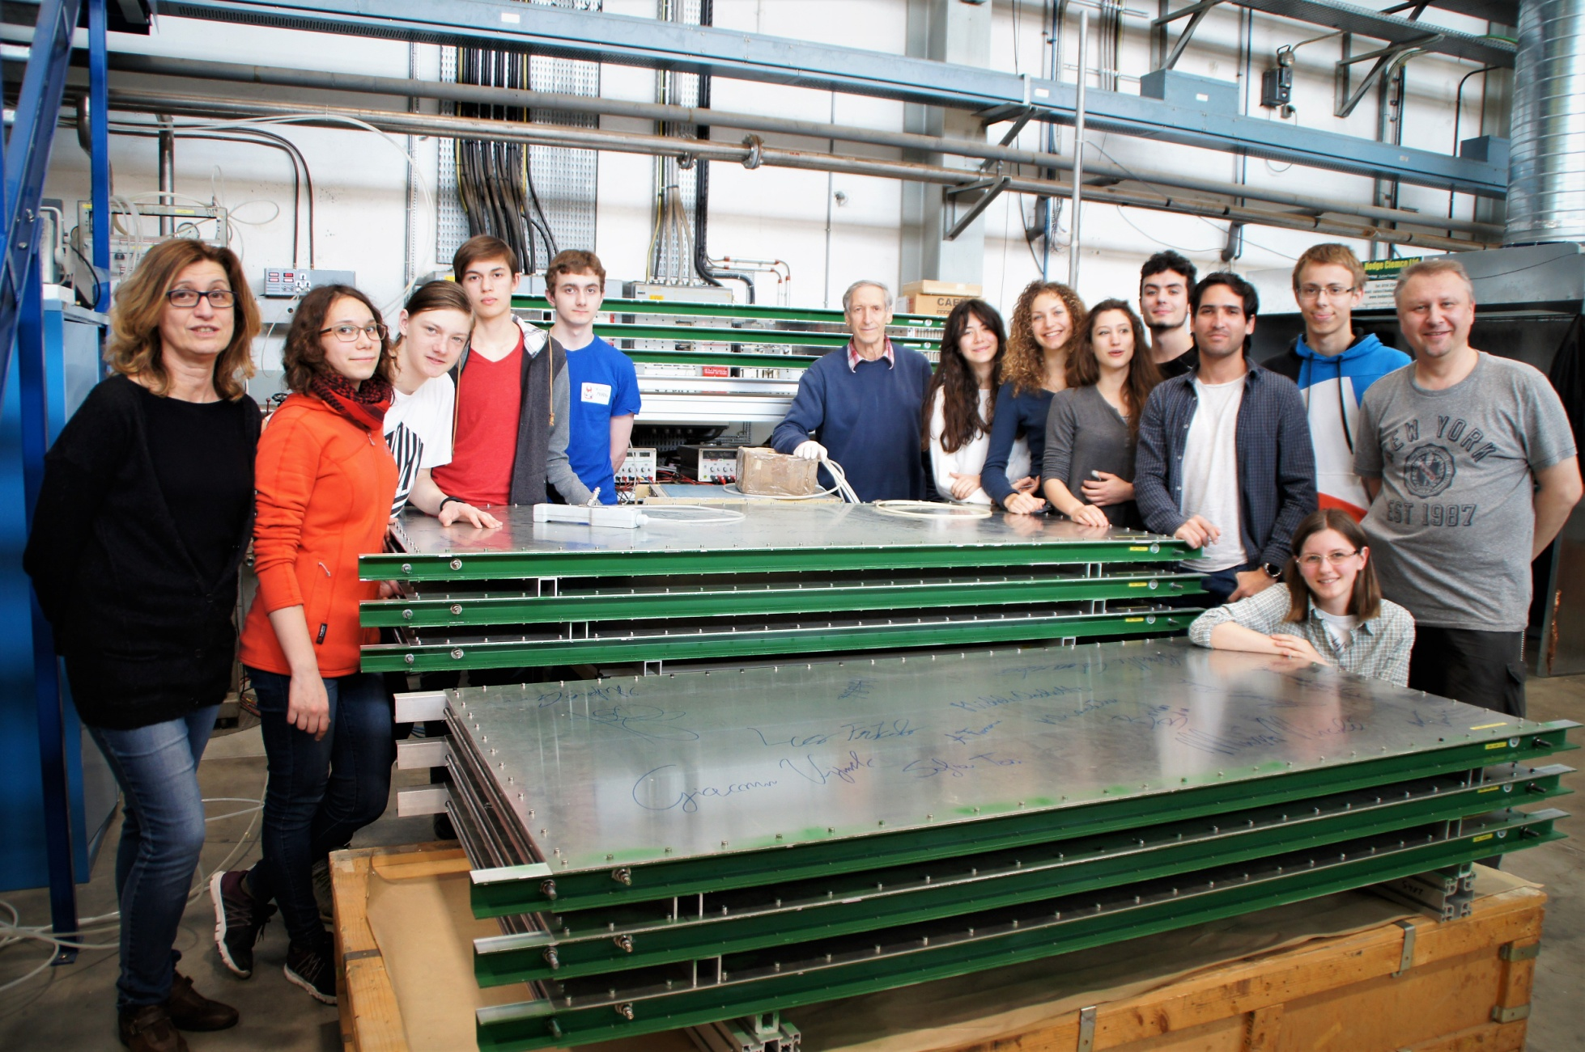
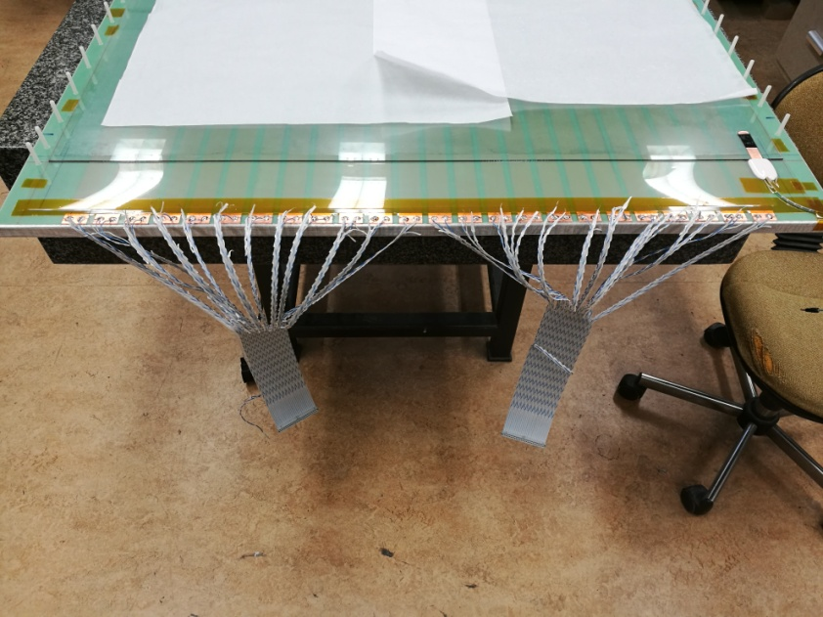
Costruction details
HV electrode
Spacing the glasses
Strips readout
EEE arrives to Moscow

Slide 11
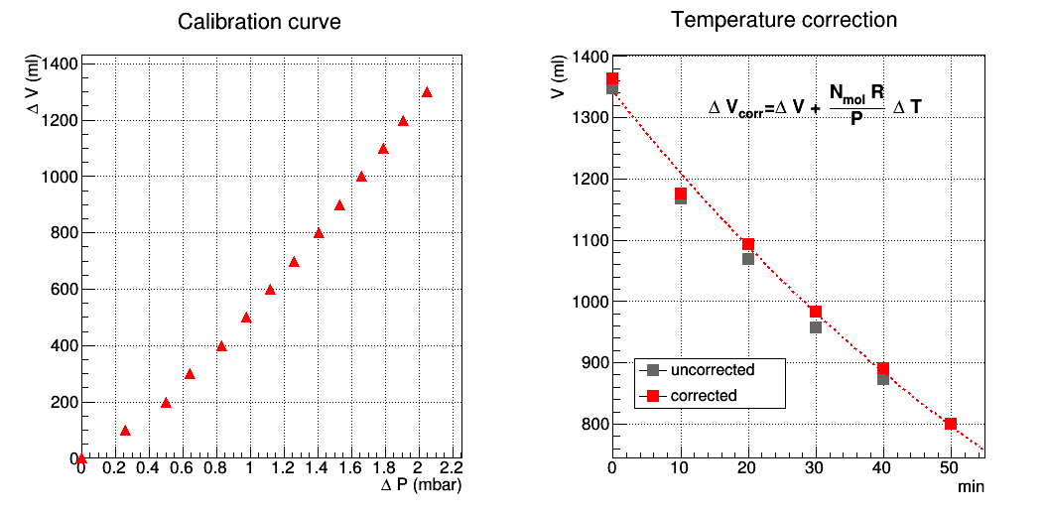
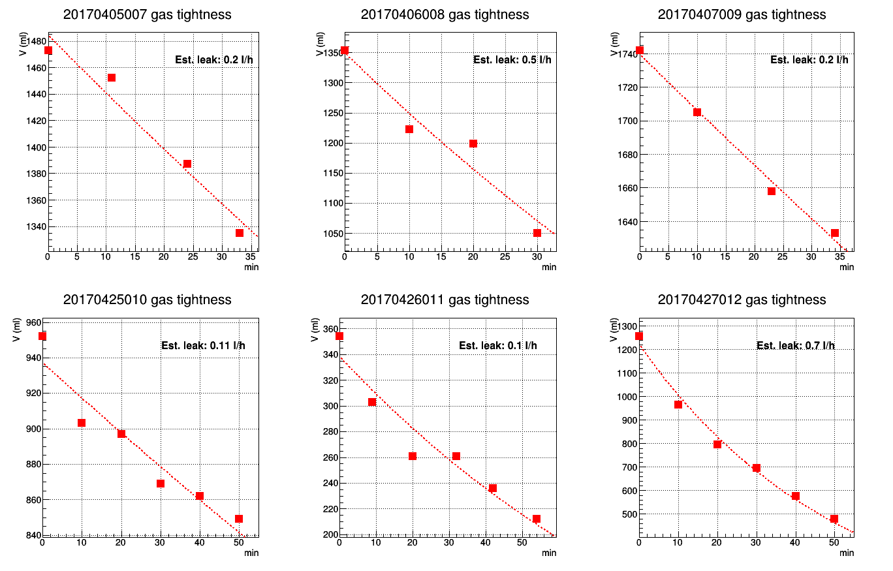
Chambers tightness tests
Leaks are measured by injecting known volumes of air inside the chambers and measuring the relative overpressure
Overpressure vs. time is then measured in an hour time span and leak rate can be inferred via an exponential fit
Corrections are applied to take into account possible temperature variations during the measure
Very precise measure at the chamber operating overpressure

Slide 12
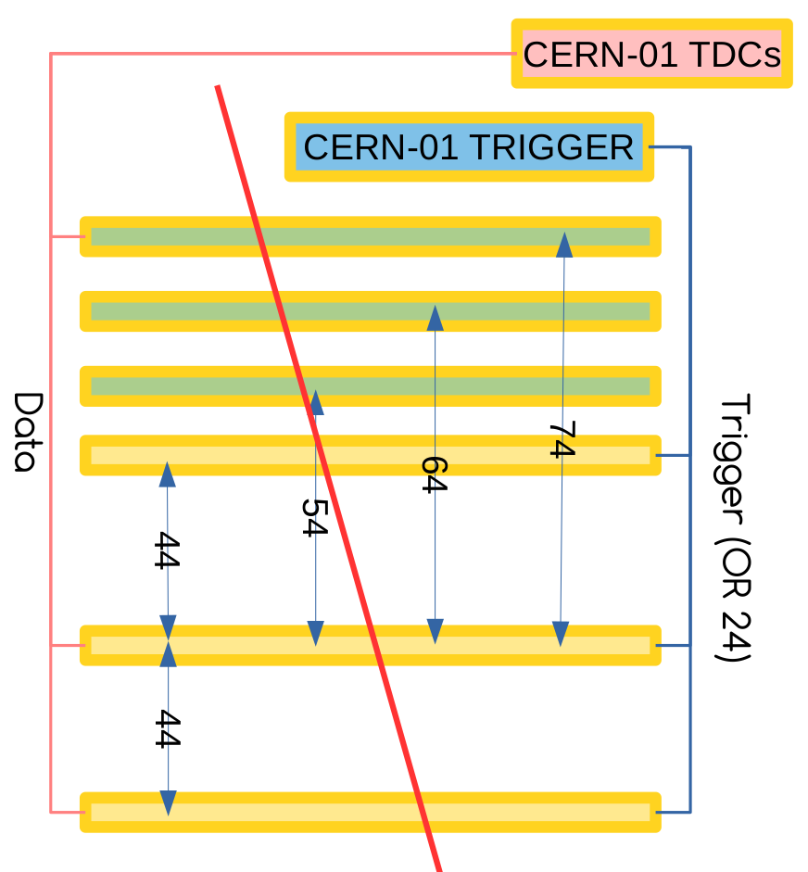
Chamber tests: efficiency
Efficiency is measured for three chambers placed on top of on CERN-01 (green).
Chambers are fluxed 4 days before measurements.
The trigger and tracking is from CERN-01.
Data from CERN-01 “bottom” and “middle” chambers and from the chamber under test are acquired
Efficiency is measured by searching hits on the chamber under in a fiducial zone around the track

Slide 13
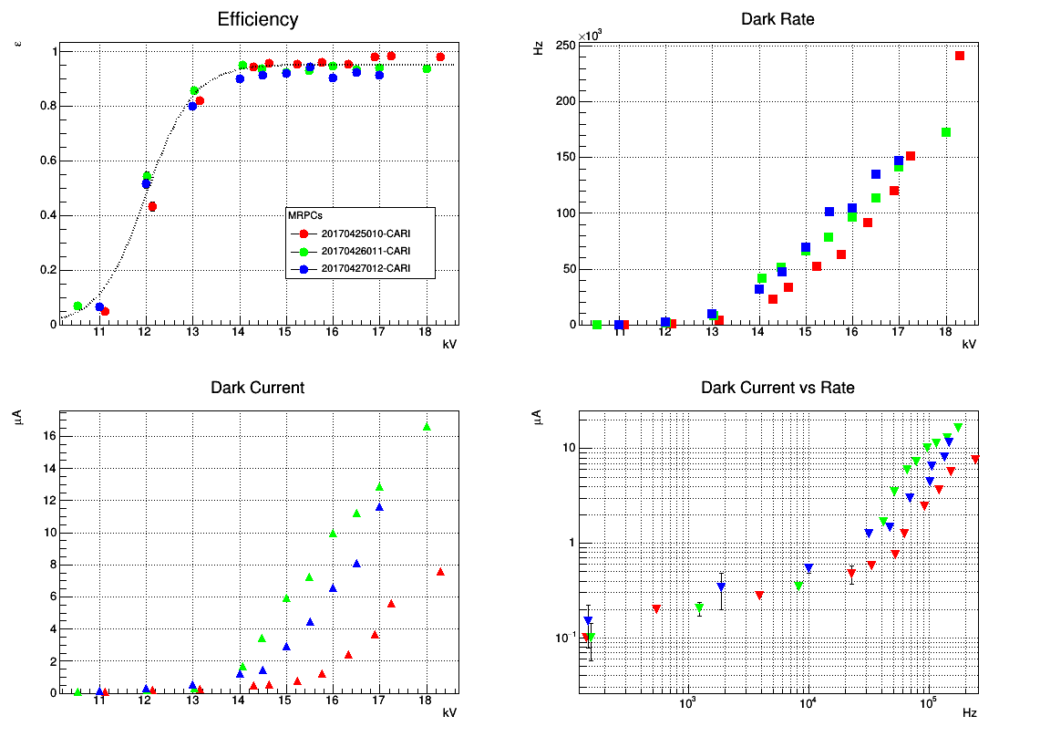
Some tests results
Typical curves for a set of 3 new MRPCs. These chambers are now installed as the new EEE telescopi at Cariati (CARI-01)
Counting ratet
EEE preliminary
Efficiencyt
EEE preliminary
Current vs. rate
“Dark” currentt

Slide 14
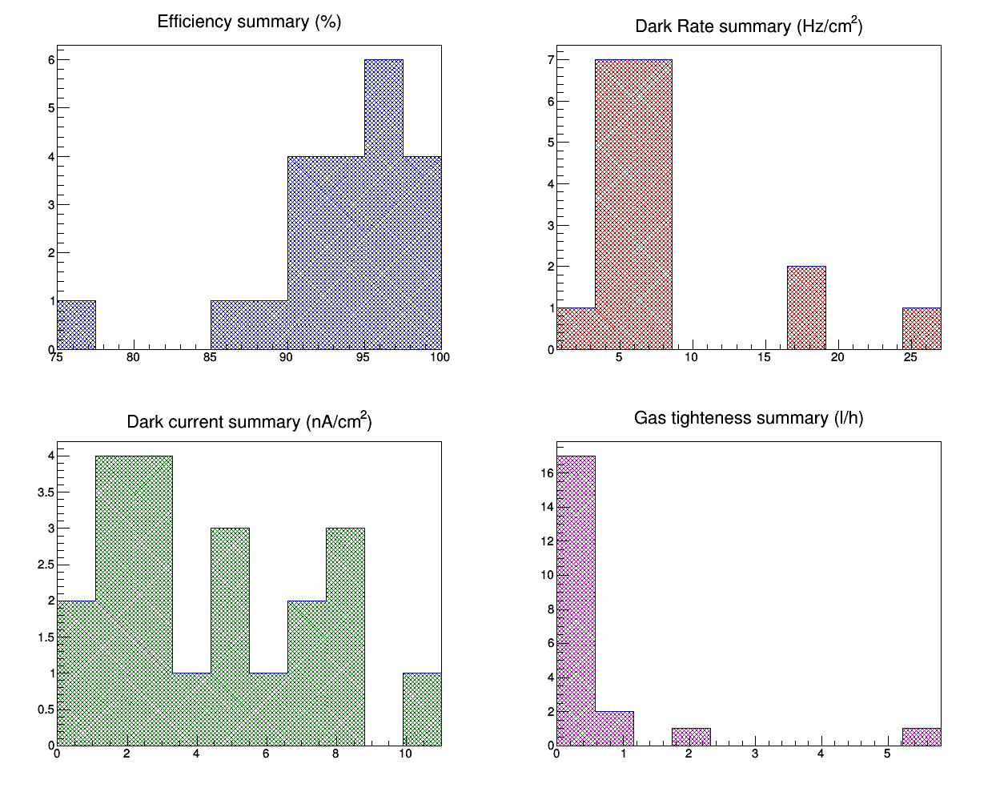
Some overall statistics
EEE preliminary
EEE preliminary
Counting ratet
Efficiencyt
Chamber to be checked
EEE preliminary
EEE preliminary
Current vs. rate
“Dark” currentt
Leaks detected

Slide 15
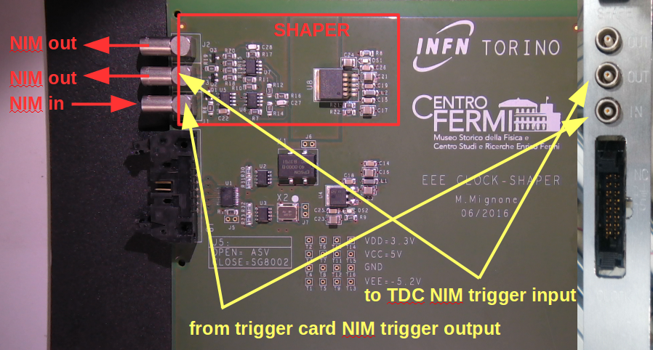
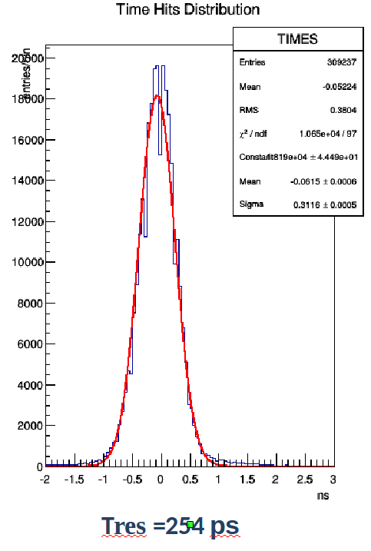
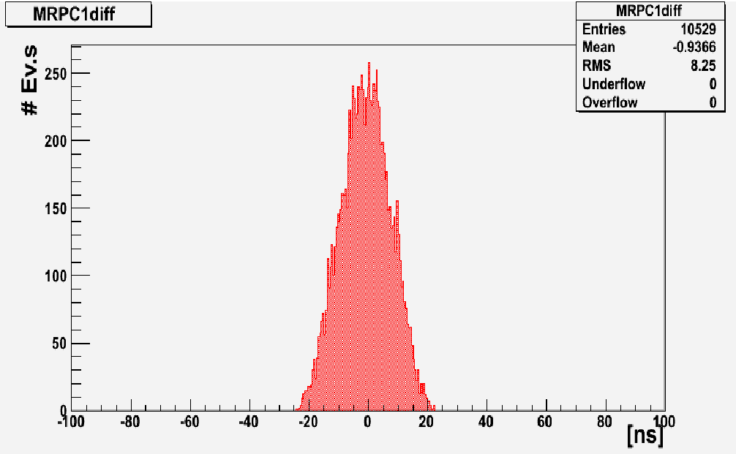
New EEE clock distribution card
Designed at INFN Torino
Distributed the same clock to the two TDCs of the EEE readout
Essential to exploit time info from the middle chamber
Built and installed in all EEE telescopes
σ_{t} ≈ 8 ns
EEE preliminary
σ_{t} ≈ 0.25 ns

Slide 16
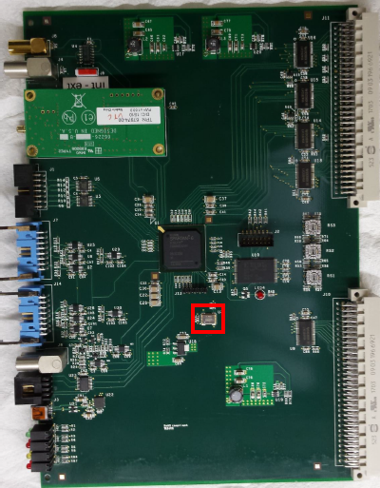
New trigger/GPS cards
Developed between Bari and Lecce INFN sections
Joins the functionalities of the present trigger and GPS boards (+ GPS interface)
Additional functionalities:
-clock distribution
counters accessible via VME
trigger logic programmable via VME
Already installed at LODI-02, FRAS-02, SIEN-01, TORI-02, VICE-01
Plan to be deployed in all stations
Proposal to be commercialized from CAEN

Slide 17
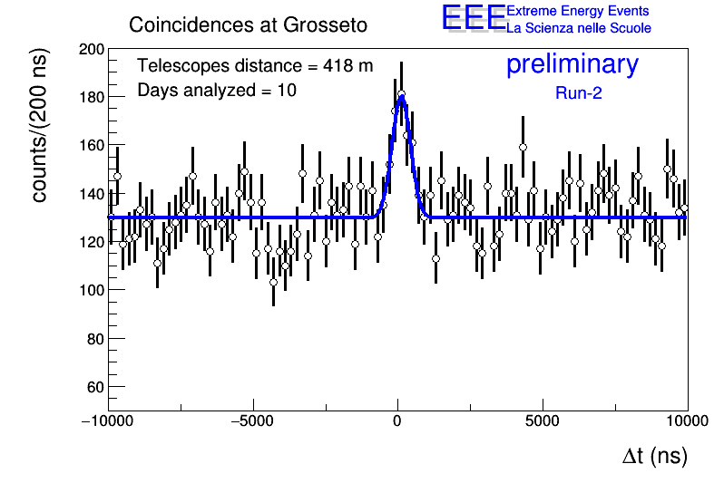
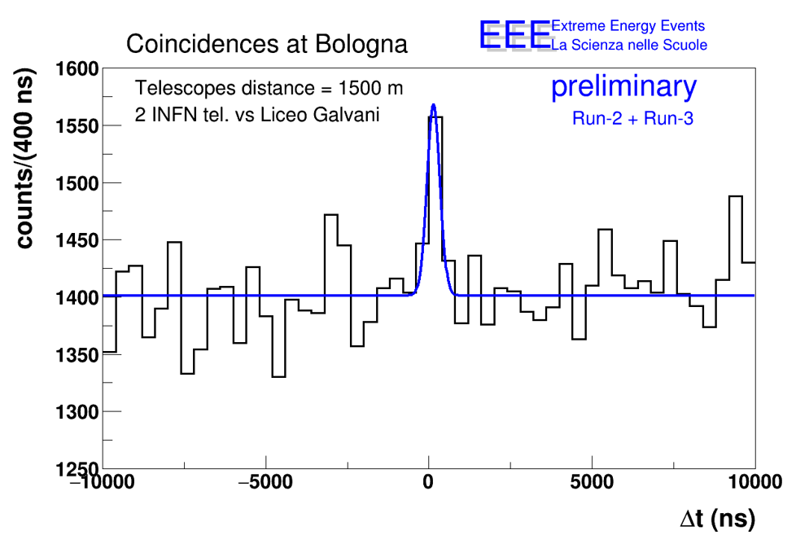
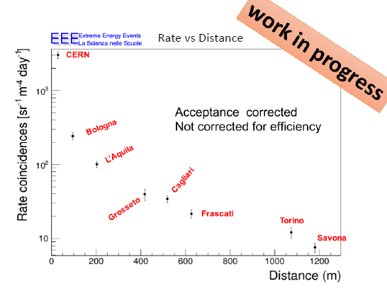
EEE coincidences searches
Detected coincidences at 1.5 km
Higher distance → higher energy
Last born in the EEE family
EEE collaboration Time correlation measurements from extensive air showers
detected by the EEE telescopes, Eur. Phys. J. Plus (2013) 128:148, DOI 10.1140/epjp/i2013-13148-3
Coincidence rate vs. distance
Each cluster is sensitive to showers
of Energy high enough to involve both
stations
Developing an accurate Monte Carlo
Simulate shower development
Simulate environmental effects

Slide 18
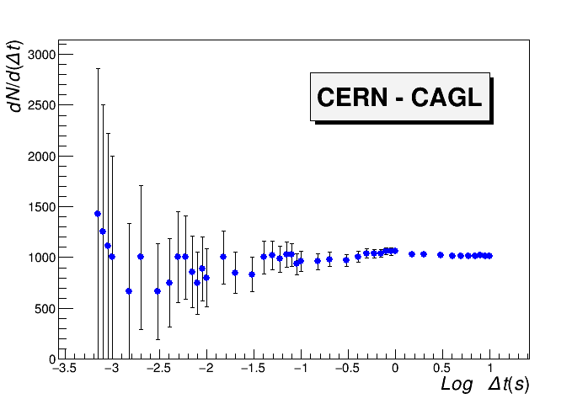
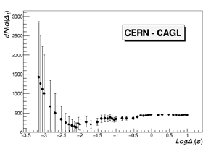
EEE: long distance correlations
Strategy: correlations between individual showers in telescopes clusters
Shower rate: 0.001 - 0.04 Hz (depending on cluster and S/N ratio)
Spurious rate in 1 ms: 10⁻⁸ - 10⁻⁷ Hz (0.001 - 0.01/day)
Number of events dN/d(Δt) for decreasing time window
Not the same results for all pairs of clusters: studies ongoing!
No cut on relative angle between showers
Cut on relative angle< 10
Cut on the relative angle
EEE collaboration Search for long distance correlations between extensive air showers detected by the EEE network, Eur. Phys. J. Plus (2018) 133:34, DOI 10.1140/epjp/i2018-11898-x
10 ms

Slide 19
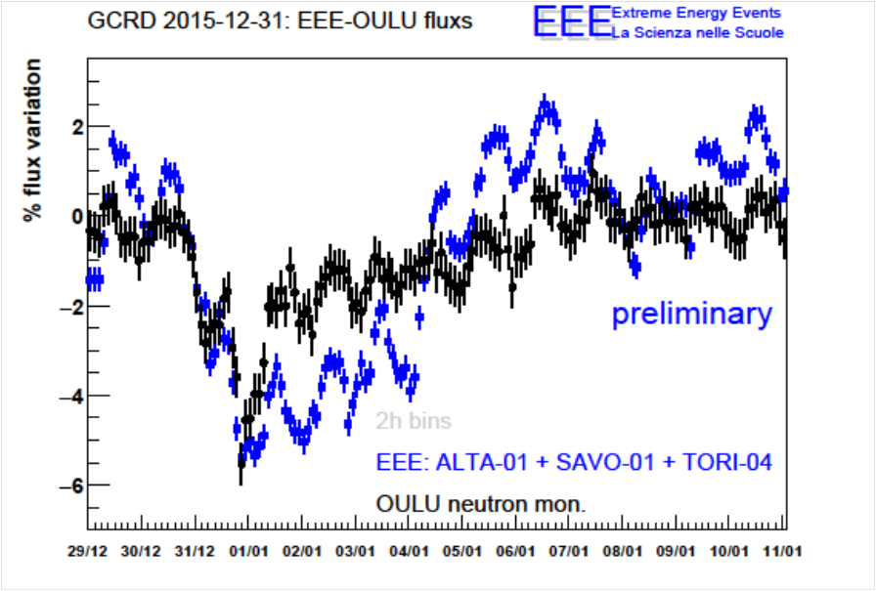
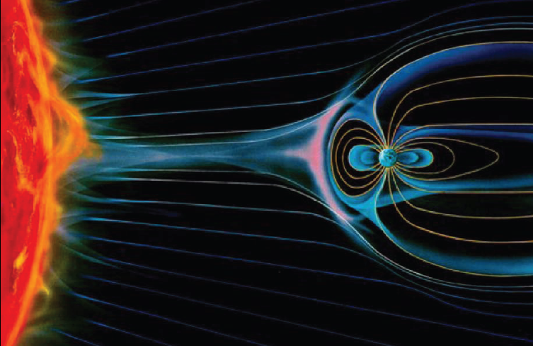
Forbush decreases
Solar Flares followed by Coronal Mass Emission, whose eject sometimes envelops the Earth and adds up to the Earth magnetic field, provoking a sudden decrese in Cosmic rays revealed on the ground
New year!
EEE Collaboration, The EEE experiment project: status and first physics results, Eur. Phys. J. Plus (2013) 128, 62.
The 2016 new year Forbush: at 24.00 of 31/12/2015 our telescopes -in schools- were up and running!

Slide 20
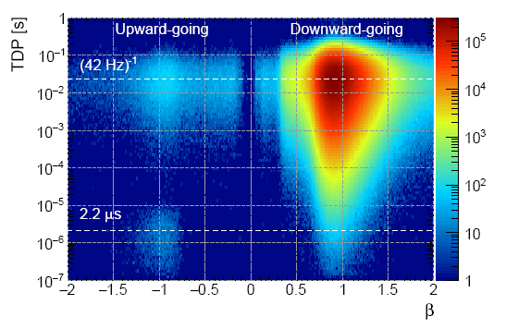
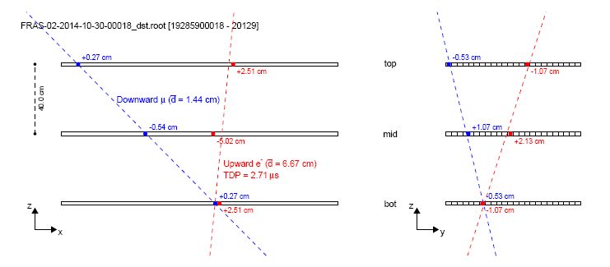
Upward-going events
About 1 event over 2000 observed to go in an upward direction
Some of them identified as
electrons coming from muon decays (in the floor or in the bottom chamber),
Blue track: downward muon
Red track: upward electron
Tagged downward µ + upgoing electron
Event display
(in the two projections)
EEE collaboration, A study of upward going particles with the Extreme Energy Events telescopes, NIM-A 816 (2016), 142-148
Notes:
Qui i dati ottenuti ad Altamura vengono confrontati con quelli di Catania (sempre telescopio EEE, ma sito presso il dipartimento di fisica)
e quelli di OULU dove c’è un Neutro Monitor.

Slide 21
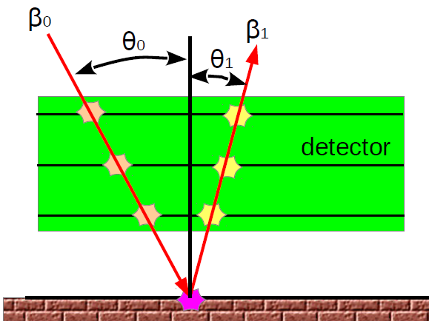
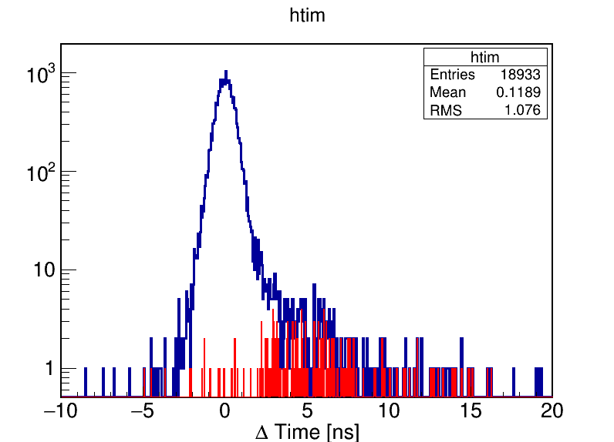
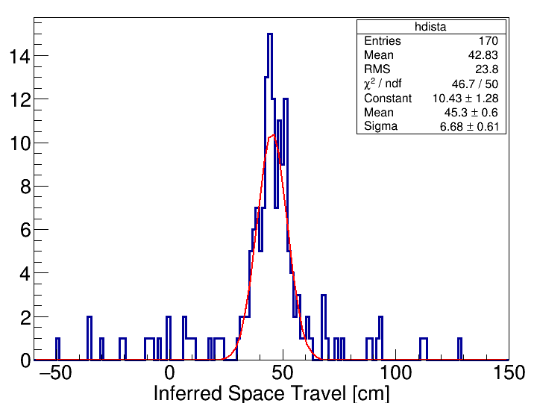
Backscattered events
coincidences
β₀>0 & β₁>0
170 Backscattering events:
β₀>0 && β₁<0
Large time difference due
to Time Of Flight
Inferred distance to the ground:
46 cm below the telescope
The excellent performance of EEE telescope allows to map the enviroment around them

Slide 22

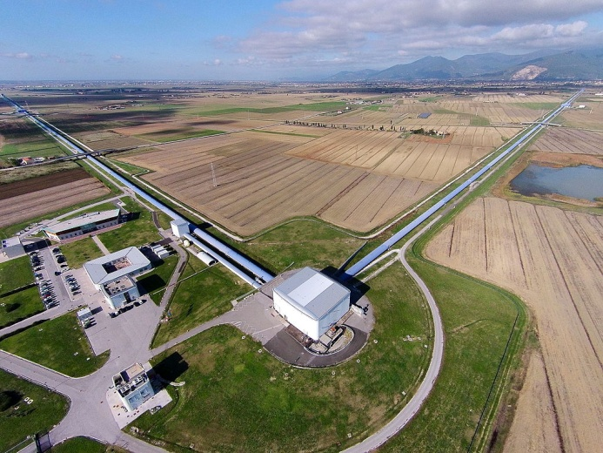

External collaborations
EGO-VIRGO collaboration interested in having one (or more) EEE telescopes hosted at their lab in Cascina
As a veto for cosmic ray showers in coincidence with possible signals coming from gravitational waves
  Similar device already at LIGO
  Some literature already available
University of Santiago de Compostela (Spain) interested in anaylizing EEE data looking for correlations between the cosmic rays flux and temperature and pressure conditions in the throposphere
Memorandum Of Understanding signed up

Slide 23
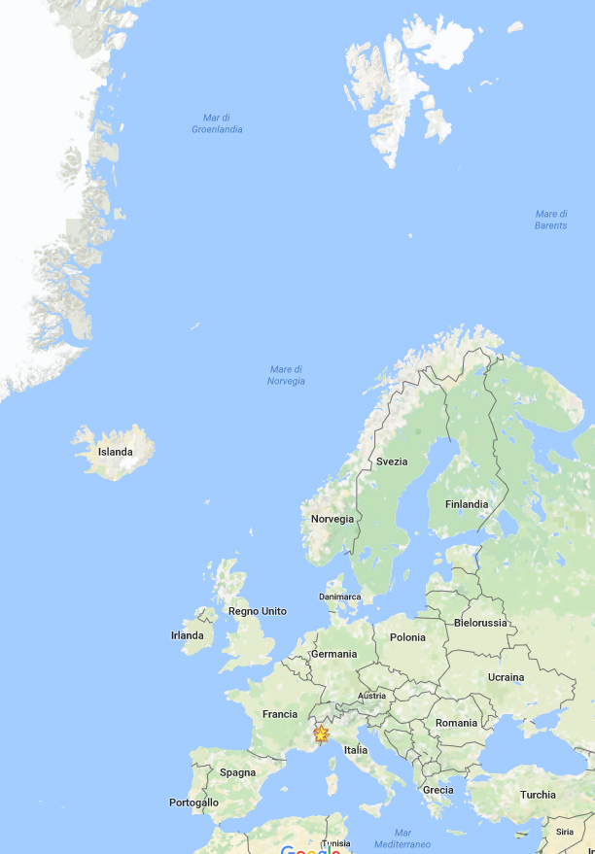
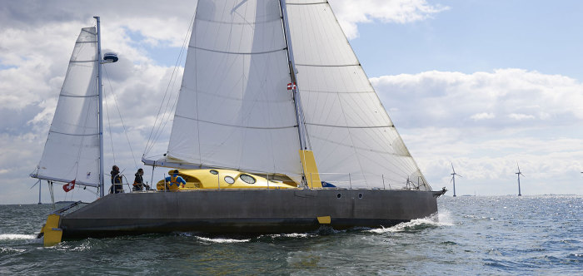
Polar QuEEEst
3 PolarQuEEEst detectors
onboard on boat Polar Nanuq
installed in a Norwegian High School
installed in an Italian High School
Mounted by students, in the EEE tradition
45° in latitude, span 5000 km
www.polarquest2018.org/

Slide 24

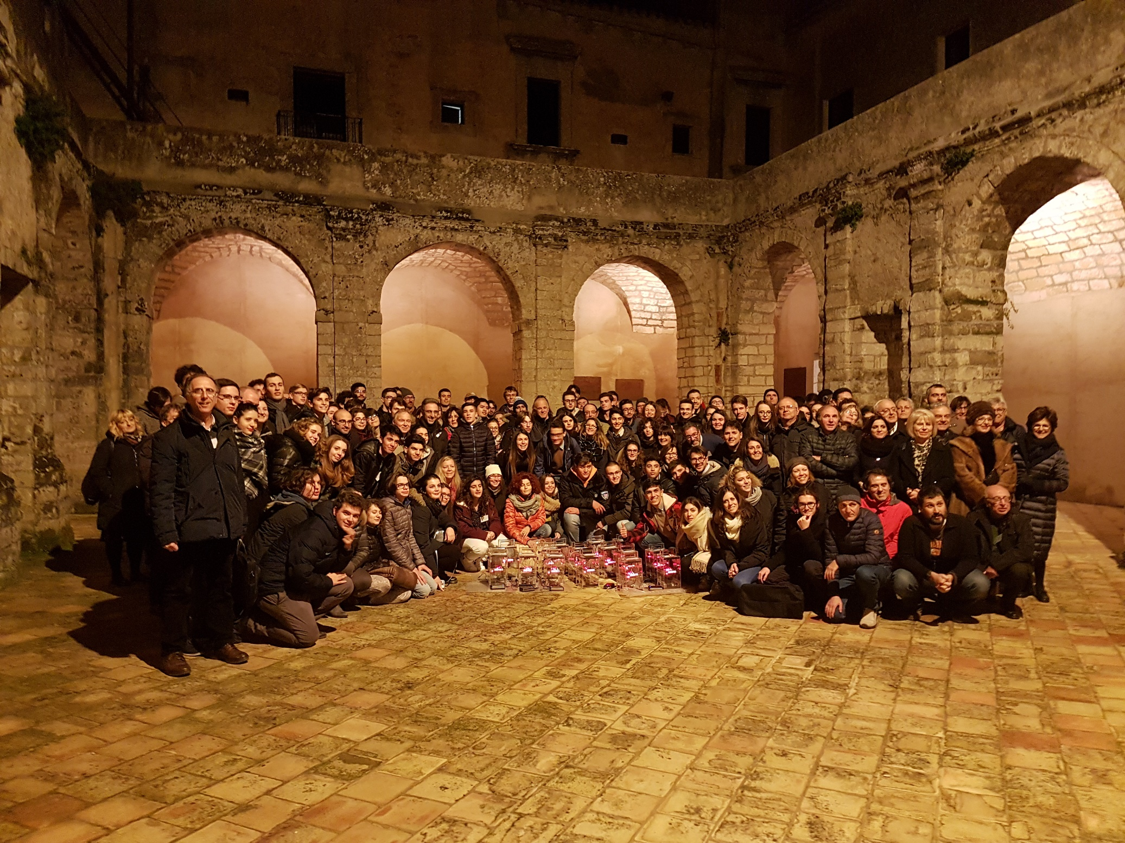
Conclusions
The EEE experiment is the largest system implemented with MRPCs in the world
  Detector performance similar to LHC experiments
  Will soon run with eco-gas
Its stations –located in high schools- continuosly take data
  Already > 60 billions muon tracks collected
EEE produces -a lot of- physics!
  very interesting observations of cosmics phenomena

Slide 25
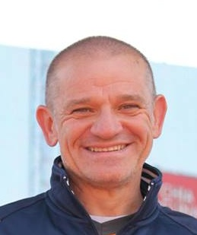
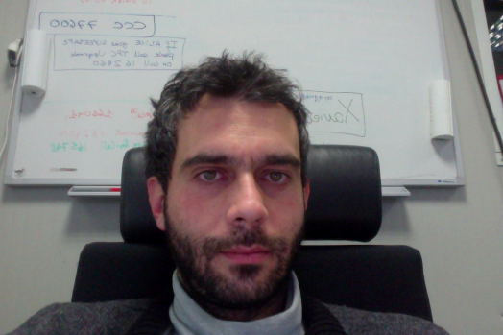

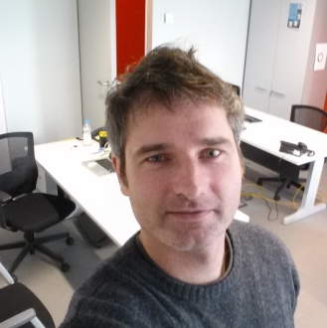
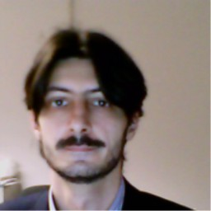
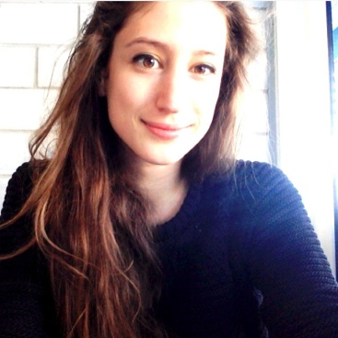















Thanks for the attention
Questions?
The End:
25

Slide 26
The End:
Thanks for the attention
Questions?

Slide 27
The End:
Thanks for the attention
Questions?

Slide 28

… it is a lot of fun!

Slide 29

EEE smallest (but great) town
Plan to build another 20 telescopes
Will increase the capability of the EEE network to study the high-energy part of the cosmic rays spectrum
Huge effort for 2017-18!
Liceo Scientifico “Patrizi” di Cariati

Slide 30


EEE: the taskforce
A task force of hardware experts, to intervene where setting up/commissioning/reparation of an EEE telescope is needed
Started activity at beginning of 2017
Already interventions at:
TREV-01 (commissioning, now telescope
taking part to the data taking)
VICE-01 (telescope set-up, waiting for trigger card)
ROMA-01, ROMA-02 (testing and repairs)
FRAS-02, FRAS-03 (small repairs, now both telescopes taking part to the data taking)
Programming interventions at COSE-01,
LECCE, etc.

Slide 31

EEE meetings with schools
Since end of 2016 monthly EEE run coordination meetings open to schools
Using dedicated Vidyo virtual rooms
Around 50-60 schools connected → hundreds of participants!

Slide 32


EEE plenary meetings
Bologna, November 6-7
North Italy schools
Grosseto, April 15-16
Center Italy schools
Bari, October 13-14
South Italy schools
Erice 2017:
May, 29, 30 and 31
December, 6, 7 and 8

Slide 33
EEE: goal of the project
Aims at covering the most interesting, and still unexplored, region of the cosmic ray spectrum:
  E > 10¹⁸ eV
  Extragalactic sources
  GZK cutoff
  (Greisen, Zatspein and Kuz’min)

Slide 34

The future: Run-4
Start: 2 October 2017 – End: 31 May 2018
Commissioning week: 25 September 2017 – 1 October 2017
Schools are called to:
(help) fix all issues in their telescopes (particularly in the Long Shutdown)
  50 cm distance between chambers
  2 l/h gas flow
Complete the measure of the telescope angle wrt. North
Start measures of the gas consumption
Telescope startup and shutdown responsibility of the schools
Read emails, diffuse them and react
Take part and present to the EEE Run meetings open to schools
Keep the telescope in operation
Monitor the telescopes (ALL)

Slide 35



The detector used
Efficiency
(in dedicated beam tests)
Time resolution
(in dedicated beam tests)
It is a wider (~2 m²) and cheaper version of the Multi gap RPC developed for the ALICE TOF
Operated with a mixture of C₂H₂F₄/SF₆ 97/3
at a continuous flow in the order of 2 l/h

Slide 36



The EEE experiment structure
Each station consists of a telescope made out of 3 MRPC
  Exceptional tracking and timing performance
Coincidences among distant telescopes are searched for, to spot high energy showers
Corrections because of the propagation of the wave front of the shower, made possible thanks to the EEE telescopes directionality

Slide 37
Okay, this is all about detector stuff, but…
why is EEE so peculiar?

Slide 38

EEE is so peculiar…
  because the experiment does not take place in scientific labs but…
in italian high schools
  because main actors of the experiment are not scientists but…
high schools students and teachers
  With the help of experts from the scientific world, students and teachers, they:
  Build their detectors at CERN
  Build the stations at their schools
  Take care of the data taking and relative analysis

Slide 39
…Aaahhh, okay:
It is a didactic experiment!

Slide 40
The upgrade

Slide 41
Some
physics results

Slide 42


EEE chamber performance
Efficiency measurements
…and counting rate
Efficiency HV scan performed last year (middle chamber)
To be repeated for all chambers
Time resolution measurements
With time slewing corrections, improving time resolution about 20%
See talk by D. De Gruttola for details

Slide 43

DAQ&Reconstruction architecture
5-10 TB per year
Full statistics from Pilot run to Run-1:
∼2.4 TB (raw: ∼2 TB, reco: ∼0.4 TB)
(+3 TB from past years)
A complex software architecture has been set-up to reconstruct the data and provide quasi-online (few hours) histograms on the web for monitoring purposes

