Slide 1
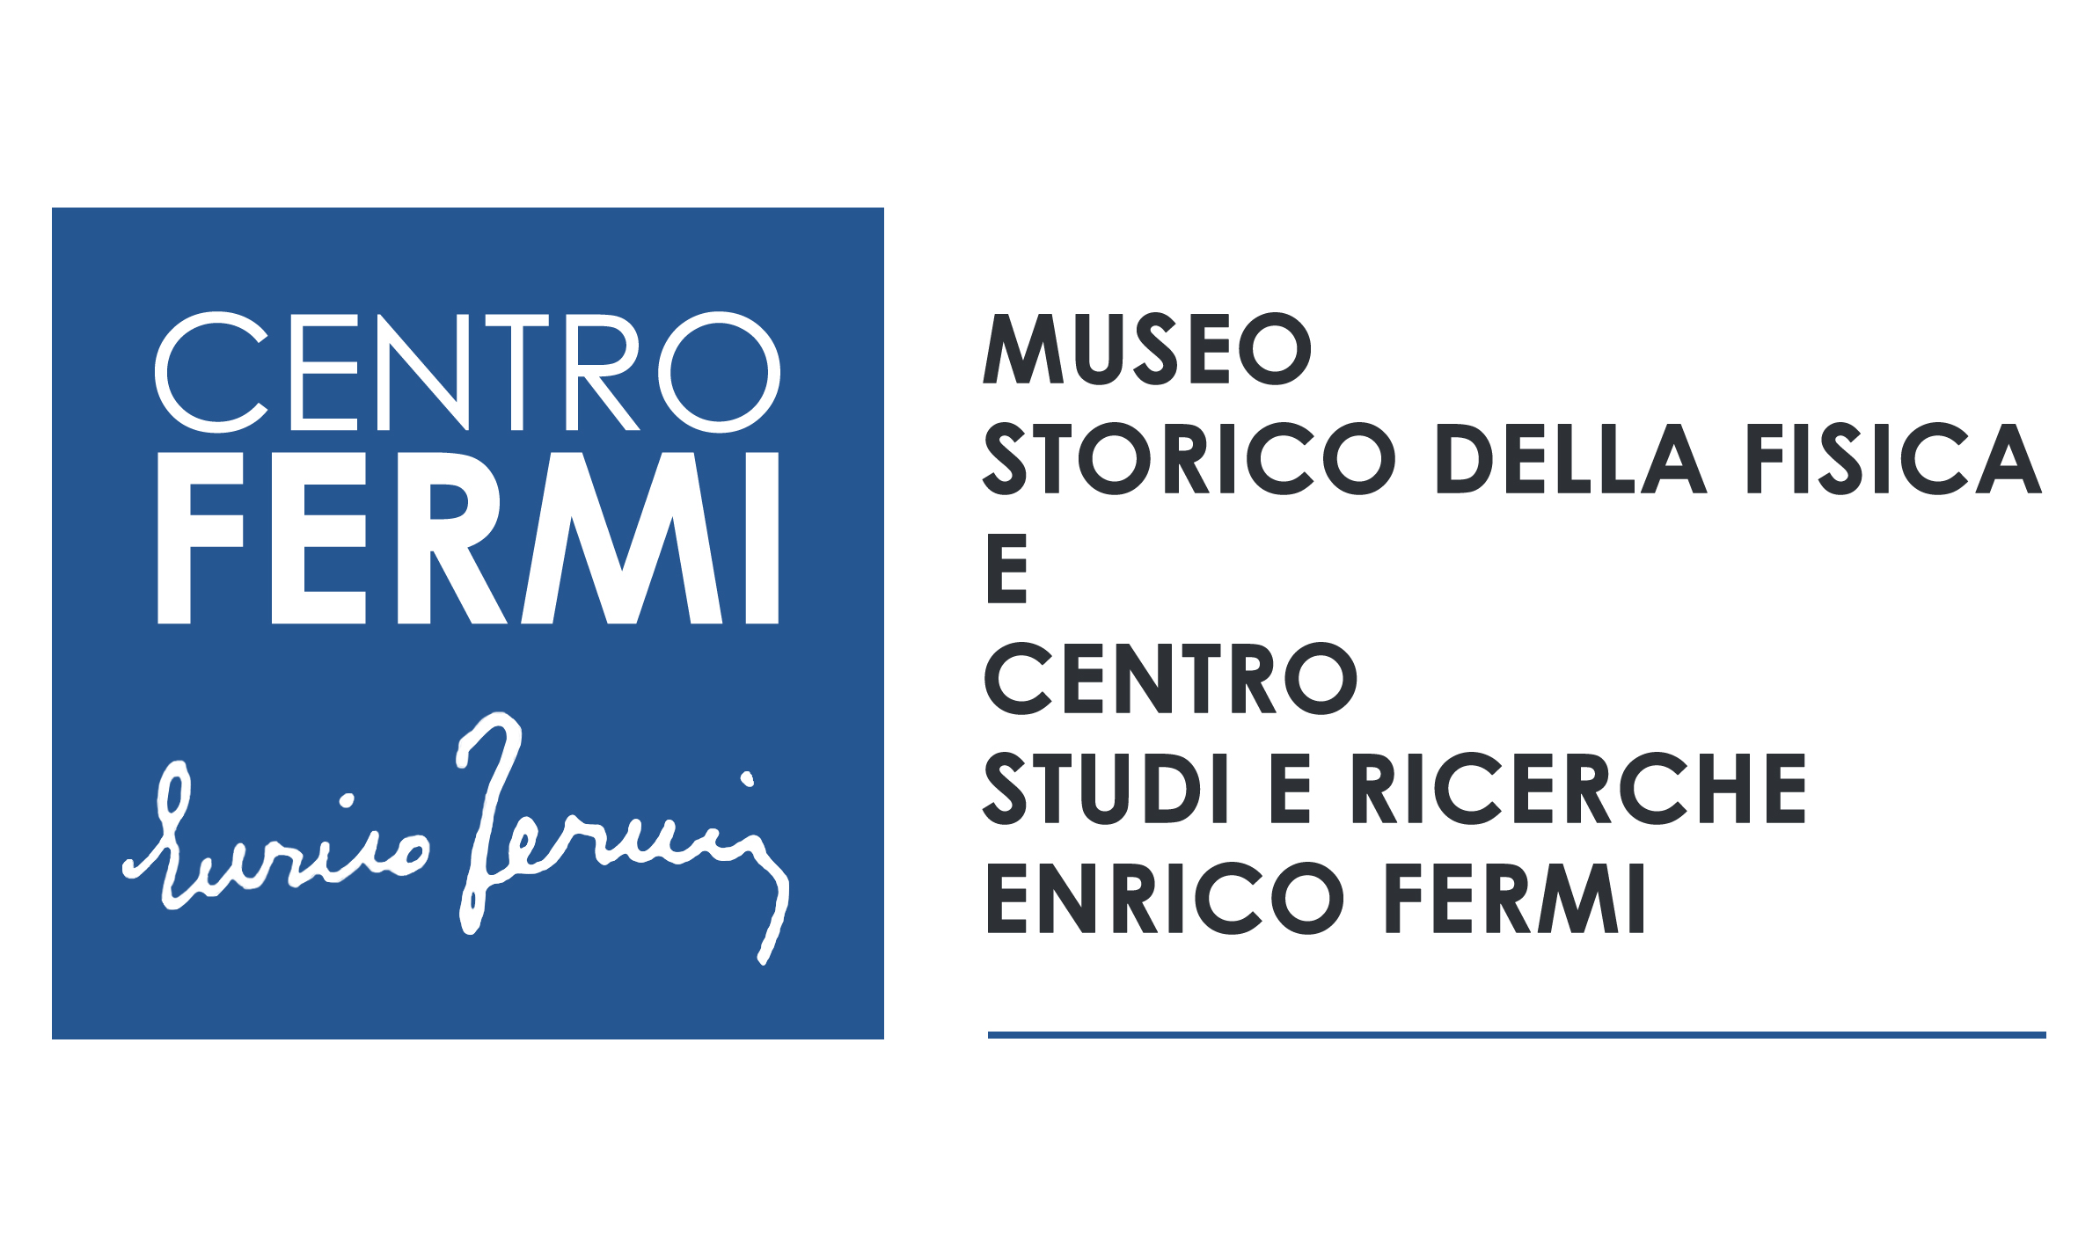
TNAAF – Neutron techniques for
Archaeology and Forensic Science
Tecniche Neutroniche per Archeologia ed Analisi Forense
Coordinator: Roberto Senesi, Università degli Studi di Roma Tor Vergata, Centro NAST
Participants:
Università Tor Vergata – Team: C. Andreani, R. Senesi, C. M. Labarga, O. Rickards (Centro NAST).
Centro Fermi – Team: G. Festa, L. Arcidiacono (October 2017- September 2018)
Università di Firenze - Team: P. Baglioni; Università di Milano-Bicocca – Team: G. Gorini
University College London (UK) Science and Engineering in Art, Heritage and Archaeology (SEAHA) Centre for Doctoral Training - Team: Marcos Martinon-Torres
Place of work & Collaborations:
Place of Work
Centro Fermi - Research and Heritage Institution
ISIS Spallation Neutron Source (Harwell, UK) – Research Institution
University College London (UK) – SEAHA, http://www.seaha-cdt.ac.uk - Research Institution
Università degli Studi di Roma Tor Vergata - Research Institution
Collaborations
Research Institutions: Consiglio Nazionale delle Ricerche (CNR-IBAM Catania and CNR-IPCF Messina) ; MOLAB (I), Oak Ridge National Laboratory (USA), Helmholtz-Zentrum Berlin (G), Argonne National Laboratory (USA); Sapienza Università di Roma (I); Universita’ di Milano Bicocca (I) ; Scuola Normale Superiore (I); Universita’ di Palermo (I); University of Coimbra (PT); Università degli Studi di Firenze (I).
Heritage Institutions: Anthropological Service, Soprintendenza Archeologia del Lazio e dell‘Etruria Meridionale - (MIBACT, I) Museo Egizio, Torino (I) ; Tarisio – Fine Instrumentations & Bows (UK), Fondazione Pro Canale (I); University of Coimbra (PT); Scuola Normale Superiore (I);.

Slide 2
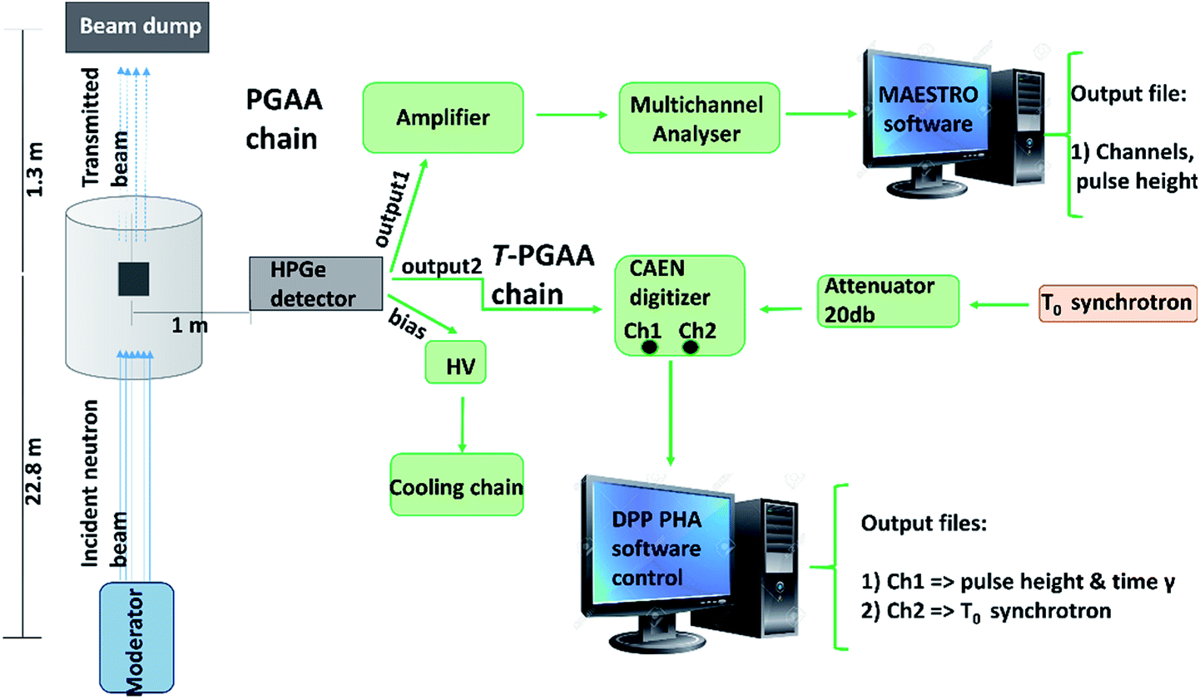
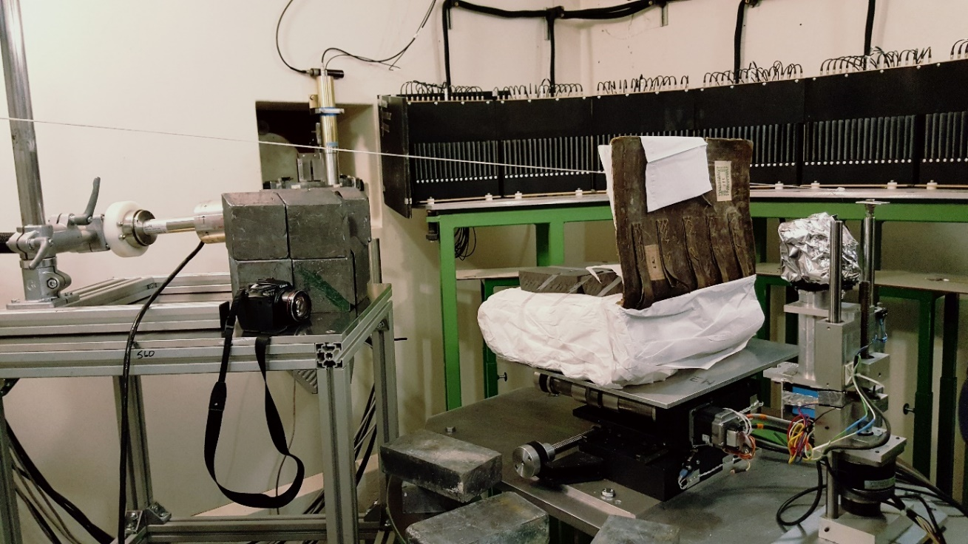
TNAAF - Neutron techniques for
Archaeology and Forensic Science
Project main goals and results achieved in 2017
Project goals: Element/isotope analysis, microstructure and spectroscopy on samples of archaeological and forensic relevance.
To realise a Time-Resolved Prompt Gamma Activation Analysis (T-PGAA) apparatus not yet available at Spallation Neutron Sources→ broaden the scope of chemical/isotope analysis for Cultural Heritage and forensic studies.
To create an outpost in UK of the Centro Fermi - TNAAF team (under the CNR-STFC Agreement) for interdisciplinary research activities and projects: Harwell, London.
To integrate advanced neutron techniques with molecular and atomic spectroscopy techniques for the study of cultural heritage artefacts, materials and forensic samples.

Slide 3
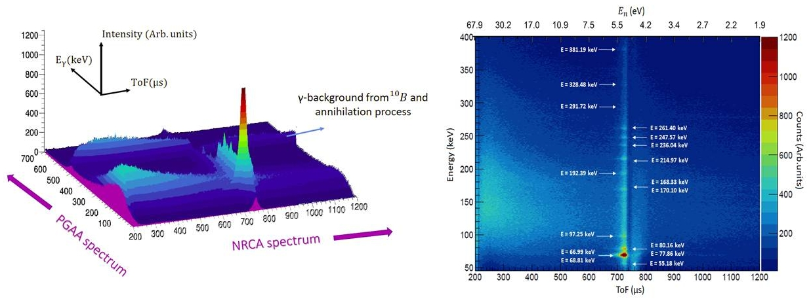
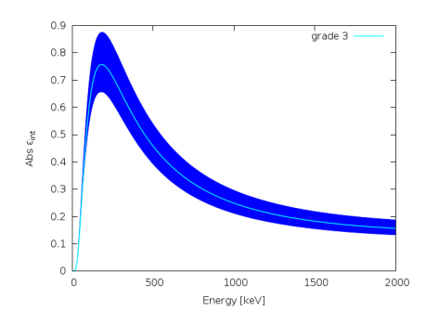
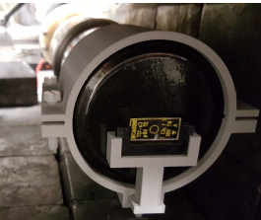
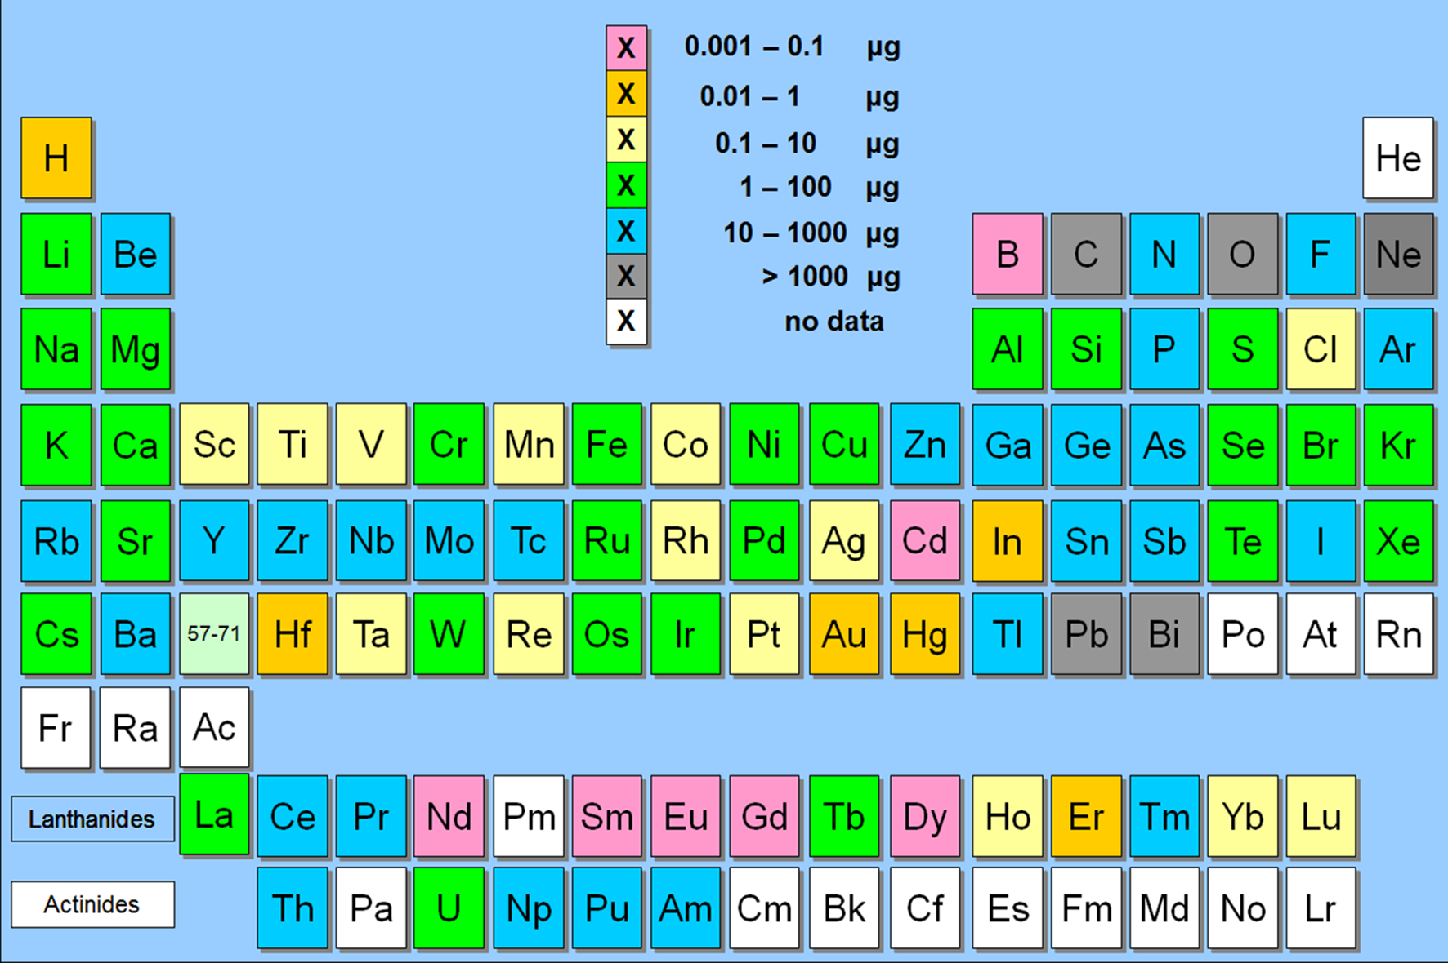
TNAAF - Neutron techniques for
Archaeology and Forensic Science
Project results achieved in 2017+ eV Neutrons Workshop 2017
1) Two –dimensional (photon energy-neutron energy) Prompt gamma emission from gold in the thermal and resonance region
2) Ge detector absolute efficiency calibration (path towards quantitative analysis)

Slide 4
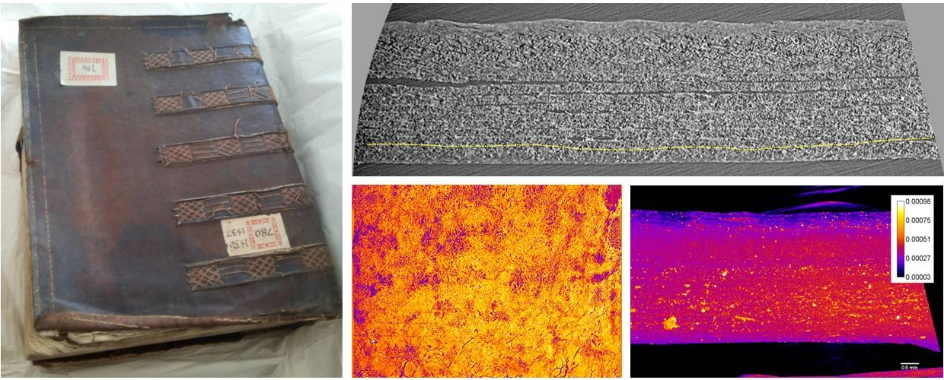
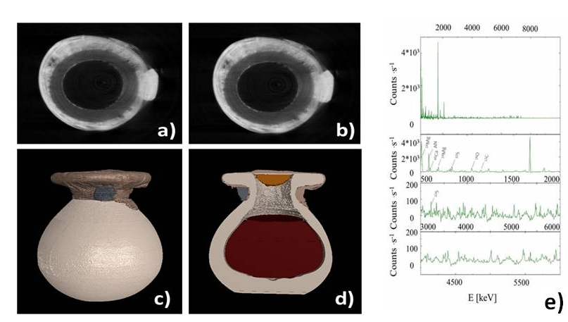
TNAAF - Neutron techniques for
Archaeology and Forensic Science
Project results achieved in 2017
3) Integration of neutron and photon techniques for the analysis of manuscripts/books
Synchrotron X-Ray (DIAMOND- UK) tomography of a
XVII century book from archivio Salviati (SNS)
4) Integration of neutron tomography and Prompt Gamma Activation Analysis on Egyptian sealed vase from 1400 BC
Alabaster sealed with linen textiles and glue
G. Festa et al. Accepted for publication in Angewandte Chemie (2018)

Slide 5
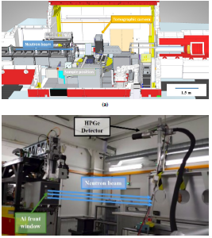
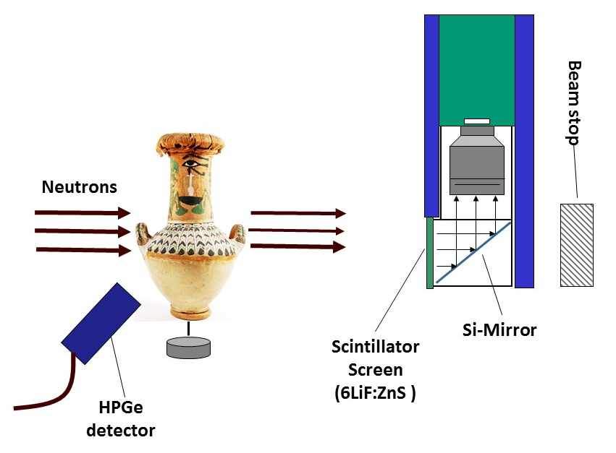
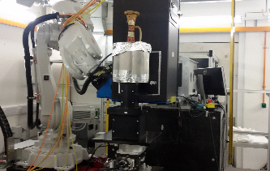
TNAAF - Neutron techniques for
Archaeology and Forensic Science
Project results achieved in 2017- two main publications
1) G Festa, C Andreani, L Arcidiacono, G Burca, W Kockelmann, T Minniti, R Senesi,
“Characterization of γ-ray background at IMAT beamline of ISIS Spallation Neutron Source”, Journal of Instrumentation 12, P08005 (2017).
2) C Andreani, F Aliotta, L Arcidiacono, M Borla, D Di Martino, F Facchetti, E Ferraris, G Festa, G Gorini, W Kockelmann, J Kelleher, D Malfitana, D Micieli, T Minniti, E Perelli Cippo, R Ponterio, G Salvato, R Senesi, V Turina, C Vasi, C Greco,
“A neutron study of sealed pottery from the grave-goods of Kha and Merit”, Journal of Analytical Atomic Spectrometry 32, 1342 (2017).
Instrumentation development
Applications to CH →

Slide 6
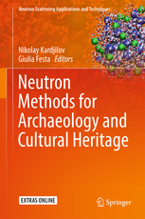
TNAAF - Neutron techniques for
Archaeology and Forensic Science
Project results achieved in 2017- two main publications- plus a book!
Neutron Scattering Applications and Techniques
© 2017
Neutron Methods for Archaeology and Cultural Heritage
Editors: Kardjilov, Nikolay, Festa, Giulia (Eds.)

Slide 7
TNAAF - Neutron techniques for
Archaeology and Forensic Science
Milestones 2018
1) Compton suppression and background optimization systems for T-PGAA
2) Consolidation of experimental plans and data analysis on textile samples from Museo Egizio
3) Data analysis on combusted bones (FTIR, neutron, Raman, PCA)
4) Three (at least) experiment proposals to be submitted to the ISIS Facility Access procedure on archaeometric standards, ancient books, oricalchos.

Slide 8
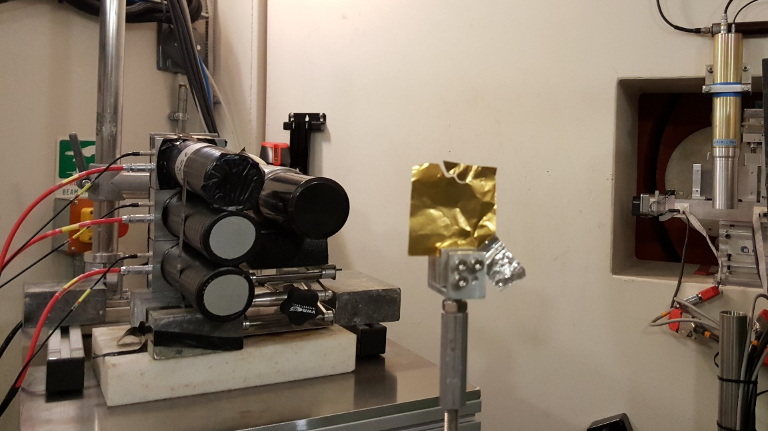
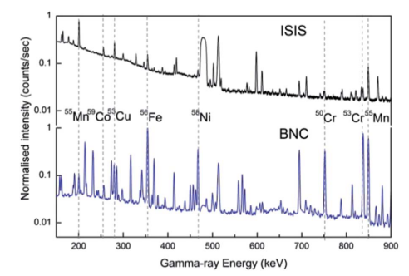
TNAAF - Neutron techniques for
Archaeology and Forensic Science
Plan of activities 2018 - 2020
A) Instrumentation development
Compton suppression systems:
HpGe+YAP
2) Measurements of time of flight
resolved background on 3
beam lines at ISIS
3) Optimization of shielding
No Compton- no shielding
Compton+ shielding

Slide 9
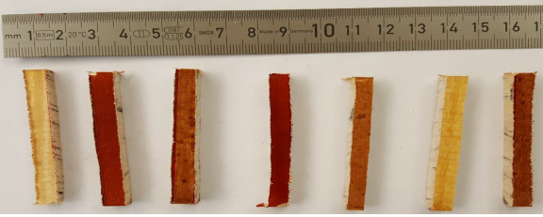
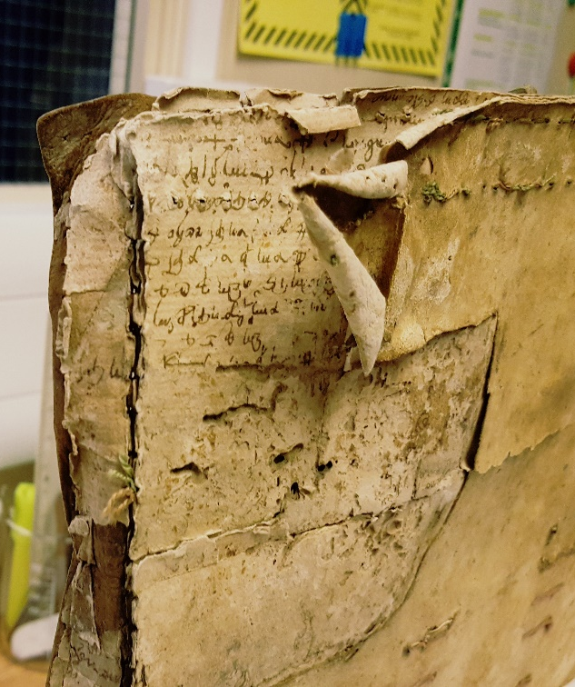
TNAAF - Neutron techniques for
Archaeology and Forensic Science
Plan of activities 2018 - 2020
B) Applications and techniques
integration. Experiment
proposals on:
Metallic archaeometric
standards
2) Antique violins- integration with
tomography and varnish surface analysis
3) Ancient books: Neutron and X Ray
analysis
4) Orichalcos

Slide 10
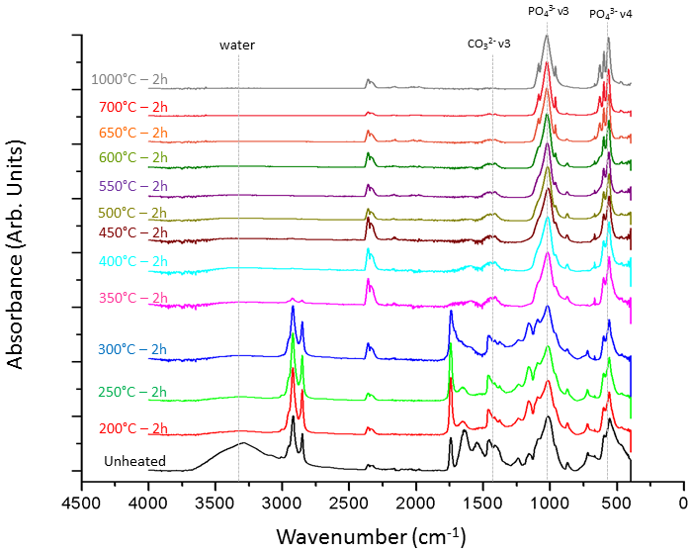
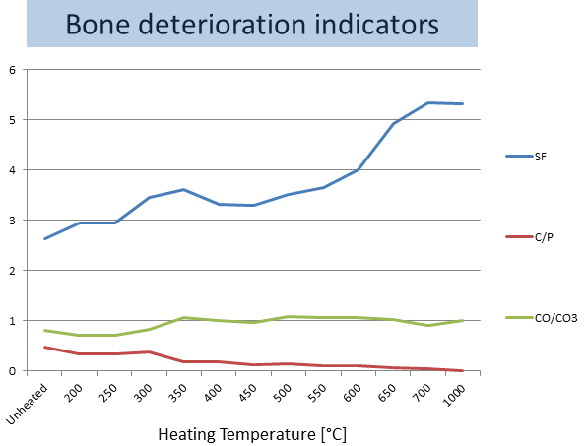
TNAAF - Neutron techniques for
Archaeology and Forensic Science
Plan of activities 2018 - 2020
C) X-Ray and neutron imaging,
neutron spectroscopy and FTIR
on combusted bones
D) Integration of the above techniques
with EDXRF-Raman
(see presentation by G. Festa)

Slide 11
TNAAF - Neutron techniques for
Archaeology and Forensic Science
Expected funding in the 3-year period:
Request of funding by Centro Fermi
Grant: 1 grant for 2019 (assegno di ricerca, 25 keuro); 1 grant for 2020
(assegno di ricerca, 25 keuro);
Travel/missions: 15 keuro/year for the years 2018,2019,2020
External funding : 1 grant for 2018 (assegno di ricerca, 25 keuro);
- Potential external funding
Bandi Distretto Regione Lazio BC, results expected in 2018

