Slide 1





Open Problems in Quantum Mechanics (PAMQ)
Coordinator:
Catalina Curceanu, LNF-INFN and Associated to Centro Fermi
Participants:
Kristian Piscicchia, grant CF, Feb 2016 – Feb 2019
Place of Work & Collaborations:
LNF-INFN
LNGS-INFN
Univ. Trieste
Univ. Bologna
SMI-OeAW, Vienna (Austria)
Univ. Vienna (Austria)
IFIN-HH Bucharest (Romania)
Wigner Institute (Hungary)
Rennes Univ. (France)
Stephen Adler- Inst. For Advanced Study, Princeton, USA
Univ. Melbourne (Australia)
Roma, March 2018 - PTA

Slide 2
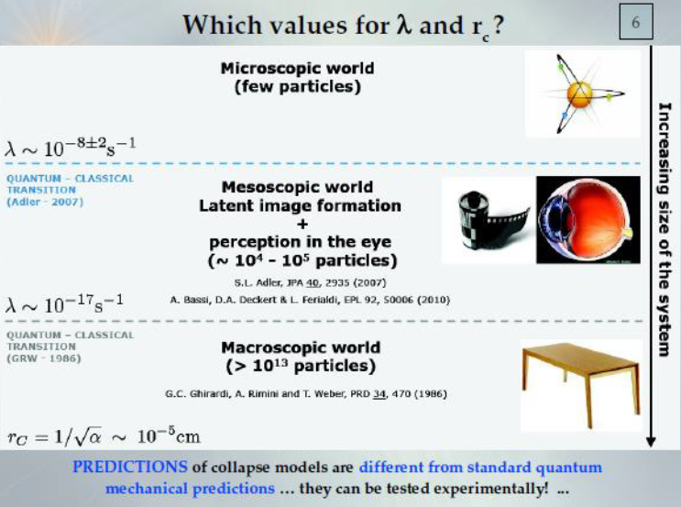
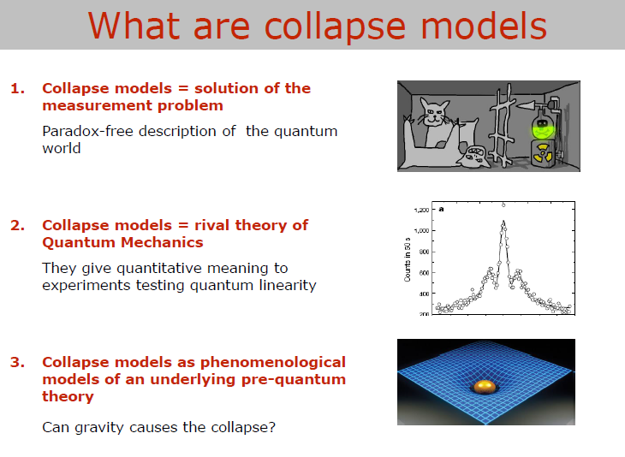
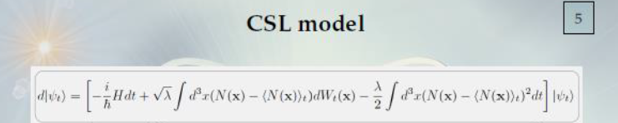
Open Problems in Quantum Mechanics
Brief reminder of PAMQ:
WE DEAL with OPEN PROBLEMS IN QUANTUM MECHANICS, in particular with:
- The “measurement problem” -> searching signals related to the collapse models – Continuous Spontaneous Localization and its relation to dark energy
Tests of the Pauli exclusion
principle for electrons
Quantum technologies
quantum era/flagship

Slide 3

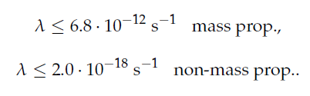
Open Problems in Quantum Mechanics (PAMQ)
Project main goals and results achieved in 2017
Scientific Activity:
- New limit on colapse models parameters – Entropy 19 (2017) 319

Slide 4
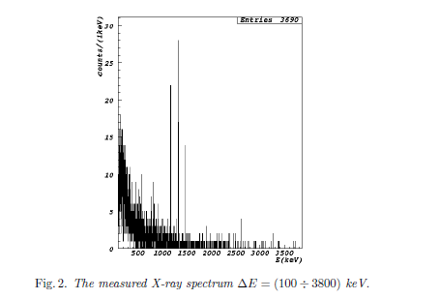
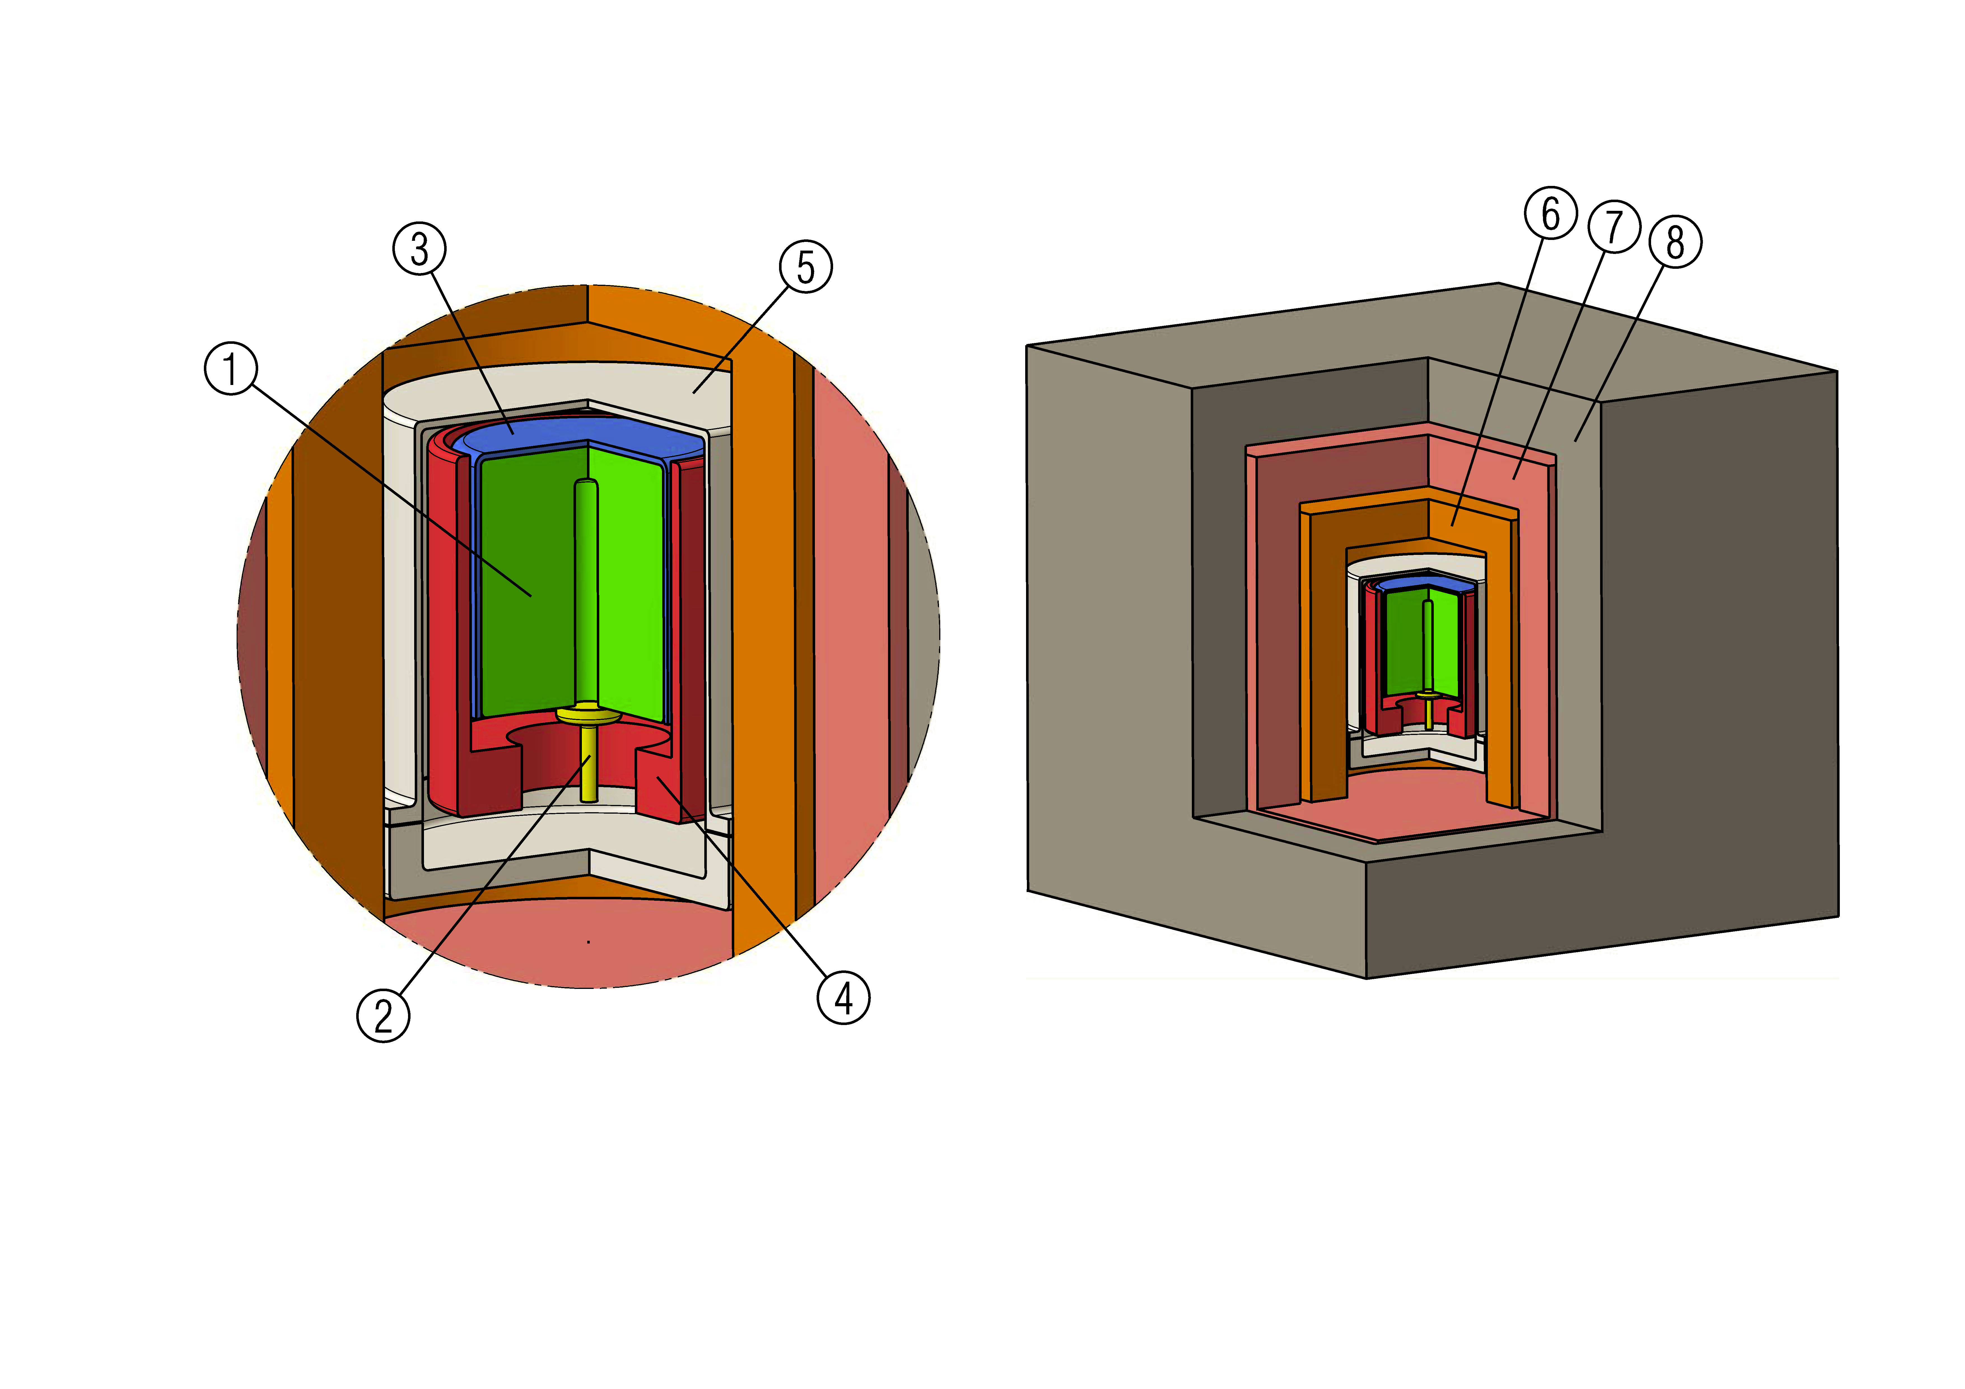
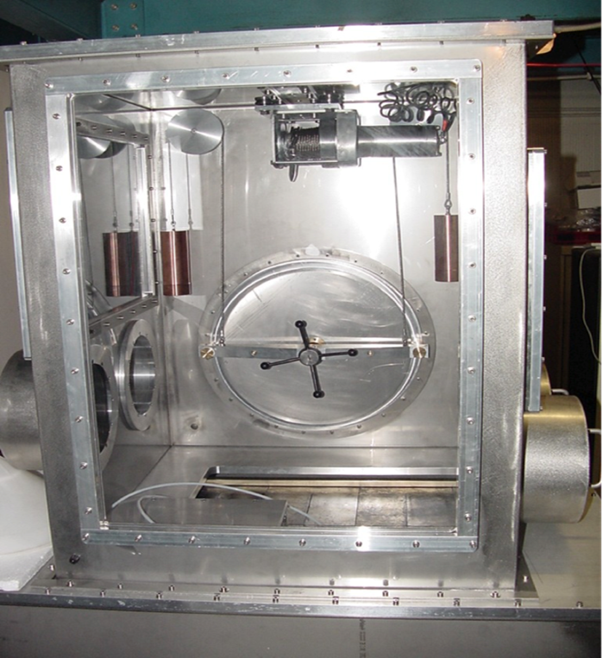
Open Problems in Quantum Mechanics (PAMQ)
Project main goals and results achieved in 2017
Scientific Activity:
- New data taking at LNGS with dedicated setup and data analyses: paper in preparation (Science) – best limit

Slide 5
Open Problems in Quantum Mechanics (PAMQ)
Project main goals and results achieved in 2017
Scientific Activity:
Interpretation of data on collapse: dark energy?
Test of the Pauli Exclusion principle – VIP2: best limit on violation: Entropy 2017, 19(7), 300
Future quantum technologies: limits from collapse models, quantum tomograph (positronia)....
Applications of radiation detectors in medicine (Wollongong univ.)
Publication of 17 papers; 16 talks at workshops and conferences

Slide 6
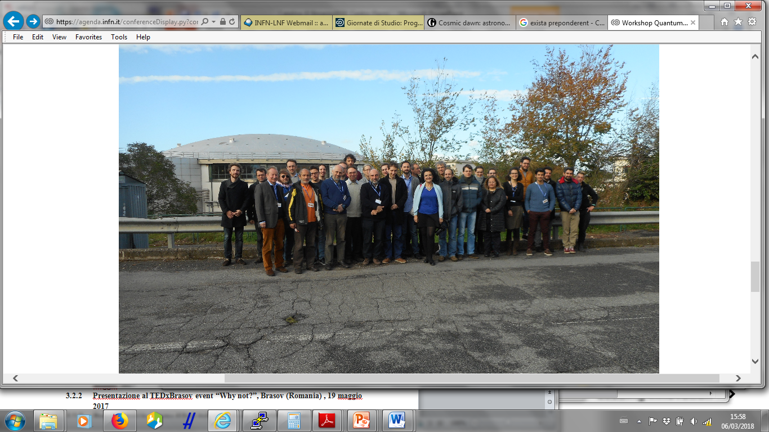
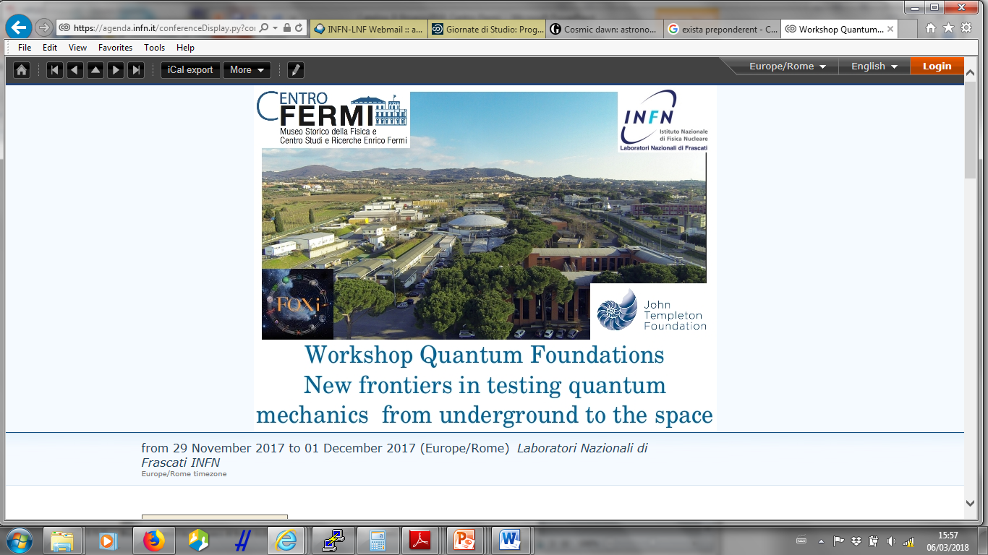
Open Problems in Quantum Mechanics (PAMQ)
Project main goals and results achieved in 2017
Events organizations:
Workshop in Quantum Foundation: New Frontiers in Testing Quantum Mechanics from underground to the space

Slide 7
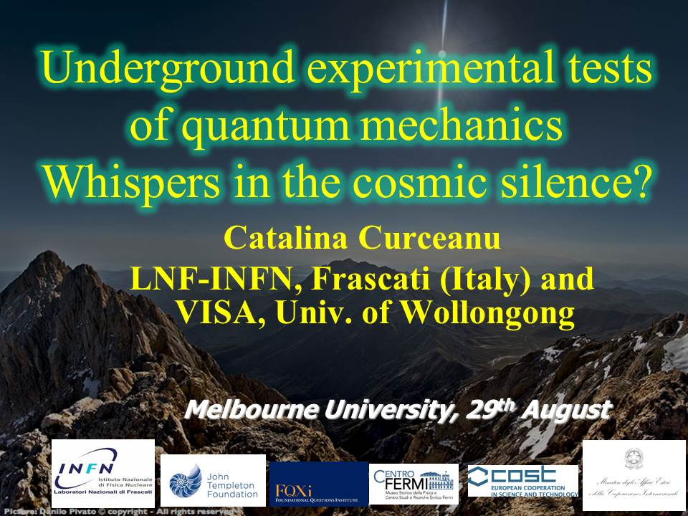
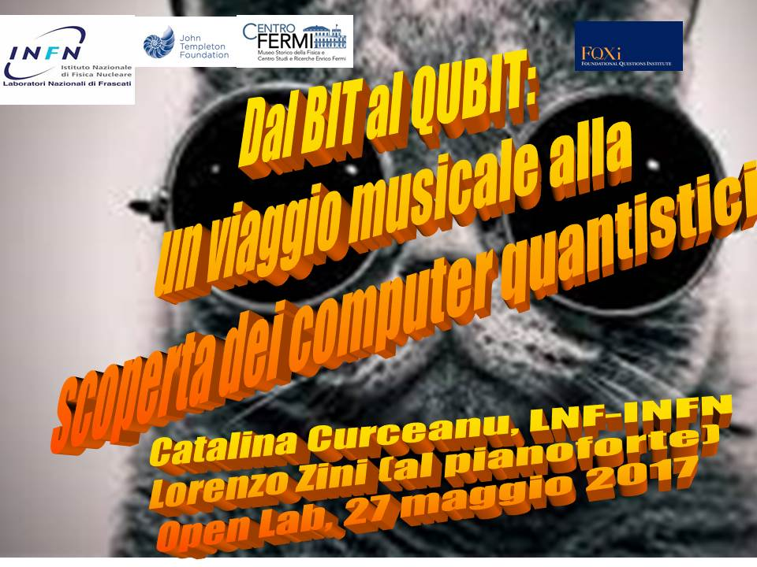
Open Problems in Quantum Mechanics (PAMQ)
Project main goals and results achieved in 2017
Dissemination Activity:
Open lab at LNF-INFN
talks in 6 schools
Talk at TEDxBrasov event “Why not?”, Brasov (Romania) , 19 maggio 2017
6 talks in australia including PAMQ (ANU Canberra; Univ. Melbourne; Wollongong Univ., Sydney)
Dedicated radio interview - FISICAST

Slide 8
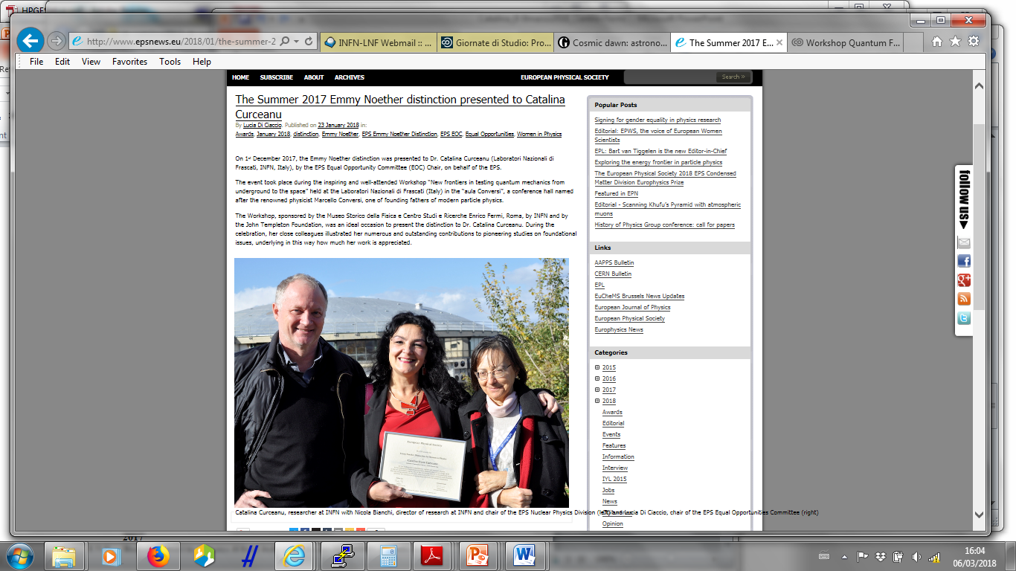
Many thanks to Centro Fermi
especially to
Prof. Luisa Cifarelli

Slide 9

Open Problems in Quantum Mechanics (PAMQ)
Milestones 2018
Publication of the results of the data analyses for collapse models for Ge dedicated data taking in high-impact peer-reviewed journal
Data taking with VIP2 and publication of new results – best limit on pep violation probability
Detector development and new data taking for study of collapse models to gain 1-2 orders of magnitude
Organization of a workshop on quantum foundation and quantum technologies
New directions of quantum investigations: quantum technologies, quantum medicine…

Slide 10
Open Problems in Quantum Mechanics (PAMQ)
Plan of activities 2018 - 2020
Scientific activities:
Refinement of Bayesian analyses methods for the study of collapse models parameters
Refinement of collapse models with Univ. Trieste. Include protons signal
Data analyses for the data taking 2017 at LNGS (with roman lead target prototype) – article
Data taking at LNGS in 2018 and 2019 with optimized setup for collapse models studies
Work with theoreticians: collapse models -> dark energy? -> new dedicated experiments
VIP2 data taking, analyses -> articles
Detector development; crystals, diamond…
Quantum Technologies (in Space) and Quantum medicine

Slide 11
Open Problems in Quantum Mechanics (PAMQ)
Plan of activities 2018 - 2020
Events organization:
Workshops in Quantum Foundations n 2018, 2019 and 2020 (3 workshops)
One Training School in:
Quantum Foundations and Quantum Technoogies
(2019)

Slide 12
Open Problems in Quantum Mechanics (PAMQ)
Plan of activities 2018 - 2020
Dissemination:
At least 12 talks at international workshops and conferences
At least 20 papers in peer-reviewed journals
Presentation in openLab 2018, 2019 and 2020
Talks for public (TEDxCluj…)
Talks including PAMQ in at least 10 high-schools in Italy
Talks including PAMQ in inspyre international schoo in Frascati
Talks including PAMQ in at least 10 public events (libraries, festivals, etc)
Dedicated videos in youtube channel
Postings on facebook, Instagram…

Slide 13
Open Problems in Quantum Mechanics (PAMQ)
Expected funding in the 3-year period:
Request of funding by Centro Fermi
Assegno Ricerca junior : 2019– 20120 : 45 kEuro
Funds for organizing 3 workshops: 3 x 5 kEuro/year = 15 kEuro
Travel expenses (missioni): 3 x 5 keuro/year = 15 keuro
Consumables for the setups: 10 kEuro/year
Co-funding in 3 years period (estimate)
INFN: 100 kEuro (VIP)
Austrian Scence Foundation: 50 kEuro
Others (IFIN-HH, Templeton, Trieste): 25 kEuro
- Potential external funding
FQXI: 50 kEuro
EU Funding (COST Actions, MCurie, FET,….): 100 kEuro
PRIN: 50 kEuro
Other nationals and internationals possible fundings: 50 kEuro

