Slide 1



Photonic Microcavities
Microcavità Fotoniche (MiFo)
Project Leader: Giancarlo Righini
Coordinator: Gualtiero Nunzi Conti
Participants:
Coccetti, Fabrizio primo tecnologo Centro Fermi
Enrichi, Francesco assegnista Centro Fermi (04/2016 – 04/2018)
Ferrari, Maurizio CNR, associato al Centro Fermi
Nunzi Conti, Gualtiero CNR, associato al Centro Fermi
Pelli, Stefano CNR, associato al Centro Fermi
Quandt, Alexander Wits Univ., associato al Centro Fermi
Righini, Giancarlo associato al Centro Fermi
Zur, Lidia assegnista Centro Fermi (12/2015 – 11/2018)
Cosci, Alessandro assegnista Centro Fermi (07/2014 – 07/2017)
Gianfreda, Mariagiovanna assegnista Centro Fermi (12/2016 – 12/2017)
Place of Work & Collaborations:
Istituto di Fisica Applicata “N. Carrara” (IFAC-CNR)
Istituto di Fotonica e Nanotecnologie (IFN-CNR, CSMFO Lab Trento)

Slide 2
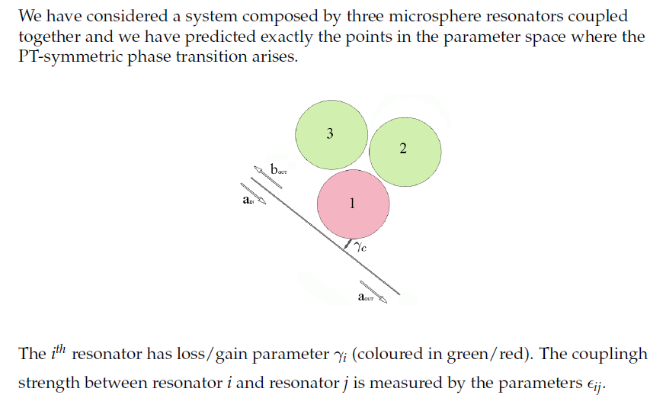
Photonic Microcavities
Microcavità Fotoniche (MiFo)
PATISS (Parity Time Simmetry System) subproject: main goals and results achieved in 2017 (Grant Mariagiovanna Gianfreda, also with IFAC-CNR, Sesto Fiorentino (FI))
Theoretical studies on three PT-symmetric coupled microring resonators
With the aim of generalizing the obtained classical results on coupled microring resonators to the quantum regime, a theoretical study on the action-angle operator equations for non-autonomous quantum systems have been performed, by using time dependent canonical transformations. In particular, the results have been applied to the time dependent anharmonic quantum oscillator.
The study has been performed in collaboration with Prof. Giulio Landolfi, Mathematical Physics Group of Universita del Salento, Dipartimento di Matematica e Fisica Ennio De Giorgi, Lecce.
M. Gianfreda and G. Landolfi, ”Non-autonomous Hamiltonian quantum systems, operator equations and representations of Bender-Dunne Weyl ordered basis under time- dependent canonical transformations”, Theoretical and Mathematical Physics 193, 1444 ,2017

Slide 3
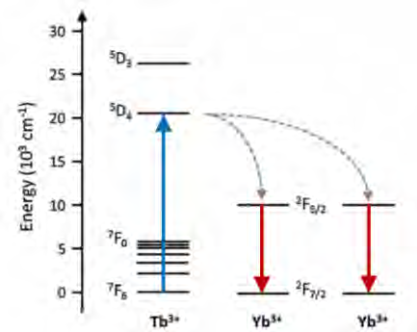
Photonic Microcavities
Microcavità Fotoniche (MiFo)
PLANS (PLAsmonica e Nanoantenne per celle Solari) and PLESC (Italy-South Africa) subprojects: main goals and results achieved in 2017
Topic: Ag nanoaggregates and Tb³⁺/Yb³⁺ co-doped silica-hafnia and silica-zirconia sol-gel glasses and glass-ceramics for increasing the efficiency of solar cells (Grant Francesco Enrichi, also with Vinnmer Marie Curie Incoming Fellow, Luleå University of Technology, Luleå (Sweden))
Host material
SiO₂-HfO₂ glass-ceramics (sol-gel)
SiO₂-ZrO₂ glass-ceramics (sol-gel)
Combine the advantages of glasses and the better spectroscopic properties of crystals
  Silica-based coatings, waveguides, fibers
  Low phonon energies ~ 700 cm⁻¹
  High refractive index (500 nm) ~ 2.1 – 2.2
One UV or blue (488 nm) photon
Two infrared photons @ 980 nm
Aim of this research:
to increase the excitation efficiency and the spectral bandwidth of Tb³⁺ ions by energy coupling with optically excited mediators
Ag ions / multimers

Slide 4
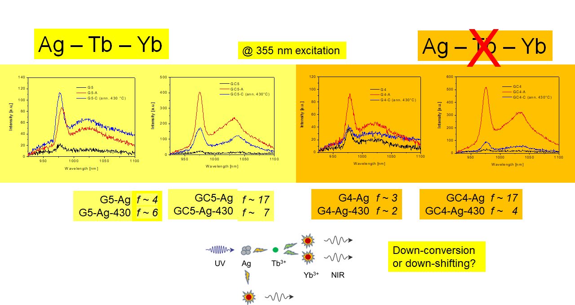
Photonic Microcavities
Microcavità Fotoniche (MiFo)
PLANS and PLESC subprojects: main goals and results achieved in 2017
Ag nanoaggregates are efficient broadband sensitizers for Tb³⁺-Yb³⁺ ions with strong potential for many applications
F. Enrichi, …, L. Zur, “Visible to NIR downconversion process in Tb3+-Yb3+ codoped silica-hafnia glass and glass-ceramic sol-gel waveguides for solar cells”, Journal of Luminescence 193, 44-50 (2018)
F. Enrichi, A. Quandt, G.C. Righini, “Plasmonic enhanced solar cells: Summary of possible strategies and recent results”, Renewable and Sustainable Energy Reviews 82, 2433-2439 (2018)

Slide 5
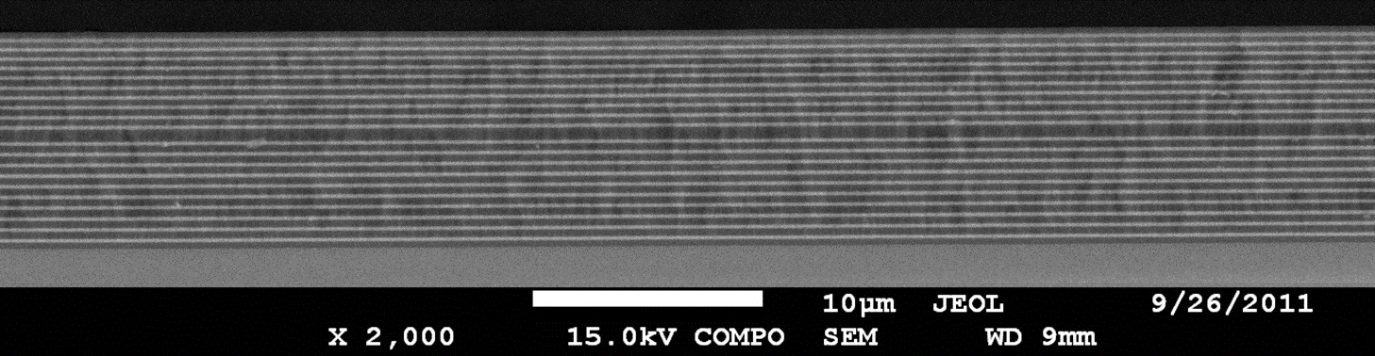
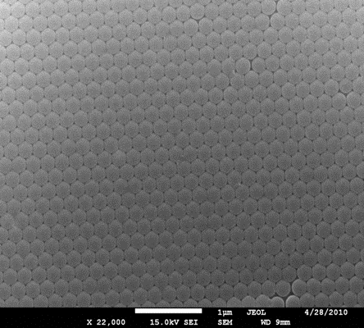
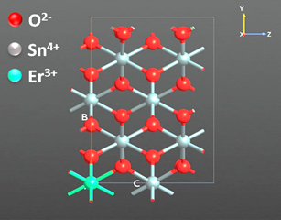
Photonic Microcavities
Microcavità Fotoniche (MiFo)
PLANS and PLESC subprojects: main goals and results achieved in 2017
RF-sputtering fabrication protocols of 1D microcavities
The scientific activity was mainly but not only based on the PLANS project, which ended in 2017, and on the themes of the new MiFo project. The latter includes the engineering of nano-objects activated with luminescent ions, a topic that is transforming the field of photonics because using confined structures, quantum and plasmonic effects, it is possible to tailor the optical and electromagnetic properties resulting e.g. in an increase of the quantum yield of the devices and implementing new functionalities
Sol-gel fabrication protocol of direct and inverse silica opals
The results achieved in 2017 are validated by 15 publications. Of these, 5 publications are ISI-JCR and 7 are in international conference proceedings (2 invited), 3 book chapter invited. 13 congress communications were presented, 7 invited. Co-organization as CF of the International Workshop PRE’17 in Rome
The structure of SnO₂:Er³⁺
Evidence of ET SnO₂ → Er³⁺
The Unit succeeded in:
Sol-gel fabrication protocols of transparent glass ceramics bulk and thin films xSiO₂-(1-x)SnO₂ activated by Er³⁺
Demonstration of the role of SnO₂ as rare earth ions sensitizer [Energy transfer efficiency]
Preliminary assessment of the photorefractive properties
RF-sputtering fabrication protocols of 1D microcavities
Sol-gel fabrication protocol of direct and inverse silica opals
L. Zur et al., “Tin-dioxide nanocrystals as Er3+ luminescence sensitizers: Formation of glass-ceramic thin films and their characterization”, Optical Materials 63, 95-100 (2017)

Slide 6
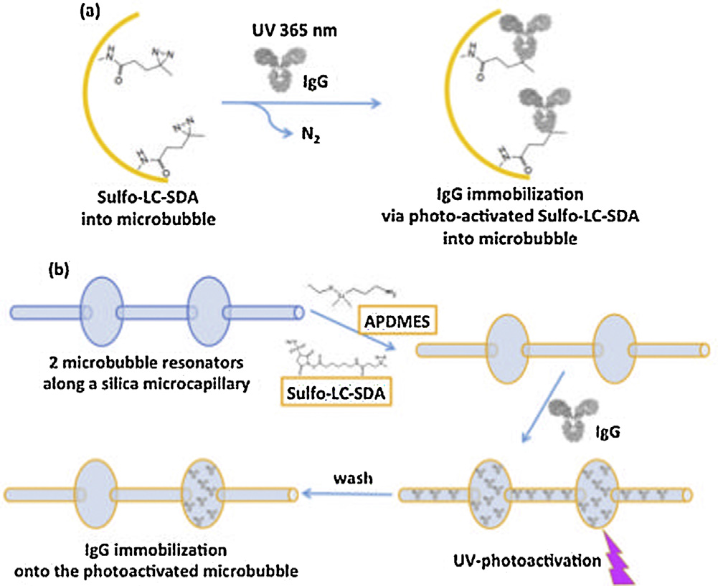
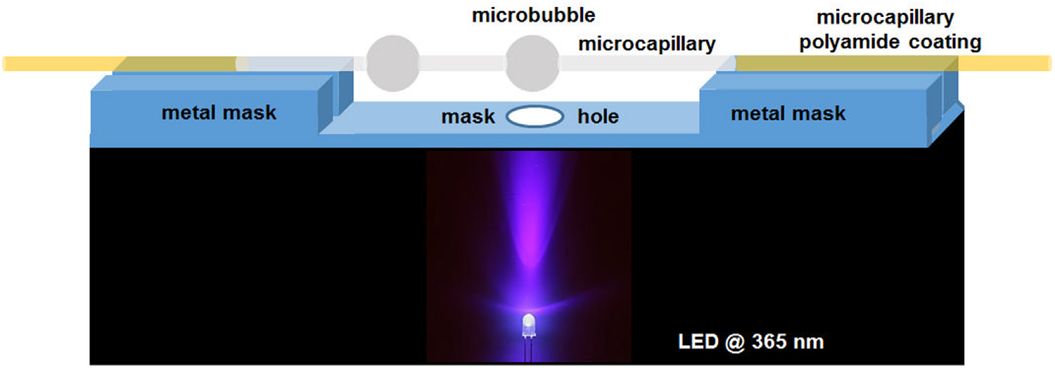
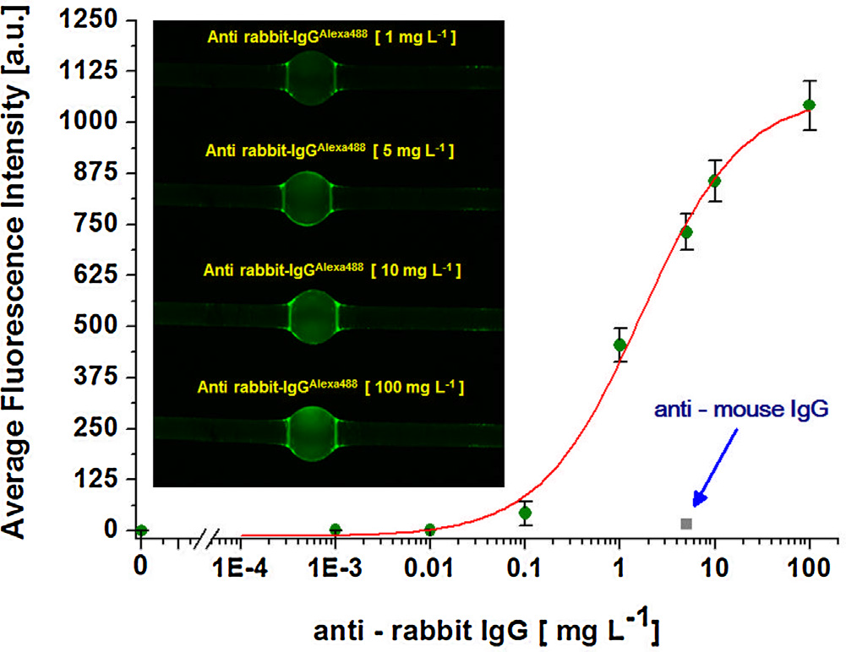
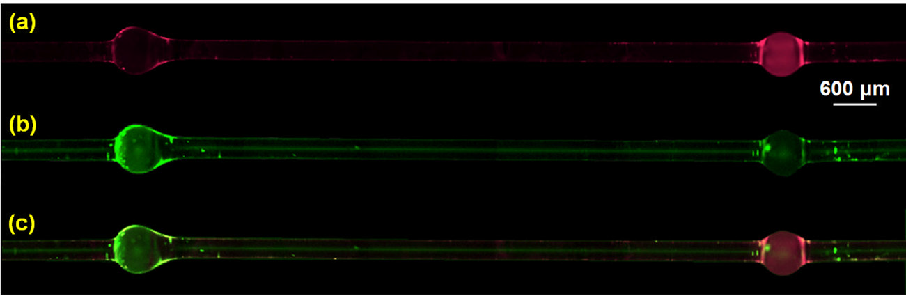
Photonic Microcavities
Microcavità Fotoniche (MiFo)
TFB: Tecniche Fotoniche per Biomedicina (biosensing with Whispering Gallery Mode Resonators (WGMR) subprojects): main goals and results achieved in 2017
Achievement of a biochemical protocol for selective excitation of microbubble resonators
occurrence of a selective labelled antibody immobilization into the OMBRs system
S. Berneschi, F. Baldini, A. Cosci, D. Farnesi, G. Nunzi Conti, S. Tombelli, C. Trono, S. Pelli, A. Giannetti, “Fluorescence biosensing in selectively photo–activated microbubble resonators”, Sensors and Actuators B: Chemical 242, 1057 (2017)

Slide 7
Photonic Microcavities
Microcavità Fotoniche (MiFo)
TFB: Tecniche Fotoniche per Biomedicina (biosensing with Whispering Gallery Mode Resonators (WGMR)) subprojects: main goals and results achieved in 2017
Another results has been the development of a methodology to access coupled WGM in coated resonators
SU-8 coated
μsphere
SU-8 coated
μsphere
thermocouple
heater
thermocouple
heater
SU-8 ridge waveguide
taper
PMMA substrate
(a)
A. Barucci, et al., “Selective coupling of Whispering Gallery Modes in film coated micro-resonators“ provisionally accepetd on Opt. Express

Slide 8
Photonic Microcavities
Microcavità Fotoniche (MiFo)
From PLANS + PLESC projects to MATER Project coordinated by CNR on Solar Cells
Milestones 2018
SiO₂-SnO₂ Thermodynamic properties (June 2018)
Evaluation of the optical, spectroscopic and structural properties (October 2018)
Quantitative evaluation of the photorefractive properties (September 2018
Demonstration of photon management in Rare Earths activated Opals and 1D microcavities (November 2018)
Fabrication of 1D multilayer structures for sensing and energy (December 2018)
Plan of activities 2018 - 2020
Use of the photorefractive properties for the fabrication of integrated laser sources;
Preliminary drawing test starting from the SiO₂-SnO₂ preforms
Fs laser writing on SiO₂-SnO₂ bulk and different irradiation techniques to modify the structures
Sensors of gaseous species with MIR-IR absorption and Vis detection
Development of coherent sources with threshold close to zero
Engineering of electronic states and control of energy transfer processes [1 D and 3D photonic crystal structures activated with rare earth ions: applications and in the field of renewable energy]
Pressure sensors based on 1D structures
Detection tests of weak photoluminescence signals and single photon detection using cavities
Outreach actions: “Esploratori della Fotonica” a series of events with high school teachers and students from Trento; International Day of Light; The night of researchers; “Siamo Europa” one day information on Trento citizenship about the running European Projects

Slide 9
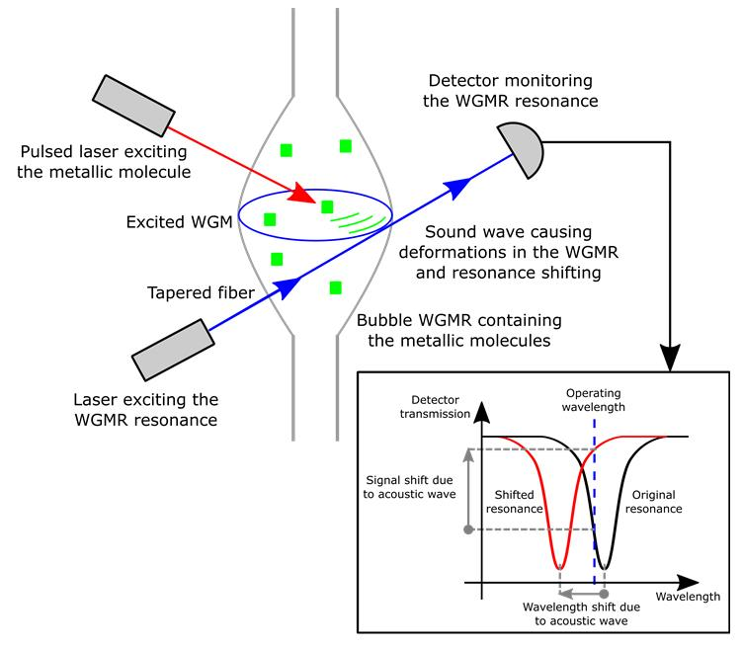
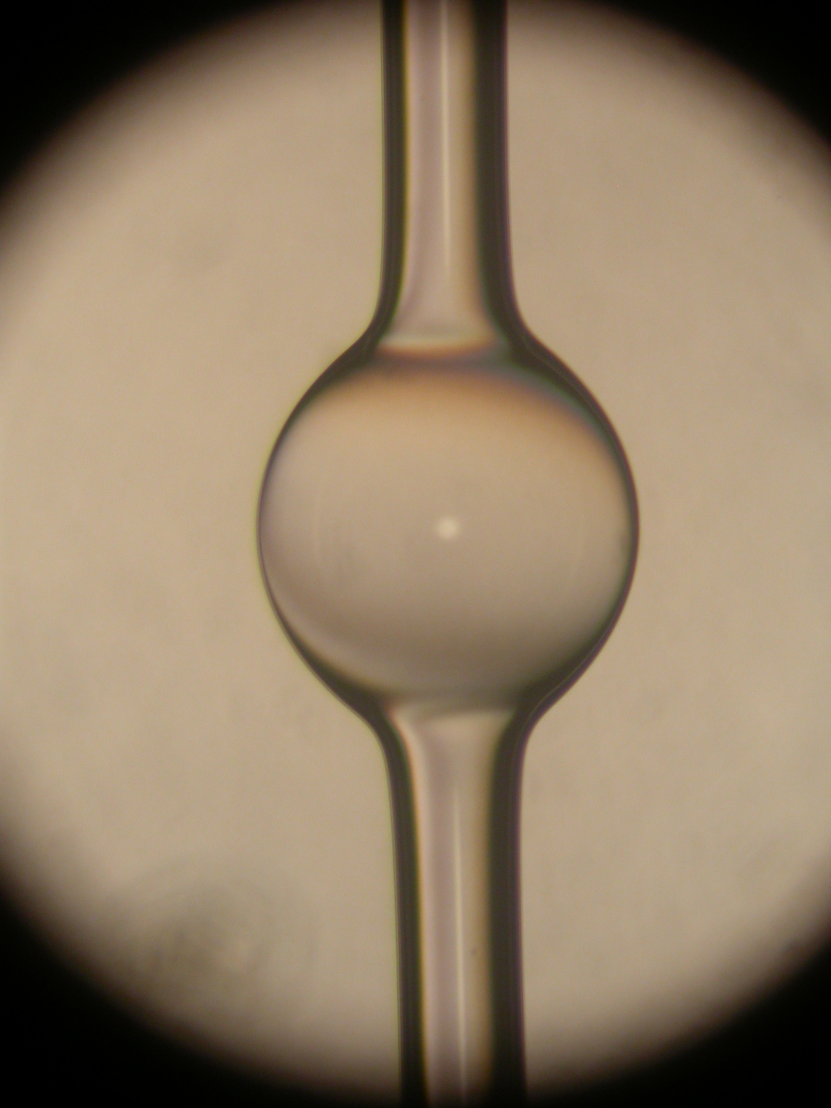
Photonic Microcavities
Microcavità Fotoniche (MiFo)
Photoacustic microscopy project: The principal task will consist in the development and integration of an innovative acousto-optical transducer based on optical micoro-bubble resonators into a photoacoustic spectro-microscope for applications in life and materials sciences.
Strong cooperation with CNR-CONACYT project ‘All-optical morphogenesis of nanostructures characterized by photo-acoustic microscopy’ (IFAC-CNR, Silvia Soria PI, G. Frigenti, L. Cavigli, F. Rossi, and F. Ratto)
Light absorption ➔ photoacustic emission
Resonance shift ➔pressure measurement
Low NEP (noise equivalent pressure)
Broad acoustic bandwidth
Minute size
Intrinsic microfluidics

Slide 10
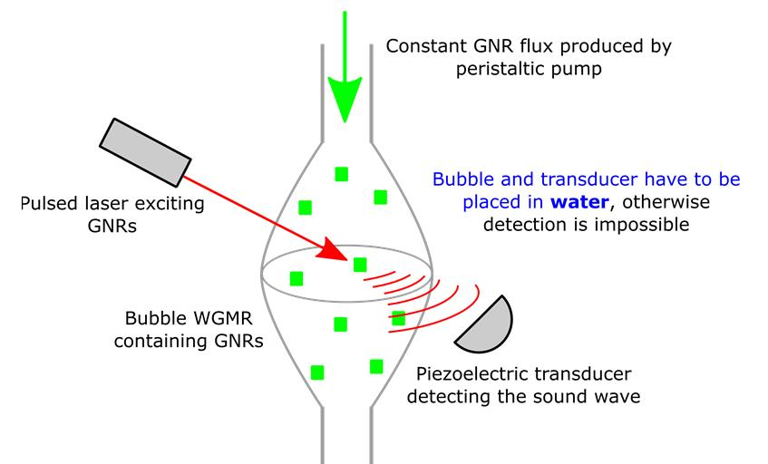
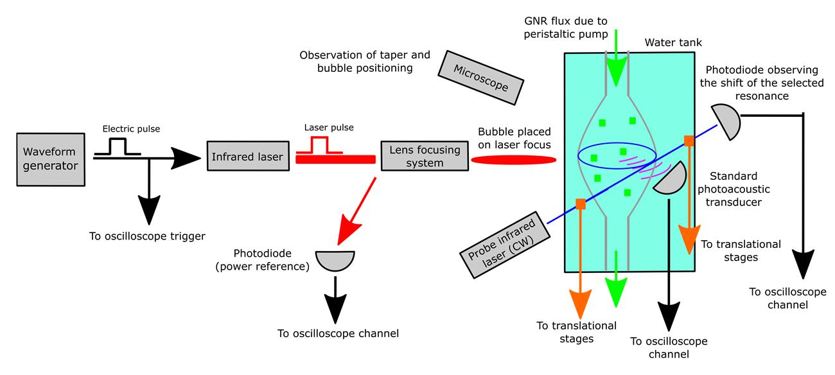
Photonic Microcavities
Microcavità Fotoniche (MiFo)
Photoacustic microscopy project : Milestones 2018
Standard approach: detection through a piezoelectric transducer
Bubble resonator hosting GNR
(Gold NanoRods)
Reference experiment for future work
Plan of activities 2018 – 2020
Double detection for validation of the new technique
Final target will be the implementation of a hybrid platform integrating the nanostructures production of metal colloids by optical methods (PLD), and the photoacoustic spectro-microscopy through the innovative acousto-optical transducer in order to perform the dynamic inspection of nanostructures during their formation.

Slide 11
Photonic Microcavities
Microcavità Fotoniche (MiFo)
Expected funding in the 3-year period:
Request of funding by Centro Fermi
Grants (number and period requested):
  1 Junior Grant (2019 and 2020)
  1 Senior Grant (01/12/ 2018- 30/11/2021)
consumables/inventory per year
15,000 € in 2018 and 20,000 in 2019 and 2020
Potential external funding
Collaborating CNR Institutes and Universities co-fund the research by covering the cost of their personnel (besides the listed collaborators) and of the laboratories which are made available for the research activities (estimated total 40 K€/year).
Beside the present ones (like Conacyt-CNR project on Photoacustics) new applications for external Calls (Italian like MAECI and MIUR or EU) are envisaged.

