Slide 1





CPV: Concentrated
Photovoltaic
Coordinator:
Prof. Sandro Centro, University of Padua
Participants:
Dr. Nardello Marco, Centro Fermi, Research fellow, 09/06/2016-now
Place of Work & Collaborations:
Dept. of Physics and Astronomy “Galileo Galilei” University of Padua

Slide 2

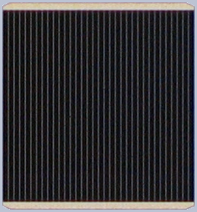
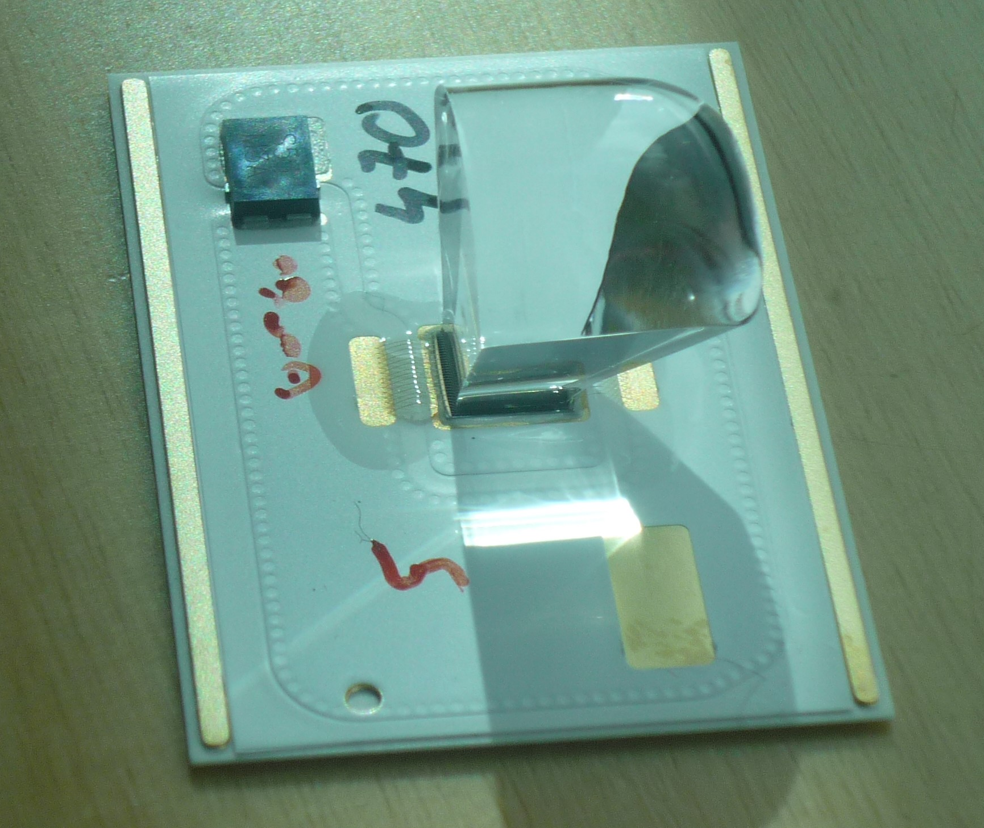
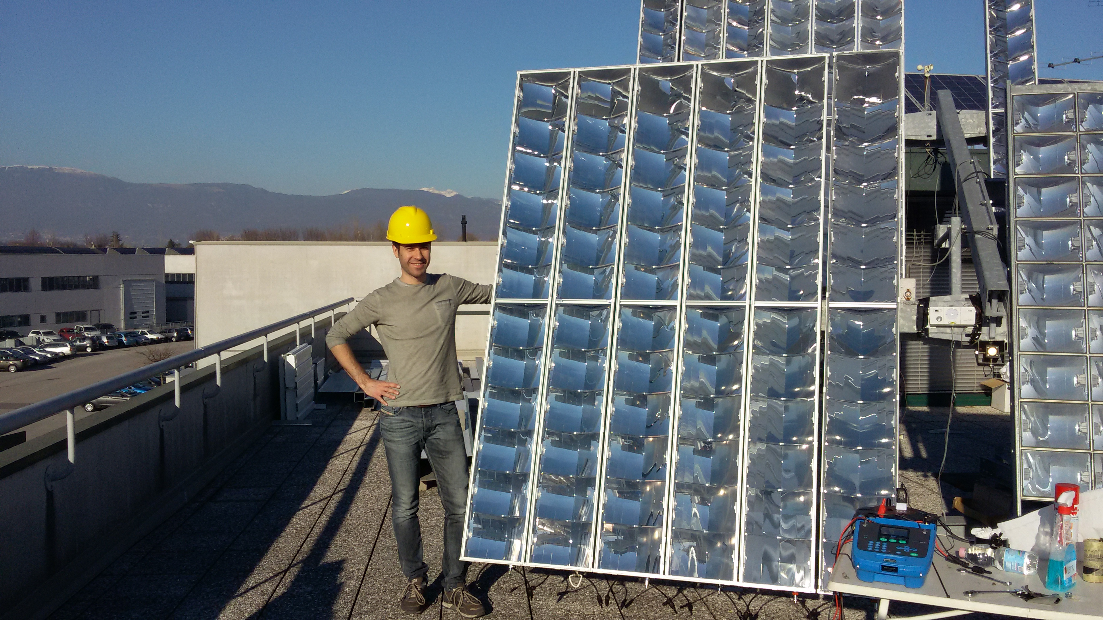
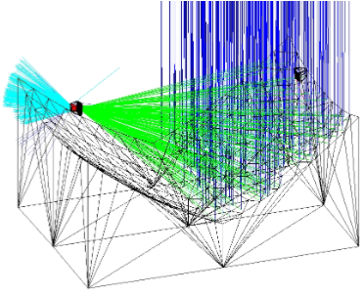
CPV: Concentrated
Photovoltaic
Project main goal
Producing an industrial CPV photovoltaic system
3J solar cells
  High efficiency (ƞ=44%)
  Small surface (5,5x5,5mm)
  Allow for light concentration
  Better behavior at high temperature
Recyclable materials
  Avoids problems of Si decommissioning
Concentration (700x)
  Al mirrors, PC substrate
  SiO₂ prism as a secondary optic
  Low cost
  Better quality than lenses
  Low volumes
Solar tracking
  Higher light collection
  Higher complexity and costs

Slide 3
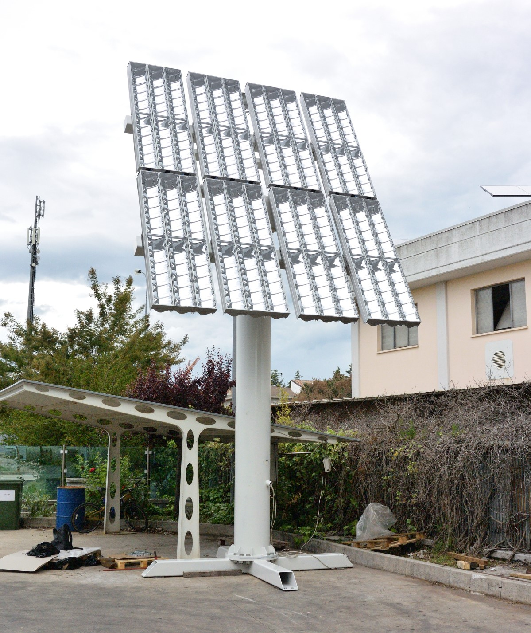
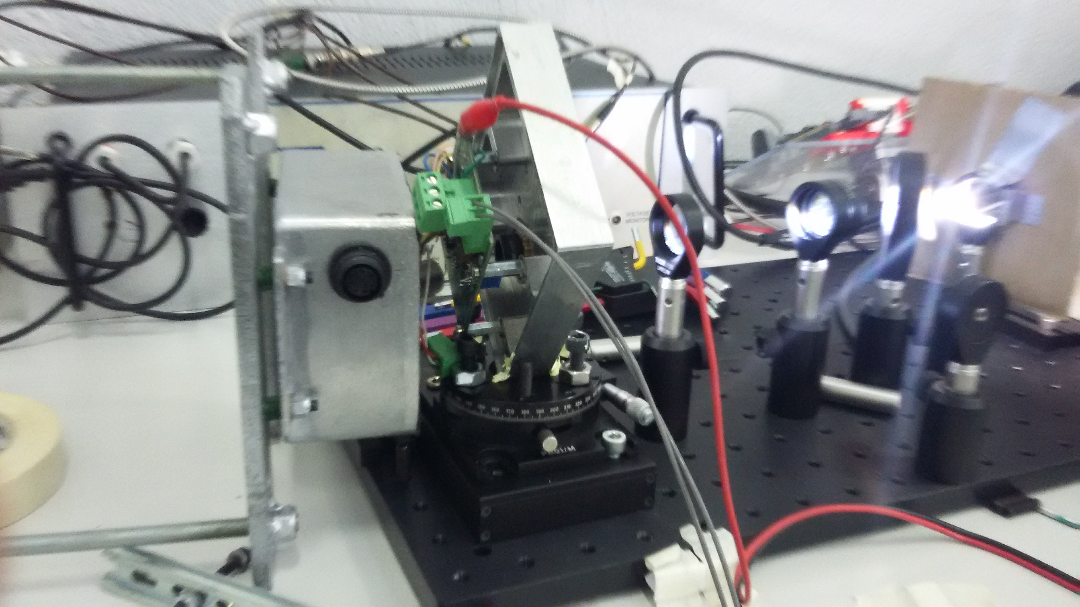
CPV: Concentrated
Photovoltaic
Results achieved in 2017
Realization of a prototype
3,6kW
24 modules
Pyrheliometer and remote data collection
New pointing system
Enclosure with IP68 impermeability
Mechanical 3 axes alignement
Correction of sensor position

Slide 4
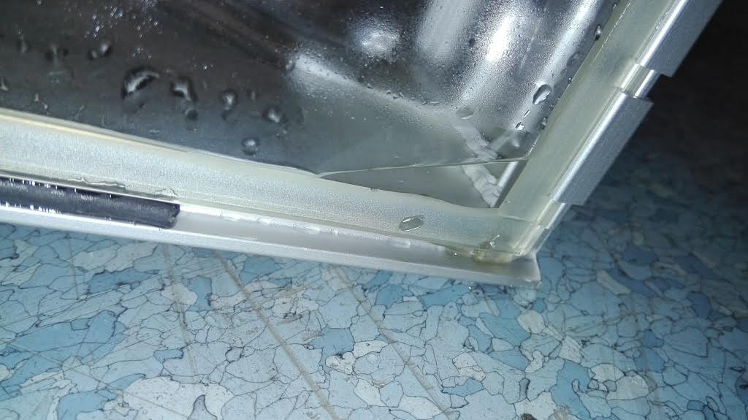
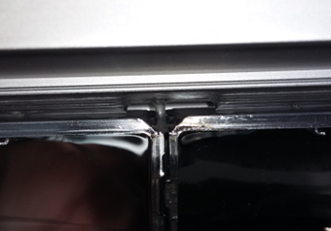
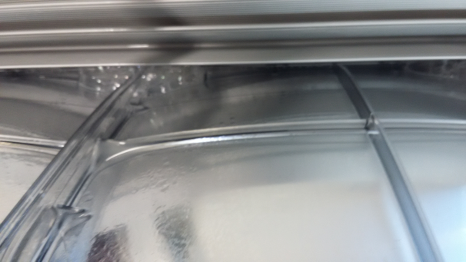
CPV: Concentrated
Photovoltaic
Results achieved in 2017
Solved permeability problem
Small gaps found at the junction between
optical elements
Resulting humidity (water under extreme
conditions)
Use of a spray sealant to block the gap
Use of a setup to increase the pressure inside the module
and a foam to reveal the location of the gaps
Now modules are watertight
Choice of correct glue for the receiver
Based on thermal simulation (2016)
Need for a better thermal dissipation
Epo-Tek T7110-38
k=1,38W/mK
good adhesion and curing time

Slide 5
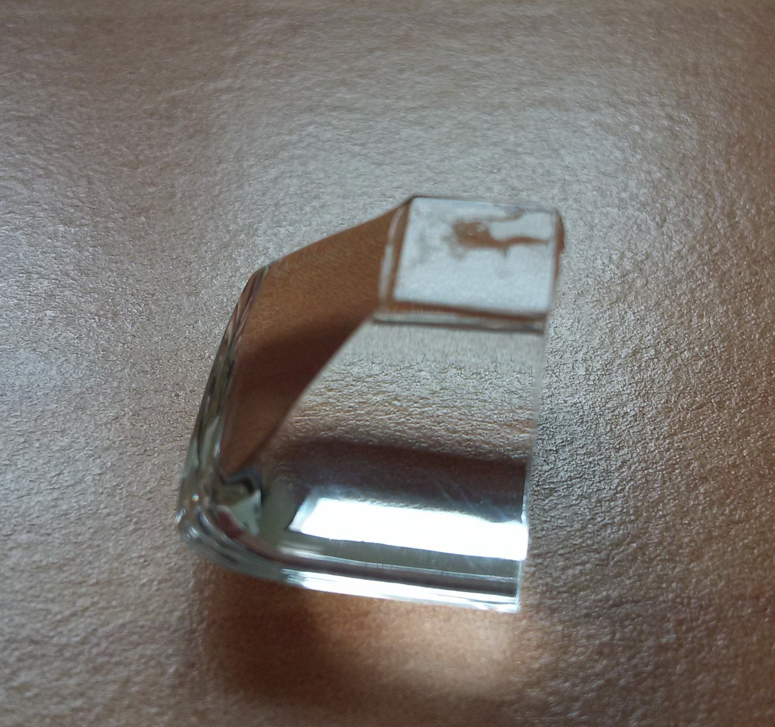
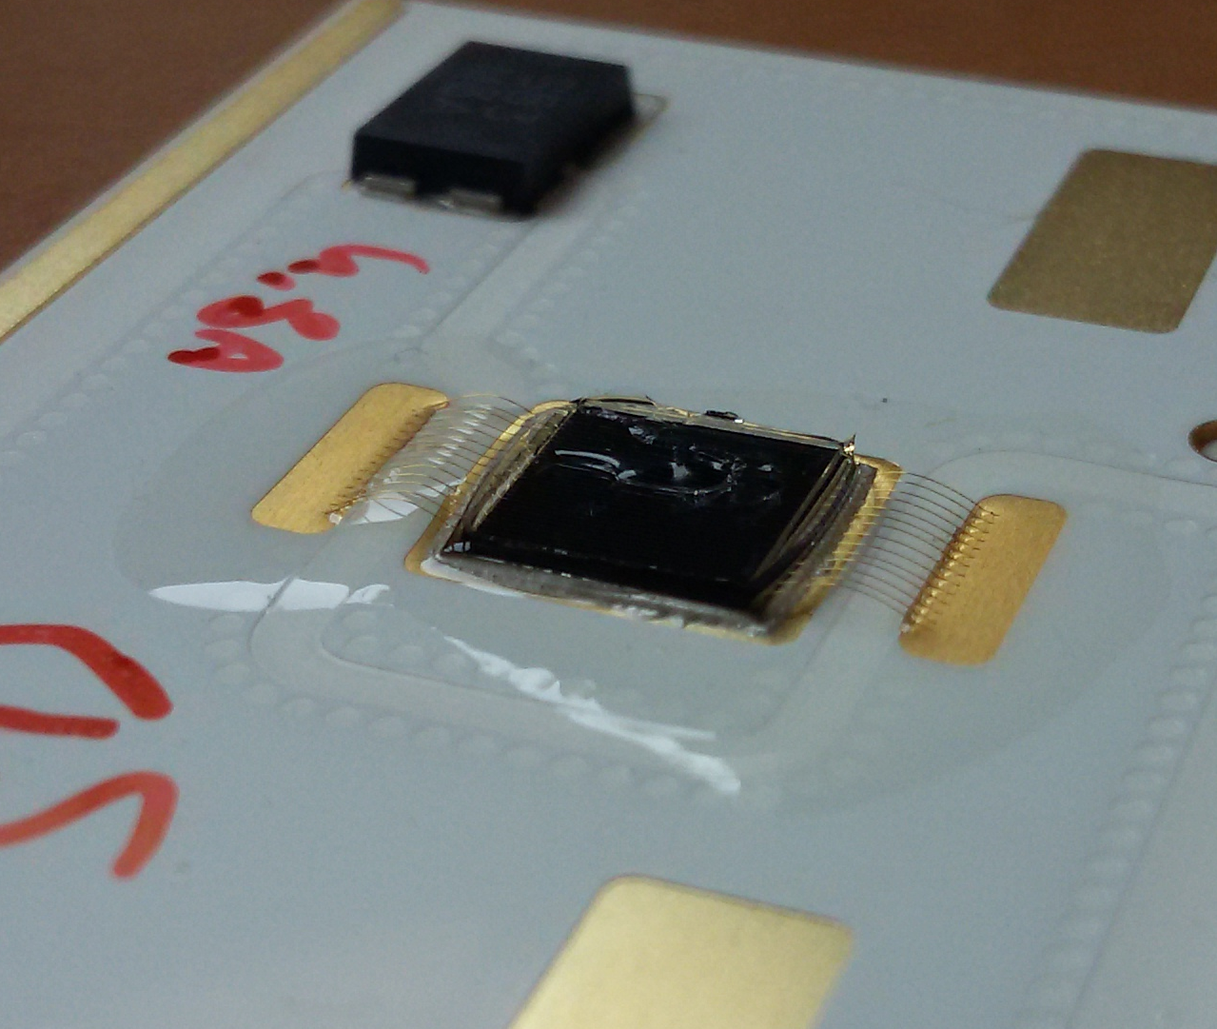
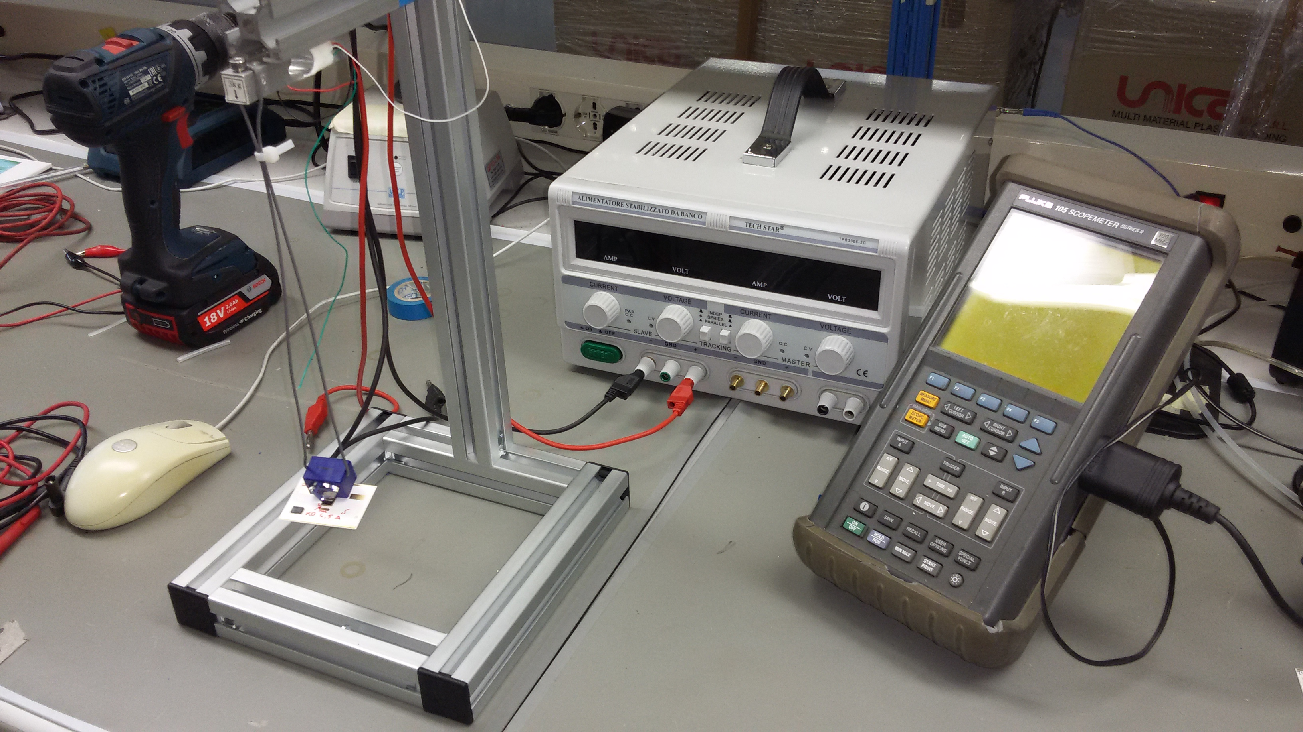
CPV: Concentrated
Photovoltaic
Results achieved in 2017
Study of procedure to attach secondary optics to the cell
Not constant results in terms of adhesion
Curing temperature increased to 150°C
Curing time increased to 2h
Stronger bond obtained and delamination avoided
Realised setup for measuring bond strenght
Load cell
Support for receiver
Quality test

Slide 6
CPV: Concentrated
Photovoltaic
Milestones 2018
Installation of the prototype tracker in Sicily and collection of data for 2 years
Modification of shape and dimensions of the DBC support, along with a new compatible secondary optics: simulations and optical bench phase
Simulations and thermal measurement on DBC supports of different dimensions and geometry
Realization of an optical setup with LED illumination able to grant light intensity and collimation necessary to test receiver efficiency and primary optics reflection

Slide 7
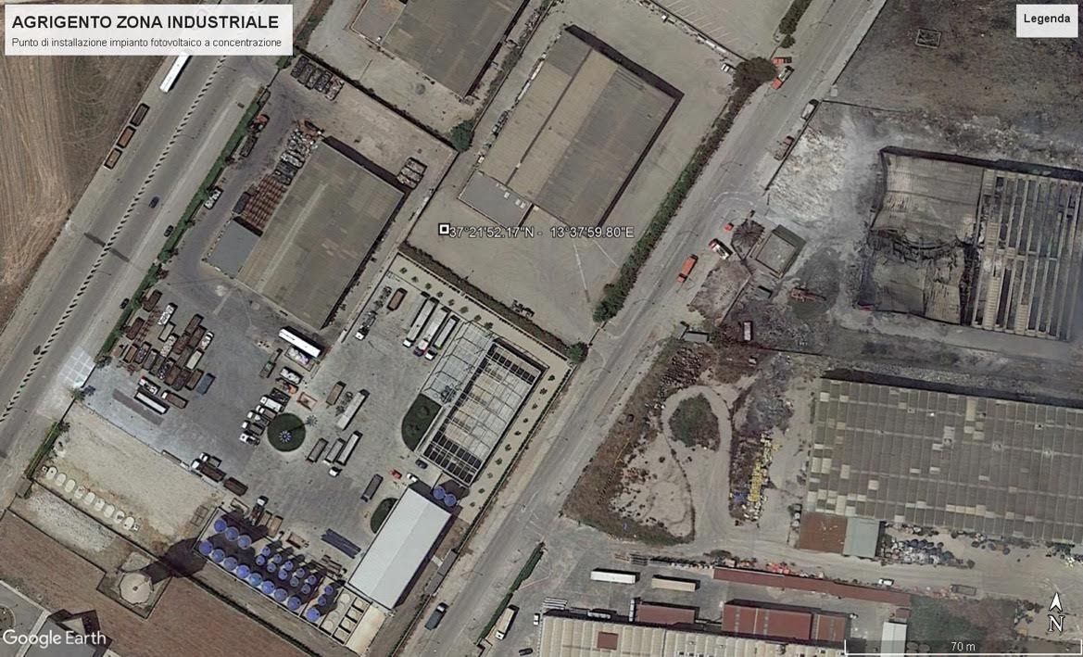
CPV: Concentrated
Photovoltaic
Plan of activities 2018 - 2020
Installation in Sicily
Closure of agreement with company in Agrigento for free loan
Transportation and installation
Data collection (for a 2 year period)

Slide 8
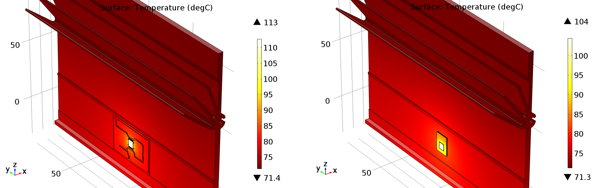
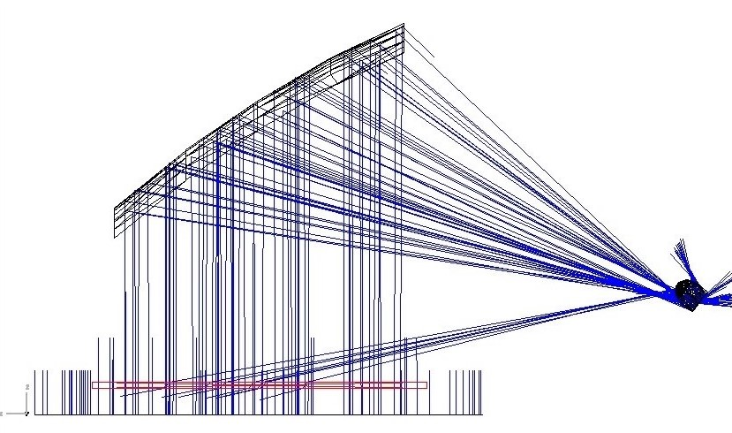
CPV: Concentrated
Photovoltaic
Plan of activities 2018 - 2020
Modification of the receiver assembly
Cost reduction (less material)
Changing of custom layout
Possiblity of using a complete receiver produced by AzurSpace (less suppliers in the chain)
Need for a feasibility study and new handling techniques
Need for a modification of the optics
Already done:
Study of the thermal impact of the new design (loss of dissipation due to lower area negligible)
Loss of light due to different geometry not irrelevant (10%), modifications need to be made

Slide 9
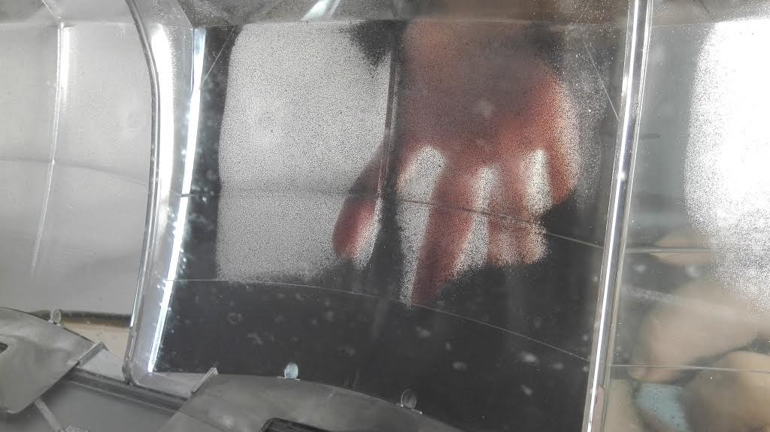
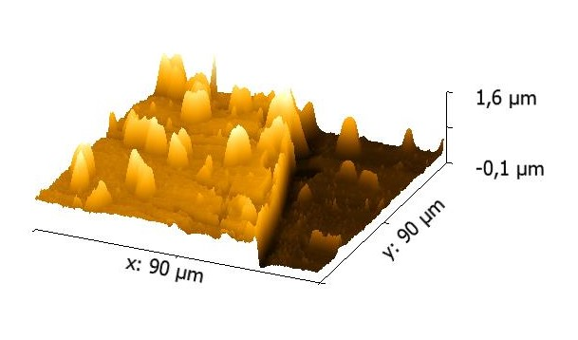
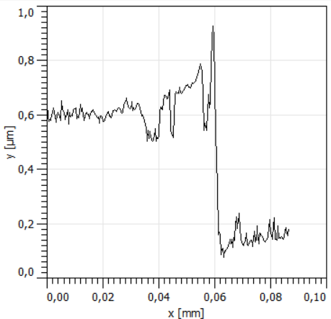
CPV: Concentrated
Photovoltaic
Plan of activities 2018 - 2020
Quality of aluminum layer on the primary optic
Good reflective power
Weakness of protective SiO₂ layer
Permeation with water can ruin the mirror
Already done
SIMS analysis shows modification of chemical
structure and topography
Thickness of SiO₂ layer of 10nm
(Collaboration with UniPD)
To be done
Increasing SiO₂ Thickness
Change of deposition method
(Collaboration with SuNaGen)

Slide 10
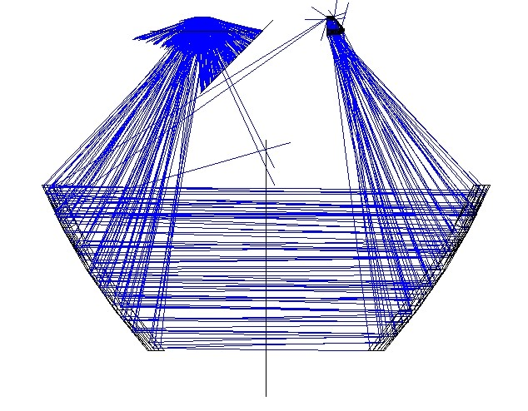
CPV: Concentrated
Photovoltaic
Plan of activities 2018 - 2020
Tests for ageing, humidity and temperature effect on modules
Realisation of modules of reduced dimensions
Thermal and humidity cycle in climate chamber (0-80°C, 20-80% RH)
@University of Padova – Physics Department
Verification of stability under extreme condition
Verification of reliability of drying system (silica salts)
Use of LED light for testing setup
Need for a cheap, stable, wide light beam to light entire optical element or entire module
Use of different type of LEDs can simulate solar spectrum
Difficulty to obtain a collimated beam of adequate dimension and intensity
Already done
Concept to use primary mirror as collimator for the source

Slide 11
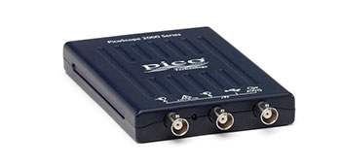
CPV: Concentrated
Photovoltaic
Plan of activities 2018 - 2020
Realisation of a portable instrument for measurement of module’s electrical behavior
Need to test performances of single modules on the tracker
Lightness and maneuverability are important
Instrument needs to work with batteries
Instrument needs to work in a 0-100V range
Already done
Circuit diagram
Portable oscilloscope acquired
To be done
Acquiring the electical components
Build it

Slide 12
CPV: Concentrated
Photovoltaic
Papers and presentations
CPV-13 Ottawa
Poster
Paper:
M. Nardello, S. Centro, "TwinFocus® CPV system", AIP conference proceedings (2017) 1881, 010001
SIF congress
Oral presentation
SMAU Padova
Innovation and digital expo
Stand and oral presentation (Speed pitching) available on web: https://www.smau.it/padova17/schedules/smart-communities-risorse-e-servizi-per-le-nuove-citta/

Slide 13
CPV: Concentrated
Photovoltaic
Expected funding in the 3-year period:
Request of funding by Centro Fermi
Grant: 1 grant, for the 3-year period of the plan (75k€)
Consumables/inventory per year (15k€)
Travels: Sicily - to work on installed tracker, conferences, trip to productive area (8k€)
Instrumentation (7k€)
Potential external funding
Possible funding through special agreements with the industries involved in the project (e.g. specific
modelling or analysis).
In 2016 42.7k€ collected through provided industrial consulting.

