Slide 1
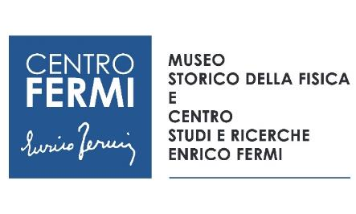
Lab-VIEW: laboratory for
cultural heritage
Participants:
Centro Fermi – Team: F. Casali, F. Albertin, F. Coccetti, G. Festa
Università di Bologna - Team: M. Morigi, M. Bettuzzi, R. Brancaccio
Università Tor Vergata – Team: R. Senesi
Place of Work:
Centro Fermi - Research Institution
Università degli Studi di Bologna - Research Institution
Università degli Studi di Roma Tor Vergata - Research Institution
Notes:
Possibili altri nomi: ArcheoLab, ViewLab, ScienceLab

Slide 2
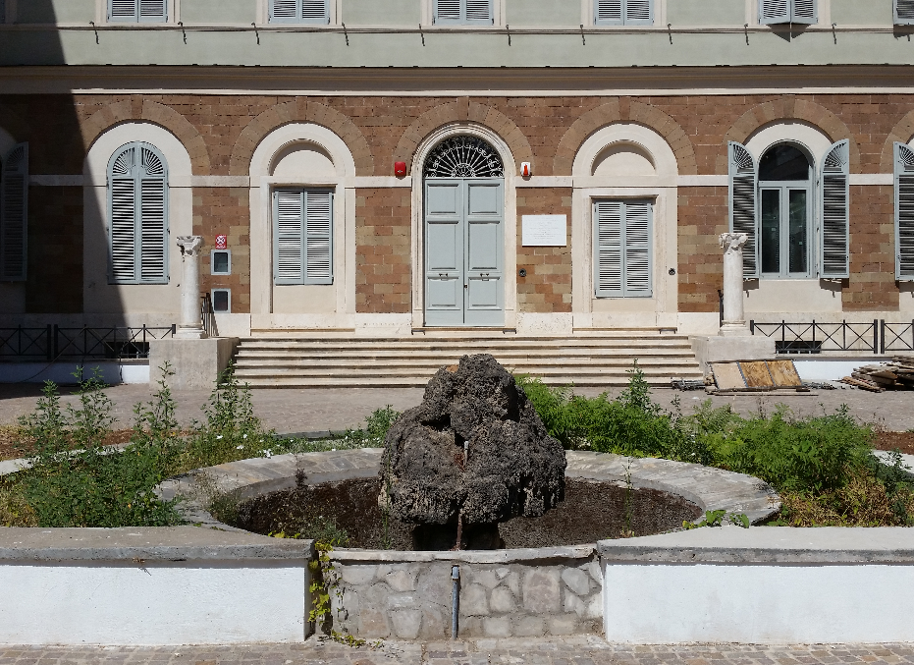
Lab-VIEW: laboratory for
cultural heritage
Objectives and Main goals:
Development of a laboratory for the study of cultural heritage objects
@ Centro Fermi

Slide 3
Lab-VIEW: laboratory for
cultural heritage
TRAINING AND DISSEMINATION
RESEARCH
R&D -Instrumentation
Measurements on Ancient Objects
TARGET
High School Student Internship (Alternanza Scuola Lavoro – ASL)
Visitors of the Centro Fermi Museum
THROUGH
Master and PhD Students (from Universities)
Students
Fixed Instrumentation
Mobile Instrumentation
…

Slide 4
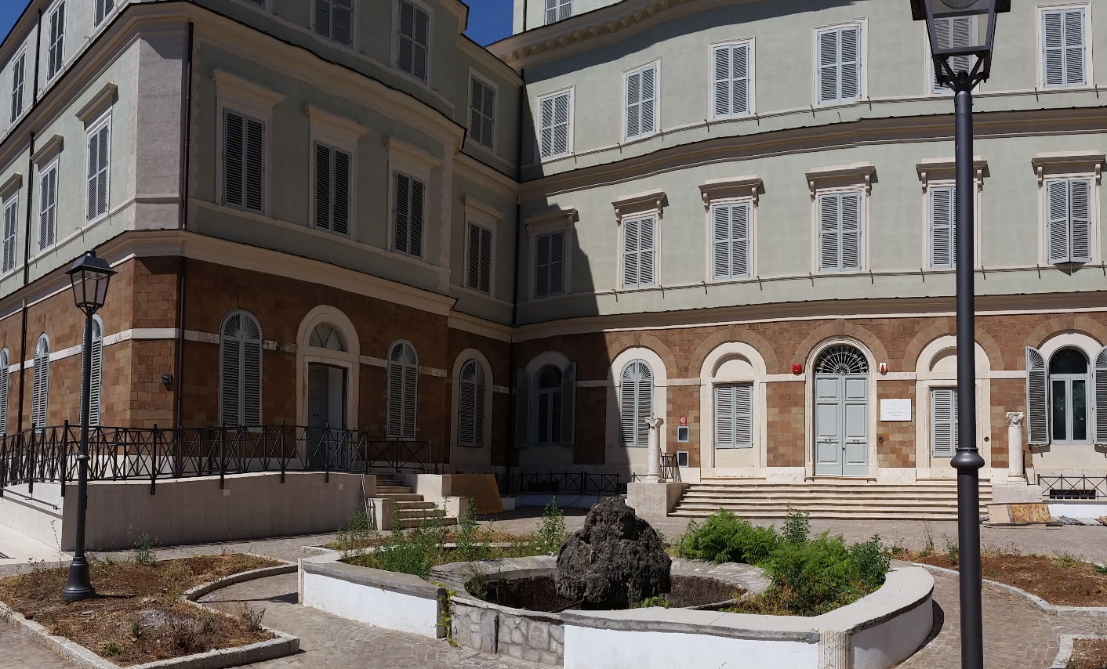
Lab-VIEW: Location
A multi-layer and multi-purpose laboratory for Cultural Heritage

Slide 5
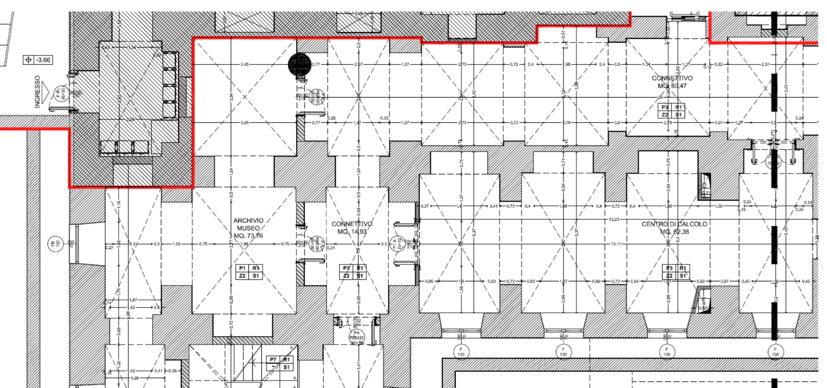

Lab-VIEW: Location
A multi-layer and multi-purpose laboratory for Cultural Heritage
X-ray Tomography
Dissemination and Control Room
XRF+Raman
-1 Floor

Slide 6
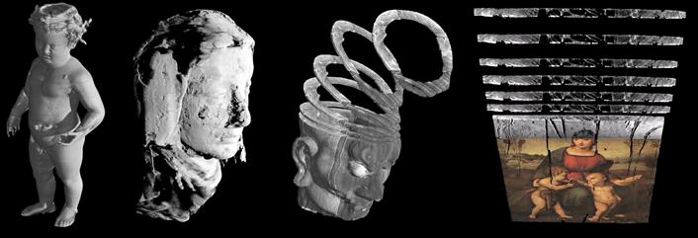
Lab-VIEW: Instrumentation
The Science And Heritage@Fermi (SAHF) project
OBJECTIVES: It consists of the creation of two "dialogue" parts: a laboratory equipped with X-ray diagnostic systems (optimized for Cultural Heritage) and a multimedia system for scientific dissemination.
Project Financing ∼ 40%
The Project started in January 2018
Costs remodeling
Notes:
Esso si articola nella realizzazione di due parti tra di loro “dialoganti”: un laboratorio dotato di validi sistemi di diagnostica mediante raggi X (ottimizzato per Beni Culturali) e un sistema multimediale per la divulgazione scientifica.

Slide 7
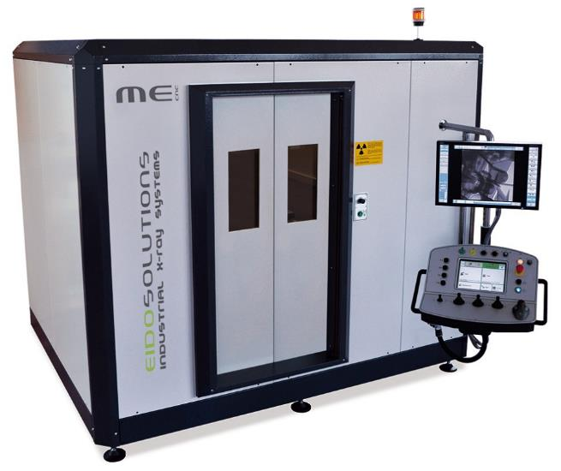
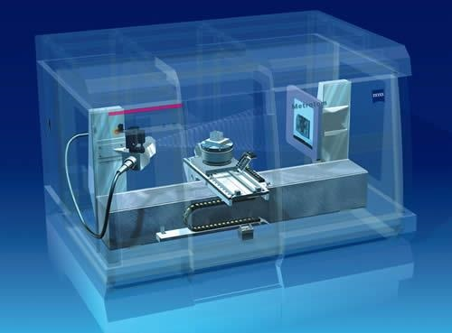
Lab-VIEW: Instrumentation
The Science And Heritage@Fermi (SAHF) project
1) X- ray tomography
Cabinet
X-Ray tube 200 KV
Flat panel Detector (area of 40x40cm², resolution of ∼200μm)

Slide 8
Lab-VIEW: Instrumentation
The Science And Heritage@Fermi (SAHF) project
Example: Tomography of medium size objects
The Diagnostic Study of a Wax Anatomical Model of the 18th Century
made by Anna Morandi Manzolini.
3D Rendering of tomographic data and data visualization through an holographic pyramid.

Slide 9
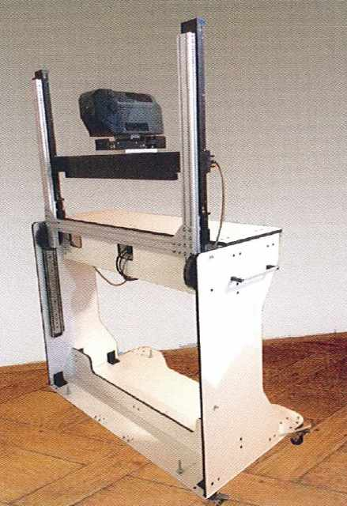
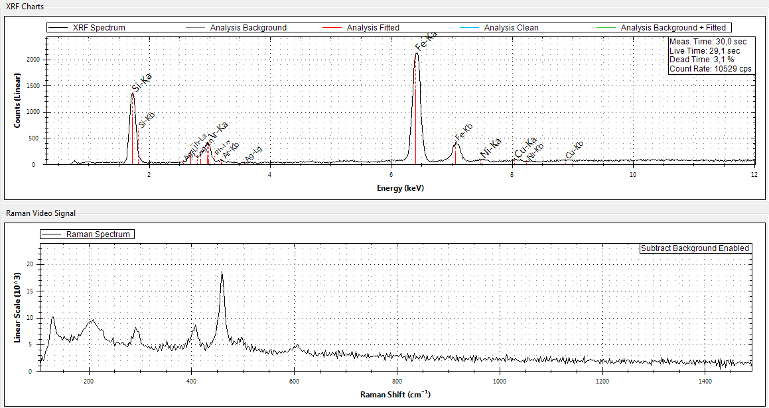
Lab-VIEW: Instrumentation
The Science And Heritage@Fermi (SAHF) project
2) Portable XRF and RAMAN
Integrated measurements of X-Ray Fluorescence (XRF) and Raman Spectroscopy.

Slide 10
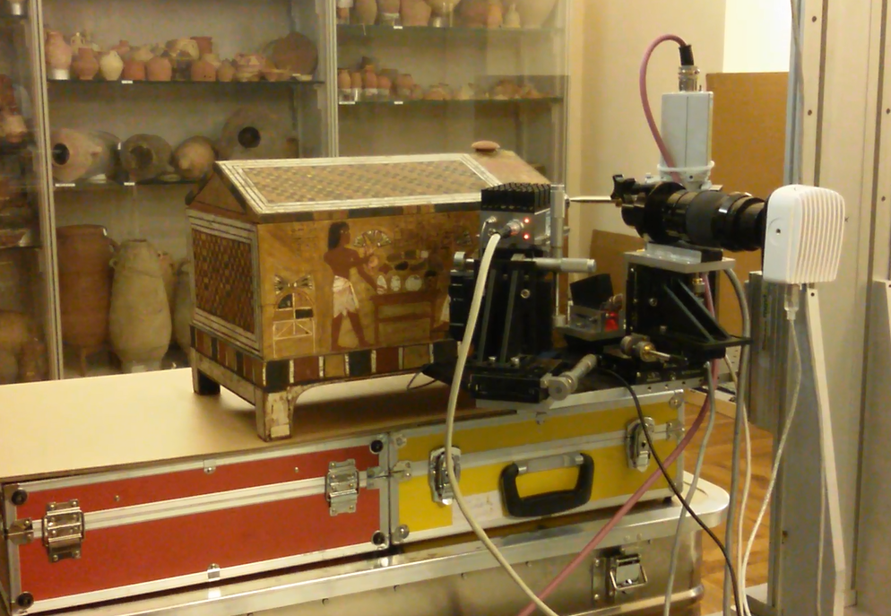
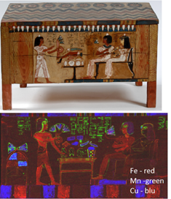
Lab-VIEW: Instrumentation
The Science And Heritage@Fermi (SAHF) project
Example: Elemental imaging (XRF-imaging)
Elemental maps of wooden coffers allowed to establish the nature of pigments. Blue and green were characterized by Cu; Brown and red by Fe; Yellow by As; White by Ca.

Slide 11
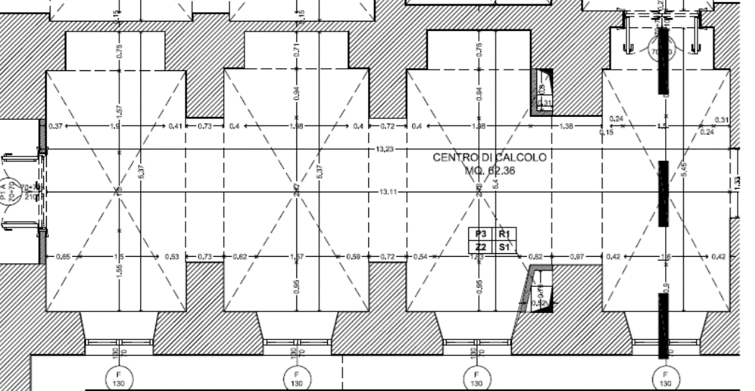

Lab-VIEW: Ideas for Training and Dissemination
Dissemination and Control Room
Console for remote control
Multimedia Tools for dissemination

Slide 12
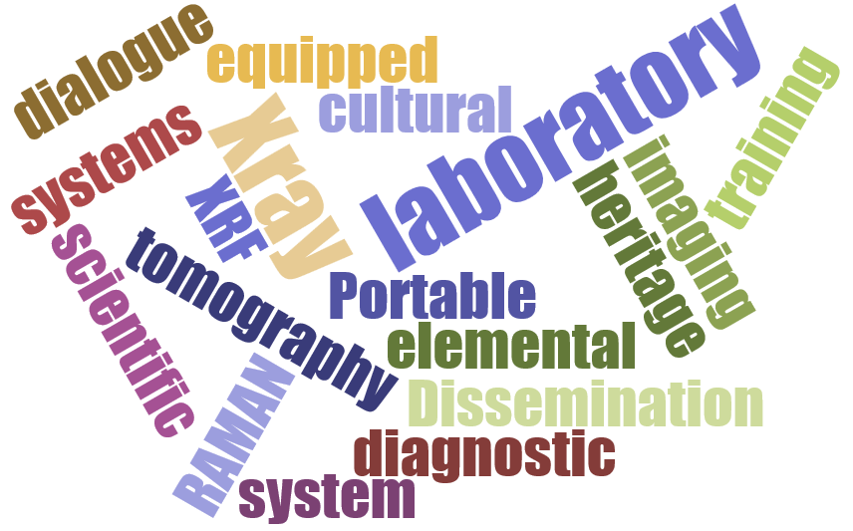
Lab-VIEW: laboratory for
cultural heritage
Milestones 2018:
Laboratory equipped with first instrumentation.
First pilot measurements and outputs.

Slide 13
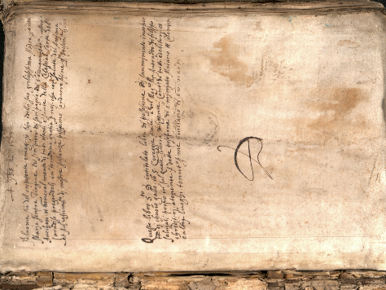
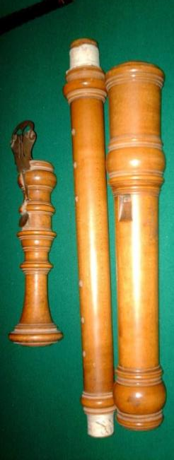
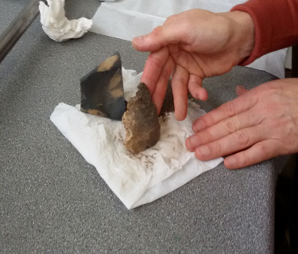
Lab-VIEW: laboratory for
cultural heritage
Plan of activities 2018 - 2020
2018-2019: instrument development and activities.
Information campaign dedicated to Museums in Rome (a dedicated workshop focused on science and cultural heritage at Centro Fermi, meetings at museums, etc.)
Pilot studies on archaeological objects.

Slide 14
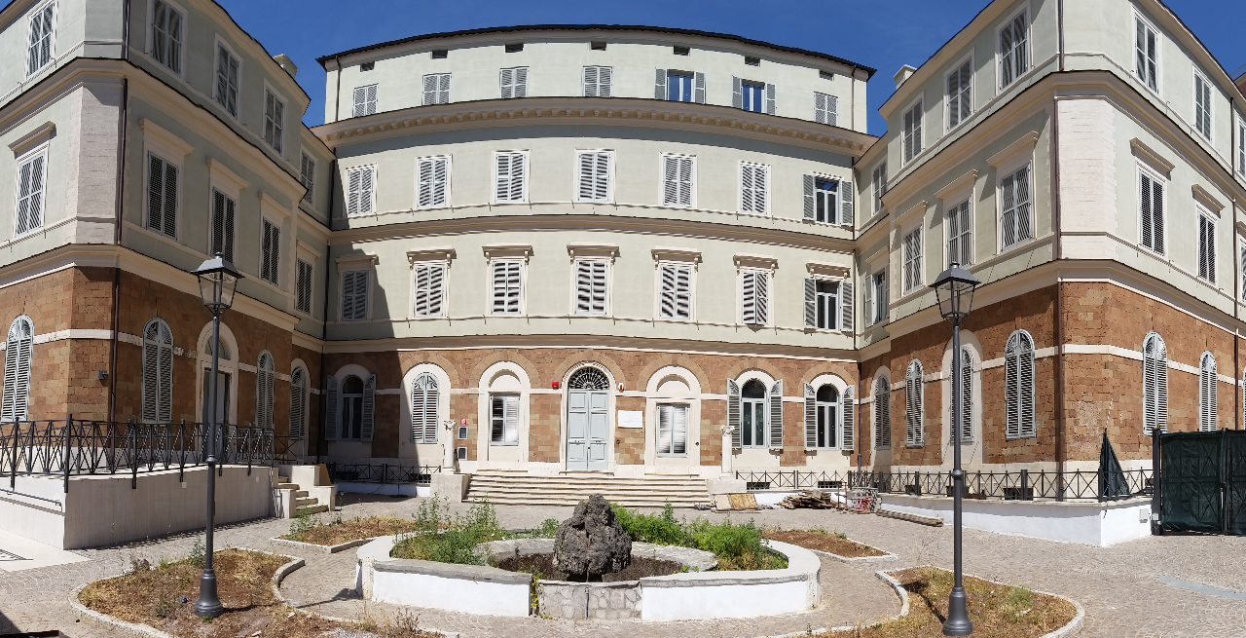
Lab-VIEW: laboratory for
cultural heritage
Thank you for your attention

