Slide 1
Run meeting
Erice
Notes:
Programmazione:
1 Erice: quando, come e perché
2 Cosmic Boxes
3 Prendere le misure: come
4 Le varie altitudini
5 Elaborazione dati

Slide 2
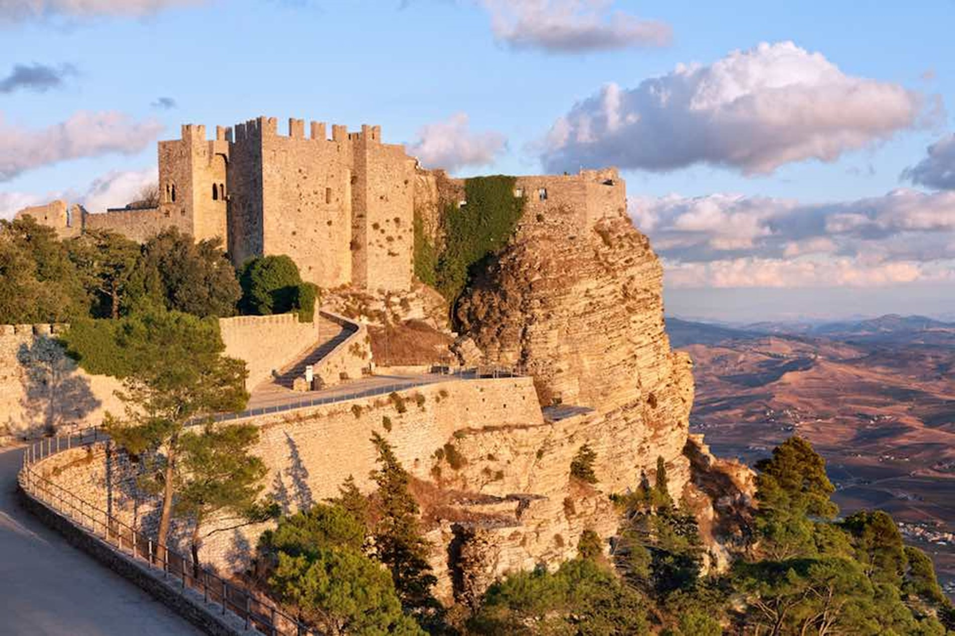
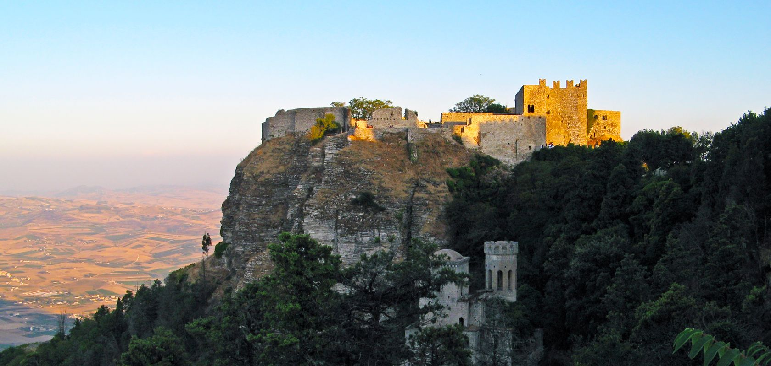
Erice
Francesco Colangelo, Giorgio Crescenzo - L.S.S. 'G. da Procida'
8th Conference
From Wednesday, 6 December to Friday, 8 December 2017

Slide 3
The Cosmic Boxes
Francesco Colangelo, Giorgio Crescenzo - L.S.S. 'G. da Procida'
Cosmic Boxes are portable particle detectors deployed during the Data gathering campaign held in Erice
These telescopes were built by the students of the 'ITIS Avogadro' in Turin, in association with the 'Centro Fermi'
Their original pourpose was measuring the efficiency of the MRPCs telescopes
Notes:
Che tema usiamo?

Slide 4
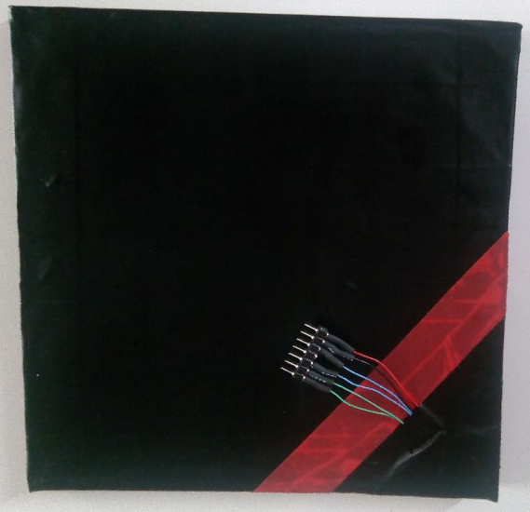
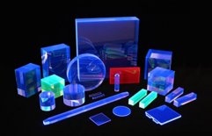
Francesco Colangelo, Giorgio Crescenzo - L.S.S. 'G. da Procida'
Scintillators
Unlike the EEE telescopes installed in our schools these detectors use a double scintillator chamber setup
An organic compound shaped as a tile is wrapped in mylar and connected to two silicon photomultiplier that detect light emitted by the material when crossed by a ionising particle (i.e. muons)

Slide 5
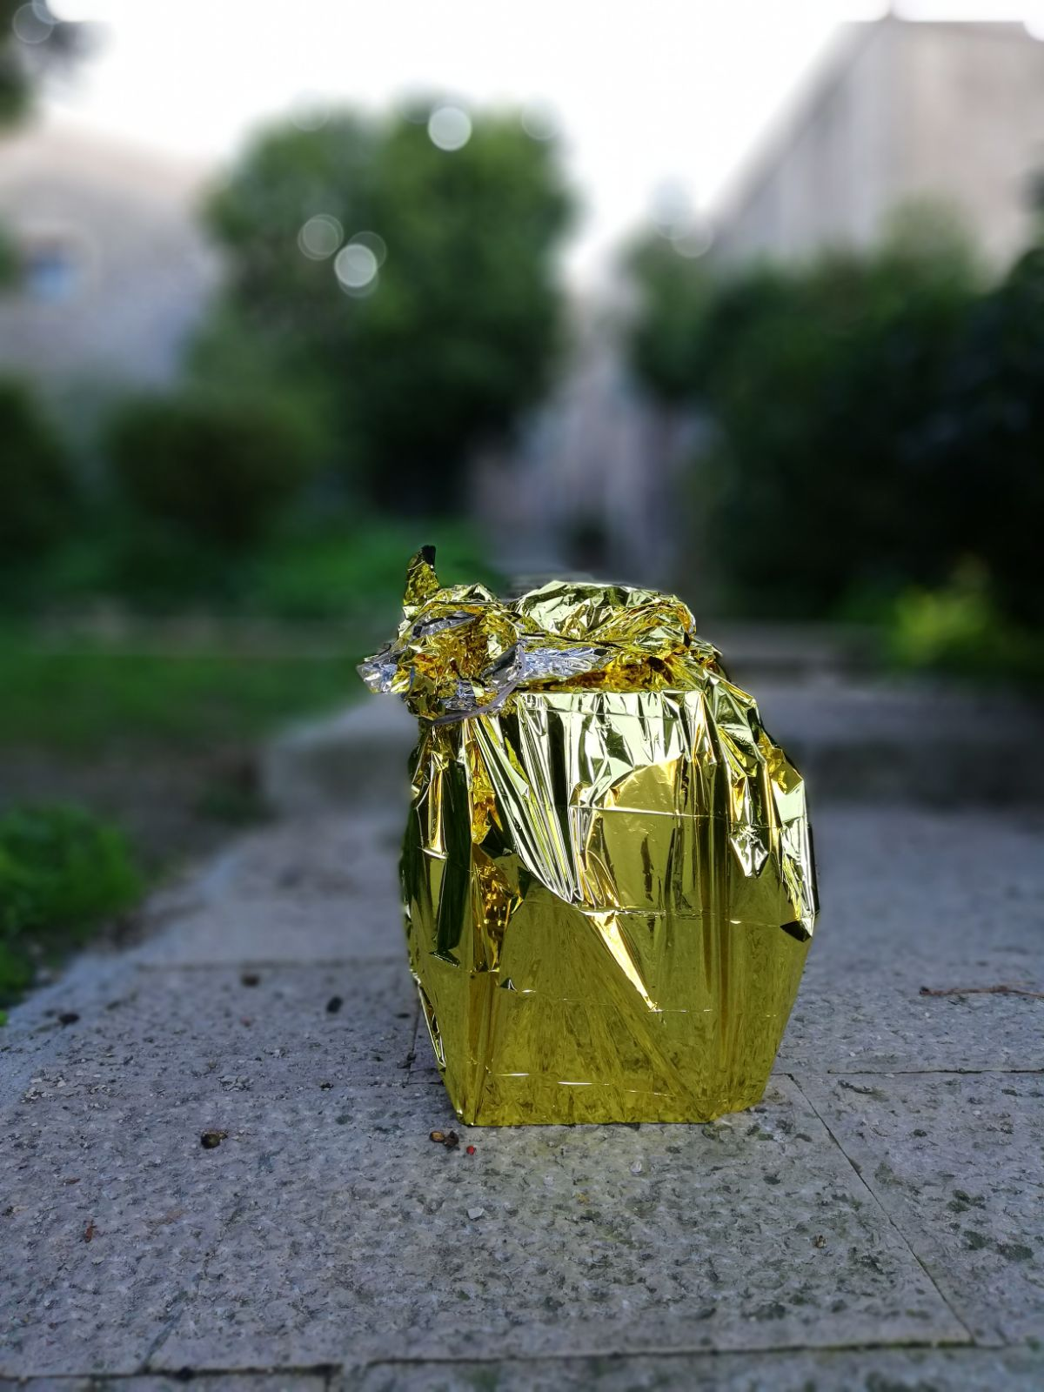
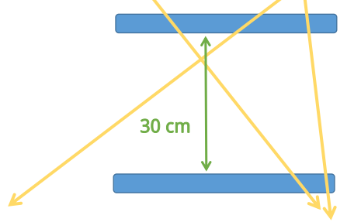
Configuration
Francesco Colangelo, Giorgio Crescenzo - L.S.S. 'G. da Procida'
With scintillator-type telescopes errors and false triggers occour frequently
For this reason the electronics will only count coincidences of triggers in both tiles
Moreover, when acquiring data, it is fundamental to cover the Cosmic Box with an aluminum sheet to reduce the noise

Slide 6
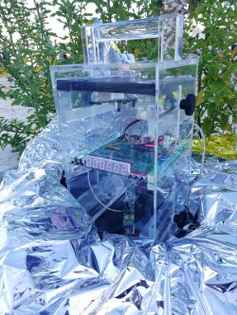
Data gathering campaign
Francesco Colangelo, Giorgio Crescenzo - L.S.S. 'G. da Procida'
15 Cosmic Boxes were granted to groups of 3 institutes
Each run lasted 40 minutes
Periodically during the run data like atmospheric pressure, altitude and temperature were logged in an excel sheet
It was crucial to have the highest number of counts possible (and so the most Boxes running for the most time possible) in order to have a small percentage error.

Slide 7
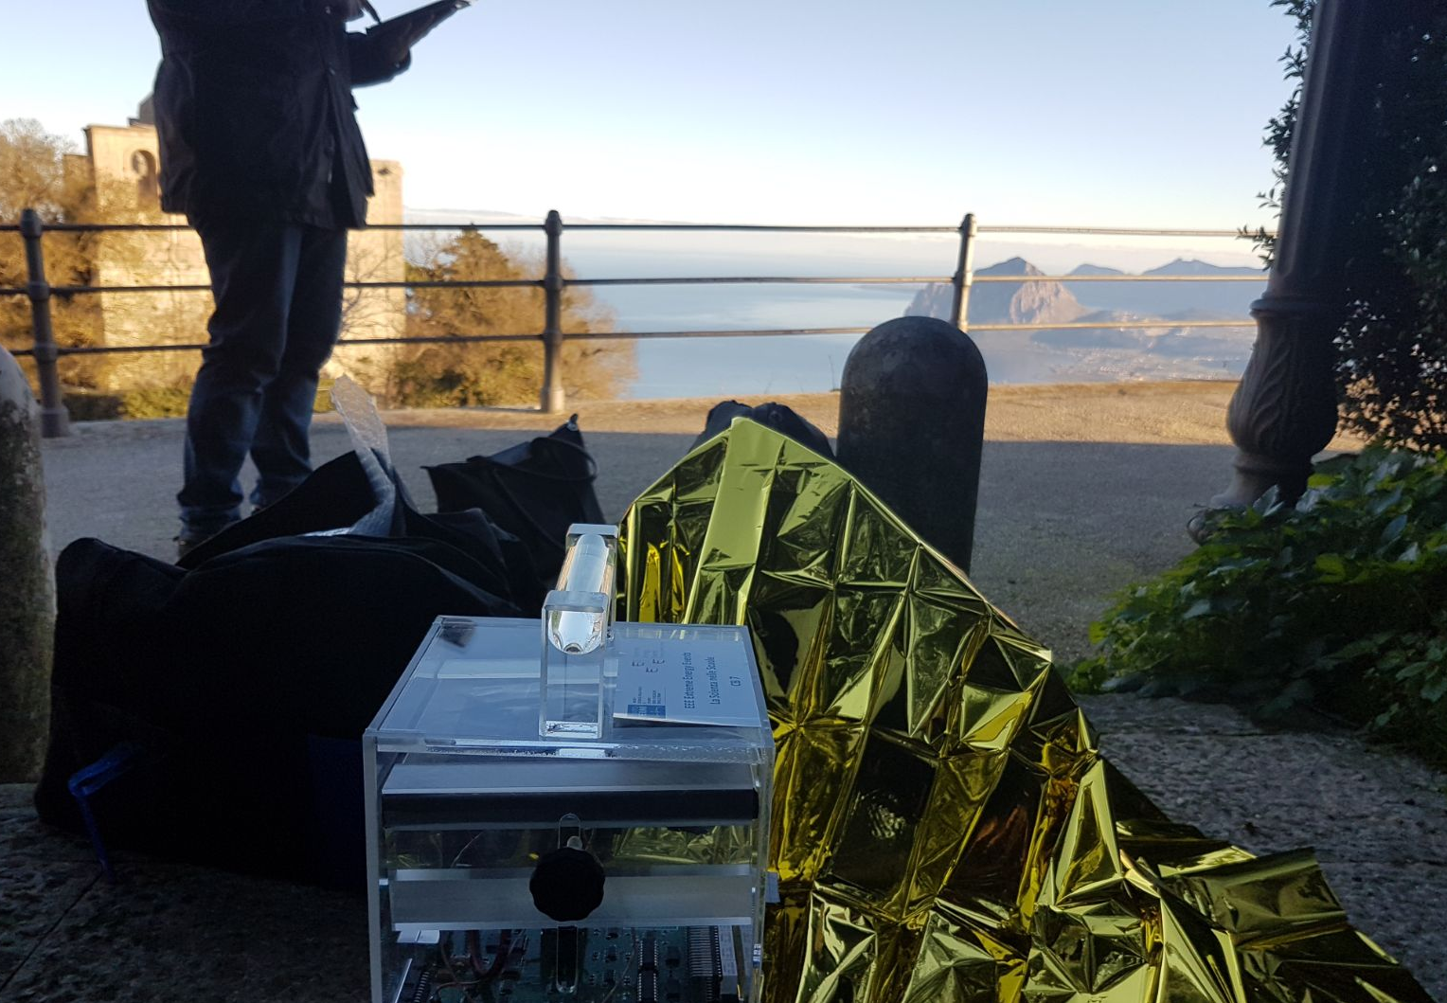
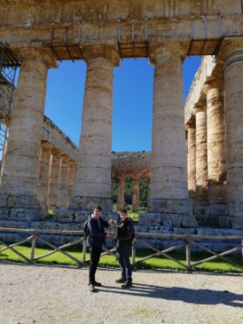
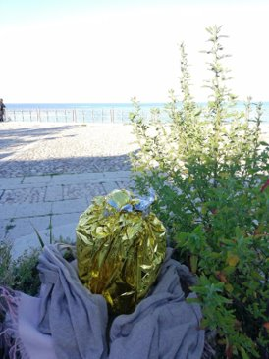
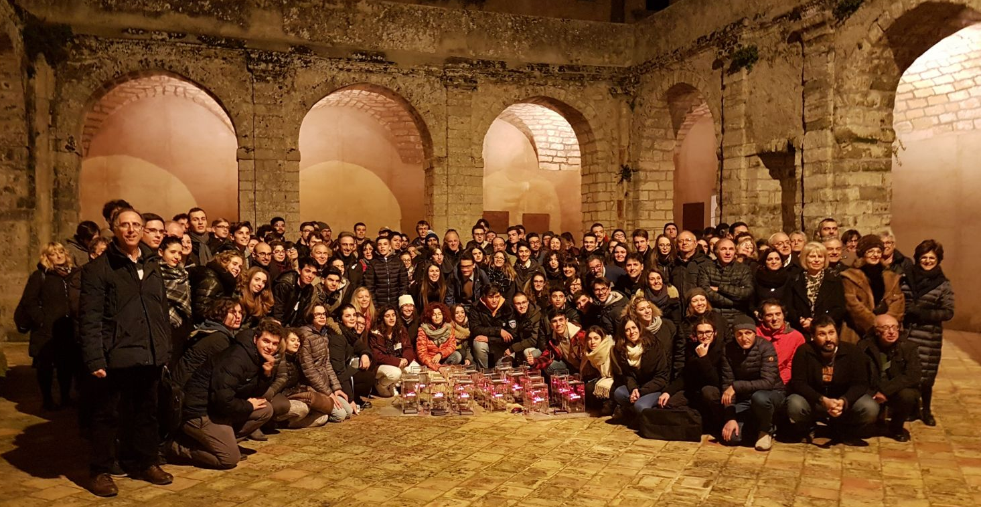
Height Dependance
Francesco Colangelo, Giorgio Crescenzo - L.S.S. 'G. da Procida'
The most important aspect of the campaign was collecting data at different altitudes. Measurements were made in:
- Segesta (350m)
-Castellammare del Golfo (20m)
-Erice (740m) in the early morning...
… and at night

Slide 8
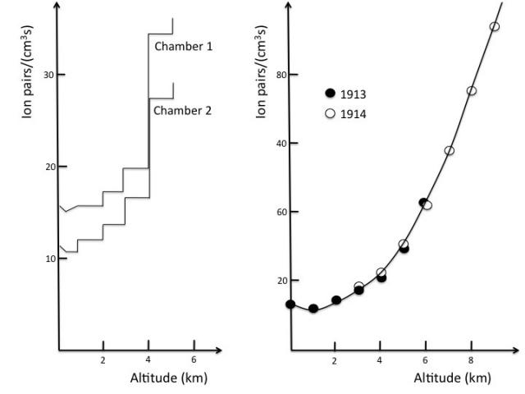
The aim of the experiment
Francesco Colangelo, Giorgio Crescenzo - L.S.S. 'G. da Procida'
We wanted to investigate how the frequency of muons is related to the altitude
In fact, because of the atmosphere absorption, the frequency should increases with the altitude... let's see what we obtained!

Slide 9
Data analysis
Francesco Colangelo, Giorgio Crescenzo - L.S.S. 'G. da Procida'
Each group put his data on a excel sheet. That is ours.
At the end of the day we sent all the sheets to the professors

Slide 10
Data analysis
Francesco Colangelo, Giorgio Crescenzo - L.S.S. 'G. da Procida'
The professors made a graph with the acquired data

Slide 11
Data analysis
Francesco Colangelo, Giorgio Crescenzo - L.S.S. 'G. da Procida'
Then they have excluded some values in order to get a more reliable linear function

Slide 12
Data analysis
Francesco Colangelo, Giorgio Crescenzo - L.S.S. 'G. da Procida'
So they made a new graph using the corrected data

Slide 13
Data analysis
Francesco Colangelo, Giorgio Crescenzo - L.S.S. 'G. da Procida'
The professors made a gaussian fit of the frequencies...

Slide 14
Data analysis
Francesco Colangelo, Giorgio Crescenzo - L.S.S. 'G. da Procida'
...and put all the distributions in one one graph.
Finally, he reminded us how serious is the data treatment!

Slide 15
Questions time!
Francesco Colangelo, Giorgio Crescenzo - L.S.S. 'G. da Procida'
We can't pledge you we can answer, but we'll do our best!

