Slide 1
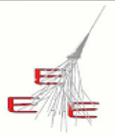
Stops in the data taking
D. De Gruttola
05/10/2016
EEE meeting

Slide 2
Status
sporadic holes present in DQM
data not processed (or sent to CNAF) in some cases
data taking actually stopped from time to time
the only way to realize it is the missing files in local
some ideas on how to better track these cases?
05/10/2016
EEE meeting
2

Slide 3
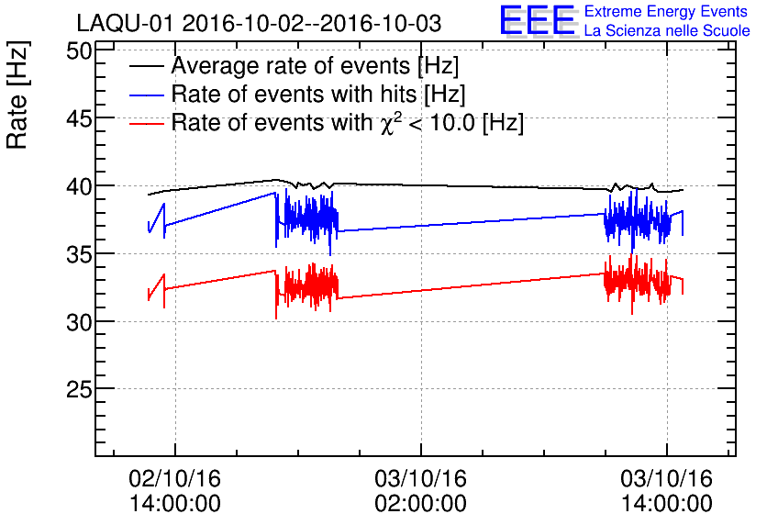
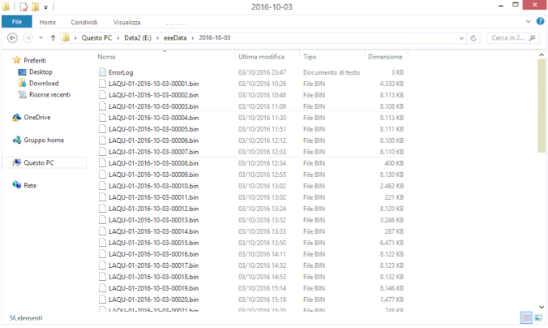
LAQU-01
hole in DQM from 02/10 at 11 pm to 03/10 at 10 am
no files produced in the
same time interval
data taking stopped for
some reason
no errors in the error log file!
05/10/2016
EEE meeting
2

Slide 4
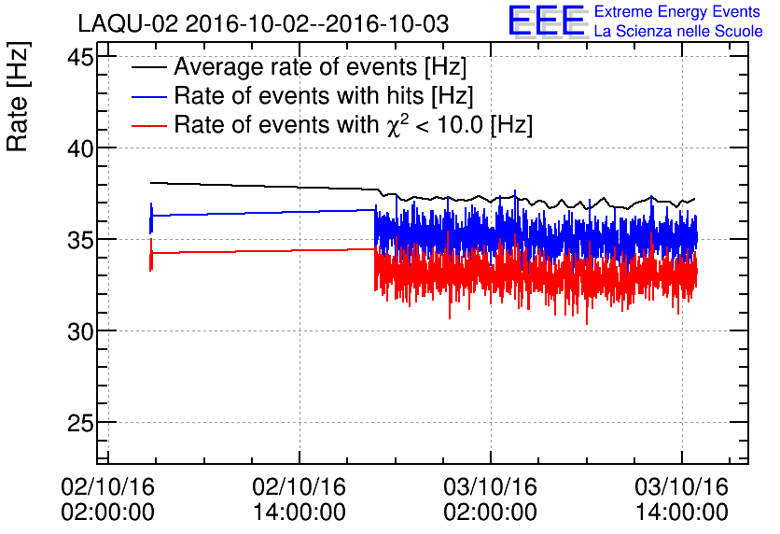
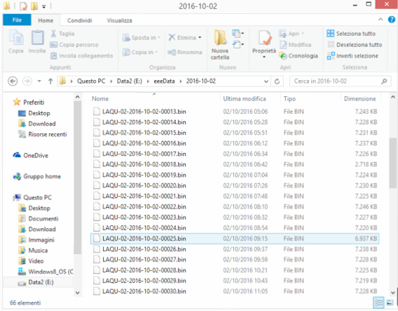
LAQU-02
hole in DQM from 02/10 at 5 am to 03/10 at 17 am
files were produced in the
same time interval
data taking ok →
data not processed by DQM (or not sent to CNAF)
05/10/2016
EEE meeting
2

Slide 5
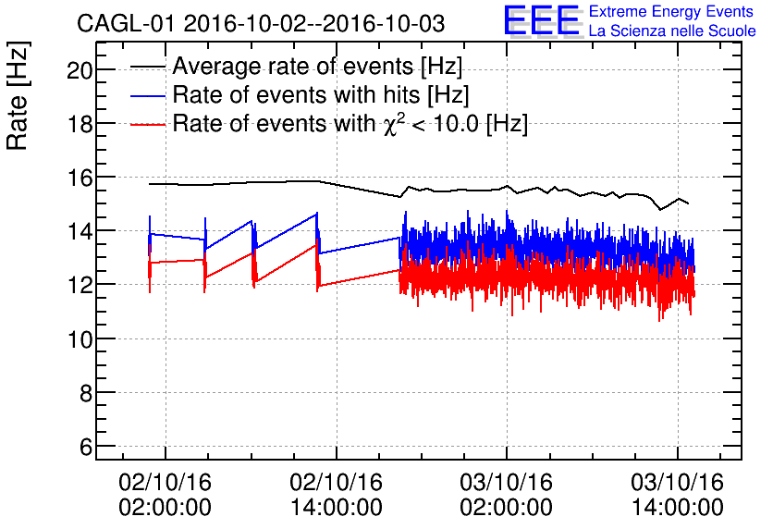
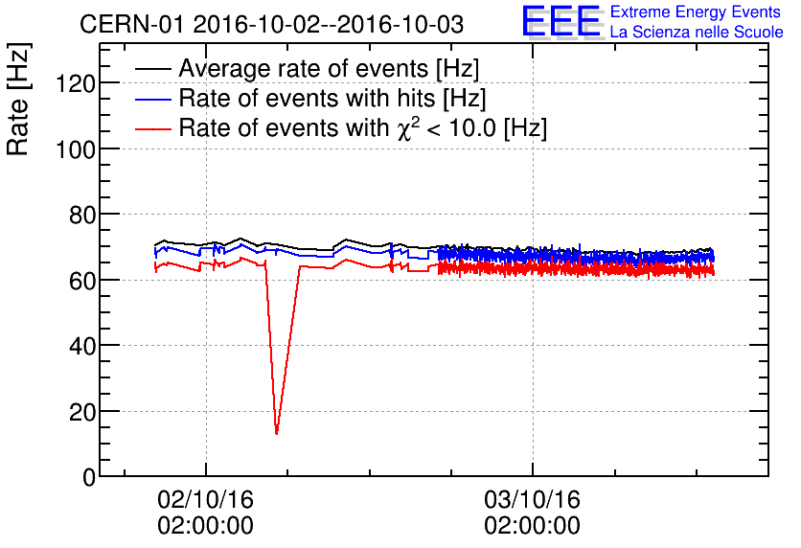
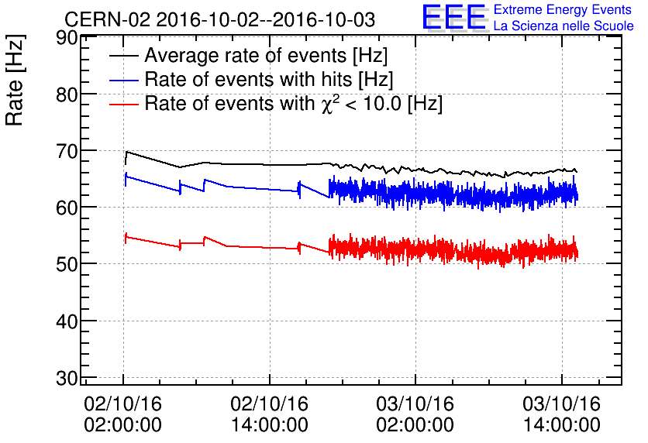
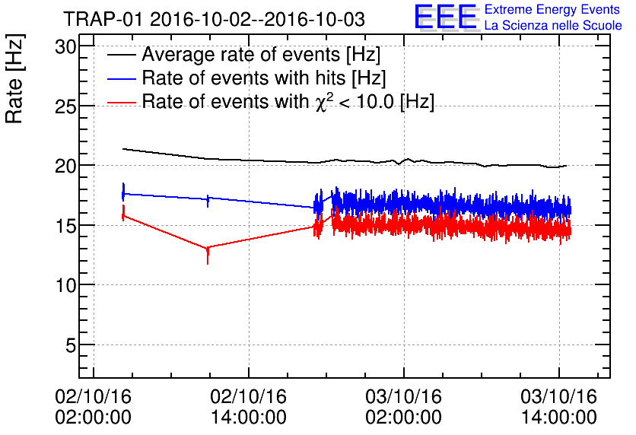
Other telescopes
holes in some of the telescopes active in the last few days
check if files were produced
05/10/2016
EEE meeting
2

