Slide 1
Our eeexperience
Liceo giolitti-gandino BRA

Slide 2
Our first approach towards the topic consisted in the realization of a cloud chamber with poor materials; the purpose was to find out a possible charged particle track
We have joined eee project in february2017
Despite the fact that our school has not got a cosmic ray detector yet, we have conducted a formative and instructive work, whose aim was the acquisition of knowledge regarding the phenomenon

Slide 3
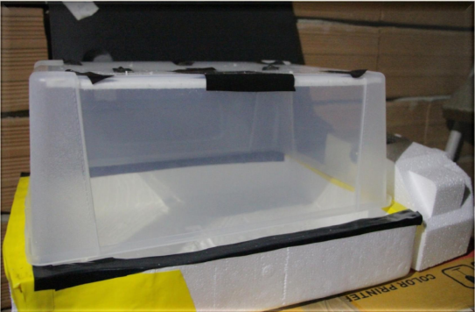
MAIN MATERIALS
Black coloured copper sheet
Felt layer
Electrical flashlight
Trasparent plastic box
Styrofoam tray
Isopropyl alcohol

Slide 4
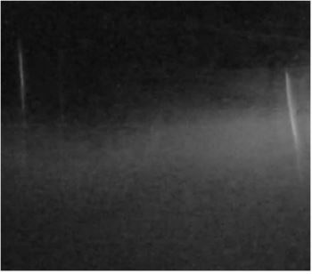
Our discoveries:
MUONS ?
The muon is an elementary particle similar to the electron, with an electric charge of −1 e and a spin of 1/2, but with a much greater mass.

Slide 5
Analyzing data
We sincerely hope to have a detector because we believe that being operative in practice is very stimulating also for the purpose of theoretical study
We know that there are many aspects that can be analyzed and studied

Slide 6
Our ICD day:
Measurement of the angular distribution of secondary cosmic rays

Slide 7
Thank you for your attention

