Slide 1
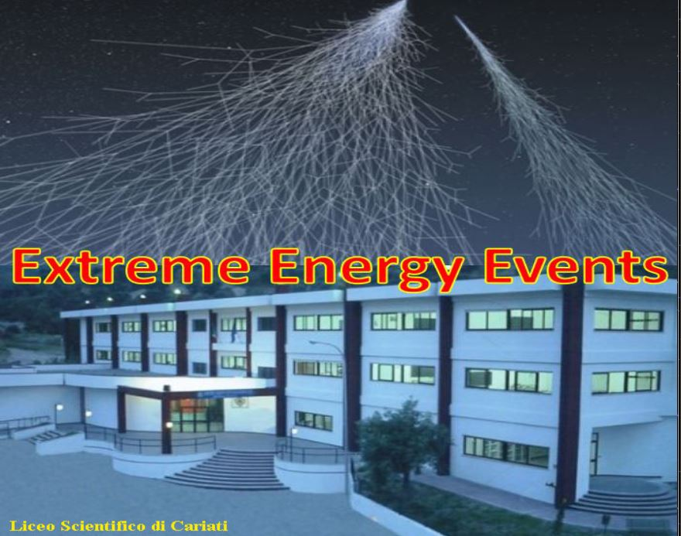
VIIIª Conferenza dei Progetti del Centro Fermi – December 6th-8th 2017 - Erice
Domenico Liguori
How cosmic rays change scolars life
Building of the MRPC for CARI01
Chamber gas tightness test
Spread-sheet for the duration of gas bottle
Telescope Efficiency
Study of Telescope Geometrical Acceptance

Slide 2
Before the CERN stage
Convention with the Centro Fermi (February 7th 2014)
EEE Conference – Erice, December 14th-17th 2014
Centro Fermi Meeting – Rome, April 15th 2015
Meeting of south schools – Bari, October 13th-14th 2016
Run coordination meeting
Data analysis and visit of other telescopes
Masterclass
HYSTOGRAM BUILDER
ESAEEE (http://agenda.centrofermi.it/indico/event/26)
Exercises with other experiments on cosmic rays
Notes:
prot. n° 203/14 del 07/02/2014 il run meeting di ESAEEE è del 10/4/17

Slide 3
Didactic Relapse
The cosmic rays as an introduction to the modern physics
Involvement of the students in research projects at a national and international level
Application of the experimental method
Experience in using electronic instrumentation for the data acquisition
Experience in using softwares for the data analysis
Experience in preparing and presenting theses for state exams
“A.S.L.”
Notes:
alternation school-work

Slide 4
School achievements in physics
Notes:
Miglioramenti: III a =17%, IIIB = 20%

Slide 5
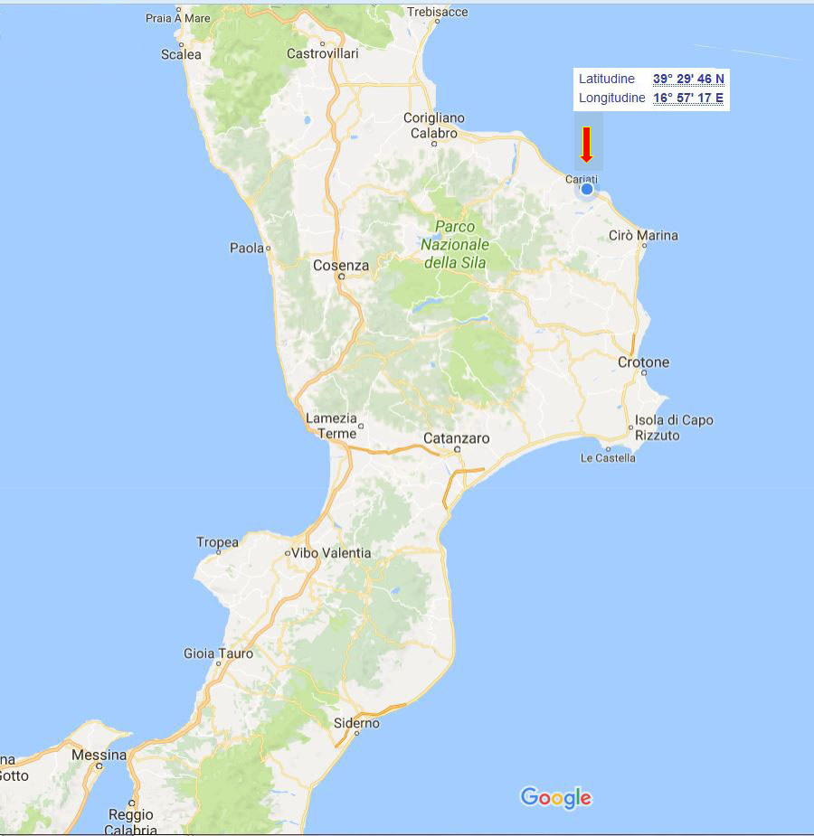
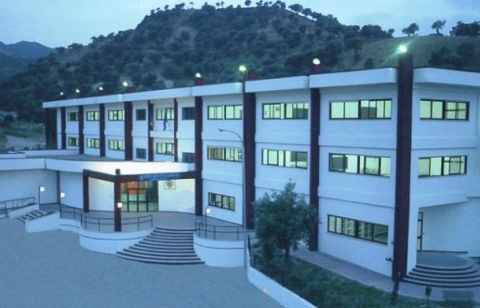
Liceo Scientifico di Cariati
CZ Lido
Notes:
Cariati-CS=CS-CZ=circa 60 Km; Cariati-CZ=80 Km

Slide 6
EEE laboratory planimetry- ground floor
55 m²
200 m³
EEE Lab

Slide 7
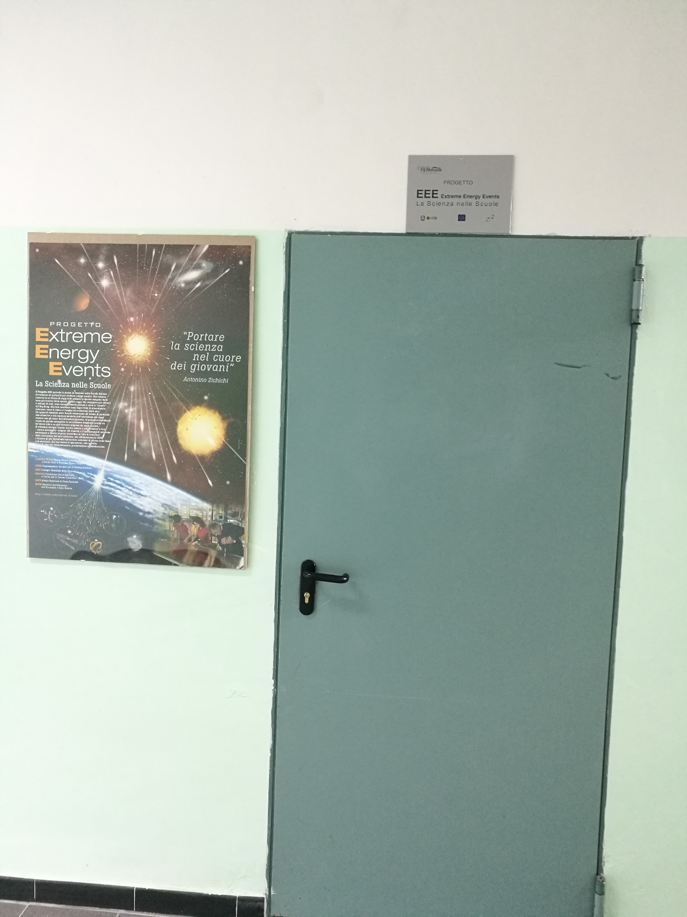
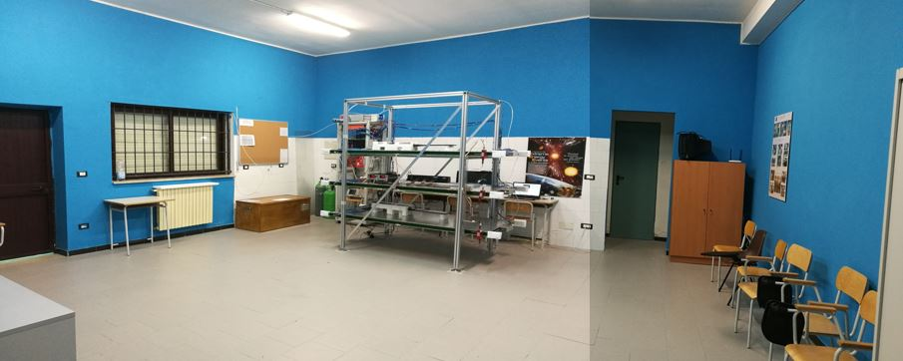
EEE laboratory

Slide 8
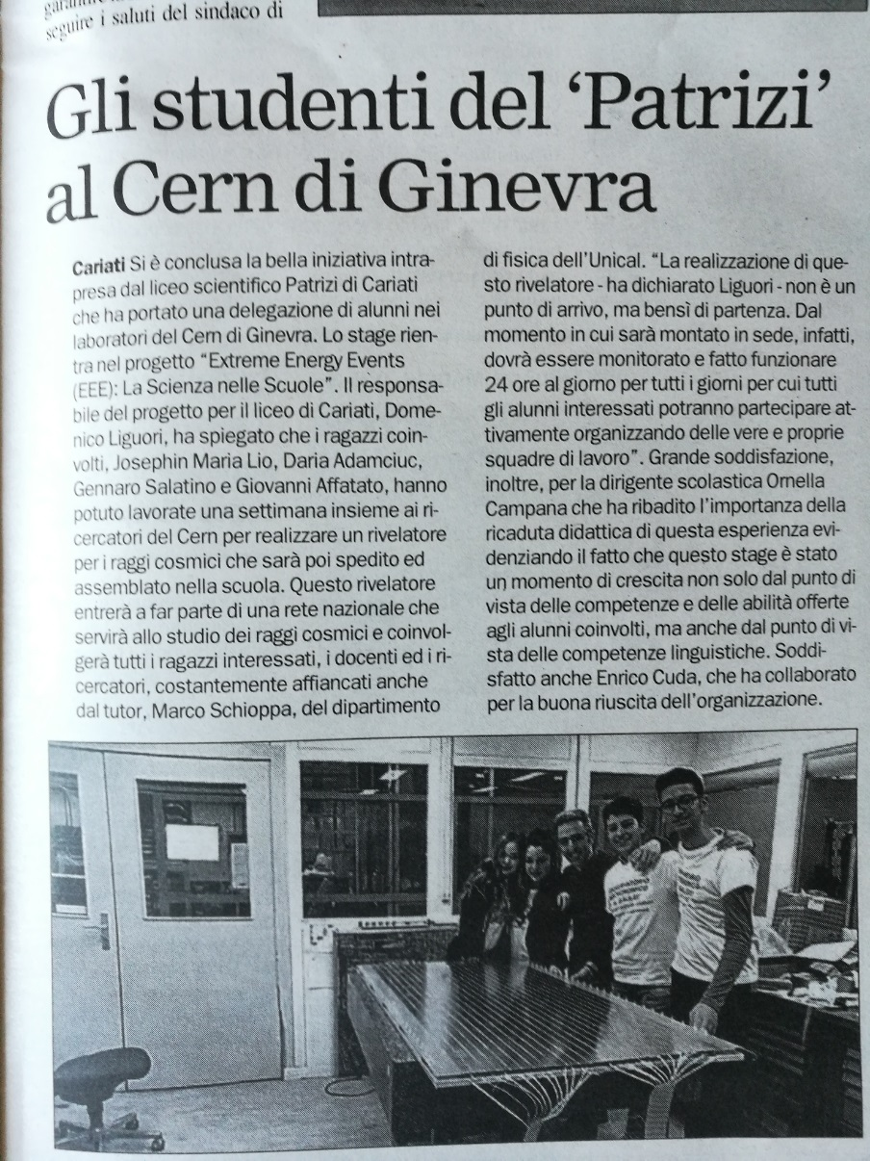
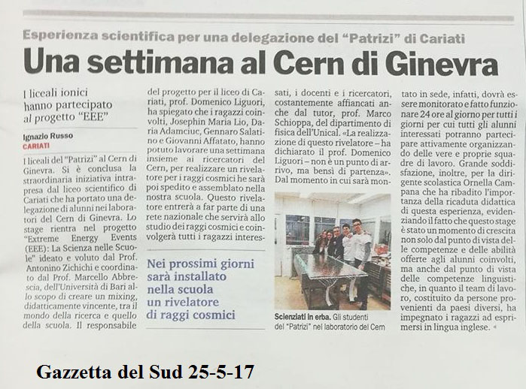
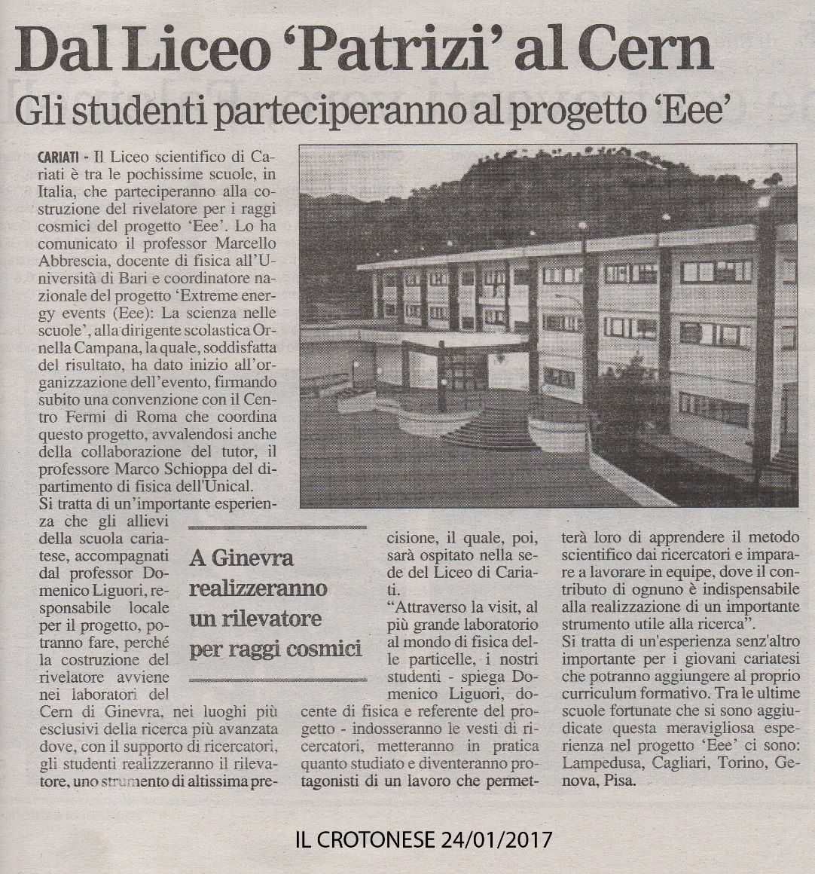
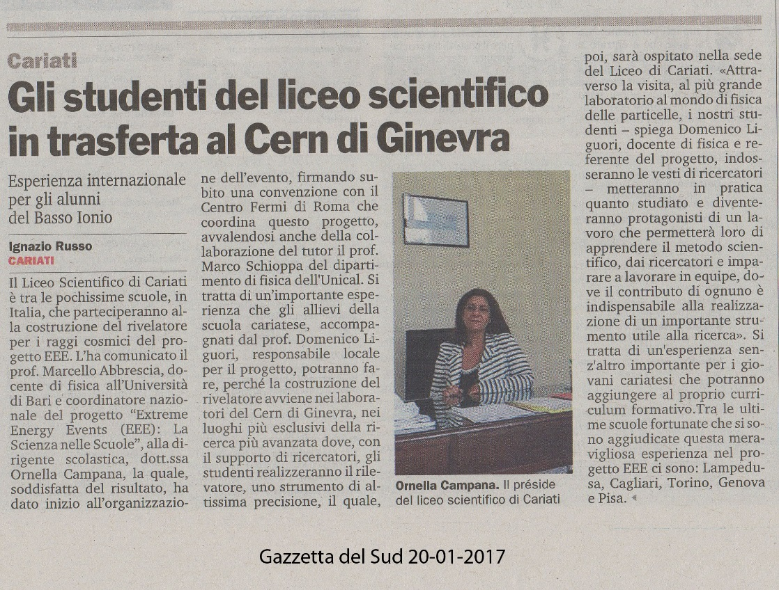
Our experience in the newspapers

Slide 9
The word to the students…
Giovanni Affatato
Gennaro Salatino

Slide 10
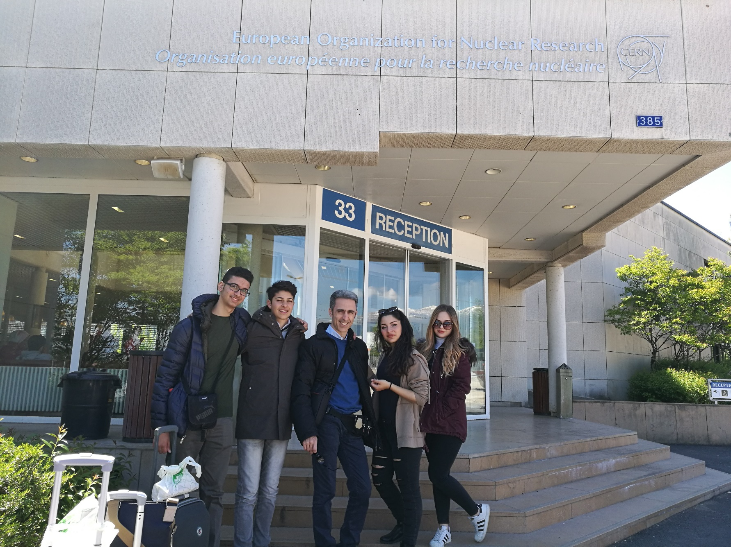
Our experience: Extremely Exciting Experience
Our experience at CERN for the building of the MRPC
(Multigap Resistive Plate Chambers)
for the Cosmic Rays Telescope
from the
EEE (Extreme Energy Events) project
The science in schools

Slide 11
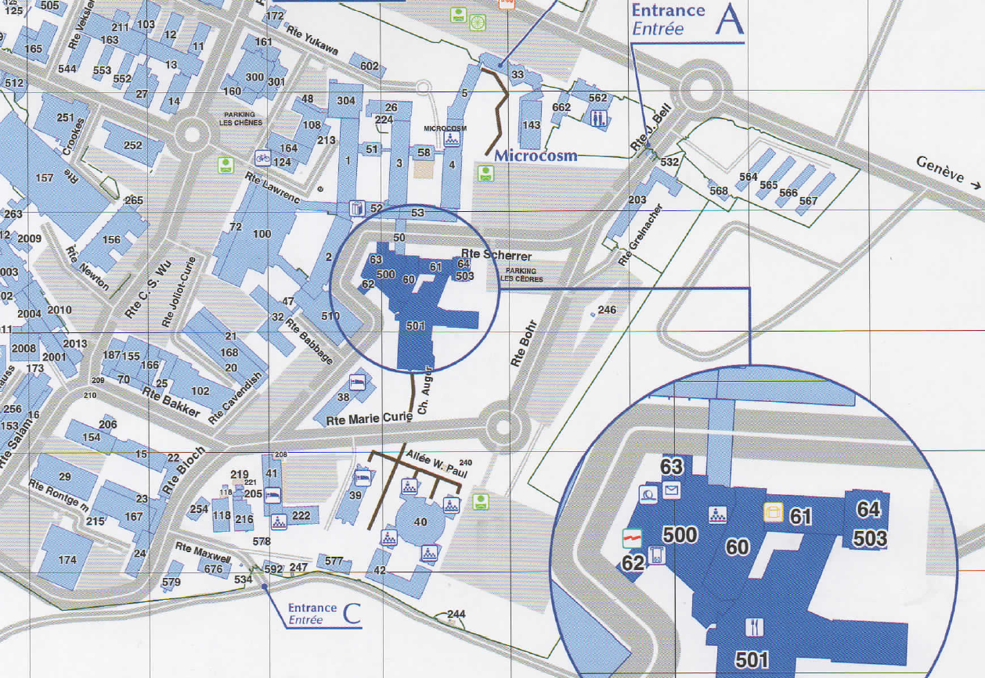
Our times and workplace
09:30 – 13:00
14:00 – 19:00
Lunch break
13:00 – 14:00
Canteen
EEE Lab
Foyer

Slide 12
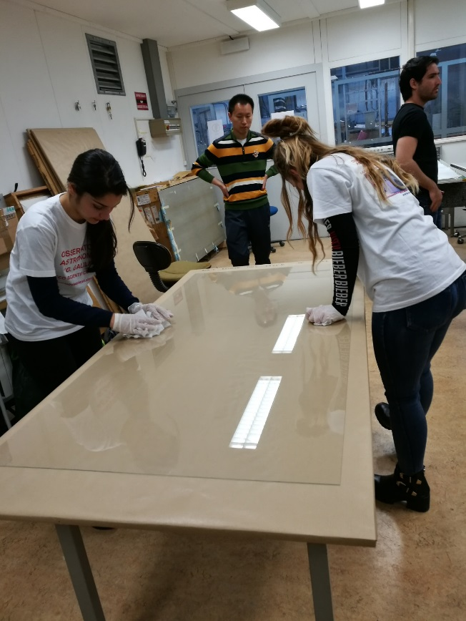
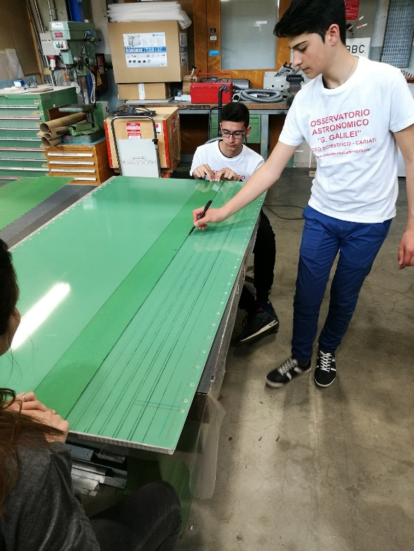
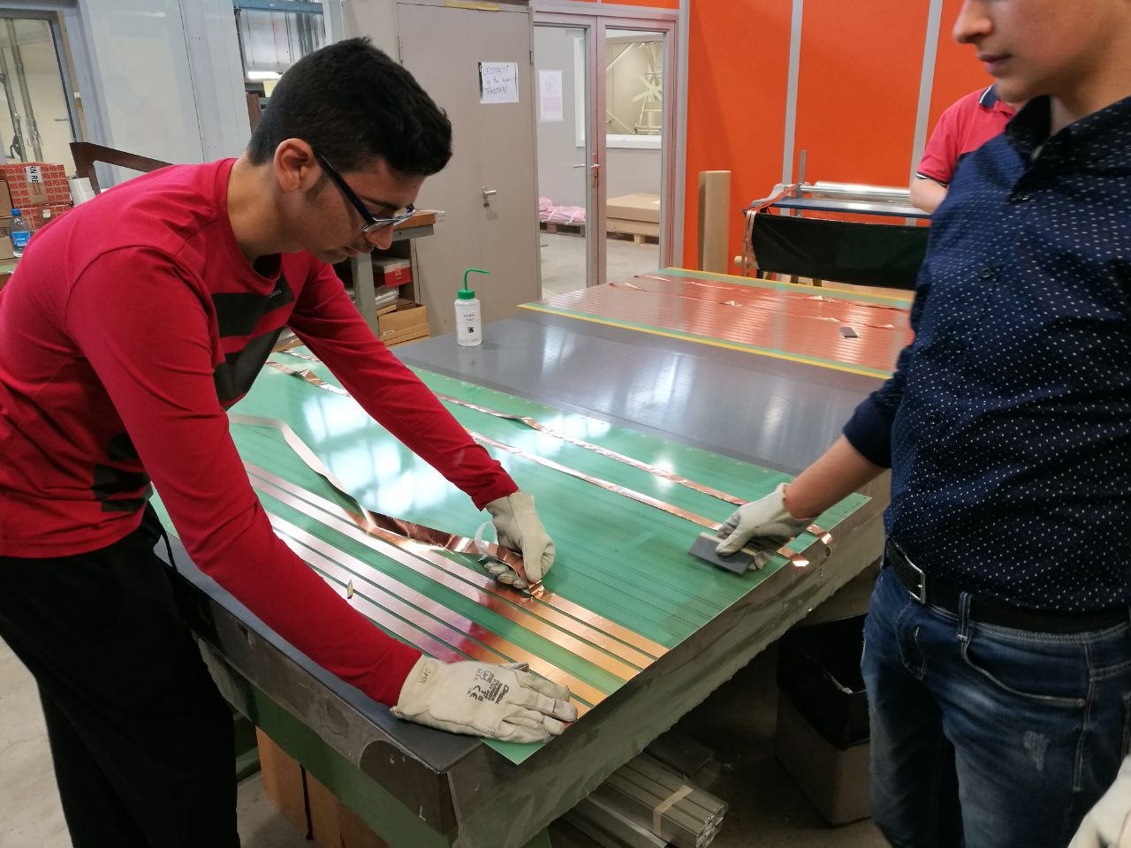
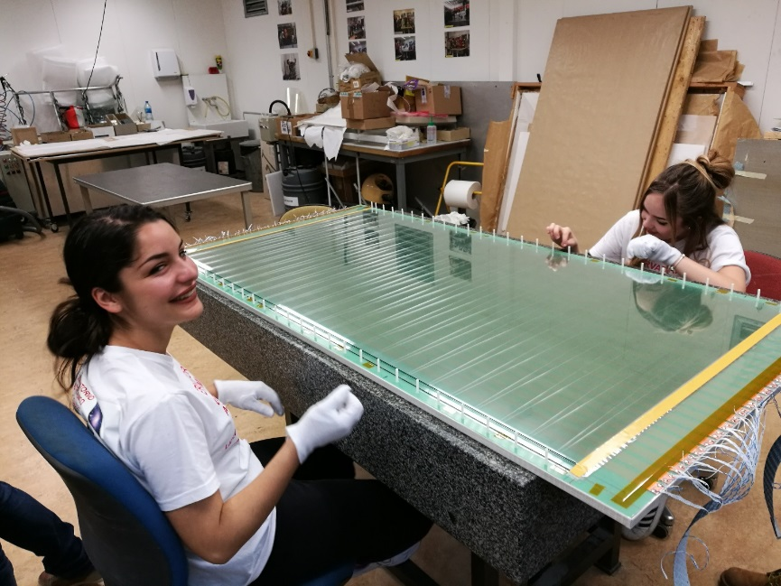
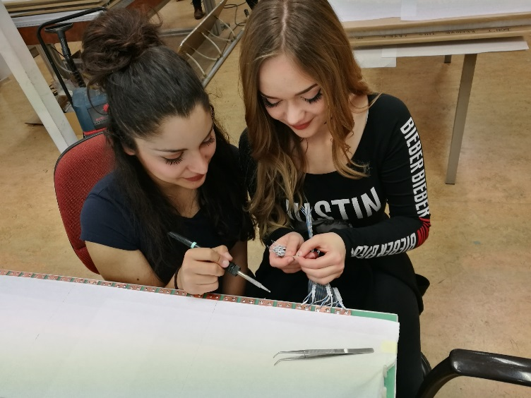
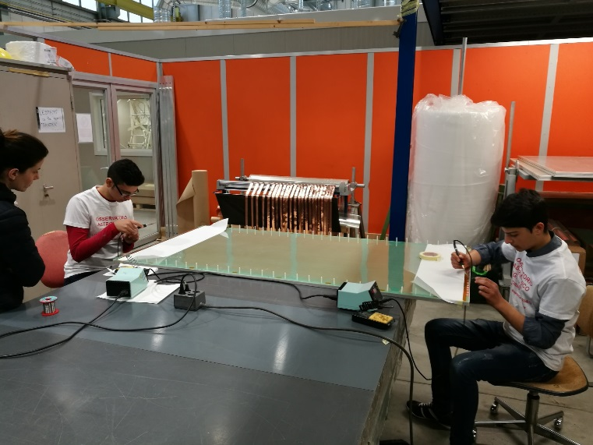
Some work steps at CERN april 24th - 28th 2017

Slide 13
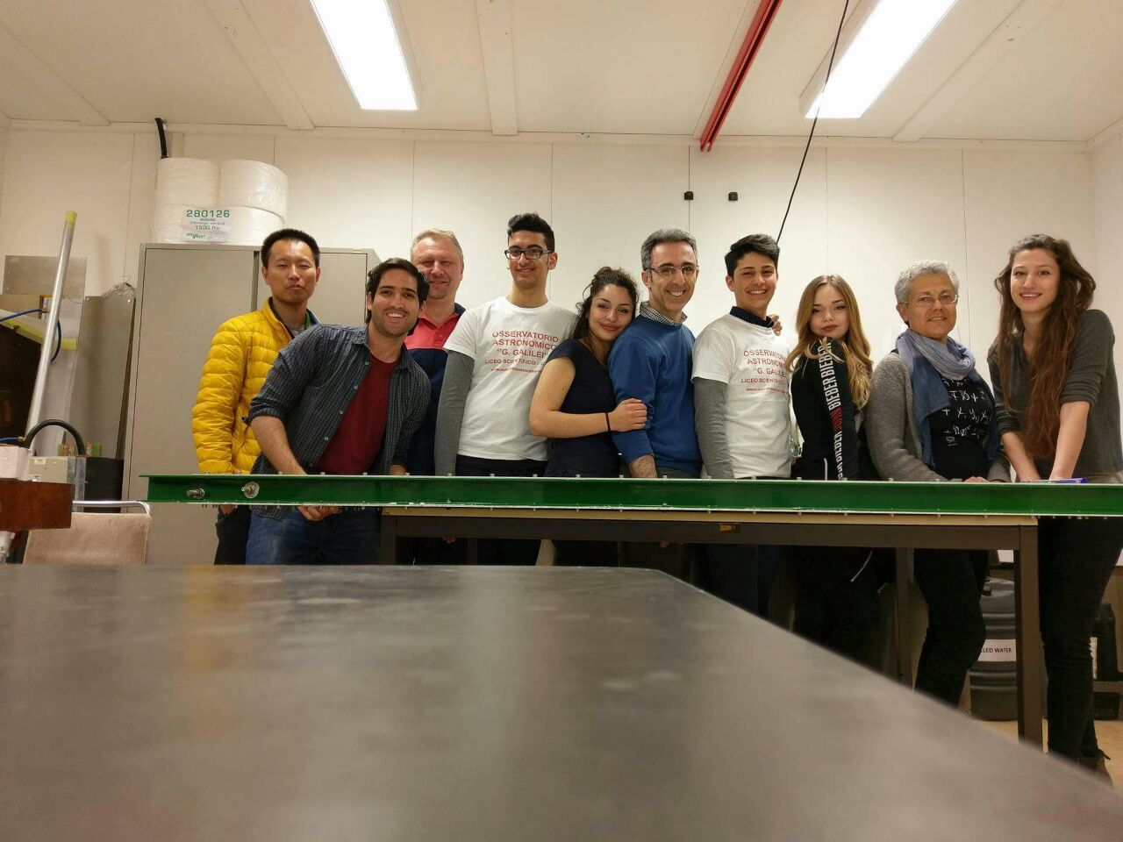
Our international work team

Slide 14
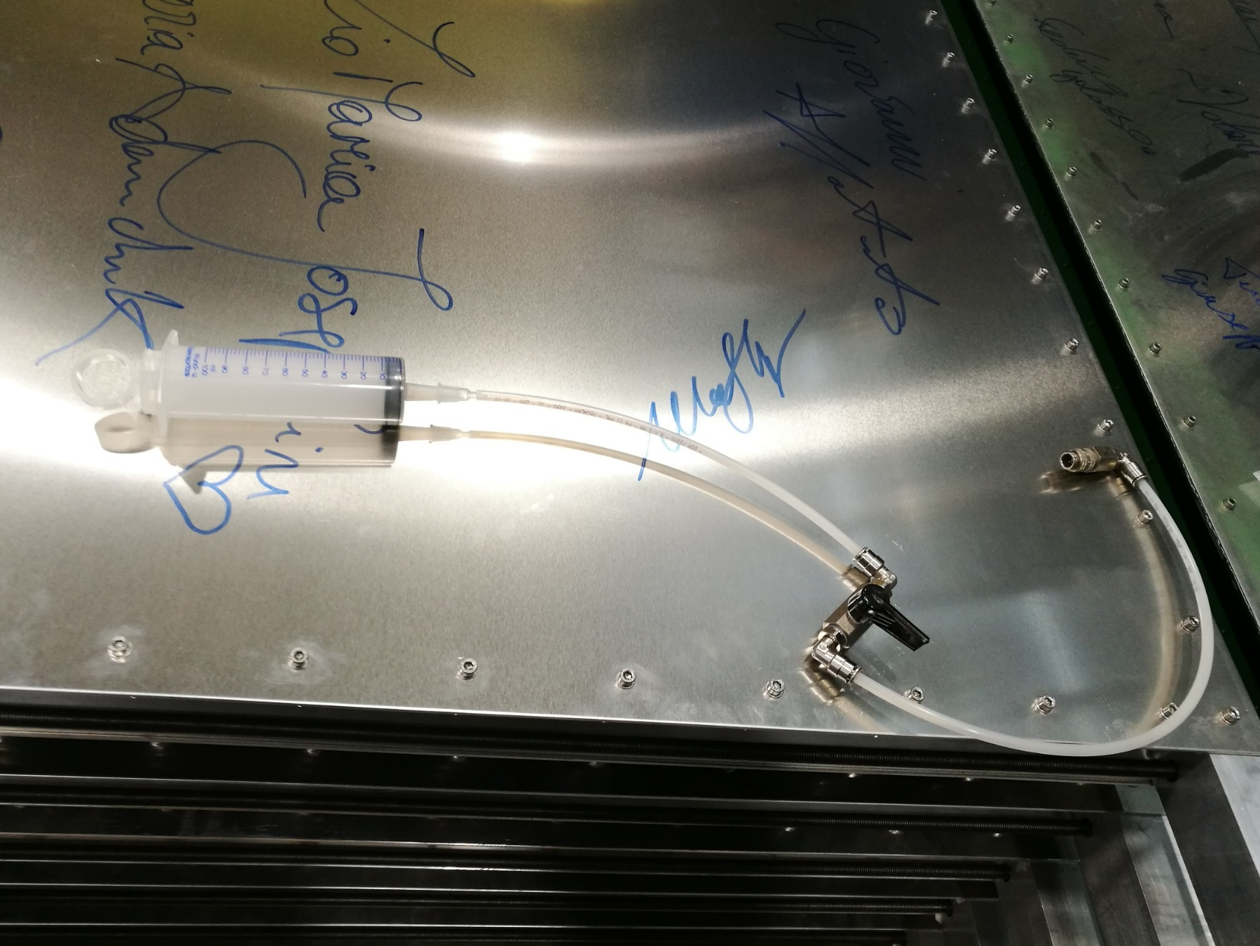
FLOW TEST

Slide 15
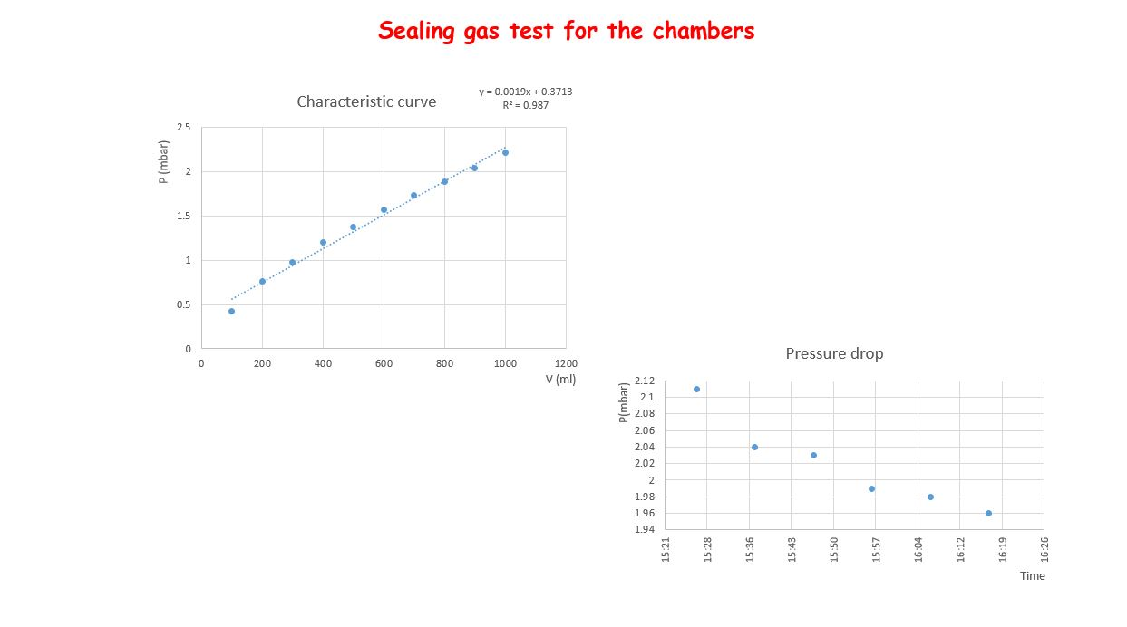
Gas tightness test of the chamber
Notes:
Si pompa aria, si misura ogni 10 min quanto cala la P. Si fa la curva caratteristica e poi dalla perdita di P nel tempo si ricava la perdita di V nel tempo. In questo caso circa 2 litri/giorno

Slide 16
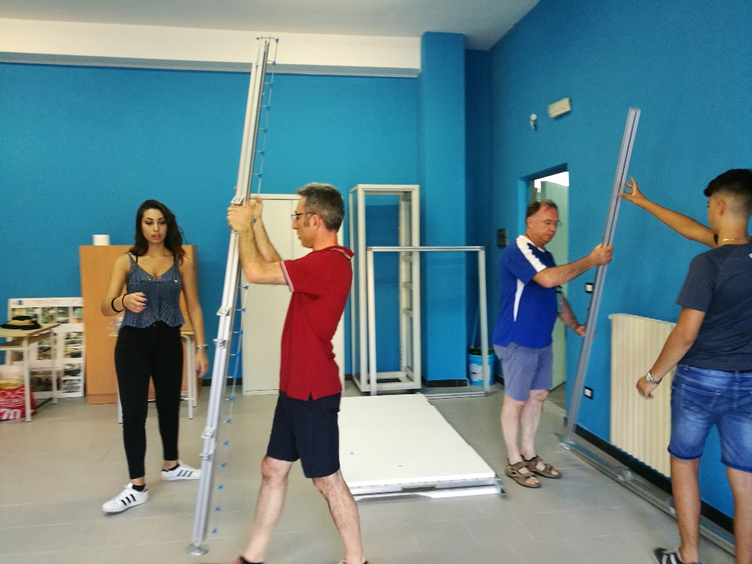
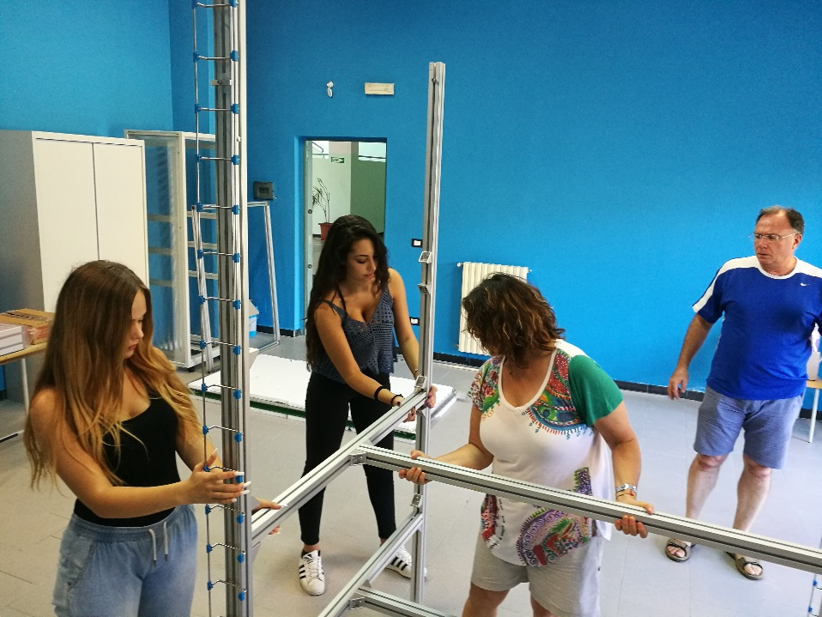
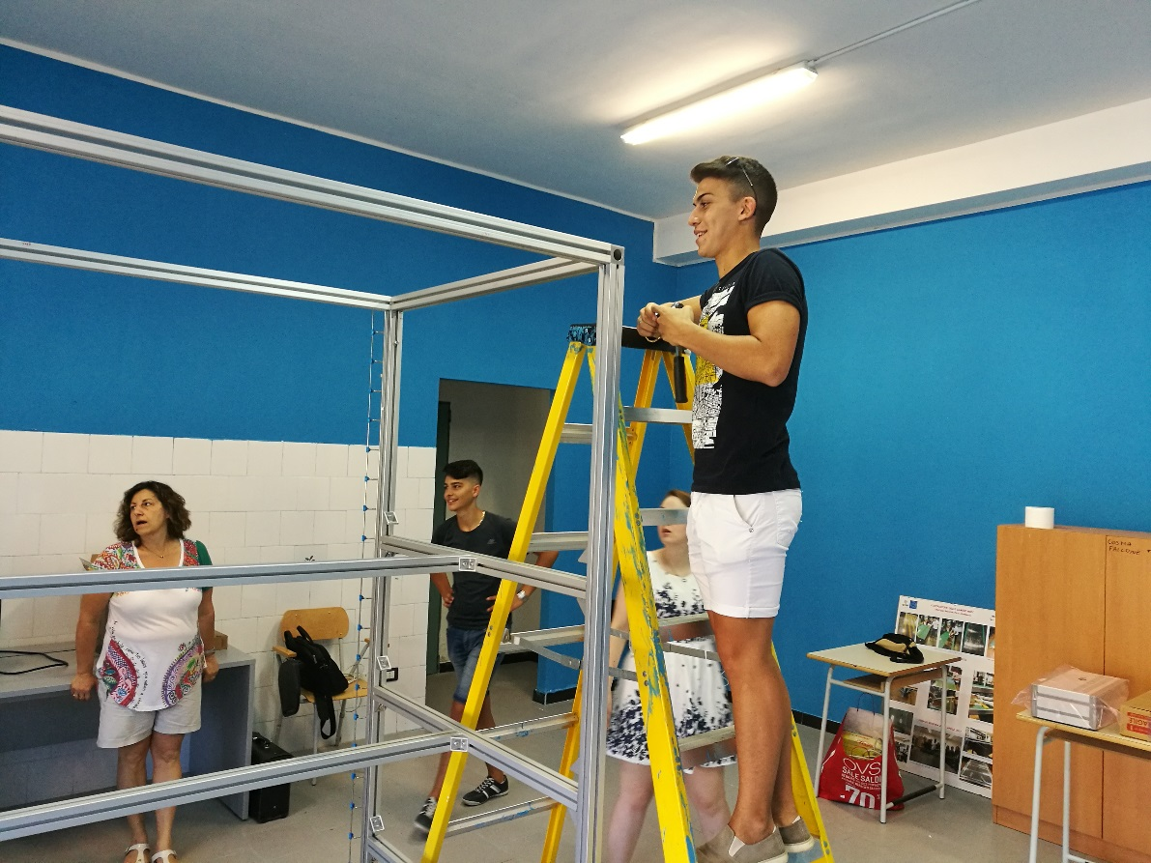
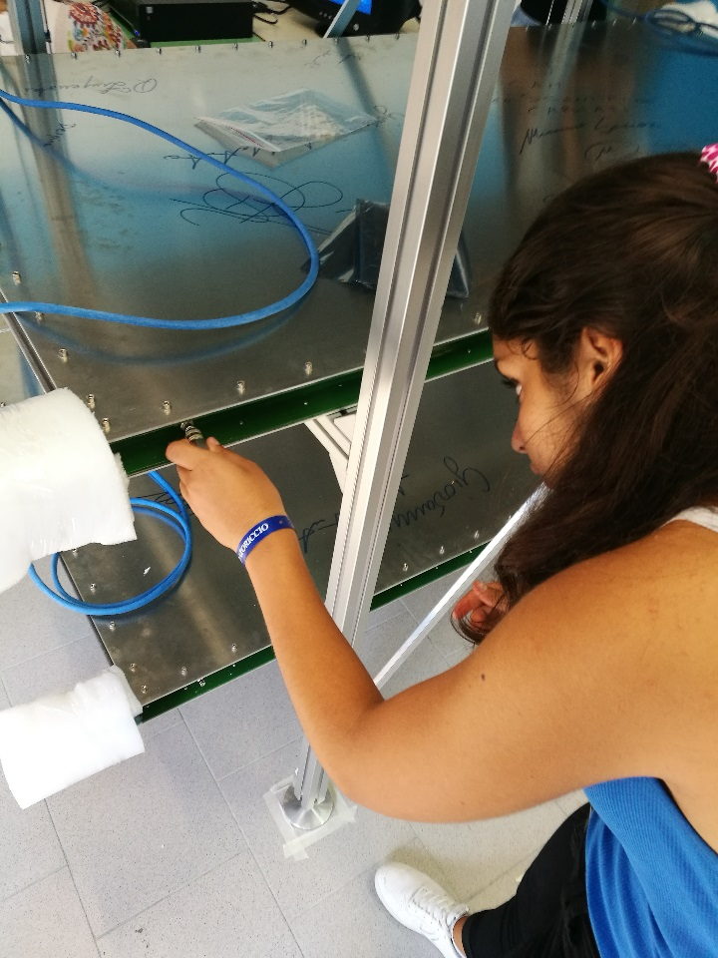
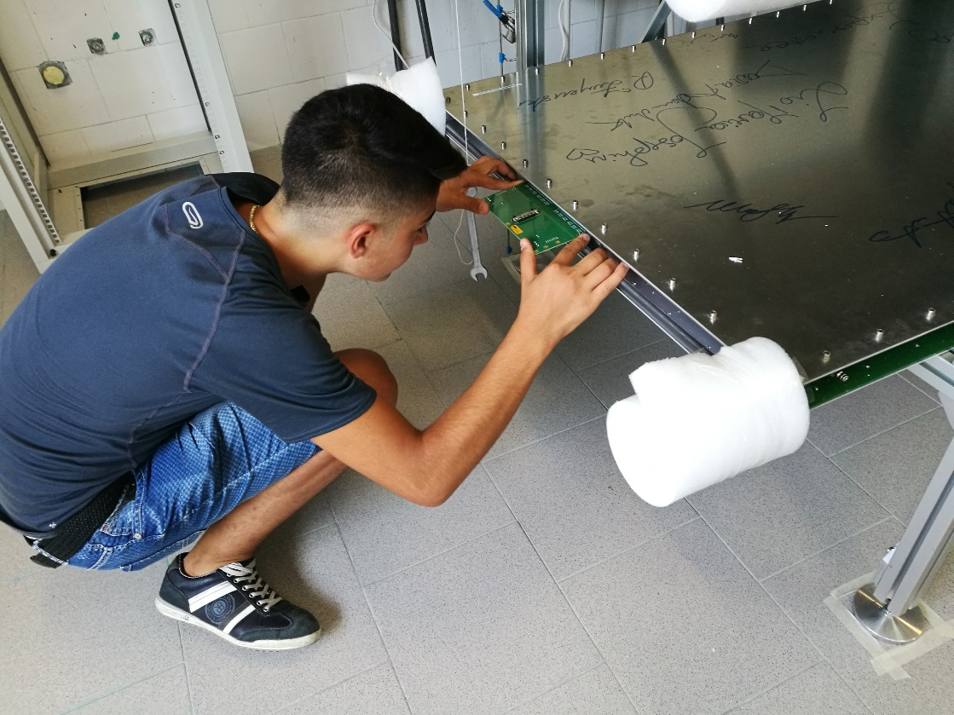
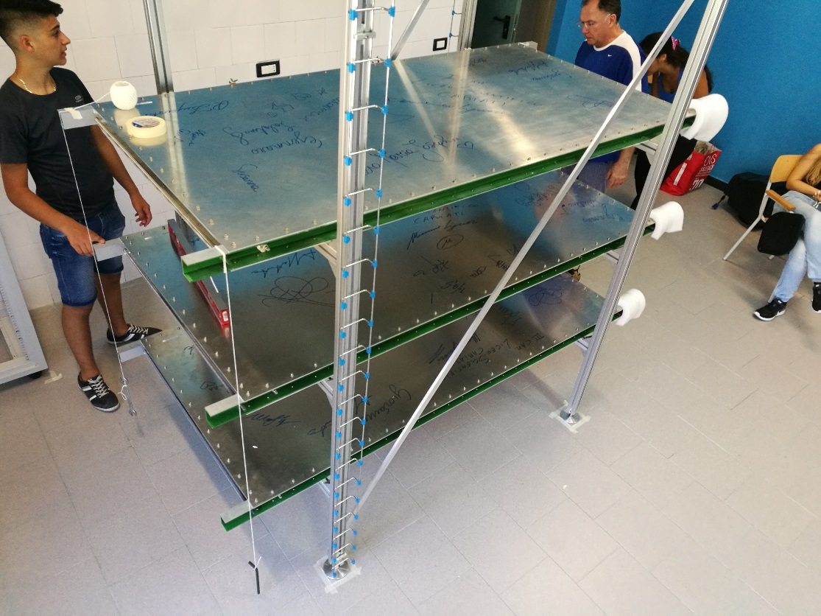
The telescope arrival at headquarter and first step of assembly and cabling: august 8th - 9th 2017

Slide 17
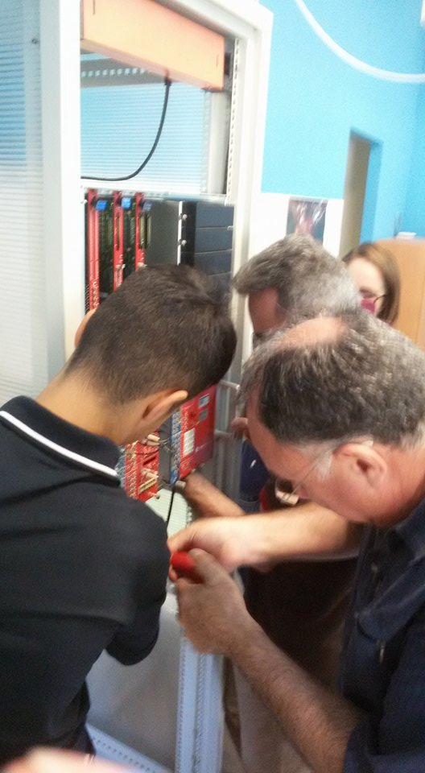
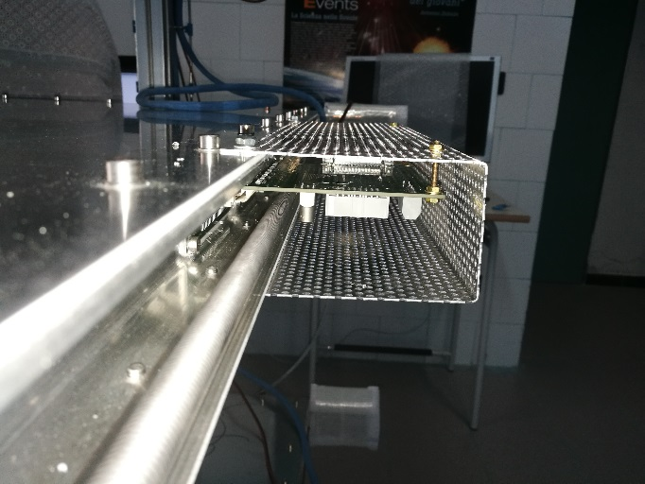
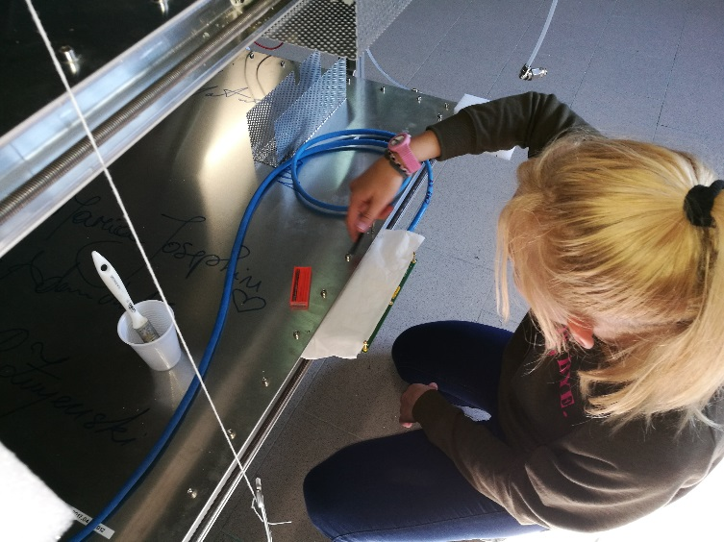
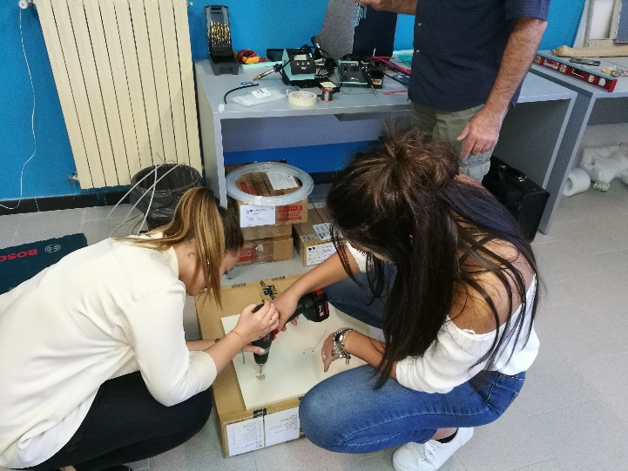
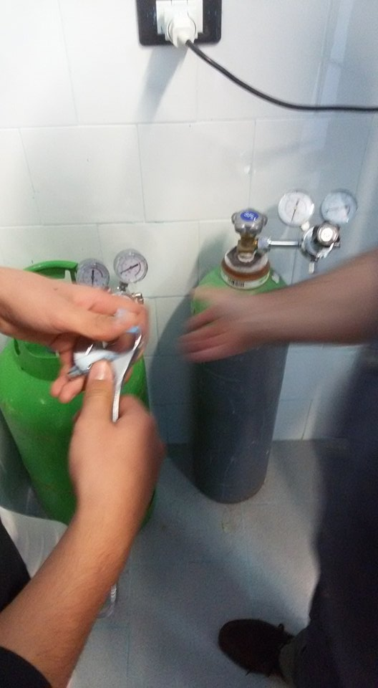
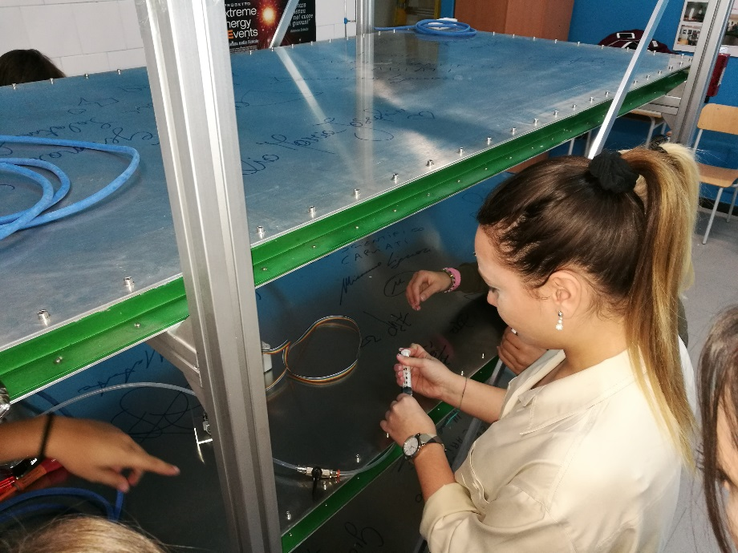
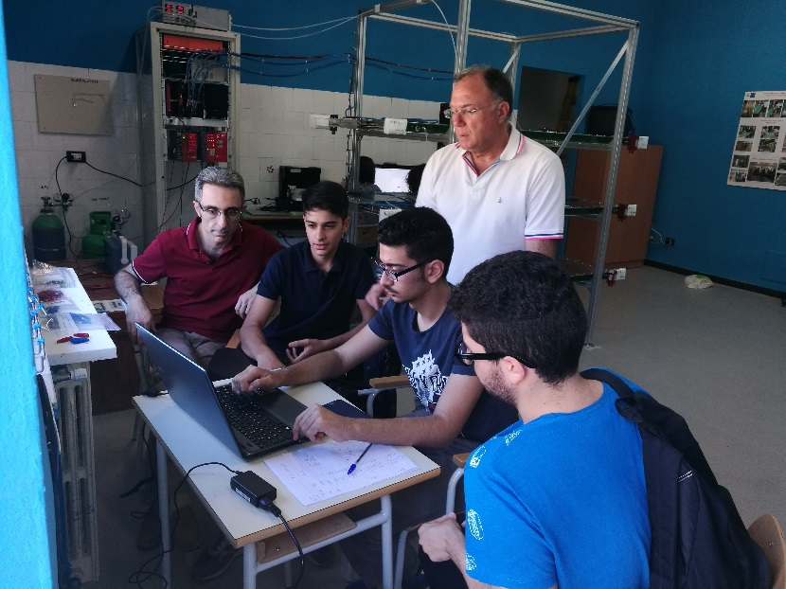
Gas, electronics and software september 22th and 23th 2017

Slide 18
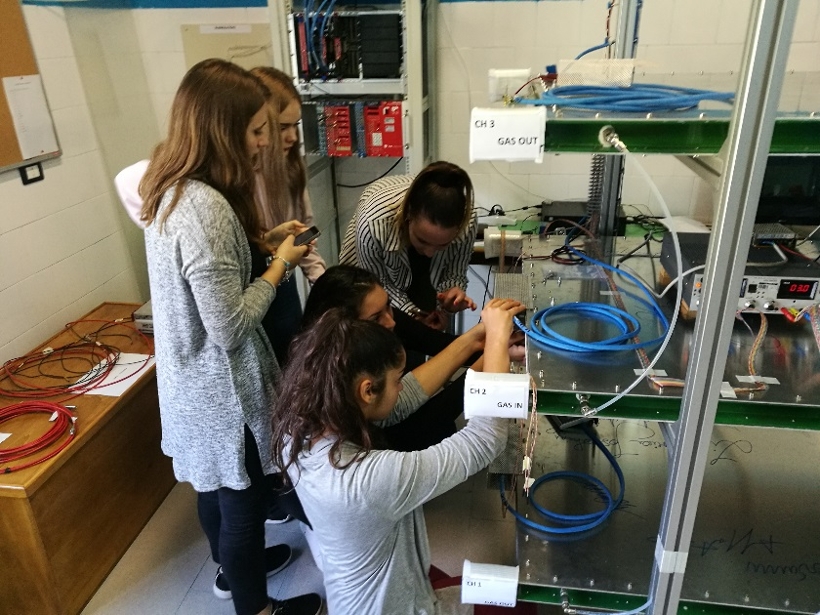
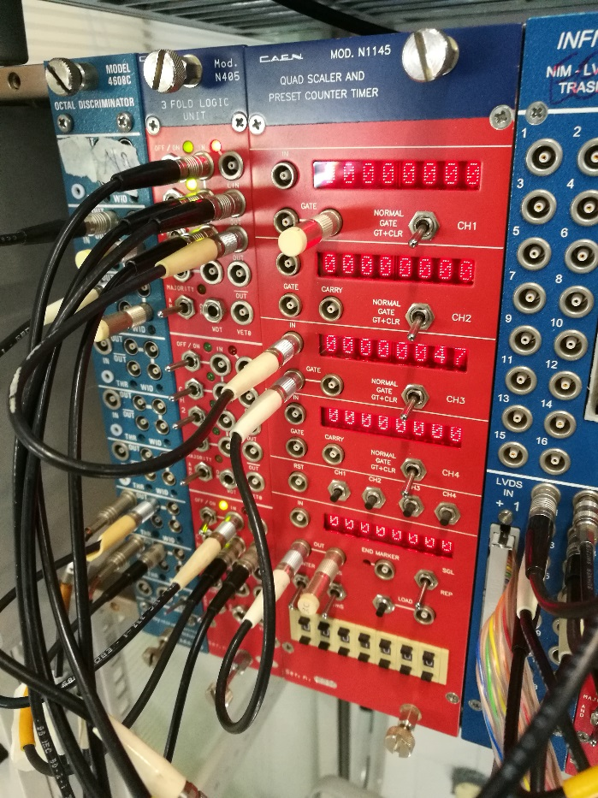
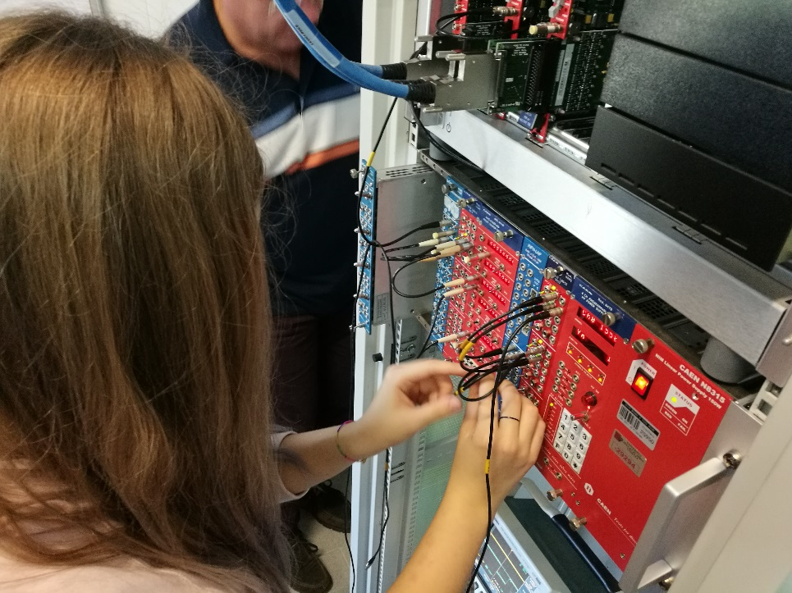
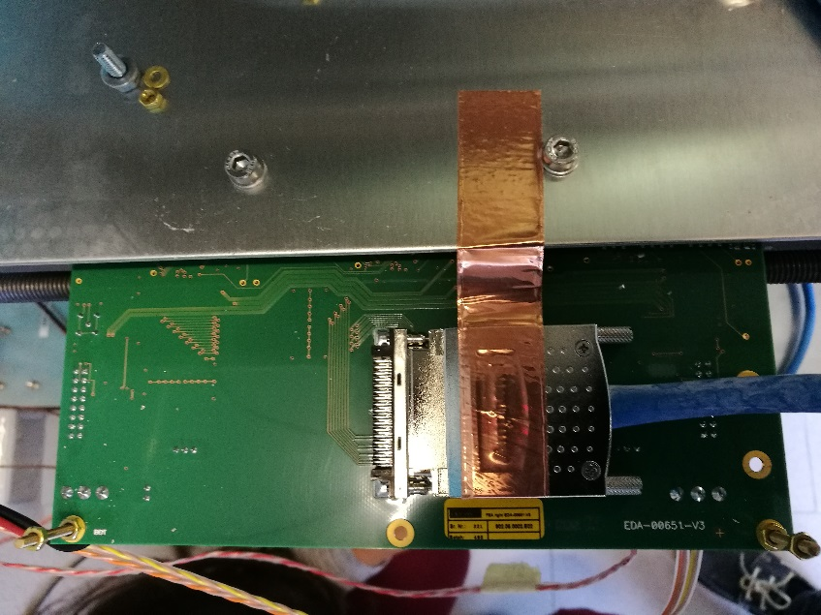
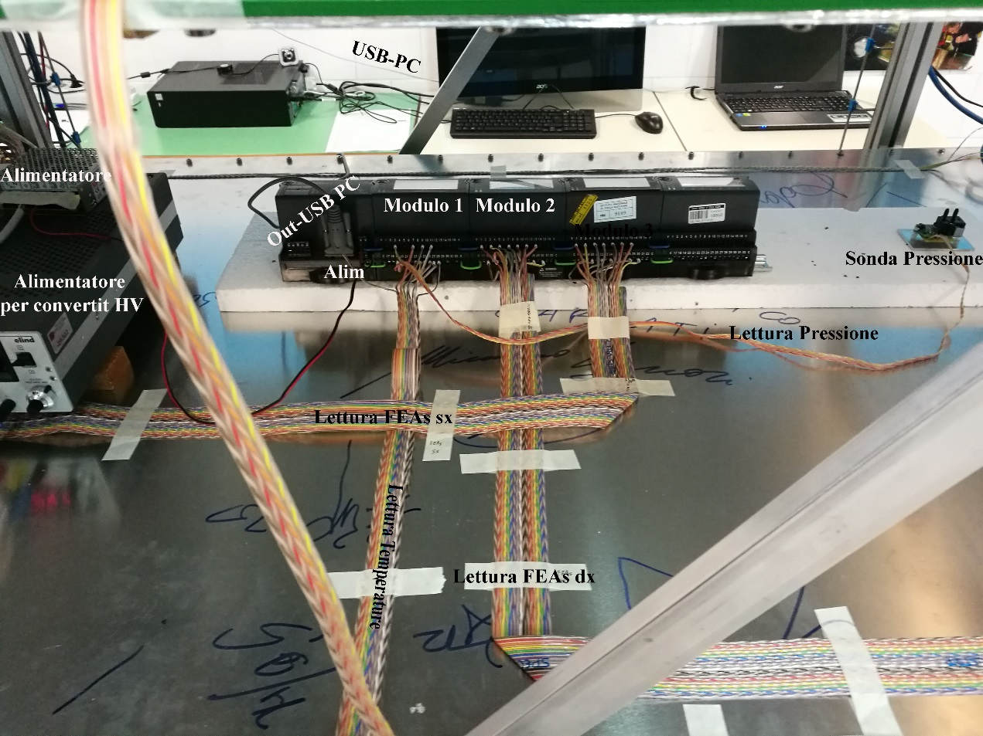
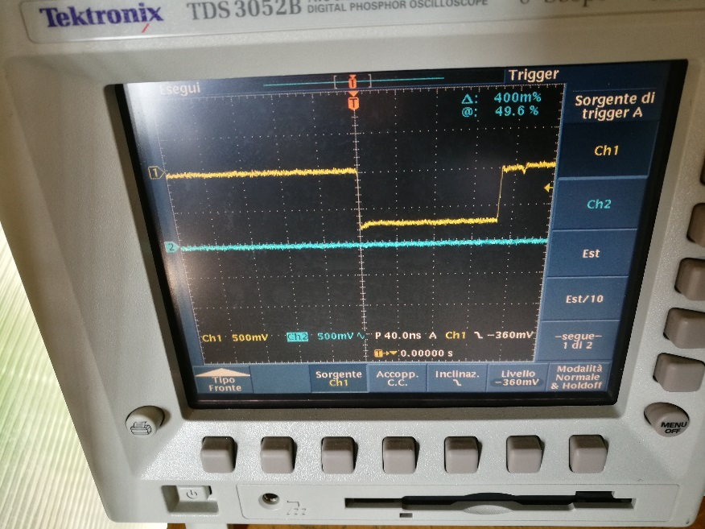
LV, HV, automatic reading of P and T, cabling october 5th 2017

Slide 19
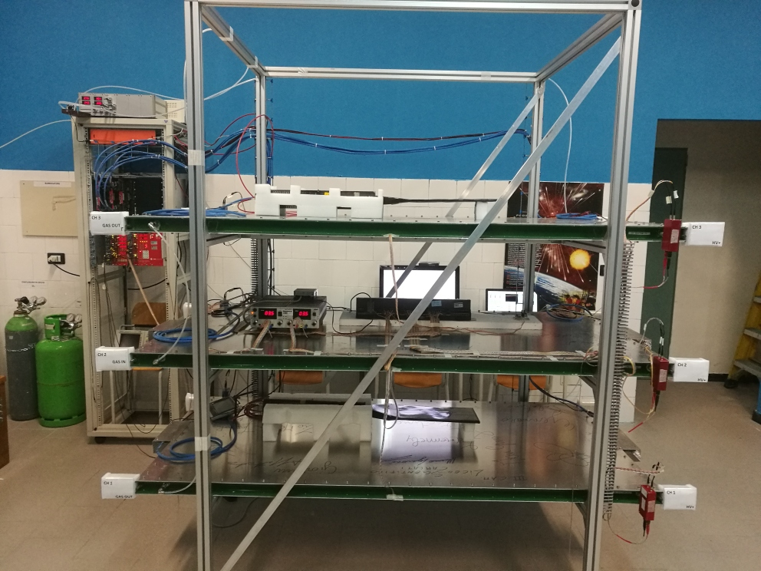
Telescope CARI01 … waiting for trigger card

Slide 20
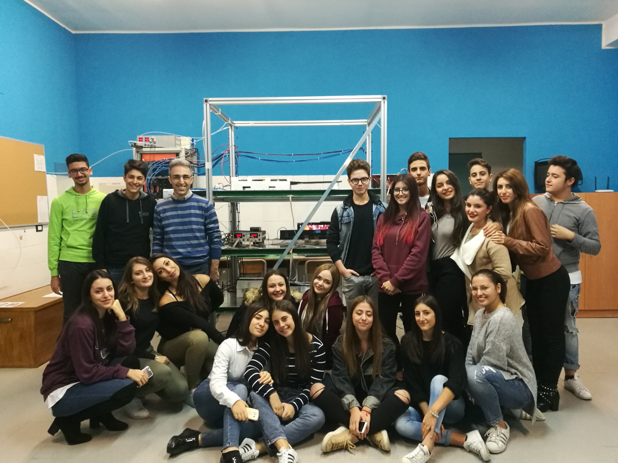

Slide 21



Short video of the stage at Ginevra CERN for the building of MRPC chambers
of the cosmic rays telescope (EEE Project)
https://www.youtube.com/watch?v=ZlujnvaUrU4
EEE Liceo Scientifico Cariati
http://www.eeeliceocariati.altervista.org

Slide 22
Analysis and results

Slide 23
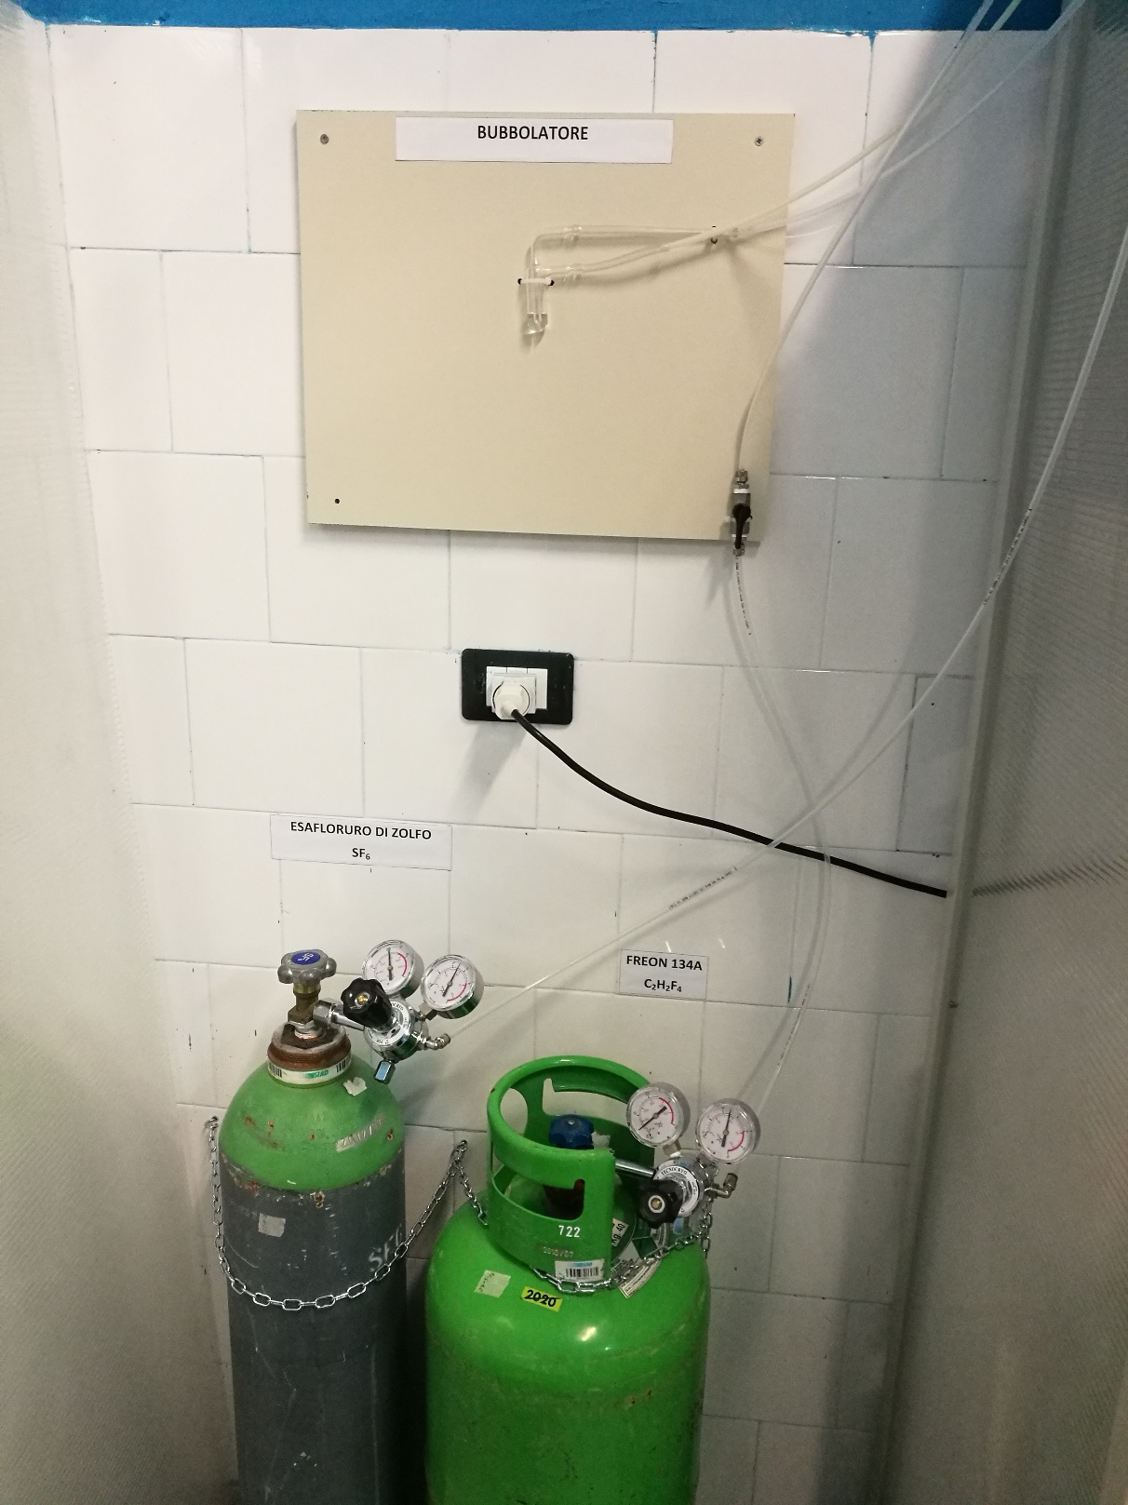
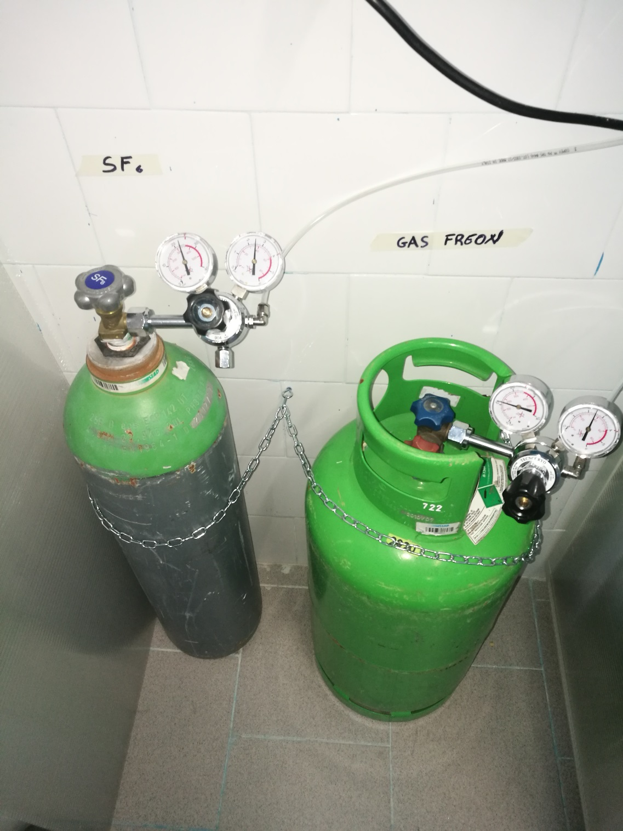
Our gas system

Slide 24
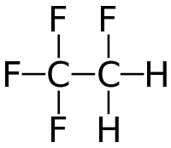
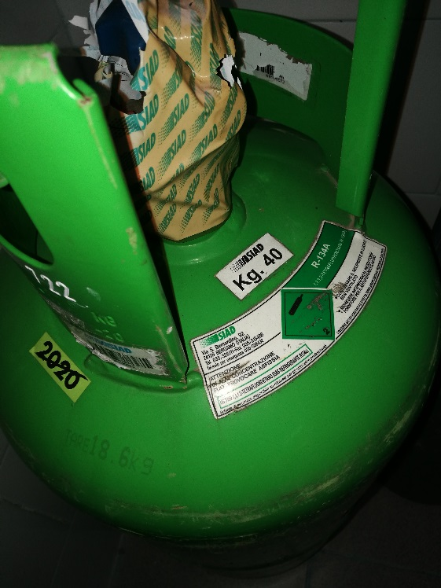
R-134A-GAS FREON C2F4H2 (1-1-1-2 Tetrafluoroethane)
Vm=22.4 l/mol (at 1 atm and 0 °C)
n=m/MW
n_{Freon}=40·10³/102≈392 mol
392 mol->8780 l
Telescope consumption= 2 l /h
% Freon=98% -> 1.96 l /h
Freon life= 8780/1.96 ≈ 4480 h ≈ 187 gg ≈ 6 months
Net weight = 40Kg
Tare=18.6 Kg
Molecular Weight =102
Notes:
Vm=V/n
N_{A}=6.022x10²³

Slide 25
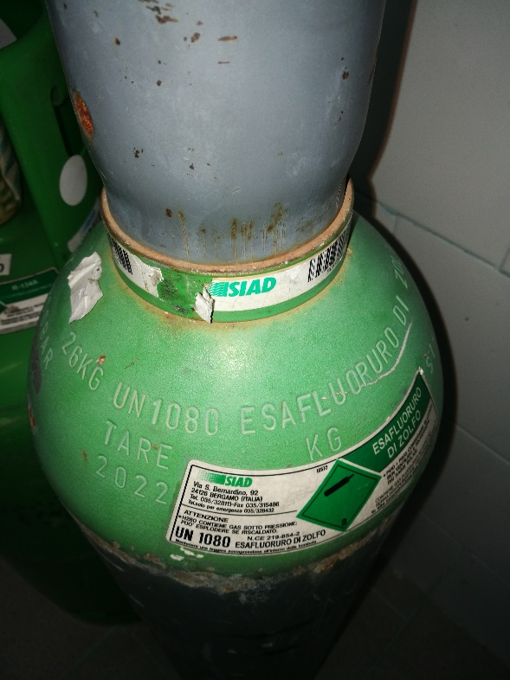
SULFUR HEXAFLUORIDE SF6
same calculation ... life about 4 years
Net weight = 26Kg
M.W.=146

Slide 26
Spreadsheet for the duration of gas tank
Run meeting coordination 11/08/2017
http://agenda.centrofermi.it/indico/event/45/
Excel

Slide 27
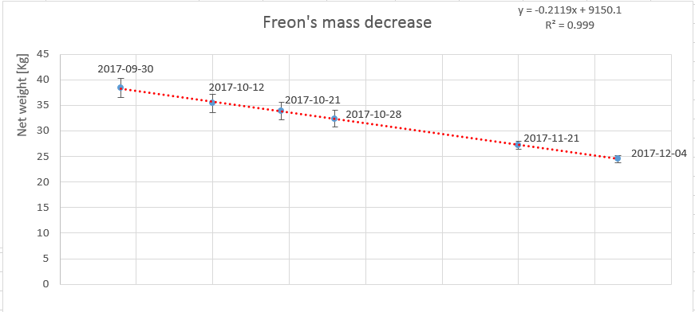
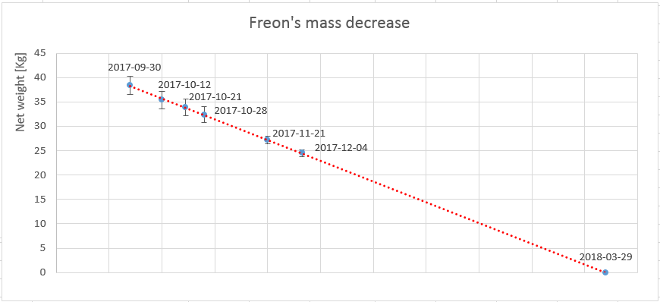
Notes:
Errore di 5% per bilancia analogica e 3% per bilancia digitale, sul peso netto

Slide 28
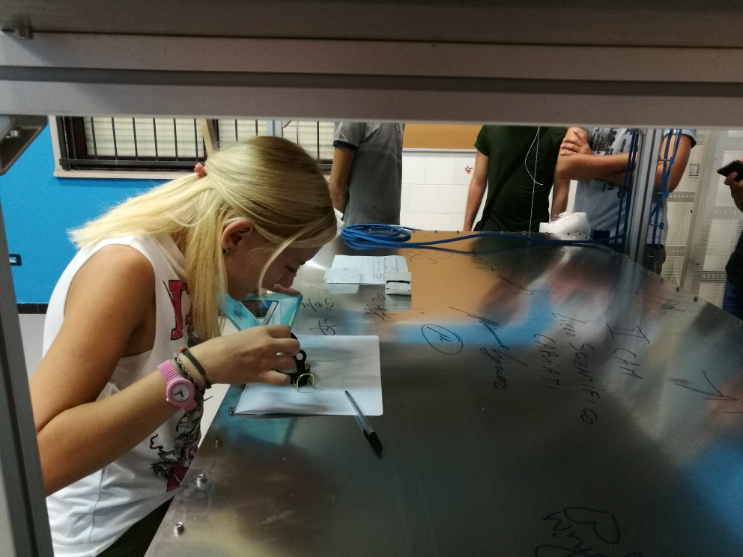
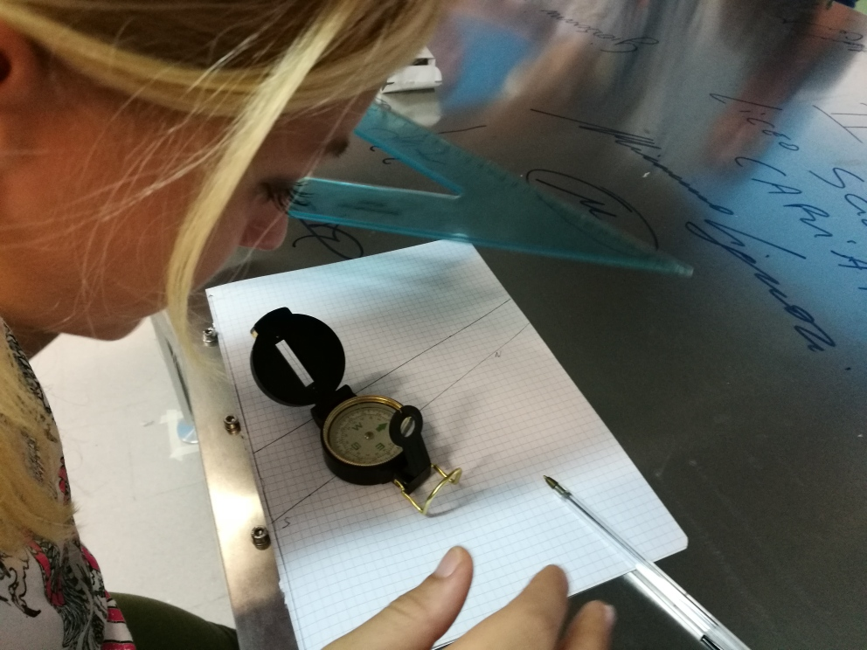
Telescope orientation measurement

Slide 29


Notes:
3.38 CON VARIAZIONE ANNUA DI 0.6°EST IL MODELLO USATO NEL CALCOLO è IGRF12

Slide 30



Meteorological Hut

Slide 31


Slide 33


Slide 34
extra slides

Slide 35


"Maquette" of the telescope for the geometrical acceptance studies

Slide 36

Notes:
Con scintillatori + ArduSiPM

Slide 37

Simulation
Coincidences every 10 min
Geometrical Acceptance %

Slide 39


