Slide 1
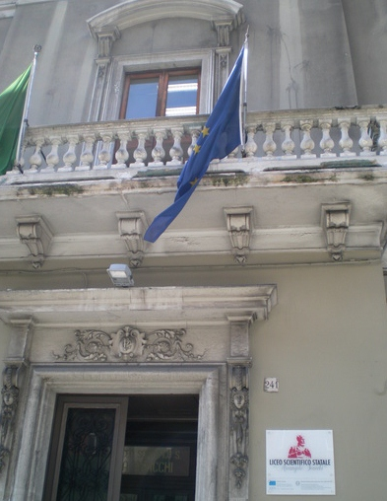


EEE@ Liceo «Scacchi» 2017/2018
Daniela Moretti - Marco Falotico
NATIONAL CONFERENCE OF THE EEE PROJECT Extreme Energy Events - La Scienza nelle Scuole (ERICE 6-7-8/12/2017)

Slide 2
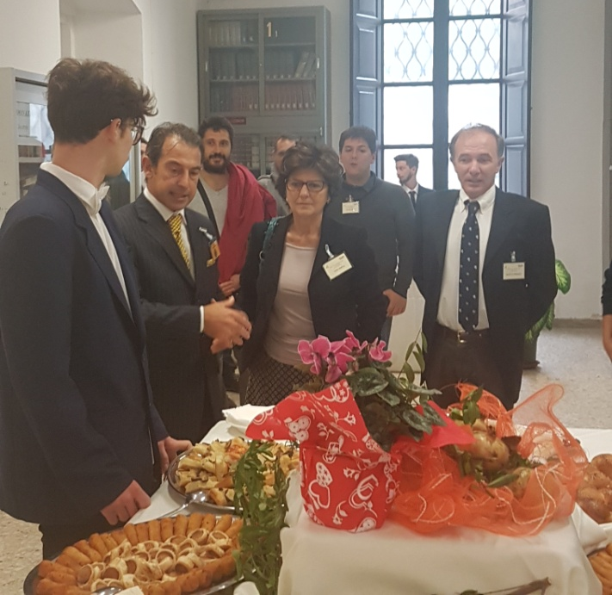
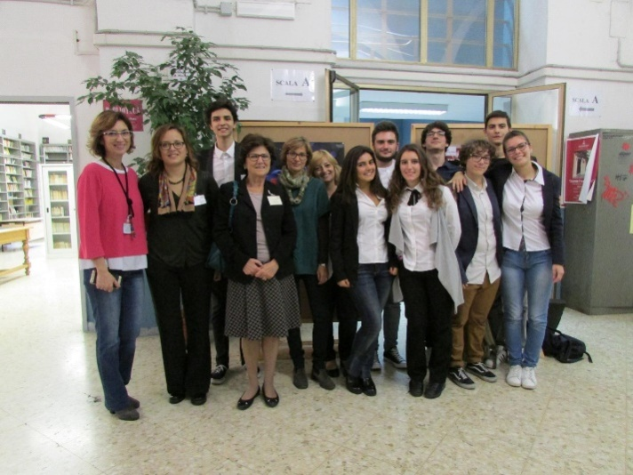

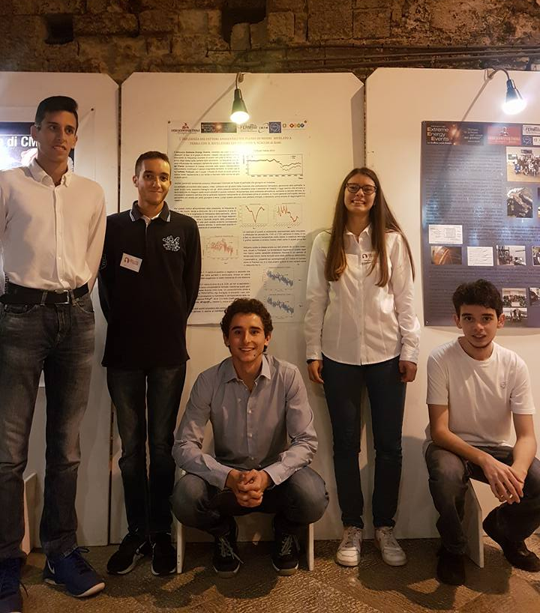
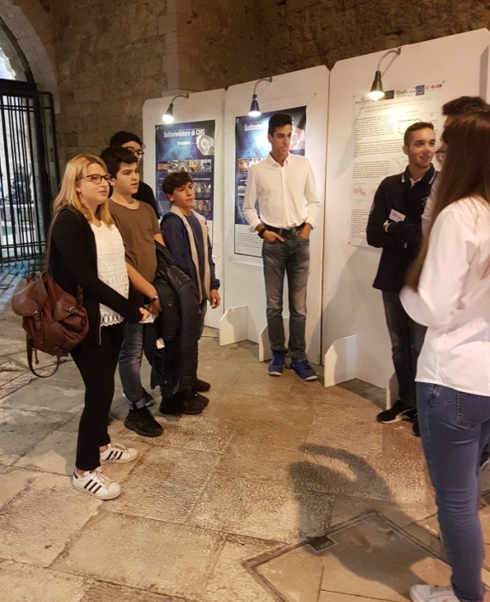
EEE activity in our school.
EEE Meeting organisation
October 13-14 2016
European Researchers Night 2017

Slide 3

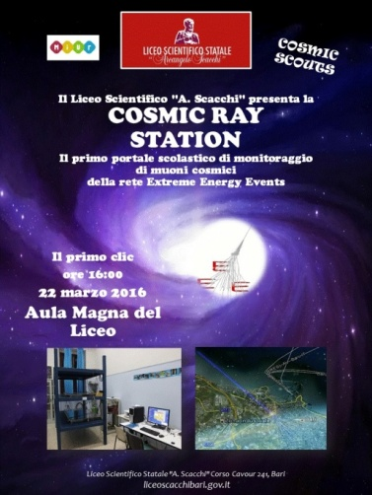
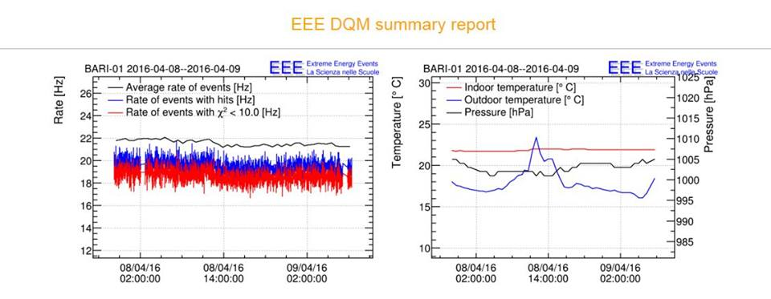
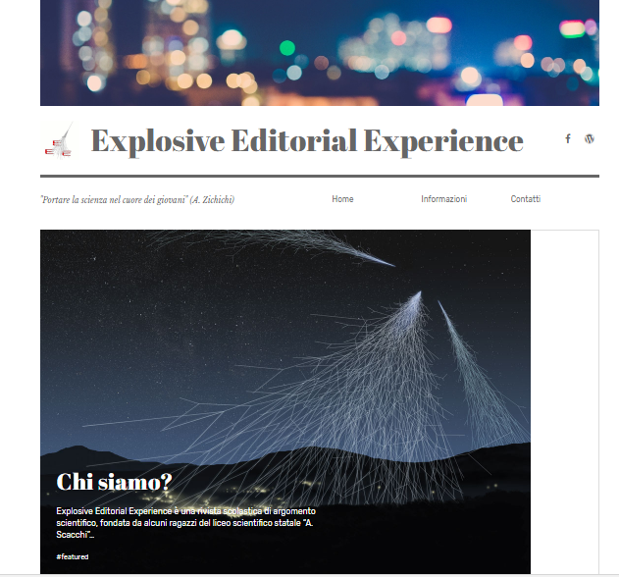
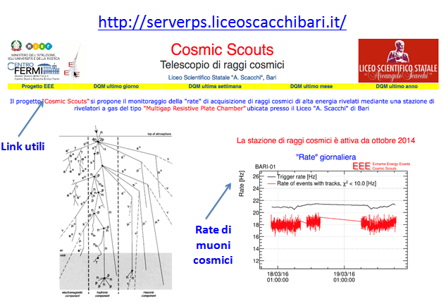
Outreach EEE activity
‘’Cosmic Ray Station’’: a web portal fully dedicated to the telescope monitoring. http://serverps.liceoscacchibari.it/
Online scientific journal
https://exedex.wordpress.com/

Slide 4
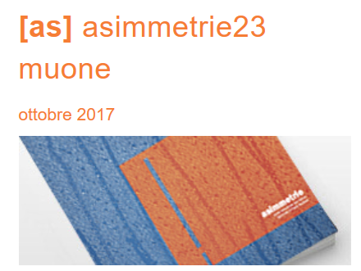
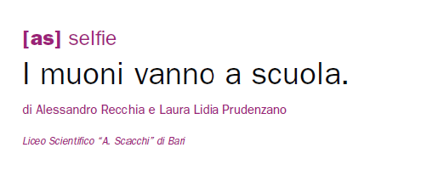
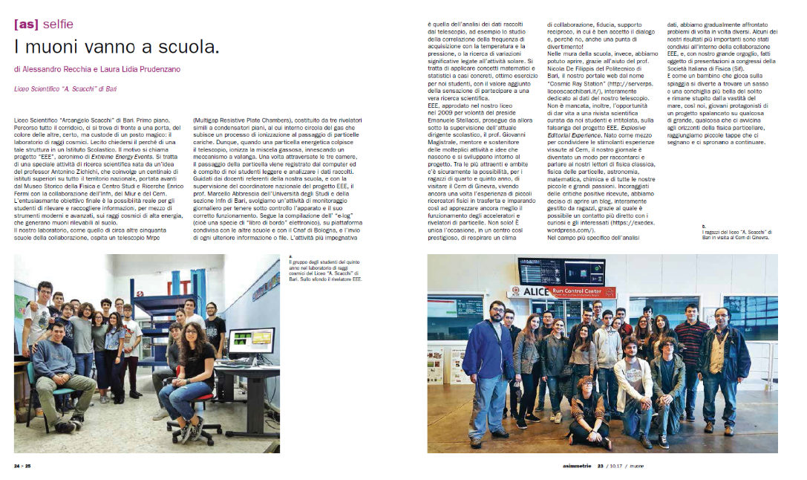
Outreach EEE activity

Slide 5
RUN 3- DATA ANALYSIS
Goal: investigate the effects of some atmospheric parameters that may influence barometrical correction.
Hypothesis: The gain of the detector at the efficiency plateau is assumed to be constant.
Dataset:
  data taken during a heavy snowfall in the last winter by telescopes Bari-01 and Trin-01
  data taken in a period with temperature and external pressure almost constant (spring).

Slide 6
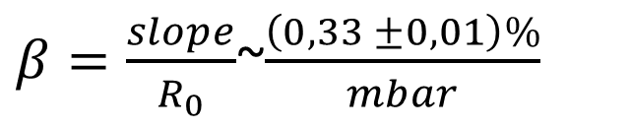
Barometric Coefficient BARI-01: some measurements
Assuming that only density can change with pressure, the relationship between the counts rate R and the pressure (p) variation is:
Where β is called barometric coefficient.
β depends on the zenith angle, on the altitude of the detector and on the minimum detectable energy
M.F. Muscarella et al. GDF vol XLVI, N.3 luglio-settembre 2015
$β=\frac{slope}{R_{0}}$~$\frac{\left(0,33 ±0,01\right)\%}{mbar}$
A.A. Kovilyaeva et Al. 2013 J. Phys.: Conf. Ser. 09012128

Slide 7
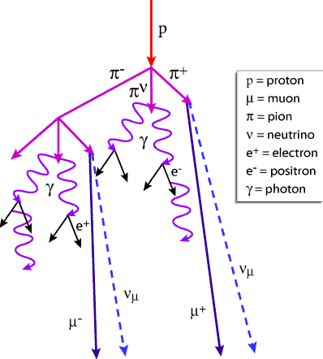
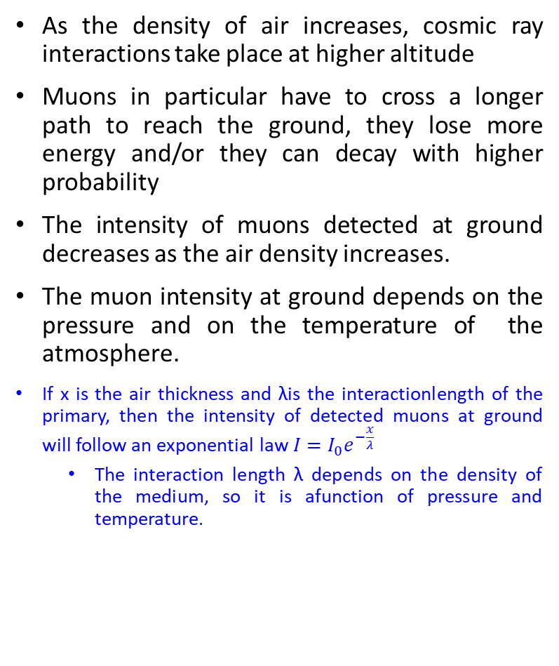
Temperature and pressure effects.
Primary
As the density of air increases, cosmic ray interactions take place at higher altitude
Muons in particular have to cross a longer path to reach the ground, they lose more energy and/or they can decay with higher probability
The intensity of muons detected at ground decreases as the air density increases.
The muon intensity at ground depends on the pressure and on the temperature of the atmosphere.
If x is the air thickness and λis the interactionlength of the primary, then the intensity of detected muons at ground will follow an exponential law $I=I_{0}e^{−\frac{x}{λ}}$
  The interaction length λ depends on the density of the medium, so it is afunction of pressure and temperature.
Air thickness crossed by the primary
30 km
Detector

Slide 8
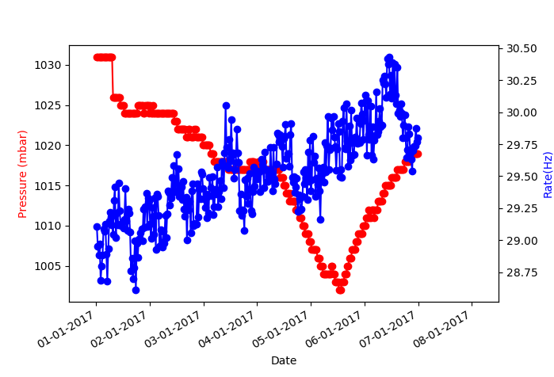
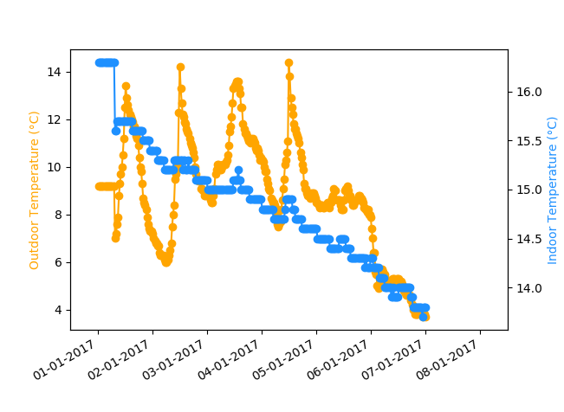
Bari-01 DATA Set 1-9 January 2017
Pressure and event Rate
Indoor and Outdoor Temperature

Slide 9
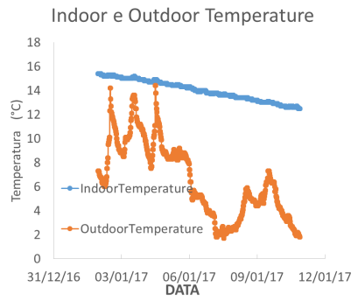
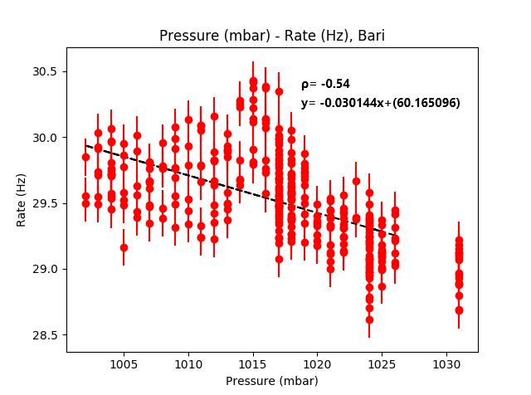
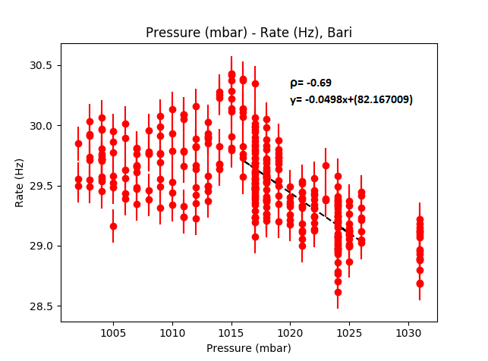
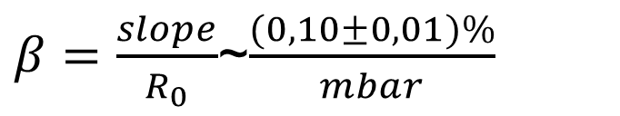
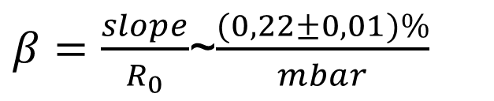
Correlation research
Rate-pressure scatter plot on the period obtained excluding days in which temperature dramatically decreased
Rate-pressure scatter plot on the period 1-9 January
$β=\frac{slope}{R_{0}}$~$\frac{(0,10±0,01)\%}{mbar}$
$β=\frac{slope}{R_{0}}$~$\frac{(0,22±0,01)\%}{mbar}$

Slide 10
Bari-01 DATA Set 28 april-6 may 2017

Slide 11
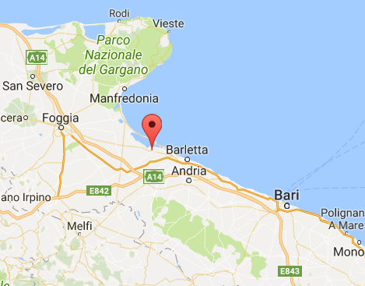
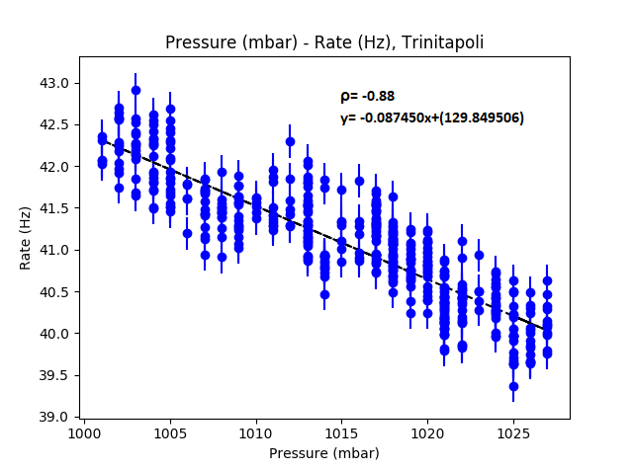
Data of TRIN-01
Trinitapoli
Correlation Plot, Trinitapoli, January 1-9

Slide 12
Conclusions
We found that a change of the target features for the cosmic rays interacting in the atmosphere, like in heavy snowfalls protracted for a few days, hides barometric effect on the muon rate
In case of small or very slow variation of pressure and/or temperature the pressure-rate correlation plot is not as expected.
  In this case barometric correction is not strictly required.

Slide 13
Aknowledgements
EEE telescope is an useful equipment. It introduces students and teachers to a real research activity, which requires the solution of physics and data analysis problems (such as the barometric correction).
We thanks to EEE Collaboration, Prof. Antonino Zichichi, Prof. Luisa Cifarelli and Prof. Marcello Abbrescia for the unique chance given us to approach scientific research world. We thanks Dr. Mario Nicola Mazziotta (INFN-BARI) for the competence, patience and time spent with us.
We thank our great friends of the EEE Group of Liceo «Scacchi», who helped us in the data analysis and the creation of this presentation, in particular Dario Colella and Susanna Fortunato, the headmaster, Giovanni Magistrale, and the teachers of the EEE group, who have been our guides through this great adventure, and thanks to all of you.
http://liceoscacchibari.gov.it/

Slide 15
OTHER SLIDES

Slide 16
Data analysis RUN3
Run 3: Start 13 ottobre 2016- End 31 maggio 2017
51 active telescopes on the Italian territory

Slide 17
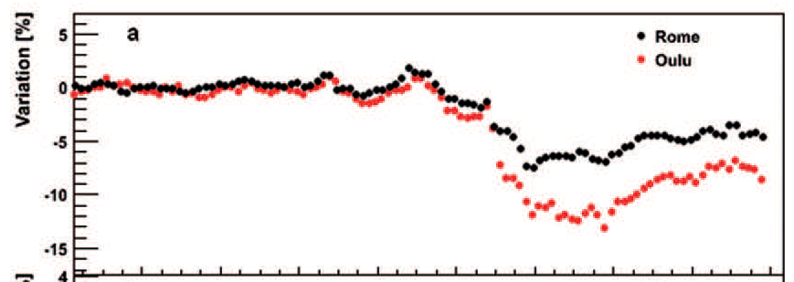
Cosmic rays flux variations
1. Variations due to Solar Events.
The events associated to transitional variations in the cosmic rays flow observed on the Earth in all their components, are called Forbush.
These are characterized by a rapid reduction (in few hours) followed by a slow recovery of the initial value within few days, with a mainly exponential trend. These phenomena are generally linked to Solar Flares and their ability to disrupt the transportation properties of the interplanetary space.
March 2012 Forbush decrease
M. Abbrescia et Al. Eur. Phys. J. Plus (2013) 128:62

Slide 18
Cosmic rays flow variations.
2. Variations due to flow anisotropy and atmospheric effects.
The cosmic rays intensity can be subject to changes:
  Anisotropy due to the observer's motion relatively to the «plasma» of cosmic rays(Compton-Getting Effect)
    Solar system motion relatively to the Galaxy
    Motion of the Earth relatively to the Sun
    Anisotropry attributable to the propagation of cosmic rays in the solar system due to the configuration of the interplanetary magnetic field.
At sea level, the variation is mainly due to effects on the production and propagation of muons into the atmosphere

Slide 19
28 aprile-6 maggio 2017:
Bari-01 (senza correzione) e OULU (conteggi corretti per l’effetto barometrico) a confronto

Slide 20
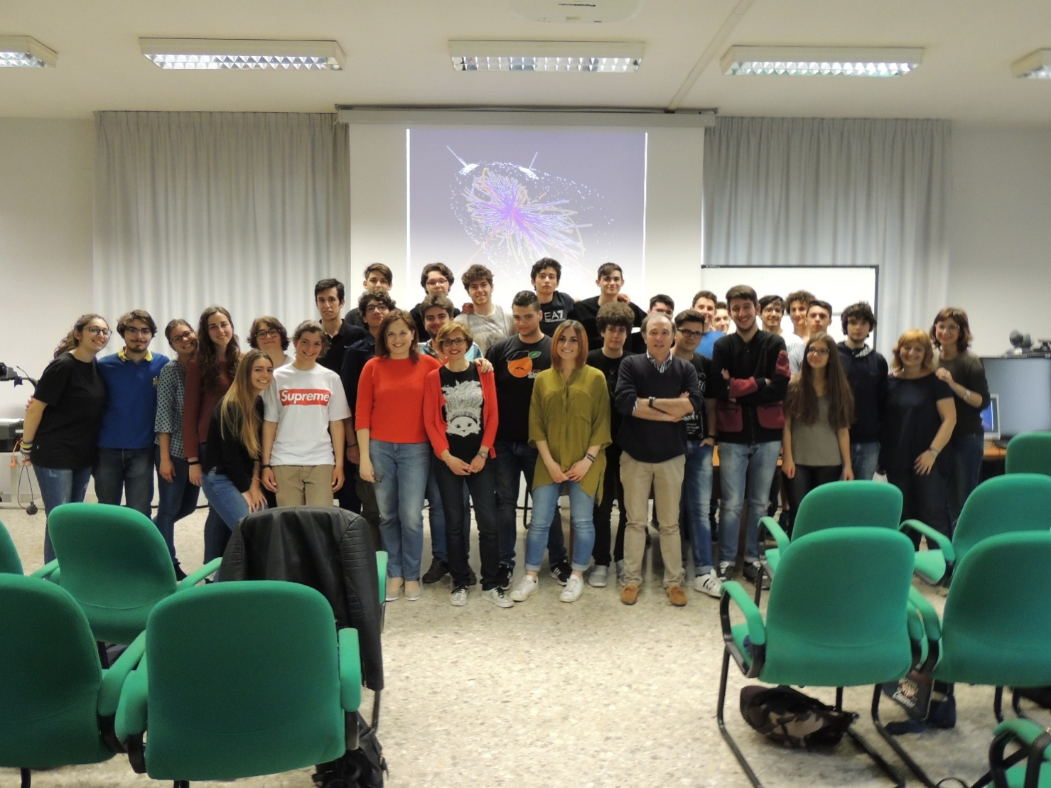
About 40 students and 5 teachers involved each year in EEE project

Slide 21
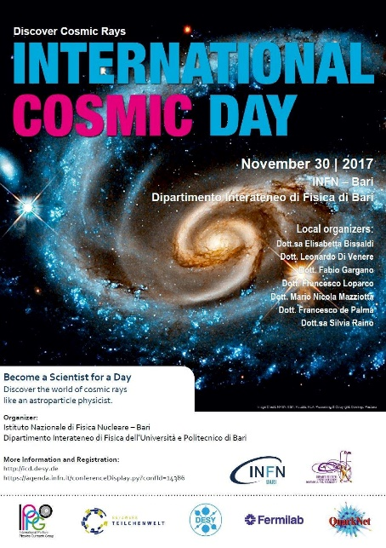

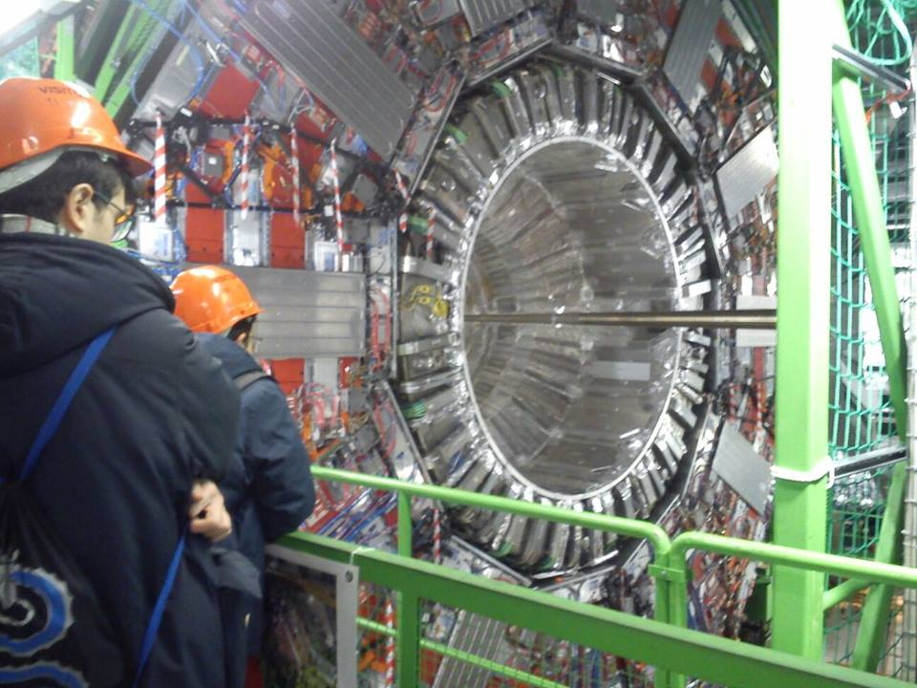
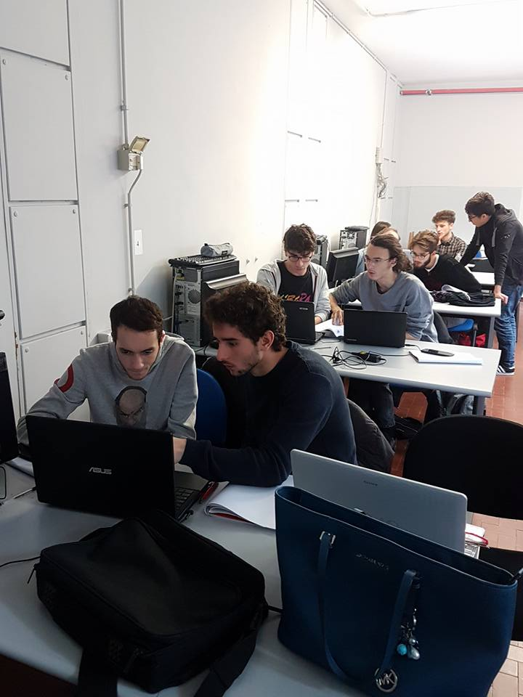
The scientific and didactic activity in our school.
A team of teachers coordinates a group of about 40 students.
Students are organised in two groups: JUNIOR and SENIOR.
Junior Students are in the project for the first year , Senior Students have been in the project for two or even three years.
Students attend a basic class of 30 hours on modern physics and data analysis . Then they practice with the monitoring of the performances of the EEE telescope, process and analyse data (the most recent analysis will be shown later) and follow the extabilished Collaboration activities, such as the telescope alignment, the efficiency measure, the monthly partecipation to the RUN MEETINGS, Masterclasses
CERN and Frascati National INFN Laboratories
conferences/Masterclasses

Slide 22
In case of small or very slow variation of pressure and/or themperature the plot of correlation pressure-rate is not like the expected one. In this case barometric correction is not strictly necessary.

Slide 23
28 aprile-6 maggio 2017:
Bari-01 (senza correzione) e OULU (conteggi corretti per l’effetto barometrico) a confronto

