Slide 1
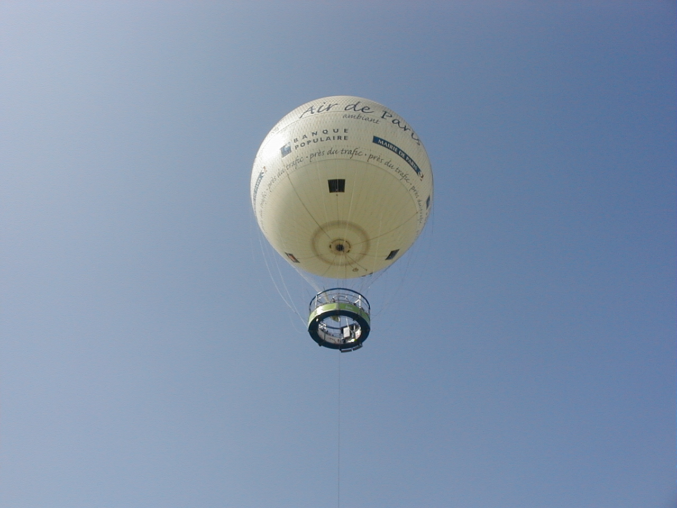
Measuring the cosmic radiation at different altitudes; an educational trip
F.Riggi, 8° Conferenza dei Progetti del Centro Fermi, Erice, 6-8 Dicembre 2017

Slide 2
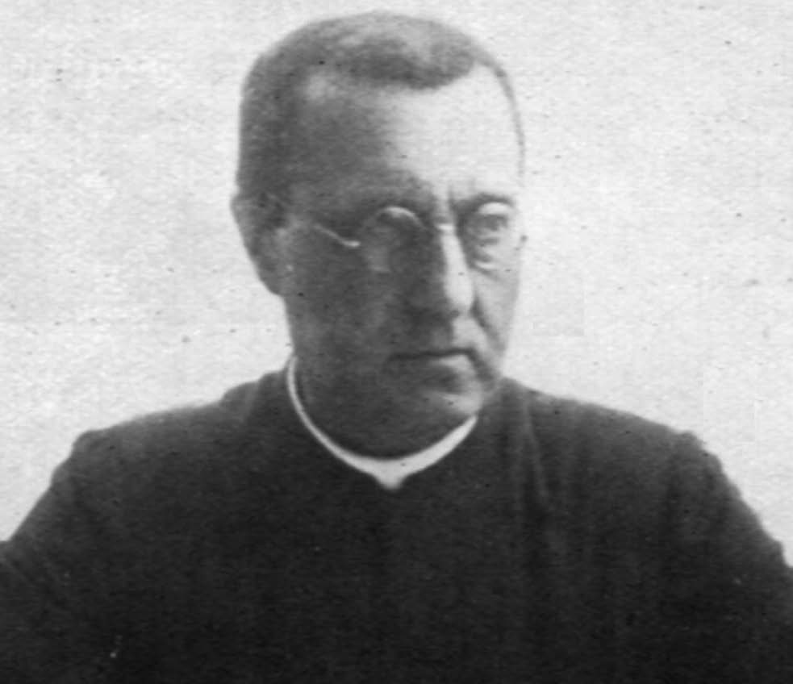
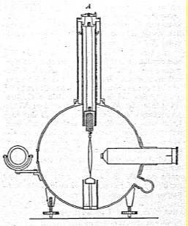
Theodor Wulf experiment
March 30, 1910: Theodor Wulf, a german physicist and jesuit priest is bringing his electroscope up to the Eiffel Tour, to perform air ionization measurements.
Why the Eiffel Tour?
Actually, he had already done measurements in different places (mountains, mines, caves) with variable results.
So, again, why the Eiffel Tour
and not mountains?
Theodor Wulf
(1868-1946)
Wulf, Theodor (1910). "Observations on the radiation of high penetration power on the Eiffel tower". Physikalische Zeitschrschift. 11: 811.

Slide 3

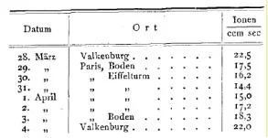
Theodor Wulf experiment
Eiffel Tower: the tallest building at that time… about 300 m
… but with just a moderate shielding below it…
In other words his goal was:
Going far from ground rather than closer to the sky
The experimental result actually was that a slightly smaller (not higher!) radiation was measured at the top with respect to ground…
Averages:
17.9 Ground
15.7 Top
Wulf original results

Slide 4
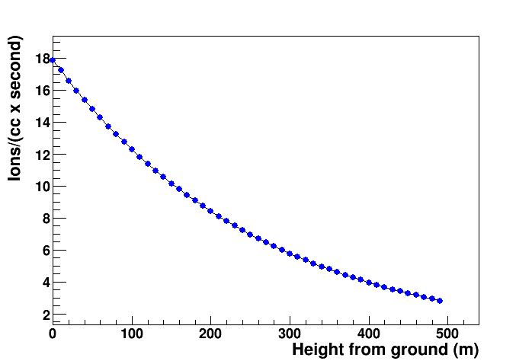
Theodor Wulf experiment reanalyzed
Observed value at ground
Observed value on the Eiffel Tour (300 m)
How to interpret this result?
Radiation emitted from rocks (due to radioactivity) was already known at the time.
Expected decrease of radiation as due to gamma absorption in air
The value obtained at 300 m was smaller than at ground, but larger than expected, and is influenced by an additional radiation coming from above.

Slide 5
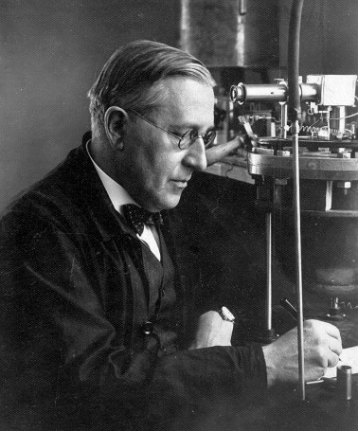
Hess and balloon flights
In the same years, an austrian physicist - Victor Hess - became interested in the problem of air ionization, reconsidering the results by Wulf:
These could be due to two causes:
1) Absorption of gamma rays in air could be much smaller
2) Another ionizing source could be active in the atmosphere
The absorption of gammas from Radium C (Bi²¹⁴) in air was first studied by Hess with greater precision.
Under the hypothesis of a uniform distribution of RaC on the Earth it was calculated that at 1000 m the radiation from Earth should reduce to 0.1% of the ground value.
To understand the results from Wulf and make quantitative measurements Hess decided to use electroscopes during balloon flights.
Several balloon flights were organized:
Victor Hess
(1883-1964)
2 in 1911
7 in 1912
1 in 1913

Slide 6
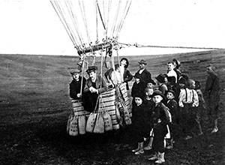
Hess and balloon flights
On August 7th 1912 a decisive flight, up to 5350 m, brougth to a firm evidence that after an initial decrease with height, the ionization started to increase again, demonstrating the extra-terrestrial origin of this radiation.
No difference between night and day was observed.
In 1936 Hess received the Nobel Prize for «his discovery of the cosmic radiation»

Slide 7
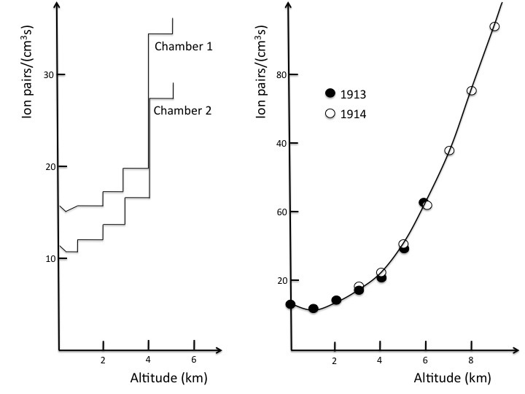
Hess and balloon flights
Results from Hess measurements with balloon flights were soon confirmed by other experimenters

Slide 8
High altitude laboratories
Systematic investigation of the cosmic ray flux was then carried out at high altitudes with permanent installations on the top of several mountains, by Hess and later by many other physicists, till today.
Hess laboratory, near Innsbruck, at 2300 m (1932)

Slide 9
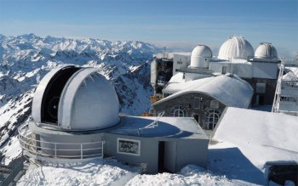
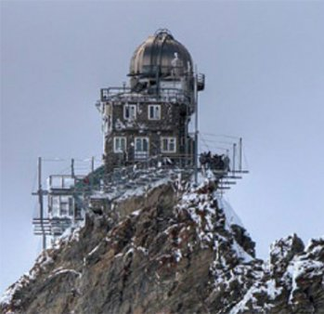
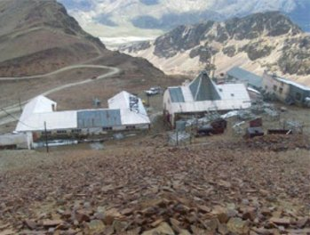
High altitude laboratories
Just a few examples..
Pic du Midi (Pirenei), 2887 m
Jungfraujoch (Svizzera), 3454 m
Chacaltaya (Ande, Bolivia), 5230 m

Slide 10
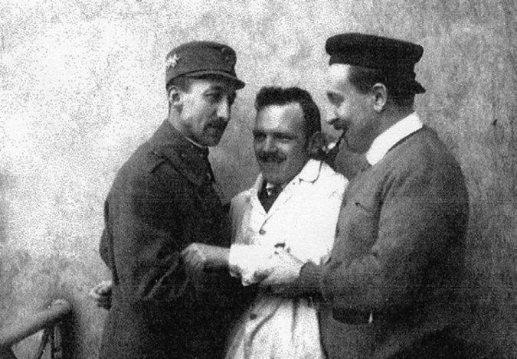
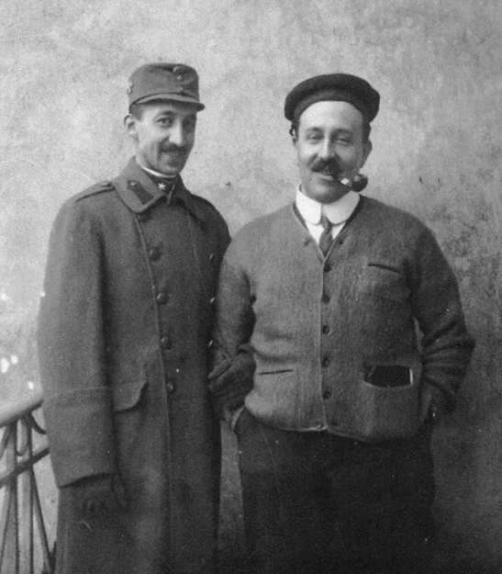
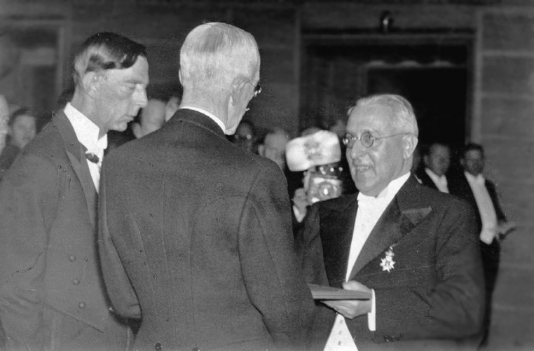
Hess life and legacy
Hess life was not easy..
Surviving to amputation of his left thumb and surgery for a larynx carcinoma in 1934, after getting the Nobel Prize in 1936, Austria was occupied in 1938 by Germany and he was arrested for a short period.
Accused to be a believing catholic (actually his wife was Jewish), and against the National Socialism, he was dismissed from his academic position, and lost everything, including his pension.
In 1938, he and his wife emigrated to the US, where he got a position at Fordham University in New York.
He did go on with research on radiations even after his retirement in 1958.

Slide 11
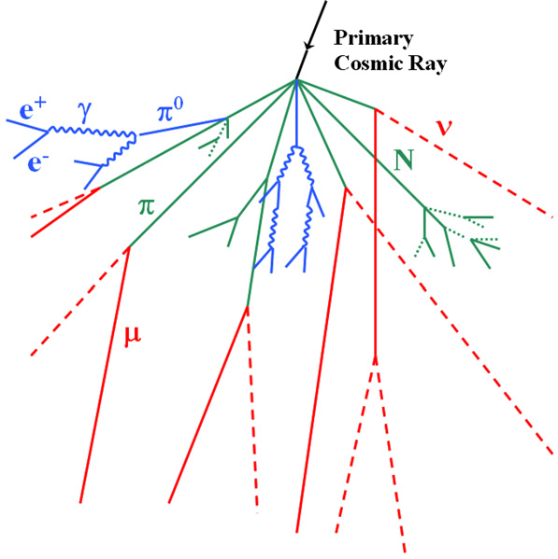
Extensive air showers in the atmosphere

Slide 12
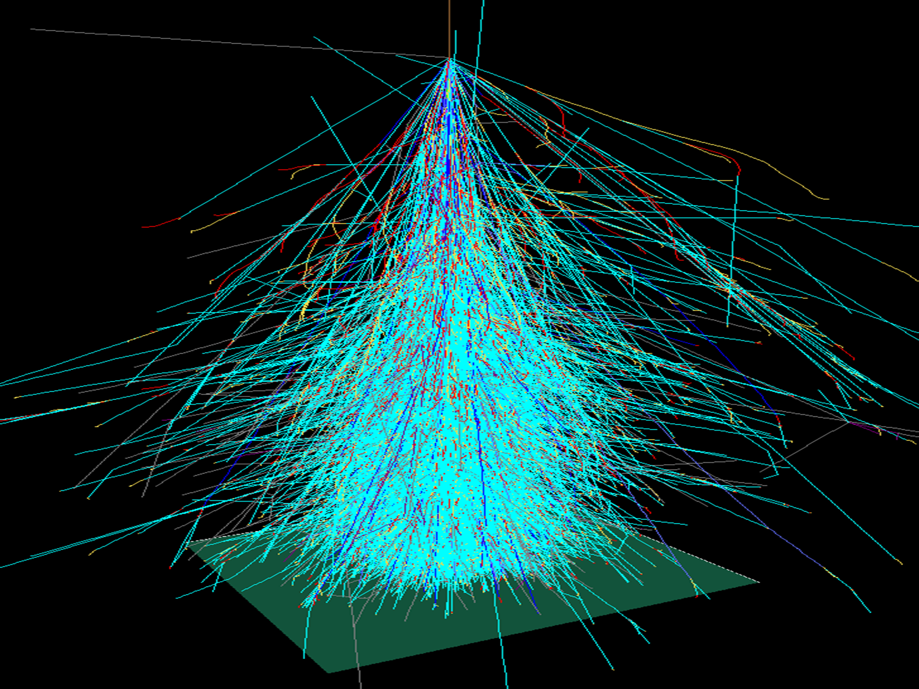
Extensive air showers in the atmosphere
15-20 km
Sea level

Slide 13
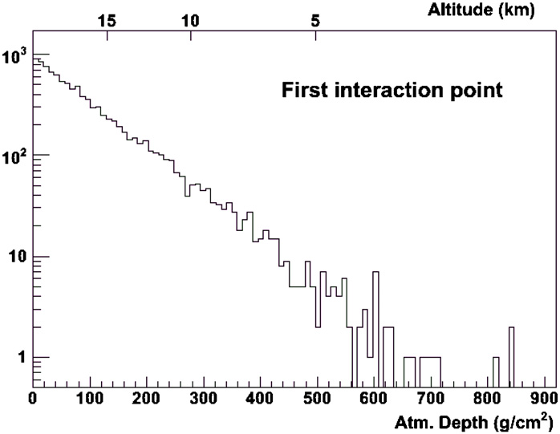
Extensive air showers in the atmosphere
Most of cosmic showers are initiated in the upper part of the atmosphere
COSMOS calculations

Slide 14
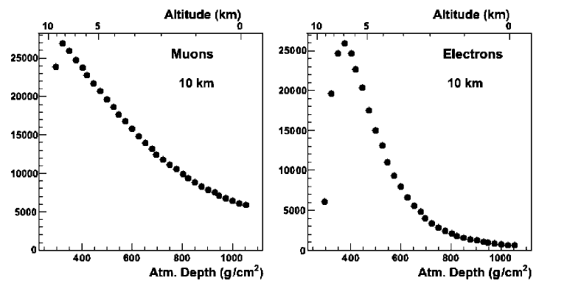
Altitude dependence
Electron and muon flux at different altitudes:
COSMOS calculations

Slide 15
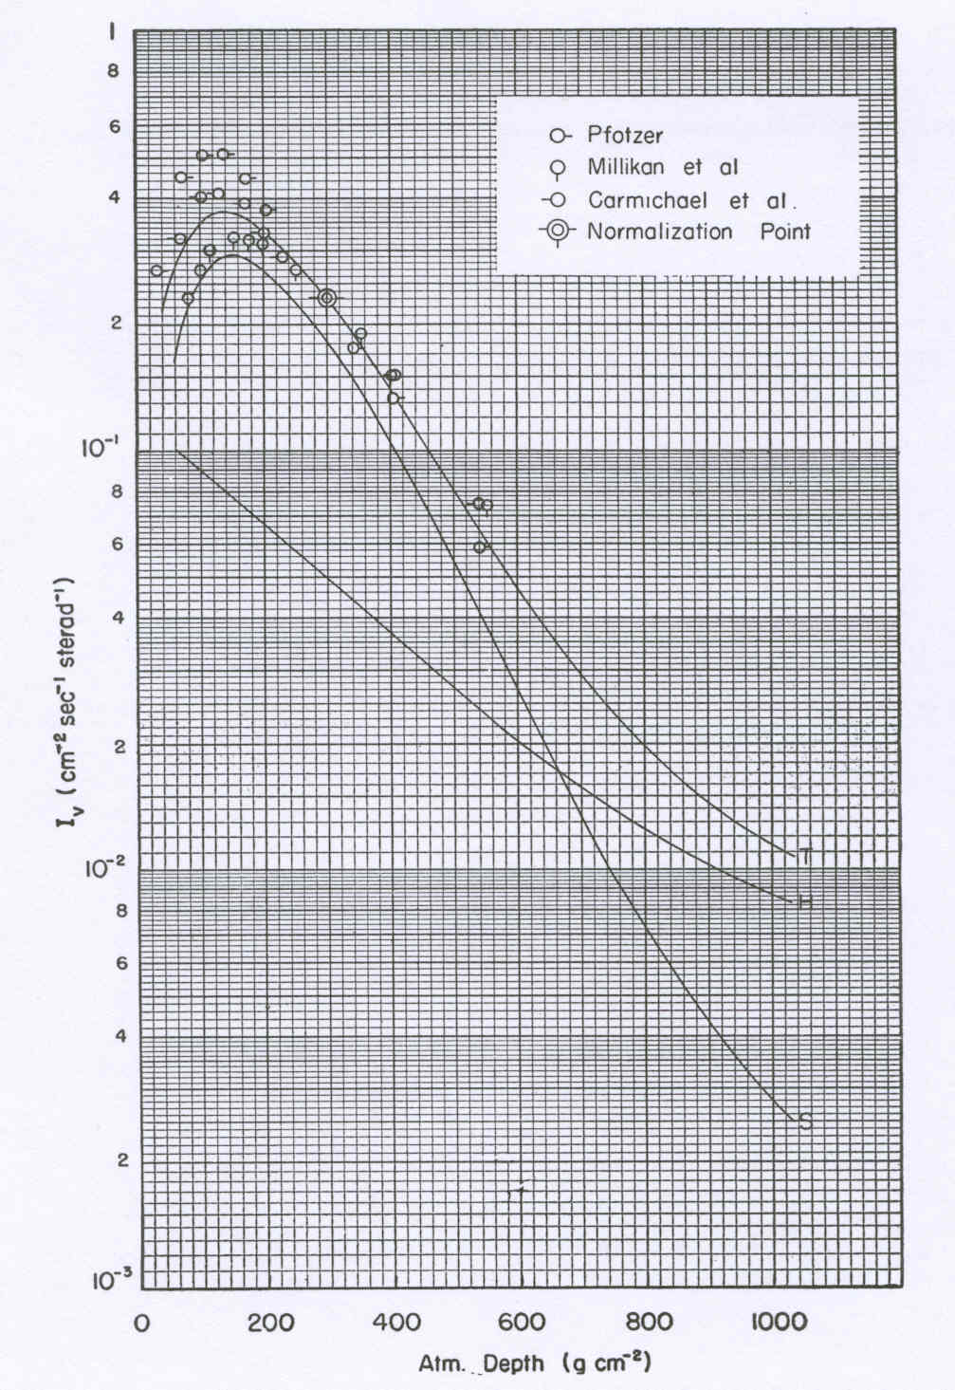
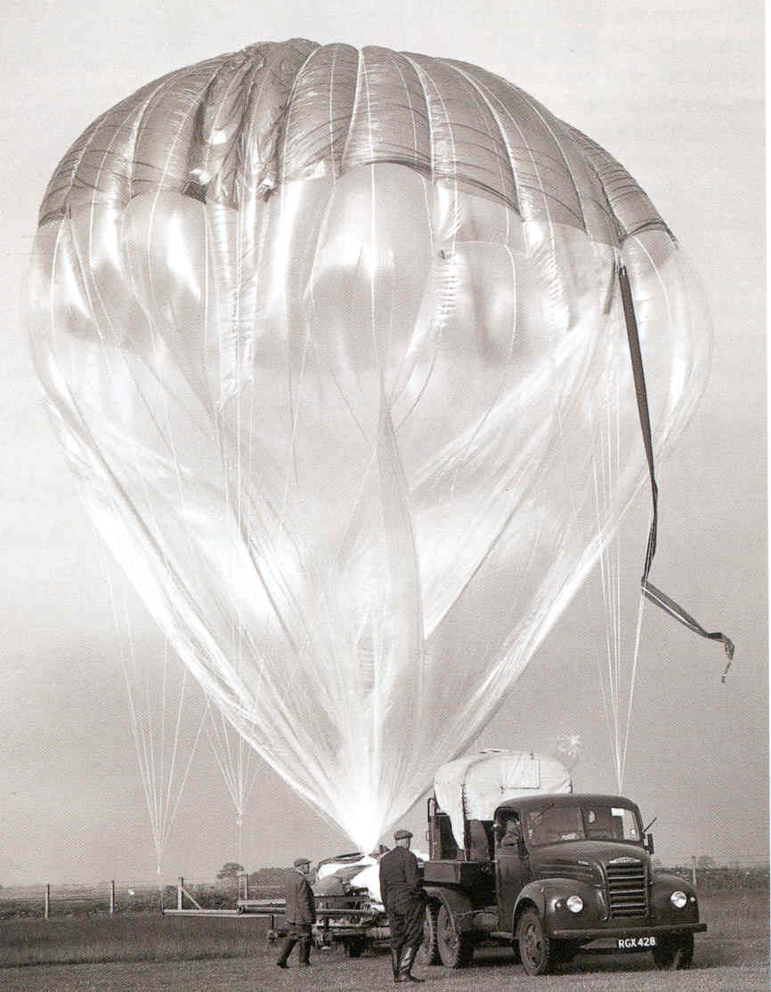
Altitude dependence
Quantitative measurements of the altitude dependence of the cosmic ray flux carried out for the various components (muons, electrons,…)

Slide 16
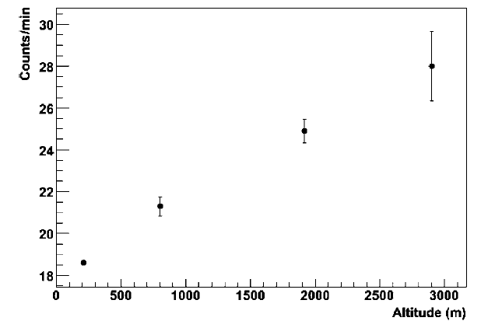
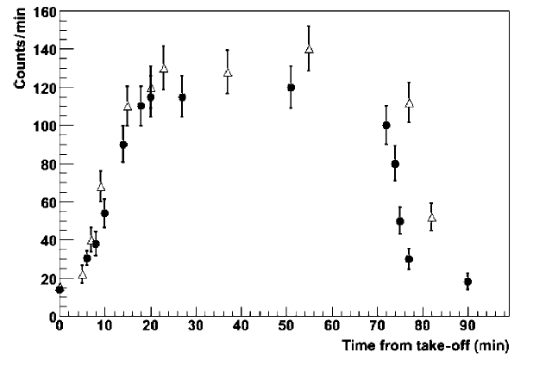
Educational measurements
Measurements of the cosmic ray flux at different altitudes are a powerful educational tool and may be carried out with different detectors
Count rate measured during two commercial flights (CT-MI) as a function of the time elapsed from take-off
Count/minute
Altitude (m)
Count/minute
Count rate measured with portable Geiger counters during a trip to Mount Etna by a school team in Catania.
Time from take-off (min)

Slide 17
The role of detectors
Geiger counters are sensitive to charged particles (cosmic muons and electrons) with a high efficiency, but also – even though a small efficiency – to gamma radiations originating from ground.
Possible solution when operating with Geiger counters:
Insert a heavy metal shield below the Geiger (Lead, Iron,..)

Slide 18
The role of detectors
Alternative solution: Use two detectors in coincidence (telescope configuration), as the COSMIC BOX
Cosmic muons (penetrating particles) pass easily through the two detectors
Gammas and low energy particles from below are not able to give signals in both detectors, so they do not contribute to the collected events

Slide 19
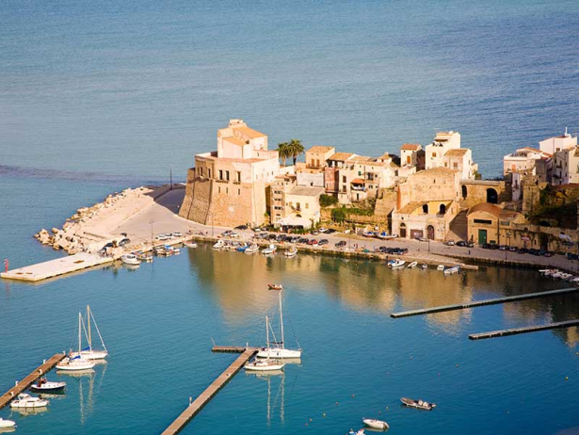
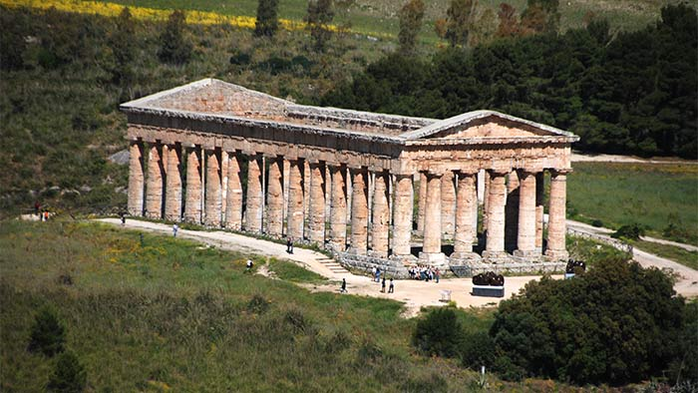
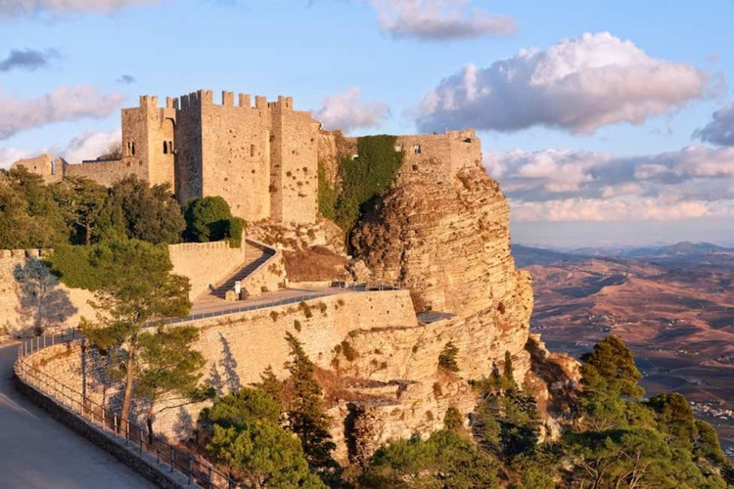
Our experiment tomorrow
Measure the cosmic ray flux with several Cosmic Box detectors at 3 different altitudes:
Near Trapani,
sea level ( 0 m )
Segesta (350 m)
Erice (750 m)

Slide 20
Our experiment tomorrow
Statistical considerations
Due to geometrical size of detectors and their
mutual distance, the expected coincidence rate
is of about 0.5 Hz
Expected number of counts in 30’: 30x60x0.5 = 900
Summing data from 15 detectors: 900x15 ~13000 counts
Statistical error (from Poisson distribution) = √N
Relative error = √N / N
√N √N / N
For a single detector (N=900) 30 3.3 %
For 15 detectors (N=13500) 116 0.9 %
With 15 detectors we should be able to see variations of a few percent

Slide 21

Our experiment tomorrow
Statistical considerations
Due to geometrical size of detectors and their
mutual distance, the expected coincidence rate
is of about 0.5 Hz
Expected number of counts in 30’: 30x60x0.5 = 900
Summing data from 15 detectors: 900x15 ~13000 counts
Statistical error (from Poisson distribution) = √N
Relative error = √N / N
√N √N / N
For a single detector (N=900) 30 3.3 %
For 15 detectors (N=13500) 116 0.9 %
With 15 detectors we should be able to see variations of a few percent
ENJOY THE TRIP!

