Slide 1
DUCA DEGLI ABRUZZI (TREVISO) 2014 : ANNUS MIRABILIS
MAKE THE INVISIBLE, VISIBLE
Elena Marenco e Nicolas Bau’
THE BEGINNING
Erice 6-8 dicembre

Slide 2
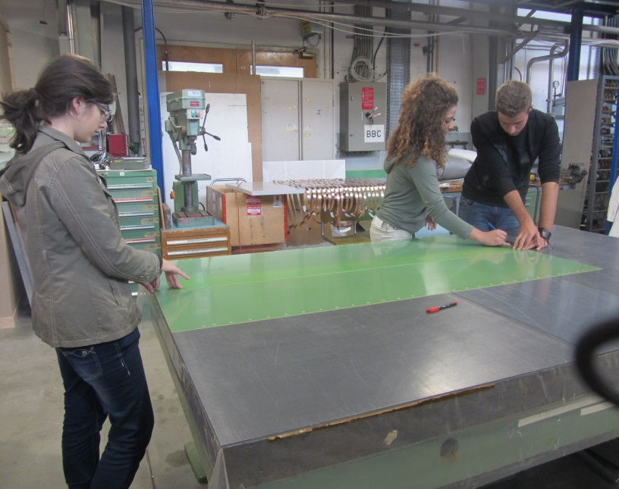
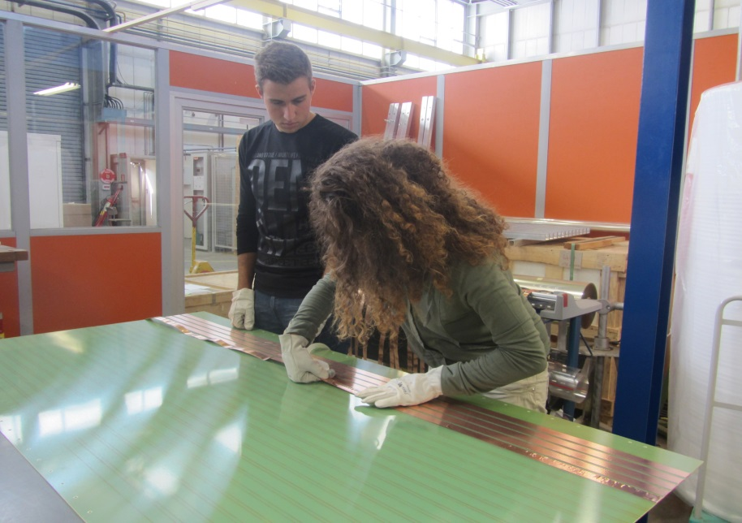
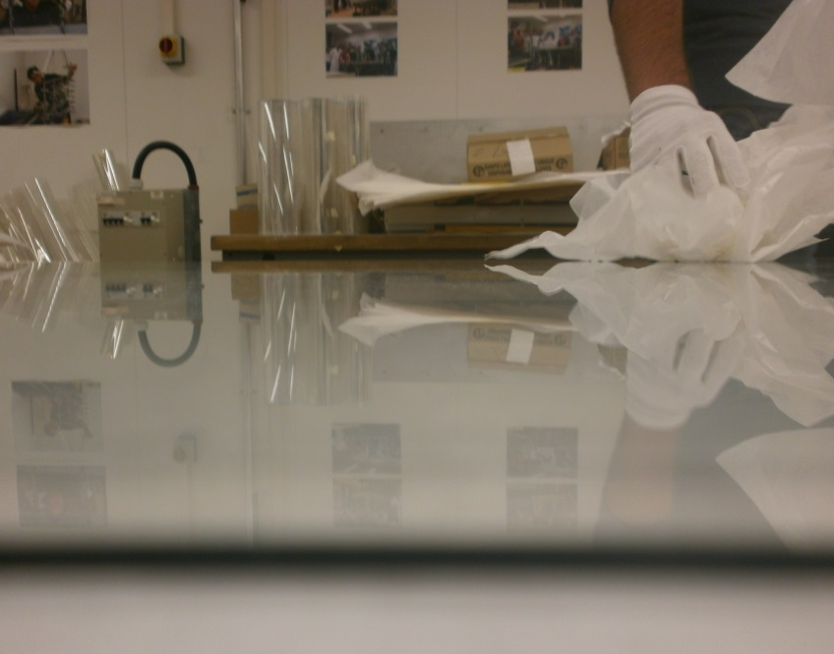
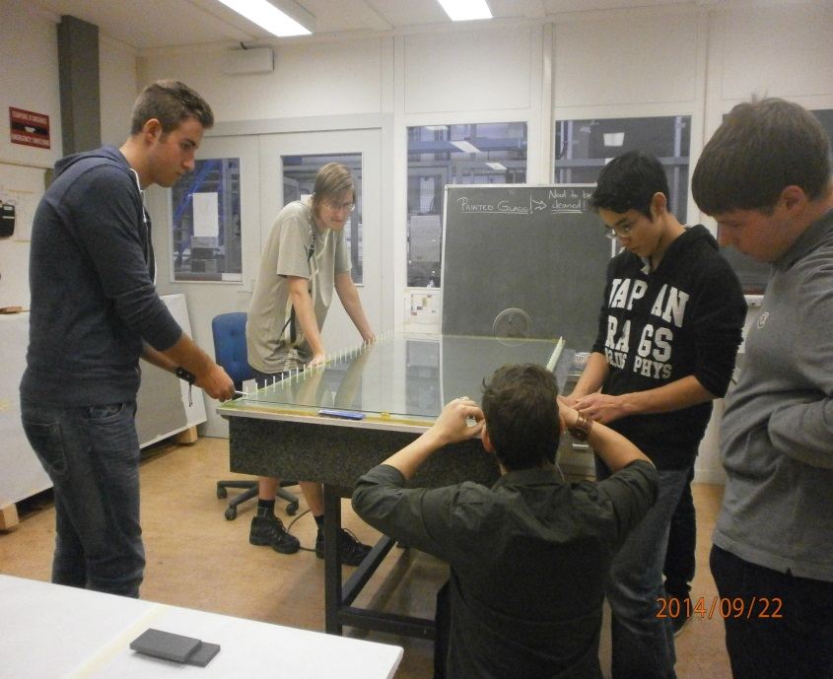
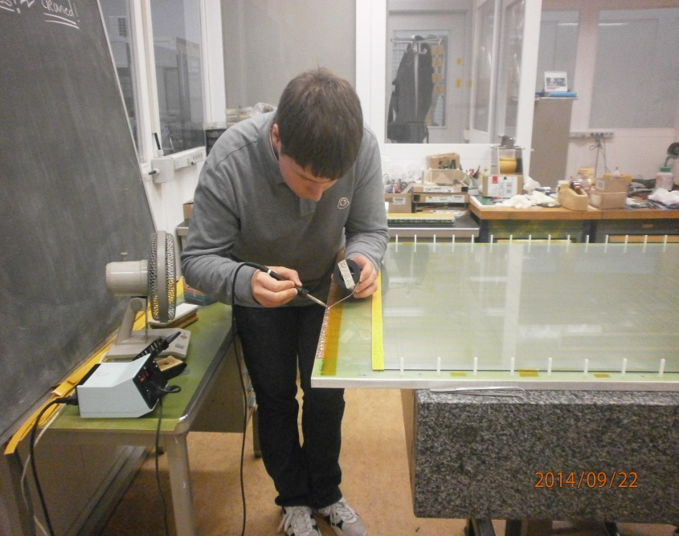
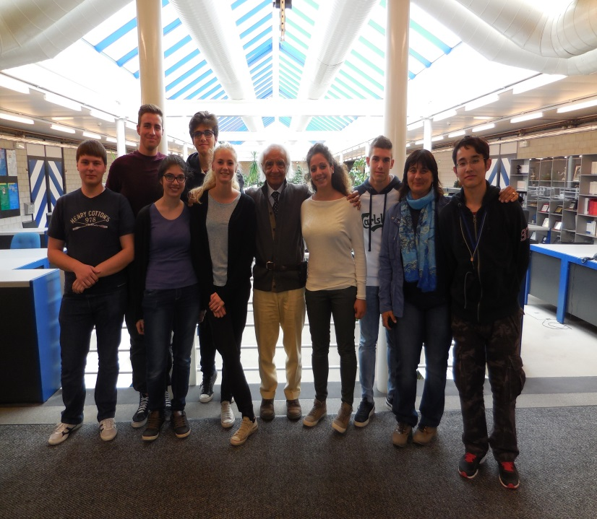
WORK IN PROGRESS...

Slide 3
The third chamber didn’t work well, so after some attemps, it was changed
Some problems with the network
Some issues

Slide 4
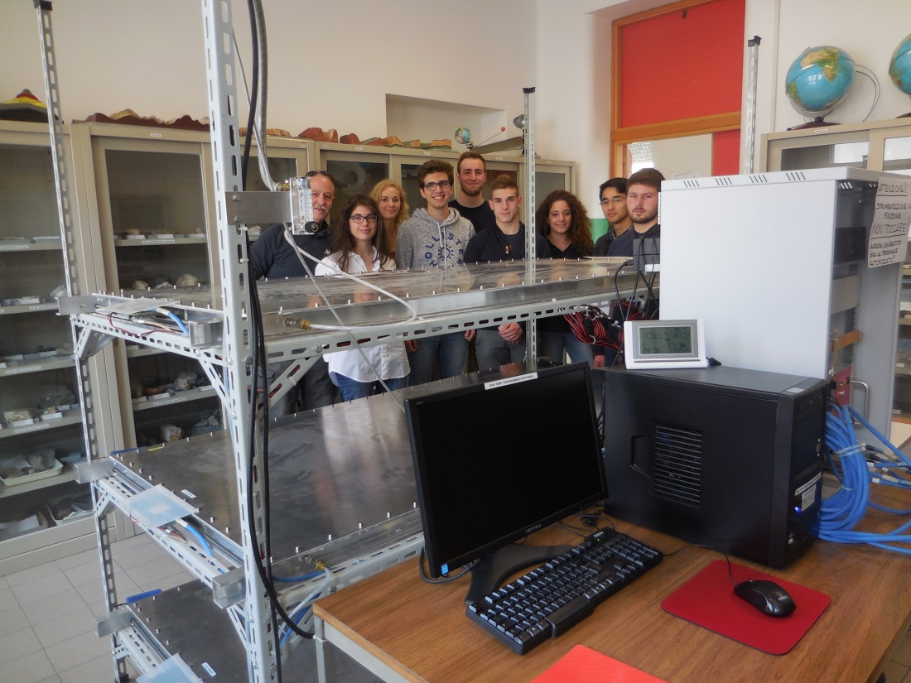
MAY 2016 : ALL IS READY

Slide 5
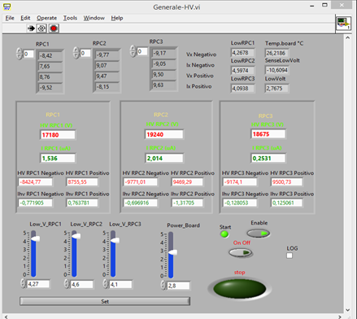
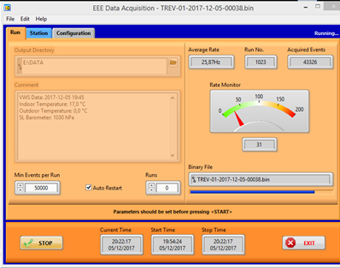
data acquisition…..

Slide 6
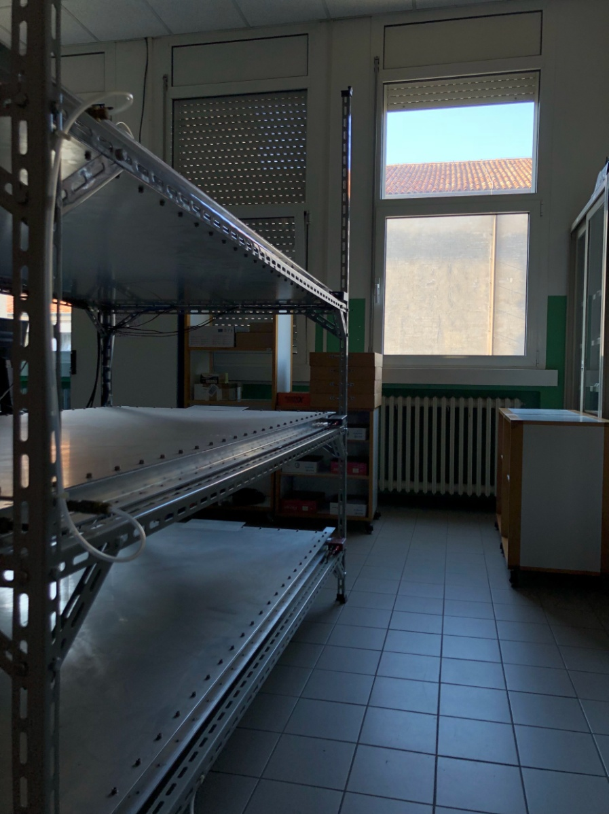
The orientation of the telescope
We decided to measure the telescope's orientation using the projected shadow method.
Strong points of measurement: use of non-specific instrumentation.
Difficulty of measurement: the presence of a building adjacent to the school that lets the telescope lighted only for a few hours.

Slide 7
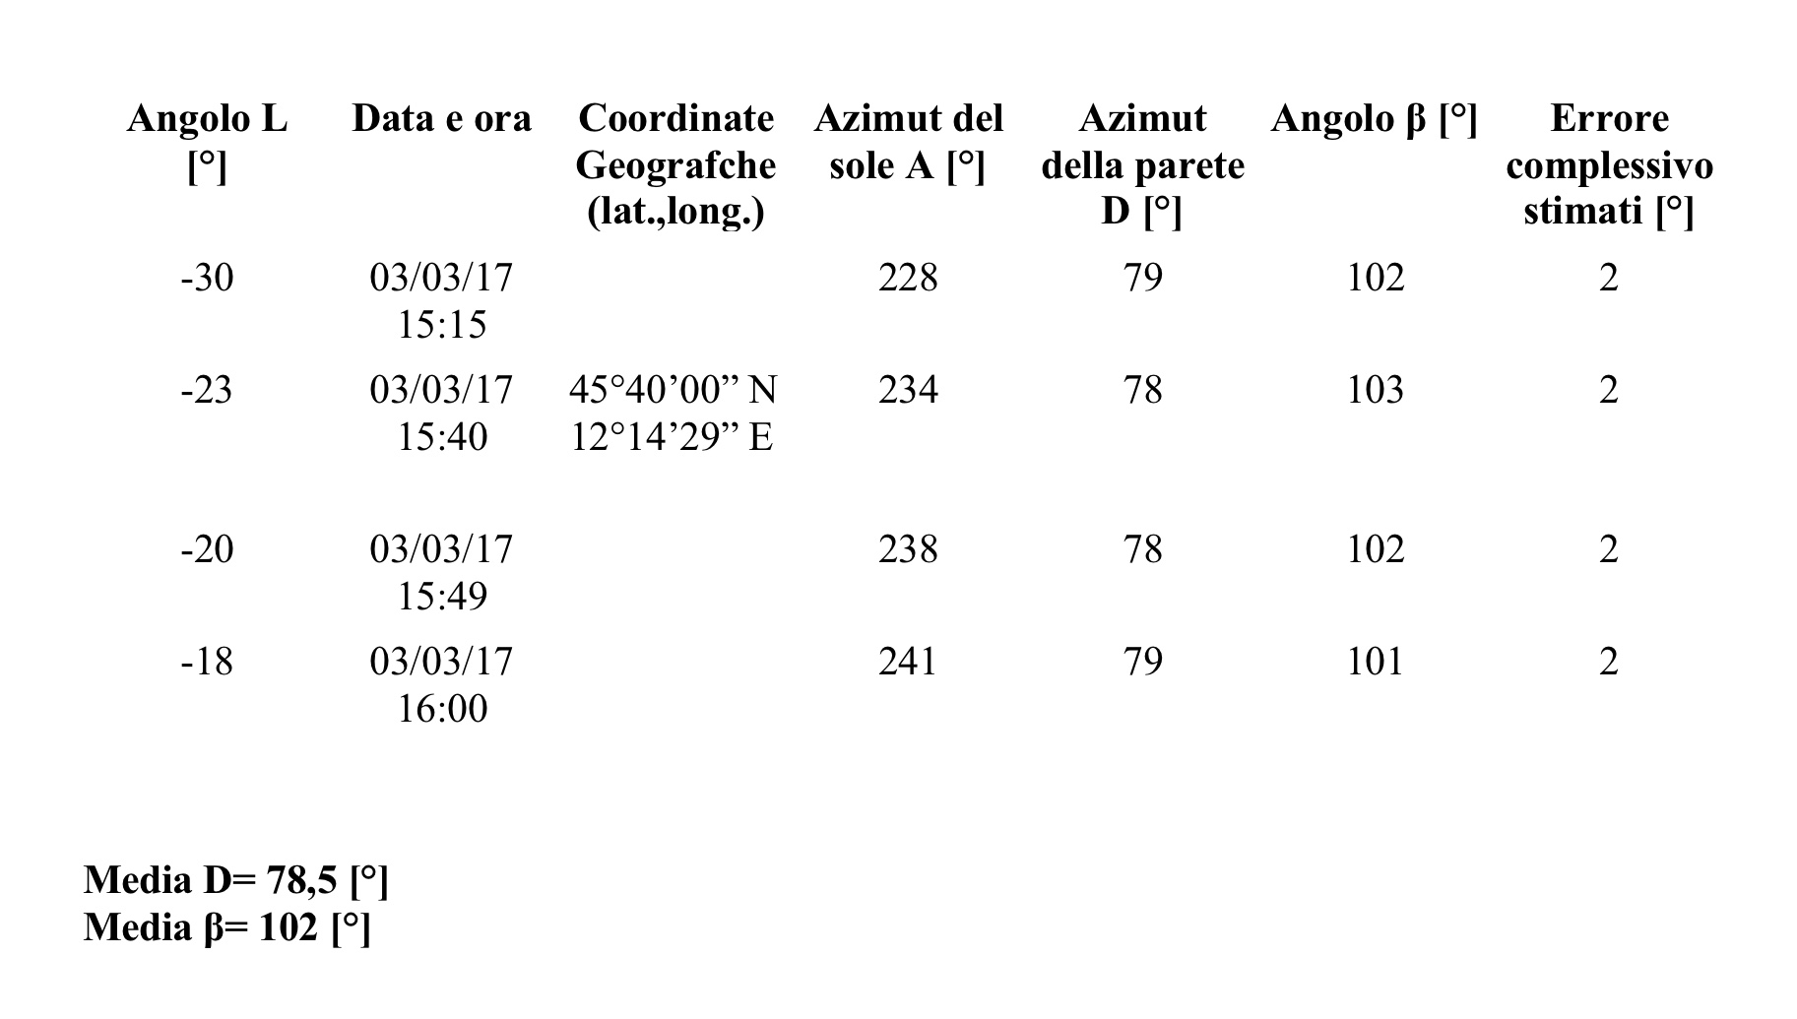
Measurement data

Slide 8
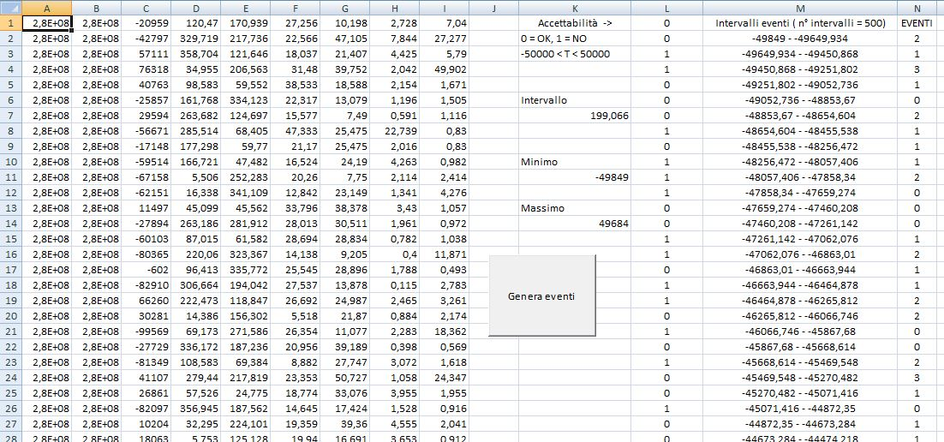
Coincidences
Following the masterclass in Grosseto, we tried to analyze data by dividing them with a Visual Basic script for they were too many

Slide 9
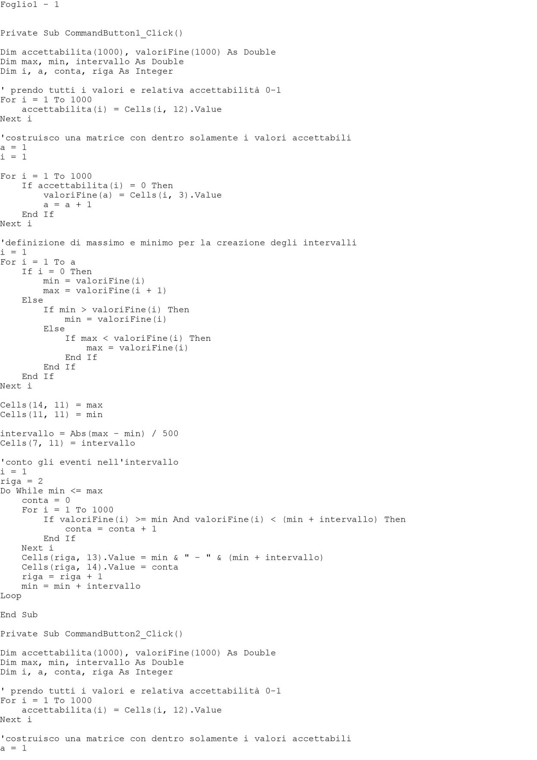
IN OTHER WORDS:

Slide 10
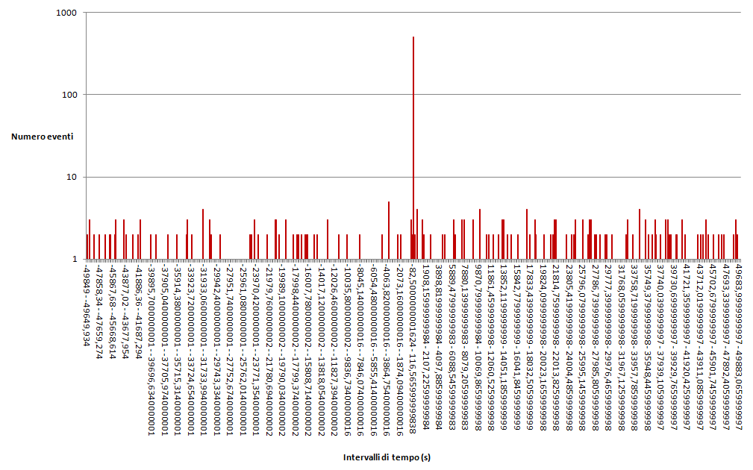
Analysis results

Slide 11
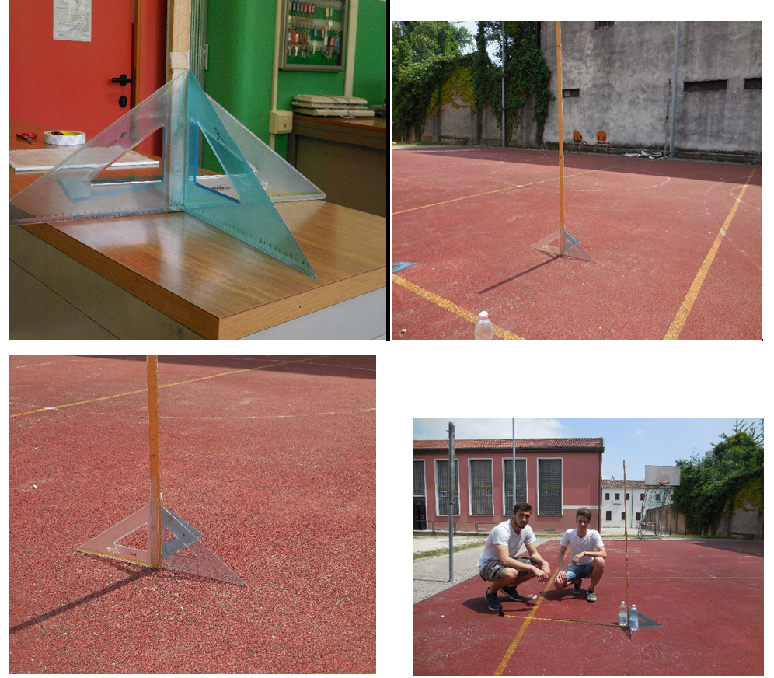
Earth radius
Despite a misunderstanding involving the guide for the measurement and the lack of people, we joined this experience and we got some problems related to weather and school position. Because of that we made some mistakes during the measurements

Slide 12
In the future…
Another physics course for the students
on EEE project and acquisition data.
Some update meetings for the teachers about EEE project
Cooperation with other schools

Slide 13
Special thanks to :
professor Zichichi
Centro Fermi and researchers
Fabrizio Coccetti
(our wonderful angel)

