Slide 1
Search for coincidences and study of cosmic rays spectrum
F. Coccetti, M. Garbini, F. Noferini

Slide 2
Outline
Previous update available here:
http://agenda.centrofermi.it/indico/event/33/
The goal and open points
Recent developments
The roadmap

Slide 3
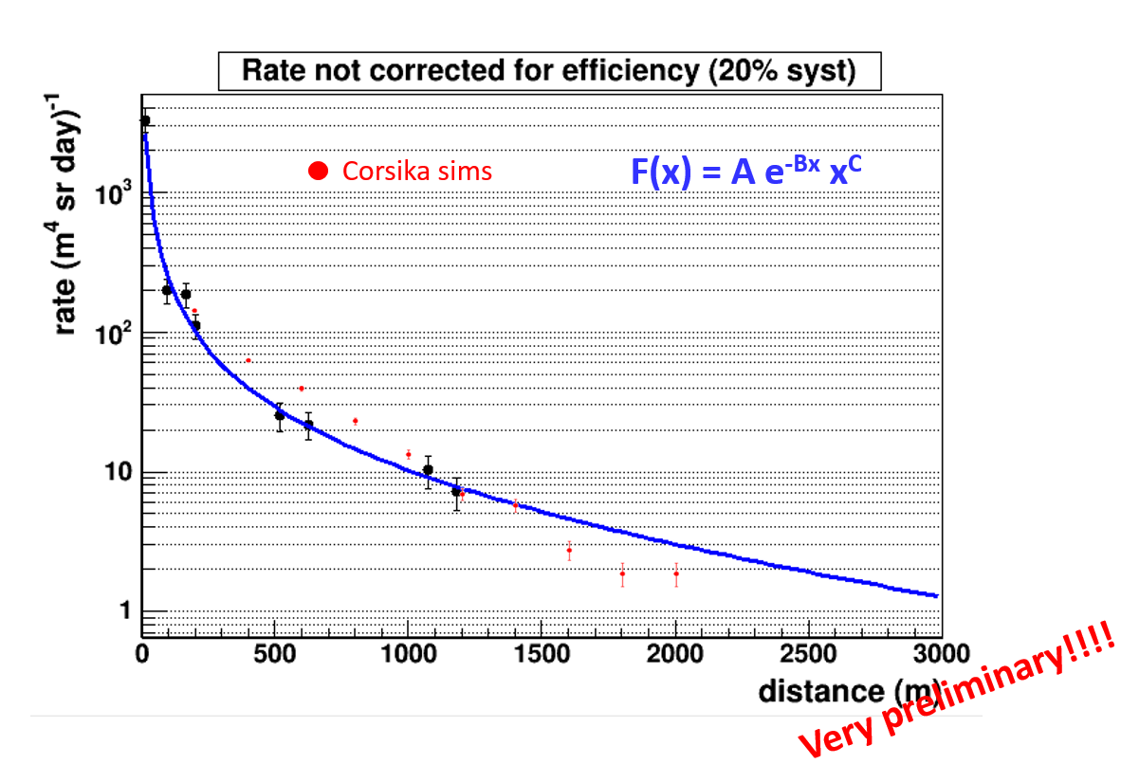
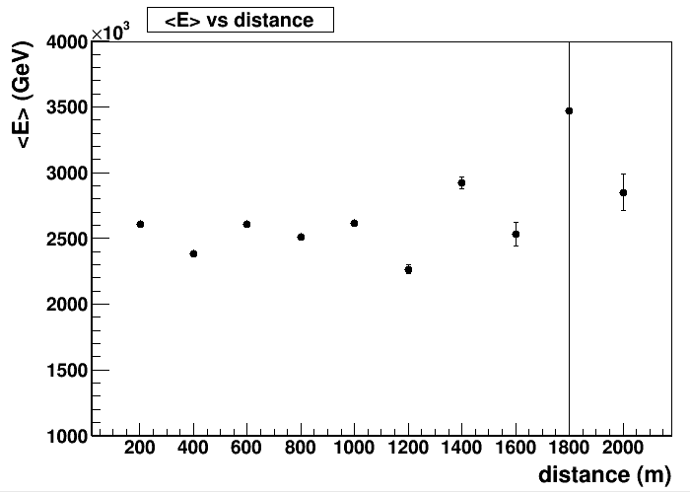
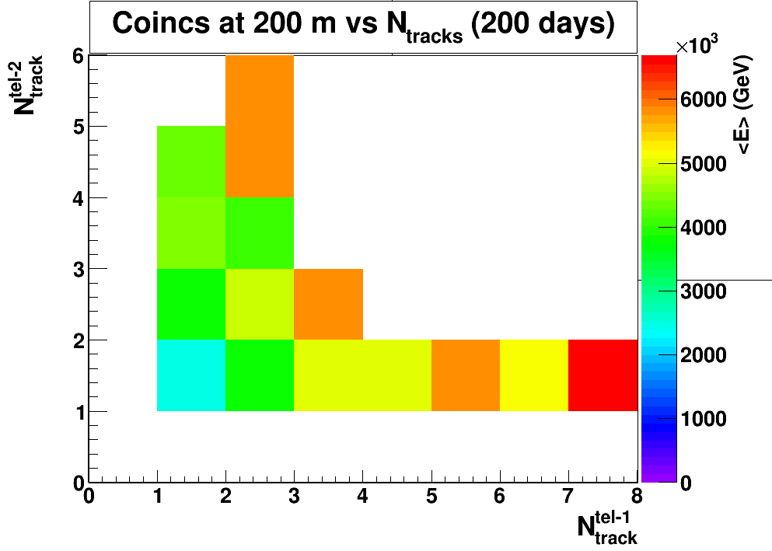
Goal → add EEE points on the energy spectrum of primary CRs
<E> ∼ 2.5 10¹⁵ eV
What we got so far
Preliminary simulations (Corsika) show EAS energies have a very small dependence on the distance between two telescopes
We need new Corsika sims
We need more detailed simulations (including material effects)
We probably can improve multi-track selection (new clock card → time can be used to build tracks)
Multitrack events may be more sensitive to the EAS energy

Slide 4
New tool: Coincidences DQM
eee.centrofermi.it/monitor/coincidences.html
under testing

Slide 5
Simulation: Corsika showers
We need to build a new sample of Corsika shower.
This because we adjusted some parameters in the configuration file → in particular we decided to remove the weighting factor which increases the production for vertical cosmic rays (usually implemented for plane detectors) → now we are simulating isotropic primaries.
We added more cores (8+4) and we planned to increase up to 16 and hopefully more (we open a ticket with a request of more resources).
We started from 10⁴ GeV showers and we are increasing the energy of the primary.

Slide 6
Status of simulations
Dir | Energy range (GeV) | N showers planned | status | Size
… | 1x10³ – 1x10⁴ | TO BE DONE | TO BE DONE
4e1 | 1x10⁴ – 2x10⁴ | 1000 | 945 | 0.50 GB
4e2 | 2x10⁴ – 3x10⁴ | 1000 | DONE | 0.57 GB
4e3 | 3x10⁴ – 4x10⁴ | 1000 | 813 | 0.51 GB
4e4 | 4x10⁴ – 5x10⁴ | 1000 | DONE | 0.67 GB
4e5 | 5x10⁴ – 6x10⁴ | 1000 | DONE | 0.71 GB
4e6 | 6x10⁴ – 7x10⁴ | 1000 | 826 (ongoing)
4e7 | 7x10⁴ – 8x10⁴ | 1000 | 514 (ongoing)
4e8 | 8x10⁴ – 9x10⁴ | 1000 | TO BE DONE
4e9 | 9x10⁴ – 1x10⁵ | 1000 | TO BE DONE
5e1 | 1x10⁵ – 2x10⁵ | 1000 | DONE | 1.2 GB
5e2 | 2x10⁵ – 3x10⁵ | 1000 | DONE | 1.7 GB
5e3 | 3x10⁵ – 4x10⁵ | 1000 | DONE | 2.2 GB
5e4 | 4x10⁵ – 5x10⁵ | 1000 | DONE | 3.4 GB
5e5 | 5x10⁵ – 6x10⁵ | 500 | DONE | 1.7 GB
5e6 | 6x10⁵ – 7x10⁵ | 500 | DONE | 2.1 GB
… | 7x10⁵ – … | TO BE DONE | TO BE DONE

Slide 7
Structure of the simulation
Event generator available:
Corsika
Isotropic muon generator (i.e. used to compute detector acceptance)
We generate events accordingly to a known flux
We keep events with at least one muon in one detector
We propagate events using geant4 and EEE telescope geometry (see MC group presentation)
We reconstruct DST as for data

Slide 8
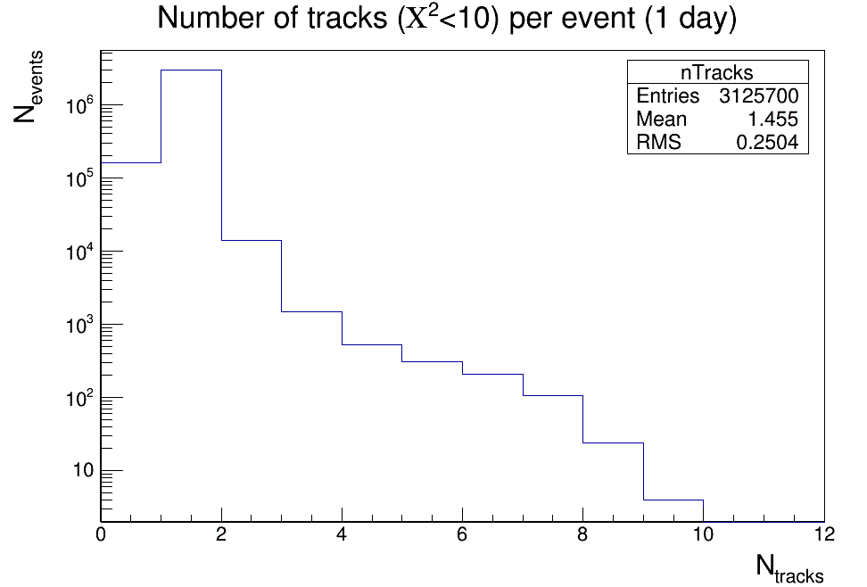
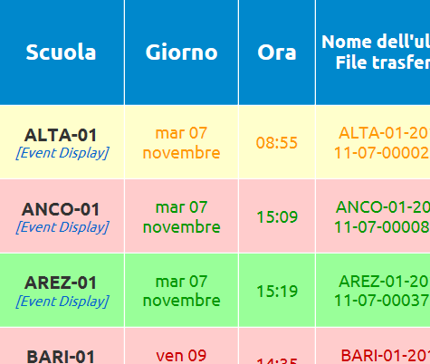
Multitrack events (data)
Currently we are able to reconstruct multitrack events up to 10 tracks in a single event.
Are they really particles or noise may mimic such an effect?
We need a comparison with MC (available soon)
We can use timing to see if clusters associated to the track are consistent also in time (to be verified)

Slide 9
The roadmap
Priority is to provide full simulation to identify the best quantities (and templates) to characterize the EAS energy
Old code was adapted to be able to include full Geant4 propagation (see MC group presentation)
Generation of Corsika showers sample is running at CNAF
Time to have the showers → by the end of the month (nov 17)
Time to have the input for Geant4 propagation → to be calculated
Time to have the output from Geant4 propagation → to be calculated
Once we will be able to reproduce the main features of data we need to define the strategy for the measurement/paper

