Slide 1
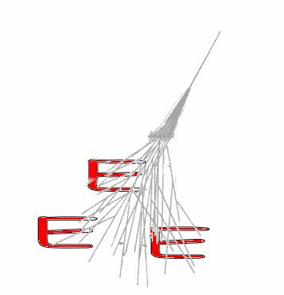
The EEE network: central data management and student activities
Edoardo Bossini
Centro Fermi and INFN-Pisa
(on behalf of the EEE collaboration)
Padova, 30 Settembre 2016
1

Slide 2
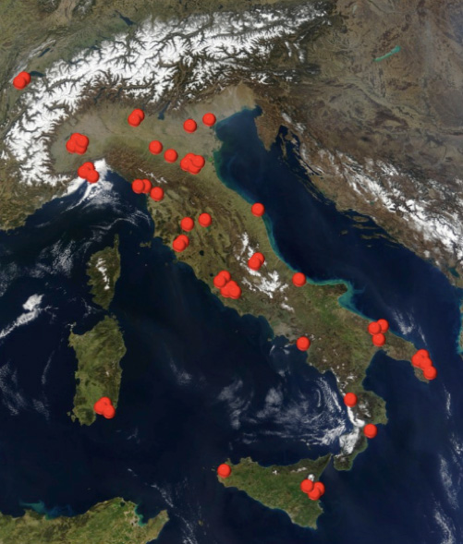
The EEE project
The Extreme Energy Events (EEE) project is a special experiment of Centro Studi e Ricerche Enrico Fermi (Roma) in collaboration with CERN, INFN and MIUR, focused on the study of high energy cosmic rays, carried out with the decisive contribution of students and teachers from high schools.
A large network of cosmic ray telescopes is deployed on the Italian territory. Students participate in the construction, maintenance and data analysis of the telescopes.
Synchronization within stations is performed through GPS system. The network is able to identify and study high energy cosmic rays (>10¹¹ eV).
Mappa dei telescopi in funzione o in installazione

Slide 3
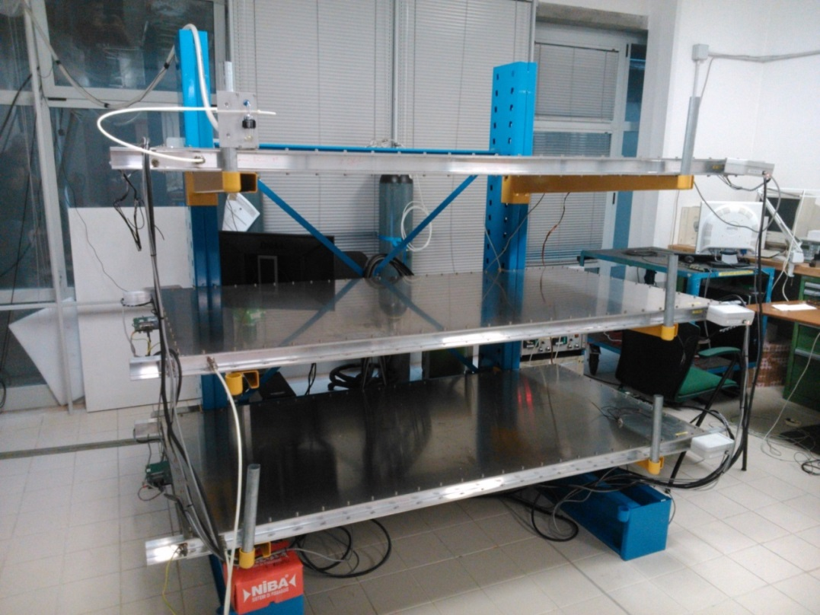
PISA-01 telescope

Slide 4
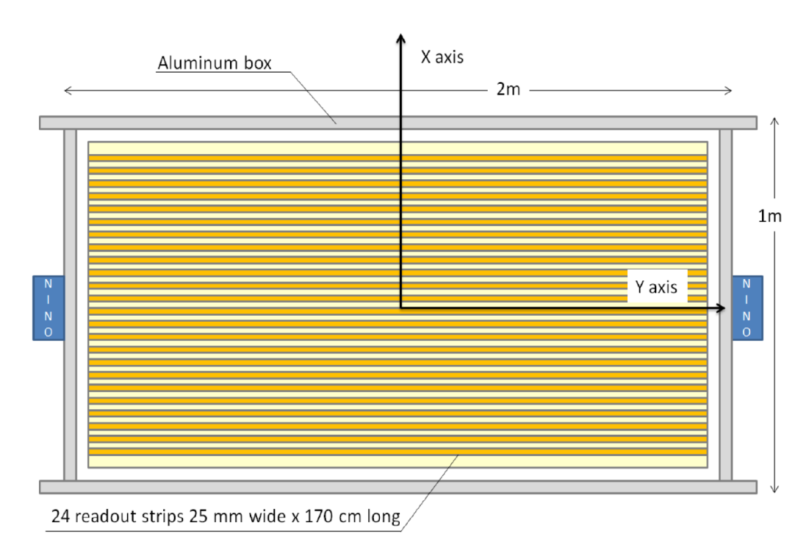
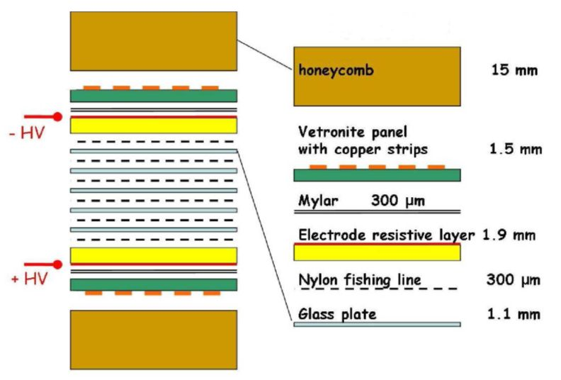
The telescope
y axis
X axis
3 Multi-Gap Resistive Plate Chambers , with active surface of ~168x80 cm², readout by 24 longitudinal strips
Each side of the chamber host two front-end card, for signals discrimination and digitization
Particle longitudinal coordinate is extrapolated measuring the difference of the signal arrival time between the two edges, using Time to Digital Converter with <100 ps resolution

Slide 5
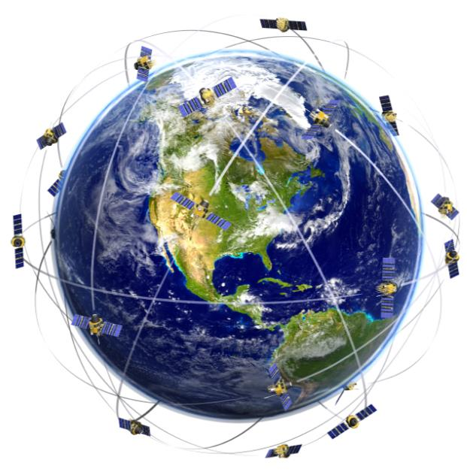
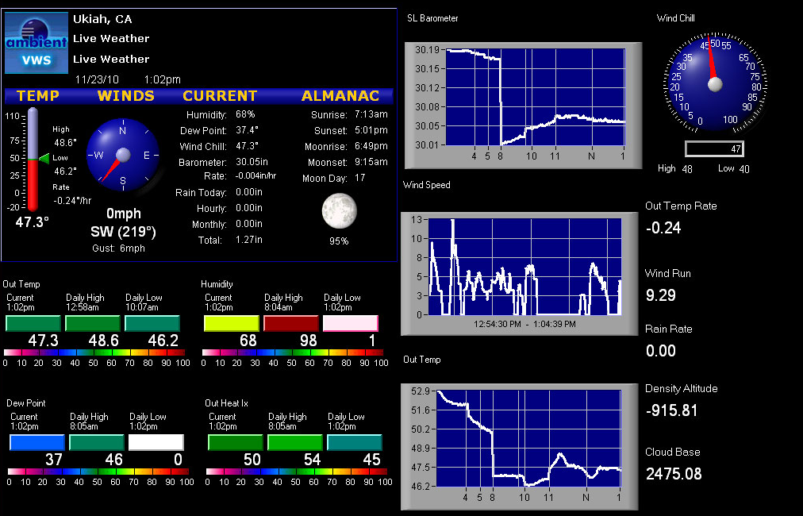
Not only tracking
Weather station:
Temperature (int., ext.)
Humidity
Pressure
Change in chamber efficiency
Impact on the muon flux (pressure)
GPS system (Spectracom TSynch)
can provide a event timestamp with a resolution $\sim$80 ns, synchronizing different stations.
Search for extended showers!

Slide 6
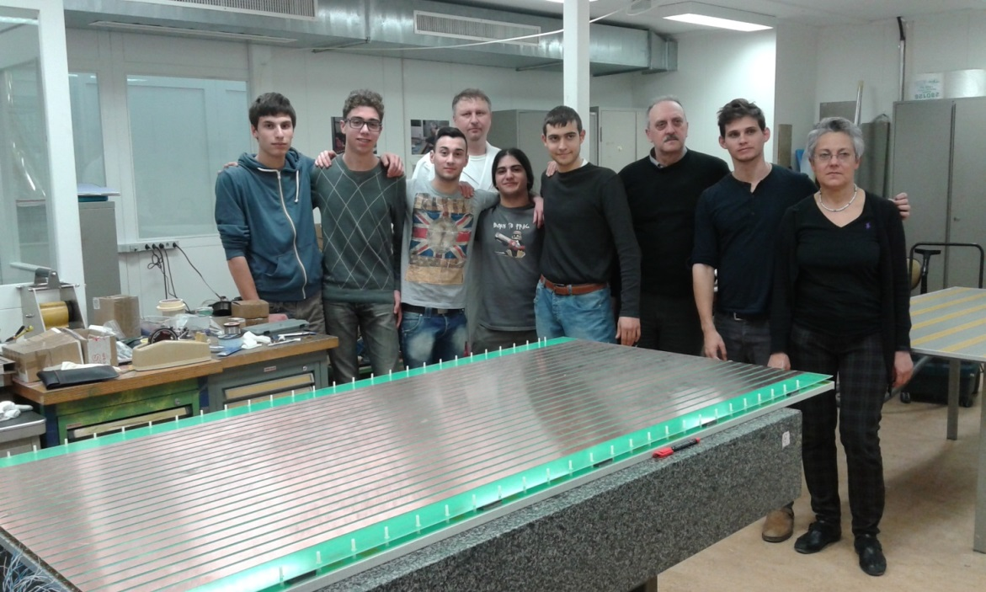
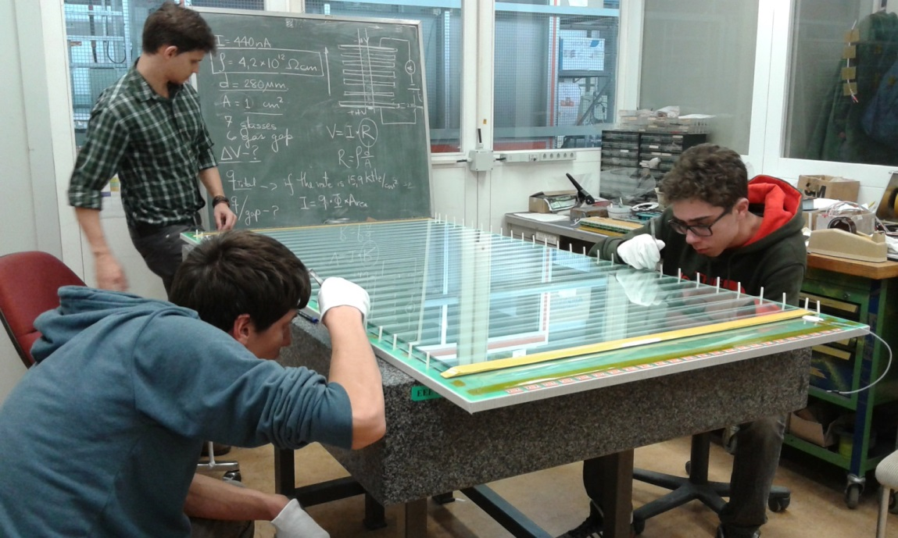
Network size
$\sim$ 80 high schools are currently involved in the project.
47 telescopes are already fully operational and took data during the Run 2 (October 2015-May 2016)
Need for a centralized data collection center :
Common (expert) analysis
Data Quality monitor
Redistribution to schools

Slide 7
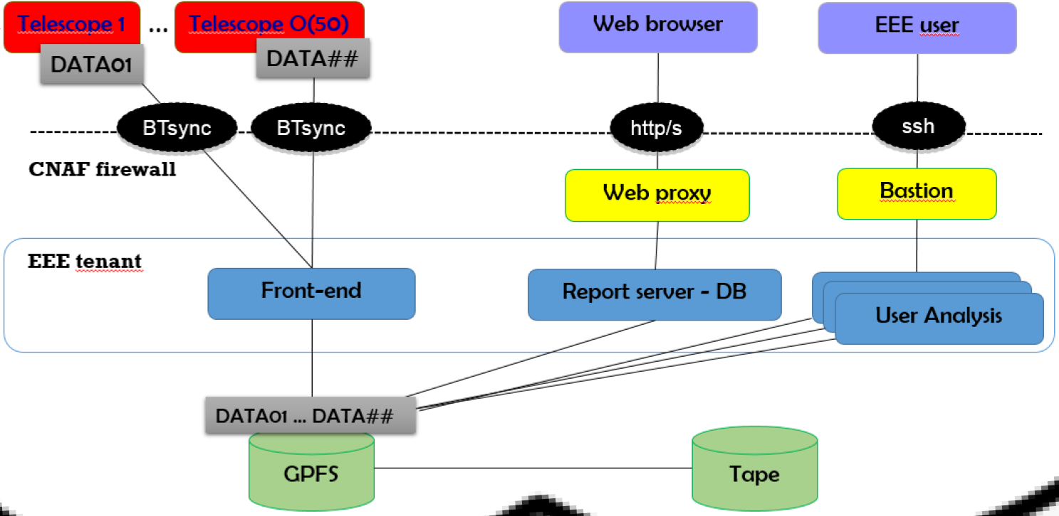
Network size
Data Reconstruction
Data quality monitoring
Database of analyzed files (with analysis relevant information)
Web services

Slide 8
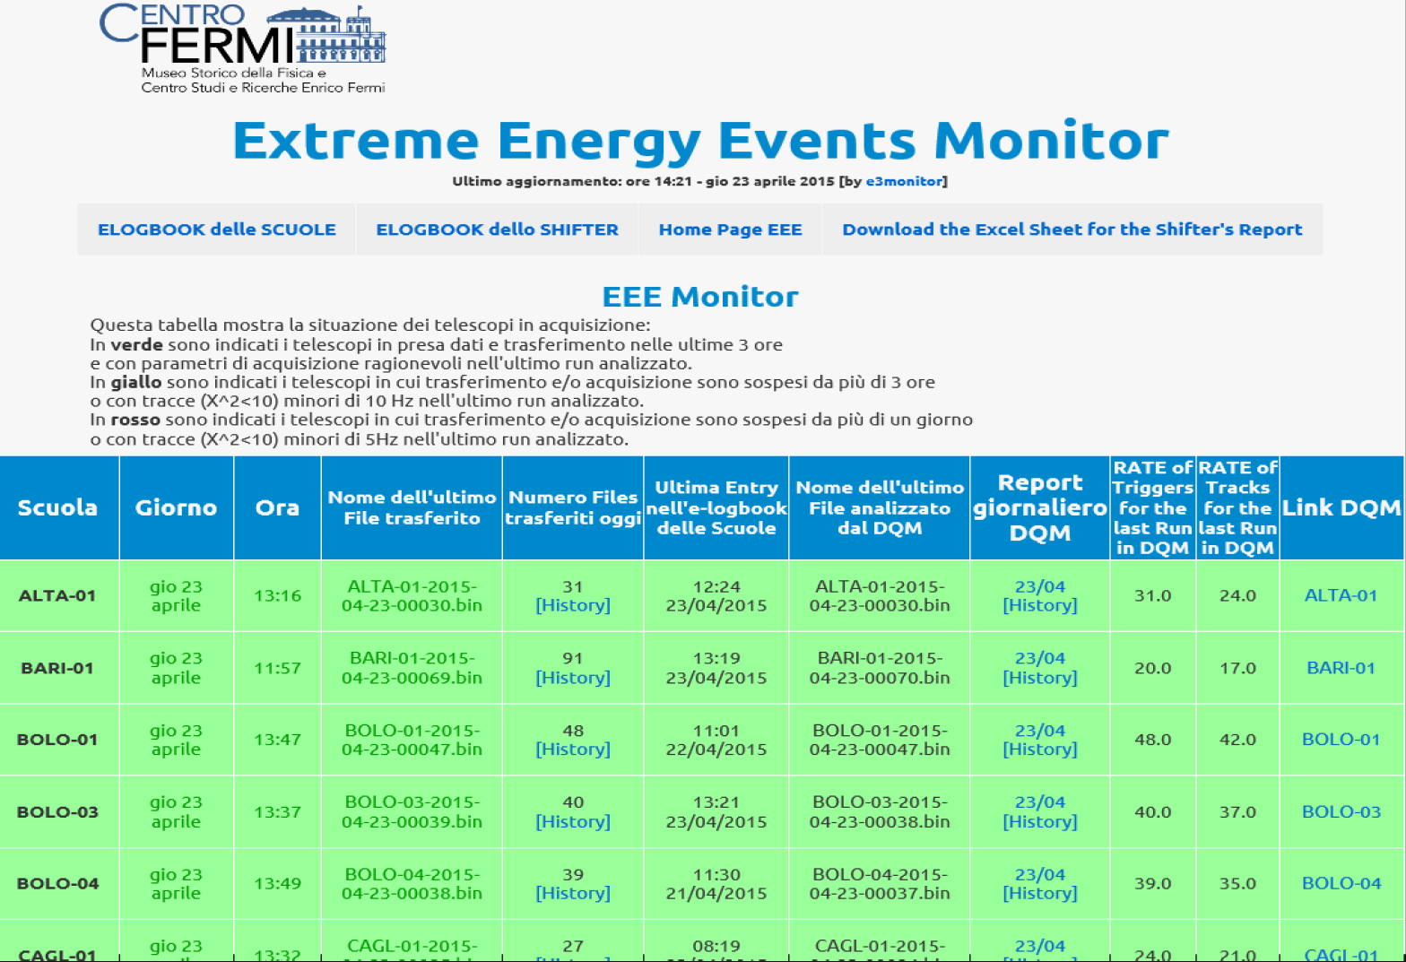
Online DQM
Trend, daily summary
Single file
analysis

Slide 9
DQM monitor
Rate of candidate
tracks
Reconstruction efficiency
Fit $χ^{2}$
Time distribution

Slide 10
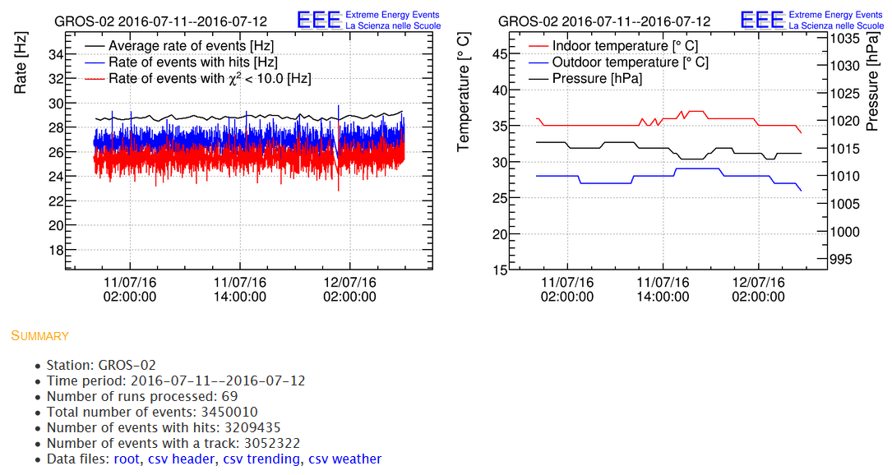
Trend monitor
Track data are available in root format
Trending can be downloaded in csv format
File can be used for students (and expert) analysis, but first…
1

Slide 11
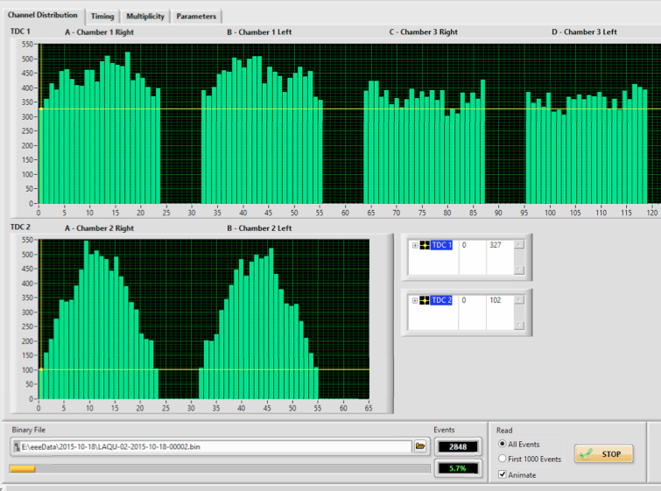
Shift
Each school performs a daily check on the instrumentation and the data are reported on the dedicated logbook.
Students become our eyes!
And
more!

Slide 12
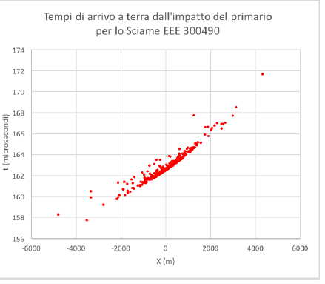
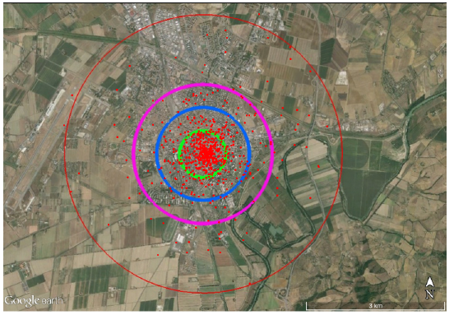
Master class
Each school can develop its own analysis, but we give periodic master classes:
Shower simulation
Coincidence search
Forbush decrease
Telescope maintenance and dqm
Shower particle profile
Ground muon distribution of a ${10}^{15}$ ev proton shower simulated with «corsica»

Slide 13
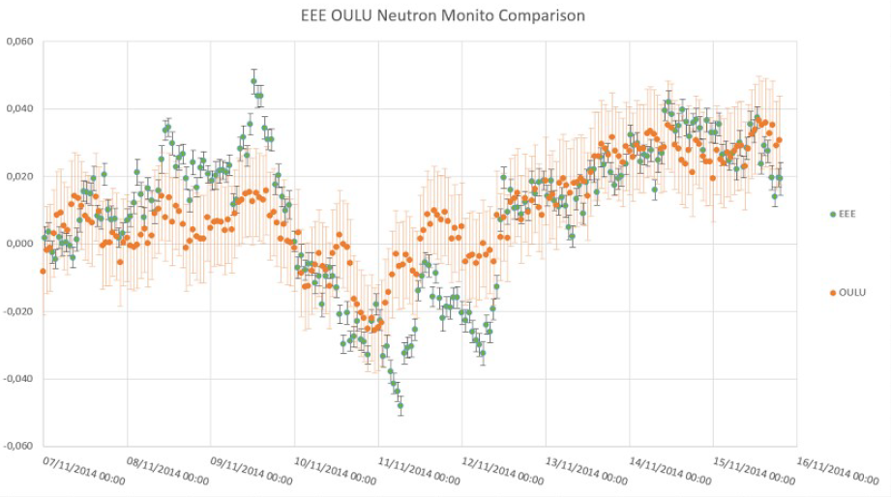
Master class
EEE (after pressure correction) Vs Oulu neutron monitor observatory
% variation
Arrival time difference between LAQU-01 and LAQU-02 stations
Pressure correction
Data comparison with international observatory
time

Slide 14
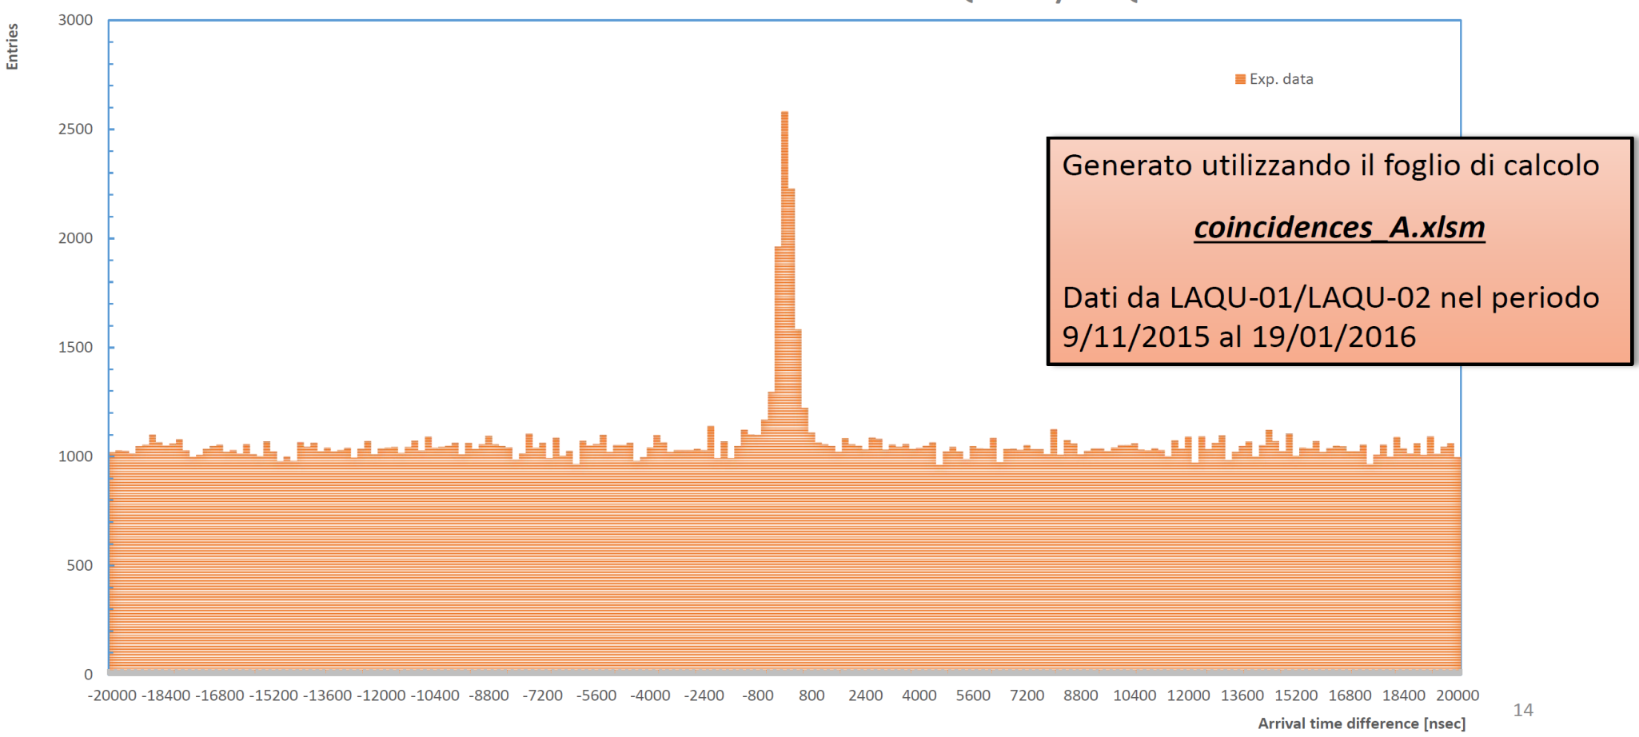
Master class
Entries
Arrival time difference between LAQU-01 and LAQU-02 stations.
Arrival time difference [msec]
Concept of background and statistics must be carefully introduced!

Slide 15
Conclusion
The EEE project is designed to combine scientific research and outreach
Students actively construct, maintain and perform data analysis of the detectors with outstanding enthusiasm
They can also take part in detector test and characterization, having a deeper overview of the research process
The introduction to the analysis is done through master classes on several topics. Main concept as background and calibration are given.
Many other talk has been presented during the congress!!

