Slide 1
New GPS-Trigger Board
A. Corvaglia for EEE Collaboration

Slide 2
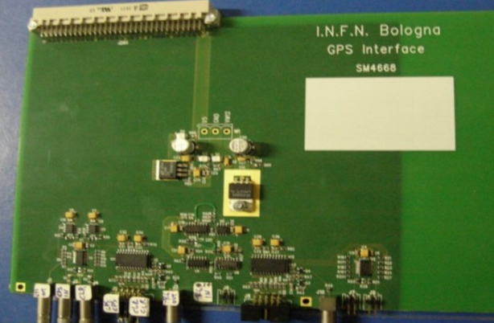
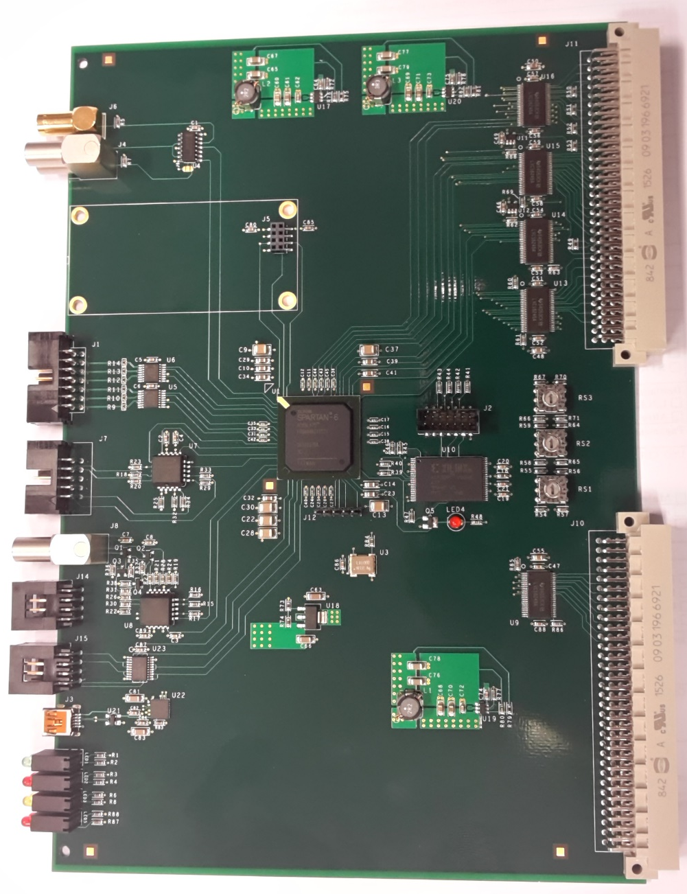
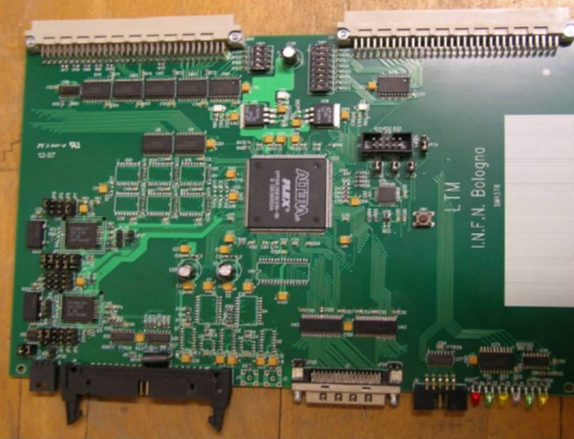
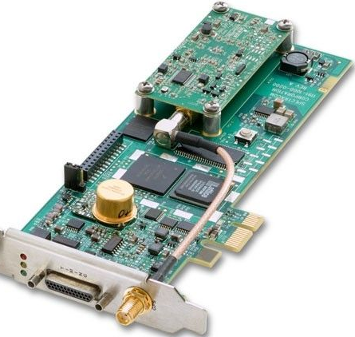
Old Vs New
GPS
Interface
Trigger
GPS
(2 models)

Slide 3
New trigger
Old Trigger
New Trigger
Coincidences
1-Triple
3-Double
3-Single
Coincidences
1-Triple
3-Double
3-Single
6 FEA
Counters for all coincidences
UART communication (via USB)
VME communiction

Slide 4
New GPS interface
GPS-interface
firmware (FPGA)
Old GPS interface
Everythings integrated into FPGA firmware

Slide 5
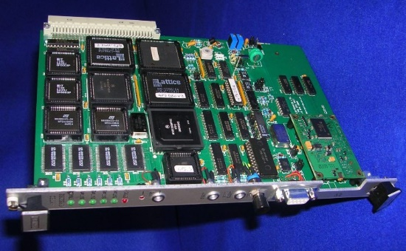
New GPS
Old GPS
New GPS
Resolution SMT 360
It is possible to externally assemble the engine GPS if needed (example Banzi Lecce)
10Mhz disciplined clock with PPS
Continuos clock also without PPS signal
Multi-GNSS (GPS, GLONASS, Beidou & Galileo ready)
PPS pulse synchronized to within 15 nanoseconds (one sigma) of GNSS/UTC

Slide 6

Integration
PPS inout
Back compatibility
Engine GPS
MRPC
Input lines
MRPC
input lines
CLR/RES TDC
Trigger to TDC
Clock distribution
Back compatibility
Coincidence
S1, S2, S3
Back compatibility
VME comm
USB comm
Signaling LED

Slide 7
Thank you !

Slide 8
Backup slides

Slide 9
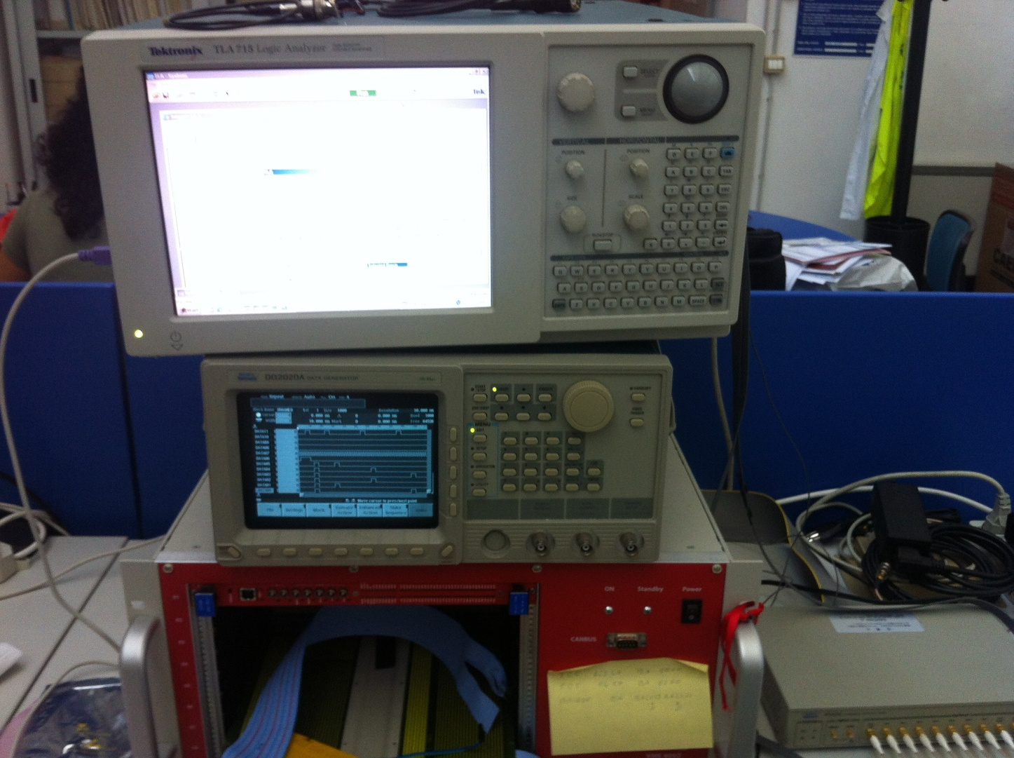
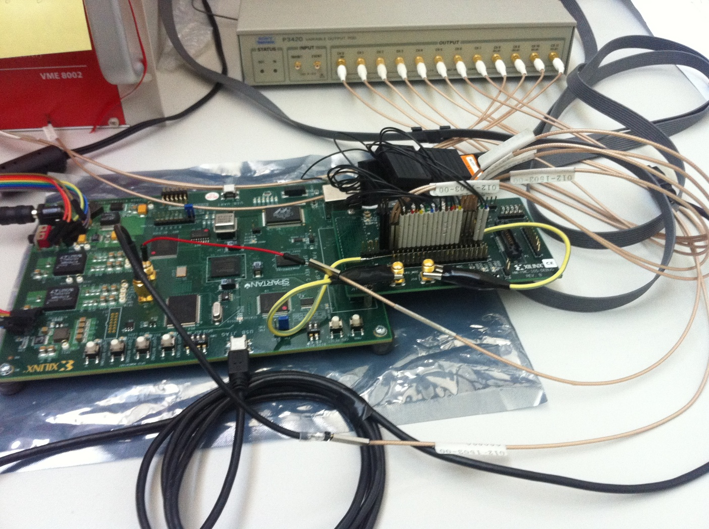
Trigger Setup

Slide 10
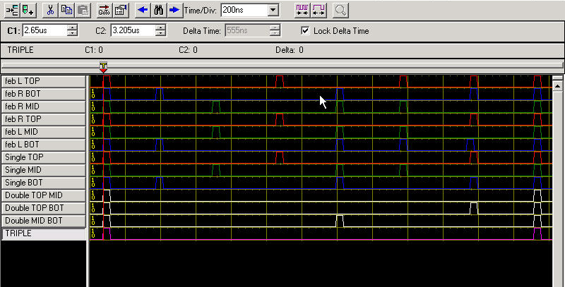
Trigger Setup

Slide 11
GPS Firmware

Slide 12
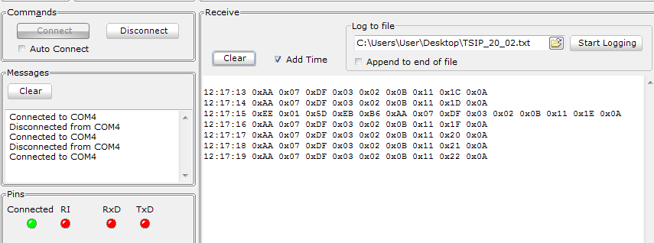
Trigger UART comm
Pre-PostAmble
UTC Time → 02/03/2015 ore 11:17’:29’’
Trigger Event → 015DEBB6 (H) = 22932406 (D)

