Slide 1
Muon Decay Observation with The Telescopes of The Extreme Energy Events Project
Maria Paola Panetta
on behalf
The EEE Collaboration
Centro Fermi Roma - Università del Salento and INFN
Padova 30/9/2016

Slide 2
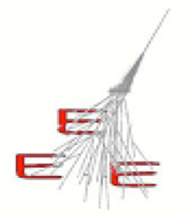
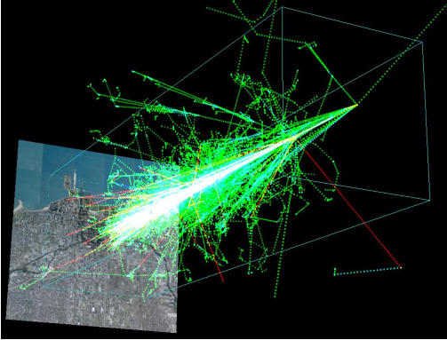
The EEE Project
The Extreme Energy Events (EEE) Project is an experiment for the detection of Extensive Air Showers
It is a joint scientific and educational initiative by Centro Fermi in collaboration with
and
102° Congresso SIF M. P. Panetta Padova 30/9/2016

Slide 3
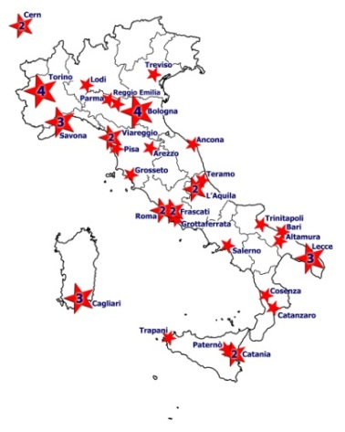
The EEE Project
It aims to reveal Extensive Atmospheric Shower by detecting long distance coincidences [>km] of secondary muons on ground, coming from very high energy primary cosmic rays. It consists of a network of tracking detectors hosted in High Schools spread on the Italian territory, each made of
3 Multigap Resistive Plate Chambers (MRPCs).
In 2004 Pilot project in 7 towns, in High Schools
In 2015 >50 EEE telescopes across an overall area of $\sim$0.5 x 10⁶ km²
11 deg Latitude
47 EEE Station in school buildings
3 at INFN sections
2 at CERN
Telescopes are organized in clusters (10m -4 km d.)
and single telescope stations
10 deg Longitude
102° Congresso SIF M. P. Panetta Padova 30/9/2016

Slide 4
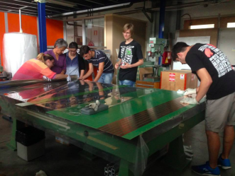
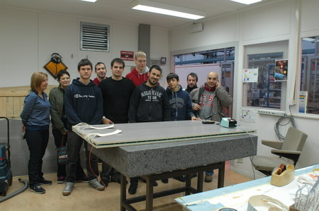
The EEE Project : a dual role
- Education instrument for students
The MRPCs are built and managed at CERN by small teams of students and teachers.
In their schools $\sim$500 students and 100 teachers are directly involved in the EEE Project, with the aim to introduce them in an advanced physics research.
MRPCs at CERN
Operating and monitoring EEE stations
Measurement campaingn
- Efficency
- Telescopes orientation with the North
Analysis Master Classes
102° Congresso SIF M. P. Panetta Padova 30/9/2016

Slide 5
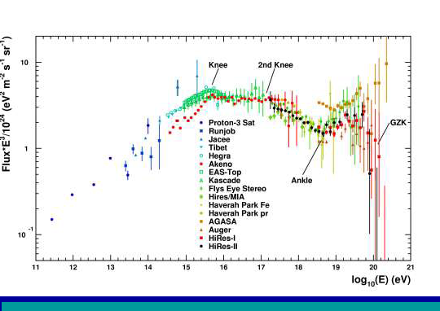
The EEE Project
Scientific instrument for physicists
EEE Collaboration involves $\sim 7$0 physicists. Many different topic in the cosmic ray physics: Search of coincidences, Correlations to solar activity,
Upgoing tracks, Search of anisotropy, ….
As a single detector : the EEE telescope is a high precision tracking detector that can study the flux of secondary cosmic muons
As telescopes cluster: in the same town, it aims to study the properties of the EAS in which muons are originated,
As an array using sites far apart: it makes possible to investigate time correlations between different EAS events.
102° Congresso SIF M. P. Panetta Padova 30/9/2016

Slide 6
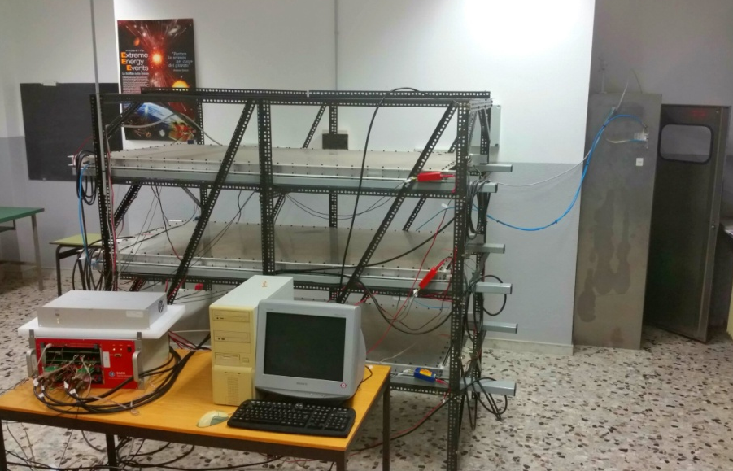
The EEE Telescope
Three MRPC Layers for tracking particles
Three Multi-Gap Resistive Plate Chambers (MRPCs) of 1.60x0.80 m², with similar operation characteristics to the ones built for the Time Of Flight array of the ALICE experiment
GPS unit provides the event time stamp (UTC time) to record and synchronize informations
Weather Station to monitor the temperature and the pressure inside and outside
the telescopes building
t₂
t₁
y
x
102° Congresso SIF M. P. Panetta Padova 30/9/2016

Slide 7
Some Physics Results
Coordinated
data taking
Pilot 27 October – 14 November 2014 (23) of the EEE array,1x10⁹ tracks
Run-1 2 February -30 April 2015 : 35 EEE telescopes, 5x10⁹ tracks
Run-2 2 February -30 April 2016 : 43 EEE stations, 15x10⁹ tracks
Run-3 Start October 2016, objective to double total statistic
102° Congresso SIF M. P. Panetta Padova 30/9/2016

Slide 8
Some Physics Results
Coordinated
data taking
Pilot 27 October – 14 November 2014 (23) of the EEE array,1x10⁹ tracks
Run-1 2 February -30 April 2015 : 35 EEE telescopes, 5x10⁹ tracks
Run-2 2 February -30 April 2016 : 43 EEE stations, 15x10⁹ tracks
Run-3 Start October 2016, objective to double total statistic
102° Congresso SIF M. P. Panetta Padova 30/9/2016

Slide 9
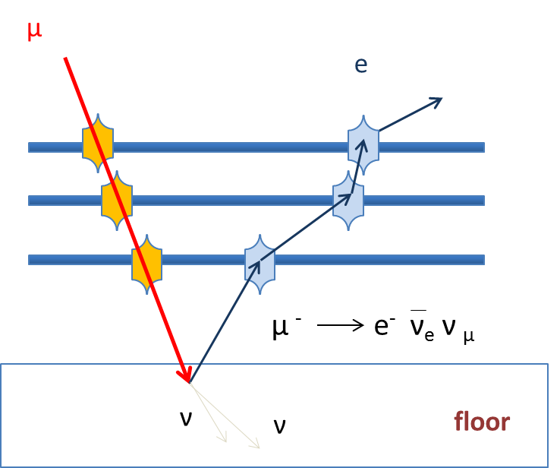
Upward going Events
Upgoing events are observed (∼ 1/2000) in EEE telescopes.
A fraction of them can be clearly identified as electrons coming from muon decays, by means of a time correlation with previous events (∼2 μs)
The upward-going events is actually originating from downward-going muons which range out in the lowermost MRPC assembly or in the concrete immediately below the telescope. They stop and subsequently decay at rest.
9
102° Congresso SIF M. P. Panetta Padova 30/9/2016
Notes:
of the upward-going events is actually originating
from downward-going muons which range out in the
lowermost MRPC assembly or in the concrete immediately below
the telescope where
The two neutrinos produced in the muon beta decay would then
travel undetected, while the outgoing electron could occasionally
escape the concrete and traverse the three chambers, triggering
the telescope.

Slide 10
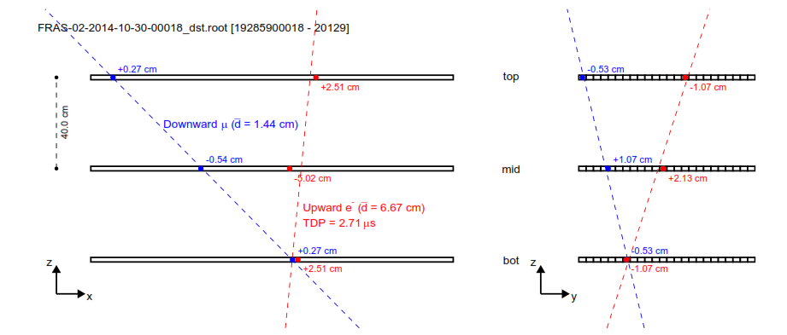
Upward going Events
blue – downward going muon
red – Upward going electron
102° Congresso SIF M. P. Panetta Padova 30/9/2016

Slide 11
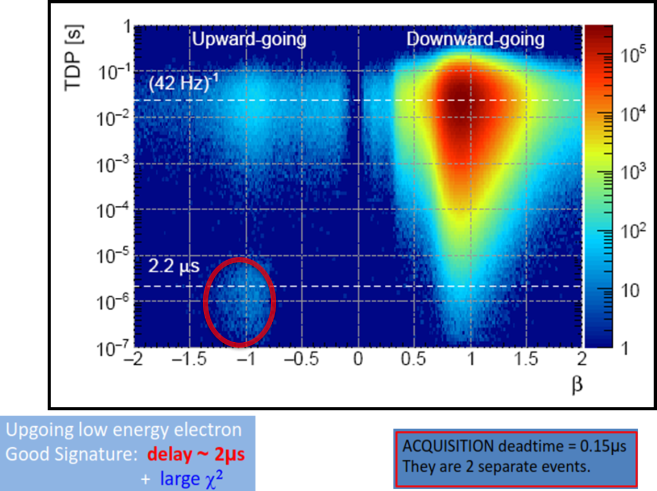
Upward going Events: Timing
Time difference to the previous event TDP vs β_{e}
Telescopes event rate ∼42 Hz
∼ 6% can be clearly identified as electrons
Notes:
Upgoing events are observed (∼ 1/2000) in EEE telescopes.
A fraction of them can be clearly identified as electrons coming from muon decays, a previous downgoing event and after delay of 2 micro_s

Slide 12
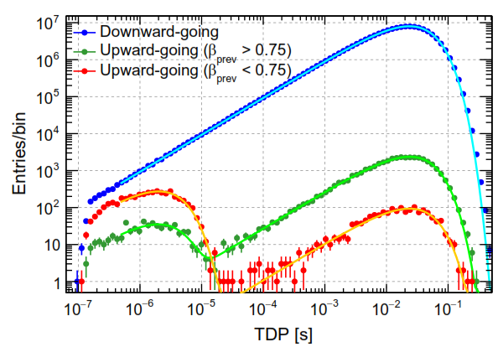
Upward going Events : τ
Blue – All downward going events
Green – Upward going event generated by a muon with β_{μ} >0,75
Red – Upward going event generated by a muon with β_{μ} <0,75 (the e correlated in time with μ )
μs
(40) Hz
τ = 2,04 ± 0,04 μs
τ < τ(decay) ∼ 2,2 μs
Notes:
Divido il campione mi aspetto muone che decade sia di minore energia slow muon 50 MeV

Slide 13
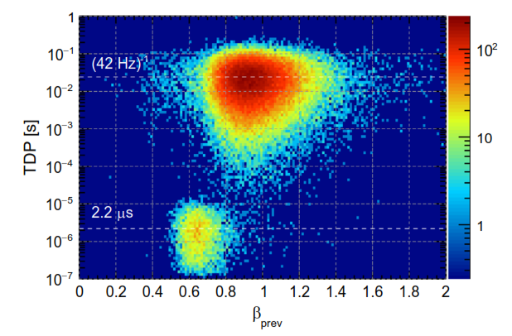
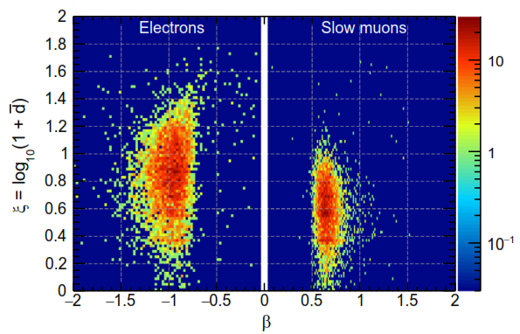
Upward going Events: ‘Track shape
_
d sum of the three- dimensional distances between the cluster positions and the best-ﬁt track
Track shape indicator
102° Congresso SIF M. P. Panetta Padova 30/9/2016
Notes:
Prev = previous -> pr - ev= precedente evento
We deﬁne the square root d of the quadratic sum of the three-dimensional distances d between the cluster positions and the best-ﬁt track

Slide 14
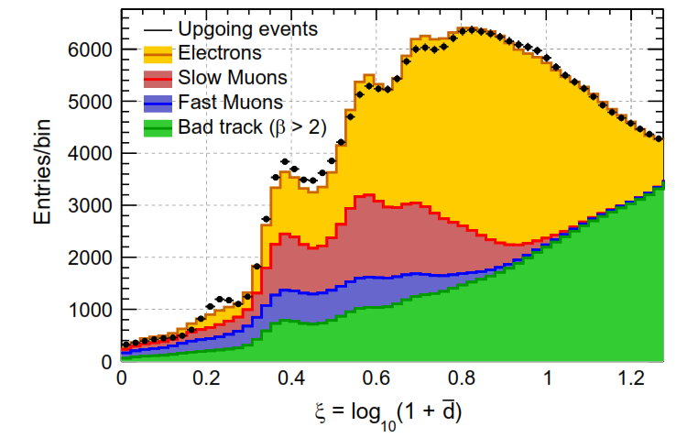
Upward going Events: ‘Track shape
Track shape indicator
The differences in the shape indicator can be used to infer the relative abundance of the different upward-going populations
102° Congresso SIF M. P. Panetta Padova 30/9/2016
Notes:
Muoni lenti e veloci, correlati co beta
Residuo sopra i 6 cm

Slide 15
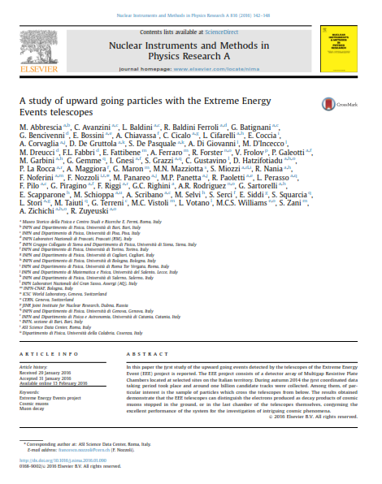
Upward going Events
A study of upward going particles with the Extreme Energy Events telescopes (M. Abbrescia et al., Nucl. Instrum. Meth. A 816 (2016) 142148.)
102° Congresso SIF M. P. Panetta Padova 30/9/2016

Slide 16
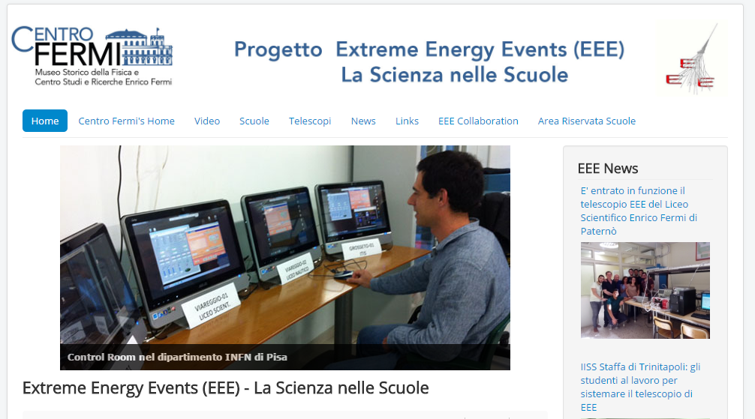
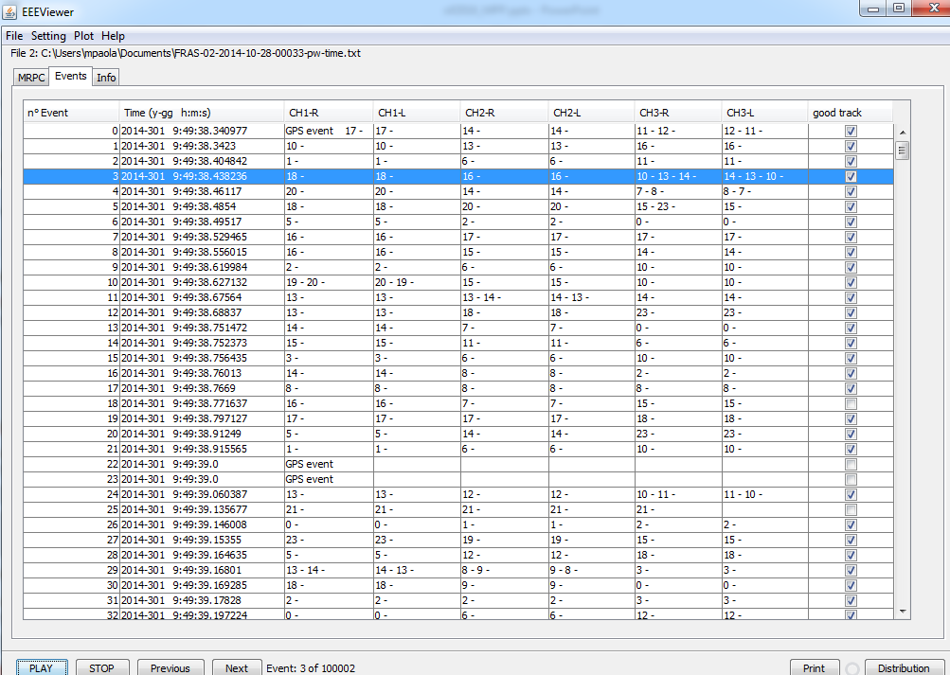
The EEE Software
EEE Software helps Students to monitor and operate the EEE telescope station
eee.centrofermi.it
EEEViewer v2.1 :
EEE event track monitor
102° Congresso SIF M. P. Panetta Padova 30/9/2016

Slide 17
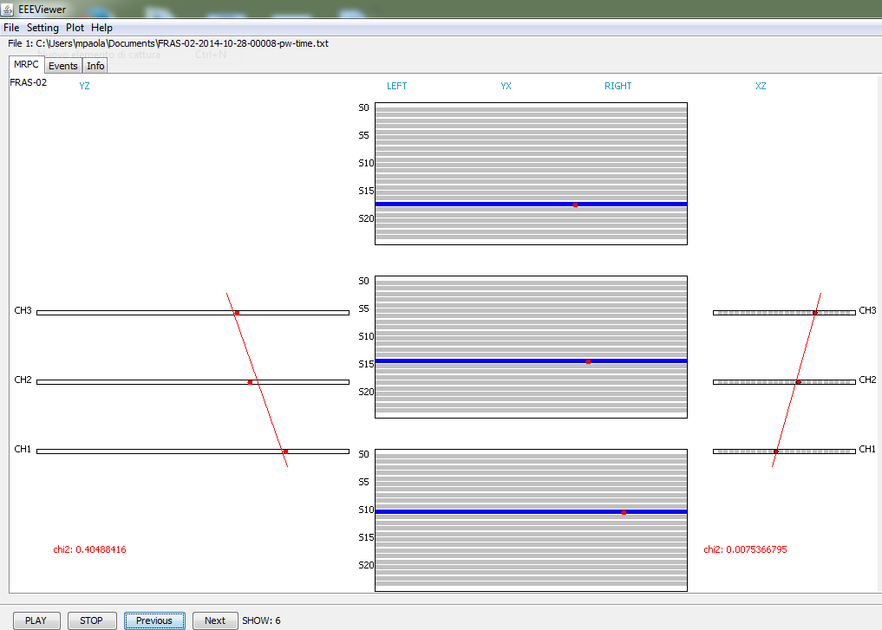
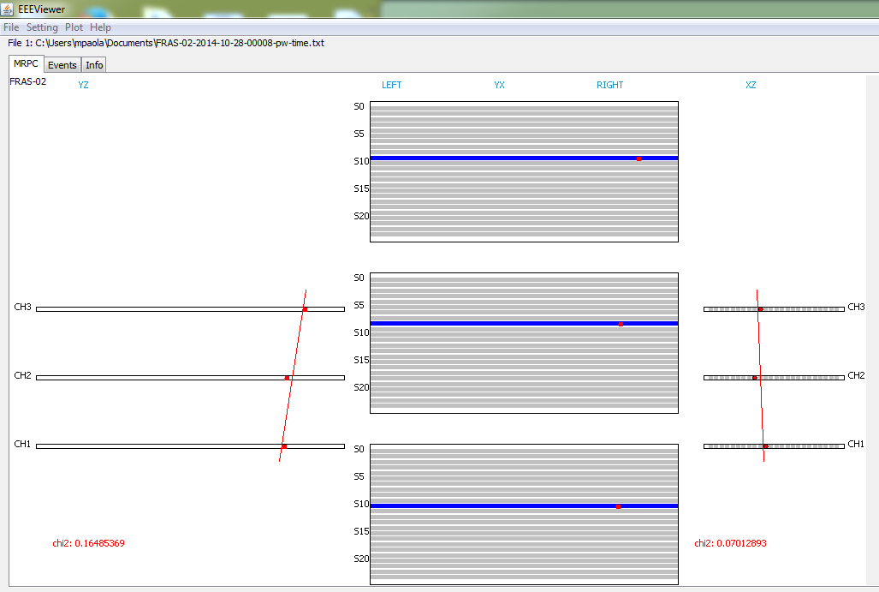
The EEE Software
eee.centrofermi.it
Students by means of EEEViewer can directly visualise the single event track in the telescopes.
Downward going
muon
Upward going
electron
102° Congresso SIF M. P. Panetta Padova 30/9/2016

Slide 18
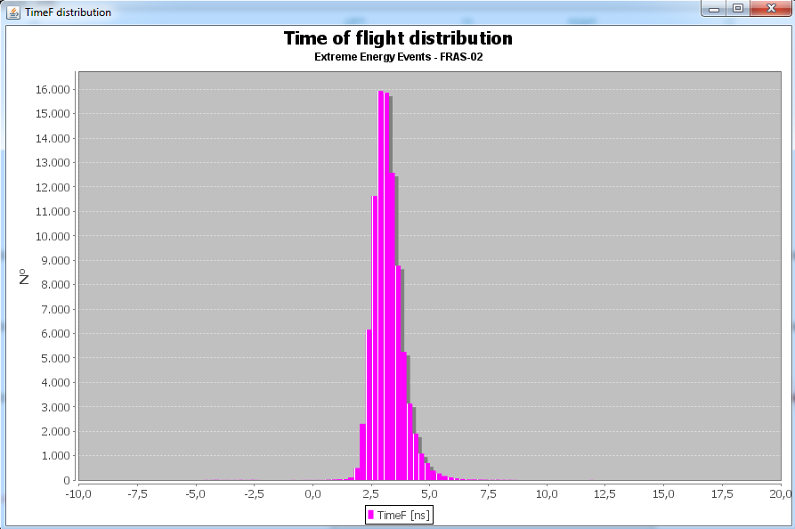
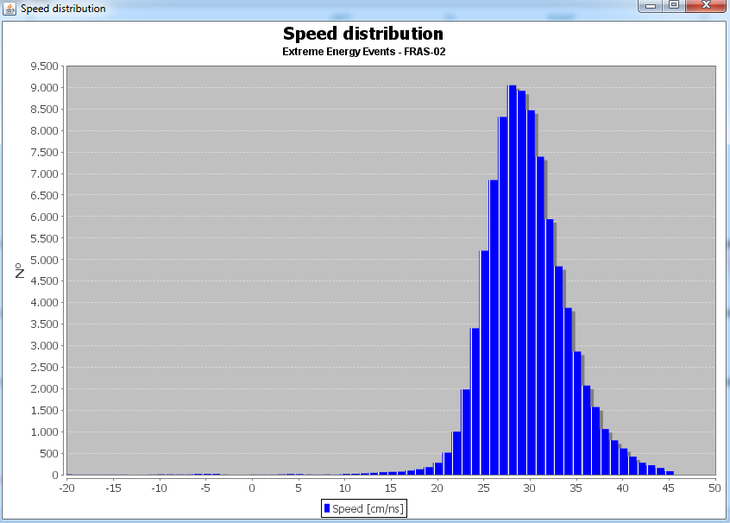
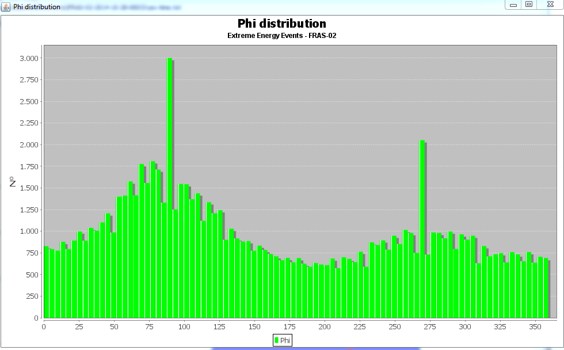
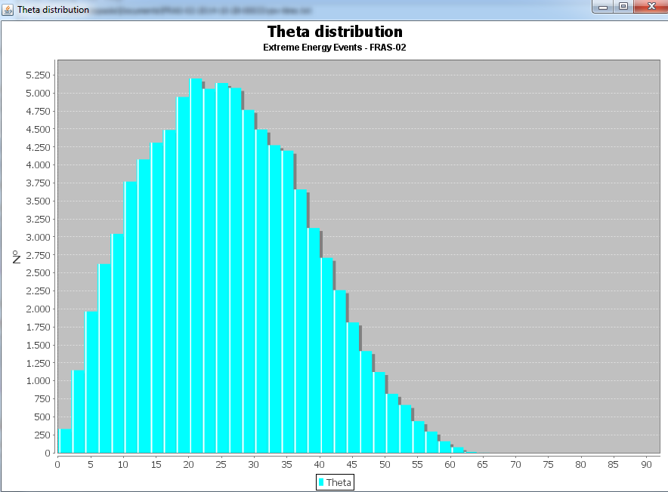
The EEE Software
Time of Flight
Speed
Phi angle
Theta angle
102° Congresso SIF M. P. Panetta Padova 30/9/2016

Slide 19
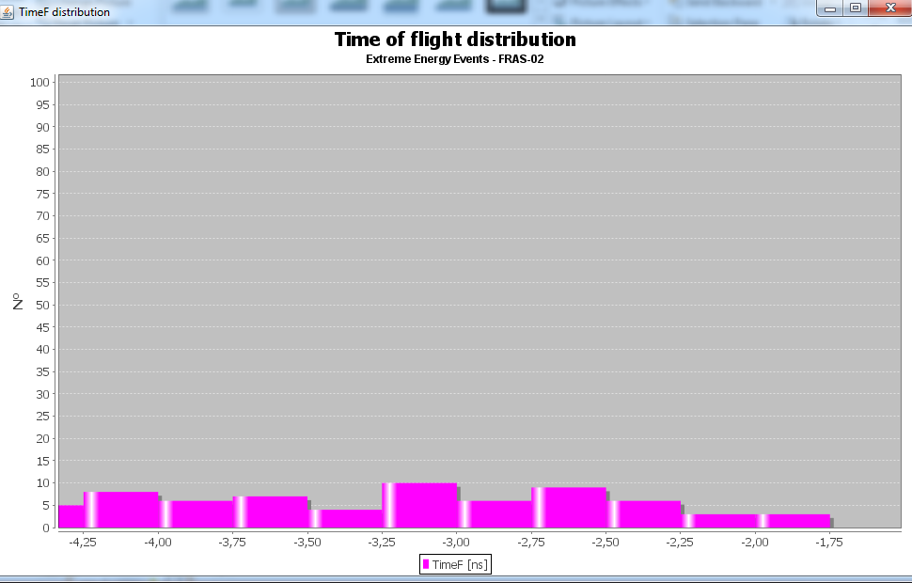
The EEE Software
5 x 10⁴ events
in the single Run
102° Congresso SIF M. P. Panetta Padova 30/9/2016

Slide 20
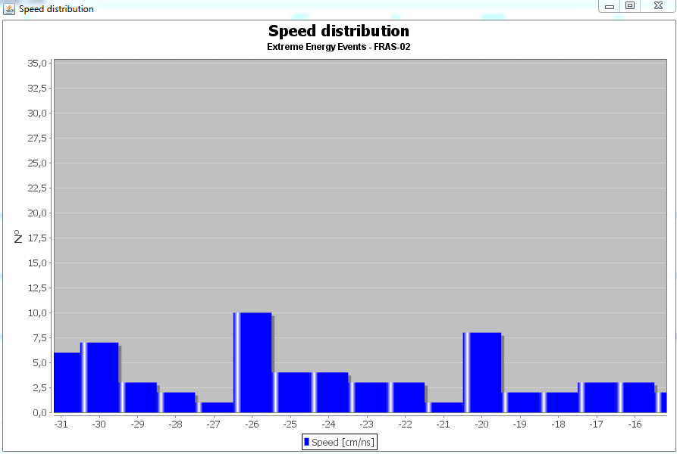
The EEE Software
102° Congresso SIF M. P. Panetta Padova 30/9/2016

Slide 21
The EEE Software
EEE Project v2.7.0
EEEAnalyzer 2.7
Run Event s ns μs cos(X) cos(Y) cos(Z) d ToF Tr length
μ
e
102° Congresso SIF M. P. Panetta Padova 30/9/2016

Slide 22
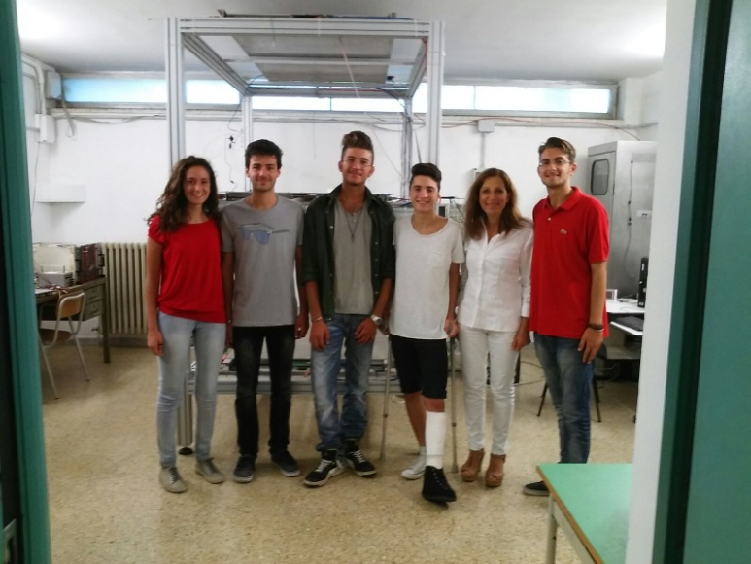
Summary
Being able to perform such an analysis is a clear indication the excellent performance of the EEE network and its telescopes.
(This is relevant for the measurements about coincidences, cosmic rays variations, etc. )
The muon decay observation has a clear value from the educative point of view:
- muon Beta decay
- Data analysis
Statistical concepts (d, χ² …)
which is one of the goals of the EEE
Project
102° Congresso SIF M. P. Panetta Padova 30/9/2016

Slide 23
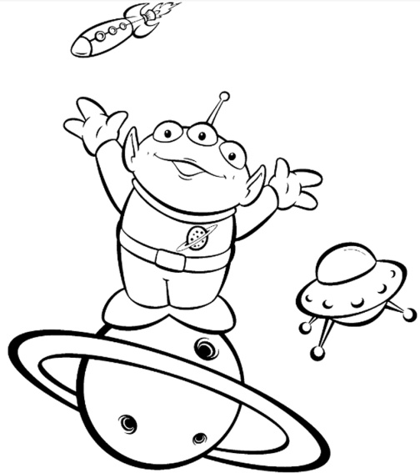
Thanks for your attention
102° Congresso SIF M. P. Panetta Padova 30/9/2016

Slide 24
The EEE Project
102° Congresso SIF M. P. Panetta Padova 30/9/2016

