Slide 1
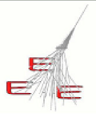


Plots for the performance paper
E. Bossini, C. Cicalò, D. De Gruttola, I. Gnesi, M. Garbini, S. Grazzi, M.P. Panetta, C. Ripoli
13/09/2017
meeting EEE

Slide 2
Status
paper almost ready for the first draft
some studies about beta still ongoing
a few sections to be refined
bibliography to be completed
13/09/2017
meeting EEE
2

Slide 3
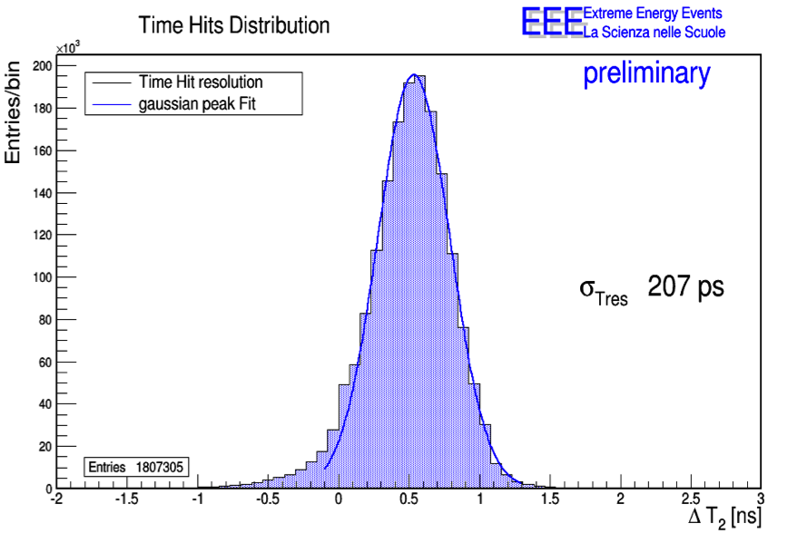
Time resolution
already approved as preliminary
results from Run 2 mentioned in the paper (no time slewing correction)
to be included (remove flag preliminary)
13/09/2017
meeting EEE
3

Slide 4
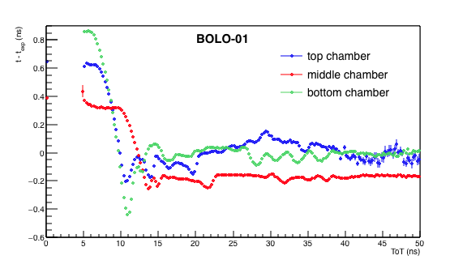
Time resolution
example of time dependence from TOT
the fit function (5th degree pol.) is used to apply the time slewing correction
13/09/2017
meeting EEE
4

Slide 5
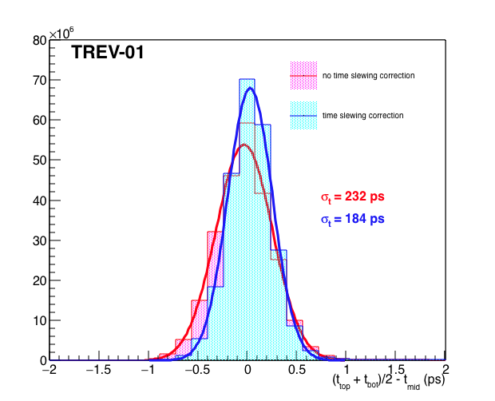
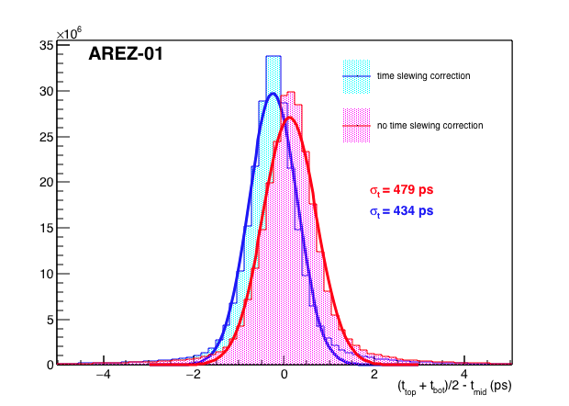
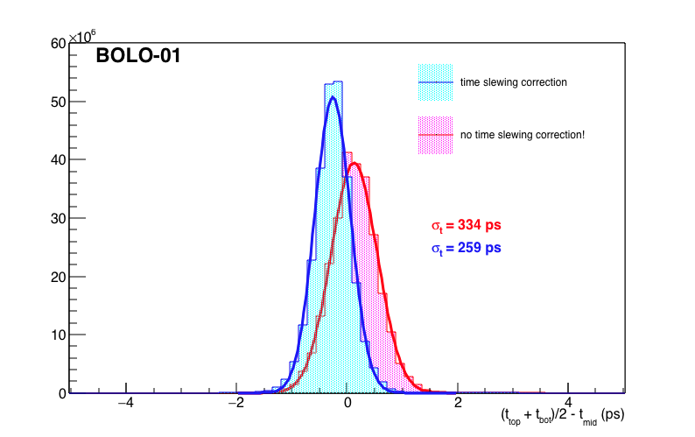
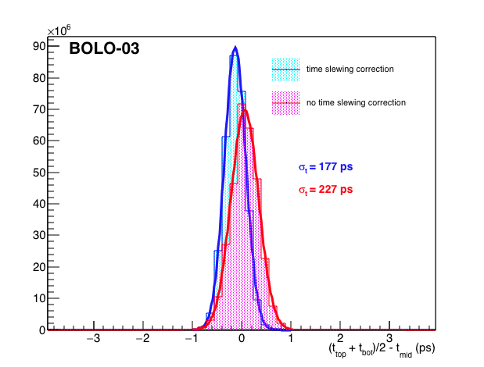
Time resolution
examples of time timing distributions used to estimate time resolution
results from Run 3 (4 telescopes over 33 analyzed)
comparison between time slewing correction and no correction
four plots in on figure
13/09/2017
meeting EEE
5

Slide 6
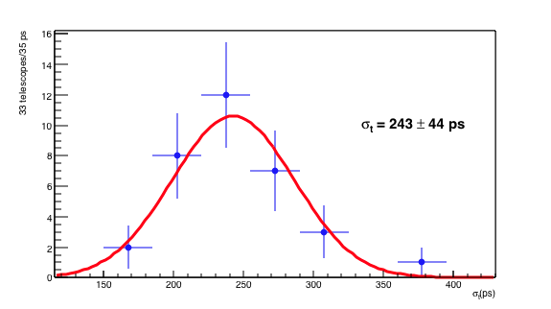
Time resolution
time resolution distributions from all 33 analyzed telescopes
gaussian function used to fit
mean from the fit is fully compatible with the arithmetic one (242 ps)
13/09/2017
meeting EEE
6

Slide 7
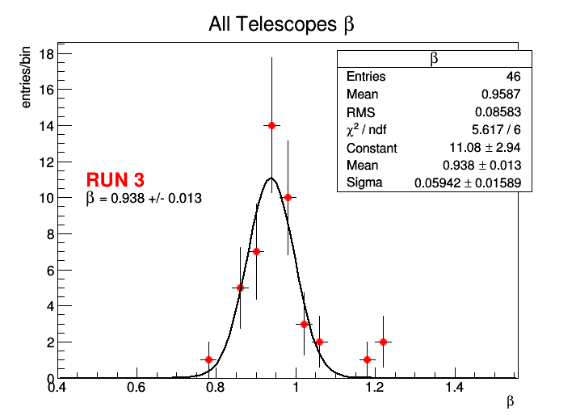
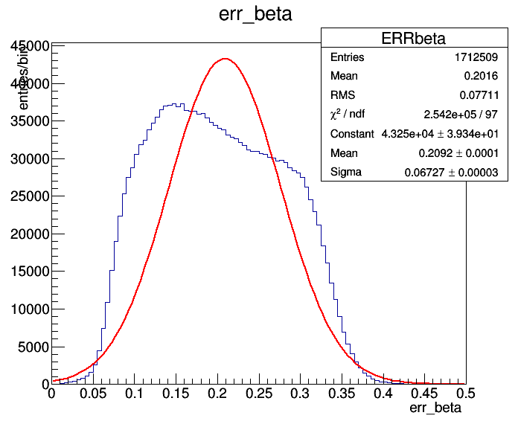
Time resolution
beta distributions from 46 analyzed telescopes
beta distribution
not to be included in the paper
error on beta distribution
to be included in the paper (study ongoing)
13/09/2017
meeting EEE
7

Slide 8
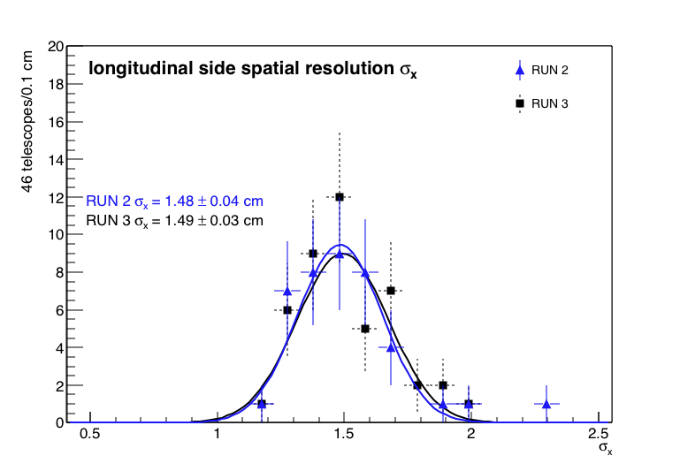
Space resolution
longitudinal side spatial distributions from 46 analyzed telescopes
comparison between Run2 and Run 3
maybe only results from Run 3?
13/09/2017
meeting EEE
8

Slide 9
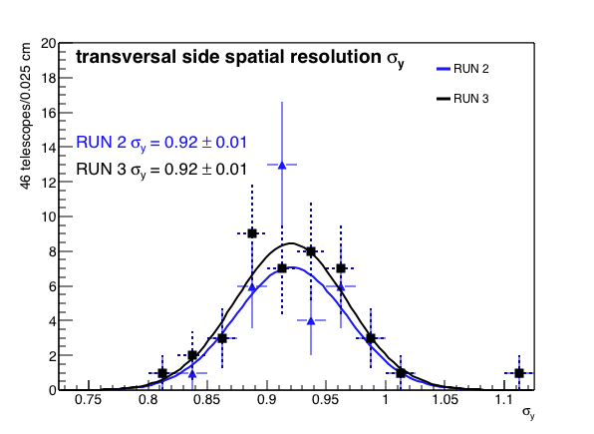
Space resolution
longitudinal side spatial distributions from 46 analyzed telescopes
comparison between Run2 and Run 3
maybe only results from Run 3?
13/09/2017
meeting EEE
9

Slide 10
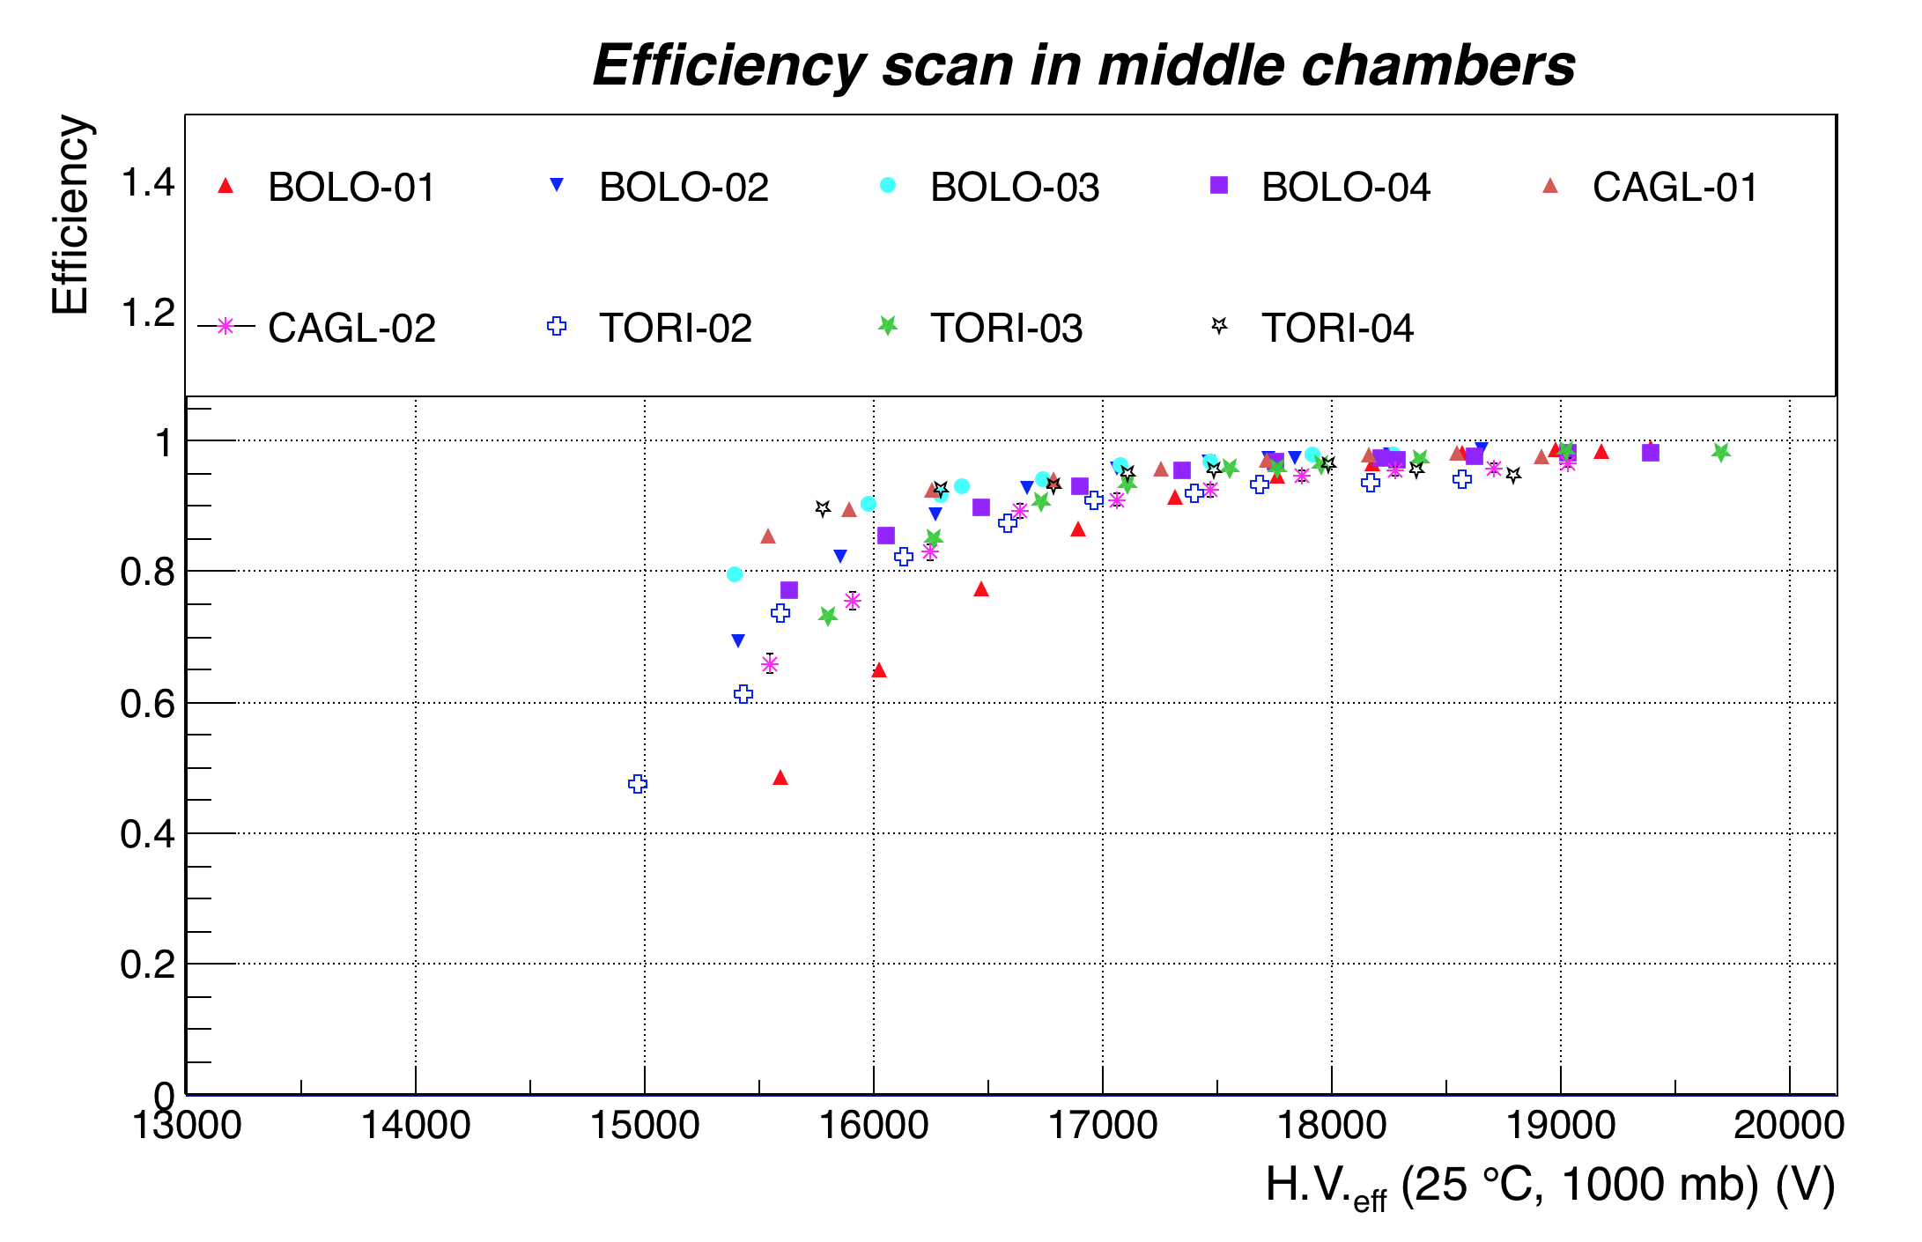
Efficiency
efficiency vs HV of the middle chamber from 9 telescopes
outer chambers used as trigger
13/09/2017
meeting EEE
10

Slide 11
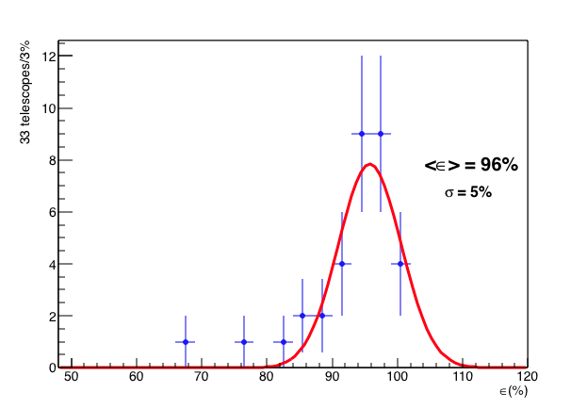
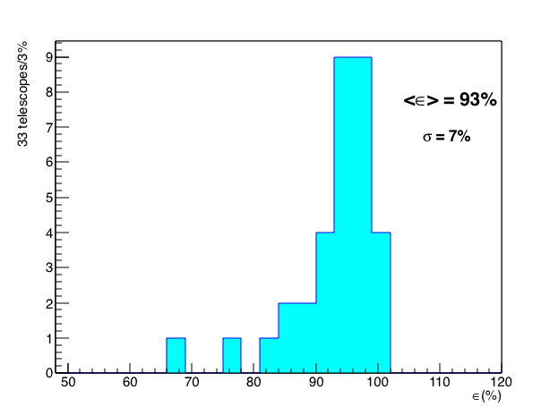
Efficiency
distribution of maximum value from 33 telescopes
need to chose plot w/o fit
gaussian distribution only with a specific bin
our favored option
13/09/2017
meeting EEE
11

Slide 12
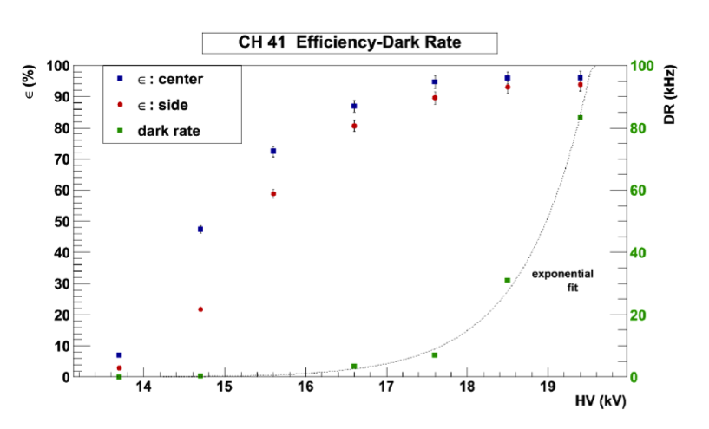
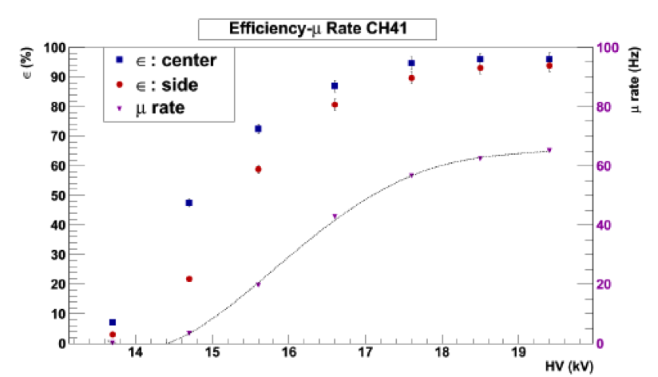
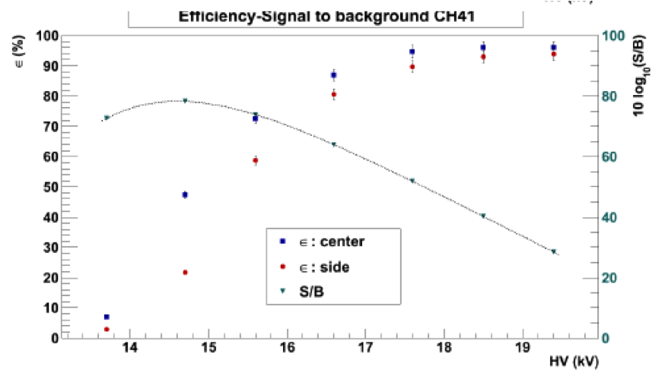
Efficiency
efficiency vs HV of the one chamber of TORI-03
external trigger (2x2x25 cm³ scintillators)
efficiency (center and side of the chamber) and dark rate in the first plot
efficiency (center and side of the chamber) and muon rate in the second plot
efficiency (center and side of the chamber) and S/B ratio in the third plot
13/09/2017
meeting EEE
12

Slide 13
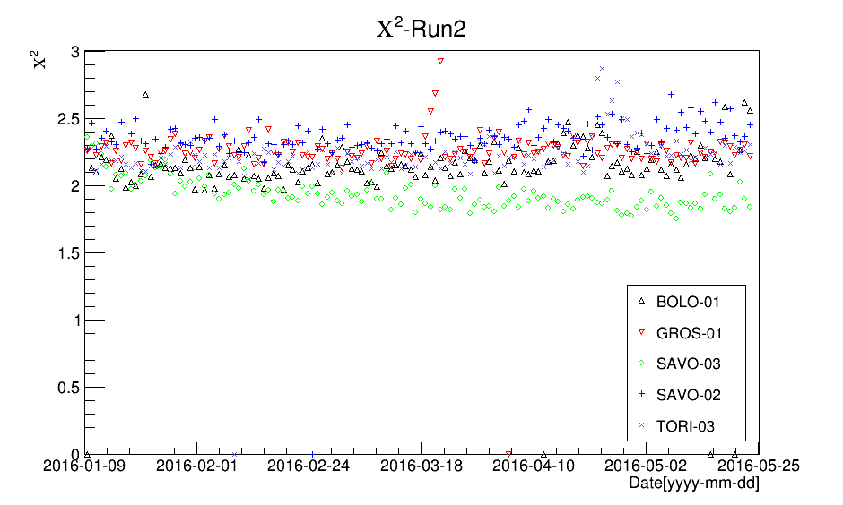
Trending
χ² of 5 telescopes showing 8 months stability in RUN 2
drops and rises are explained in the text
13/09/2017
meeting EEE
13

Slide 14
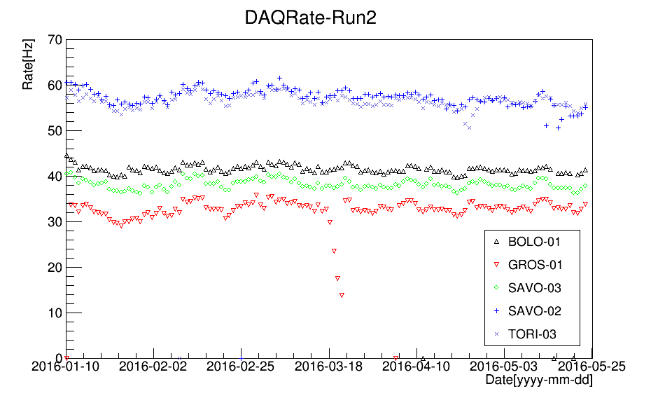
Trending
trigger rate of 5 telescopes showing 8 months stability in RUN 2
drops and rises are explained in the text
13/09/2017
meeting EEE
14

Slide 15
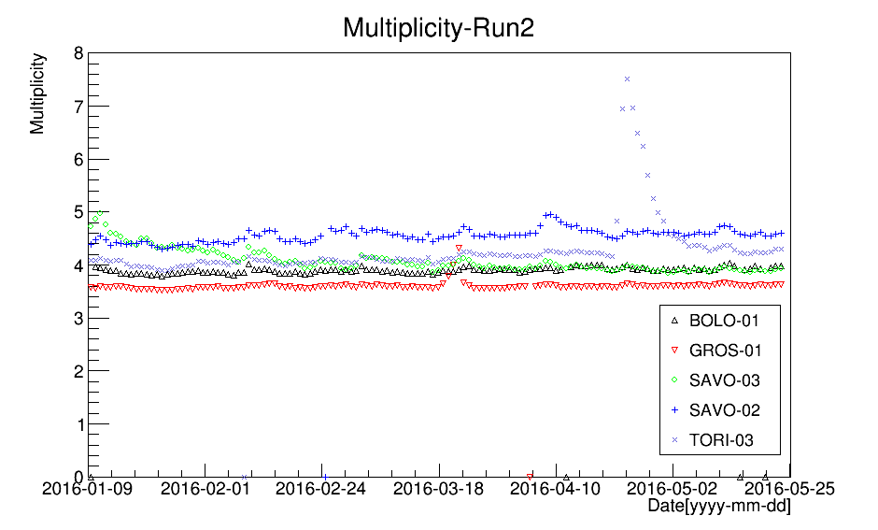
Trending
total multiplicity of 5 telescopes showing 8 months stability in RUN 2
drops and rises are explained in the text
13/09/2017
meeting EEE
15

Slide 16
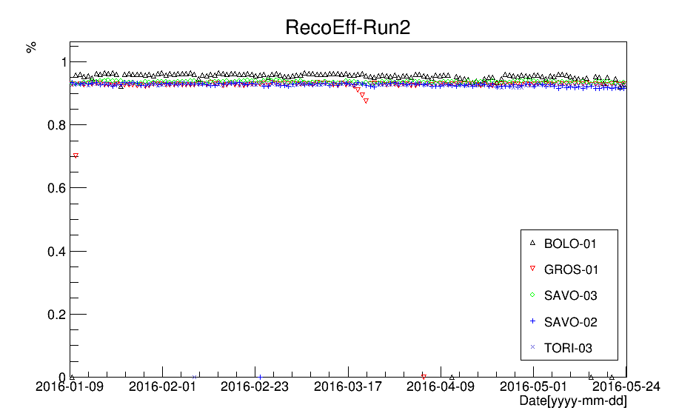
Trending
reconstruction efficiency of 5 telescopes showing 8 months stability in RUN 2
drops and rises are explained in the text
13/09/2017
meeting EEE
16

Slide 17
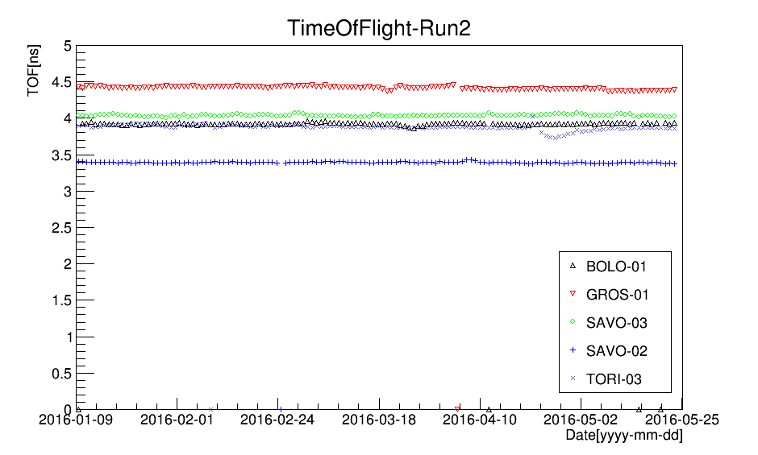
Trending
time of flight of 5 telescopes showing 8 months stability in RUN 2
TOF is not normalised to the distance between the chambers
drops and rises are explained in the text
13/09/2017
meeting EEE
17

Slide 18
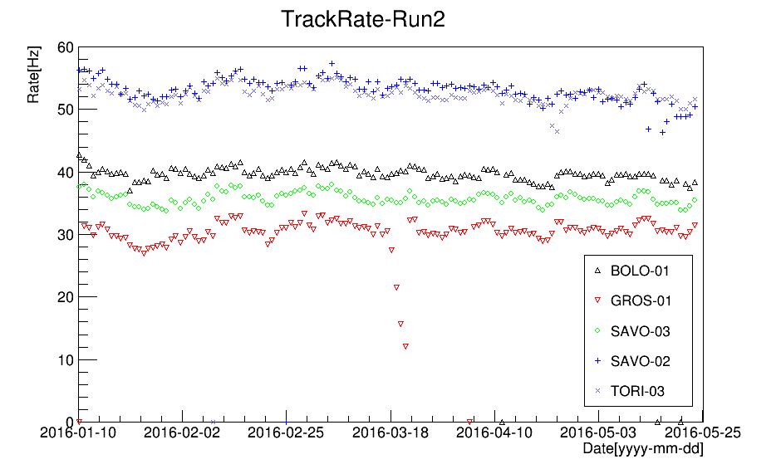
Trending
track rate of 5 telescopes showing 8 months stability in RUN 2
drops and rises are explained in the text
13/09/2017
meeting EEE
18

Slide 19
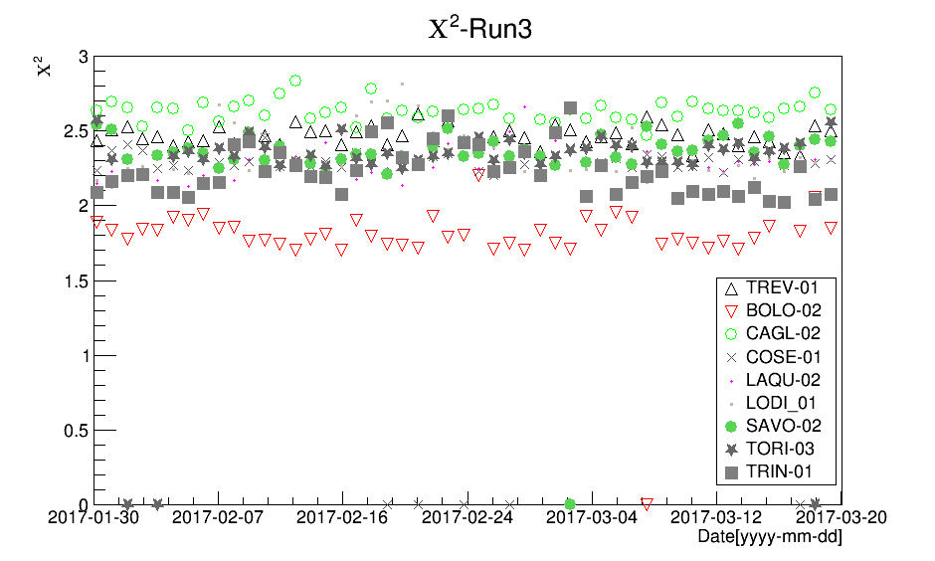
Trending
χ² of 9 telescopes showing 8 months stability in RUN 3
drops and rises are explained in the text
13/09/2017
meeting EEE
19

Slide 20
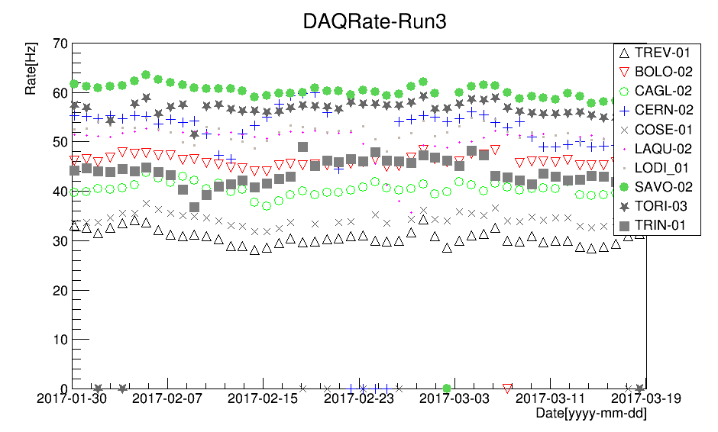
Trending
trigger rate of 9 telescopes showing 8 months stability in RUN 3
drops and rises are explained in the text
13/09/2017
meeting EEE
20

Slide 21
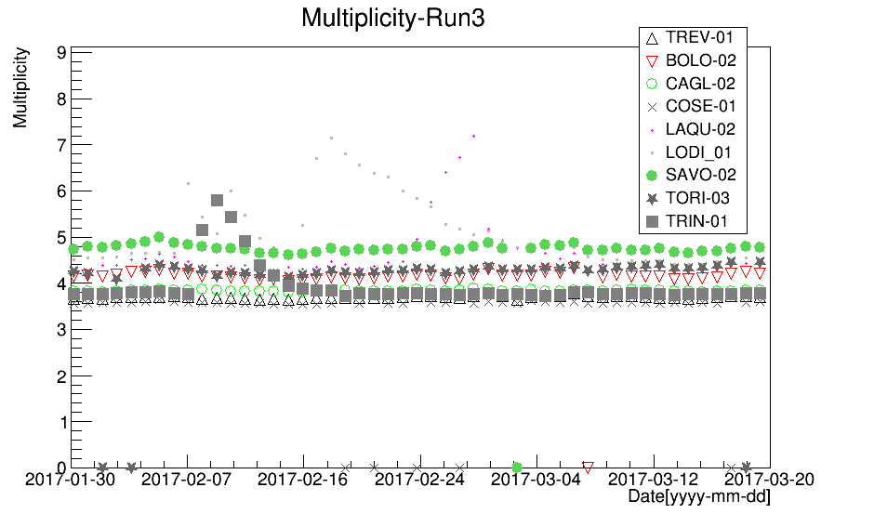
Trending
total multiplicity of 9 telescopes showing 8 months stability in RUN 3
drops and rises are explained in the text
13/09/2017
meeting EEE
21

Slide 22
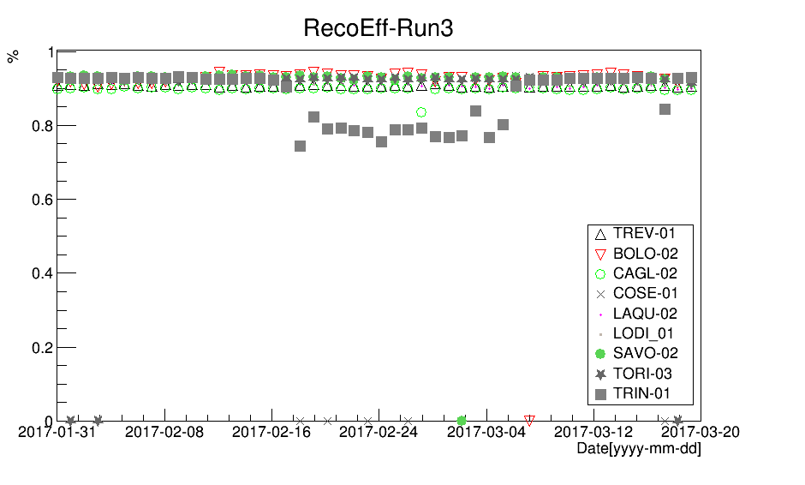
Trending
reconstruction efficiency of 9 telescopes showing 8 months stability in RUN 3
drops and rises are explained in the text
13/09/2017
meeting EEE
22

Slide 23
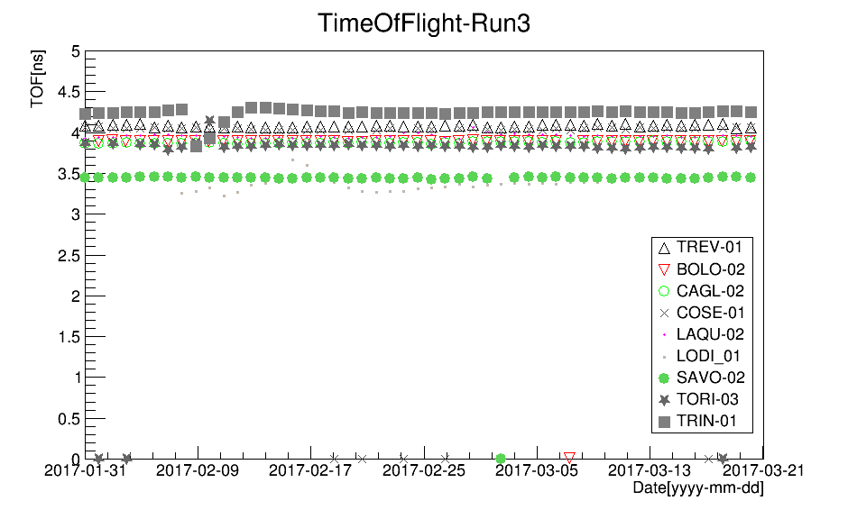
Trending
time of flight of 9 telescopes showing 8 months stability in RUN 3
TOF is not normalised to the distance between the chambers
drops and rises are explained in the text
13/09/2017
meeting EEE
23

Slide 24
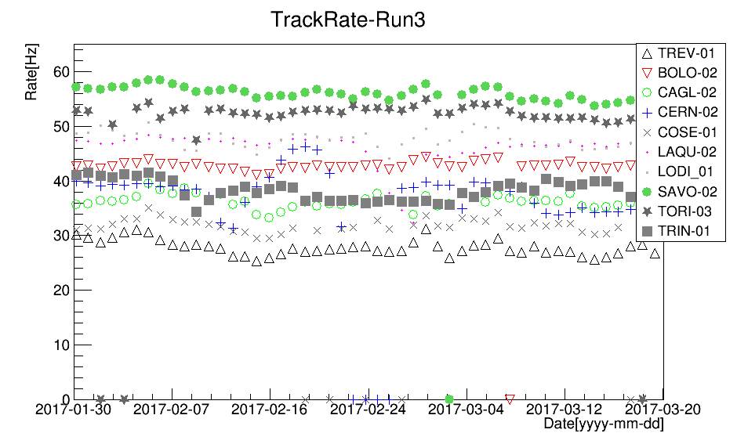
Trending
track rate of 9 telescopes showing 8 months stability in RUN 3
drops and rises are explained in the text
13/09/2017
meeting EEE
24

Slide 25
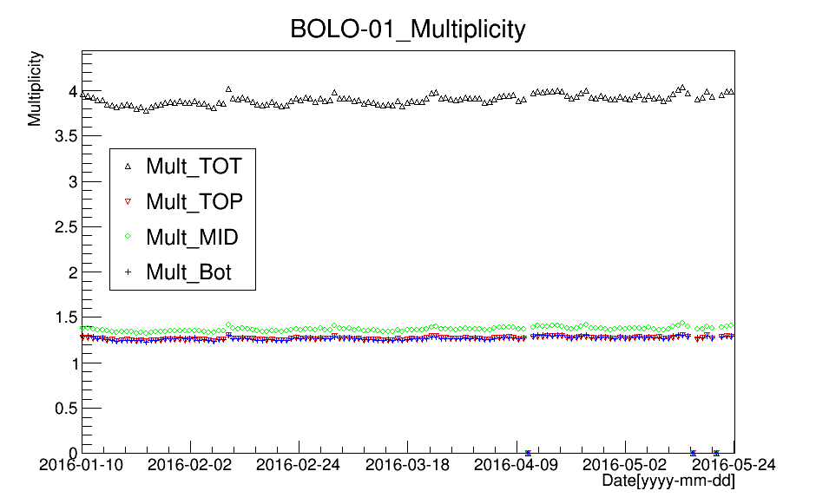
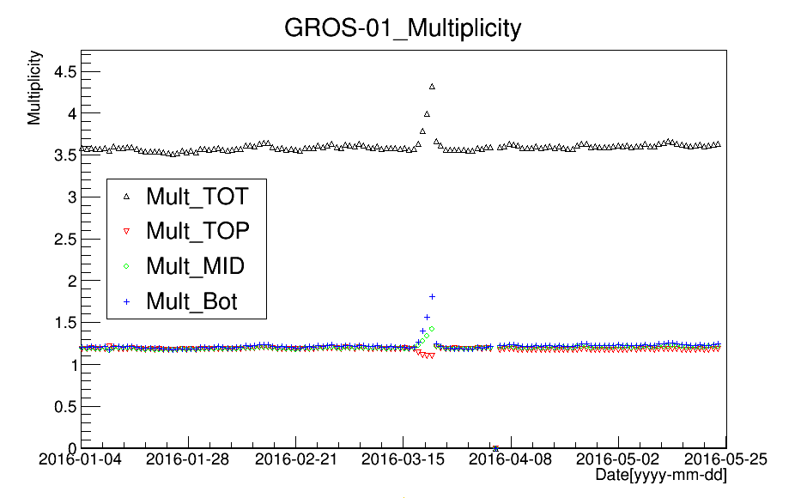
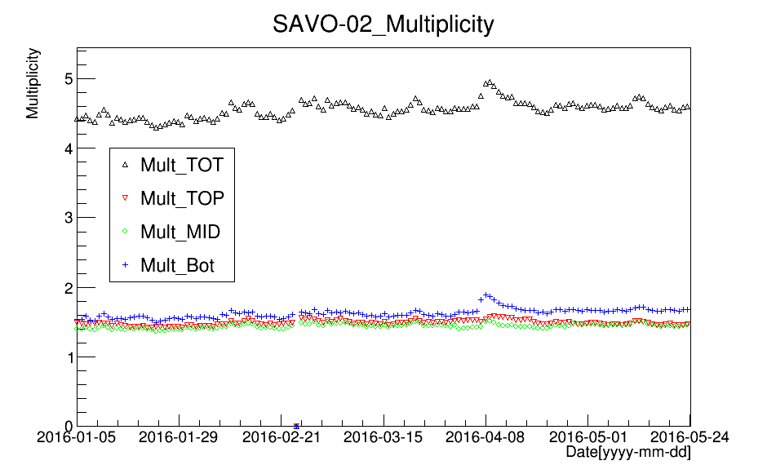
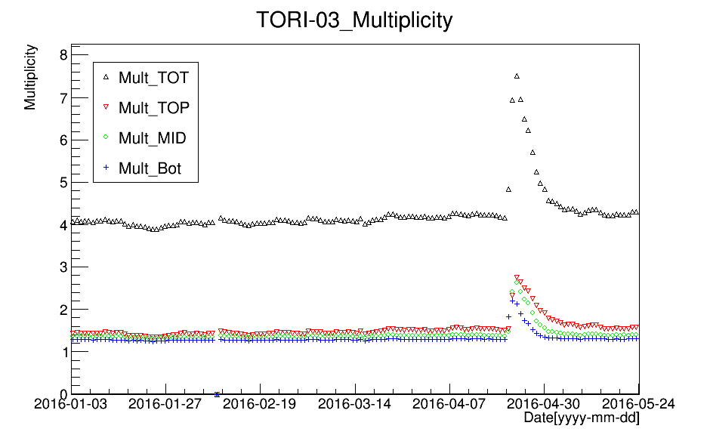
Trending
total and chamber multiplicity of 4 telescopes showing 7 months stability in RUN 3
drops and rises are explained in the text
13/09/2017
meeting EEE
25

Slide 26
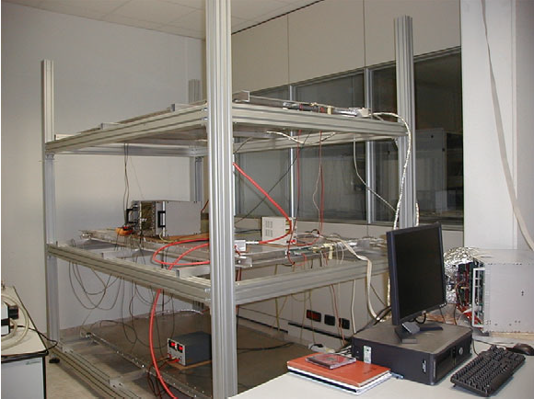
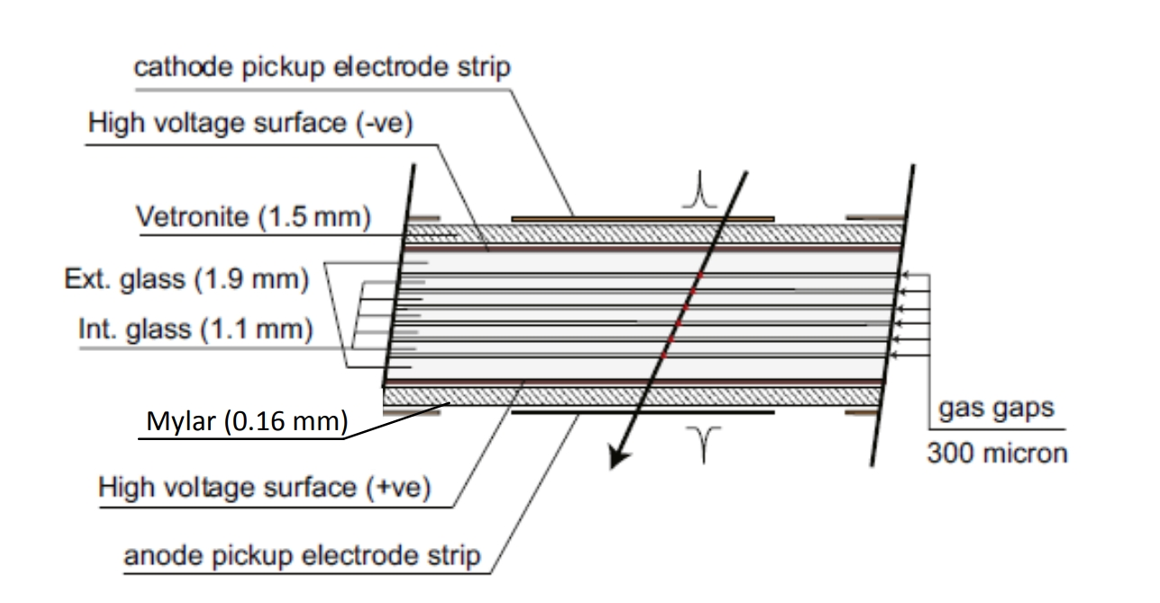
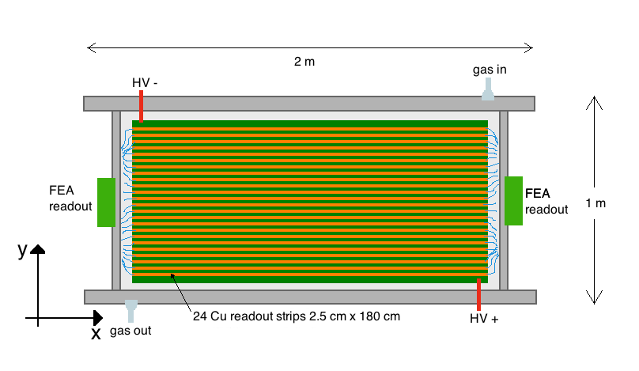
Telescope
telescope (to be changed)
MRPC
upper view
new
13/09/2017
meeting EEE
26

