Slide 1



POLA-R: What Next
M. Garbini

Slide 2
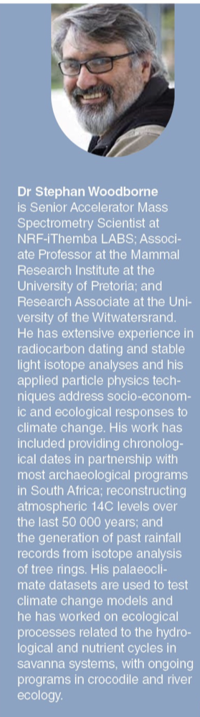
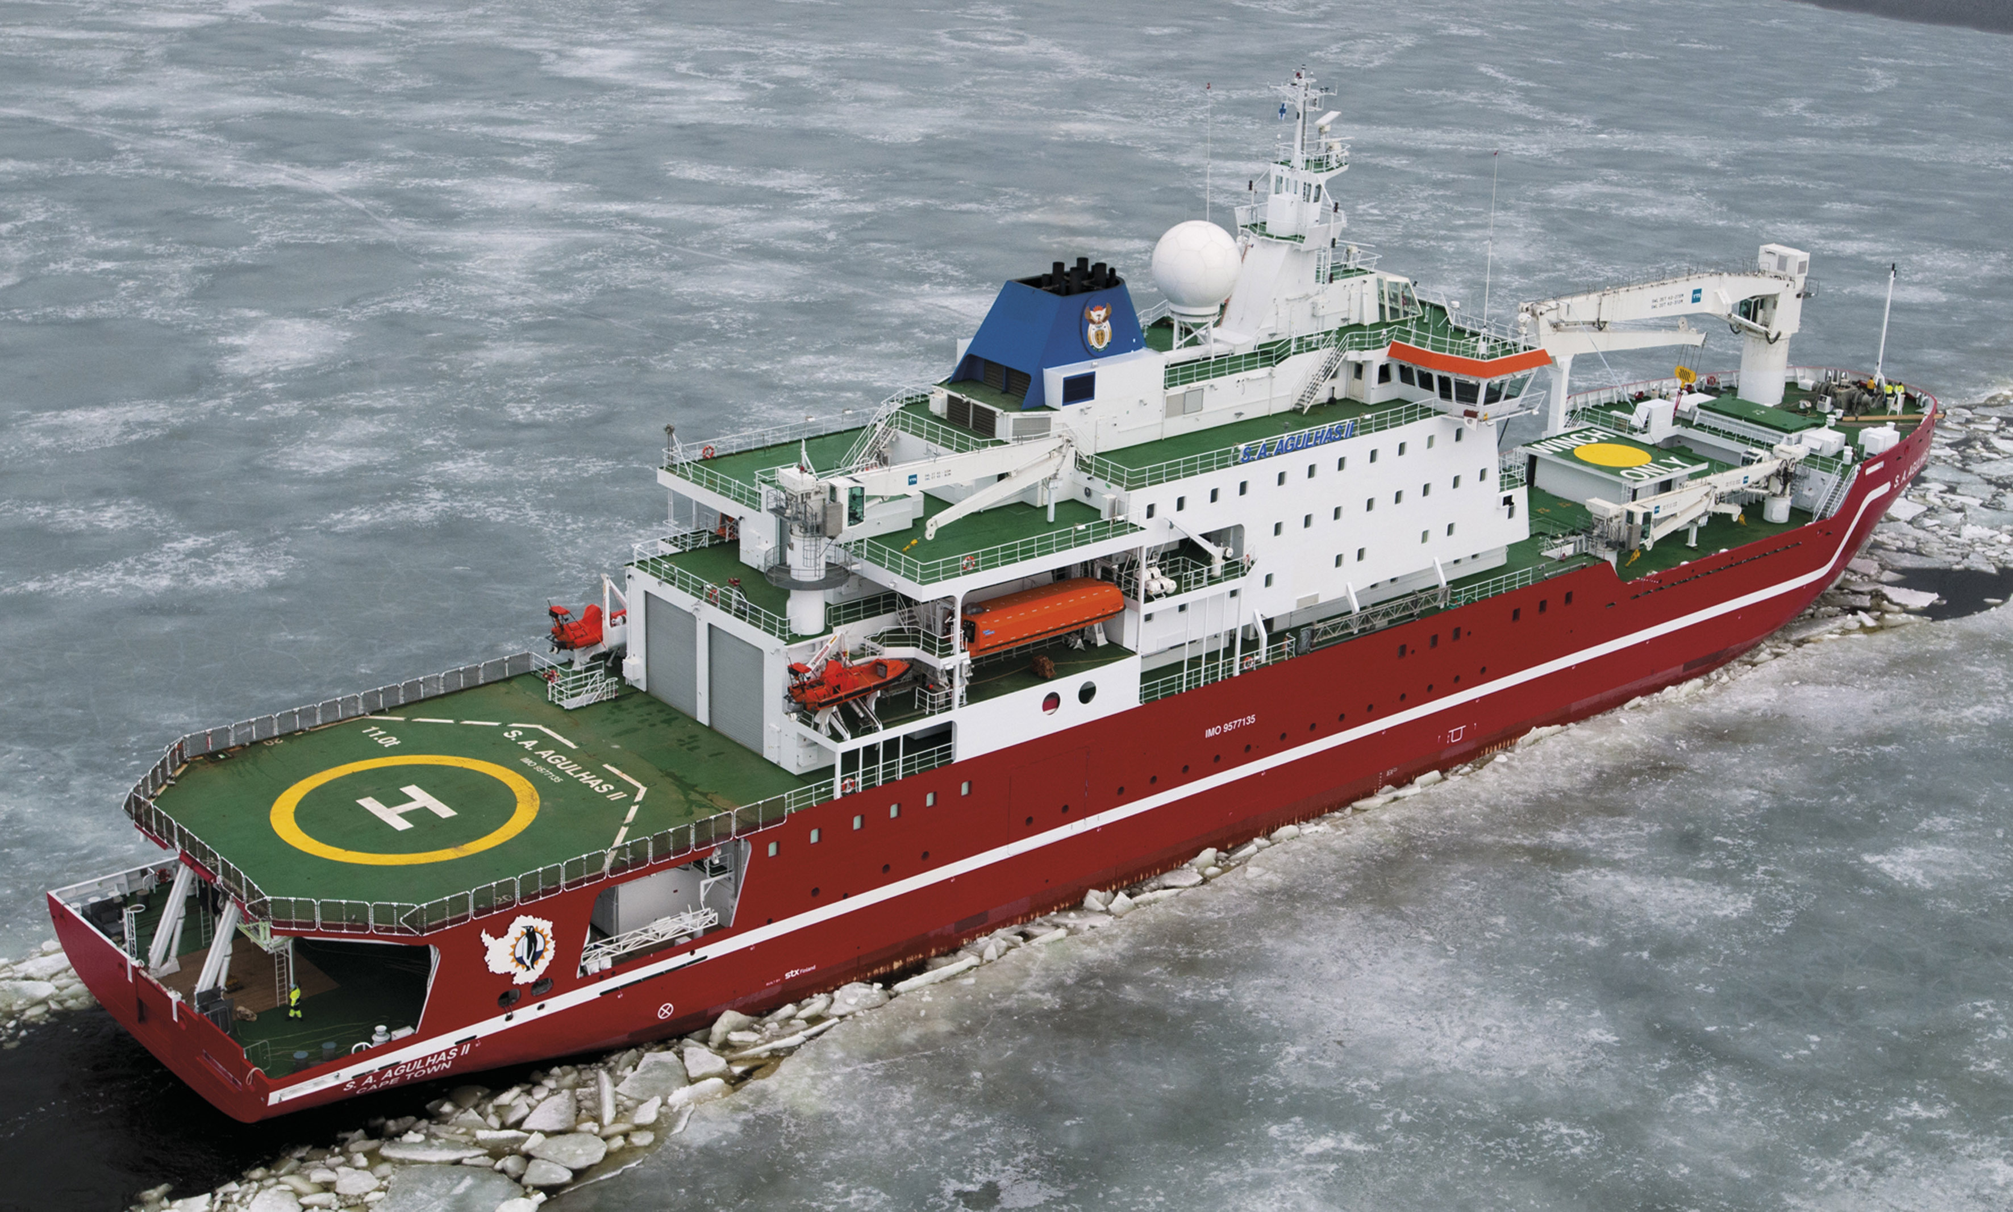
What about going south?
After my talk at ANSTT-6 @ NRF-iThemba LABS, I had a private discussion with S. Woodborne in Cape Town about the possibility of operating one of our detectors on board the SA Agulhas II, the South African icebreaker used for Antarctic research cruises.
Stephan Woodborne — NRF-iThemba LABS; University of Pretoria; University of the Witwatersrand.
Expert in accelerator mass spectrometry, radiocarbon dating, stable isotope analysis, palaeoclimate reconstruction and ecological/climate applications.

Slide 3
Preliminary Info
Scientific opportunity: operate POLA-R (02) on board the South African Antarctic vessel SA Agulhas II.
Scientific interest: measure the cosmic-ray flux over a long Southern Ocean / Antarctic route, extending previous POLA-R/PolarquEEEst measurements at high latitude.
Possible route: Cape Town → Antarctic ice shelf / SANAE logistics area → South Georgia → Antarctic ice shelf → Cape Town.
Measurement duration:
– Cape Town to Antarctic ice shelf: ~2 weeks, depending on sea-ice conditions.
– Full cruise: ~3 months, possibly a few weeks more.
– First realistic option: ship-only deployment, with the detector staying on board and returning to Cape Town with the vessel.

Slide 4
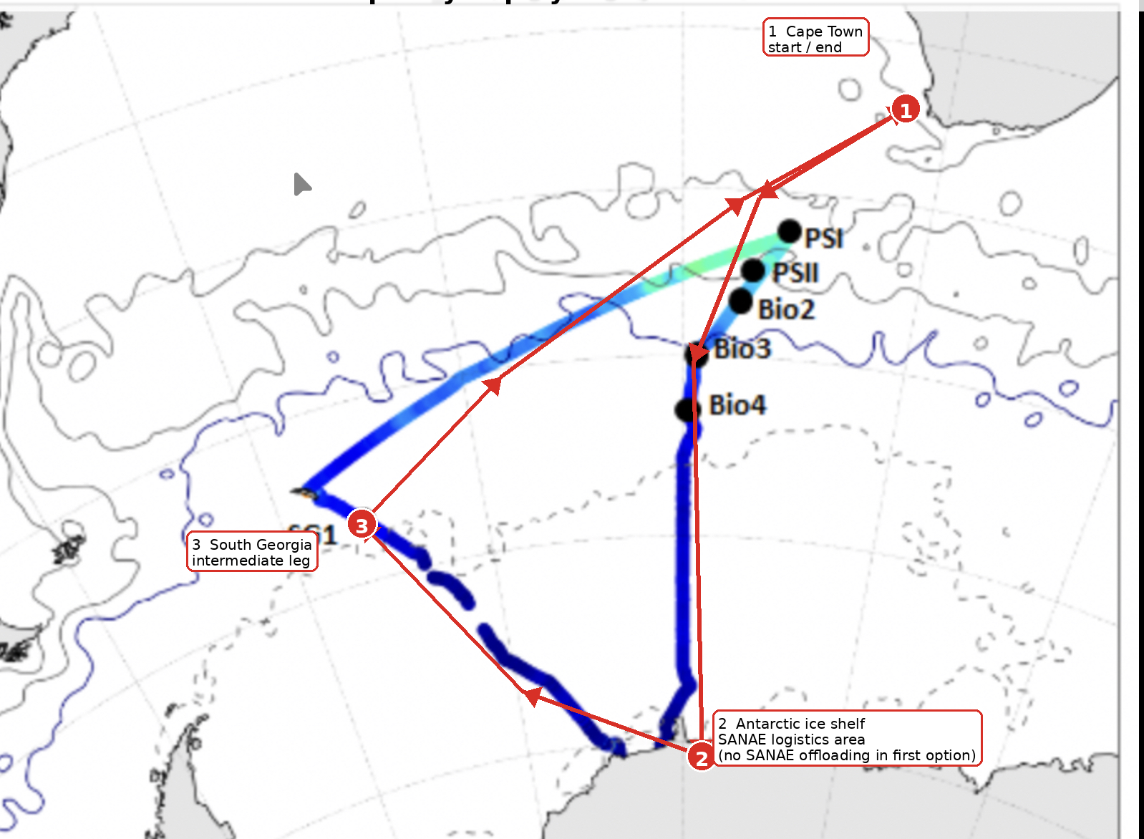
Indicative SA Agulhas II antartic cruise route
Cape Town → Antarctic ice-shelf / SANAE logistics area → possible sub-Antarctic legs (South Sandwich Islands / South Georgia) → Antarctic ice area → Cape Town.
Example route from a previous SA Agulhas II Antarctic cruise. The exact itinerary for a POLA-R deployment must be confirmed with SANAP / ship operations.

Slide 5
Detector and operation needs
W know that we need:
Suitable and safe location on the ship
Power supply
GPS visibility or suitable GPS antenna placement
Internet/Wi-Fi connection for remote monitoring/control
Occasional access for simple checks
If possible no direct Sunlight…

Slide 6
On-board support/feasibility
A full-time EEE operator on board for the entire cruise is likely not feasible.
• According to Stephan, on-board oversight could possibly be provided by people already on the ship:
– weather service / climate team
– biologists
– oceanographers
• Required local intervention should be minimal:
– check that the detector is powered
– verify acquisition status if needed
– perform a simple power-cycle if required
– no routine expert intervention expected
• Wi-Fi coverage appears likely, but technical details must be confirmed:
bandwidth, stability, firewall/VPN limitations, remote login.

Slide 7
Administrative framework / call
The deployment would require a research proposal to the SANAP programme. SANAP is the South African National Antarctic Programme, a South African funding and research framework supporting work in the Southern Ocean, Prince Edward Islands and Antarctica.
The relevant document is the SANAP 2024 Framework, under the National Research Foundation (NRF). SANAP is described as a competitive, region-specific, theme-driven funding instrument.
From Stephan’s information, the current framework spans 2024–2027. The next formal opportunity may be connected to the December 2027 cruise, but an opportunistic deployment in December 2026 may still be possible if the request is not considered onerous and if SANAP/ship contacts support it.
To be clarified: whether the proposal must be submitted through a South African PI / SANAP-associated partner, or whether EEE can contribute as an external collaborating group within a South African-led proposal.
Possible MoU with Stephan’s institution.

Slide 8
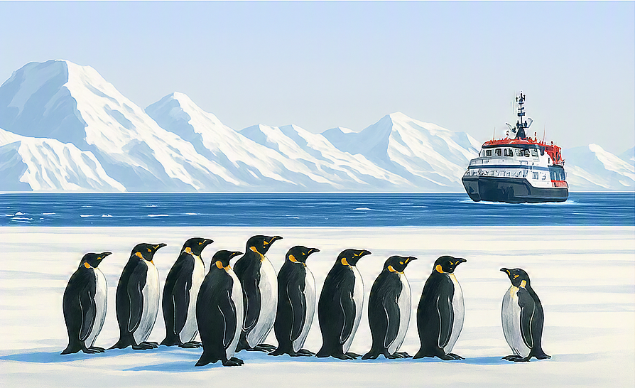
So… any news?
Maybe!

